Slide 1
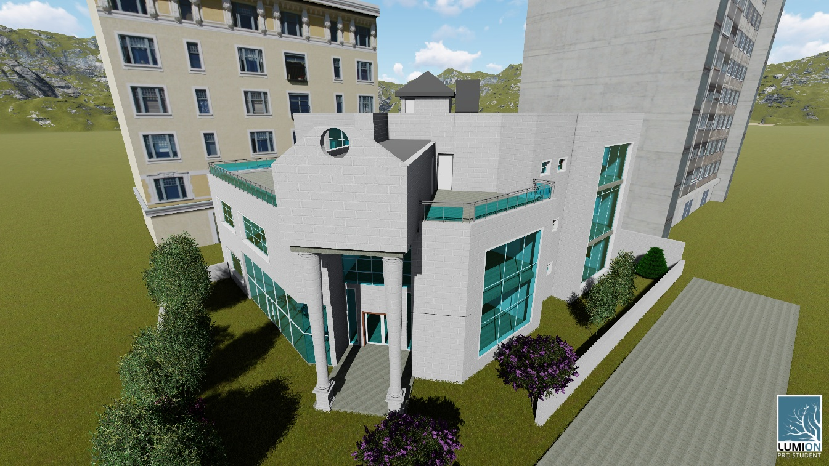
An-Najah National University
Building Engineering Department
Graduation Project II
Engineering Association-Nablus Branch Redesign
Submitted by:
Ahmad Ba’ara
Mohammad Haqash
Waleed Faqeeh
Supervisor:
Eng. Narmeen Barq

Slide 2
Presentation outline
Introduction.
Site analysis.
Architectural Design.
Structural Design.
Environmental and Mechanical Design.
Project Cost.
2

Slide 3
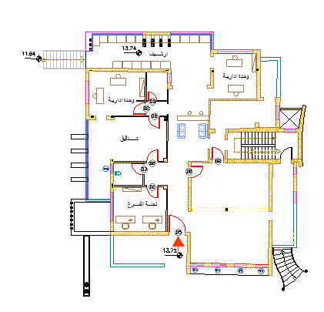
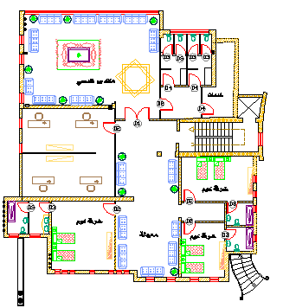
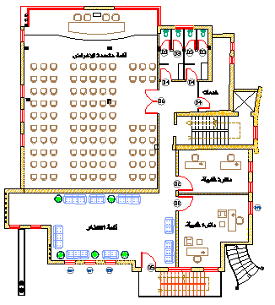
Introduction
This presentation will show the new design steps and site evaluating for Engineering Association Branch at Nablus city , the old building design there are some problems that we had to solve in the new design:
Absent of privet parking
Absent of elevators
impractical Function distribution
Doesn’t support seismic design
Inefficient Environmental design for natural lighting and ventilation
3

Slide 4
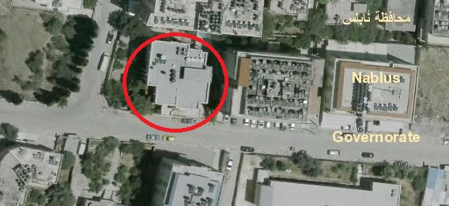
Site Analysis
Site location: Nablus- Mreige Sreet
Land Area : 830 m²

Slide 5
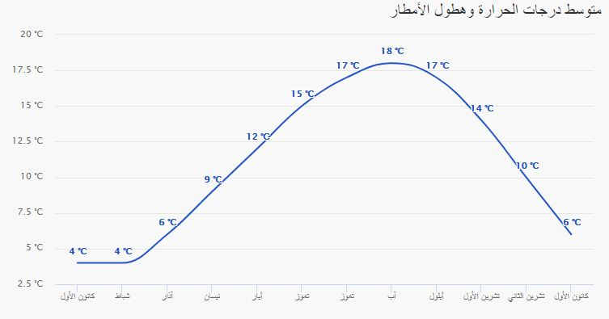
Site Analysis
Weather condition
Temperature grading figure in winter

Slide 6
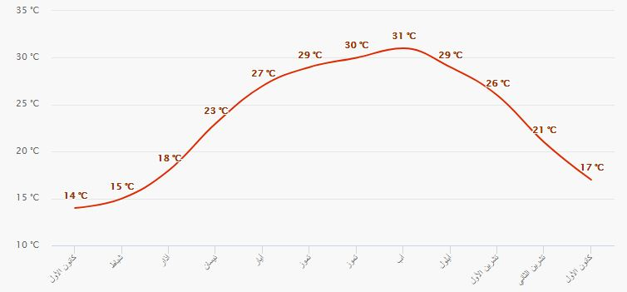
Site Analysis
Weather condition
Temperature grading figure in summer

Slide 7
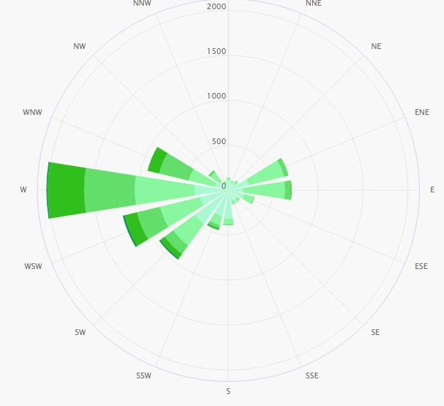
Site Analysis
Weather condition
Wind Direction

Slide 8
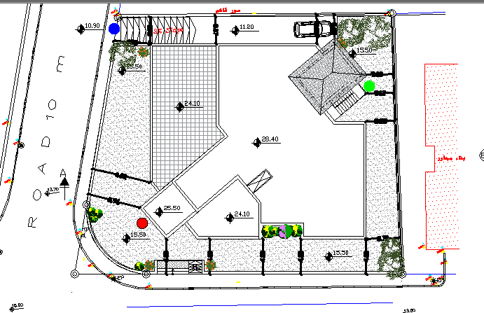
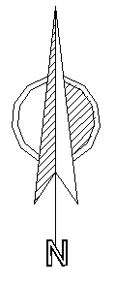
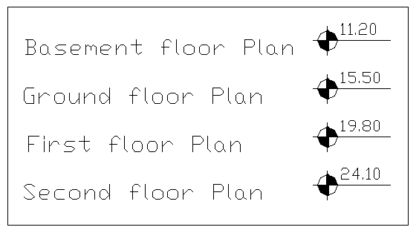
Site Analysis
Site plan and levels

Slide 9
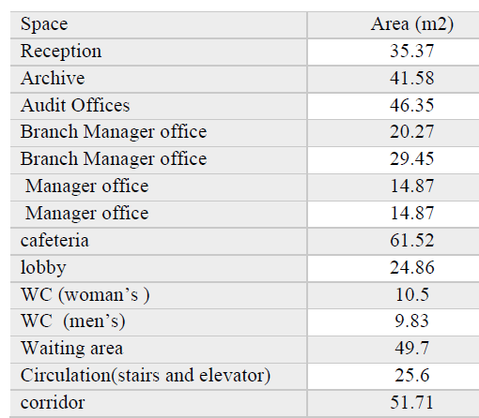
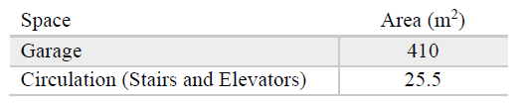
Architectural Design
Functions Spaces
Function | Area ( m²)
Basement | 435.6
Ground Floor | 496.21
First Floor | 496.2
Second Floor | 352.73
Total Building Area | 1780.75
Ground floor Spaces
Basemen Spaces

Slide 10
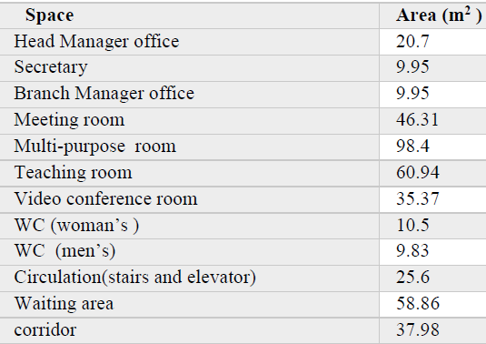
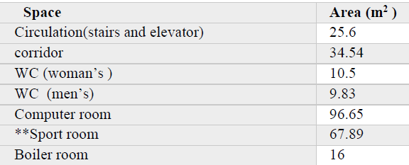
Architectural Design
Functions Spaces
First Floor Spaces
Second floor Spaces :

Slide 11
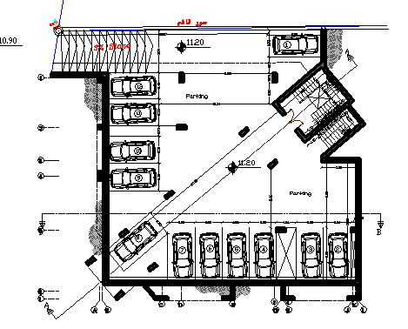
Architectural Design
Architectural Plans: Basement plan
Old Design
New Design
In the old design , the basement consist of sport room and kitchenette only

Slide 12
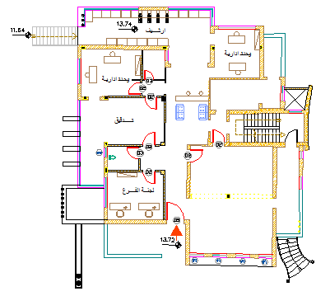
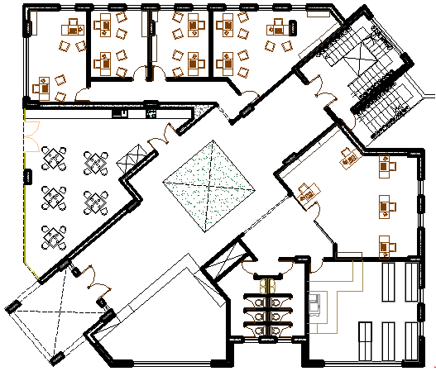
Architectural Design
Architectural Plans: Ground Floor Plan
Old Design
New Design

Slide 13
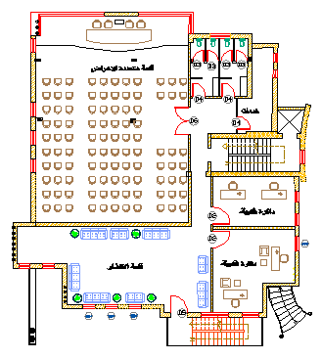
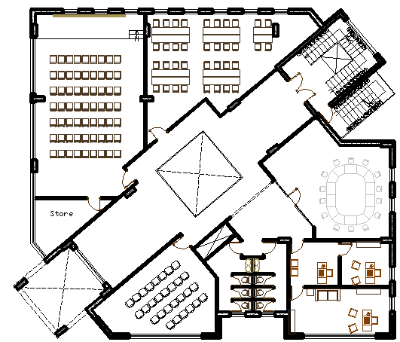
Architectural Design
Architectural Plans: First Floor Plan
Old Design
New Design

Slide 14
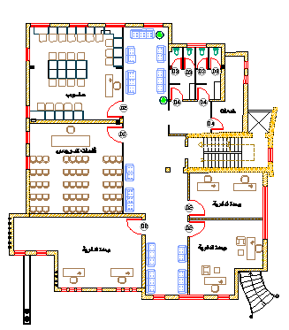
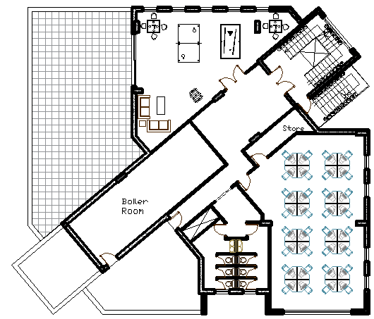
Architectural Design
Architectural Plans: Second Floor Plan
Old Design
New Design

Slide 15
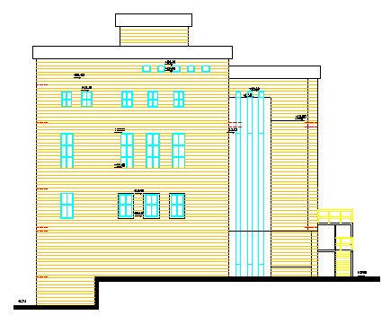
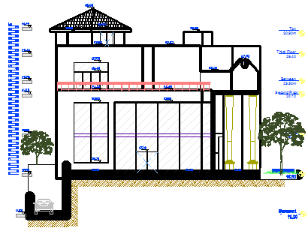
Architectural Design
Architectural Elevation : West Elevation
Old Design
New Design
15

Slide 16
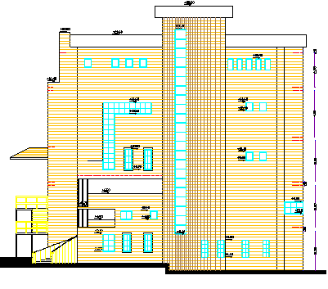
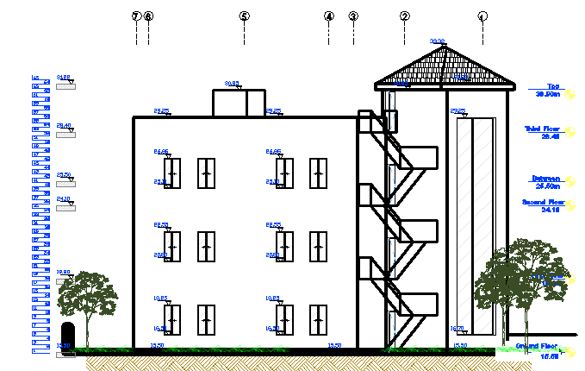
Architectural Design
Architectural Elevation : East Elevation
Old Design
New Design

Slide 17
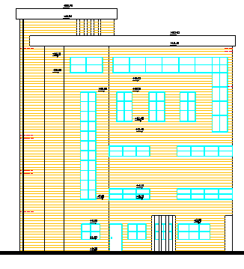
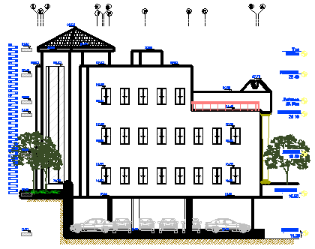
Architectural Design
Architectural Elevation : North Elevation
Old Design
New Design
17

Slide 18
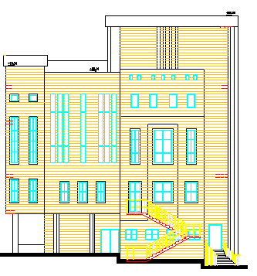
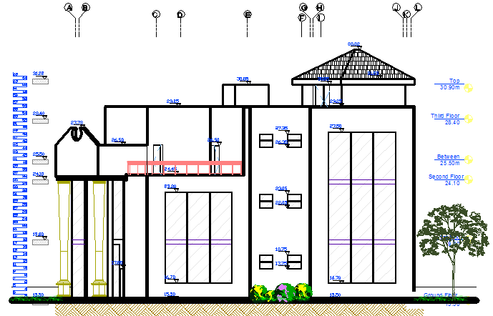
Architectural Design
Architectural Elevation : South Elevation
Old Design
New Design

Slide 19
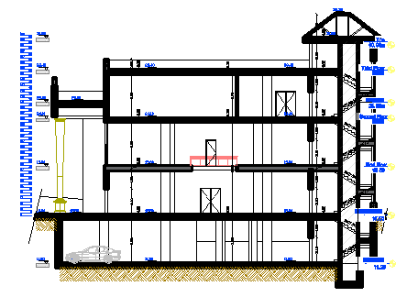
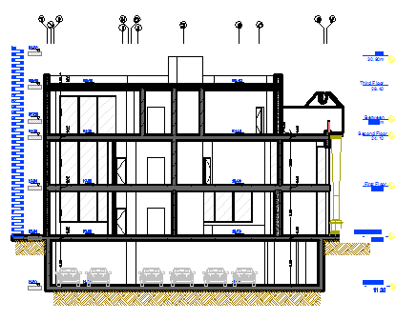
Architectural Design
Architectural Sections
Section A-A
Section B-B

Slide 20
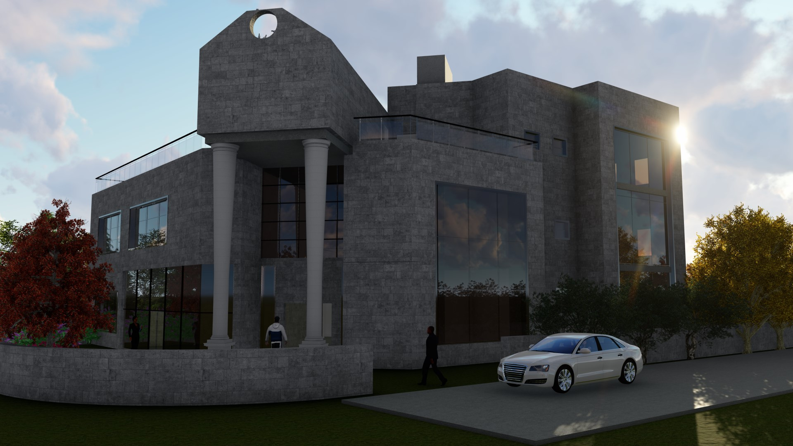
Architectural Design
3d Views

Slide 21
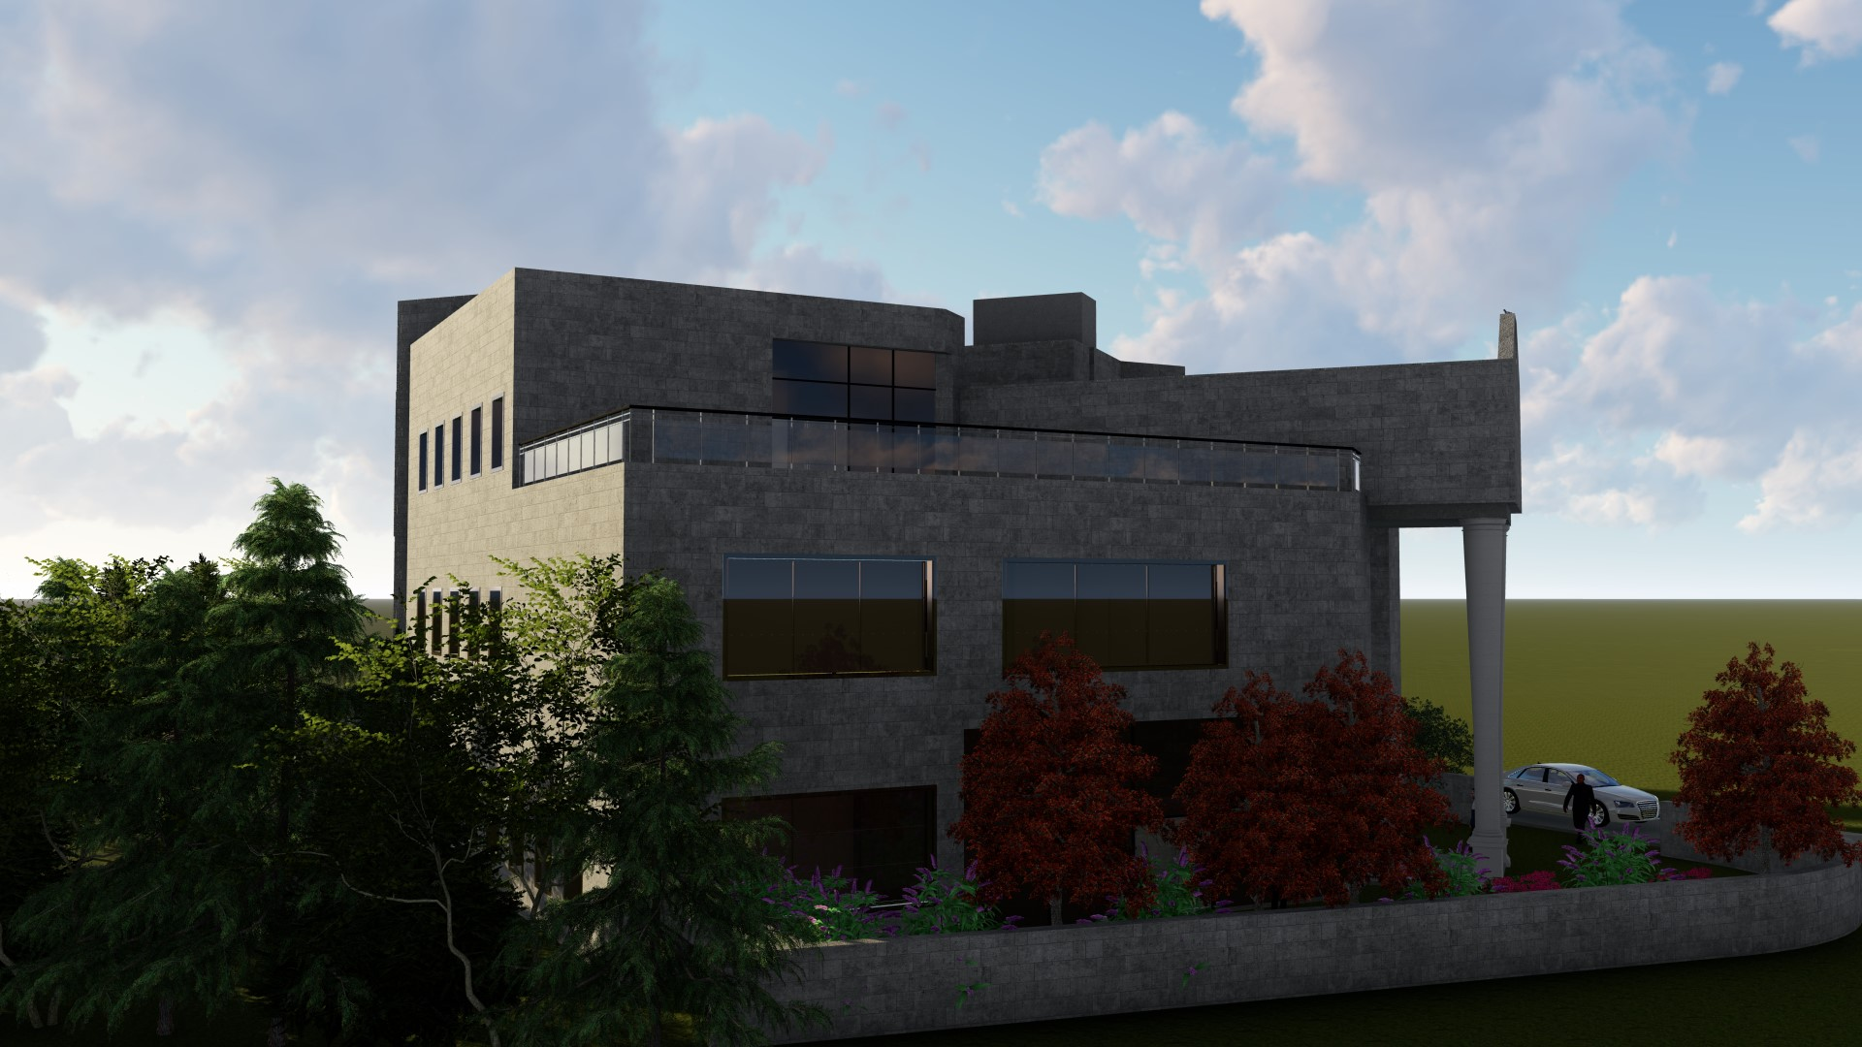
Architectural Design
3D Views

Slide 22
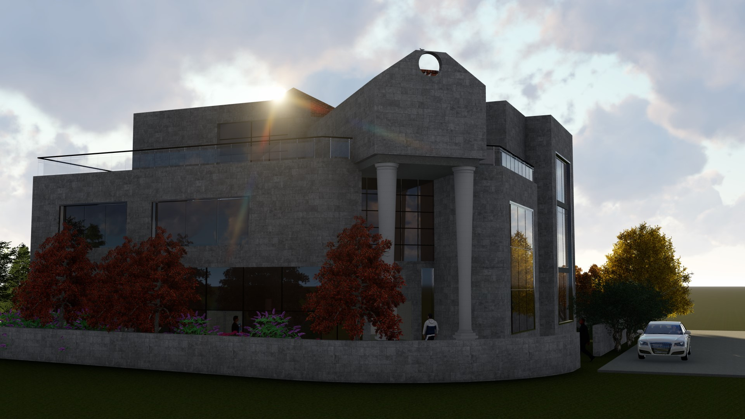
Architectural Design
3D Views

Slide 23
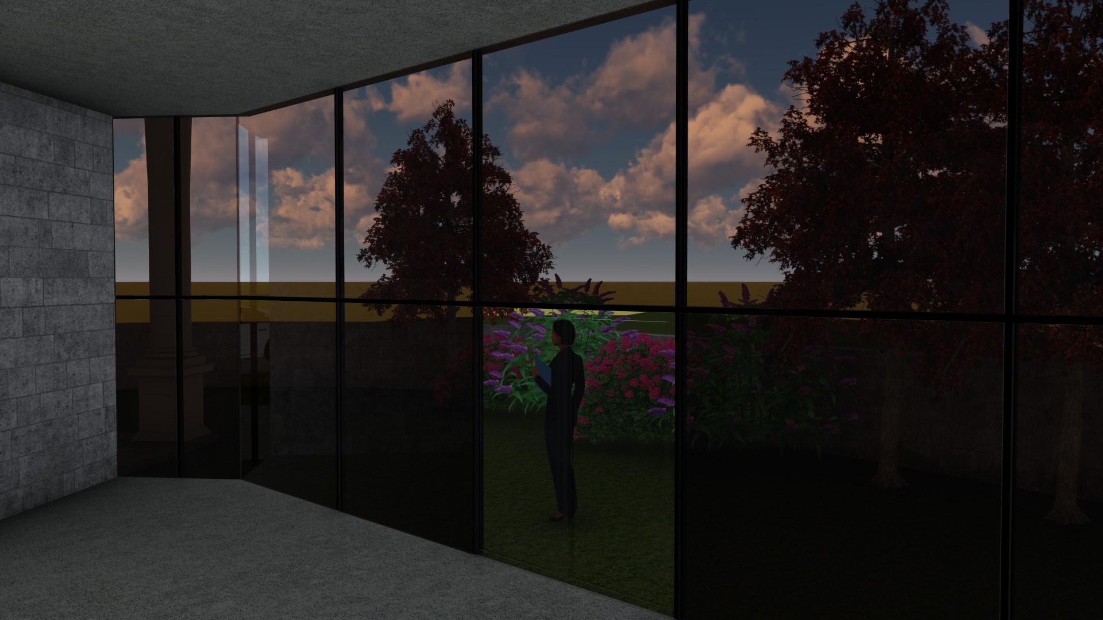
Architectural Design
3D Views

Slide 24


Structural Design
Codes and Standards
ACI -318-11 for reinforced concrete structural design.
UBC -97 for earthquake design.
ASCE 7 2010 for load combinations

Slide 25
Structural Design
Design data
Concrete strength for slabs and beams, f’_{c} =24 mpa.
Concrete strength for columns and shear walls ,f’_{c} =28 mpa.
Steel yield strength f_{y} =420 mpa.
Bearing capacity for soil = 350 kN/m²

Slide 26
Structural Design
Loads
Live load = 2 kN/m²
Super Imposed Dead (S.I.D) =6 kN/ m²
The seismic zone factor. Z=0.2.
The soil profile is type Sc.
The acceleration seismic coefficient Ca=0.24
The velocity seismic coefficient Cv=0.32.
The Seismic importance factor is 1.
The structural design type is intermediate, R=5.5

Slide 27
Structural Design
Verification of model
Compatibility check.
Equilibrium check .
Internal force check.
Deflection check .
Drift check .
Period check.
Model participating mass ratio check.

Slide 28
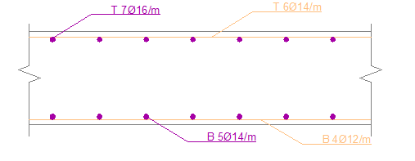
Structural Design
Slab Design
Two-way solid slab with 25 cm thickness.

Slide 29
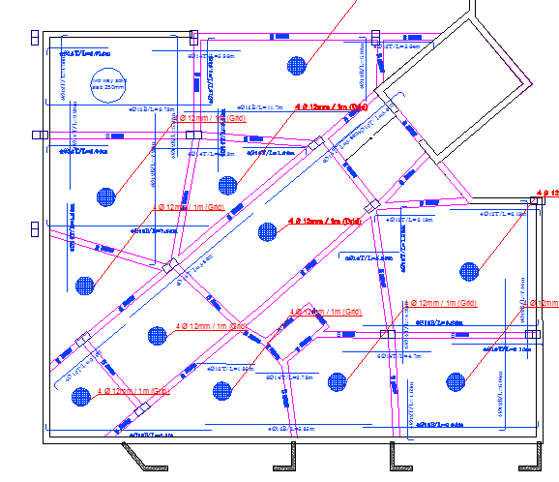
Structural Design
Beams Plan
Cross section Drop beam with 70*30 cm

Slide 30
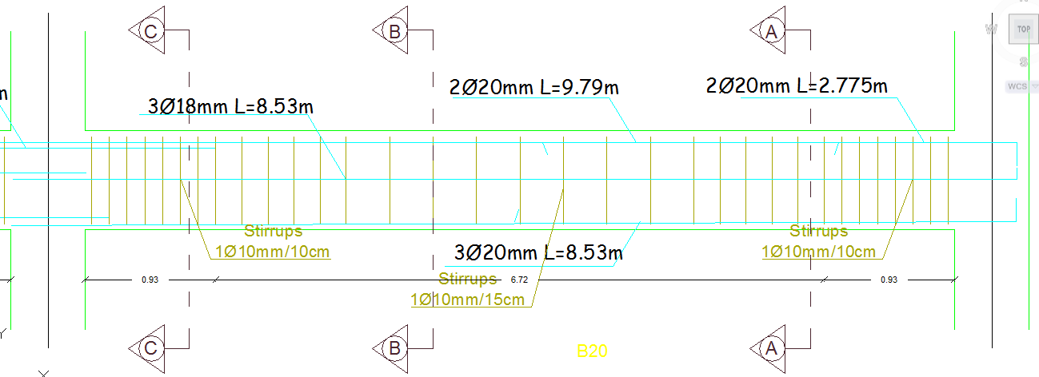
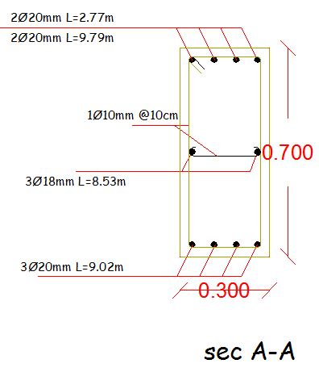
Structural Design
Beams Sections

Slide 31
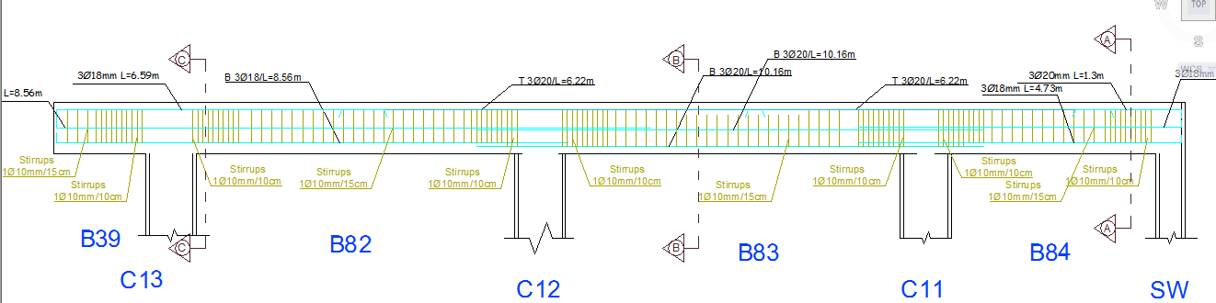
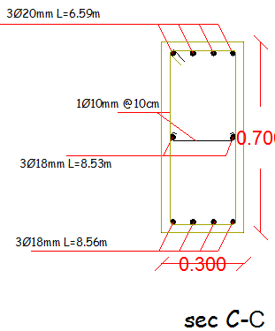
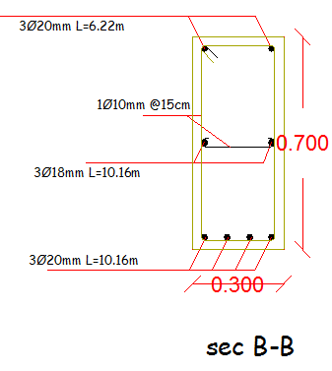
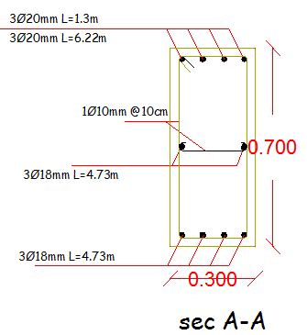
Structural Design
Beams Sections

Slide 32
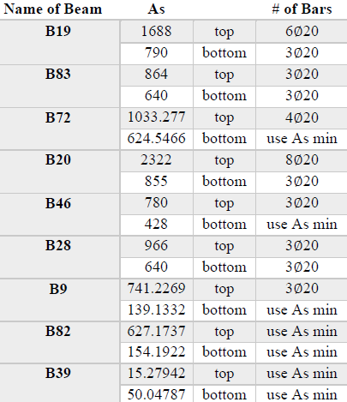
Structural Design
Beams Sections

Slide 33
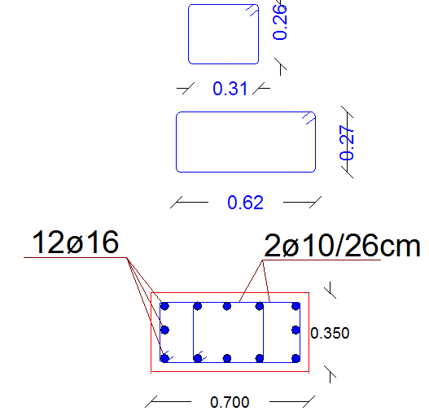
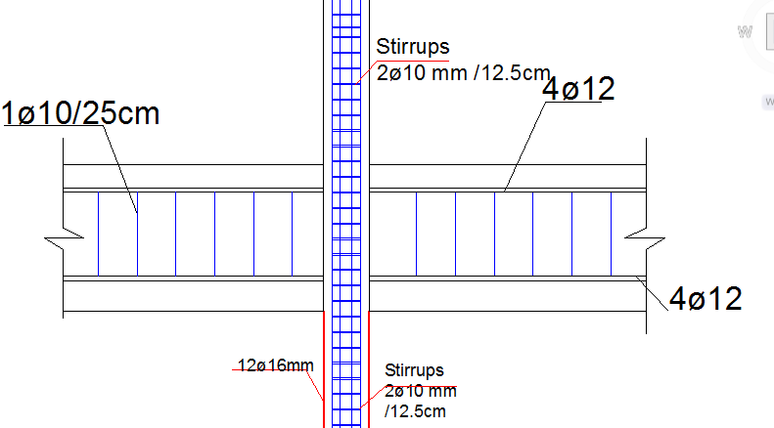
Structural Design
Column Sections

Slide 34
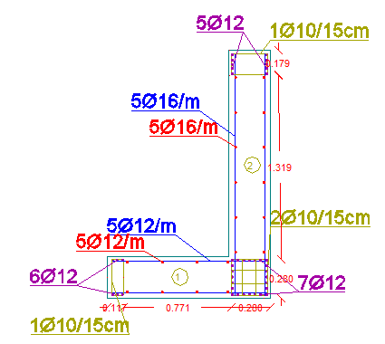
Structural Design
Shear wall Sections

Slide 35
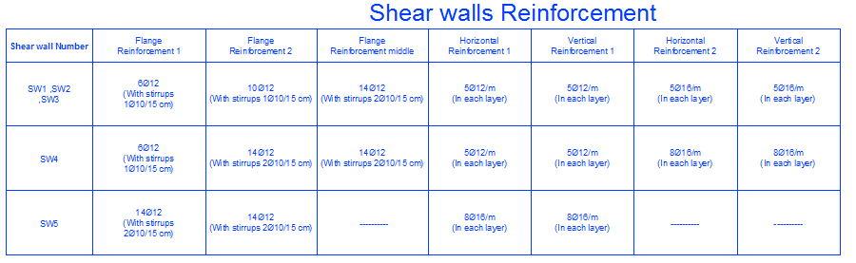
Structural Design
Shear wall Sections

Slide 36
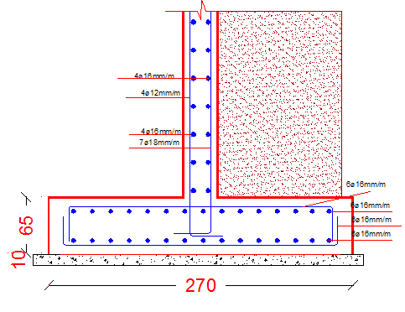
Structural Design
Retaining wall Sections

Slide 37


Structural Design
Footing Plan and Sections

Slide 38
Structural Design
Etabs Model

Slide 39
Environmental and Mechanical Design
Environmental Design
Thermal analysis
Element | U-value (w/m² .k)
External wall | 0.757
Internal wall | 1.639
flat roof | 0.419
glass | 1.493
Floor | 0.273

Slide 40
Environmental and Mechanical Design
Environmental Design
Thermal analysis
Time Schedule of working hours:

Slide 41
Environmental and Mechanical Design
Environmental Design
Thermal analysis
Site Energy
Heating and cooling load

Slide 42

Environmental and Mechanical Design
Environmental Design
Thermal analysis
Building heating capacity:
Fangers:

Slide 43
Environmental and Mechanical Design
Environmental Design
Thermal analysis
Consumption of electromechanical in kWh/m²):

Slide 44


Environmental and Mechanical Design
Environmental Design
Shading:
21/1 at 12:00 PM
21/1 at 08:00 AM

Slide 45


Environmental and Mechanical Design
Environmental Design
Shading:
21/7 at 12:00 PM
21/7 at 08:00 AM

Slide 46


Environmental and Mechanical Design
Environmental Design
Daylight:
Office
Multi-purpose room

Slide 47
Environmental and Mechanical Design
Environmental Design
Daylight:
Function | Average Daylight factor (%)
Office | 1.8
Multi-purpose | 2.25
Meeting | 1.15
Corridor | 1.03
Video conference | 2.13
Stairs | 1.59
Computer room | 1.99
Teaching room | 1.37
Average Daylight factor

Slide 48



Environmental and Mechanical Design
Environmental Design
Lighting
Luminaires part list:

Slide 49
Environmental and Mechanical Design
Environmental Design
Lighting
Function | E_{avg} (lux)
Office | 610
Multi-purpose | 988
Meeting | 752
WC | 170
Corridor | 512
Video conference | 663
parking | 657
Stairs | 164
Computer room | 341
Teaching room | 463
Level of illuminance each space:

Slide 50



Environmental and Mechanical Design
Environmental Design
Lighting
Lighting views from DiaLux EVO:

Slide 51



Environmental and Mechanical Design
Environmental Design
Acoustical Design System (Multi- Purpose room)
STC ( Sound transmission coefficient) in North External wall. :

Slide 52



Environmental and Mechanical Design
Environmental Design
Acoustical Design System (Multi- Purpose room)
STC ( Sound transmission coefficient) in west External wall. :

Slide 53

Environmental and Mechanical Design
Environmental Design
Acoustical Design System (Multi- Purpose room)
RT60 ( Reverberation time).
53

Slide 54
Environmental and Mechanical Design
Mechanical Design
Drainage System
Vertical Line drainage:

Slide 55


Environmental and Mechanical Design
Mechanical Design
Drainage System
Drainage System in Basement floor

Slide 56

Environmental and Mechanical Design
Mechanical Design
Drainage System
Drainage System in WC’S

Slide 57

Environmental and Mechanical Design
Mechanical Design
Water supply System
The consumption in building is divided to
Employee = 15*45 = 675 liter /day.
Visitors = 30*45 = 1350 liter/day assuming 30 visitors of 60 will consume water same as each employee.
Workers = 5*45 =225 liter/day.
Cleaning and irrigation almost = 150 liter/day.
The total consumption = 675 + 1350 + 225 + 150
= 2400 liter/day.
The municipality provides water every (3-5) days.
The consumption in four days = 2400*4 = 9600 liter.
7 tanks with 1.5 m³ is needed

Slide 58

Environmental and Mechanical Design
Mechanical Design
HVAC System
VRV system (Variable Refrigerant Volume) was used for HVAC system .
Duct system were used .

Slide 59

Environmental and Mechanical Design
Mechanical Design
Electrical System
Basement lighting

Slide 60

Environmental and Mechanical Design
Mechanical Design
Electrical System
Ground floor lighting

Slide 61

Environmental and Mechanical Design
Mechanical Design
Electrical System
First floor lighting

Slide 62

Environmental and Mechanical Design
Mechanical Design
Electrical System
Second floor lighting

Slide 63

Environmental and Mechanical Design
Mechanical Design
Electrical System
Number of sockets in each space.

Slide 64


Environmental and Mechanical Design
Mechanical Design
Electrical System
Branches.

Slide 65

Environmental and Mechanical Design
Mechanical Design
Electrical System
Sockets distribution in first floor.

Slide 66


Environmental and Mechanical Design
Mechanical Design
Fire Fighting System

Slide 67
Project cost
Element | Total cost ($) | Unit cost ($/m2)
Excavation | 2829 | 1.58
Civil | 234235.4 | 136.64
Architectural | 224628.14 | 126.19
Mechanical | 51730 | 29.06
Electrical | 63945 | 35.92
Total | 561767.54 | 315.46

Slide 68
Thank you

