Slide 1

BUS Acounting System Based On RFID
Designed By :
Eng.Hasan Ibraheem al Nahawy
Eng.Fayez Mohammad Haj Mohammad

Slide 2
BUS Acounting System Based On RFID
The project is a device that allows the student to pay the bus fare through the university student card ....

Slide 3

RFID Technology
Radio Frequency Identification
This chip technology based on “systems to identify radio waves”.
Radio Frequency Identification (RFID) began development of ten years ago and aims to replace the coding systems (Barcode) used in the numbering and classification of goods for which coding is printed on the goods, or which card is independent and is read by a special device (Barcode Reader).
RFID technology the advantage of being able to store more information by these chips are installed on the goods start to be read wirelessly

Slide 4
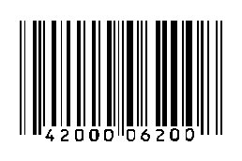
RFID vs Barcode
Barcode readers require a direct line of sight to the printed barcode .But RFID doesn’t need that .
RFID tags can be read at much greater distances.
RFID tags much faster than Barcode .
Barcodes have no read/write capability, But RFID
reader can communicate with the tag, and alter as much of the information as the tag design will allow.

Slide 5
Project Description
The project is a device that allows the student to pay the bus fare through the university student card .
It Consist From Two Devices :
The First one Located on the bus which read student’s card’s and communicate with the Second Device via wireless and send the data for it .
The Second Device connected with the server that’s have students accounts , it process the data and return the result to the Firs Device .

Slide 6

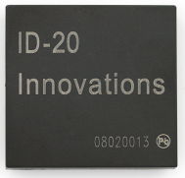
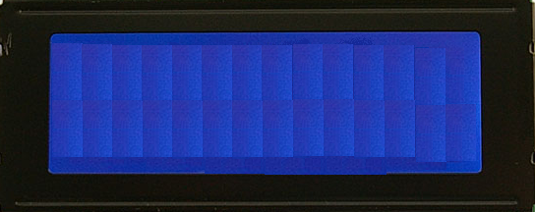
Student
Card
.
.
.
.
.
.
.
.
.
Xbee device
Microcontroller
.
.
.
Student Name
Student Balance
.
.
.
.
.
.
.A
Xbee device
Now Send Name & Balance
Receive ID
University Server

Slide 7
Project Features
The project makes it easy and more efficient for students not to rush in front of the bus and being late for lectures, because the device takes the student number and the examination and show information on the display screen by passing near the device there is no need to show the card and wait .

Slide 8
System Upgrade
In order to upgrade our system we can replace the xbee wireless device with GSM Module that's depends on Mobile Network Coverage like (jawwal) to make the system global in whole Palestine .
To eliminate collision we can use another type of the RFID reader device with one has anti collision property so its easy to upgrade our system and make it globally and anti collision .

