Slide 1

Applying six sigma approach with simulation to improve
production performance at “Adi” sewing workshop.
Prepared by:
Sabrin Abu Amsha Omar Thaher
Walaa Salmeyah
Kareem Baniowda Khaled Khoja
Supervisors:
Dr. Ahmad Ramahi
Eng. Tamer Haddad

Slide 2
01
Introduction
02
Define Phase
Outline
03
Measure Phase
04
Analyze Phase
05
Improve Phase
06
Simulation
07
Conclusion & Recommendations

Slide 3
*Define Phase
Project Charter:
Project sponsor | “Adi” Sewing Workshop
Team leader | Ahmad Al-Ramahi, Tamer Haddad, Sabrin, Walaa
Project title | Applying six sigma approach with simulation to improve production performance at Adi sewing workshop.
Problem definition and purpose
The problem is the high defects rate in their products and wastes and long time it takes the sewing process to complete its process. The goal is to reduce the defects and time as much as possible to ensure the required quality, and this leads to increased productivity and reduced cost as expected.
Business case
* Excess waste in waiting time during assembly operation of the shirt . * High number of defects such as: “stains, holes and skipped stitches, etc.” * It consumes a high value of cost, time, present and more parameters without adding value to the product.

Slide 4
Process Name | Average Time (min)
Preparing sewing machine | 2
Stitching buttonhole area | 0.7725
Cutting the excess fabric | 0.06783
Stitching button area | 0.6667
Stitching the back of the shirt | 1.05
Stitching the inside left shoulder | 0.7333
Stitching the inside right shoulder | 0.8178
Stitching the sleeve | 0.9166
Make ulna hole | 4.5145
Stitching the ulna (for two pairs) | 2.263
Preparing the collar | 1.536
Stitching the collar | 3.5946
Stitching the round from the bottom | 0.4322
Knit the sleeve on the shirt (for two pairs) | 1.3386
Knit the ulna on the sleeve (for two pairs) | 2.0111
Knit the collar on the shirt | 1.0176
Stitching the label | 0.1668
Preparing buttonholes machine | 1
Make a buttonholes in the shirt | 2.5053
Preparing buttons machine | 0.917
Stitch the buttons in the shirt | 2.0225
Inspection | 1
Ironing | 2.1181
Packaging | 1.0015
*Analyze Phase
Processing Time:

Slide 5
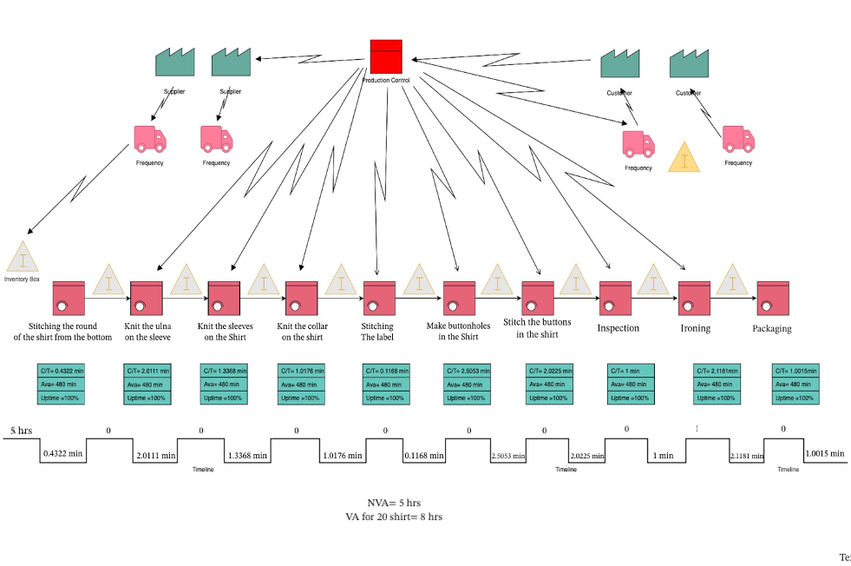
Value Stream Map:

Slide 6
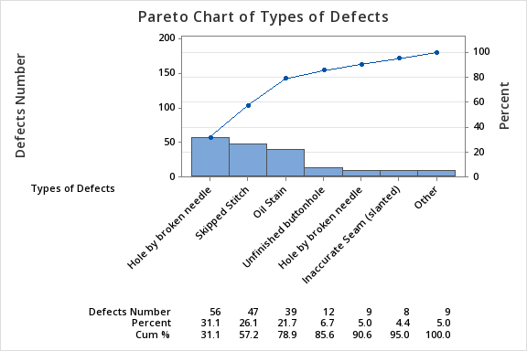
Type Of Defects | Number Of Defects
Hole by broken needle | 56
Skipped Stitch | 47
Oil Stain | 39
Unfinished buttonhole | 12
Hole by broken needle | 9
Inaccurate Seam (slanted) | 8
Seam Puckering | 5
Uneven Stitch | 3
Uncut thread | 1

Slide 7
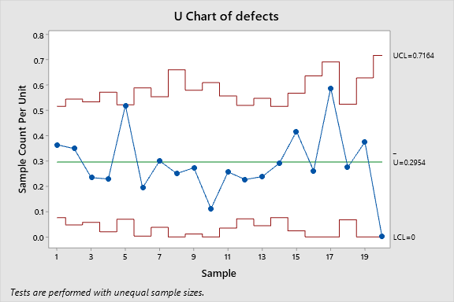
Defects | Checked Pieces | Batch Number
20 | 55 | 1
15 | 43 | 2
11 | 47 | 3
8 | 35 | 4
27 | 52 | 5
6 | 31 | 6
12 | 40 | 7
5 | 20 | 8
9 | 33 | 9
3 | 27 | 10
10 | 39 | 11
12 | 53 | 12
10 | 42 | 13
16 | 55 | 14
15 | 36 | 15
6 | 23 | 16
10 | 17 | 17
14 | 51 | 18
9 | 24 | 19
0 | 15 | 20

Slide 8
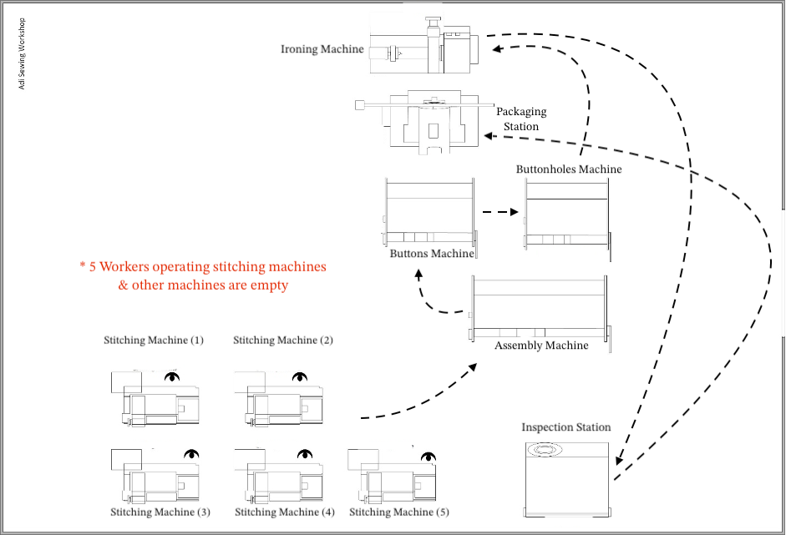
*Improve Phase:
Layout before Improve:

Slide 9
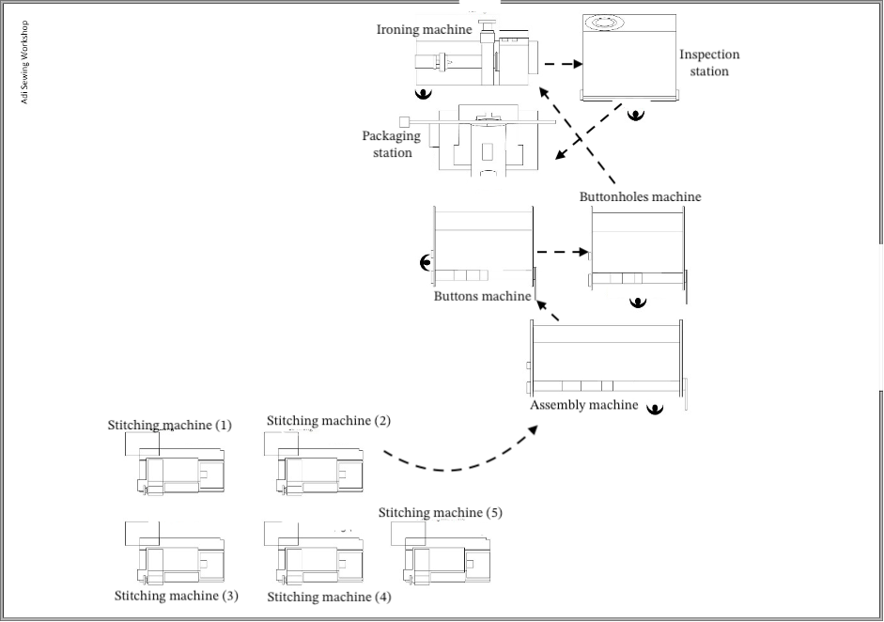
Layout after Improve:

Slide 10
Hole by Broken Needle & Skipped Stitch solution:
1- Determine the default life of the needle in hours by
experience of the workers so that the needle is replaced before the problem occurs
2- Ensure that the speed of the needle frequency is
adjusted through the machine to obtain a suitable
frequency
3- Continuous and periodic change of needle “once a month for example” because the price of needles not
expensive, where the price of one needle is 1.5 shekel.
4- Needle size & thread size must be adjusted.
Oil Stain solution:
  Give a break for the workers during the work day for eat in a place far from a place of work, so that the machines don’t get dirty.
  After eating, ensure that every worker washed their hands well
  The worker must ensure that the machine is clean before starting work, and make sure that the oil is in the machine and doesn’t leak out.
  After work, make sure that each shirt placed in clean place.
  Correct machine maintenance and oil leakage checking will be ensured by manager of the workshop.

Slide 11
*Simulation:
Goodnes of fit test:
Distribution type | Process
Normal ( 1.50645 , 0.172136 ) | Stitch buttonhole area & button area & cutting excess fabric
Normal ( 3.04025 , 0.289877 ) | Stitching the back of the shirt & Stitching the round from the bottom &Stitching the inside left& right shoulder
Weibull (7.18301 , 0.97776 ) | Stitching the sleeve
Normal (6.7517 , 0.584346 ) | Make ulna hole & Stitching the ulna (for two pairs)
Lognormal (5.05604 , 0.572440 ) | Preparing the collar & Stitching the collar
Weibull (13.86126 , 4.69760 ) | Knit of (ulna on the sleeve (for two pairs) & ulna on the sleeve (for two pairs) & collar on the shirt) & Stitching the label
Normal (2.50094 , 0.253789 ) | Make a buttonholes in the shirt
Normal (2.02314 , 0.112387 ) | Stitch the buttons in the shirt
Normal (1.01337 , 0.0702543) | Inspection
Gamma (867.86471 , 0.00243 ) | Ironing
Normal (1.00029 , 0.0109081 ) | Packaging

Slide 12
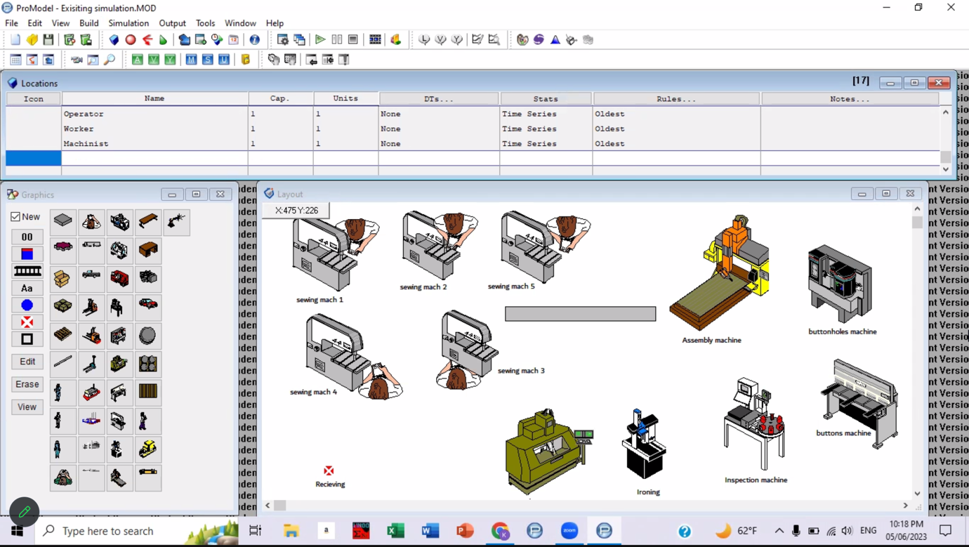
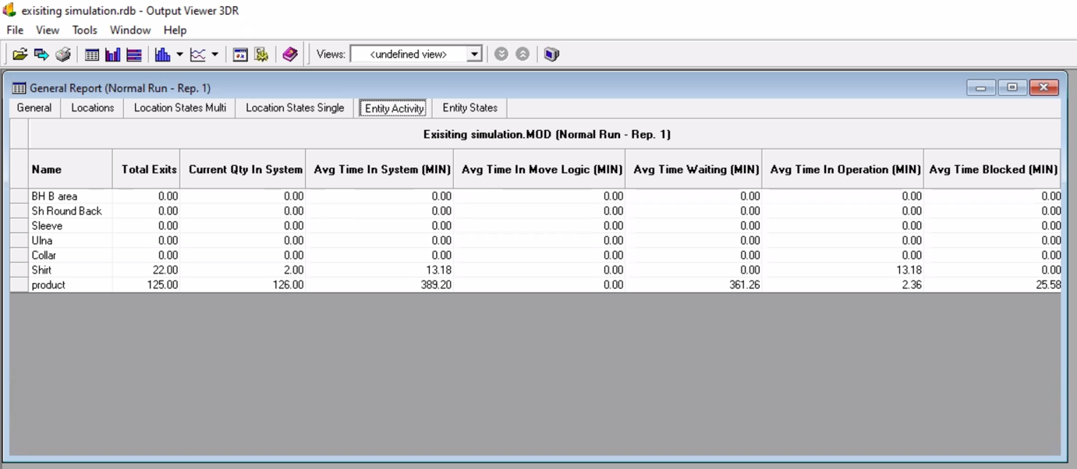
Current situation:
In one work day “8 hours”, 22 shirts have been
produced, and the waiting time was 331 min
“5.5 hours”
They gain at one shirt 7 NIS
So the profit will be 7*22= 154 NIS/day=
4004 NIS/month

Slide 13
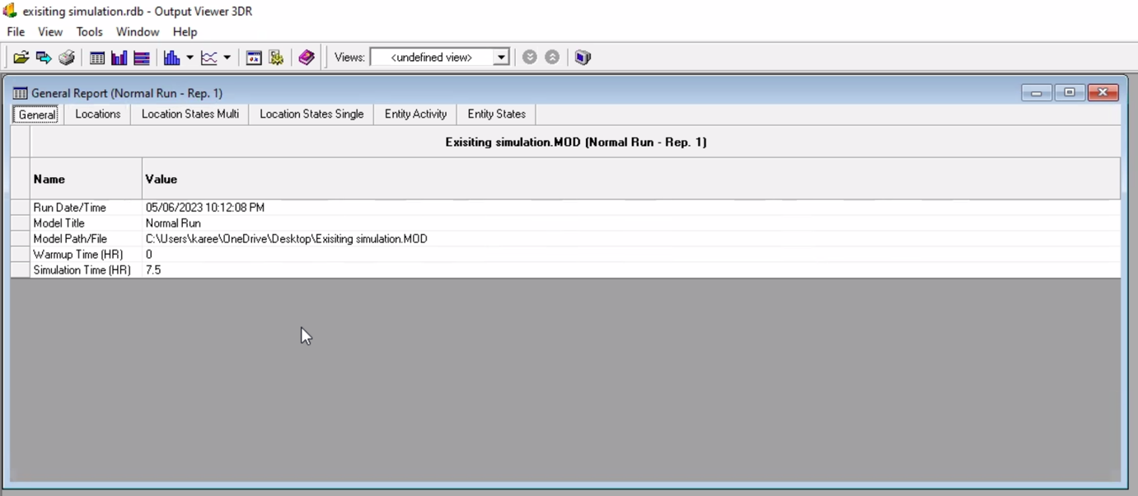
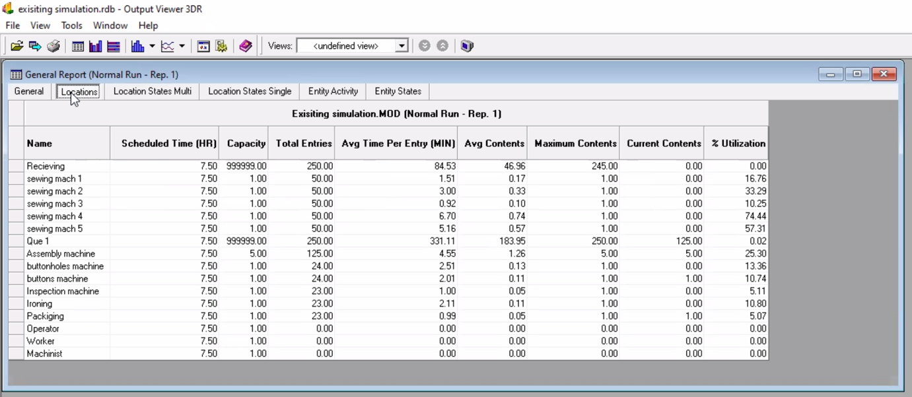
Processing time for 22 shirts= 7.5 hours
Waiting time = 331 minutes= 5.5 hours

Slide 14
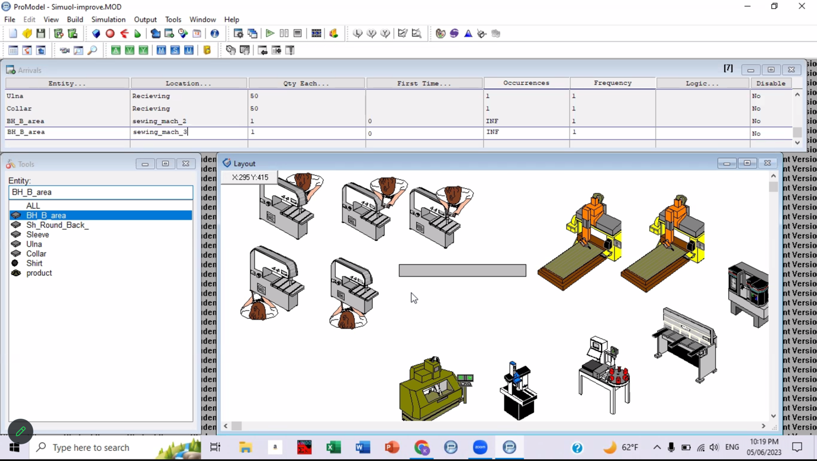
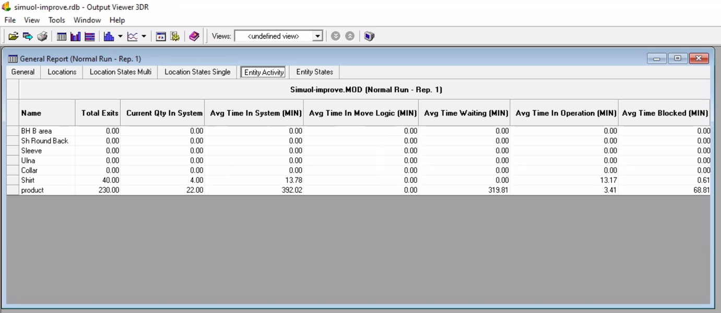
Scenario 1: Purchasing another assemply machine
In one work day “8 hours”, 40 shirts have been produced,
and the waiting time was 308 min “5 hours”
They gain at one shirt 7 shekels
So the profit will be 7*40= 280 shekel/day
= 7280 shekel/month
Purchasing cost for another assembly
machine = 2500 shekel which will be
covered in 12 months, so in one month the
cost will be= 208 shekel/month
The net profit will be= 7280-208= 7072
shekel/month

Slide 15
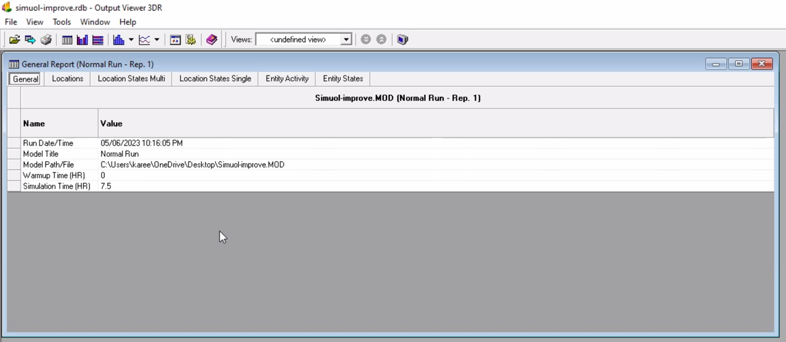
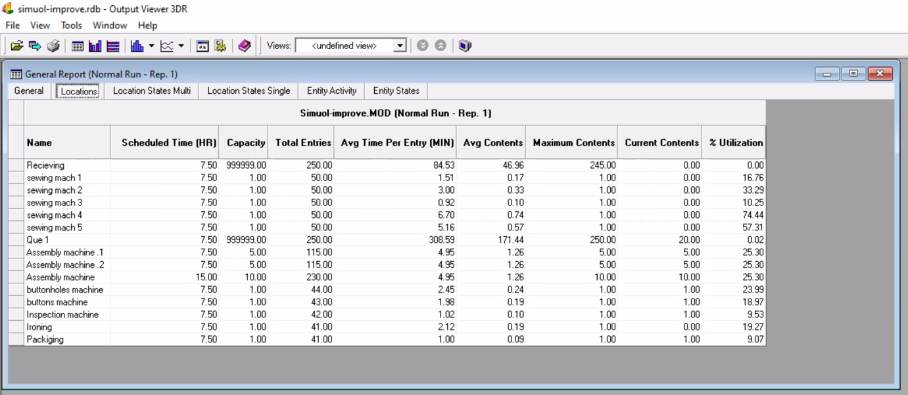
Scenario 1: Purchasing another assemply machine
Processing time for 40 shirts= 7.5 hours
Waiting time decreased to
308 minutes= 5 hours

Slide 16
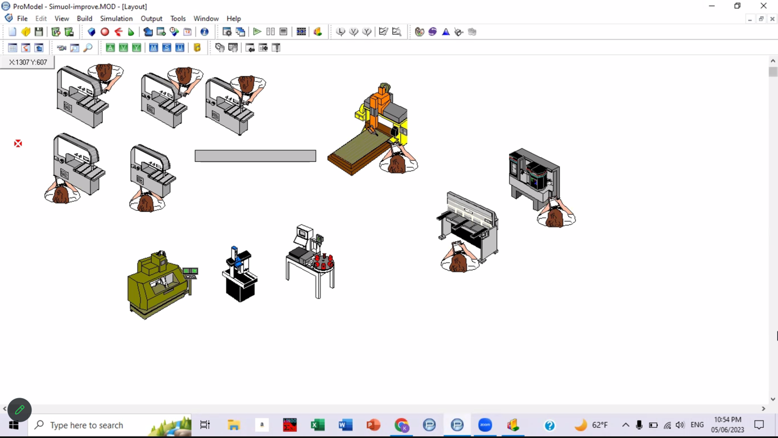
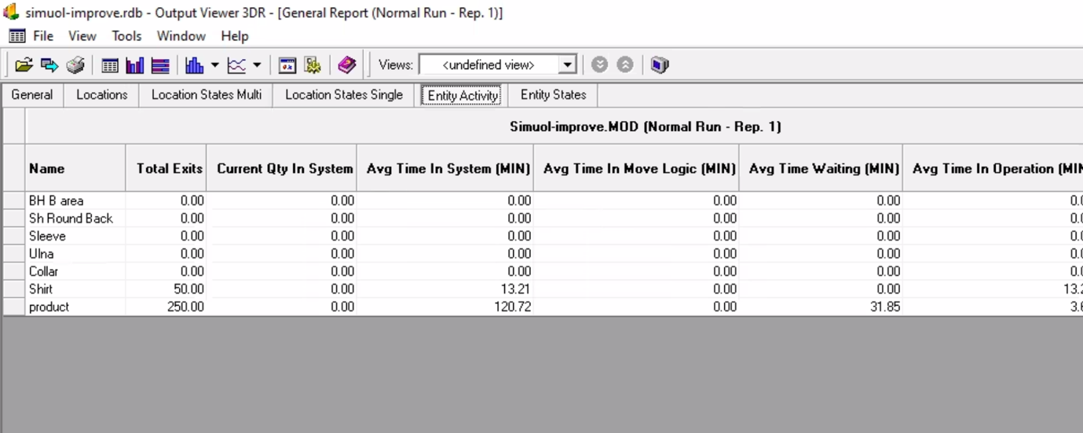
Scenario 2: Bringing another 3 workers
The production time reduced to 5.8 hours, 50 shirts have been produced, and the waiting
time decreased to 31 minutes
They gain at one shirt 7 shekels
So the profit will be 7*50= 350 shekel/day=
9100 shekel/month
Salary for one worker = 1500 shekel= 4500 shekel/3workers in one month
The net profit will be= 9100-4500=
4600 shekel/month

Slide 17
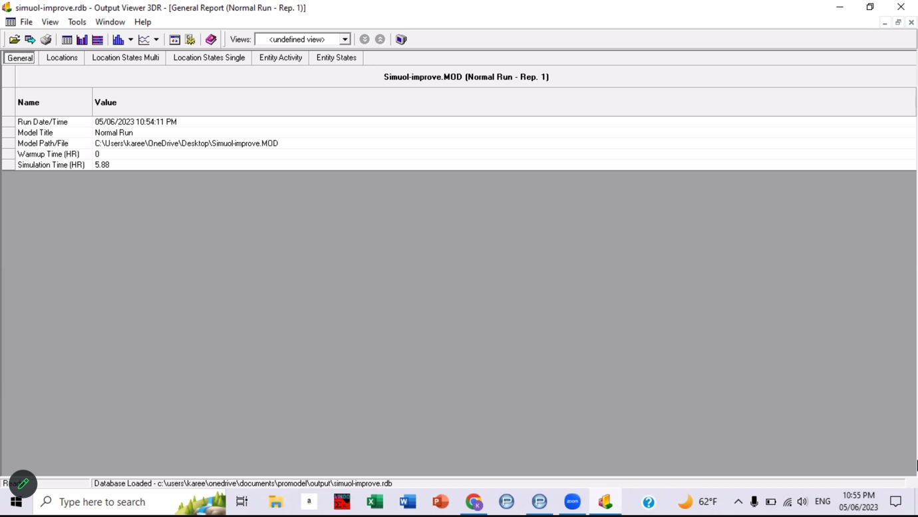
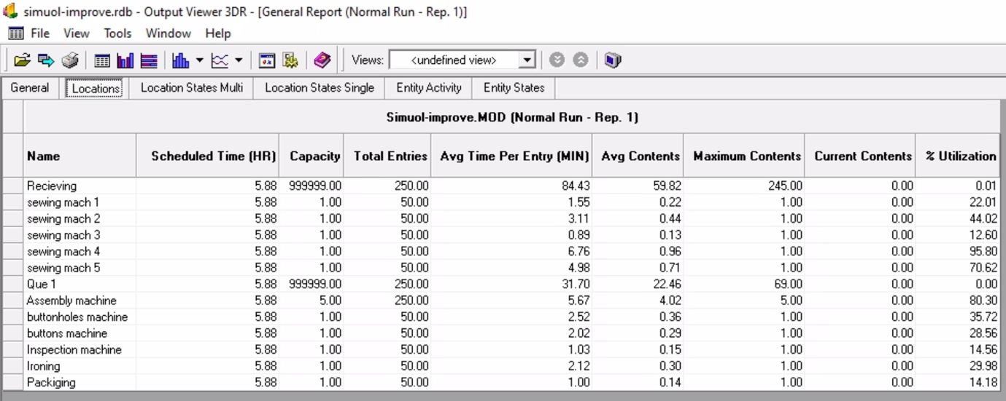
Processing time for 50 shirts
= 5.88 hours
Waiting time decreased to
31 minutes

Slide 18
Conclusion
Reducing average processing time.
Increasing net profit to 84,864 NIS/year.
Increase productivity/hour.
Reduce defects.
Recommendations
Performing regular preventive maintenance.
Modernization of some machines due to the age and due to the inconsistency in the production capacity of the machines.
Purchasing another assembly machine.

Slide 19
Thank you

