Slide 1
ohjiatech
Tamer H. Naana & Mahmood K. AbuSamaha

Slide 2
Outline
Introduction
Overview
Ohjiatech
Tools
Technical Perspective
Constraints
Future Work
Scenario

Slide 3
Introduction
People seek for an efficient approach to be up for challenges.
350+ M Rubik’s cubes sold since 1980.
1.5+ M copies of “You can do the cube, by Patrick Bossert” was sold.
Learning by doing is the best.
2.1+ B smartphones around the world.
Ohjiatech is our solution.

Slide 4
Overview
Tutorial-based mobile app.
Play, learn, get help and challenge friends.
Four modes:
  Single player.
  Multiplayer.
  Tutorial.
  Solver (Assistant).
Progress by score

Slide 5
Ohjiatech

Slide 6


Slide 7


Slide 8


Slide 9




Slide 10
Tools
Unity3D.
OpenCV4Unity.
Bitbucket.
MySQL.

Slide 11
Technical Perspective

Slide 12
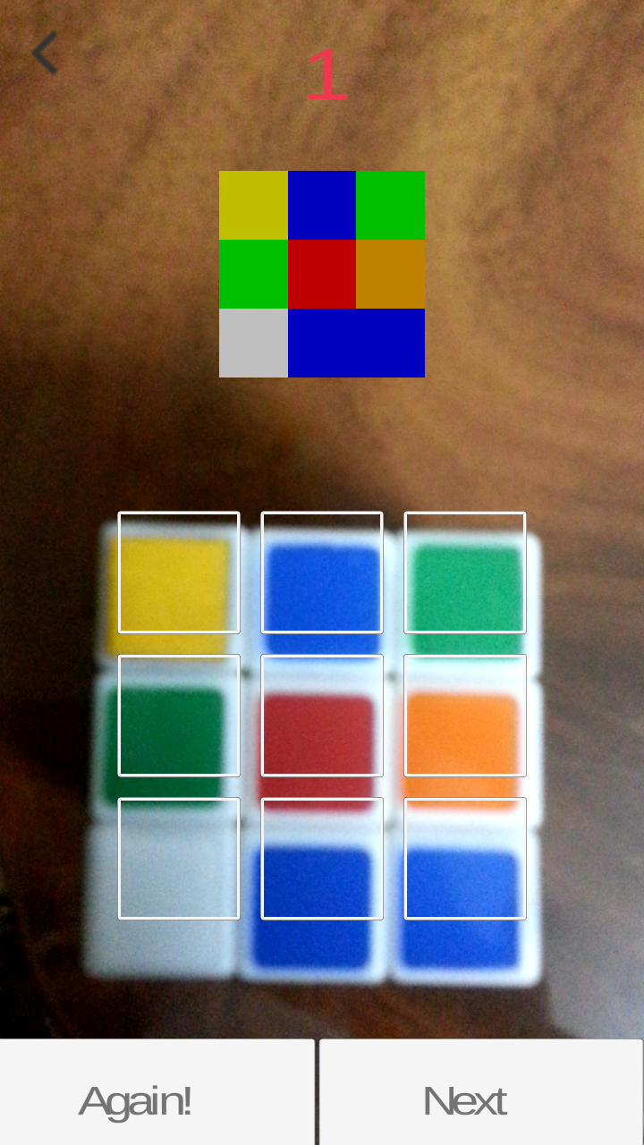
Capturing the Cube

Slide 13
Server Side
User registration & signing in.
Leaderboard.
User scores history.

Slide 14
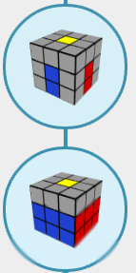
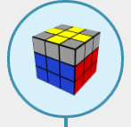
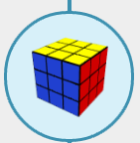
Solution Method
F2L
A*
Thislethwaite

Slide 15
Unity stuff
3D modelling
Commands
Scenes

Slide 16
Constraints
Time Constraint.
OpenCV for Unity is not free.

Slide 17
Future work
New puzzles & games.
Multiplayer mode.
Better design.

Slide 18
Scenario

Slide 19
Thank you

