Slide 1



intelli-Diet
Prepared by: Hanin Mizyed ,Razan Qraini
Supervisor: Dr. Luai Malhis

Slide 2
Content Outline
Introduction
Existing problem
The solution
Description of our App
How IOS side system work
How Android side system work
Problems
Related works
Conclusion

Slide 3
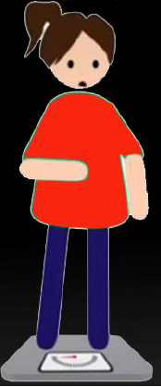
Introduction
everyone want to have healthy body.
Overweight became like a nightmare .
Do you like to lose weight ?

Slide 4
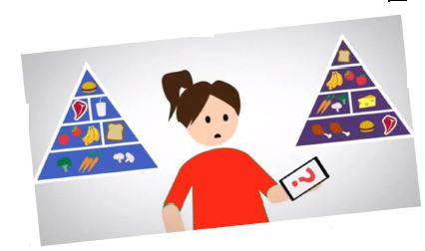
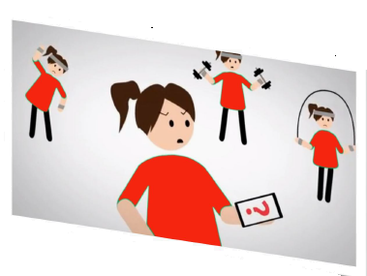
Existing Problems
Which Diet To Do
Which Exercise To Do

Slide 5
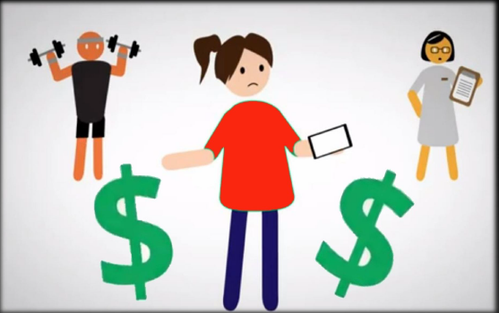
Existing Problems
Expenses Of Personal Trainer
Don’t have time to go to gym

Slide 6

Solution
Smart phones become the most used devices
IOS and Android Mobile application for health & fitness Tracking

Slide 7
Application Description
Its Think You Eat
A calorie tracker application
find and track the amount of calories you can burn
a database of healthy recipes and a map for the healthy restaurants nearby.
Food Tracking
Weight Tracking
Exercise Tracking

Slide 8
Application Description
Our Application has a Server/Client architecture.
It was developed in two versions: iOS and Android.
    Client: objective-c.
    Server: ASP.NET framework .
    Databases: SQL Database, SQLite Database.

Slide 9
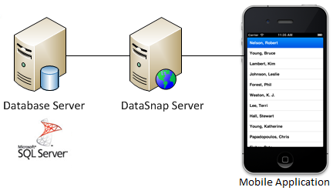
Application Description
Why we build a server ?
Mobile size.
Data updating.
Social Environment

Slide 10
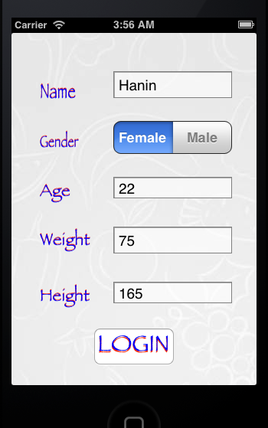
How IOS App Work
Registration
Entering your profile info

Slide 11
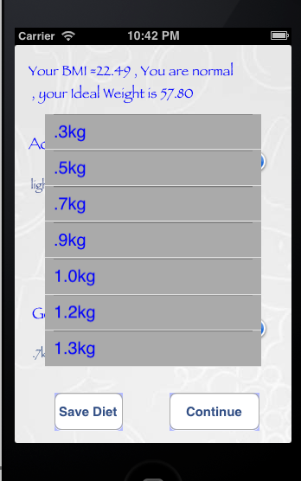
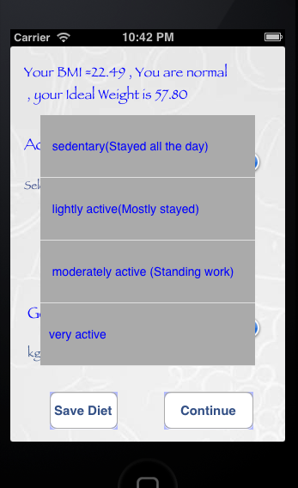
How IOS App Work
BMI calculation
Classify user body state
How many kg could be lost per week

Slide 12
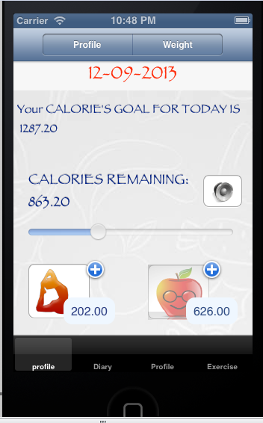
How IOS App Work
we determine how many calories the user should eat per day to reach his goal of weight.
Calories burned , gained , and total calories will be saved using
NSUserdefaults class
Voice Notification .

Slide 13
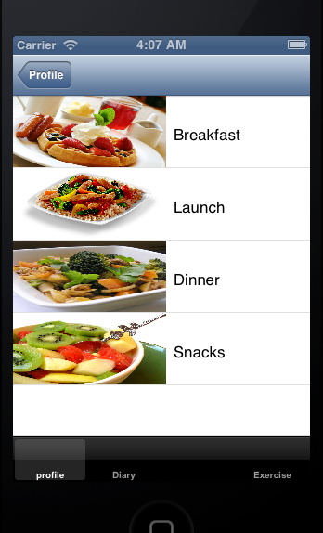
Food Tracking
Recipes on divided into breakfast, lunch, dinner and other snacks.
Mobile send request to server , recieve it in JSON format
Track food using IateThis button

Slide 14
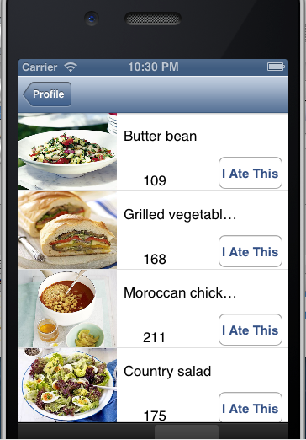
Food Tracking
The user can add comments to each recipe
Comments send to server and received in json format

Slide 15
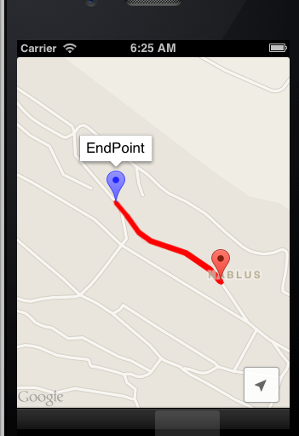
Exercise Tracking
An exercise tracker with real-time GPS .
Draw user route on google maps/ios sdk

Slide 16
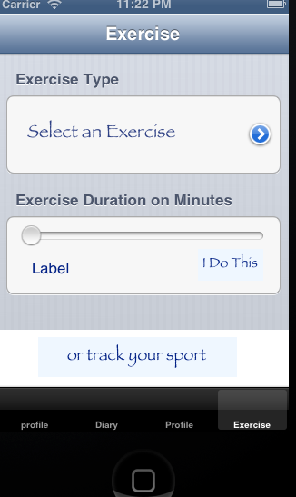
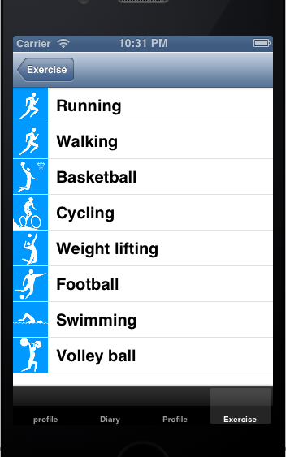
Exercise Tracking
also find and track the amount of calories you can burn using our database of exercises and activities.

Slide 17
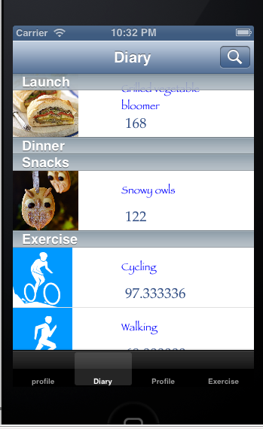
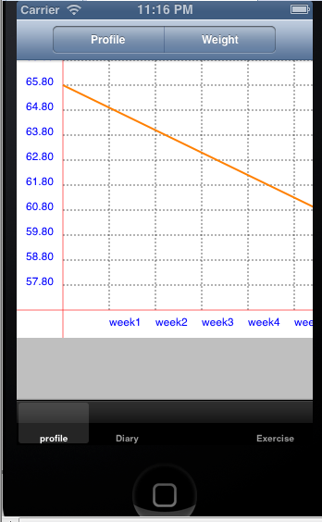
Exercise Tracking
Diary page.
Weight Chart

Slide 18
Problems
No license to test ios app

