Slide 1

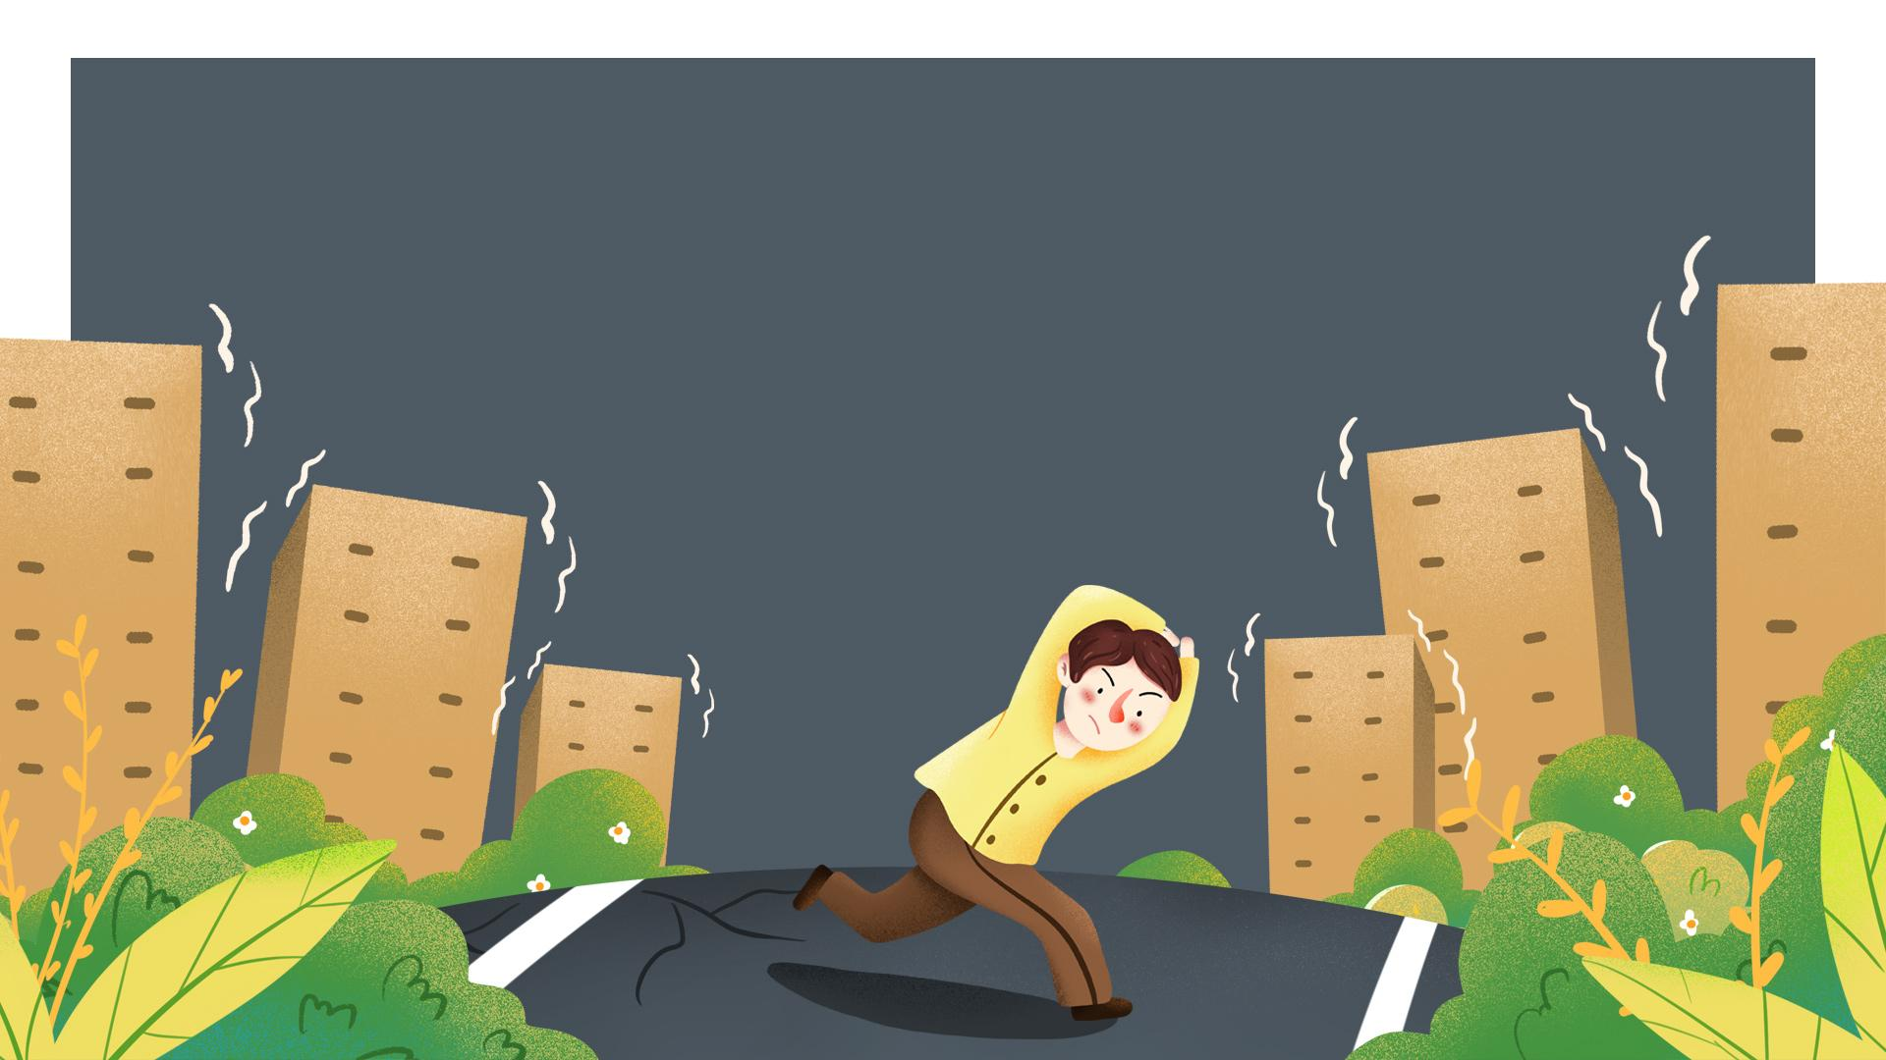

Marah Jaber
Seba Salahat

Slide 2
1
What is LifeQuake?
2
Project’s idea?
Outlines
3
Robot Design
4
Used Tools
5
Features
6
Constraints
7
Future Work

Slide 3
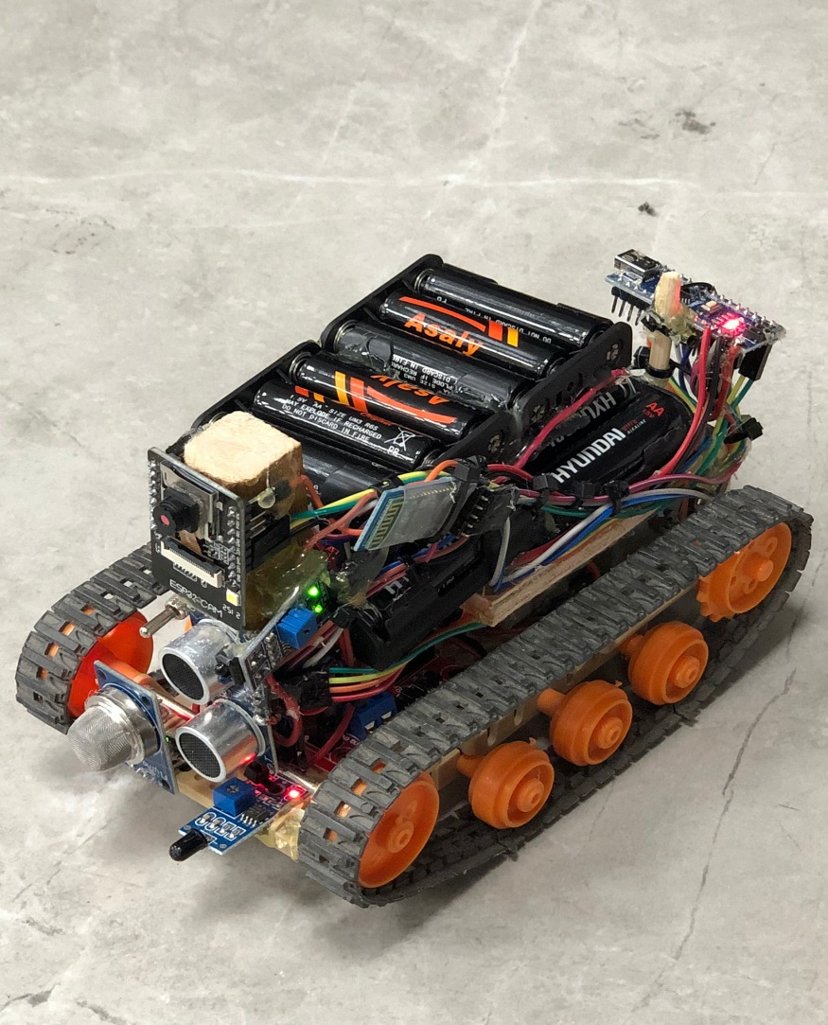
What is LifeQuake?
LifeQuake It is a searching robot that is used to find earthquake victims by going inside rubbles and streaming video to the outside while indicating the risks in LifeQuake It is a searching robot that is used to find earthquake victims by going inside rubbles and streaming video to the outside while indicating the risks inside. side.
LifeQuake It is a searching robot that is used to find earthquake victims by going inside rubbles and streaming video to the outside while indicating the risks inside.

Slide 4
Where did we get the idea?
We chose this idea after the devastating earthquake that struck Syria and Turkey, and we saw that one of the most critical problems was finding victims, so we decided to assist rescuers in finding victims and then rescuing them as our slogan "finding victims, restoring hope."

Slide 5
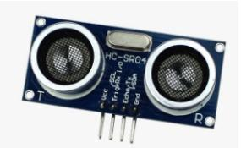
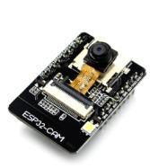
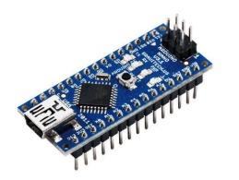
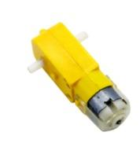
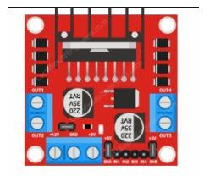
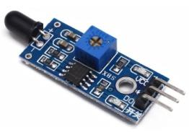
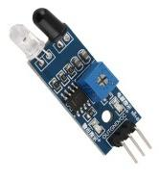
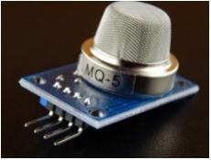
Used Tools
Ultrasonic Sensor
ESP 32 CAM
Arduino nano
DC - Motor
L298N motor driver
Flame Sensor
IR Sensor
MQ 05 Gas Sensor

Slide 6
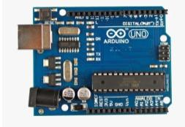
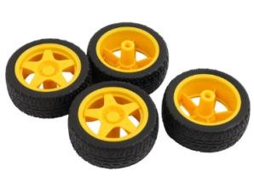
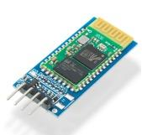
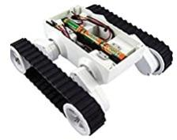
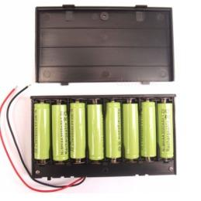
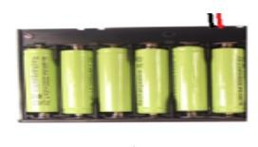
Used Tools
Arduino uno
wheels
HC05 Bluetooth Module
Robot Chassis
9V dc Battery
12V dc Battery

Slide 7
Robot Design
We added an ultrasonic sensor to prevent the robot from crashing into an obstacle.
We added various types of sensors to give the rescuers an indication about the risk inside
2
4
1
3
It is small and light enough to enter the rubble easily and safely. To make movement easier on rough surfaces, we used wheels with chains.
We added a camera to stream video from the rubbles to rescuers outside, as well as several levels of flash lighting to ensure video quality in low-light conditions.

Slide 8





Features
Wifi mode
Bluetooth Mode
Flame Sensor
User can move the robot using buttons in the app screen that moves the robot forward, backward, left and right.
The user can control the robot by saying one of the Defend 7 commands.
Detect any fire and alert the rescuers for burning risk.

Slide 9

Features
Ultrasonic Sensor
IR Sensor
Co2 Sensor
Stops the robot’s movement if there is any obstacle in front of it.
Detects if there is a human near the robot.
Measure gas levels and alert the rescuers for suffocation risk.

Slide 10
Constraints
We couldn't find the type of wheel required to allow the robot to easily walk the
inconsistent surfaces.
We had difficulty supplying the necessary power for all of the electronic components.
The camera was very sensitive and had been damaged due to high voltages and even
weak strikes.

Slide 11
Future Work
01
03
We are planning to add a GSM system to provide a contact way
between the victims and outside so they can talk to the rescuers and give them information
about their state of health or talk to their families and loved ones outside to reassure them.
We intend to improve our robot to hold assistance to victims such as food,
water, and blankets to help them withstand conditions longer.
Connect software system which contains addresses of all harmed houses
and victims’ names, so that after rescuing a home, the names of victims will be deleted,
that will make the process easier.
02

Slide 12
THANKS

