Slide 1

Smart Parking System
(EPark)
Done by :
Dyala Saadeh
Aseel Assi

Slide 2
CONTENTS
01
Introduction
02
What is EPark
03
Main Features
04
Problems
05
Future Work

Slide 3
01
Introduction
Rapid technological development.
Problem in parking slots
Smart Parking System.

Slide 4
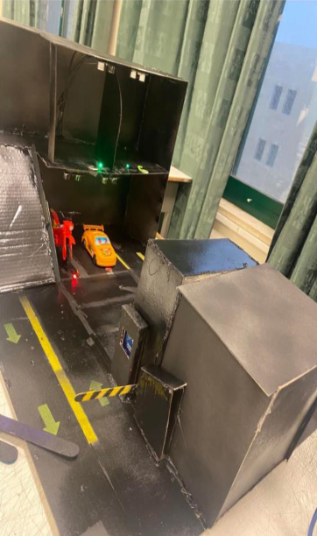
02
What is EPark
IOT system.
2 floors with 6 parking lot.
Automatic Gates
Payment procedure.

Slide 5
03
Features
Software (mobile application and website).
Smart and secure parking
Easy and automatic payment process.

Slide 6
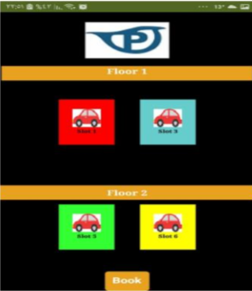
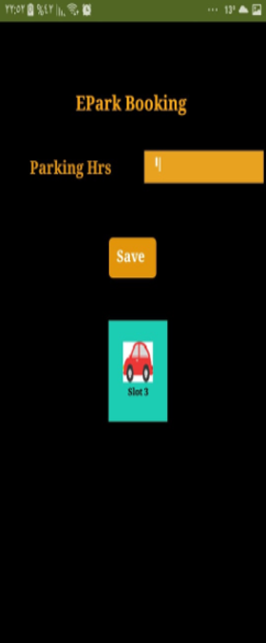
Software(mobile)
Home Page
Booking Page

Slide 7
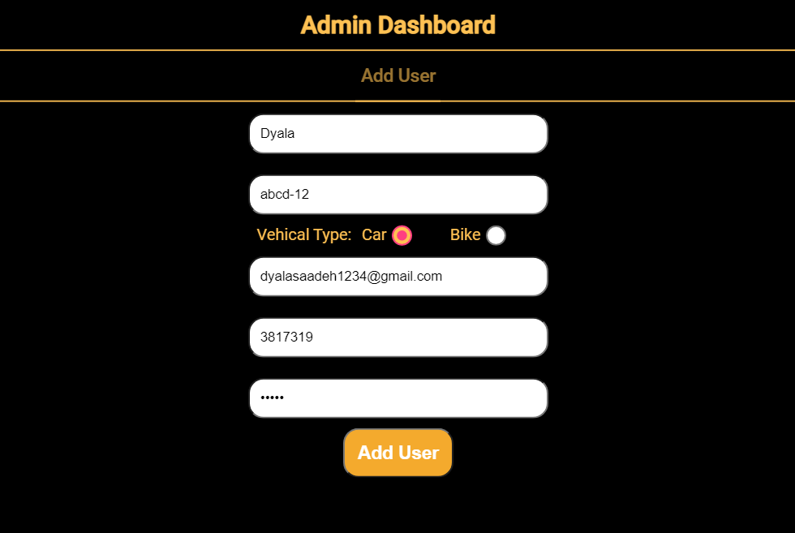
Software(web)

Slide 8
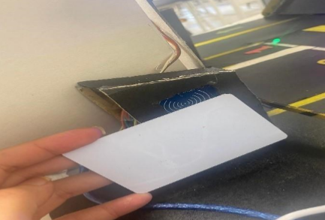
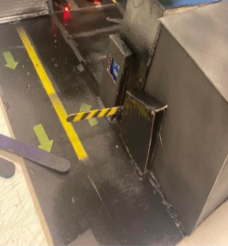
Smart and Secure Parking
Entrance
Exit

Slide 9
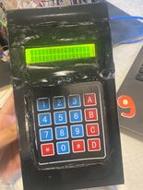
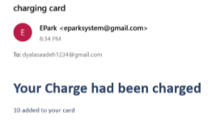
Payment Process

Slide 10
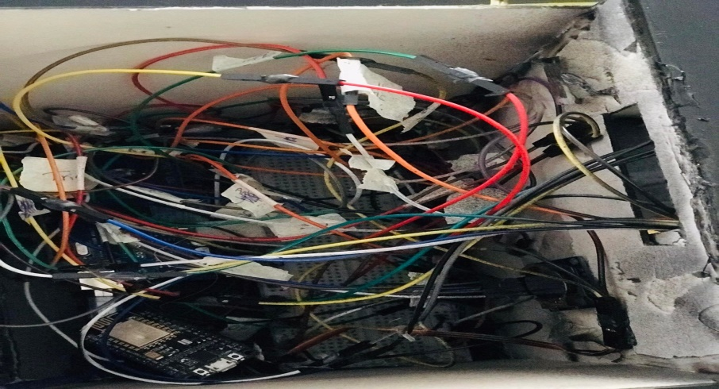
05
Problems
Serial communication & firebase
Ultrasonic sensors
Wires
Delays

Slide 11
06
Future Works
Improve payment way
Increase number of floors and parking slots
Use a gas sensor
Use image processing
Give directions

Slide 12
THANK YOU

