Slide 1
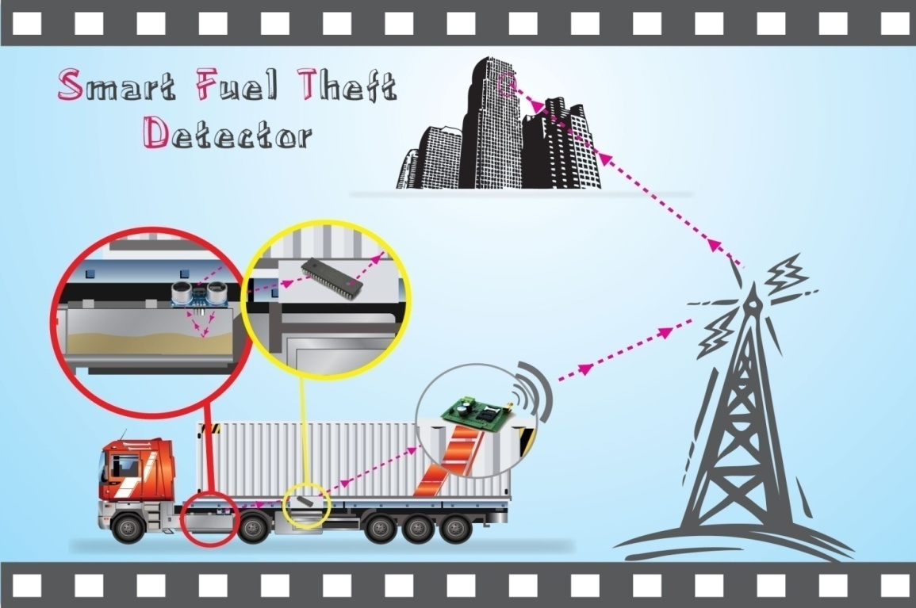

Smart Fuel Theft Detector
An-Najah National University
Faculty of Engineering
Supervisor:
Dr. Samer Mayaleh
Prepared by:
Amjad Rabaya
Adham Sawafta

Slide 2
شكر وتقدير

Slide 3
OUTLINE
Review
Limitations & Challenges
Solution methods
Used Elements
Measuring & Theft
Hardware Tutorial
Database
The End

Slide 4
OUTLINE
Review
Limitations & Challenges
Solution methods
Used Elements
Measuring & Theft
Hardware Tutorial
Database
The End

Slide 5
Review
What is smart fuel theft detector ?
Why to use smart fuel theft detector ?

Slide 6


Review
What is Theft?
The fuel is being stolen from the vehicle's tank through withdrawing using a pipe.
The tank is filled with amount less than written in the bill.

Slide 7
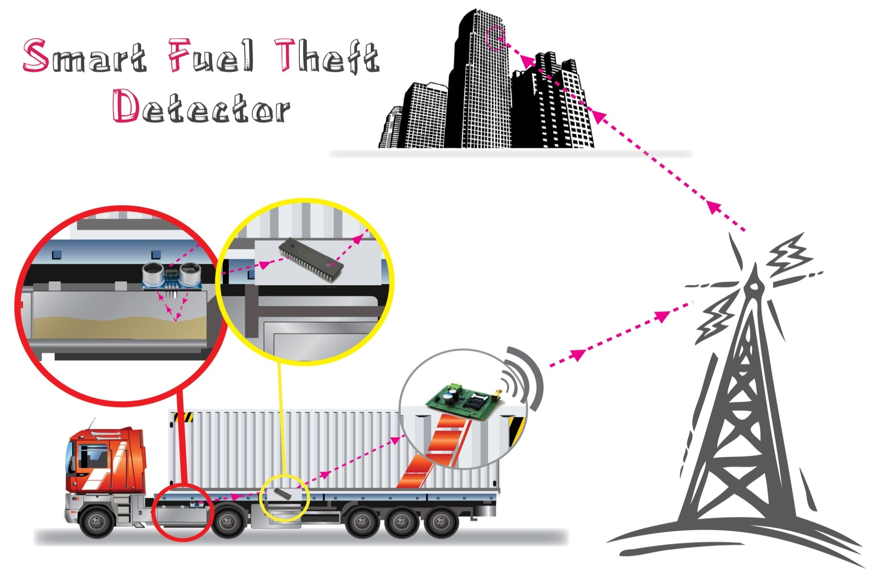
Review

Slide 8
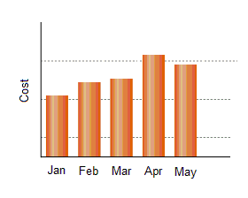


Review
Why to use smart fuel theft detector ?
Helps the companies to monitor and identify exactly its fuel consumption periodically and in real-time.
Prevents fuel theft from the vehicles tanks.
Helps identifying the fuel thief (the driver or other people).

Slide 9
OUTLINE
Review
Limitations & Challenges
Solution methods
Used Elements
Measuring & Theft
Hardware Tutorial
Database
The End

Slide 10

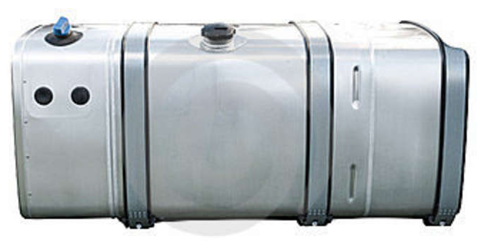
Limitations & Challenges
The flammability of the fuel
Accurate and Safe Isolation

Slide 11
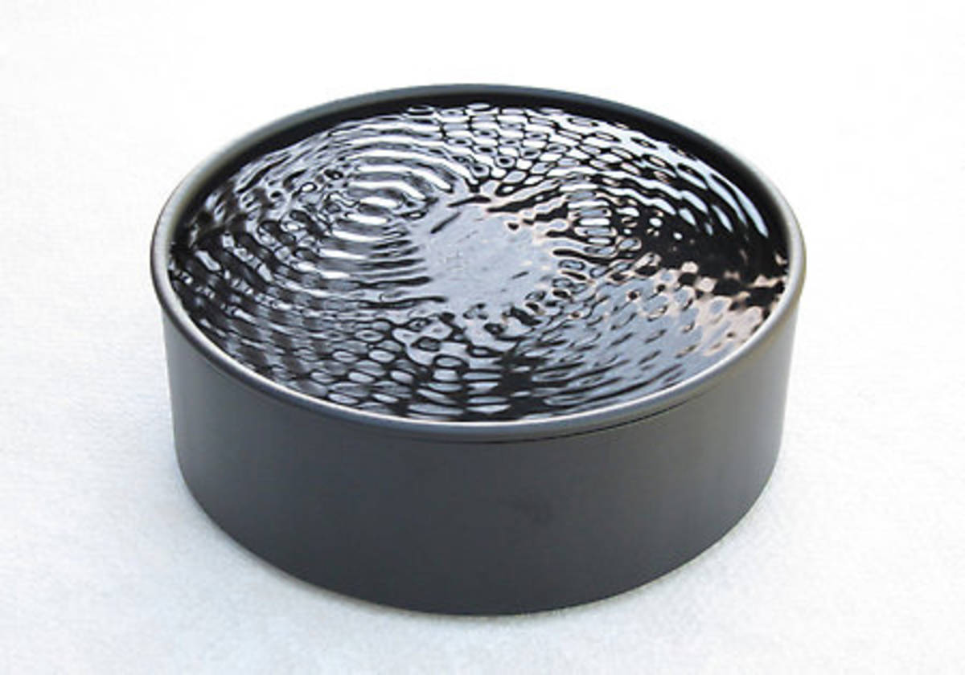
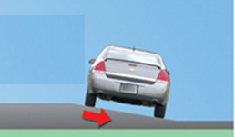


Limitations & Challenges
Dynamic motion of the fuel
Multi Readings per Second

Slide 12
OUTLINE
Review
Limitations & Challenges
Solution methods
Used Elements
Measuring & Theft
Hardware Tutorial
Database
The End

Slide 13
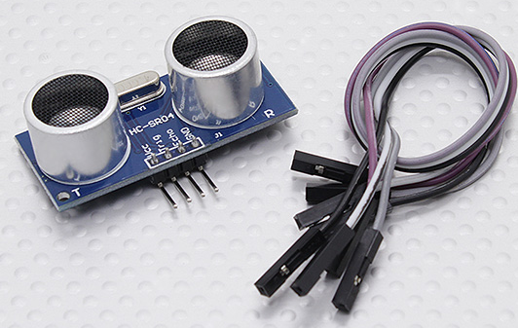
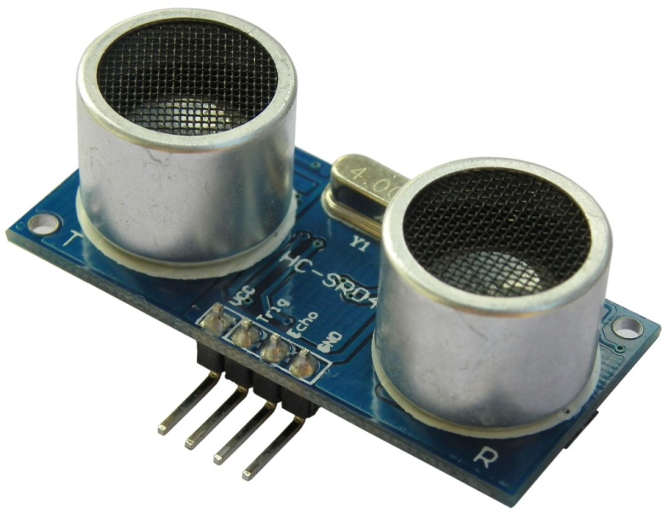
Solutions
Ultrasonic Sensor
Flammability
no electrical connection between the sensor and the tank.
Spark-Free device
  Accurately closed Tank
Small size, no need to make large holes in the tank.
Dimension:
45mm x 20mm x 15mm

Slide 14

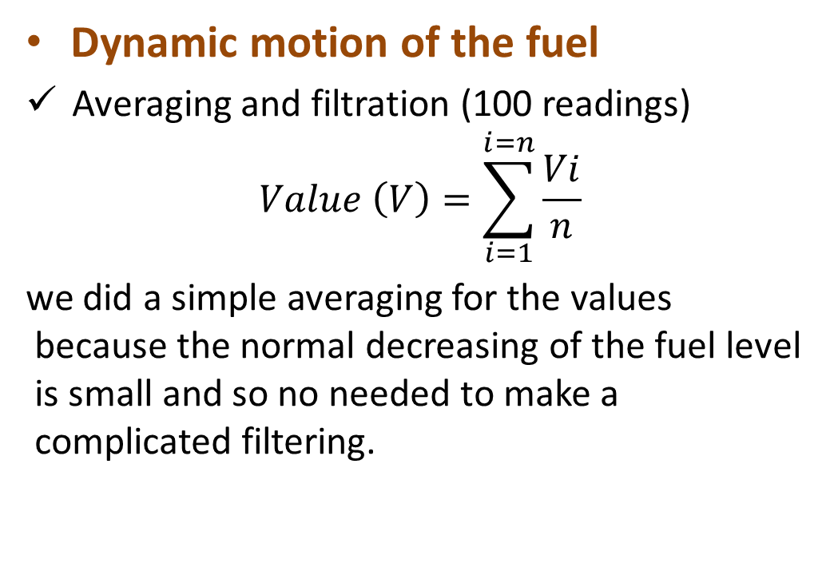
Solutions
Dynamic motion of the fuel
Averaging and filtration (100 readings)
$$Value \left(V\right)=\sum_{i=1}^{i=n}{\frac{Vi}{n}}$$
we did a simple averaging for the values because the normal decreasing of the fuel level is small and so no needed to make a complicated filtering.

Slide 15
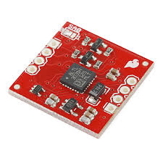
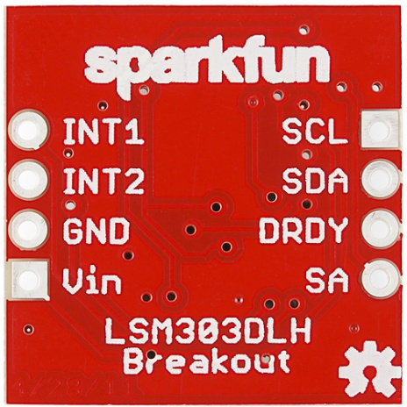
Solutions
  Slope of the roads
  Using LSM303DLH sensor to
  Determine the slope.
  Find the actual level considering the slope of the road.
  It is fitted outside the tank

Slide 16
OUTLINE
Review
Limitations & Challenges
Solution methods
Used Elements
Measuring & Theft
Hardware Tutorial
Database
The End

Slide 17
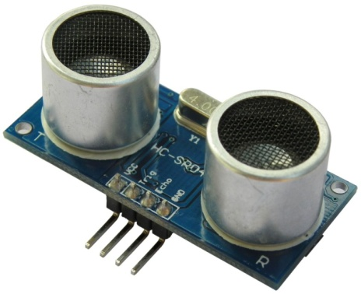
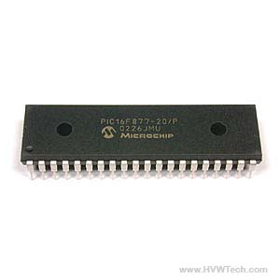
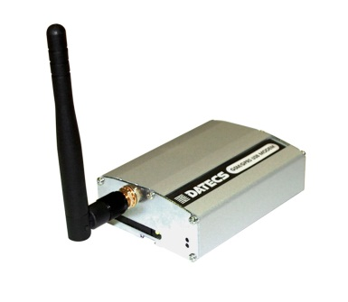
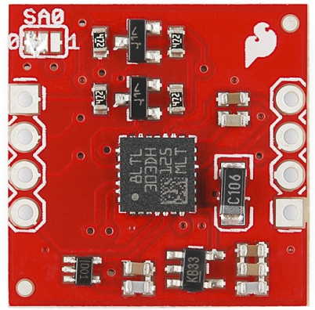
Used Devices
Ultrasonic Sensor (HC-SR04)
Microcontroller (PIC16f877)
Slope Sensor (LSM303DLH)
GPRS Module (not available!)

Slide 18
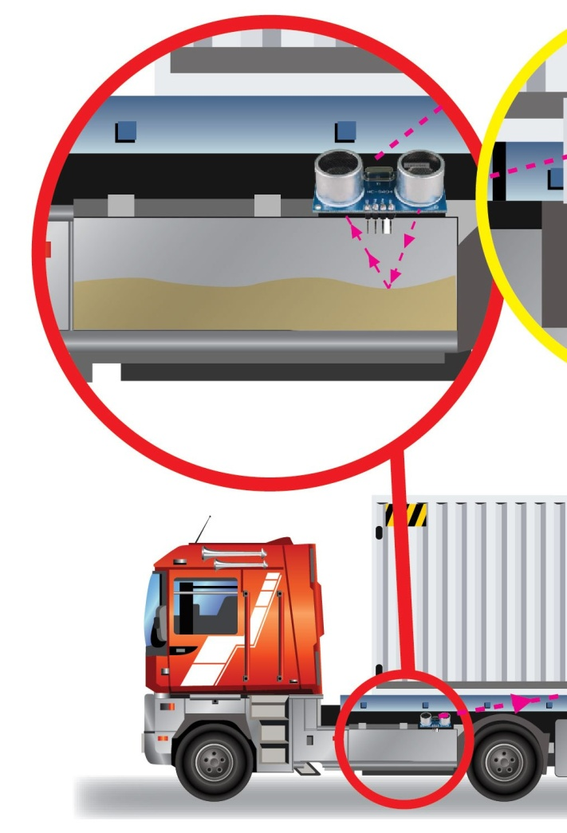
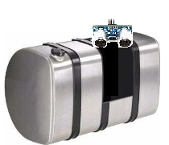
Used Devices
Ultrasonic Sensor
Fitted on the tank directly
Connected wired to the controller

Slide 19
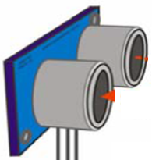


Ultrasonic Principle of Work
Receiver
Transmitter
Some Object
Output: Time of Flight (uSec)

Slide 20
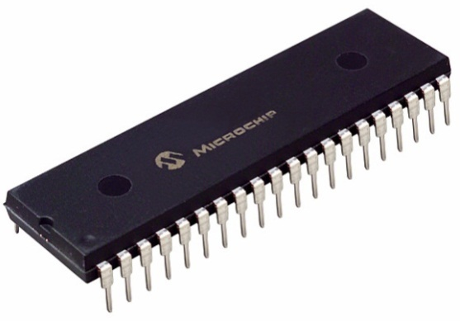
Used Devices
Ultrasonic Sensor
5 volt
10 uSec
Trigger
Echo
PWM
depends on the distance

Slide 21
Used Devices
Microcontroller
Filters the readings (50 to 1)
Converts the readings to volume
Theft detection
Pass readings to GPRS module

Slide 22
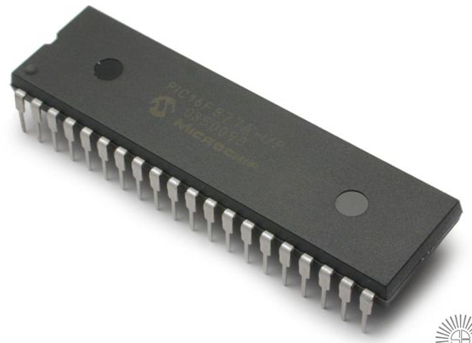
Used Devices
Microcontroller
Converts from PWM time to digital volume
Volume signal
(Liter)
Time (uSec)
PWM signal
Digital

Slide 23

Used Devices
Microcontroller
Filtering and averaging
i.e. Microcontroller is
faster than the sensor
Give one reading
10
9
…
3
2
1
1

Slide 24



Used Devices
Microcontroller
YES
NO
Check For Fuel Theft

Slide 25
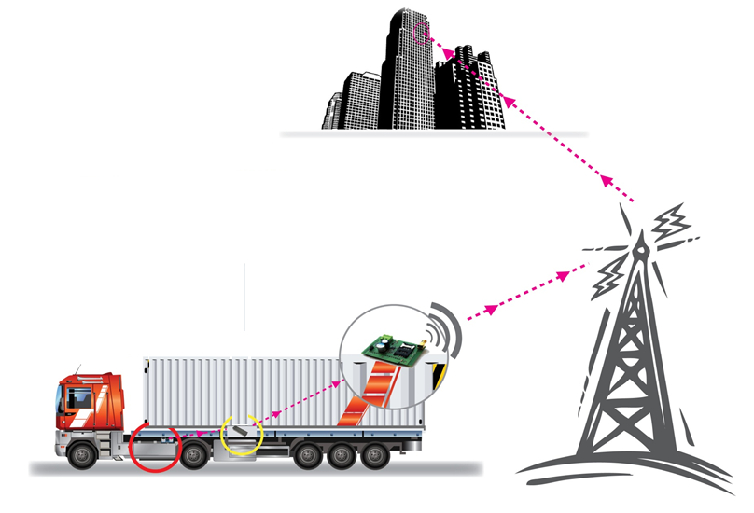
Used Devices
GPRS Module
Receives readings from the microcontroller
Sends it to the company for further processing.

Slide 26
OUTLINE
Review
Limitations & Challenges
Solution methods
Used Elements
Measuring & Theft
Hardware Tutorial
Database
The End

Slide 27
Measuring Scenarios
Flat-Road & Stopping
Probable Theft!
Flat-Road & Moving
Impossible Theft.
Tilted-Road & Stopping
Probable Theft!
Tilted-Road & Moving
Impossible Theft.

Slide 28
Theft Detecting
The principle of Theft-Detecting is based on the Consumption Rate and the Fuel Change of the vehicle.
Fuel Change ≥ Consumption Rate
Fuel Change ≤ Consumption Rate
THEFT
Normal

Slide 29

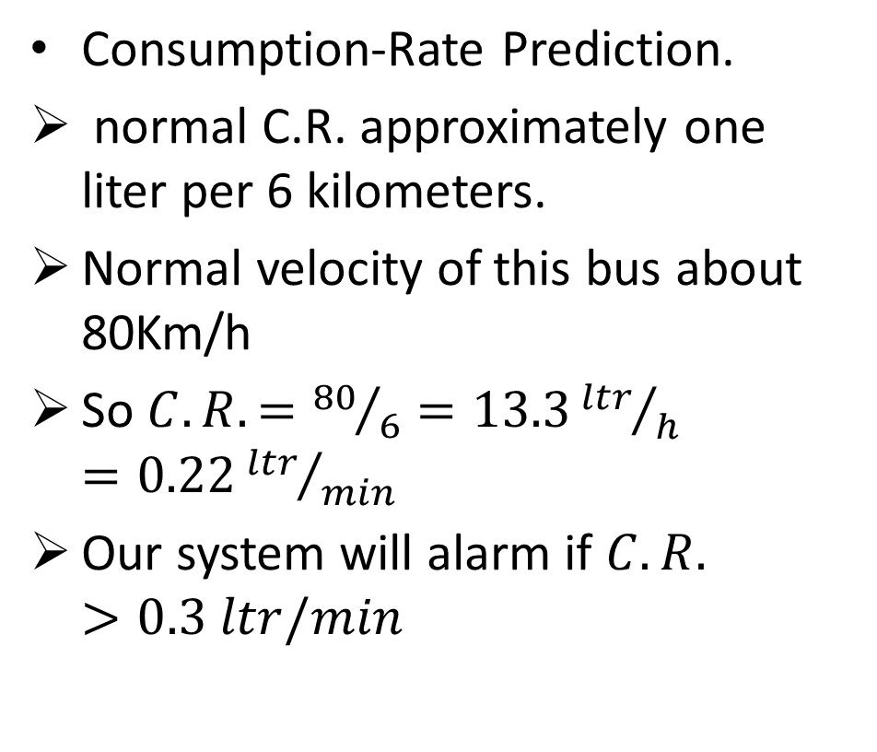
Case Study
50-passengers-bus

Slide 30
OUTLINE
Review
Limitations & Challenges
Solution methods
Used Elements
Measuring & Theft
Hardware Tutorial
Database
The End

Slide 31

Hardware Tutorial

Slide 32
OUTLINE
Review
Limitations & Challenges
Solution methods
Used Elements
Measuring & Theft
Hardware Tutorial
Database
The End

Slide 33
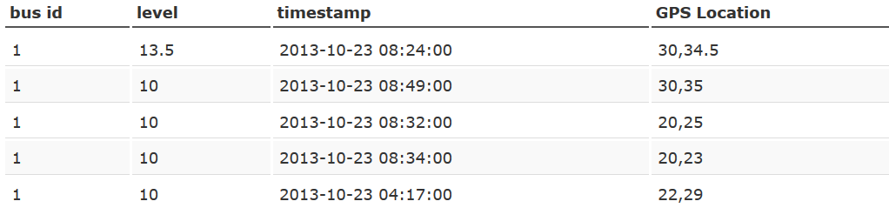
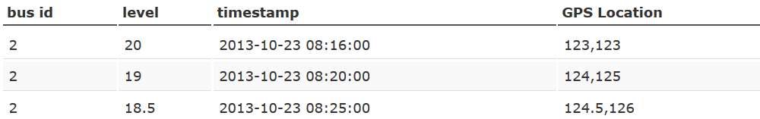
Database

Slide 34
THANKs For Listening

