Slide 1

Smart Home
By : Ahmad Salah Nour Mousa Supervisor :Ahmed Awad

Slide 2

what is smart home ?
Smart House is a system for securing any faculty using special equipment such as sensores .

Slide 3


Why Smart Home ?
looking at current security options we see a lot of problems that need to be addressed

Slide 4
Problems with current systems
1-the cost for such systems is high
2-takes too much storage to store logs and data
3-the need of continuous observations of the system
4-if an accident occur will not know until u can see the effect of it

Slide 5
Pros of Smart Home
1-low cost compared to the current security systems
2- flexibility
3-fast response to accidents
4-easy to implement
5-could be reached using web page or android app

Slide 6
How does Smart Home work ?
data is collected from the sensors and sent to the microcontroller
then, the data is processed to make it useful
data is transferred to clients when needed

Slide 7


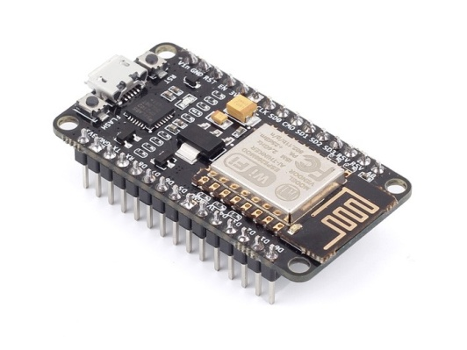


Motion detected
Sound detected
Send req
Motion detected
Receive data
Temp detected
Temp detected

Slide 8
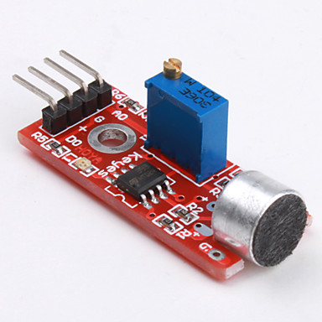
Components of Smart Home
1- Microphone :
data is collected in analog fashion then , it is manipulated to become
useful data

Slide 9

2- Thermostat :
data is collected in analog fashion then , it is manipulated to become
useful data

Slide 10
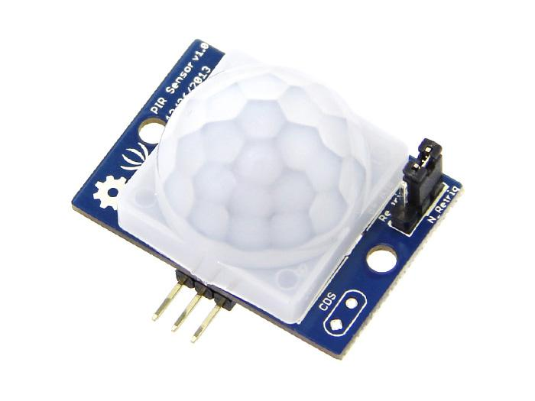
3- PIR ( Motion sensor) :
PIR sensor gives reading in binary data and sends it directly to the microcontroller

Slide 11

4- esp8266 :
The heart of the system , works as :
1-microcontroller : controls all sensors connected to it , collects the data and process it .
2-server : used to communicate with all the clients in a client-server fashion through sockets
3- wifi module : used to connect to the internet using wifi

Slide 12
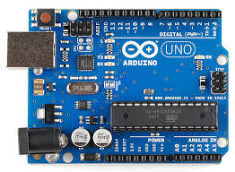
5- Adriano :
in our project it's used as a power source since most of the sensores require more power than the esp can offer

Slide 13
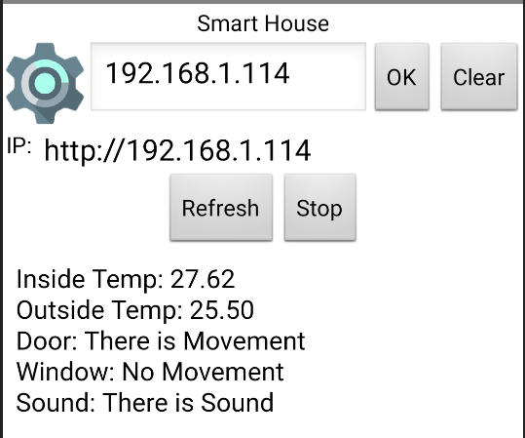
Smart Home app
using the Smart Home app you can connect to the system and receive information :
1-first type the ip of the esp to connect to it
2-information will start to appear in real time as shown in the picture below

Slide 14
What’s next ?
Smart Home still has more to provide :
1-loge system
2-in-app notification system
3-ios app

Slide 15
Demo

