Slide 1


An- Najah National University
Graduation Project (2)
HHO CELL:
Design, efficiency and effect
Supervisor: Dr. Ramiz AL- khaldi
Prepared by:
Alaa Nazzal
Qais Obaid
Suhaib Qaddoha
Ahmad Hakam
Motaseam Qotmosh

Slide 2
INTRODUCTION
project is about design and experimented development an efficient dry hydrogen generator providing hydrogen on demand which electrolysis water into hydrogen and oxygen by using a 316L stainless steel plates as cathode and anode, neutral and the possibility to Exploit it as fuel in many applications such as internal combustion engine, steel cutting, welding and heating.

Slide 3
Objective

Slide 4
Objective:
The main objective of this project is to design and manufacture hydrogen generator system stainless steel plate.
To investigate the effectiveness and the efficiency of the system

Slide 5
Objective
Answering the question does it actually work?

Slide 6
Principle of Operation

Slide 7
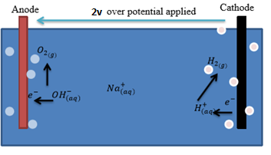
Principle of Operation

Slide 8
Principle of Operation
There are effectively 90 stainless steel plates with 89 spaces containing electrolyte.
a 2.08V to 2.33V drop across each successive plate in the electrolyses.
4*5=20(inch) /2 = 10 amps
are the maximum to apply on the cell

Slide 9
Design

Slide 10
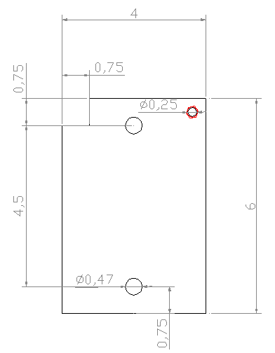
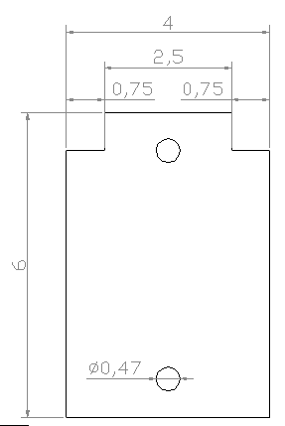
Design
Selected material :
High chromium Stainless Steel Grade 316L is used where corrosion resistance is high.

Slide 11
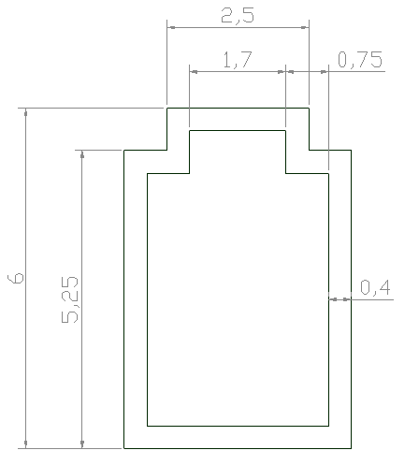
Design
Selected material :
Gasket

Slide 12
Design
Selected material
Distilled water :

Slide 13
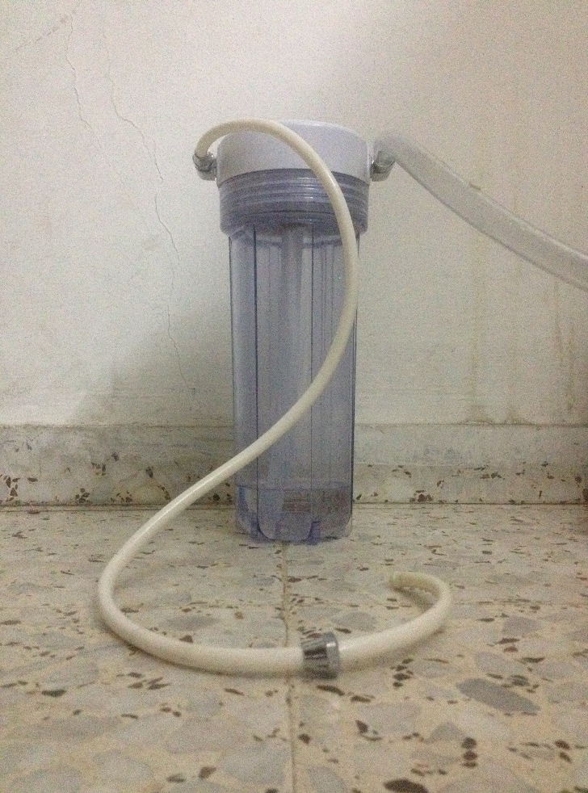
Design
Selected material
Bubbler
as safety to ensure and prevent
reveres spark to the system

Slide 14
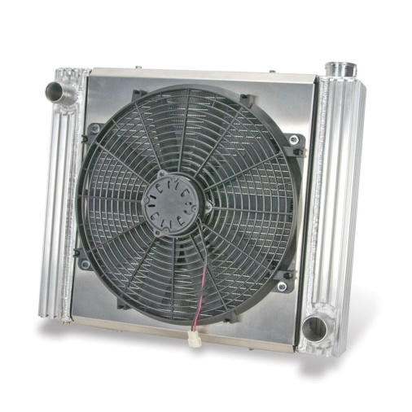
Design
Selected material
Cooler:
to keep the system's contents under 100

Slide 15
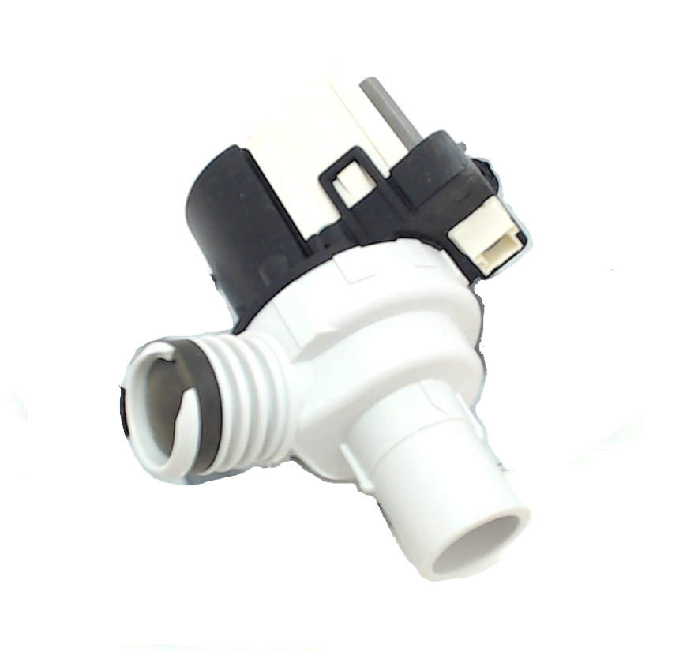
Design
Selected material
Pump :
to circulate water throw the system

Slide 16
Design
Selected material
hoses and tube:
hydrogen is 14 times faster in diffusion than air
which can stand with very high pressure approximately(10 bar)

Slide 17
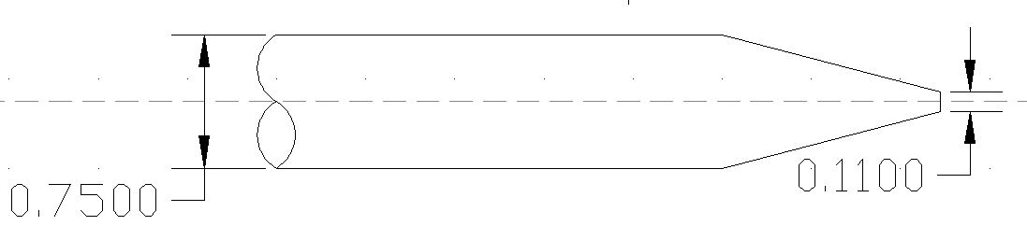
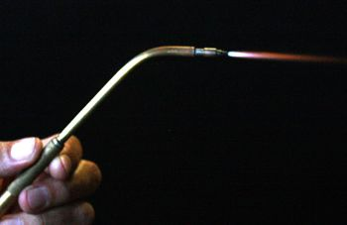
Design
HHO Torch
To prevent the spark from get in tube this nozzle will increase the velocity above the hydrogen flame speed

Slide 18
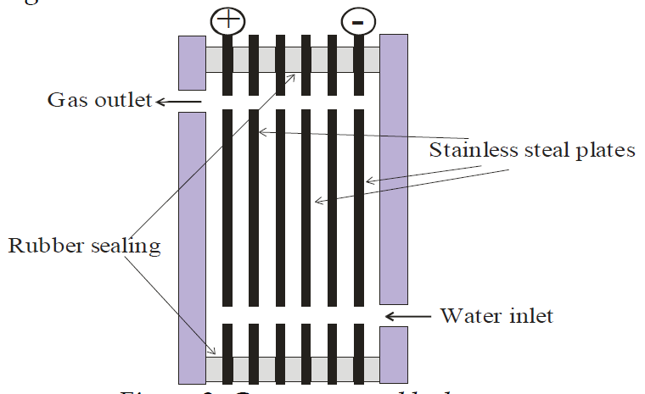
Design
cell design
The cell contained 90 stainless steel plate
With surface area of = 5*3*90 = 1350

Slide 19
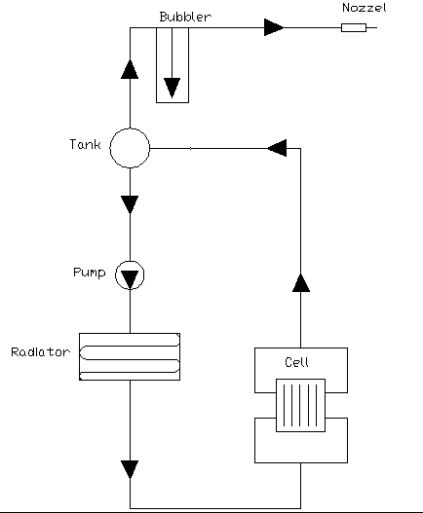
Design
Generator assembly:

Slide 20
Safety

Slide 21
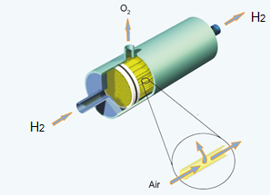
Safety
around 1L stored in the bubbler equivalents to 0.17g of diesel
There three possible design to solve reveres spark to bubbler
Membrane separation:
Its polymer membrane
allows separating gases
under high pressures (up to 6.5 MPa)

Slide 22
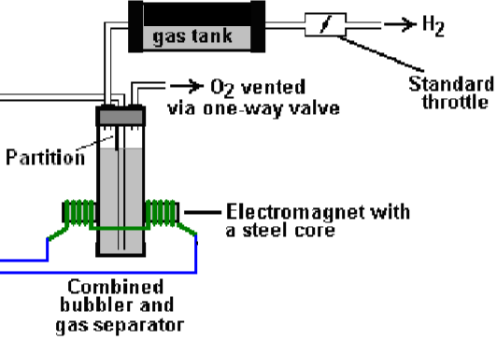
Safety
2. Bubbler separator:
which separate the oxygen from
the gas due to the atom charge,
using electromagnetic

Slide 23

Safety
Flash arrestor :
Which made from fire stone
And stop the spark
Note : Flash Arrestors for various gases do not work for HHO gas

Slide 24
Safety
So we chose the flash back arrestor
As the best solution due to
Cost
effective
Safety

Slide 25
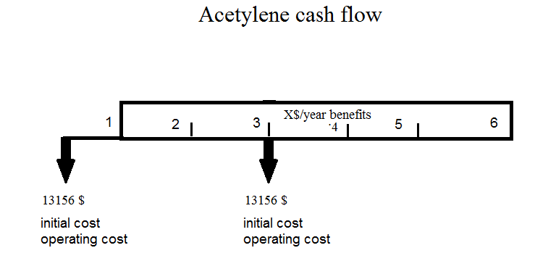
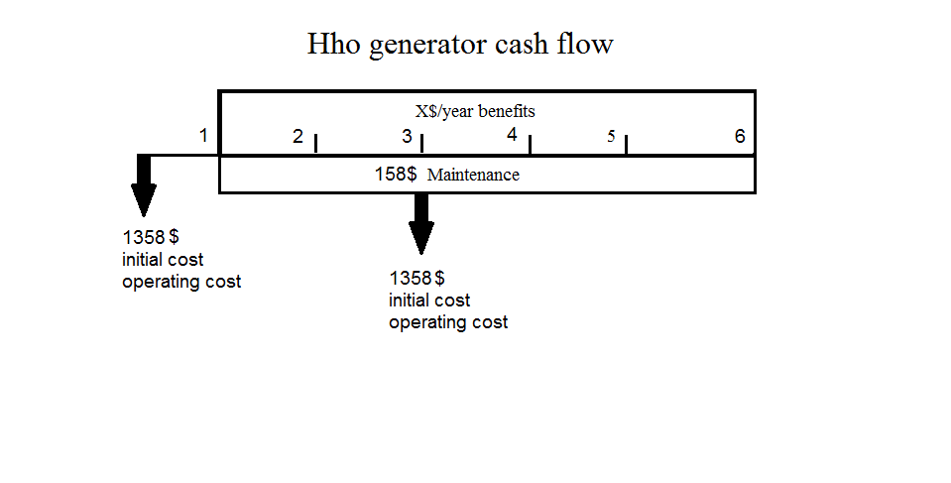
Economic analysis

Slide 26
Economic analysis
Present worth for hho generator welding machine is = - 6276.19
Present worth for Acetylene = - 48324.02
So the hho welding machine is more economically accepted

Slide 27
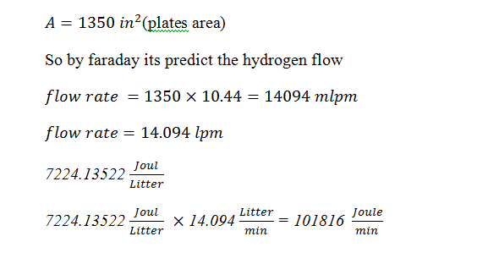
Result

Slide 28
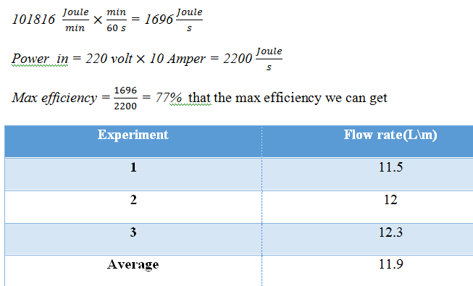
Result

Slide 29
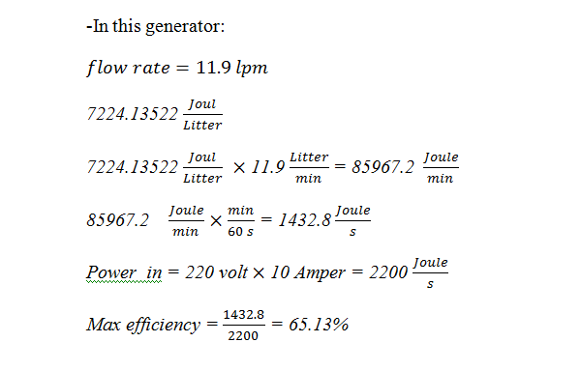
Result

Slide 30
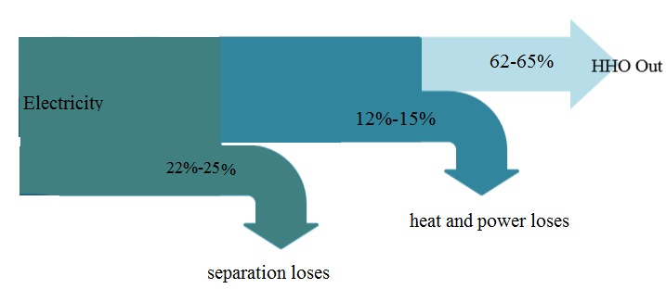
Result

Slide 31
Result
electricity consumption
Power of generator = 220v * 10A = 2200W = 2.2 Kw
For 1 hour running per day → 2.2* (1 hr)= 2.2 kWh per day
For 1 month → 2.2 * 30 days= 66 kWh/month
Cost (0.6 NIS per 1 kWh) → 66*(0.6)= 39.6 NIS per month (1 hr per day)
If the generator running for 4 hours per day( average), then the cost per month is
39.6 * (4 hr) =158.4 NIS per month

Slide 32
Prob and challenges

Slide 33
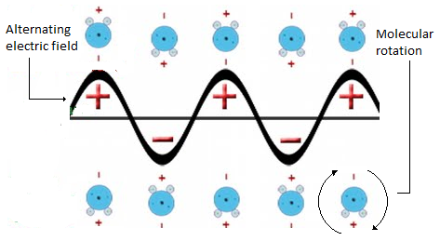
Problem and challenges
Boiling water :
AC
We use full bridge rectifier to solve this problem

Slide 34
Prob and challenges
2. circulation
The hho gas presser against the pump or the planned circulation and reveres

Slide 35

THANK YOU
Any Question ?

