Slide 1
Hospital Online Registration
Muna Al-Hasan
Rowaida Safadi

Slide 2
Outline
Overview about our project.
The main functionalities.
Traditional registration Vs. E-registration.
Methodology.
Results and Analysis
conclusion

Slide 3
Hospital Online Registration
(HOR)
Our project is a website about E-Registration. The main purpose of our website is to give the users an easy, short and fast way to do their own registration process.
The main functionalities that we covered in this project are:
an-online scheduling system(Appointment Booking)
Virtual Chatroom
Consultation.

Slide 4
Part1: Online scheduling System:
Online scheduling System: | Traditional scheduling
Online reservation Time saving | Time consuming
Free-cost | Costly
none | Rooms of waiting

Slide 5
Part2: Virtual Chatroom:
In traditional system patient must travel, maybe long distances, to take an appointment, or to ask doctor simple question like "can I take medicine x instead of y ?".
If a patient couldn't attend to a clinic in traditional system or arrived late, he/she would miss, lose his appointment. On the other hand, in our system patient can chat his doctor and tell him he couldn't come.

Slide 6
Methodology
We have used many languages in designing and building this system and these are:
HTML, CSS (for designing).
PHP language, JavaScript (for the functionality).
XAMPP Server (for the Database).
Bootstrap.

Slide 7
Results and Analysis
How our project work

Slide 8
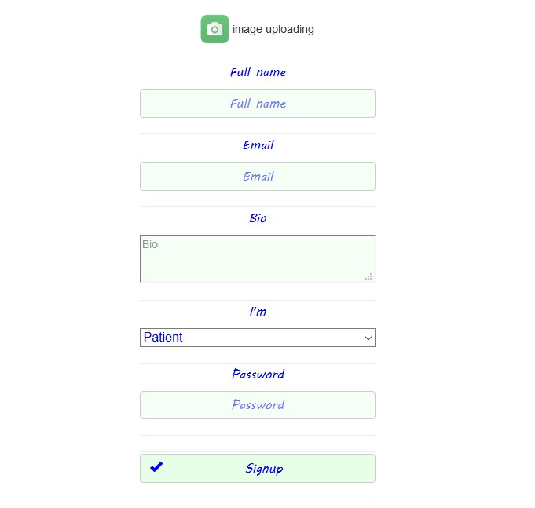
Registration

Slide 9
Patient Account
Patient can select
Department
Doctor
Send message
Book an appointment
Consultation

Slide 10
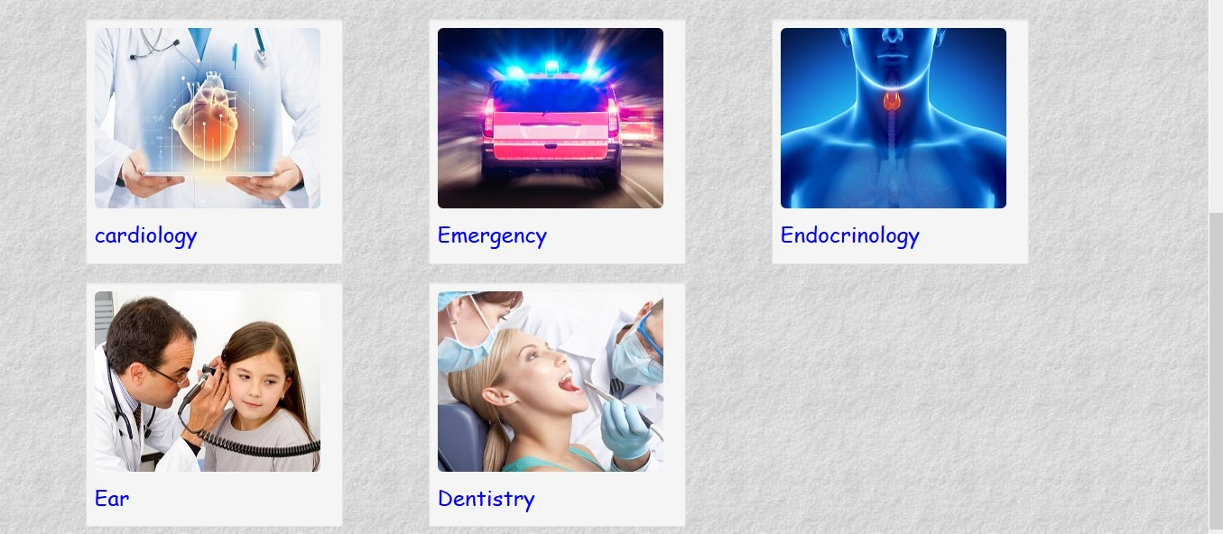
Patient Account choose department

Slide 11
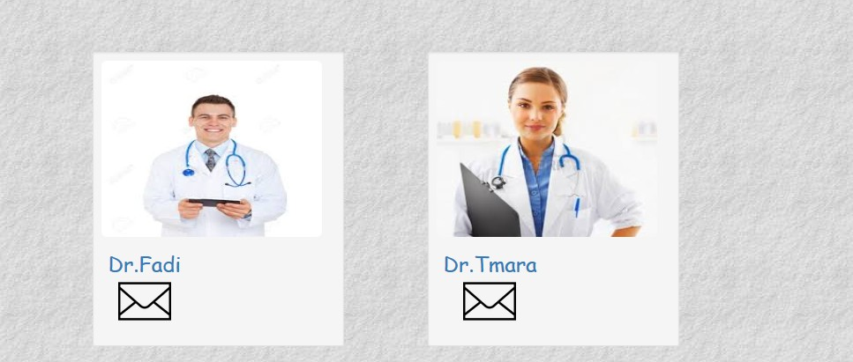
Patient Account choose doctor

Slide 12
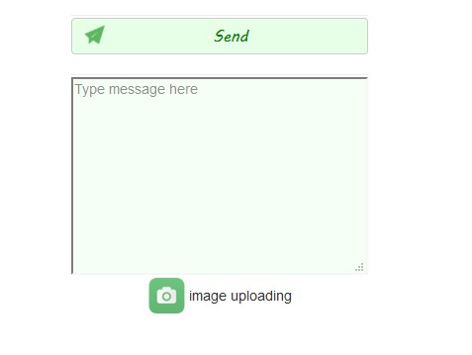
Patient Account send message-message form

Slide 13
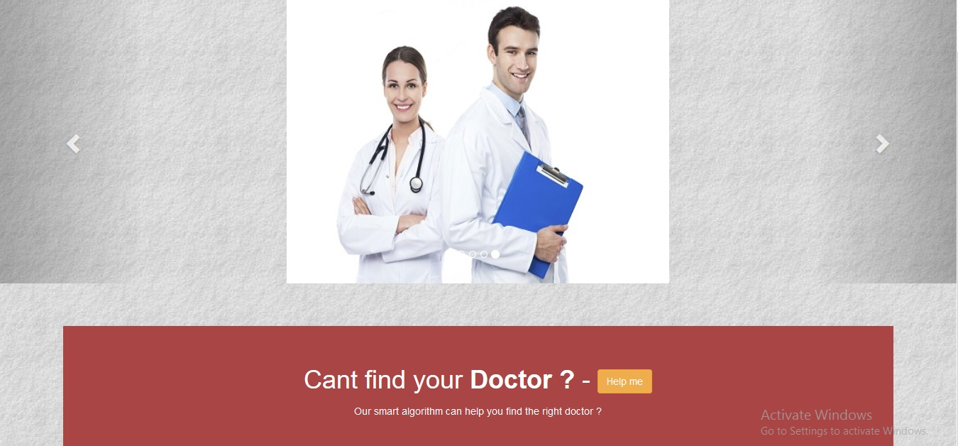
Patient Account
Consultation

Slide 14
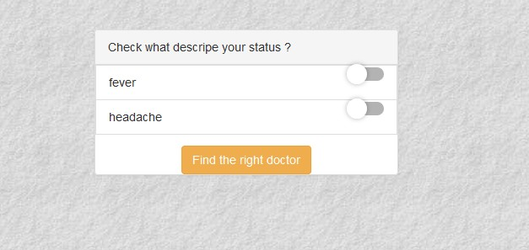
Patient Account
Consultation (cont.)

Slide 15
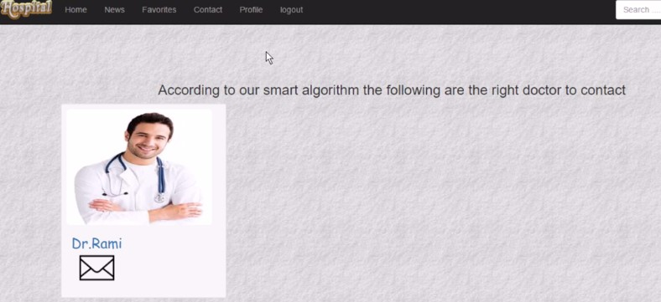
Patient Account
Consultation (cont.)

Slide 16
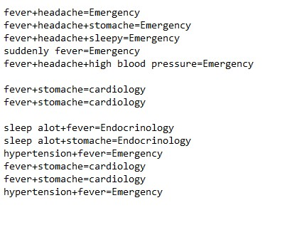
Patient Account
Consultation (cont.)-data in DB

Slide 17
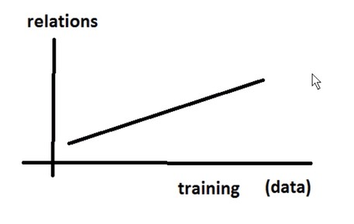
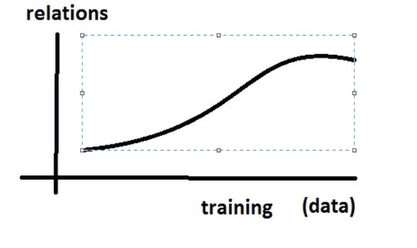
Patient Account
Consultation (cont.)

Slide 18
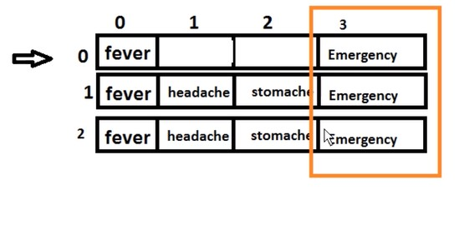
Patient Account
Consultation (cont.):Multi-dimensional array

Slide 19
Doctor Account
Doctor enter his account to send or receive messages.

Slide 20
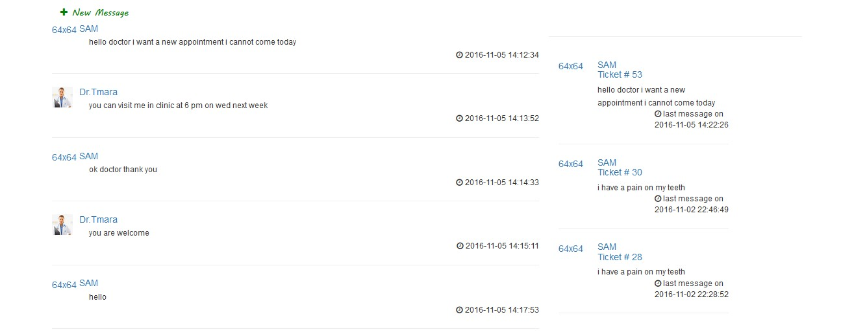
Messaging System

Slide 21
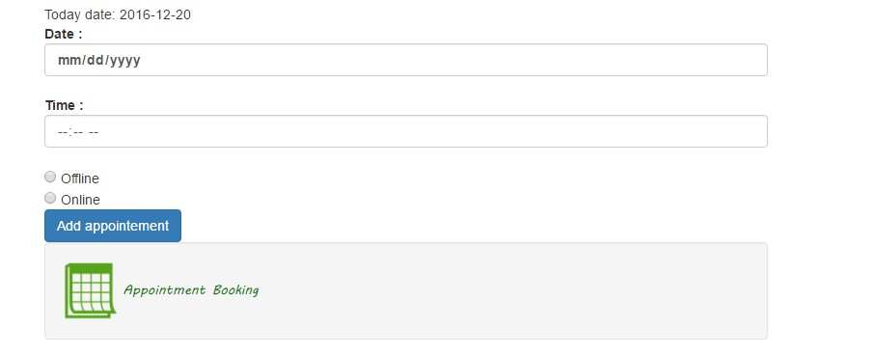
Booking an appointment

Slide 22
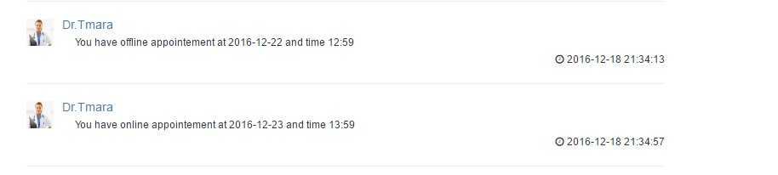
Booking an appointment(cont.)

Slide 23
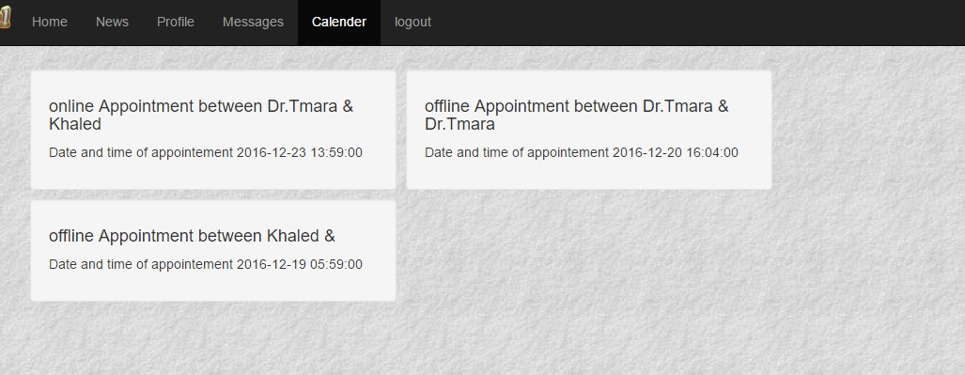
Booking an appointment(cont.)

Slide 24
Mobile application
We designed web application to be applicable to mobile.

Slide 25
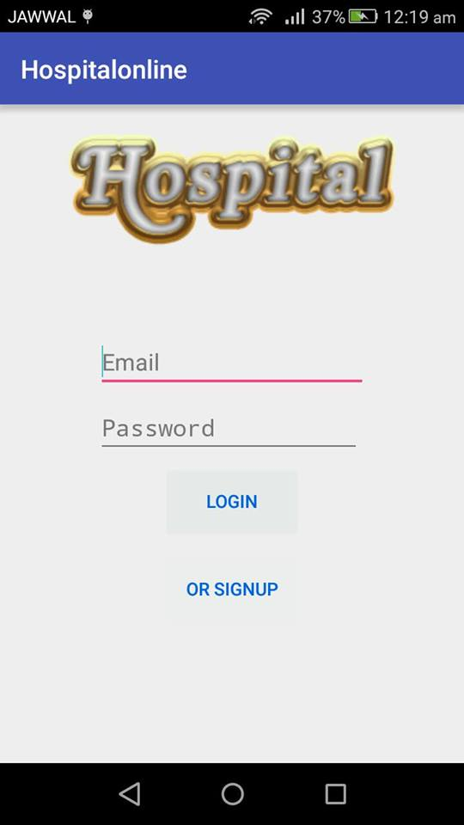

Slide 26
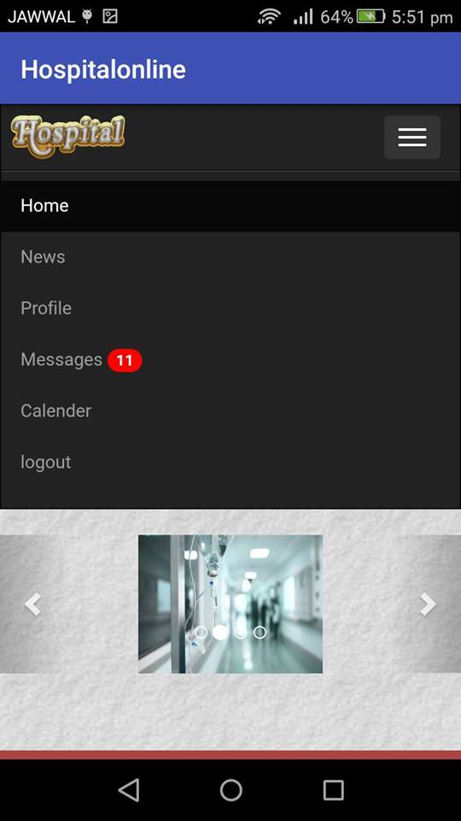

Slide 27
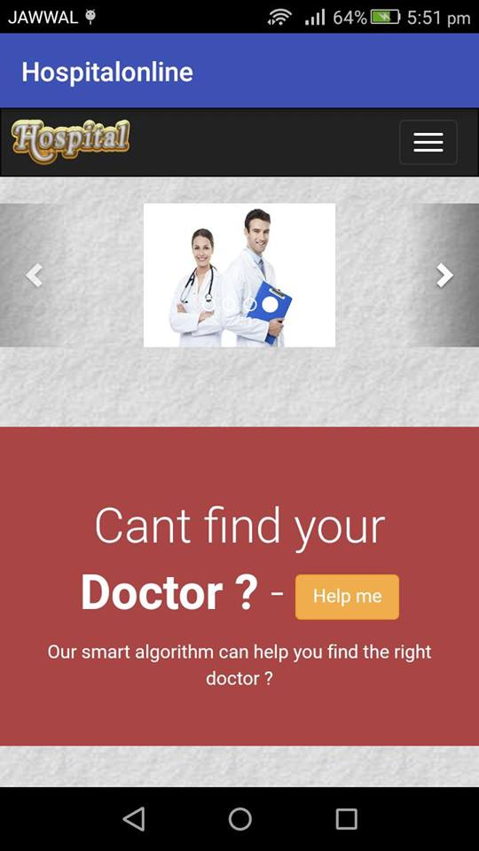
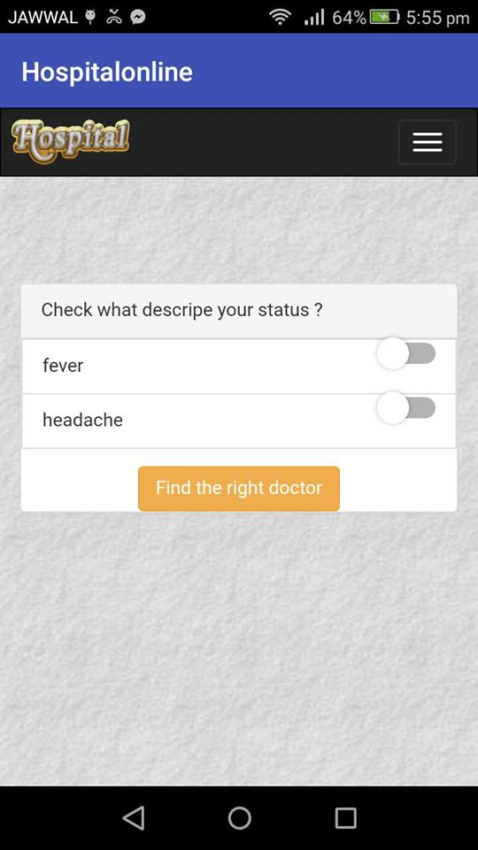

Slide 28
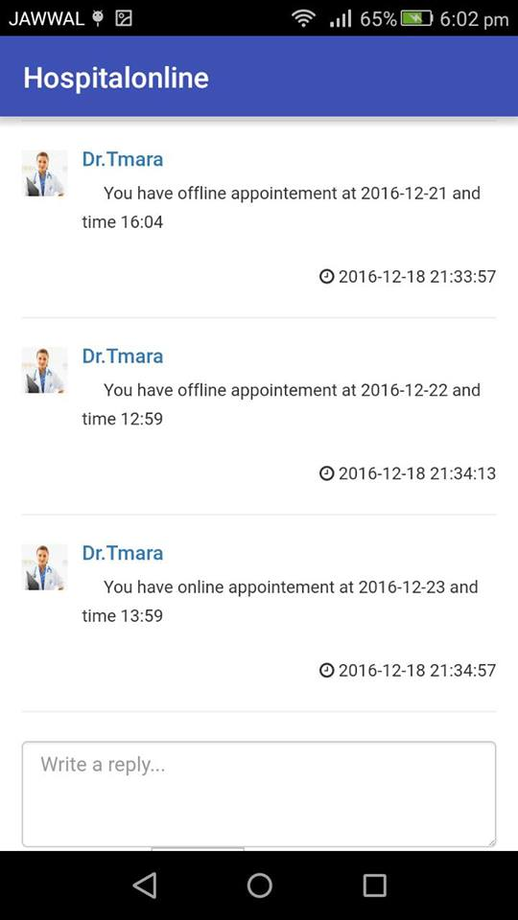

Slide 29
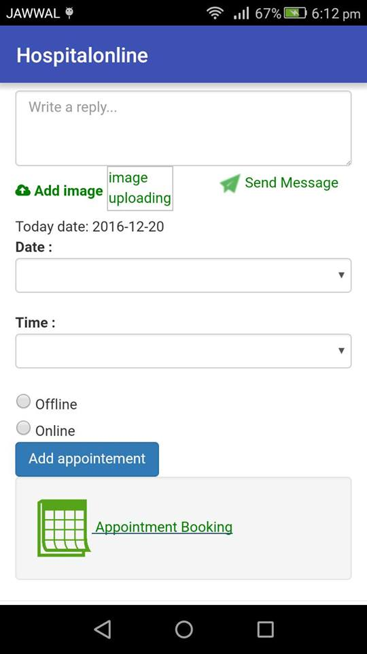
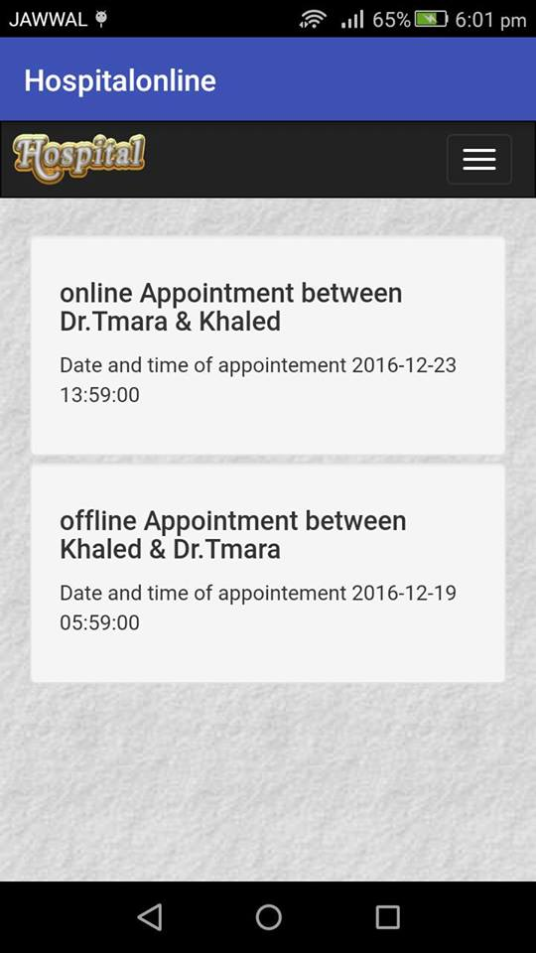

Slide 30
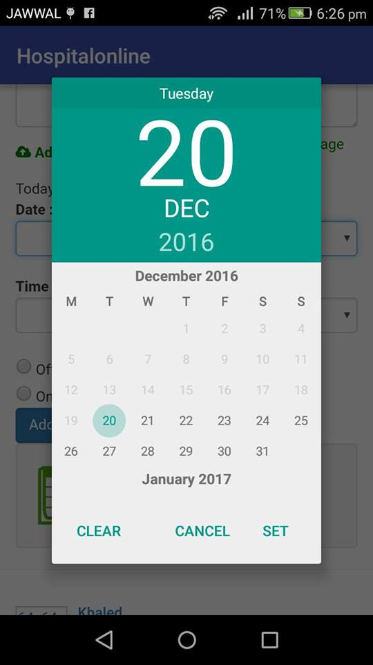
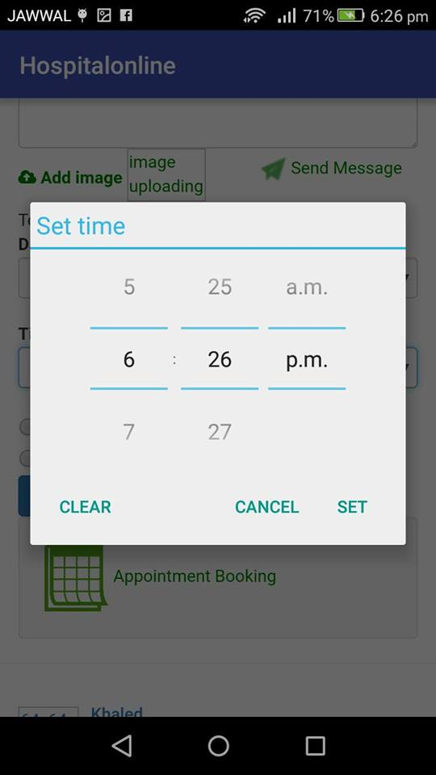

Slide 31
Conclusion
we solve the most problems of the traditional registration process which we described before. Technically, we have achieved a great result to facilitate and enhance the traditional registration process.
The main aspects and functionalities that we have covered in this website are: an online scheduling system, virtual chatroom and expert consultation system. So that, any doctor or patient can access it from anywhere.
Our website is simple, easy to use and user friendly. To use it, all what you want is to have an internet connection and enjoy a new way of effective registration.

Slide 32
Future Work
Report: Detail reports showing information about New and Old patients taking appointment.
Blood Availability: that shows patient blood status available in specific district in patient's state.

Slide 33
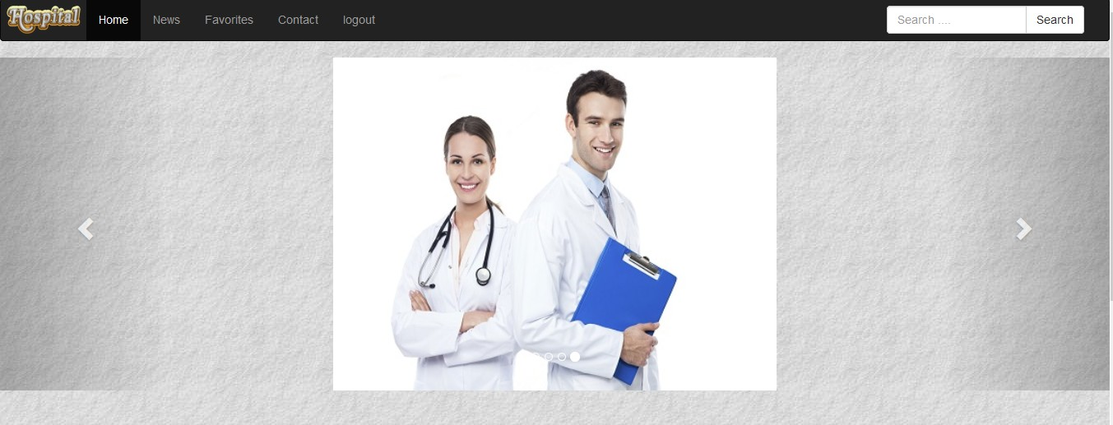
Thank you

