Slide 1

Graduating Project
Presented by
Nimer Hindy
Supervisor:
Dr. Osaid Abdul-Fattah
fall/2018

Slide 2
Outline
1-Introduction and Background
2-Research Objectives
3-Literature Review
4-Methodology
5-How does it work
7-Discussions and calculations
8-Results

Slide 3

Introduction

Slide 4
Introduction
Discussions and calculations
How does it work
Methodology
Literature Review
Research Objectives
Results
There is no way to enter the AD of companies or any Corporation to every house without paying a lot of money, efforts, and time.
Notes:
إن استيراد مصادر الطاقة ، مثل النفط والغاز الطبيعي وغيرهما بكميات كبيرة ، يمثل مشكلة حقيقية تواجه البلدان النامية مثل فلسطين. لذا فإن الحفاظ على الطاقة جزء مهم من أي استراتيجية وطنية للطاقة في بلد بلا موارد. علاوة على ذلك ، فإن توفير الطاقة من شأنه أن يحمي البيئة ويحقق التنمية الاقتصادية.

Slide 5
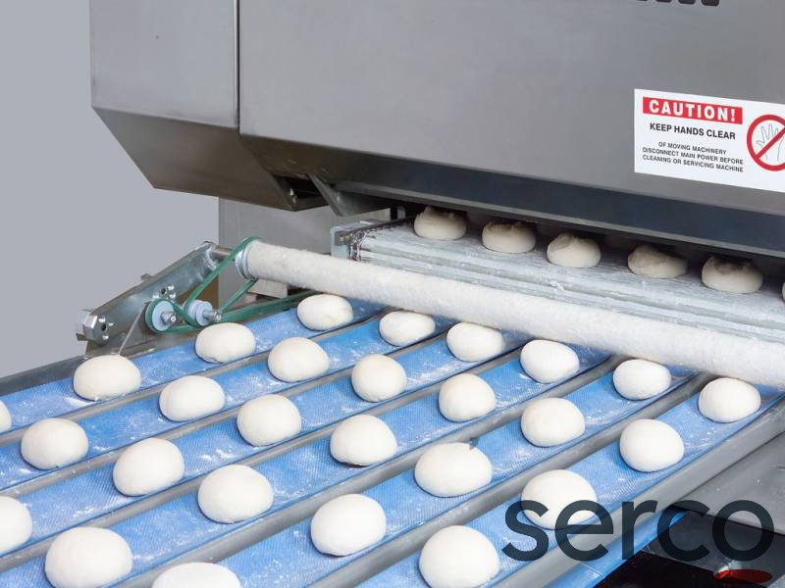
Introduction
Discussions and calculations
How does it work
Methodology
Literature Review
Research Objectives
Results
The bread stamper machine will take the bread dough and print on its face before entering the furnace.
Notes:
Can we reduce this consumption?
If we can, how ?
From these questions, our research are came !

Slide 6



Introduction
Research Objectives
Literature Review
Methodology
Discussions and calculations
How does it work
Results
Me and my ex teammate Anas Ishtayah went to different companies and furnaces and asked them about our idea in advertising ,the welcomed the idea and said they were support the idea

Slide 7

Research Objectives

Slide 8

Introduction
Discussions and calculations
How does it work
Methodology
Literature Review
Research Objectives
Results
The main objective of this research is to make a new creative way to advertising in the world, any way these method is not used in any place we know.

Slide 9

Literature Review
9

Slide 10
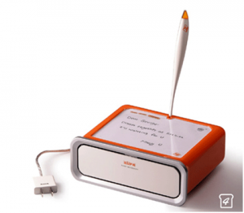
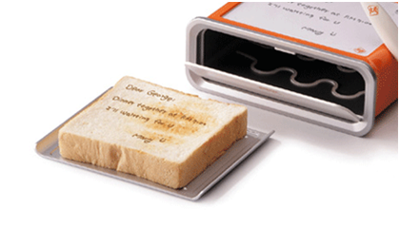
Introduction
Discussions and calculations
How does it work
Methodology
Literature Review
Research Objectives
Results
1/3
I saw many and different ideas about printing or writing on bread
Hot plate printing
Laser printing
A hot end pin
Hot air jet fixed on a 2D CNC machine

Slide 11

Introduction
Discussions and calculations
How does it work
Methodology
Literature Review
Research Objectives
Results
Methods of writing on bread
Hot plate printing
Laser printing
A hot end pin
Hot air jet fixed on a 2D CNC machine

Slide 12
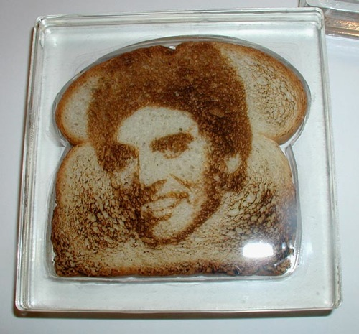
Introduction
Discussions and calculations
How does it work
Methodology
Literature Review
Research Objectives
Results
Methods of writing on bread
Hot plate printing
Laser printing
A hot end pin
Hot air jet fixed on a 2D CNC machine

Slide 13
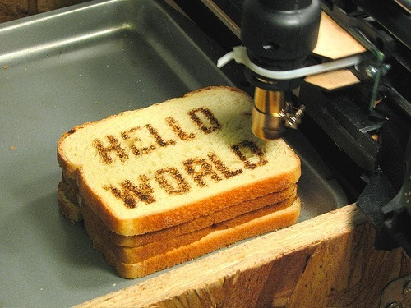
Introduction
Discussions and calculations
How does it work
Methodology
Literature Review
Research Objectives
Results
Methods of writing on bread
Hot plate printing
Laser printing
A hot end pin
Hot air jet fixed on a 2D CNC machine

Slide 14
Introduction
Discussions and calculations
How does it work
Methodology
Literature Review
Research Objectives
Results
Major problems of all these methods are :
Needs long time
Expensive
Health problems such as laser method
Its affect to a taste of a bread

Slide 15
Methodology

Slide 16
Introduction
Discussions and calculations
How does it work
Methodology
Literature Review
Research Objectives
Results
1/2
The bread stamper idea came from needing to an effective AD method can do the task without any extra and traditional costs, it is a smart machine which can control all the system without any human mediation or interface.

Slide 17
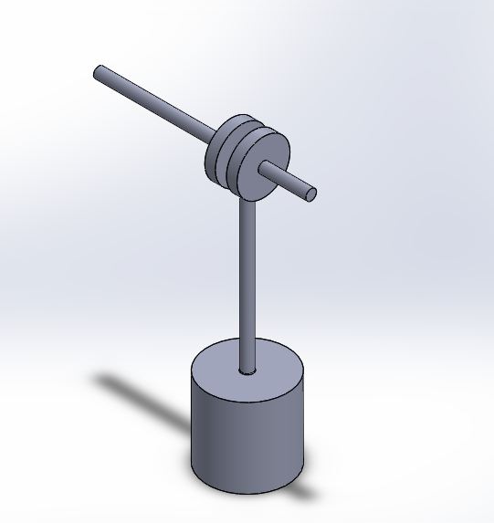
Introduction
Discussions and calculations
How does it work
Methodology
Literature Review
Research Objectives
Results
2/2
I will use 3 stampers to ensure a good speed performance to the baker, each stamper consist of crank shaft, 2 cams, connecting rod and stamper

Slide 18
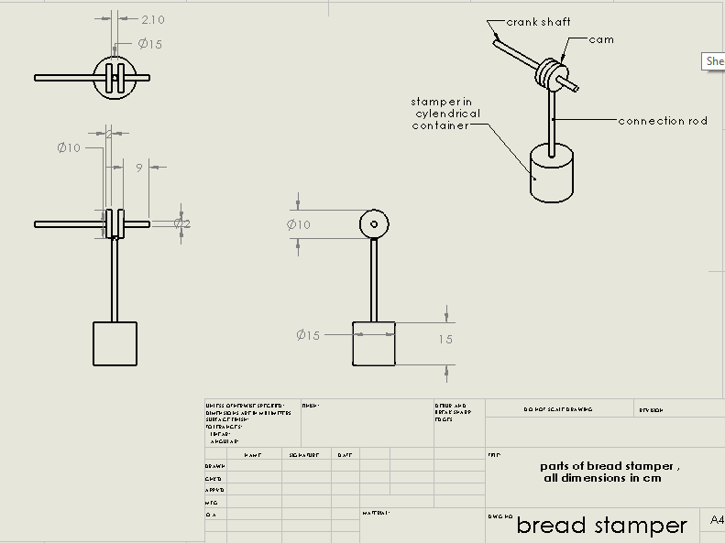
Introduction
Discussions and calculations
How does it work
Methodology
Literature Review
Research Objectives
Results
18

Slide 19
How does it work
19

Slide 20
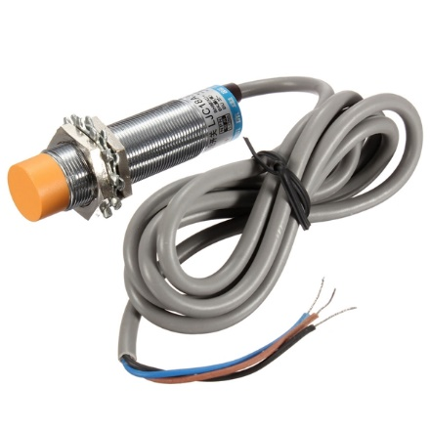
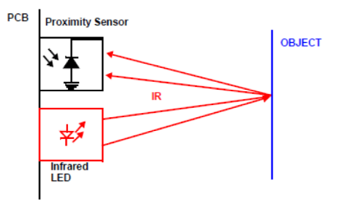
Introduction
Discussions and calculations
How does it work
Methodology
Literature Review
Research Objectives
Results
The sensor detect the bread dough and give the signal to the Arduino witch give an order to stepper motor to rotate in order to press on the face of bread dough
20

Slide 21
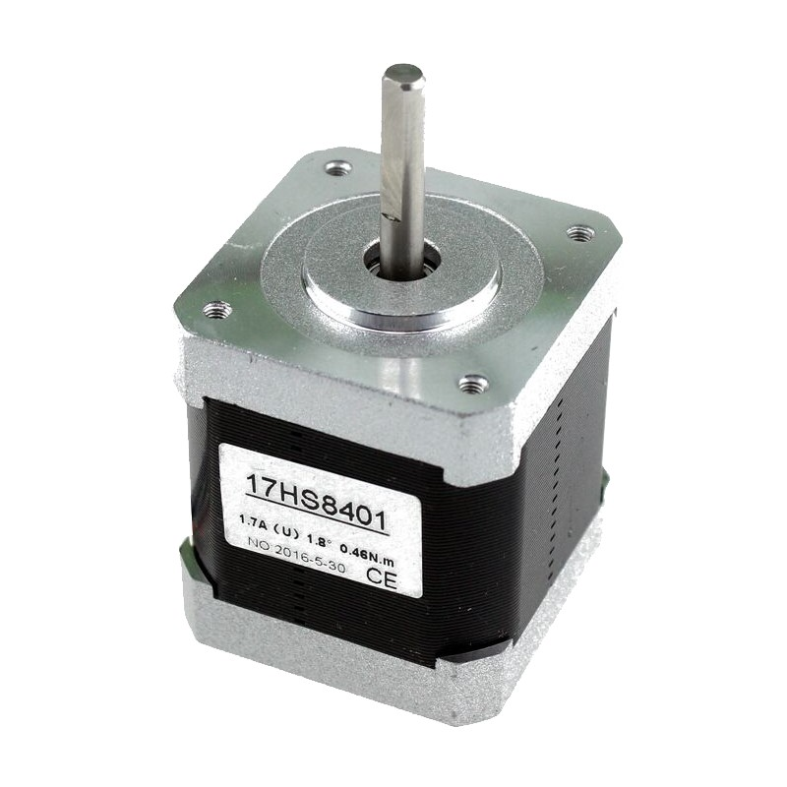
Introduction
Discussions and calculations
How does it work
Methodology
Literature Review
Research Objectives
Results
NEMA 17 stepper motor
Connected with the crank shaft and take orders from Arduino

Slide 22
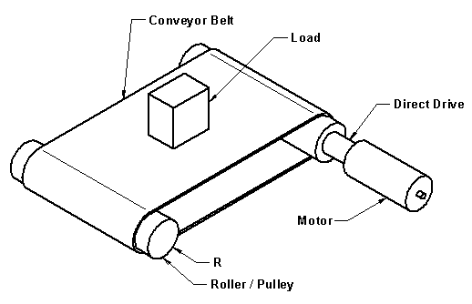
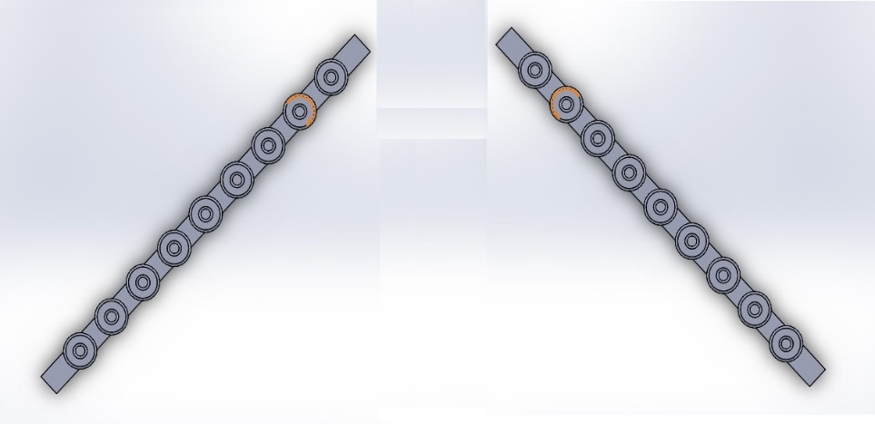
Introduction
Discussions and calculations
How does it work
Methodology
Literature Review
Research Objectives
Results
The bread dough will stay in the same axis according to directional steers witch located on the top of the belt

Slide 23
Introduction
Discussions and calculations
How does it work
Methodology
Literature Review
Research Objectives
Results
The stepper motor will rotates the crank shaft witch make the stamper goes down and facing the bread just in time

Slide 24
Discussions and calculations

Slide 25
Introduction
Discussions and calculations
How does it work
Methodology
Literature Review
Research Objectives
Results
To avoid the speed issue, we have designed three arms with stampers that have the same performance and functionality, and work separately at the same time. Fourth device can be added if required, all these devices are working separately depends on sensors data (this solution can caused extra costs).

Slide 26
Introduction
Discussions and calculations
How does it work
Methodology
Literature Review
Research Objectives
Results
To avoid the quality issue, we considered the (Consumer Protection Department) and ministry of health conditions, we will use stainless steel and ABS plastic to the most of the device parts that may touching the bread.

Slide 27
Introduction
Discussions and calculations
How does it work
Methodology
Literature Review
Research Objectives
Results
To avoid thermal printing technique and the smell issue, we canceled it and replaced the thermal printing by cold printing which means printing on the bread before it enters the oven.

Slide 28
Introduction
Discussions and calculations
How does it work
Methodology
Literature Review
Research Objectives
Results
To avoid laser printing problem, we canceled it and replace it by pre-made mold.
This way has fulfill all conditions of speed, quality, and work efficiency. So we choose this way to make the machine.

Slide 29

Results

Slide 30
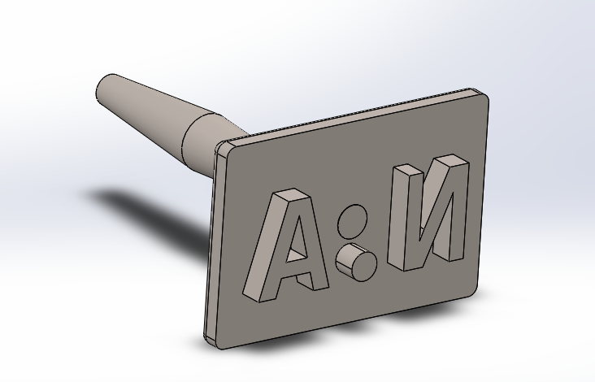
Introduction
Discussions and calculations
How does it work
Methodology
Literature Review
Research Objectives
Results
We found that we can print on BD with a simple way summarized by using a stamper without any rising in temperature, with an acute stamp.

Slide 31
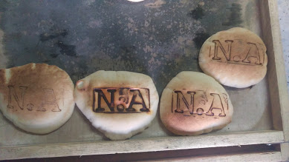
Introduction
Discussions and calculations
How does it work
Methodology
Literature Review
Research Objectives
Results
It gives us a very good shape and briefly brand on the face of bread without any effect on health, without extra cost by Appling a small force by the stamper to shape the BD with ease and a fast production rate.

Slide 32
Thank you

