Slide 1
Introducing
ROBOTICS ARM
Notes:
This presentation demonstrates the new capabilities of PowerPoint and it is best viewed in Slide Show. These slides are designed to give you great ideas for the presentations you’ll create in PowerPoint 2010!
For more sample templates, click the File tab, and then on the New tab, click Sample Templates.

Slide 2

Samer noi’rat
Mohammad barakat
Younis fakhoury
Osama mudallal
Supervised by : Dr.Salamah Abdel-Fattah
Presented by

Slide 3
Outline:
1-Introduction
2-Mechanical hardware
3-Electronic hardware
4-Software
5-Conclusion

Slide 4
AIM OF THE PROJECT
Design a Six Degree Of Freedom robot arm to do many of the tasks requiring high precision, speed and endurance.
in our design we tried to reduce the cost and we have built it from tools can be found anywhere in everyday life .

Slide 5


ROBOTICS ARM???
What is a

Slide 6
ROBOTIC ARM
A robotic arm is a robotic manipulator, usually programmable, with similar functions to a human arm.
Robot manipulators are created from a sequence of link and joint combinations.
joints allowing either rotational or translational motion.

Slide 7
To build a gestures control robotics arm
1
2
3
Mechanical hardware
Electrical hardware
Software
We have technical details for every step of the way

Slide 8

Mechanical hardware
1
1

Slide 9
Robotic Arm Design Mechanical Hardware
Robot arm design
Link cutting
Bearings
Axial
Stepper motors
Gear box

Slide 10


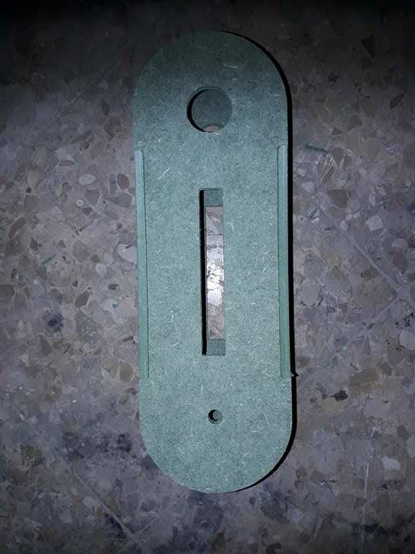
Robot arm design
in our design we tried to reduce the cost and we have built it from tools can be found anywhere in everyday life.
In the beginning we designed our robot using AutoCAD
The type of wood that we have used is durable and easy to cut and has a very good surface finish and it is relatively hard wood

Slide 11
Link cutting
We printed our cad design on a paper with a scale one to one then we cut the work pieces using saws and we made some holes in it using drills for bearings ,bolts and axils then finshing by sand papers to make it smooth and has a good surface finish

Slide 12
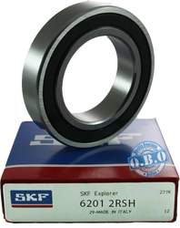
Bearings
we have used a (32\12 mm ) bearings in our project because the axial rod that we are using is 12 mm rod place to reduce the friction between the axial and the wood frame and to make this rotation more stable

Slide 13
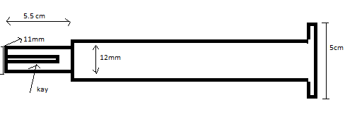
Axial
we used an iron rod 12 mm for the base shoulder and elbow axis , we have use chromium axis for the pitch
and all axel was machined on one of its ends using a lathe machine and a milling machine which was used to make the key hole ,to Connect with gear box.

Slide 14
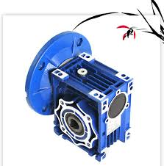
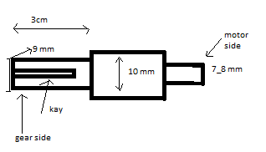
Gear box
we have used a (1:20 )reduction gear box the small size we have choose this type of gear box due to its relatively light weight where it’s made of aluminum

Slide 15
Counter load
We used a counter load on the second and the third links on the robot and we made this counter load from scrap using old hammer ,rods metal sheets etc have welded these pieces together using electric welding these counter loads where put depending on trial and error hen the beam or link is statically equilibrium and that will make the system more stable

Slide 16
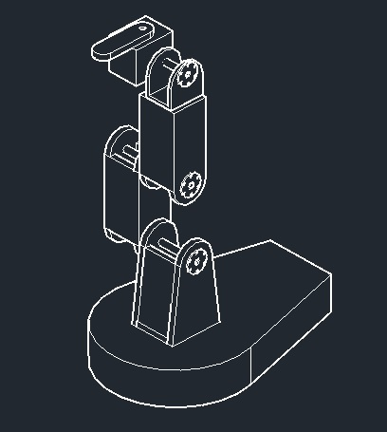
MOTORS
Motors are used for joint rotation.
The base consists of a stepper motor allowing forward/backward movement.
The elbow consists of a Stepper motor allowing up/down movement of the arm.
The end effector consists of a d.c. motor allowing to grip a object.

Slide 17
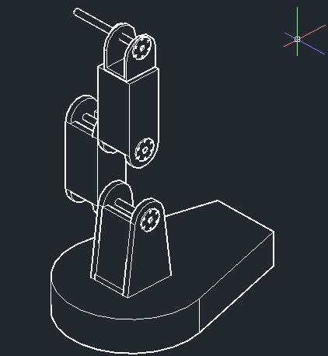
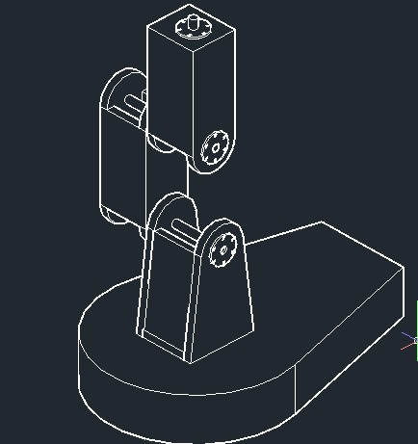
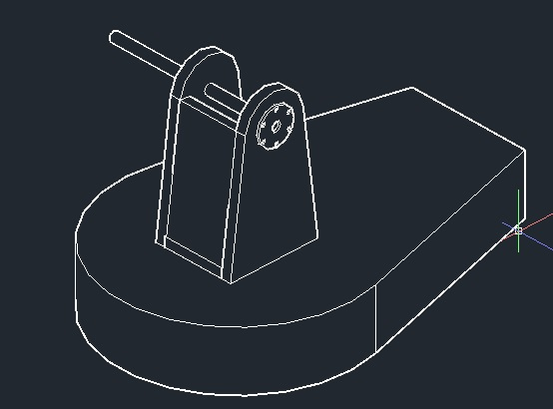
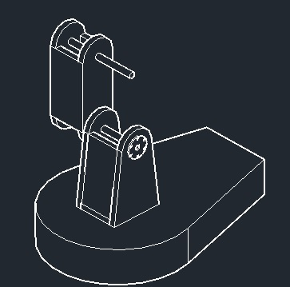
Steps how assembly the Robot

Slide 18

Electrical hardware
2

Slide 19
Robotic Arm Design Electrical Hardware
Fuse
Relay
Power supply
Drivers
Control panel
Arduino Mega
Diode

Slide 20
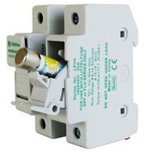
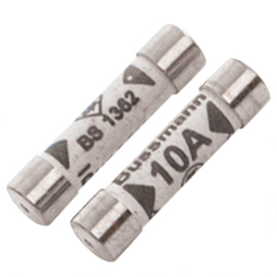
Fuse
A fuse is an electrical safety device that operates to provide over current protection of an electrical circuit including the source of power

Slide 21
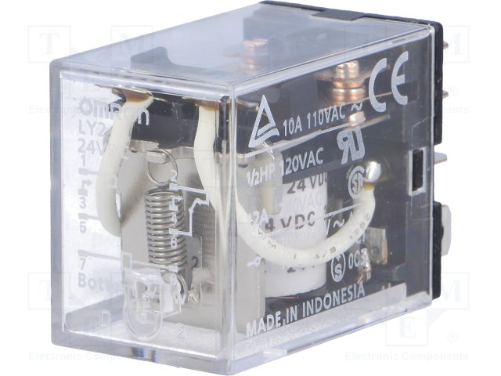
Relay
Relays use an electromagnet to mechanically operate a switch, Relays are used where it is necessary to control a circuit by a separate low-power signal, or where several circuits must be controlled by one signal

Slide 22
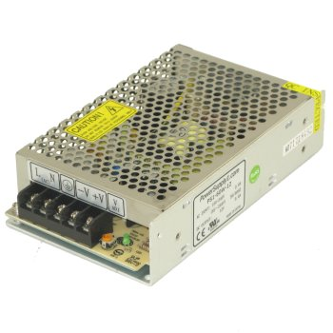
Power supply
We have a three power supply in the control panel circuit two of them are 24 volts dc to provide the drivers with the power needed , and one of them is 12 volts used to power the small motor, Arduino and the fan which is used for cooling

Slide 23
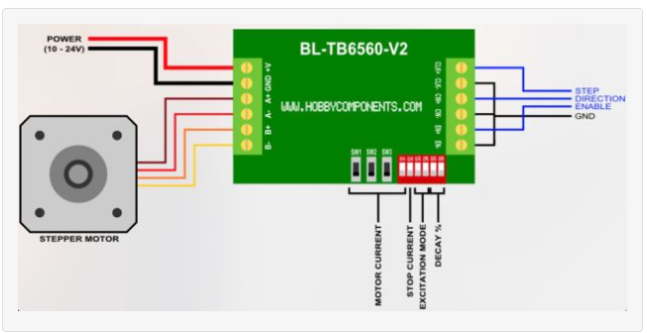
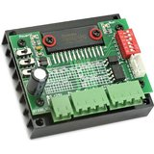
Drivers
We used driver TB6560. due to its durability and it can hold a high currant up to 4 amps . This driver is connected to the stepper motors and the Arduino and allows us to move the stepper in a specific degree that we tune using a code on the Arduino

Slide 24
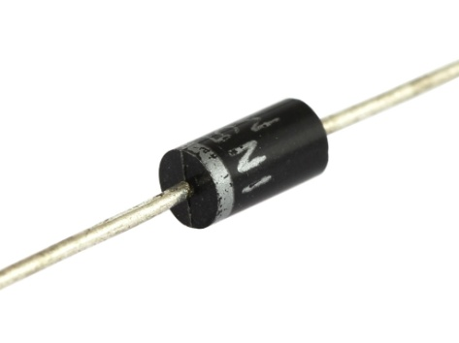
Diode
We used diodes to protect the Arduino from a sudden currant that can destroy the Arduino board

Slide 25
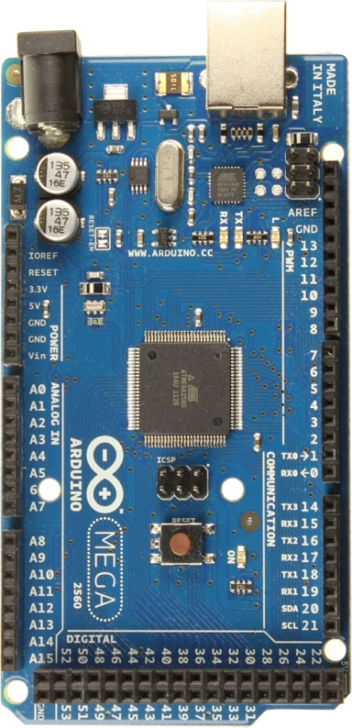
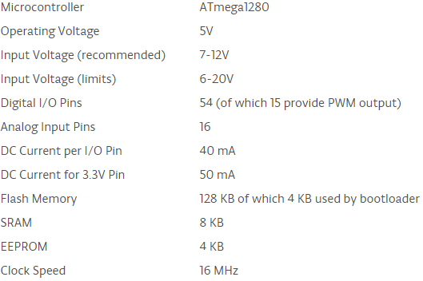
Arduino Mega
The microcontroller used for the project is ATmega1280
Characteristics :

Slide 26
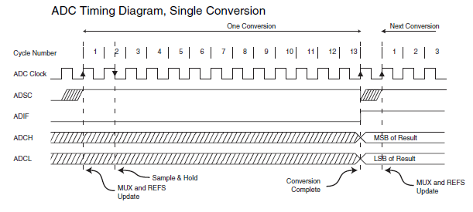
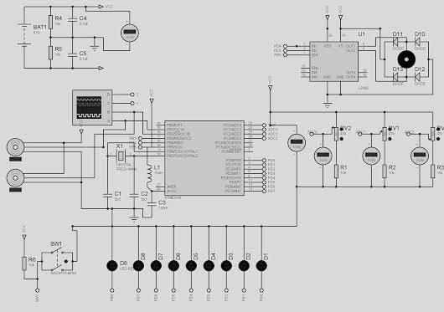
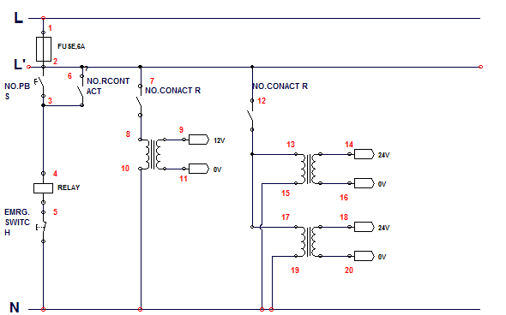
HOW DOES THE CIRCUIT WORK ?
The Port B of the microcontroller is set for the output. Reference voltage is at AVcc.
The ADC converts an analog input voltage to a 8-bit digital value through successive approximation..
The ADC is enabled by setting the ADC Enable bit, ADEN in ADCSRA.
The ADC generates a 10-bit result which is presented in the ADC Data Registers, ADCH and ADCL.
A single conversion is started by writing a logical one to the ADC Start Conversion bit, ADSC. This bit stays high as long as the conversion is in progress and will be cleared by hardware when the conversion is completed.

Slide 27
Software
3

Slide 28
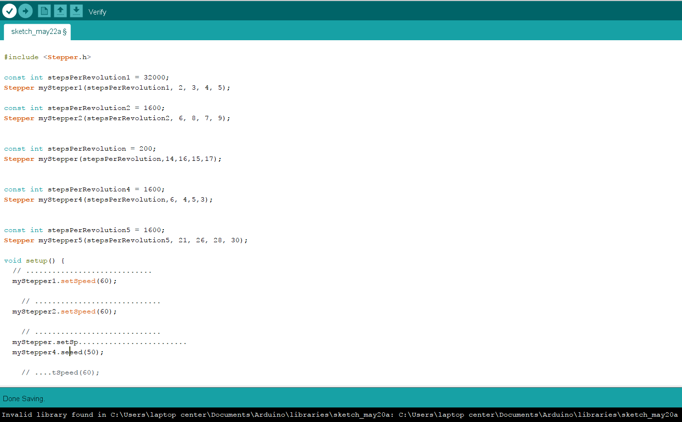

Slide 29


Slide 30
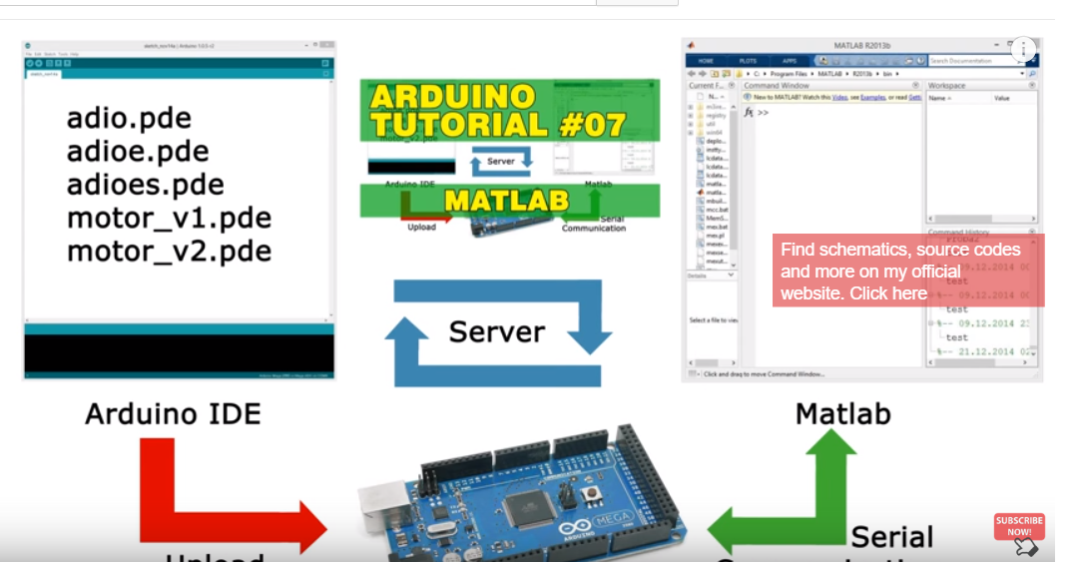

Slide 31
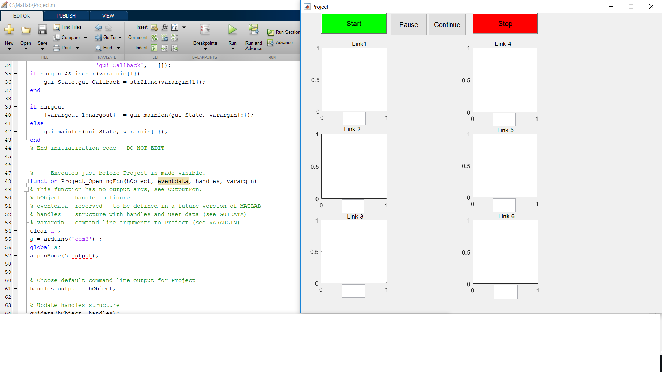

Slide 32
Appendix Description
The objective of this Appendix is to derive the complete forward and Inverse kinematic model (analytical and numerical) of a 6 DOF robotic arm.
Forward Kinematic :
Finding the position and orientation of the tool point from joint angles.
Inverse Kinematic
Finding the joint angles to set a particular position and orientation of the tool points.

Slide 33
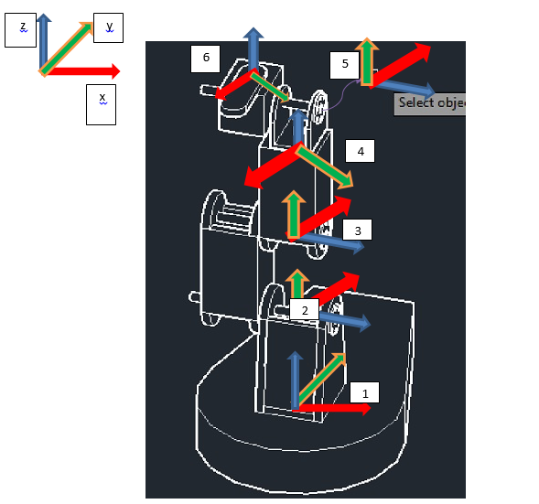
Frame Attachment and Link Parameters

Slide 34
Frame Attachment and Link Parameters
DH Parameters :
i (Joints) | αi-1 | ai-1 | di (mm) | ᶿi
1 | 0 | 0 | 0 | ᶿ1
2 | +90 | 0 | 200 | ᶿ2
3 | 0 | 0 | 200 | ᶿ3
4 | +90 | 0 | 230 | ᶿ4
5 | +90 | 0 | 70 | ᶿ5
6 | +90 | 0 | 80 | ᶿ6

Slide 35
Robotics System Toolbox
The Toolbox has always provided many functions that are useful for the study and simulation of classical arm type robotics.

Slide 36
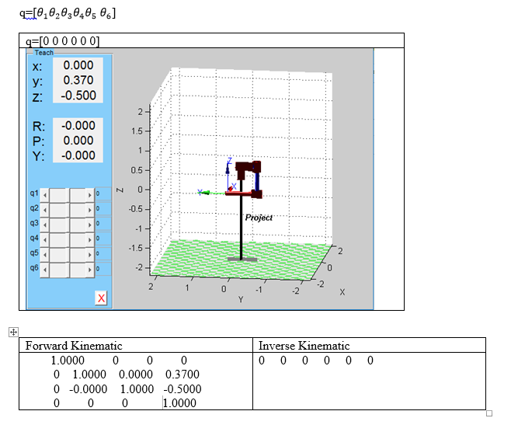
Example of Simulation

Slide 37
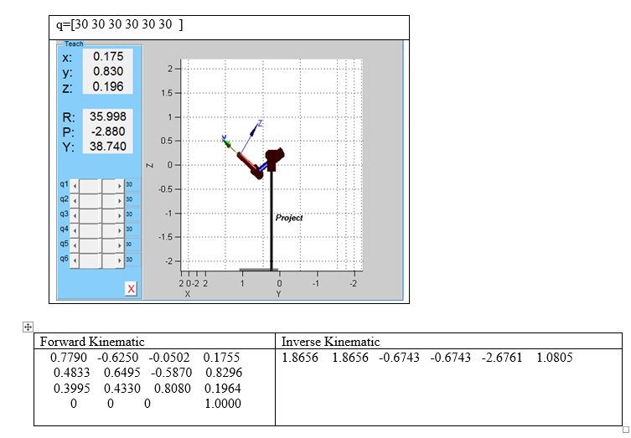
Example of Simulation

Slide 38
CONCLUSION
We build the 6DOF Robot arm from a simple tools that we founded in a local market with a lowest costs.
Robots help people with tasks that would be difficult, unsafe, or boring for a real person to do alone. These robots can learn, repeat, and can be designed to perform any desired task such as welding, gripping, spinning.

Slide 39
ACKNOWLEDGEMENT
Our deepest thanks to our mentor, Dr.Salamah Abdel-Fattah, for helping us out and guiding us with her valuable suggestions and support.

Slide 40
THANK YOU

