Slide 1
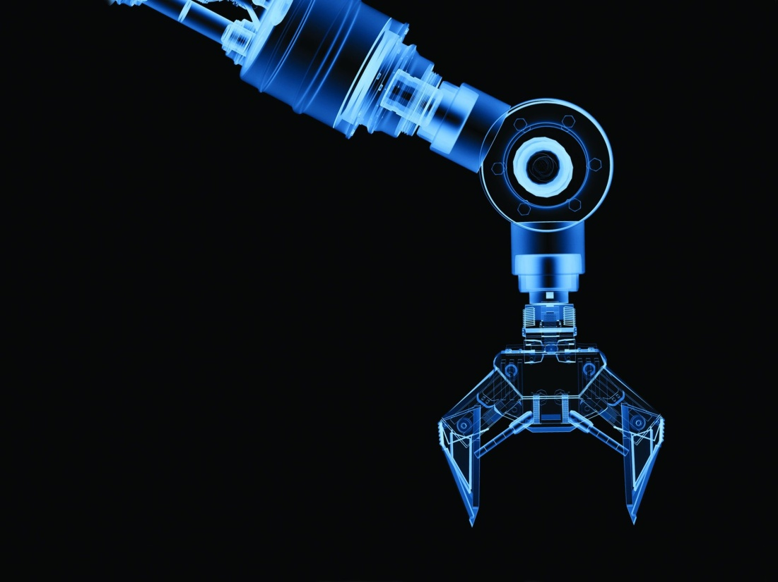


AN-NAJAH NATIONAL UNIVERSITY
FACULTY OF ENGINEERING
DEPARTMENT OF MECHATRONICS & ELECTRICAL ENGINEERING
Graduation Project 2
Robotic Arm to Sort Items by Using Image Processing
Students:
Haya Hamoudeh
Mustafa Abo Shuqair
Aseel Zarour
Rana Shayeb
Supervisors:
Dr.Kamel Subhi
Eng. Salama Abdel-Fattah

Slide 2
Introduction
Our project sorts the objects based on their color using a Robotic arm, and we propose a fully automated robotic sorting system that can sort objects by using image processing in Raspberry pi on the basis of color. The basic firmware for the Raspberry Pi is written in Python language.
our project consists of four integrated stations of identification, processing, selection, and sorting with a new image processing feature.

Slide 3
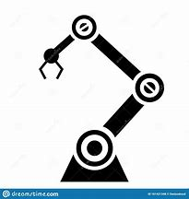
Project Objectives
Separated faulty and correct objects.
Analyze the properties of the object.
Put every single object to its specified place.
Reduce labor costs.

Slide 4
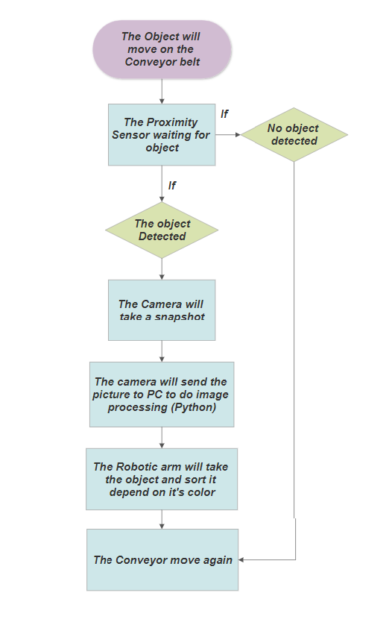
Flow Chart of the project

Slide 5
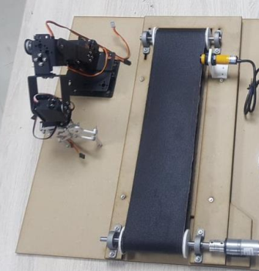
The Robot consists of two main parts:
Robot Arm.
Conveyor Belt.

Slide 6
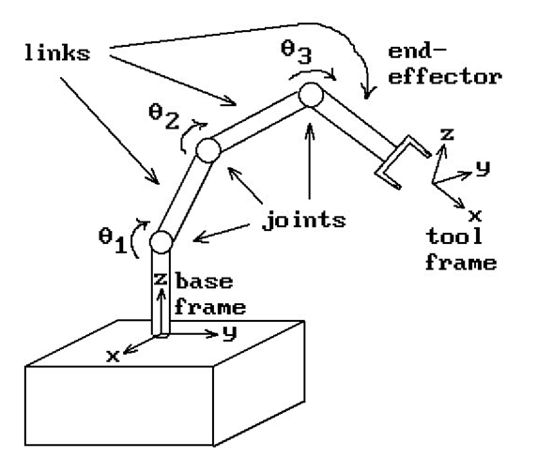
Robot Arm Part
End- Effectors.
Tool frame
Links.
Joints.
Base Frame.

Slide 7
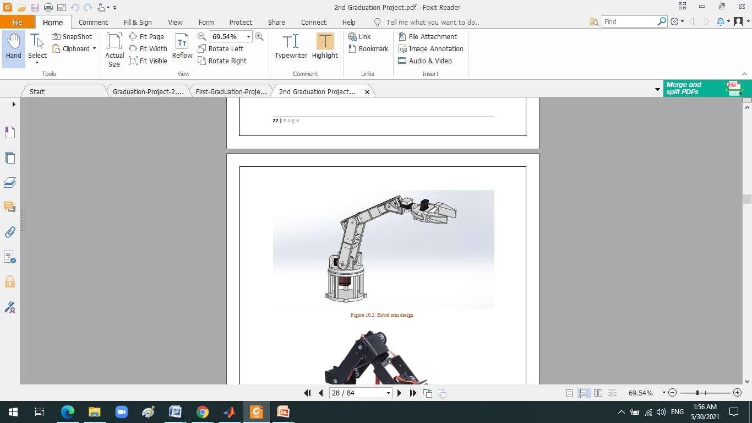
Robotic Arm Part
Robotic arms have motions similar to those of a human arm. And perform different tasks like welding, drilling, spray painting, etc.
In this project, The item sorting Robot has 1 robotic arm. The 5 DOF robotic arms consist of links and joints, and each joint is connected to a servo motor to control the movement of links.

Slide 8
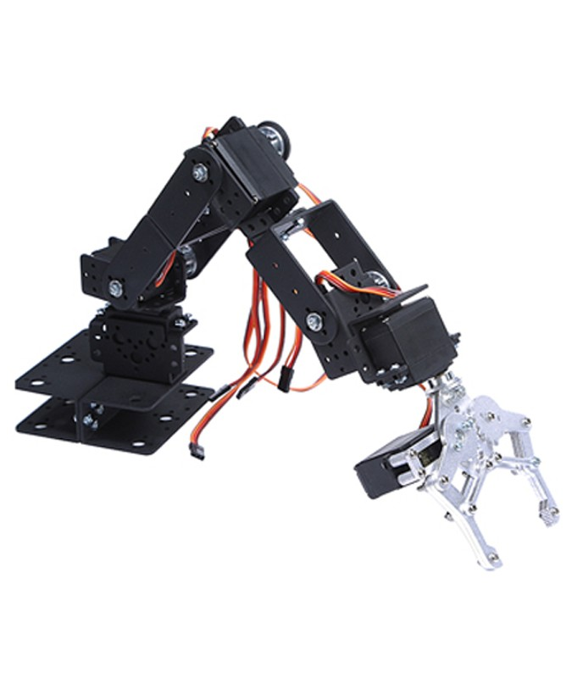
The robotic arm had a gripper as end-effectors to carry the object and put it in a specific place.

Slide 9
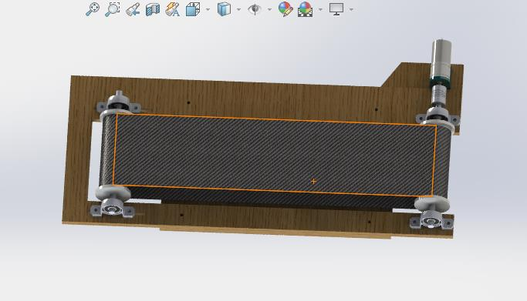
Conveyor Belt Part
A conveyor belt, A belt conveyor system is one of many types of conveyor systems. A belt conveyor system consists of two pulleys, with an endless loop of carrying medium-the conveyor belt-that rotates about them.

Slide 10
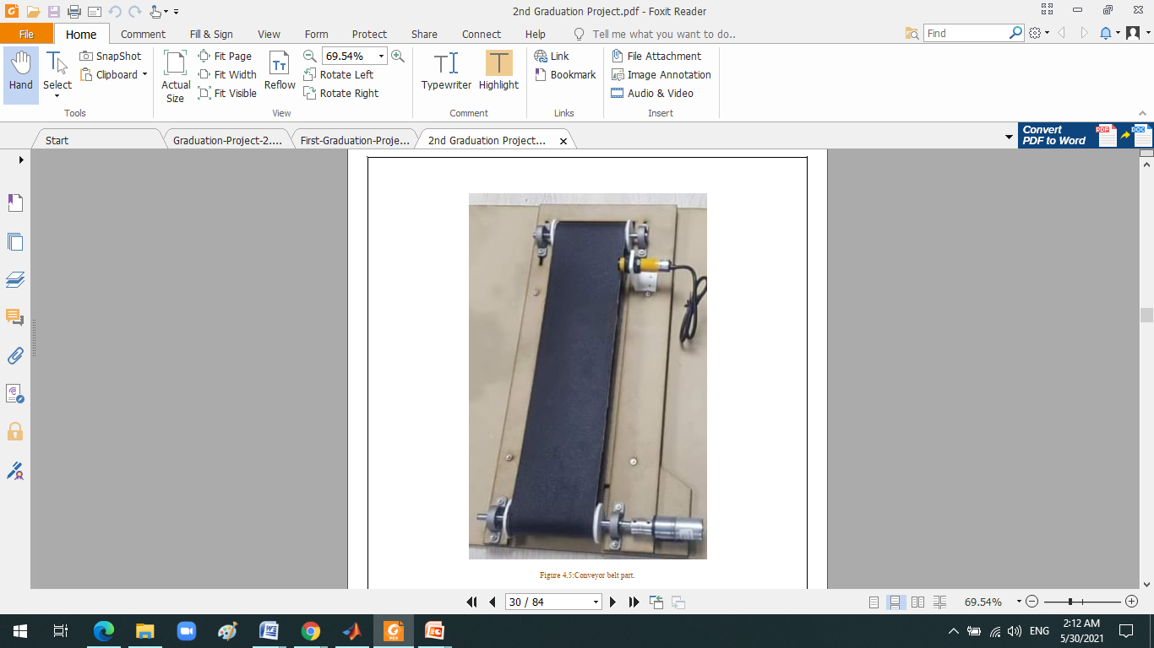
in a conveyor belt system, one or both of the pulleys are powered, moving the belt and the material on the belt forward.

Slide 11
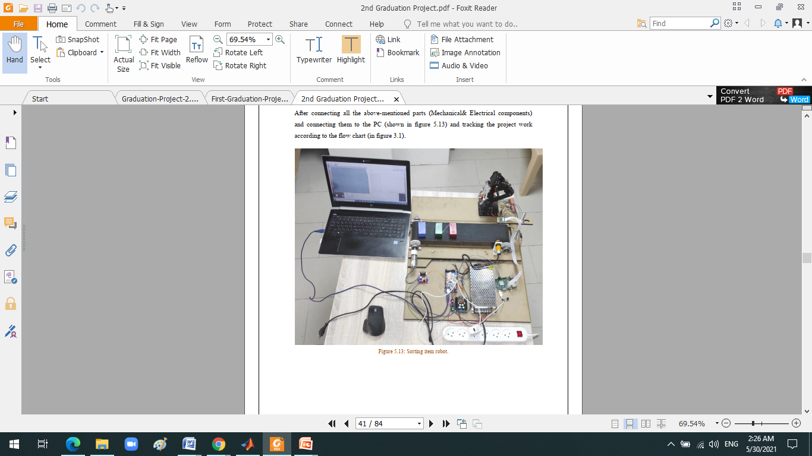
Electrical & Electronic Components
Arduino Mega.
Converter Module.
Power Supplies.
Proximity Sensor.
H-Bridge Motor Drive.
Servo motors.
Camera Module 5Mp.
Flexible Shaft Coupler.
DC Gear Motor.
Raspberry Pi 3 model B.

Slide 12
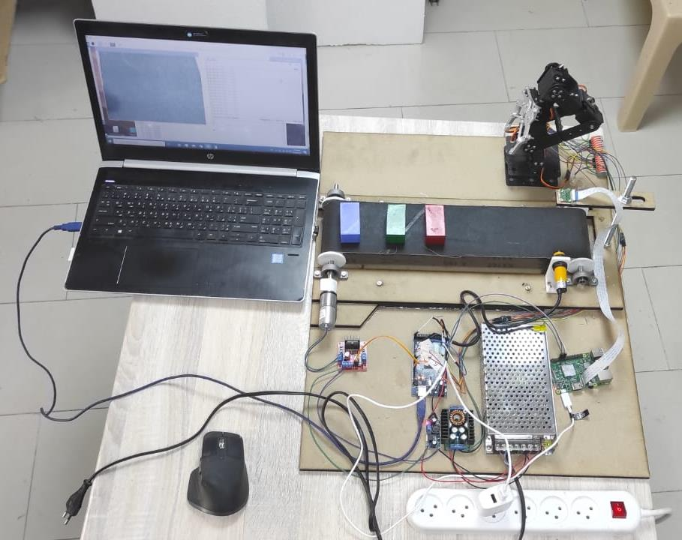
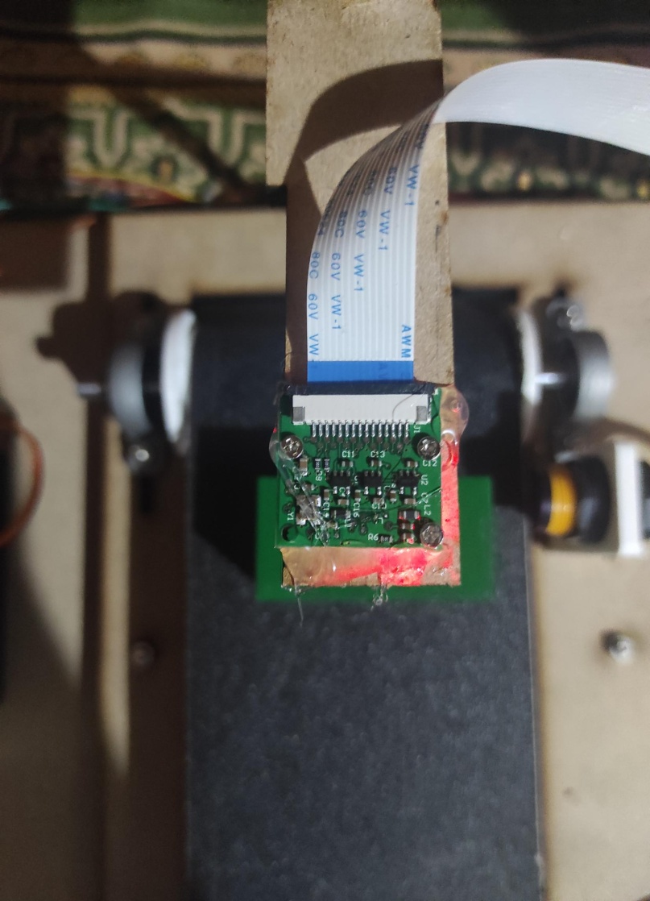
A Camera Module 5Mp and PC screen were used to enable the user to monitor the whole process, and therefore direct and control the robotic arms to perform the required task.

Slide 13
Software Design
Raspberry Pi
Arduino mega
Image processing using Python

Slide 14

>> Python
Python is a high-level, general-purpose programming language designed for ease of use by human beings accomplishing all sorts of tasks.
Python Features:
Python is free and open-source software.
you can download Python at no cost, and you can also download, look at, and modify the source code as well.
This is a big advantage for the Python language compared with other programming languages.

Slide 15
After connecting all the parts (Mechanical & Electrical components), and connecting them to the PC after doing the required programming and tracking the project work according to the flow chart.

Slide 16
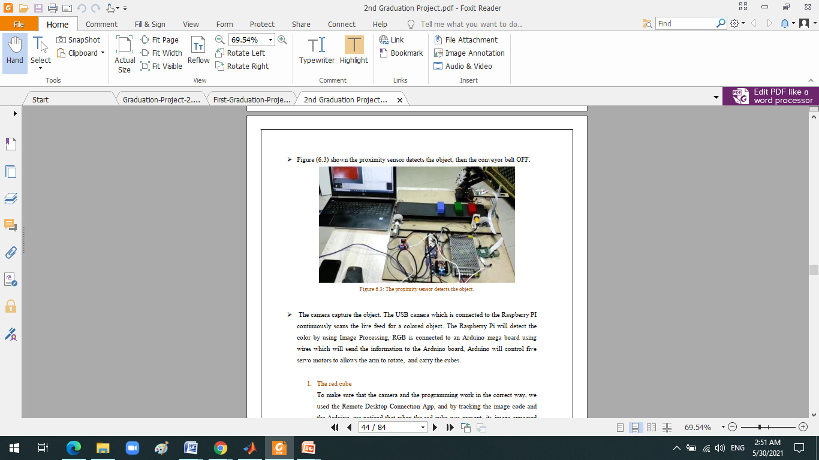
Testing The Design
The figure shows the proximity sensor detects the object, then the conveyor belt OFF.
the next chart explain the full process in sequences >>

Slide 17
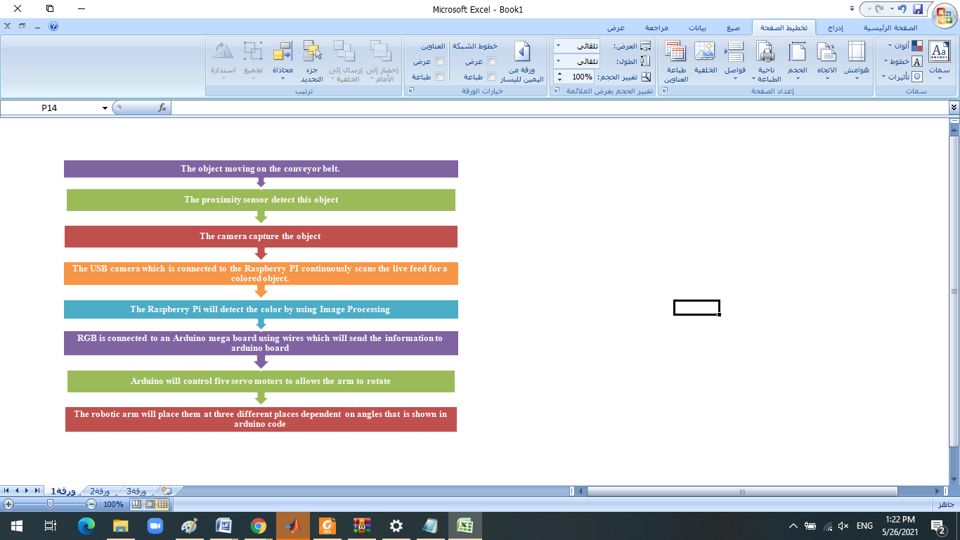

Slide 18
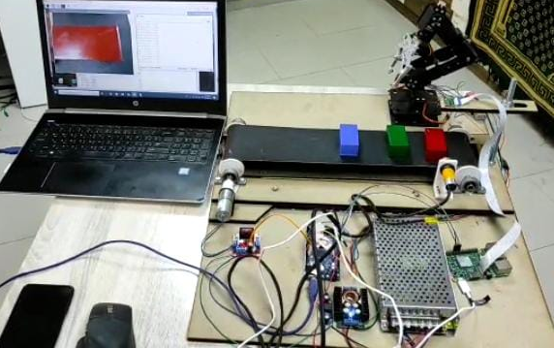
When the proximity sensor sensed the red cube (as shown in the figure below) and the camera took its picture, the image processing is underway to make sure that the camera and programming work in the correct way.

Slide 19
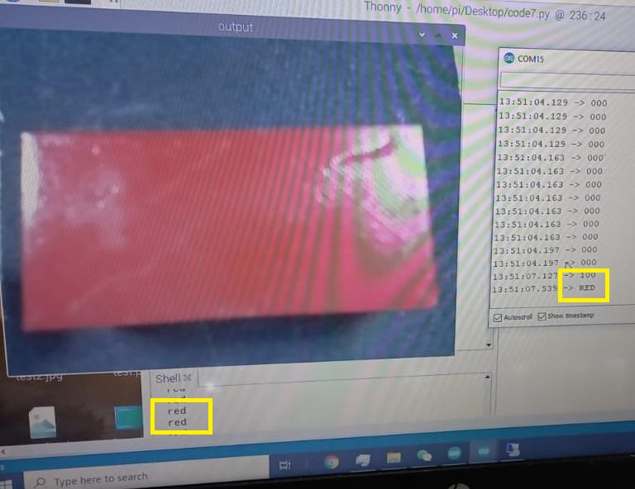
The red cube
To make sure that the camera and the programming work in the correct way, we used the Remote Desktop Connection App, and by tracking the image code and the Arduino, we noticed that when the red cube was present, its image appeared on the screen (as shown in figure below) and 'red' word and the number sequence according to code 100 that means the cube, color is red, and then the robotic arm carries the red cube to its specific place.

Slide 20
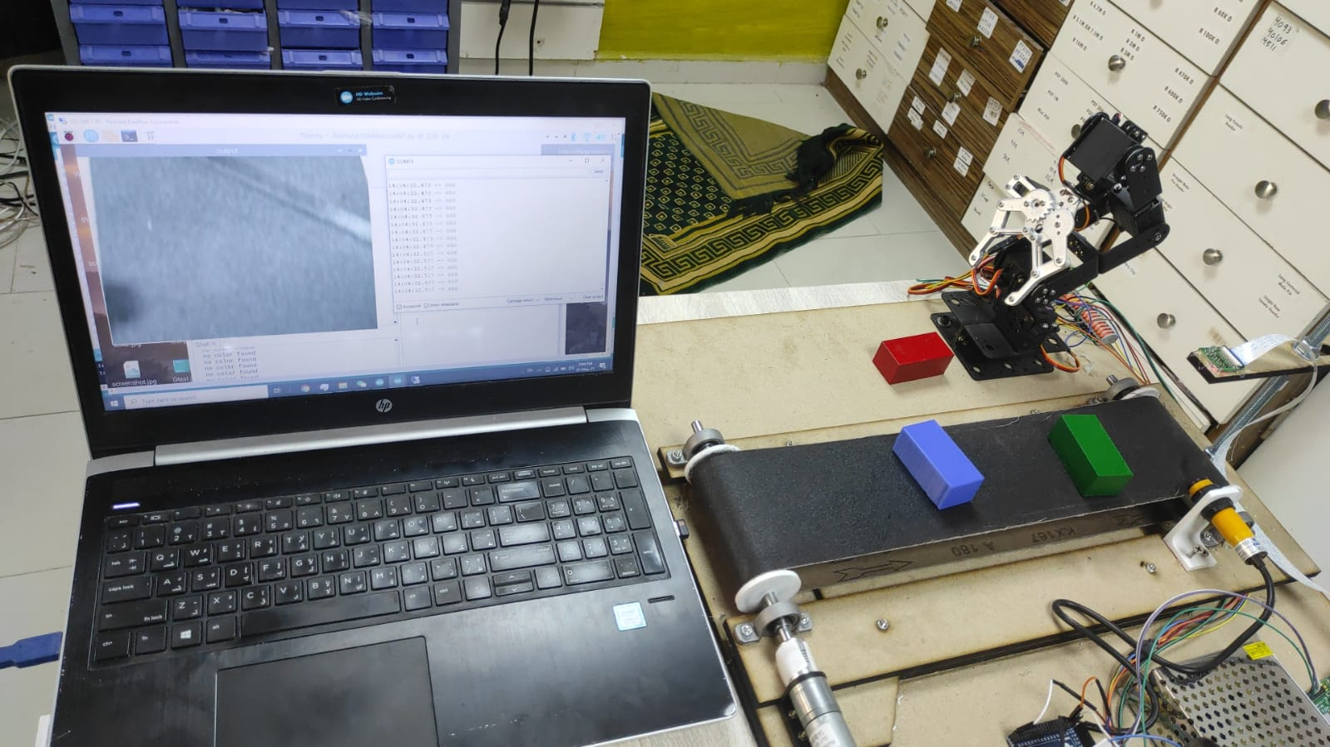
Red cube on its specific place.

Slide 21
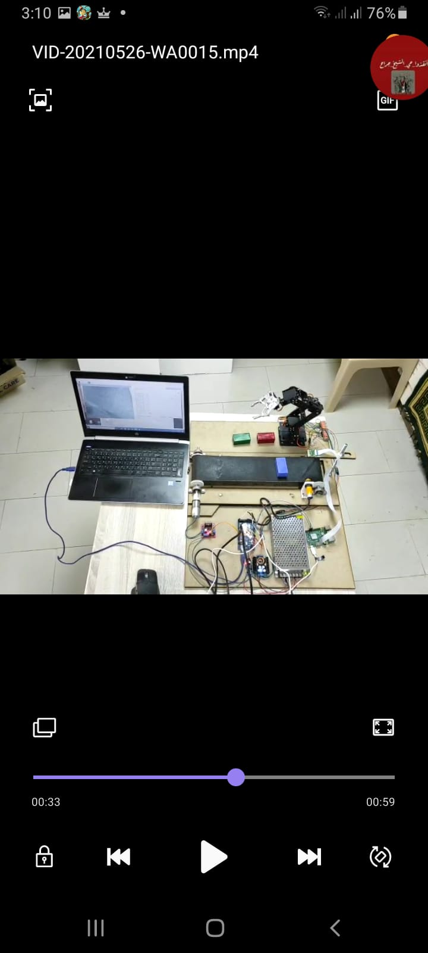
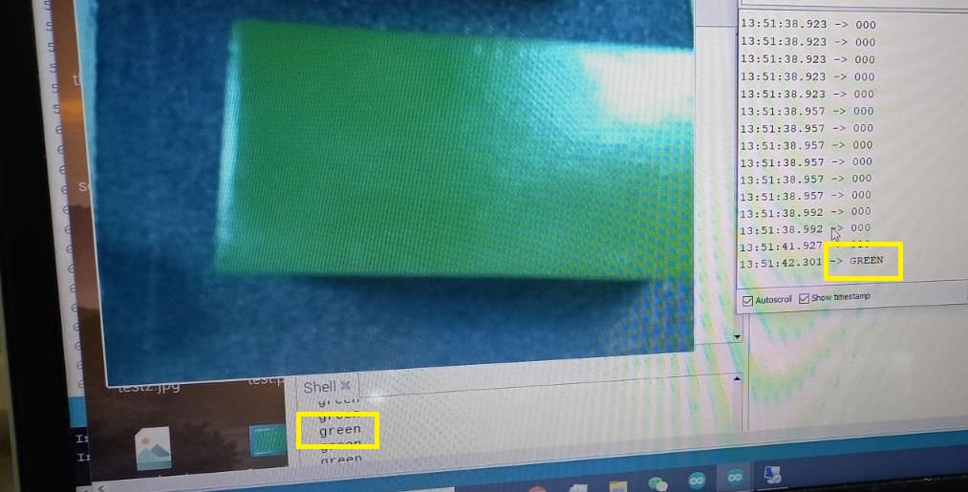
As we talked above about the red cube and how to make sure the camera and programming is working correctly, we will repeat the same steps for the green and blue cubes.
The green cube

Slide 22
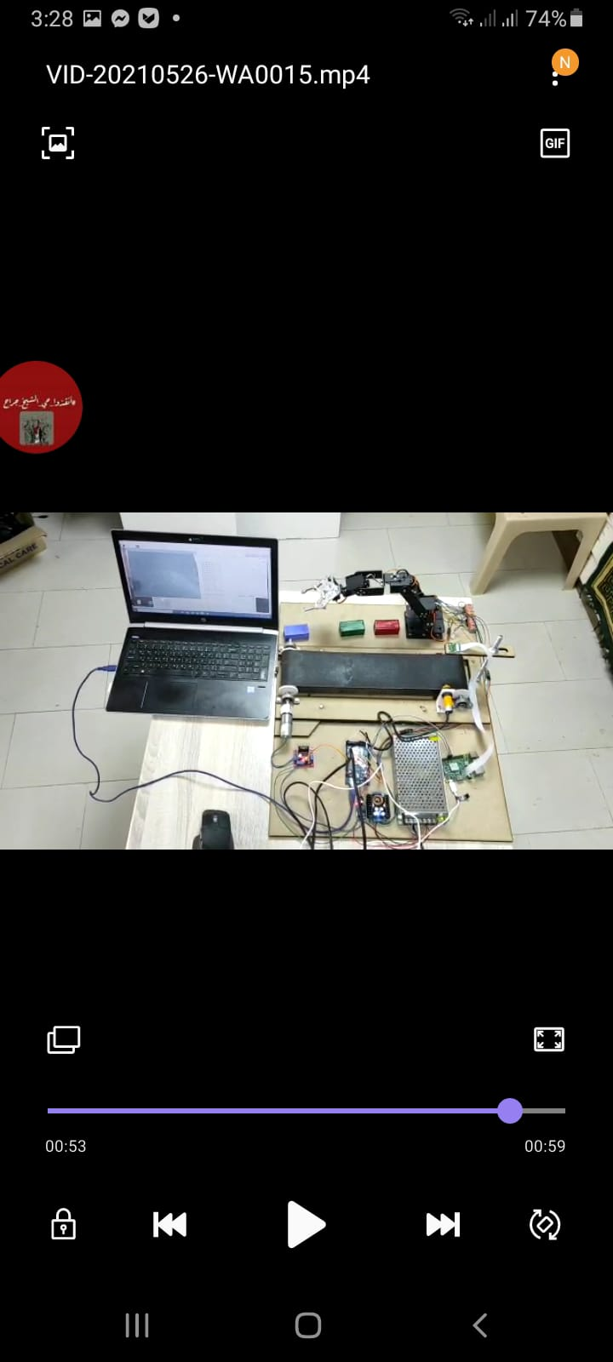
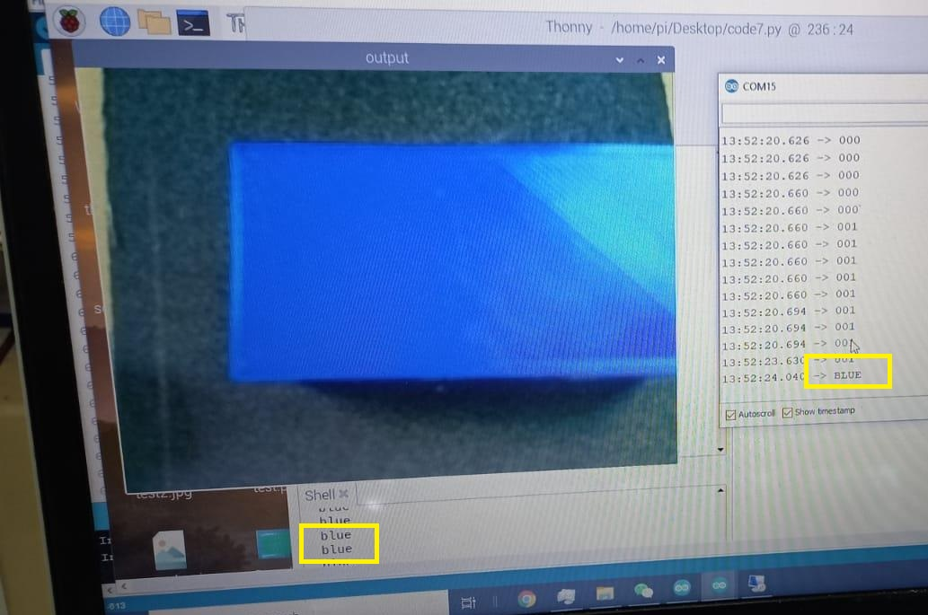
The blue cube

Slide 23
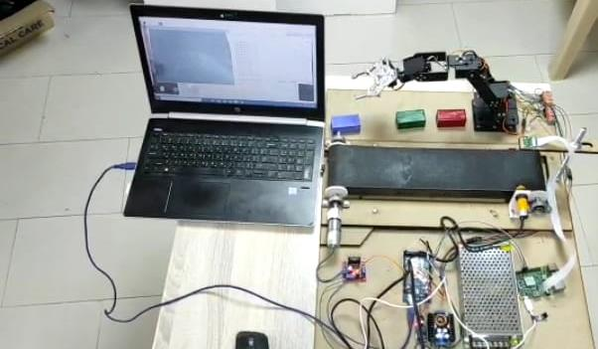
After arranging the cubes according to their color

Slide 24
Conclusion
This robotic arm presents the design, and construction of a robotic arm, which can pick and sort objects of different colors. The aim of the project was to have a fully functional robotic arm which sorts different colored item and the target is achieved successfully. The color sensing section performed two main tasks object detection and color recognition. The cost-effective system was designed to perform continuous and reliable tasks without human errors using the simplest concepts.
The robotic sorting systems are useful in industries and different household activities. In the final run of the project red, green, and blue Cubic were successfully sorted.

Slide 25
THANKS!
Any questions?

