Slide 1
Smart Finger
Made by :
Hani Arenat
Oways Othman
Supervised by :
Dr. Motasem Abu Zant

Slide 2
Index :
Introduction .
Important criterias .
Characteristics of the product .
Attentive customers .
How it works .

Slide 3

Introduction :
Since the age of Technology has begun there’s a single question should be asked .
Why this company is better than other company and why is this product is greater than that ?

Slide 4
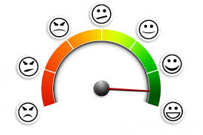
Introduction cont. :
The appropriate answer is because they’re looking for Satisfaction .
And it can’t be found without important criterias .

Slide 5
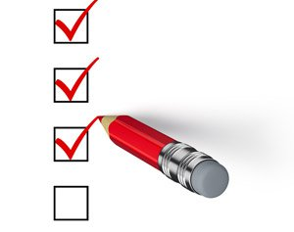
Important criterias :
Simple .
Useful .
Fast .

Slide 6
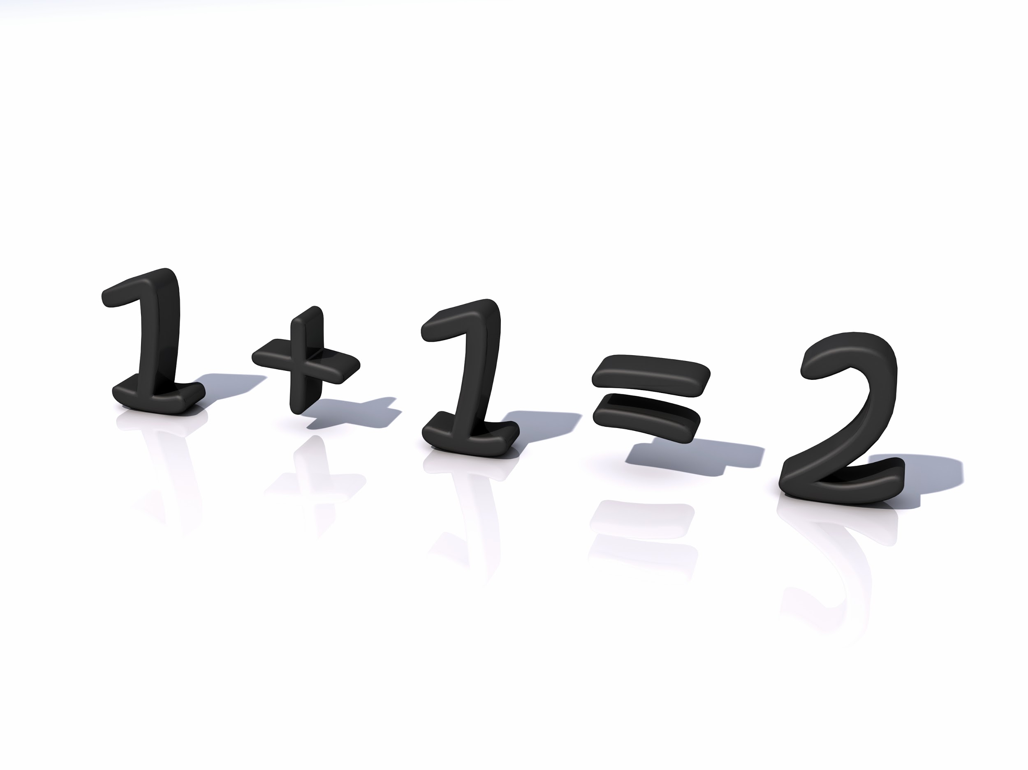
Characteristics of the product :
Easiness :
There’s no need to be good with smartphones to know how to deal with the application , in other word you could call it simple .

Slide 7
Characteristics cont. :
indispensable :
There’s no doubt that many applications may be used , but the most important thing is to be important .

Slide 8
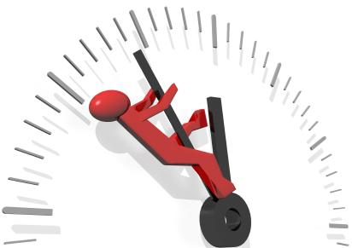
Characteristics cont. :
Time saver :
As many customers look for the something fast and quick , well one of the pros of this application is saving your time and your effort .

Slide 9

Attentive customers :
One of the great things of this application that it made for huge amount of customers because it can be used by young people , adults or even old people.

Slide 10

How it works :
It’s time to show the audience how this application actually works , hope you enjoy it

Slide 11
Thanks for Watching

