Slide 1


An-Najah National University
Building Engineering Department
Integrated Design Of Hotel
Presented by:
Amal Mohammad Haboush
Ameed Amjad Harashi
Aya Abed Al- Fatah Assedeh
Zeyad Salah Najjar
Supervisor:
Dr. Asaad Arandi

Slide 2
Outline:
  Introduction.
  Architectural Design.
  Structural Design.
  Environmental Design.
  Mechanical & Electrical Design.
  Safety Design.
  Cost estimation

Slide 3

Introduction

Slide 4
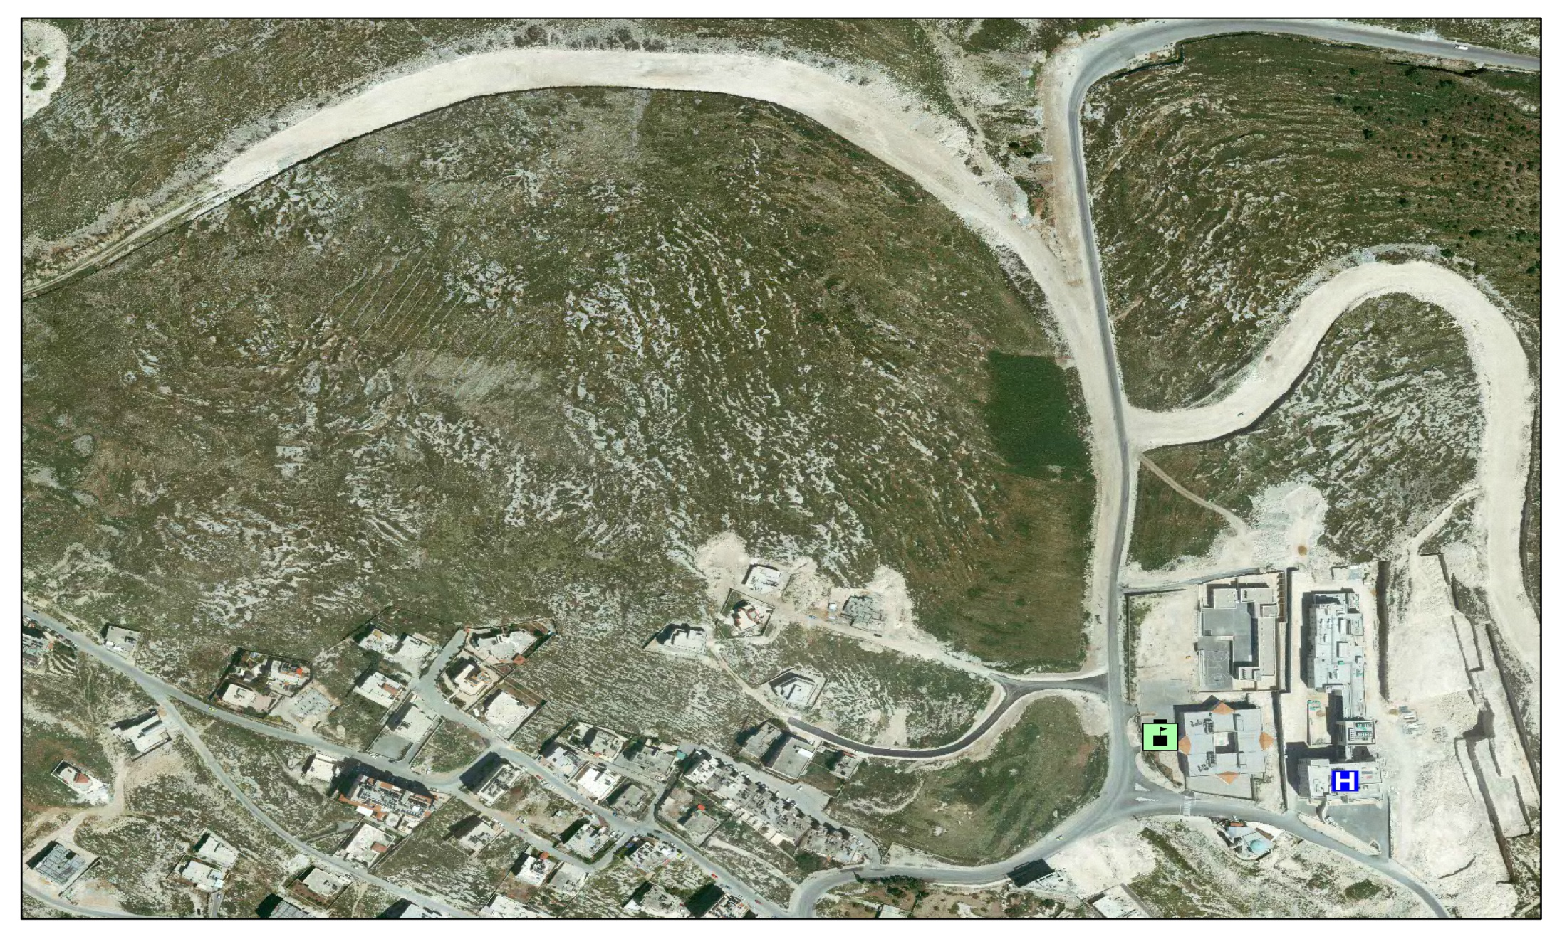
Proposed location:
Asira Main ST.
An-Najah Hospital
Proposed Site

Slide 5
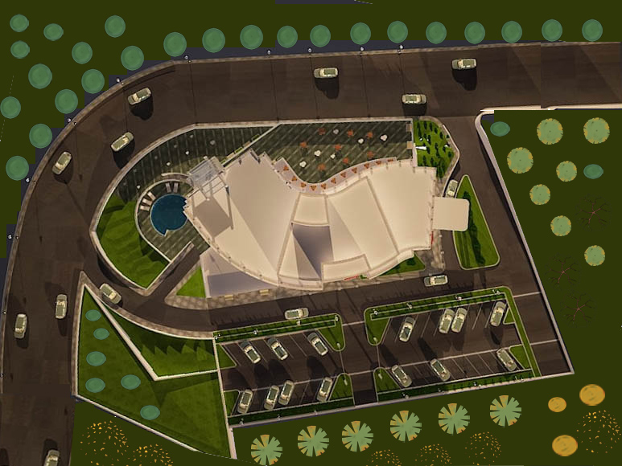
Site plan:

Slide 6
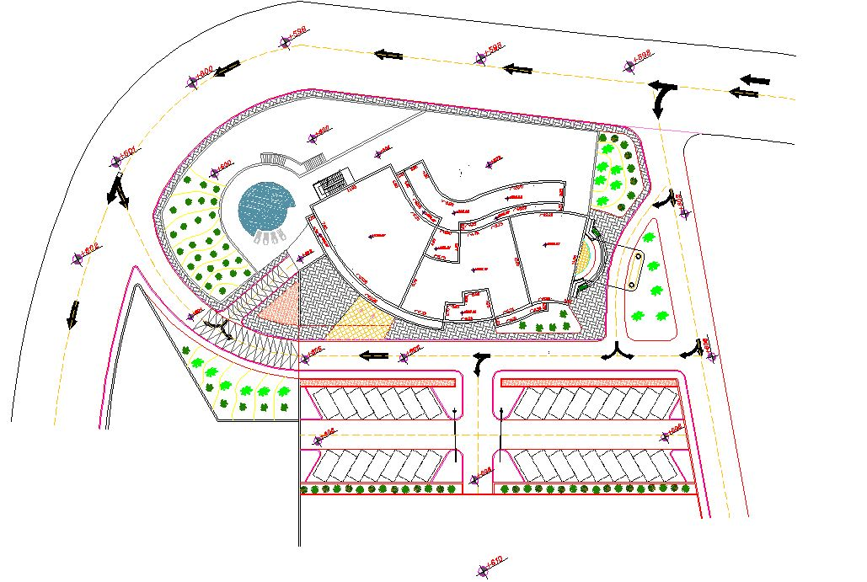
Site plan:
N

Slide 7
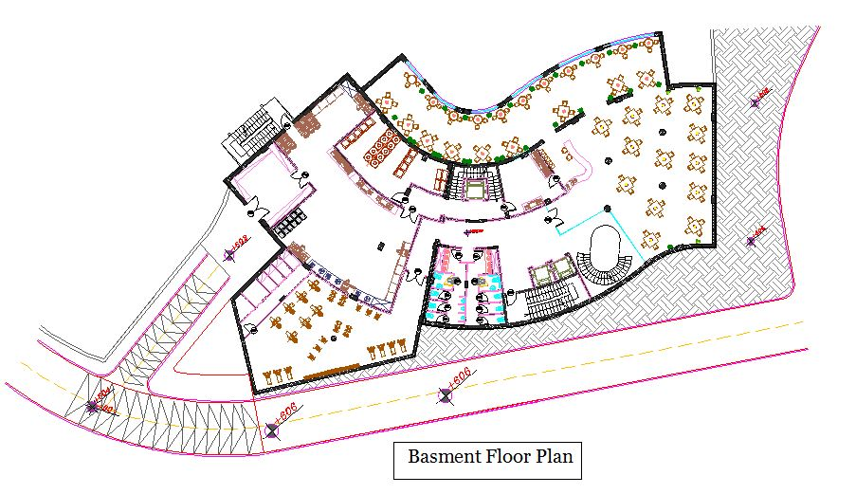
Architectural Design
Total area of Basment floor =1032 m²

Slide 8
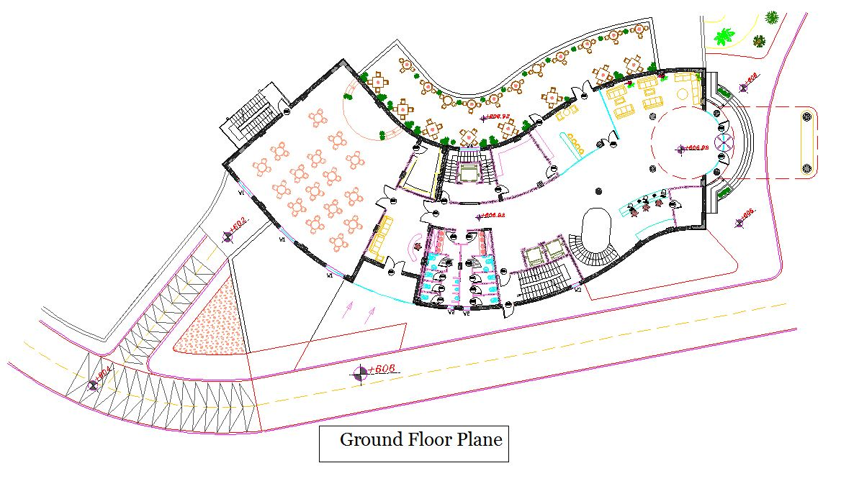
Architectural Design
Total area of GF including Terrace = 900 m²

Slide 9
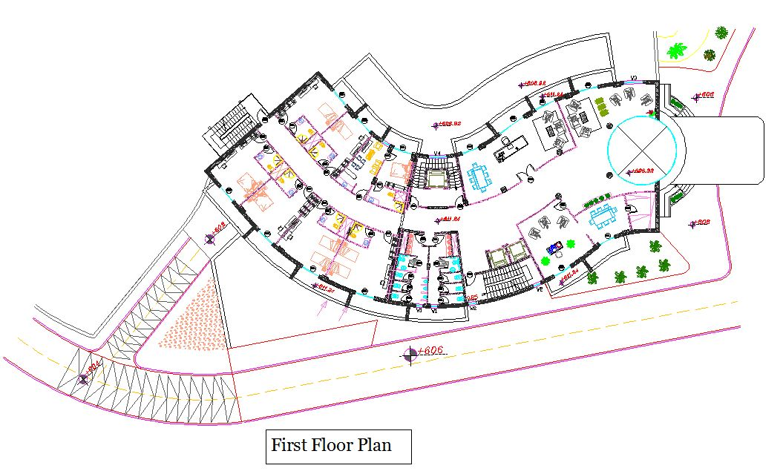
Architectural Design
Total area of first floor = 846 m²

Slide 10
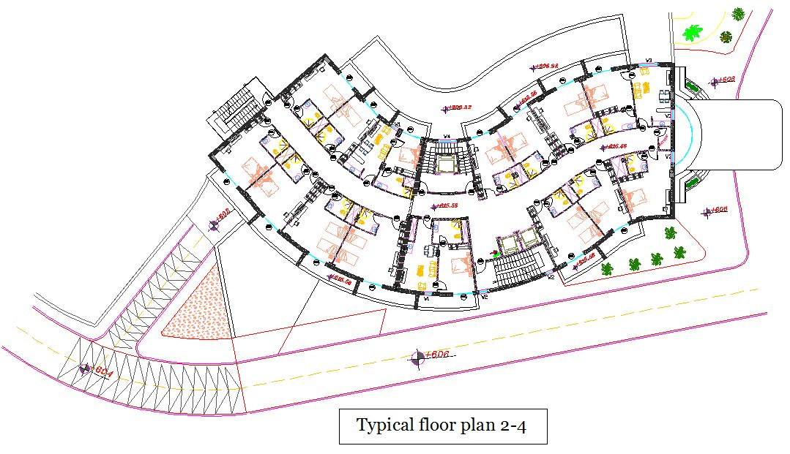
Architectural Design
Total area of floor = 846 m²

Slide 11
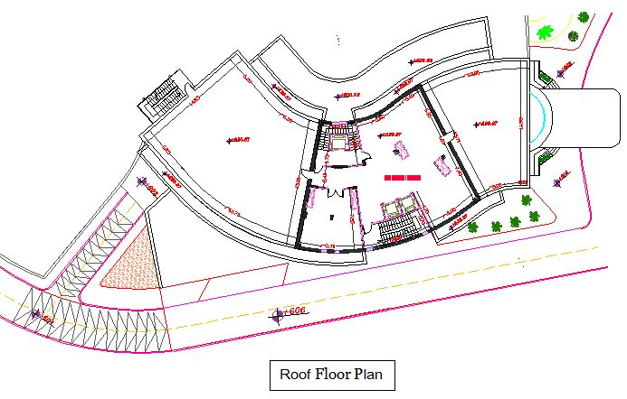
Architectural Design
Total area of roof= 292 m²

Slide 12
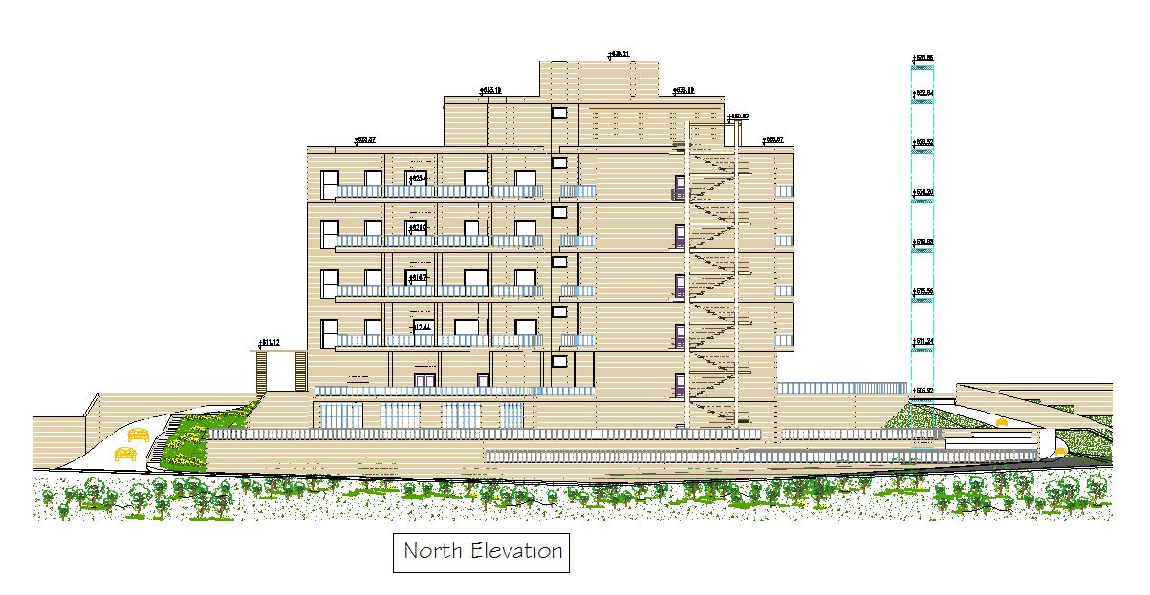
Architectural Design

Slide 13
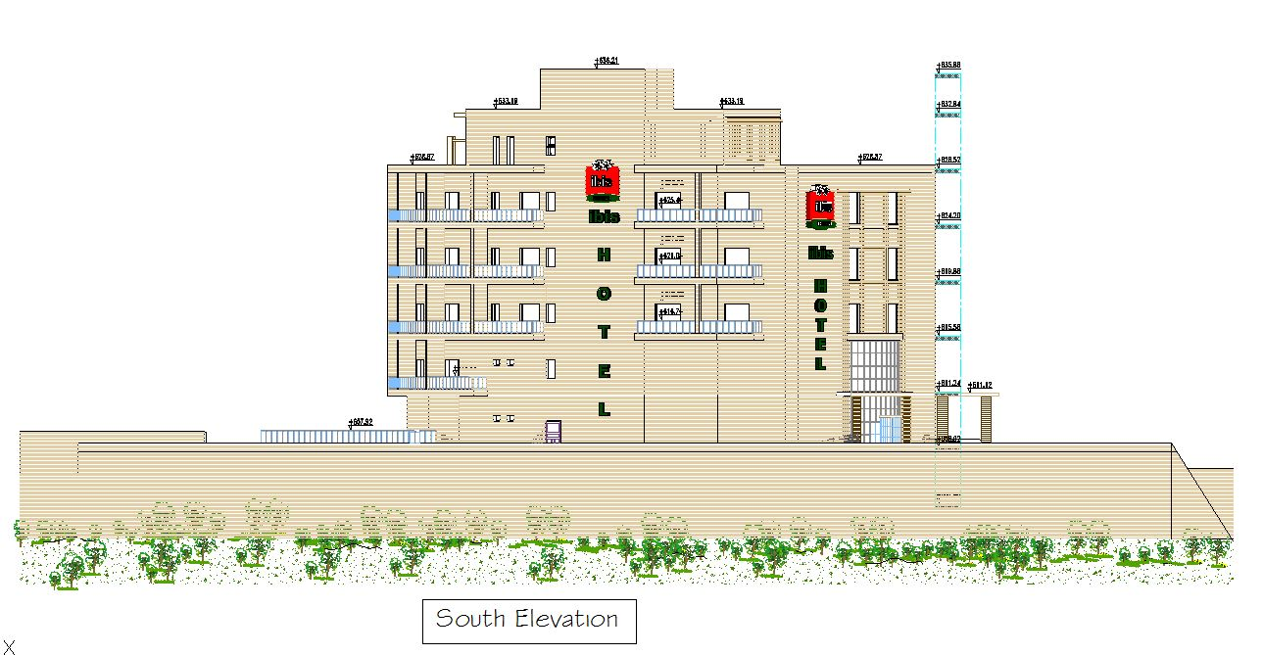
Architectural Design

Slide 14
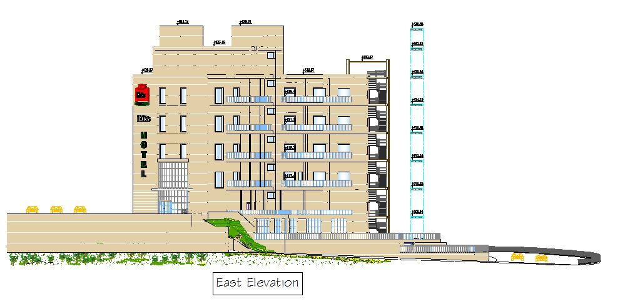
Architectural Design

Slide 15
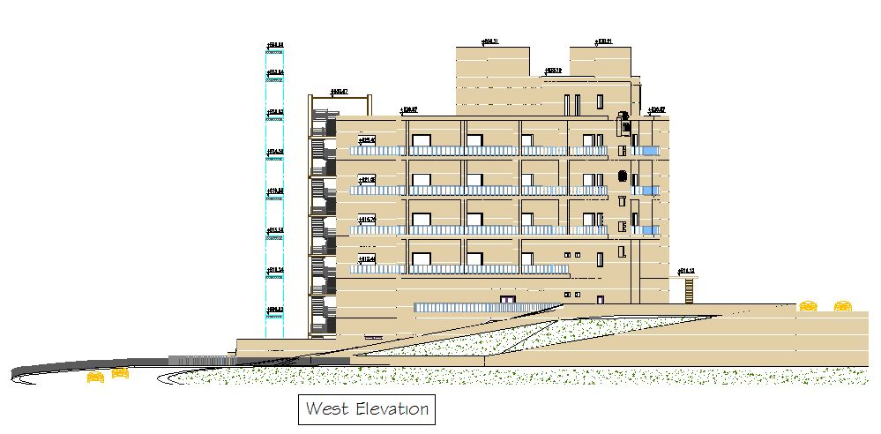
Architectural Design

Slide 16
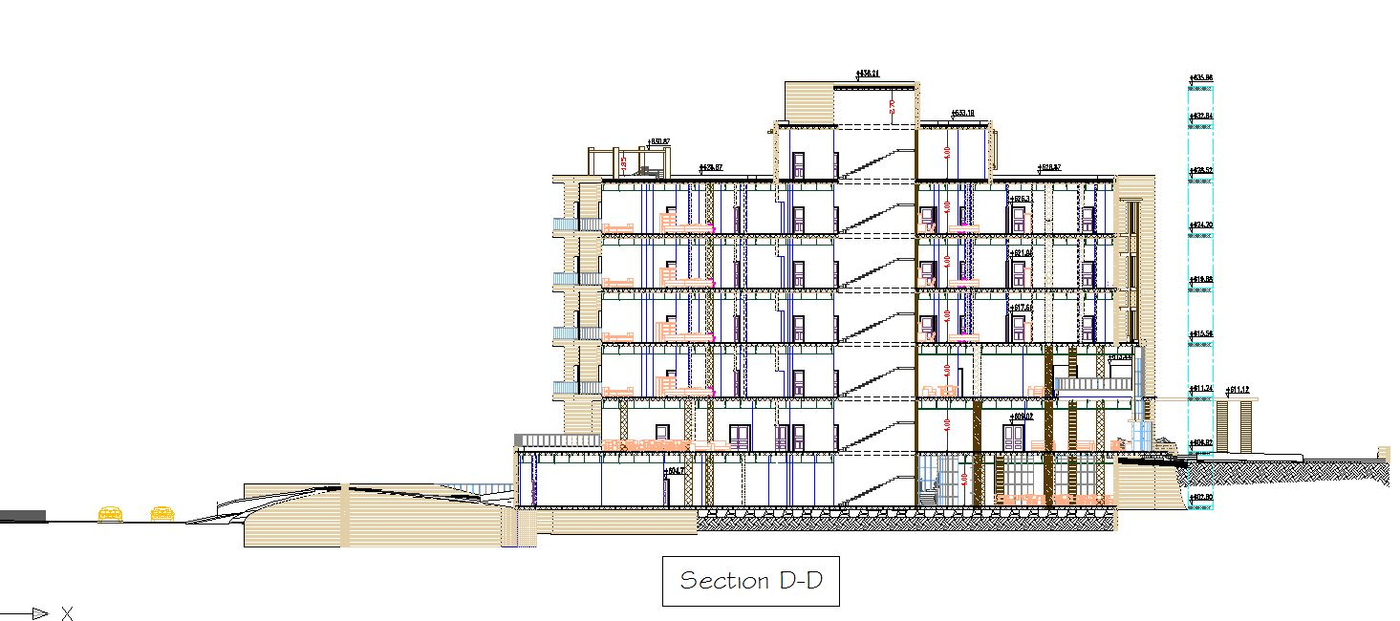
Architectural Design

Slide 17
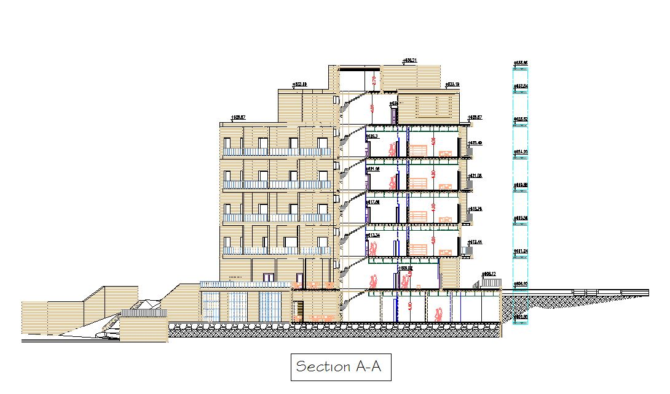
Architectural Design

Slide 18
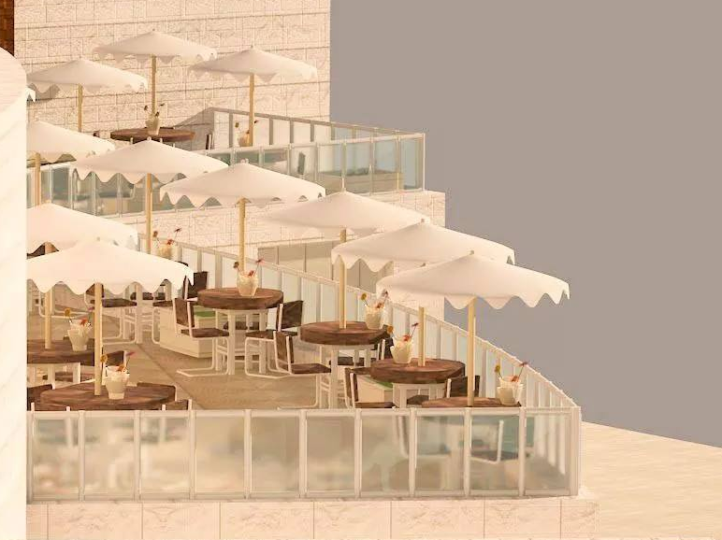

Slide 19
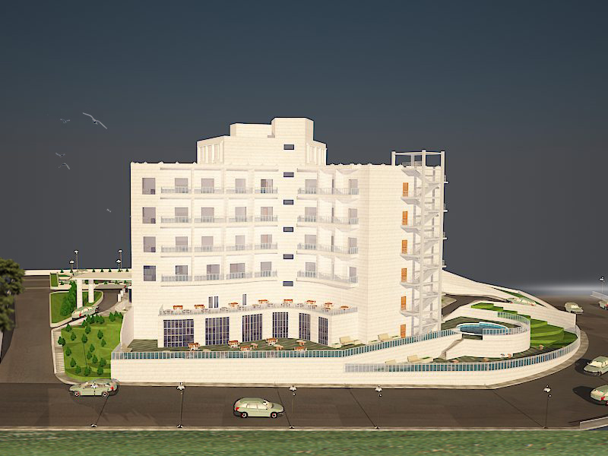
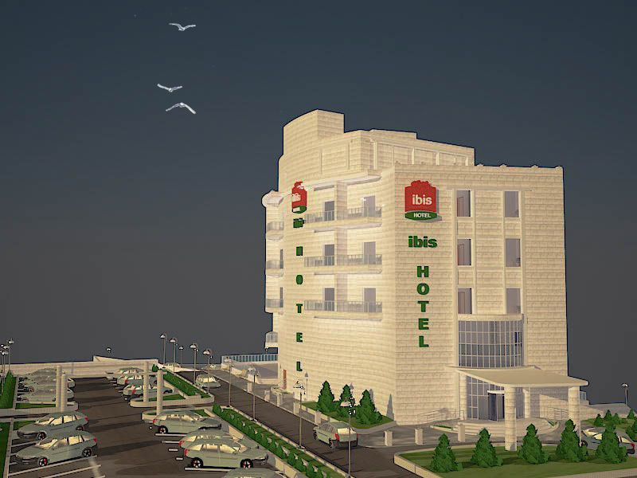
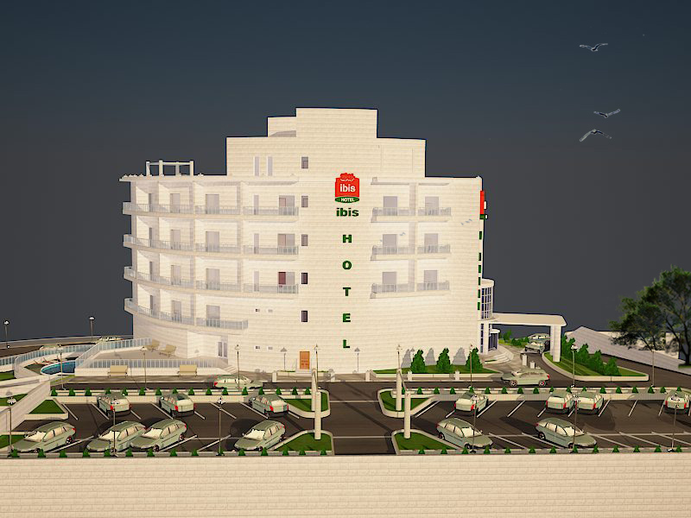
3-D Model

Slide 20
Structural &
Seismic Design

Slide 21
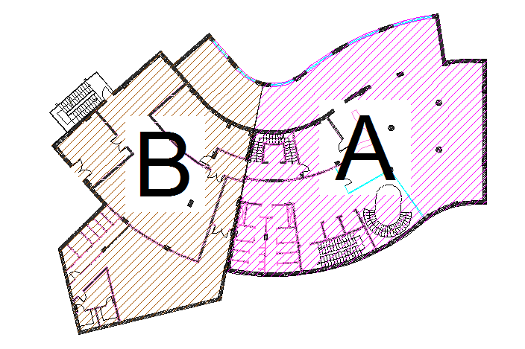
Structural Design
The project consists of two block separated by 5cm structural joint.

Slide 22
Structural Design
Design codes :
ACI -318-09 for reinforced concrete structural design.
UBC -97 for earthquake load computations.
ASCE for load computations.
The analysis and design were done using SAP2000 program.

Slide 23
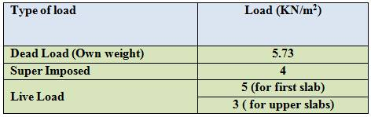
Structural Design
Material :
Concrete
Concrete compressive strength(f’c) = 24 MPa.
Reinforcement steel
The yield strength of steel Fy= 420MPa.
Loads :

Slide 24
Structural Design
Seismic load:
Soil type SB and the bearing capacity of soil = 300 KN/m² .
Z=0.2
I=1
Cv=0.2
Ca=0.2
R=5
Seismic Design by using Ritz method through define two load cases modal X and modal Y.

Slide 25
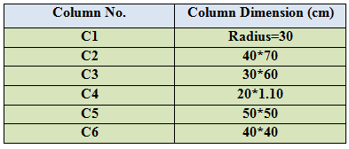
Structural Design
Foundation :
There are several types of footing:
Isolated footing.
Mat footing .
Wall footing .
Basement retaining wall .
Column :

Slide 26


Structural Design
Tie beam :
Slabs :
Structural system: One way ribbed slab with hidden beams.
Thickness = 32 CM .
Beams

Slide 27
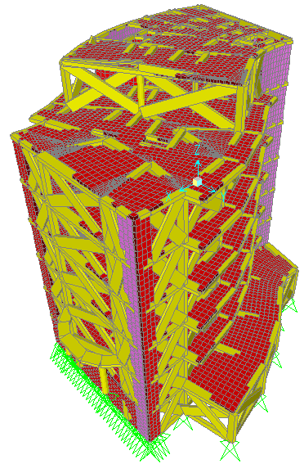
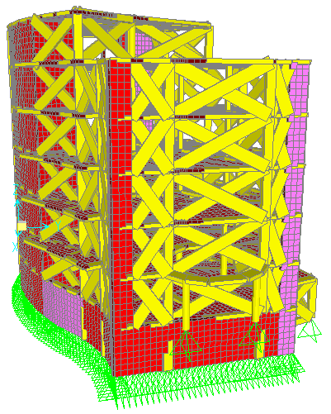
Structural Design
3D Modeling from SAP

Slide 28
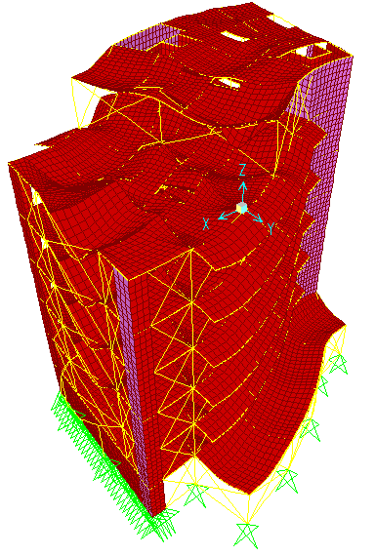
Structural Design
Checks on SAP model :
Compatibility check.

Slide 29
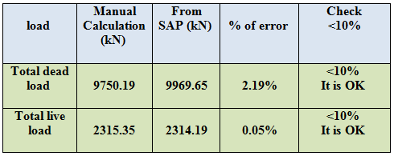
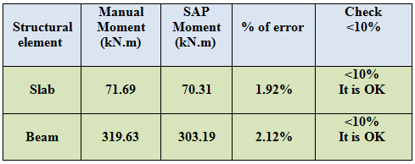
Structural Design
Checks on SAP model :
Equilibrium check
Internal forces check

Slide 30
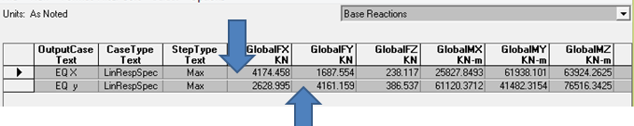
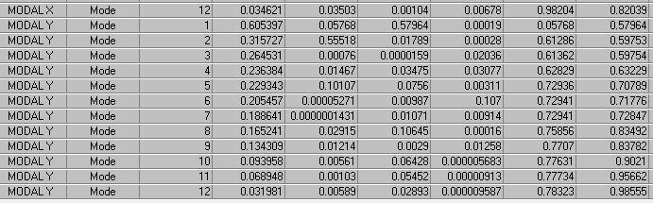
Structural Design
Checks on SAP model :
Base shear ( V ) for seismic design :
Manual calculation for ( V ) = 4158 KN .
From SAP :
mass participation ratio is larger than 90% in X, Y .

Slide 31
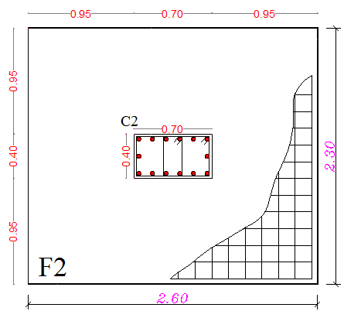
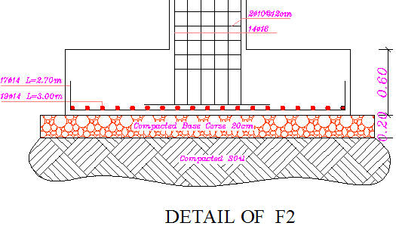
Structural Design
Design for isolated footing :

Slide 32
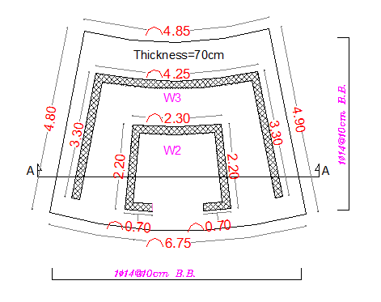
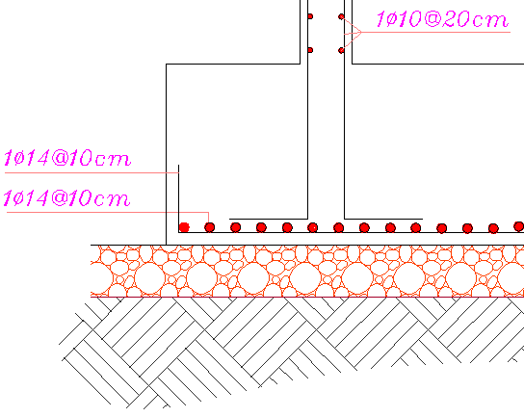
Structural Design
Design for mat footing :

Slide 33
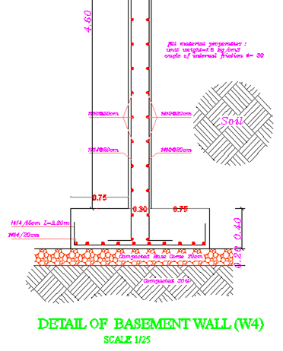
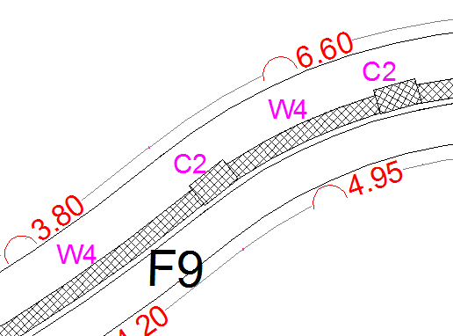
Structural Design
Design for Basement retaining wall :

Slide 34
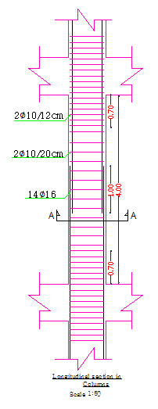
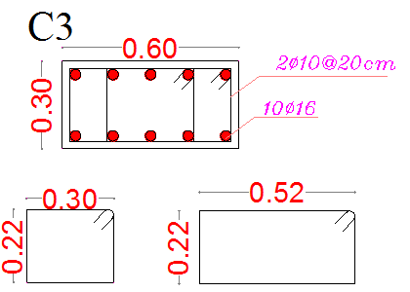
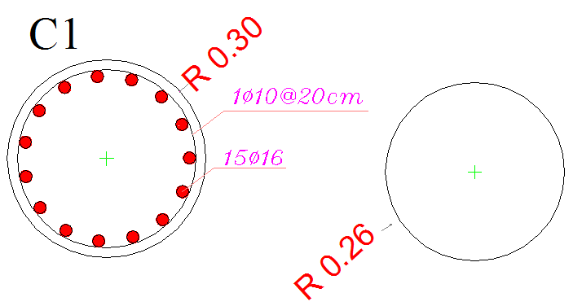
Structural Design
Design for columns:

Slide 35
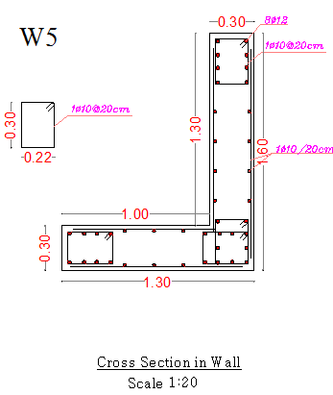
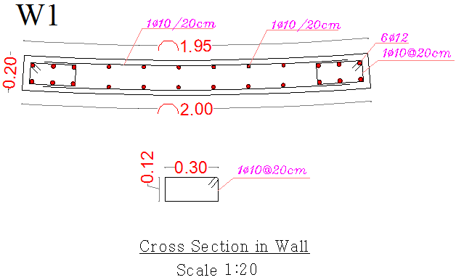
Structural Design
Design for shear wall:

Slide 36
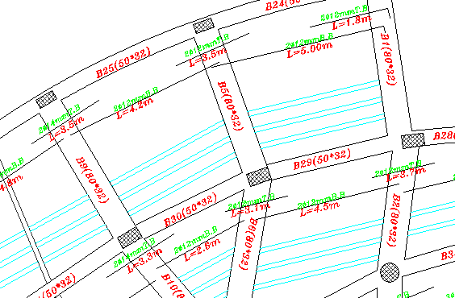
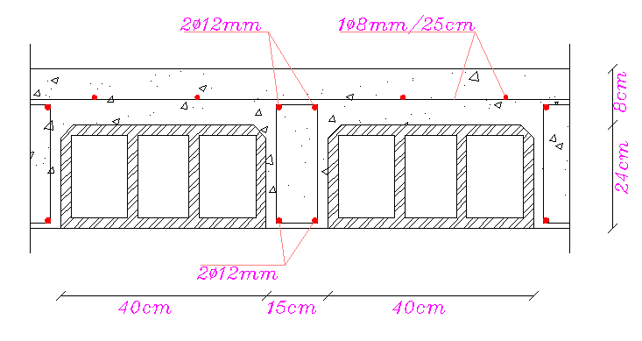
Structural Design
Design for slab :

Slide 37
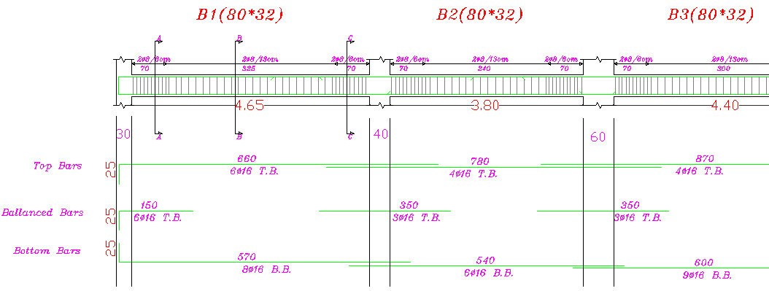
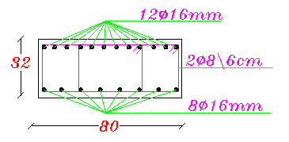
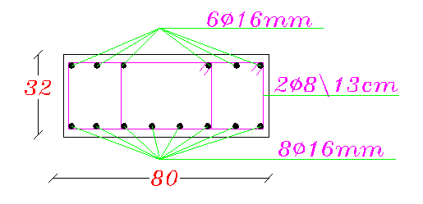
Structural Design
Design for Beams:

Slide 38
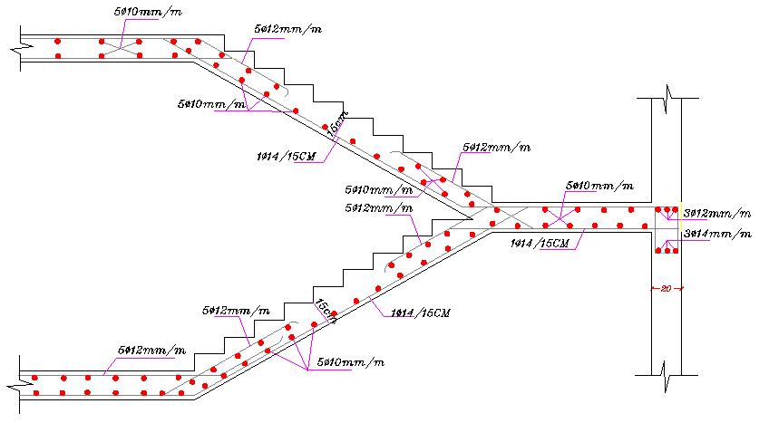
Structural Design
Design for Staircase:

Slide 39
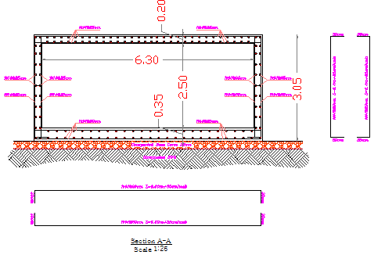
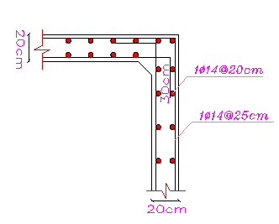
Structural Design
Design for water tank:

Slide 40
Environmental
Design

Slide 41
Environmental Design
Thermal Calculations
Acoustical Design
Daylight

Slide 42
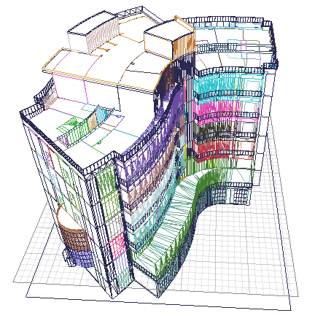
Thermal Calculations
ECOTECT Program was used to:
1. Analyze sun movement and natural lighting.
2. Calculate heating and cooling loads

Slide 43
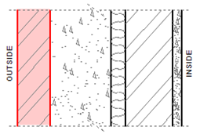
Thermal Calculations
layers for external walls
(U = 0.55 W/m².k):
Thickness(cm) | Layer
7 | Stone
13 | concrete
3 | Polystyrene
10 | Block
2 | Plaster

Slide 44
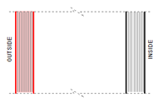
Thermal Calculations
We use double glazed window with U=2.68 W/m².k.

Slide 45

Thermal Calculations
Total heating load and cooling load per m^2 =56.6 KWh
The acceptable range from 30 to 80 KWh .

Slide 46
Acoustical Design
RT60 for Multipurpose room should be 1-1.1 sec→ RT₆₀=1.09 →in range.
%Alcon=10% so it is good.
Total STC of inside wall = 61db.
Gym:
RT₆₀=0.16*V/As=1.2
Total STC of wall = 61db

Slide 47

Acoustical Design
Layers used in Multipurpose hall wall

Slide 48

Average daylight factor:
For multipurpose hall:-
DF=4.77%

Slide 49

Average daylight factor:
For Reception :-
DF=4.32%

Slide 50

Average daylight factor:
Suite:
DF=4.13%

Slide 51
Mechanical &
Electrical
Design

Slide 52
Mechanical Design
Drainage System Design.
Water Supply System.
Vertical Transportation.
HVAC System.

Slide 53

Mechanical Design
  Drainage System Design:

Slide 54

Mechanical Design
  Drainage System Design for Ground floor:

Slide 55

Mechanical Design
  Drainage System Design for Roof floor:

Slide 56

Mechanical Design
Water supply for Basement floor

Slide 57

Mechanical Design
Supply water for bathroom

Slide 58

Mechanical Design

Slide 59

Mechanical Design
Vertical transportation
We need 2 elevators and one for service

Slide 60

Mechanical Design
  HVAC system
  In order to be able to design the duct system, heating and cooling loads must be determined for every space in the building.

Slide 61

Mechanical Design
  HVAC system for Ground floor

Slide 62

Mechanical Design
  HVAC system for First floor

Slide 63

Electrical Design
Bed room
E avg =367 lux

Slide 64

Electrical Design
Restaurant
E avg =334 lux

Slide 65

Electrical Design
Gym
E avg =499 lux

Slide 66

Electrical Design
Distribution of lighting in Basement floor

Slide 67

Electrical Design
Distribution of Sockets in Basement floor

Slide 68

Electrical Design

Slide 69


Electrical Design
Location of circuit breakers

Slide 70
Safety Design

Slide 71






Safety Design
Fire system used in the hotel:
Sprinklers
Hose Station
Fire Extinguisher
Fire Proof Door
Fire Alarm
Smoke Detectors

Slide 72

Safety Design
Fire system in Ground floor:

Slide 73


Safety Design
Sprinklers system in bedrooms and offices :

Slide 74




Safety Design
Safety signs:
Exit signs
Elevators should not use in case of fire or earthquake
First aid
Staircase

Slide 75

Safety Design
Safety signs in first floor:

Slide 76

Safety Design
Safety rout in ground floor:

Slide 77
Cost
Estimation

Slide 78
Cost Estimation
The total price of the hotel is 2.73 million $
The price for m² approximately is 480 $ / m²

Slide 79

Thank You

