Slide 1
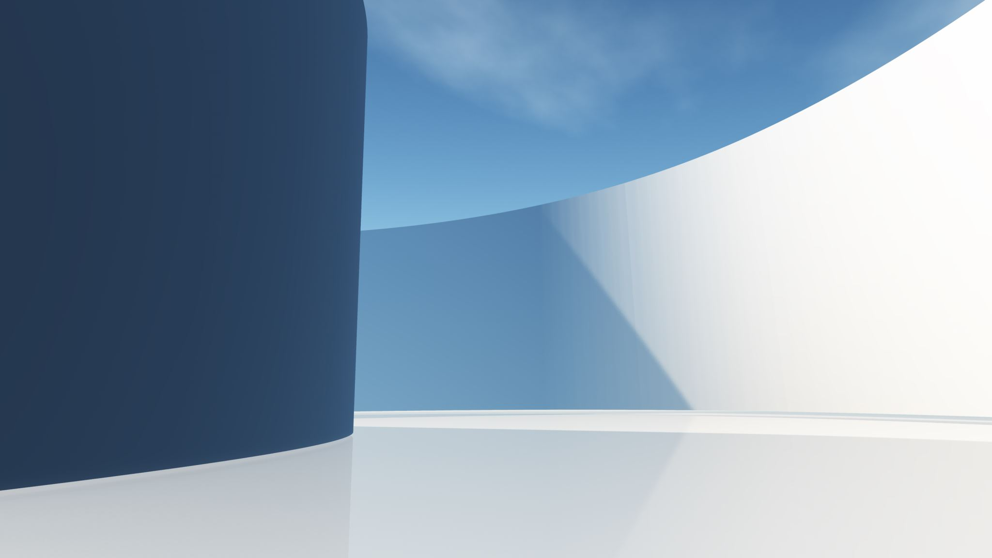
Smart WheelChair

Slide 2
What is the project about
In the era of bringing technology to the physical world, facilitating the difficulties that people with impairment face, providing them with the technologies to make them comfortable to handle what they go through everyday.
Our project consists of features for a wheelchair that gives the opportunity for those in need that have suffered conditions out of their control.

Slide 3
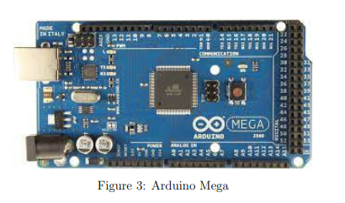
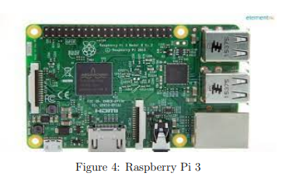
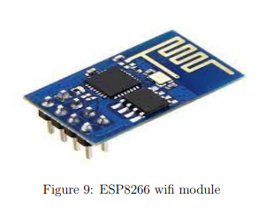
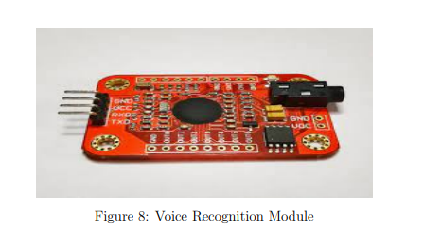
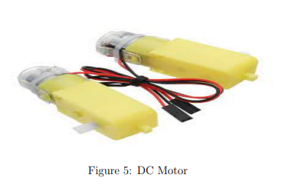
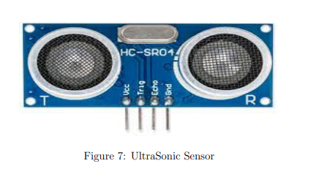
Hardware Components

Slide 4
Movement Modes
Manual Control : the patient control the chair with a mobile application.
Voice Control : the patient control the chair with voice commands.
Automatic Movement: the chair uses a camera to move the chair automatically in a certain path.

Slide 5
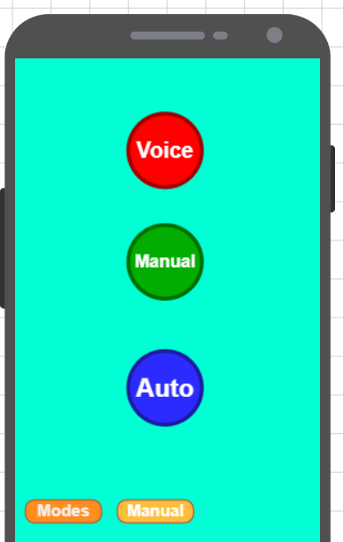
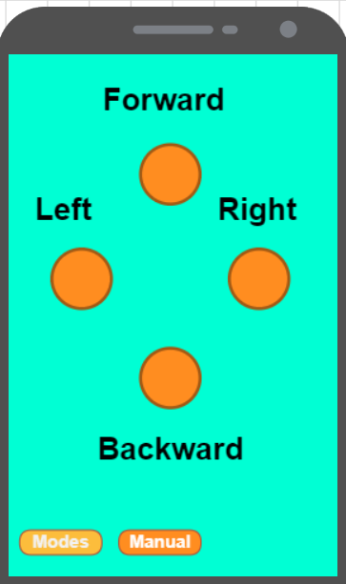
Manual Mode
We used the esp8266 wifi module S01, to connect our mobile application with the arduino.
From the mobile application we can choose which mode we will make the chair operate on.
The manual control is provided through the mobile, we can control the movement of the chair in all directions.

Slide 6
Voice Mode
We used a voice recognition module to train the words we will use to compare it with the voice commands to provide the movement required.
We have trained 4 words for each direction which are:
1) North, for forward direction.
2) South, for backward direction.
3) East, for right direction.
4) West, for left direction.

Slide 7
Since we can't use a Stop command , we Implemented an Avoid Obstacle algorithms to make sure that the wheelchair does not run into anything in its way.
There are different cases for each algorithm, whether an object is in front of it, or also at the side or it has run into a dead end.
All these different scenarios are handled by algorithms to handle it.

Slide 8
Auto Mode
In this mode the wheelchair will follow a certain path for specific locations, and it will move automatically.
To follow this path for the wheelchair, we used a camera connected to the raspberry pi so that it captures images and the raspberry pi analyzes them and give us commands on the movement of the chair.
The direction of the chair's movement depends on the camera and the different signals it captures, and these signals vary from: turning right, turning left, and stop.

