Slide 1
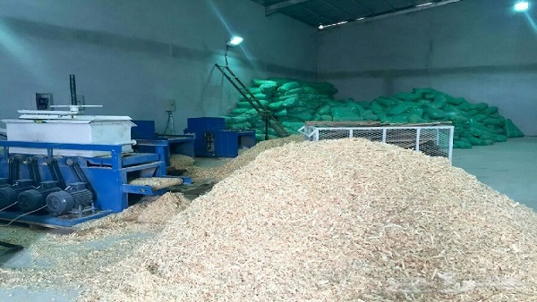
An - Najah National University
Faculty of Engineering & Information Technology
Industrial and Mechatronics Engineering Departments
“Design a wood shavings packaging machine”
Supervisor: Dr. Ahmad Al- Ramahi

Slide 2
Design a wood shavings packaging machine"
Saleh Asmair
Saleh Sholi
Salah Al-Karaki
Abdullah Dmaidi
Mohammad Jendasi

Slide 3
Problem Statement
Introduction
Objectives
Literature Review
Machine Design
Outline
Manufacturing of the machine
Feasibility study
Operation and maintenance sheet
Conclusion & Recommendation

Slide 4
Project Background
The total number of chickens in Palestine 30-40million birds , during the agricultural year 2012/2013.
Since each square meter can contain an average of 8 chicks and thus a total of 4.15 million square meters of chicken farms ,and this needs 2,500,000 bags per year.
These farms need and areas continuous supply of wood shavings , the source of wood shavings is the Israeli market and the local market
but the local market is expensive because it depends on the labor force in packaging the wood shavings.
the solution is to automate the packing process order to increase the market share of the local product, so that it can compete with the Israeli products

Slide 5
Problem Definition & Solution
There are many industrial machines that make wood shavings in the local market . But the problem with these machines is that a workers is needed to collect the wood shavings manually to fill it in unitized bag ,these bags are then distributed to the customers . All these tasks are conducted manually.
The solution of this problem is by designing an automatic machine that can automatically collect and package the wood shavings in unitized bags of 5kg .This will alleviate the cost and save time , and makes the process more safe.

Slide 6
Project Objectives
The main objective of the project is to design an automatic machine that will fill and pack bags of wood shavings with a specific weight at a specific time, in order to compete in the local market .
These are some of the benefits of the project :
1 - Save time and effort at work
2- Reduce the number of workers, thus saving money
3-Reduce work space for the operation of the machine
4 - Obtain a more accurate and efficient product, as that the weighing system works accurately and thus there is no waste in the wood shavings
5–Increase safety level in work environment
6- Satisfying the market's demand at specific time, high quality and low cost

Slide 7
Literature Review
This Chapter present how the parts and the components in the machine was selected and where each component will be used .
Parts and component :
1- Air compressor
2-Pneumatic cylinder
3- Electric motor
4- Sensors
5- Control system
6- Conveyers system

Slide 8
Air compressor
There are two main uses of air compressor:
1) to move wood shaving from wood shaving machine to main hopper through a tube
2) to supply pneumatic cylinder with the necessary air pressure to move it.
clarke shhh air 100/50 quiet run compressor
based on the previous data and the necessary calculations that will be clarified in the design chapter ; clarke shhh air 100/50 quiet run compressor was selected.
Max Pressure | Air Displacement | Receiver Capacity | Dimensions (L x H x W) | Duty Cycle | Weight
8 Bar | 3.53 CFM | 50 L | 860 x 750 x 400 mm | 50% (15 mins (ON) - 15 mins (OFF)) | 60 kg

Slide 9
Pneumatic cylinder
In this system there are three operations need pneumatic cylinder and in each process the type of pneumatic cylinder is different .
pneumatic cylinder are used :
1- to move the weighing hopper base (Making the weighing hopper open or close) .
2- to move the lateral welding bar
3- to move the lower welding bar
Type of pneumatic cylinders used :
1- Compact cylinder ADNGF-63-200
2- Short-stroke cylinders ADVC -50-25
3- Compact cylinders AND-63-250
Pneumatic cylinders tube | Piston diameter (mm) | Theoretical force(N) | Stroke (mm) | Motion
ADNGF-63-200 | 63 Mm | 1870 N | 200 Mm | Single-action Extend
ADVC-50-25 | 50 Mm | 1178 N | 25 Mm | Single-action Extend
AND-63-250 | 63 Mm | 1870 N | 250 Mm | Single-action Extend

Slide 10
Electric motors
Crane Lifting Motor Low Rpm AC Asynchronous Motor:
This motor will be used to match it’s properties with the required properties that have been identified and calculated.
characteristics of the motor :
Power | AC Voltage | Power Factor | Frequency | Number of Poles | Rotation Speed
5.5kw | 220V-440V | 0.84 | 50/60Hz | 8 | 600 rpm

Slide 11
Sensors
1- Force sensing resistor sensor (FSR):
This force sensing resistors sensor capacity is 25kg and the system needs maximum 17kg capacity so it is acceptable and it is very accurate , so it was used in weighing mechanism.
2- Photoelectric Sensor
is This type the transmitter and receiver are separated. When the target is between the transmitter and receiver, the light is interrupted , so it was used in cutting roll naylon mechanism.

Slide 12
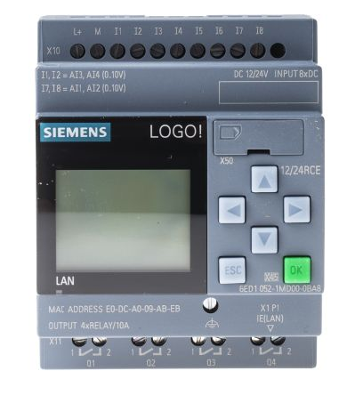
Control System
LOGO programmable logic controller :
This type of PLC is designed to be simple installation, minimum wiring , can easily implement small automation projects and lets you easily implement functions, such as time-delay switches, time relays, counters and auxiliary relays.

Slide 13
conveyor systems
Uses of the conveyor in this system
The system requires two conveyors of the belt conveyor type:
1) 1st one used for transmission of wood shavings from main hopper to weighing hopper and the conveyor belt contains small shelves to prevent skiing
2) 2nd one used to carry the ready plastic bag away from the machine ,and it does not contain shelves.

Slide 14
Machine Design

Slide 15
Machine design
This chapter presents :
the require function of the wood shavings packaging machine.
design of critical machine elements.
selection of standard component.
design the component of wood shavings packaging machine.

Slide 16
Require function of the wood shavings packaging machine
Require functions are :
closed bag of wood shavings.
produced wood shavings bag with a specific weight at a specific time.
reduce the labor force.
high quality in production

Slide 17
Design of critical machine elements
Two design method are commonly used for machine design :
The first is specifying the dimensions of every component according to the expected load on it.
And the second is roughly choosing part dimensions and then chick for the justification of safety.

Slide 18
Design of critical machine elements
To design a critical machine elements there are variables should know it :
Speed of the conveyor.
Density of the pine wood shavings.
Flow of the wood shaving from main hopper.
production rate.
Dimension of plastic bag.

Slide 19

Speed of the conveyor
The standard speed for most unit handling conveyors is 65 FPM, speed of the conveyor in mater per minute = 0.3048 * 65 = 19.8 and speed of the conveyor in mater per second = speed of the conveyor in mater per minute / 60 second = 0.33 m/s
Density of the pine wood shavings
Density of pine wood ranges from $370\frac{kg}{m^{3}}$ to $550\frac{Kg}{m^{3}}$
Density of wood shavings = 53% of wood density
So density of pine wood shavings = average density of pine wood * 53%
Density of pine wood shavings = $410\frac{Kg}{m^{3}}∗53\%$ = $217.3\frac{Kg}{m^{3}}$

Slide 20

Flow of the wood shaving from main hopper
Flow of the wood shaving from main hopper depending on the amount of the wood shavings drawn by the conveyor belt
The belt conveyor is divided into station where the station dimensions are (40*10*3)cm
So the flow of the hopper = number of station per minute * volume of station
The volume of station that have wood shavings = 37%* volume of station = $444 cm^{3}$
Number of station = the distance traveled by conveyor belt per minute / width of station = 198 $\frac{station}{minute}$
$flow=\left(444cm^{3}\right)∗198\left(\frac{station}{minute}\right)=87912 cm^{3}/minute$
$flow in Kg=0.087912 m^{3}∗217.3\frac{Kg}{m^{3}}=19.1 Kg/minute$

Slide 21

Production rate
Q = number of wood shavings bag / hour
One wood shavings bag need time for :
transfer wood shavings from main hopper to second hopper
3 second for welding
5 second the base of balance be opened
4second unload process
To transfer wood shavings of one bag need $\frac{5}{19.1}=0.2632 minute =15.8 second$
$$one bag need time=15.8+3+5+4=27.8 second$$
$$Q=128 bag per hour$$

Slide 22
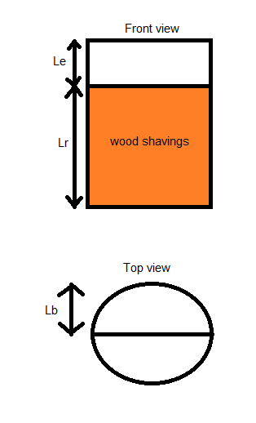

Dimension of plastic bag
Diameter of plastic bag = $(width of plastic roll−2 cm for welding)/π$
Diameter of plastic bag = 37.5 cm
The volume of the wood shavings
= $\frac{5 Kg}{217.3\frac{Kg}{m^{3}}}=0.02301 m^{3}$ = $23010 cm^{3}$
$$lr=\frac{V}{π∗r^{2}}=\frac{23010}{π∗{18.75}^{2}}=20.8 cm$$
Length of plastic bag = length for real volume +
length for two base + extra length
= 20.8 cm + 37.5 cm + 11.7 cm = 70 cm

Slide 23
Selection of standard component
Conveyor selection
Motor selection
Piston selection
Control system selection

Slide 24
Conveyor selection
Belt conveyer was selected because it’s easy to maintain , has less friction and noise , need less power and relatively inexpensive
Conveyor calculations :
Power calculations
Shaft calculations

Slide 25

Power calculations
The power needed by a conveyor motor is divided into two parts :
Power needed to rotate conveyor shafts
Power needed to move belt and wood shavings
Power needed to rotate conveyor shafts depends on:
$$T=I∗ α$$
And than:
$$P1=T∗ ɷ$$
$$P1=99.23 watt$$

Slide 26
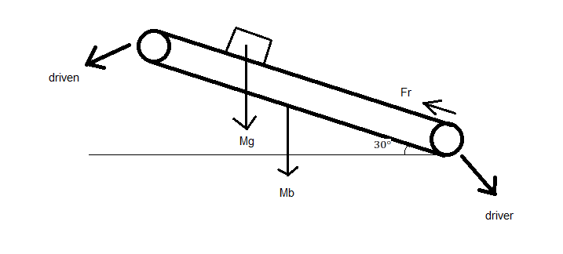

Power calculations
Power needed to move belt and wood shavings depends on:
$$T=r\left[\left(\left(Mb+Mg\right)∗\frac{α}{r}\right)+Fr\right]$$
$$T=F∗r$$
$$F=Fr+Fa$$
$$Fa=ma$$

Slide 27

Power calculations
$T=$ $91.37N.m$
$$P2=1434.5 watt$$
Total power :
$$Pt=P1+P2=1434.5+99.23=1533.74 watt$$
Power :
$$P=\frac{Pt}{efficiency}=1804watt$$
power needed in hp =$2.42 hp$

Slide 28

Shaft calculations
Stresses effect on shaft :
Torsional shear stress
Bending moment stress
Torsional shear stress :
$$Ss=\frac{T∗c}{J}$$
$$Ss=\frac{124.28∗0.0225}{0.4026}=6.946 MPa$$

Slide 29
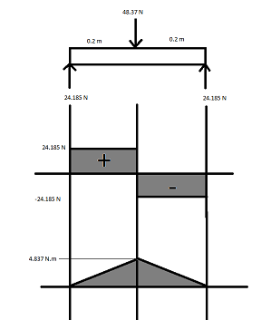

Shaft calculations
Bending moment stress
$$S=\frac{M∗c}{I}$$
$$S=0.541 MPa$$
Combined maximum shear stress
$$Ʈ={\left(Ss^{2}+{\left(\frac{S}{2}\right)}^{2}\right)}^{0.5}$$
$$Ʈ={\left({6.946}^{2}+{\left(\frac{0.541}{2}\right)}^{2}\right)}^{0.5}=6.948 MPa$$
Allowable shear stress for A307 is 82.5 MPa >>> Maximum shear stress 6.948 MPa so there is no danger on shaft

Slide 30

Motor selection
When selecting the motor must be determination:
Speed of the motor
Power of the motor
Speed of the motor
Speed of the motor should cause movement of the plastic roll (70 cm during 2 second)
The diameter of the wheel that cause movement = 4.5 cm
So the circumference of the wheel = π * D
$$circumference of the wheel = π∗4.5=14.13 cm$$
70 / 14.13 = 4.954 rotation per 2 second
$$≈150 RPM$$

Slide 31
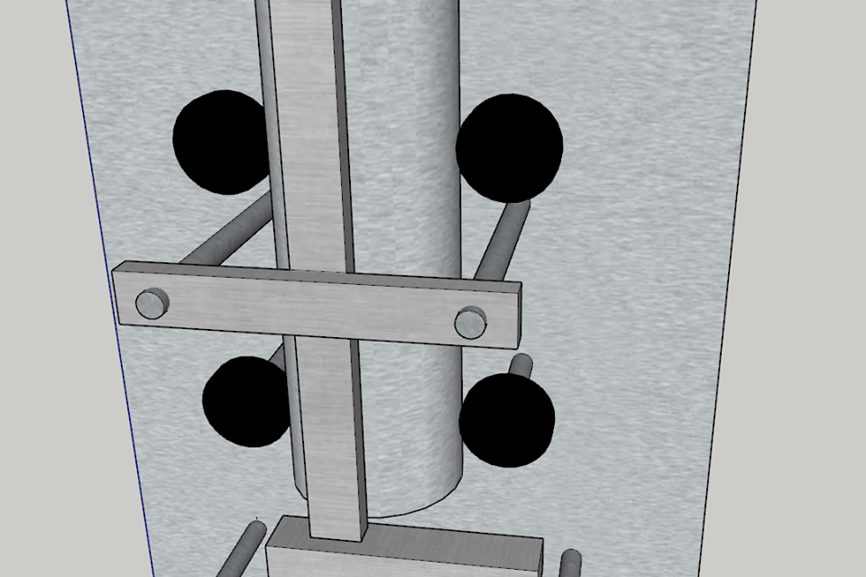
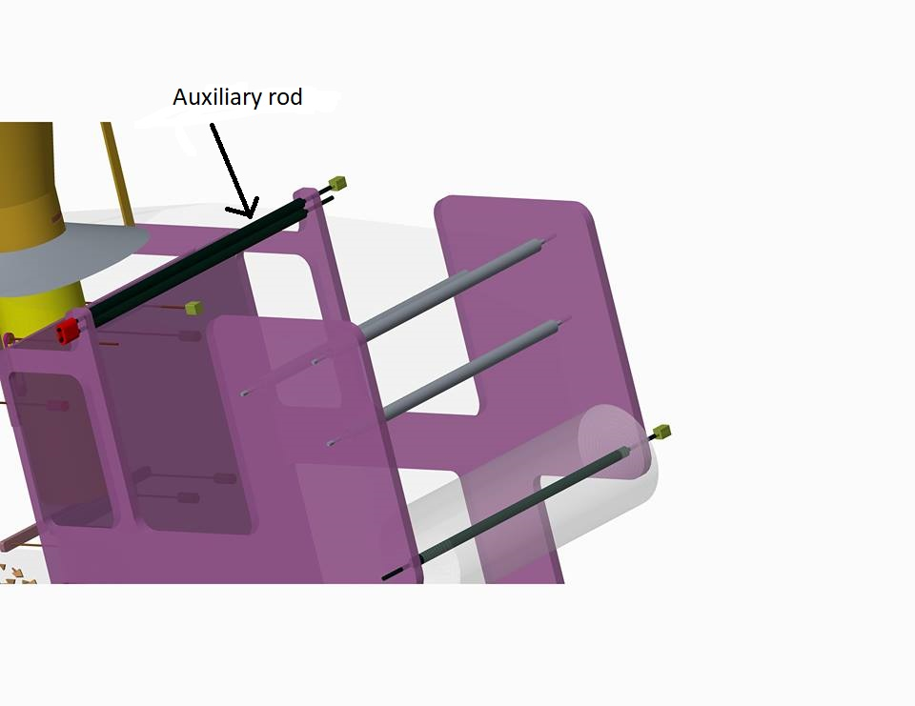

Motor selection
Power of the motor
The motor will support :
Four wheel
Four rod that holed the wheel
Two auxiliary rod
Plastic roll
$$power in horse=1.68 hp$$

Slide 32
Piston selection
When choosing a piston should consider the following :
length of stroke
Speed of the piston
Pressure available
force required
force required = friction coefficient * weight
F = µN
Such as compact cylinders AND
F = 0.018*(4650*9.81)= 824 N < 1178 N

Slide 33
Control system selection
When choosing a PLC should consider the following :
number and type input and output of the system
program size
scan time
The system needs to :
54 block (Function)
11 input two of them are analog and 9 are digital
6 output all of them are digital

Slide 34
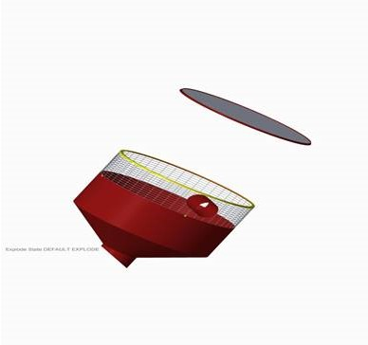
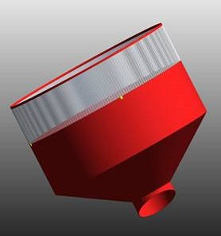
Design Components
Main Hopper
  Net and Galvanized steel

Slide 35
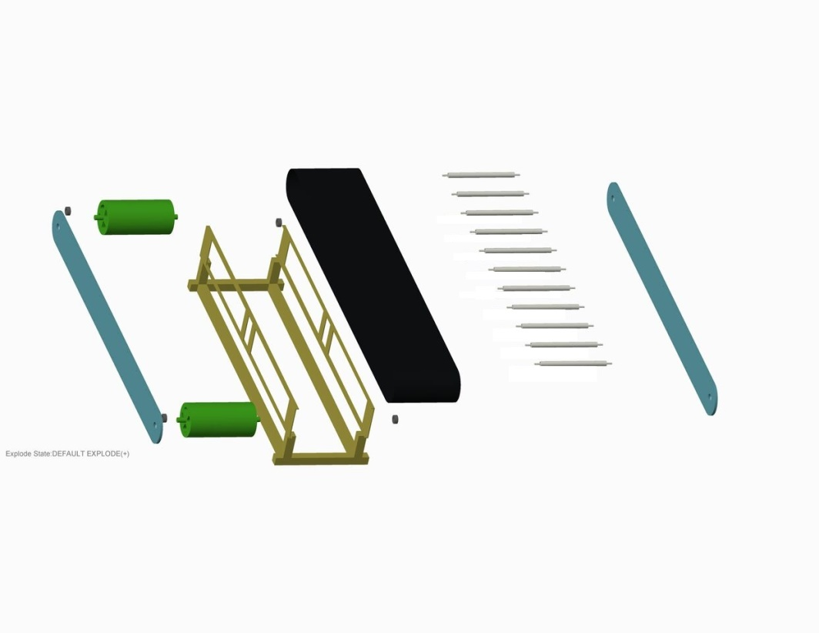
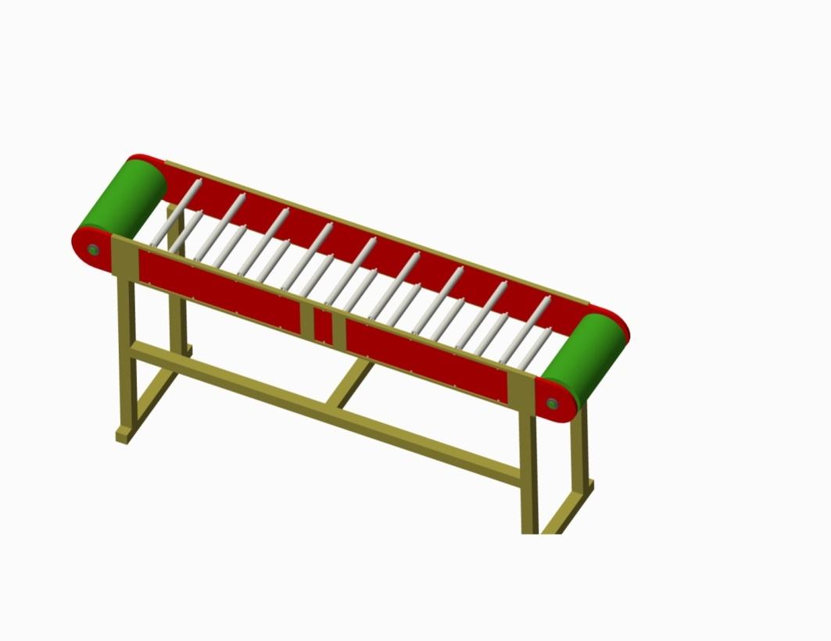
Design Components
Conveyer system
  2 main shafts, 18 secondary shafts, a belt, and a motor

Slide 36
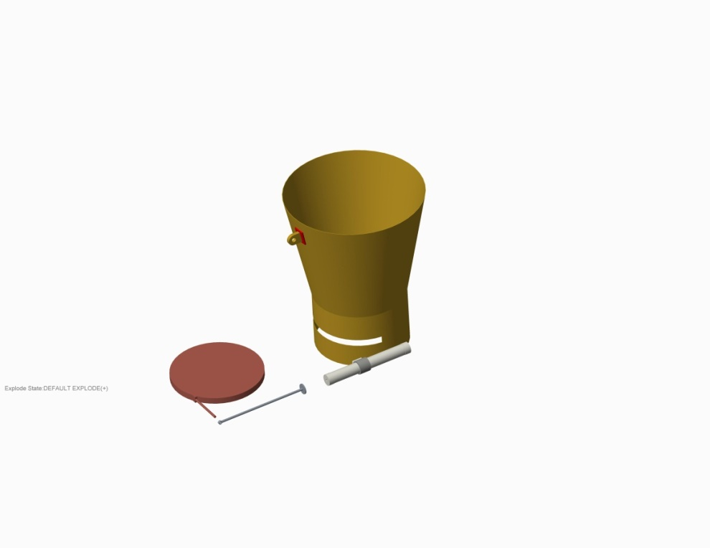
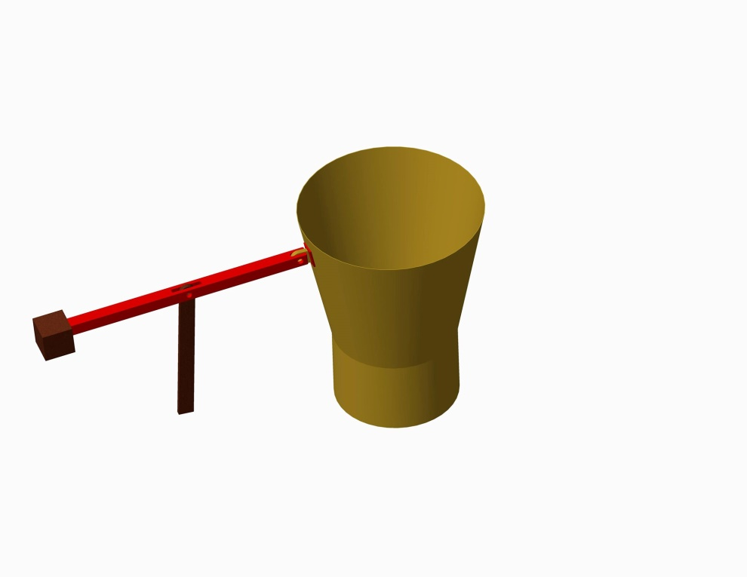
Design Components
Weighing mechanism
  two pieces of galvanized steel

Slide 37
Design Components
Structure of machine
  One of the most important things to consider is the design and construction of a suitable and strong external structure, so that it installs and holds all parts of the machine properly

Slide 38
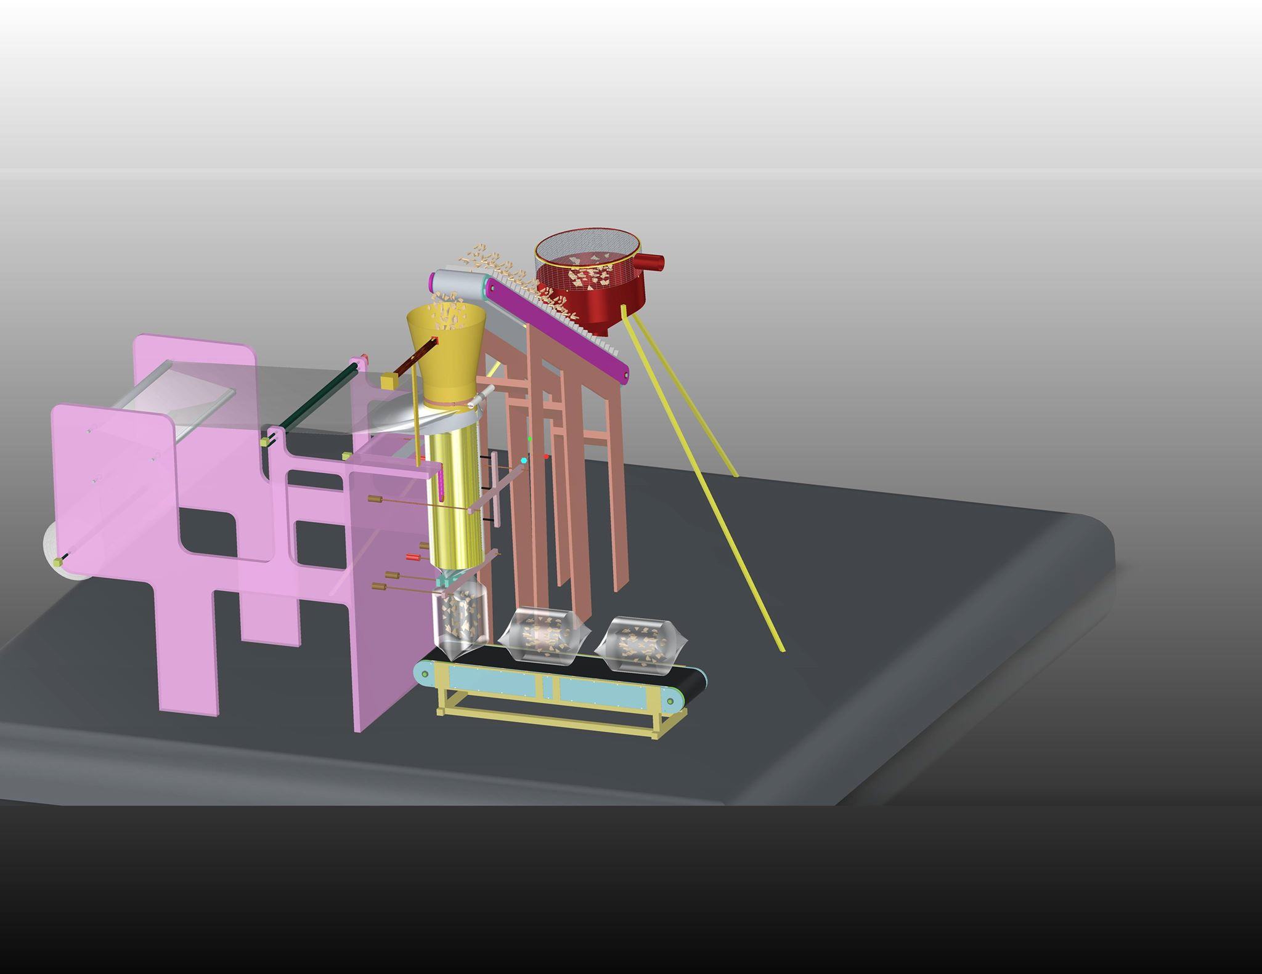
Design Components
Structure of machine

Slide 39
Manufacturing of the machine

Slide 40
Manufacturing of the machine
This Chapter present :
1- Manufacturing Operation
2- Sequence of Assembly operation
3- Bill of material

Slide 41
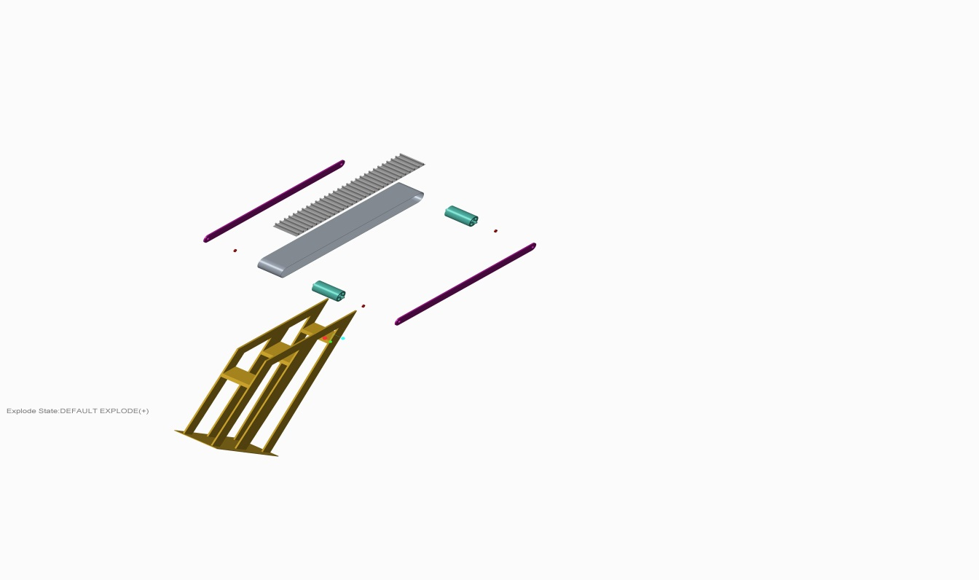
Manufacturing Operation
This section shows the manufacturing operation that where needed to produce machine parts and elements , and it shows all dimensions of the all parts to be used in the machine.

Slide 42
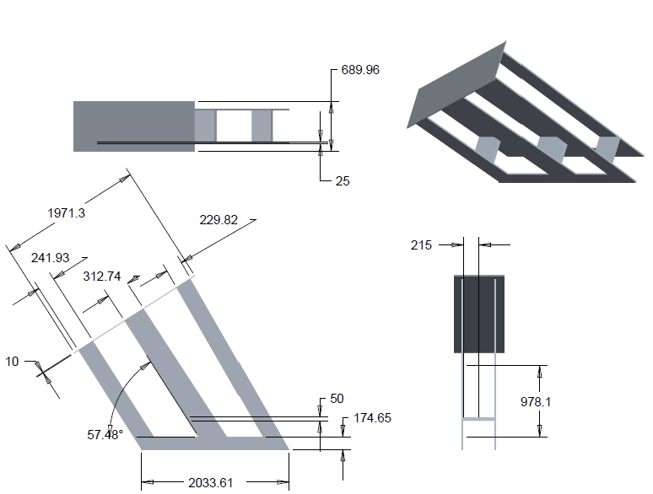
- Main body for the base of main conveyer
- The process that was used to produce this part is welding

Slide 43
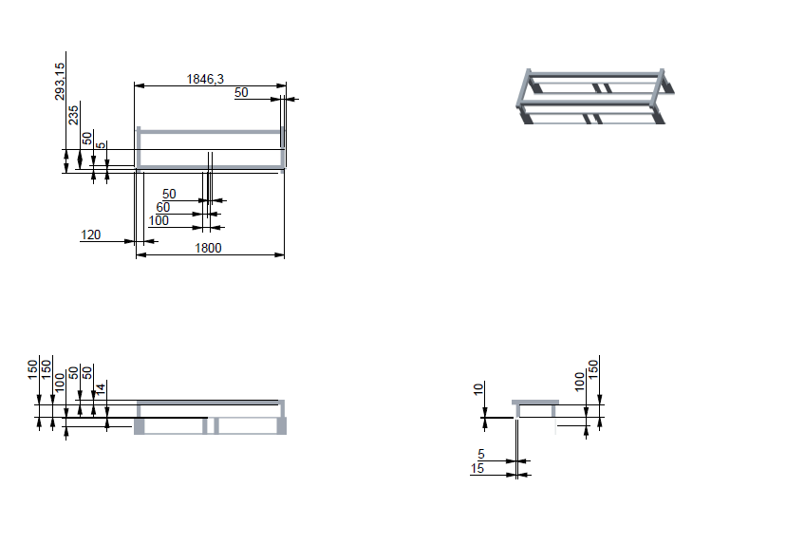
- Main body for the base of second conveyer
- The process that was used to produce this part is welding

Slide 44
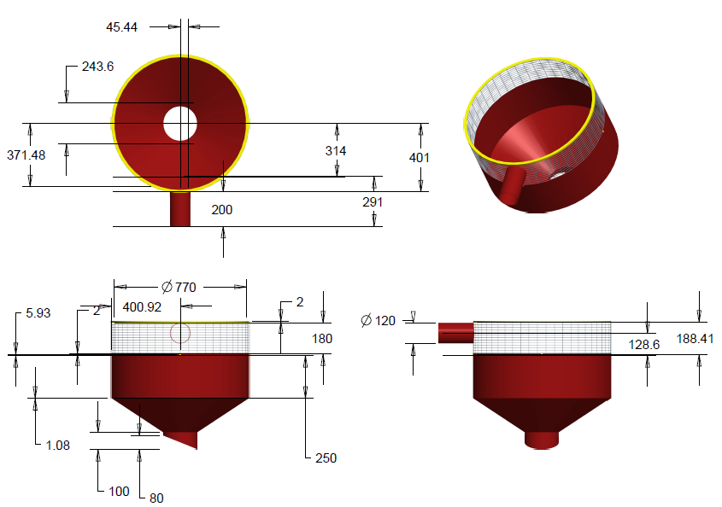
- Main body for the main hopper
- The process that was used to produce this part is bending and welding

Slide 45
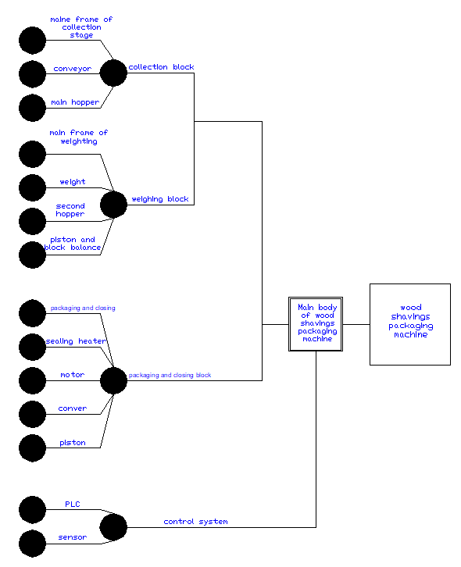
Sequence of Assembly operation
Figure 1 Assembly chart

Slide 46
Bill of materials
A bill of materials is a list of all the materials, components , parts, and sub-assemblies needed to create a product .
A bill of materials is most commonly used in manufacturing or engineering projects to create physical products .

Slide 47
PART NUMBER | PART NAME | DESCRIPTION | QTY | UNITS | UNIT COST $ | AMOUNT $
A01 | Galvanized Steel | Used in the manufacture of Hopper thickness of 2 mm | 4.0 | M^2 | 66 | 267
A02 | Screws | Used for installation | --- | QTY | 10 | 10
A03 | Wire mesh | Place on top of the hopper | 2 | M^2 | 14 | 28
A04 | Belt of conveyor | Use a conveyor | 2 | QTY | 10 | 20
A05 | shaft | Used in the bag closing phase 130cm | 1 | M | 60 | 60
A06 | Piston | Until the sealing heater is pushed | 3 | QTY | 65 | 195

Slide 48
A07 | sealing heater | Used in plastic bag welding | 2 | QTY | 110 | 220
A08 | wheel | Until the nylon is pulled | 4 | QTY | 10 | 40
A09 | motor | Operation System and Conveyors | 2 | QTY | 100 | 200
A10 | air valve | Take the signal from PLC and open the air to the piston | 3 | QTY | 40 | 120
A11 | Conveyor belt | The process of moving the wood shavings from the main hopper into the sub and the bag was moved to Pallet 220*40 cm 300*40 cm | 2 | QTY | 720 860 | 1580
A12 | Steel | Building the structure | 12 | M | 15 | 180
A13 | Belt | To increase nylon pull strength by increasing the contact distance | 2 | M | 12 | 24
A14 | Iron bar | Connect the sub-hopper with the equivalent weight | 1 | M | 25 | 25
A15 | Standard blocks | Balance the weight | 5 | Kg | 10 | 10
A16 | PLC | adapted for the control of manufacturing processes, | 1 | QTY | 200 | 200

Slide 49
A17 | Sensors | to detect events or changes in its environment and send the information to other electronics | 2 | QTY | 25 | 50
A18 | Control Panel | where control or monitoring instruments are displayed or it is an enclosed unit that is the part of a system that users can access | 1 | QTY | 100 | 100
A19 | electric Wire | Networking and Connectivity | 10 | M^2 | 10 | 100
A20 | Control Switches | To control the operation and stop | 1 | QTY | 75 | 75
 |  |  |  |  | Total | 3504$

Slide 50
Feasibility Studies

Slide 51
The selection of this project in the framework of the development of the poultry sector in particular in Palestine, and supply the Palestinian market with sufficient quantities of wood shavings.
Feasibility Studies
The idea of this project automatic wood shavings is inspired by the search for the treatment of a problem already exist in the market.
Where the problem is centered on:
the large number of workers
less productive capacity
lower quality
lost time and cause serious health problems for workers
The problem was addressed through the automation of the production line.

Slide 52
Social impacts of the project
1.Rising job opportunities with the expansion in the future
2. Dispense with the Israeli product
3. Poultry sector development

Slide 53
Ramp up Cost :
Type | Amount $
Material Cost | 3504
Manufacturing Costs | 2000
Depreciation Rate(10%) | 350
Operating Costs :
 | Number | Cost $
Insurance | 1 | 250
Labor | 1 | 9000
Type | Unit price $/ ton | Amount / year | Total cost $
Raw Materials | 430 | 1600 | 688000
Electricity expenditure
 | Amount $
Electricity expenditure | 1000

Slide 54
Marketing and supporting cost :
Type | Amount $
Marketing and Advertising | 1000
Maintenance Cost :
Maintenance Cost | 200 $
Rent Cost:
Rent The Building Cost | 500$
Over head Cost :
Over head Cost | 500$
TOTAL COST | 706304 $

Slide 55
Breakeven Point Analysis:
Production rate per Year =2.15*60*8*26*12 = 320486 bags
Fixed cost = 8054$
Variable cost = 698250$
Variable cost / unit = 698250 / 320486 =2.17 $/ bag
$/unit sales price = 3.14$
Q (BEP) = Fixed cost / (Price sales unit - variable cost unit )
Q (BEP) = 8054 / (3.14-2.17)
= 8303 Bags
Payback Period
Payback Period = Investment cost / Cash Inflow per Period
Payback Period =706304 / 310871
= 2.27 year.
Return on Investment (ROI)
ROI = (Gain from Investment - Cost of Investment) / Cost of Investment
= ((320486*3.14)-(706304)) / (706304)
= 42%

Slide 56
After a study of the project showed that the project is successful, but we have to be careful and always work in continuous development because the Israeli competition is strong so that we can continue to market.
Thus, based on the analysis of the calculations, we conclude that the capacity of the machine is approximately 1000 bags per day (within 8 hours.)
The capacity of wood cutting machine has about 200 bags per day, so we need to cover the capacity of wood packing machine 5 wood cutting machines
If you require the same amount of production machine packing 1000 bags per day, you need 5 wood cutting machines and each machine needs 12 square meters, about 60 square meters to fill wood shavings and need 4 workers at least.
The packing machine provides the space used for manual packing and therefore we use it in storage ,and also reduce the costs of workers.
Type cost | Number | Salary every month | Total cost $
Labor | 4 | 750 | 36000
Insurance | 4 | 200 | 800
 |  | Total | 36800

Slide 57
Conclusion & Recommendation

Slide 58
Conclusion
he design of a wood shavings packaging machine for Dawood company for Artificial fire wood to help them achieve the maximum benefit the machine helps in increasing production rate , decreasing number of workers , Reduce time , Improve the safety of workers and reducing operation costs
In the course of the project, the team gained practical experience in a control system and Electrical circuits such as PLC, the team gain experience in mechanical drawings for computer software applications such as Solidwork and AutoCAD
based on the analysis of the calculations, we conclude that the capacity of the machine is approximately 1000 bags per day (within 8 hours)
Thus, the existence of the filling machine will save us a lot of time, money and manpower and will increase our production capacity ,Our quality will improve and we will be able to compete in the market during the capacity to increase production, and its output rate within an hour is approximately 128 bags.

Slide 59
Conclusion
Including a simple weighting system uniting all exit bags with 5 Kg
Using an accurate packaging method
Designing the electrical and the mechanical systems using some devices and elements such as DC motors and position sensors
An air compressor is added to the packaging system
The whole procedure will be controlled by a specific computerized system using PLC

Slide 60
Recommendation
We have recognize from this project that using this machine decreases the production costs and the number of workers , Also , it increases the productivity and the usage of large area that were used for packing , as it changed to be used for storing .Also after doing the economical feasibility study.
It appears clearly that is the successful and profitable project which increases the profits . So that , we suggest to Dawood company start manufacturing the in using them in production process

Slide 61


