Slide 1


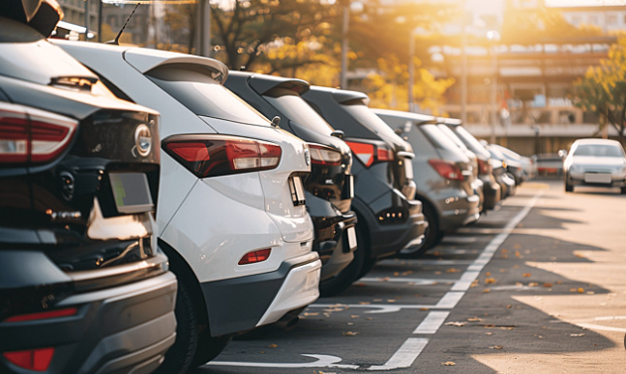

ParkNear App
Innovating the Parking Experience in Palestine
Prepared by :
Wala’a Nafa’a
Sara Odeh
Supervisor: Dr. Ahmad Shraideh
2024/2025

Slide 2
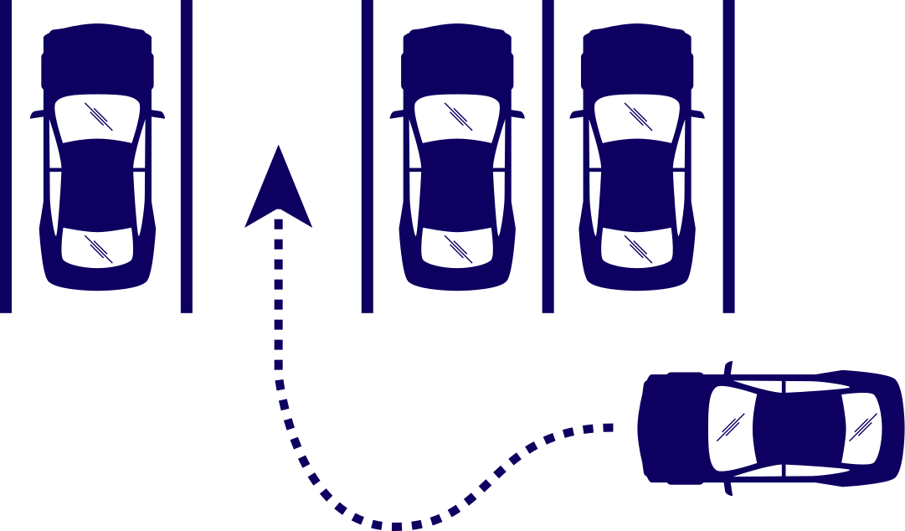
Idea
1
Index
Problem
2
Solution
3
How it work
4
Technology used
5
Functionality
6

Slide 3

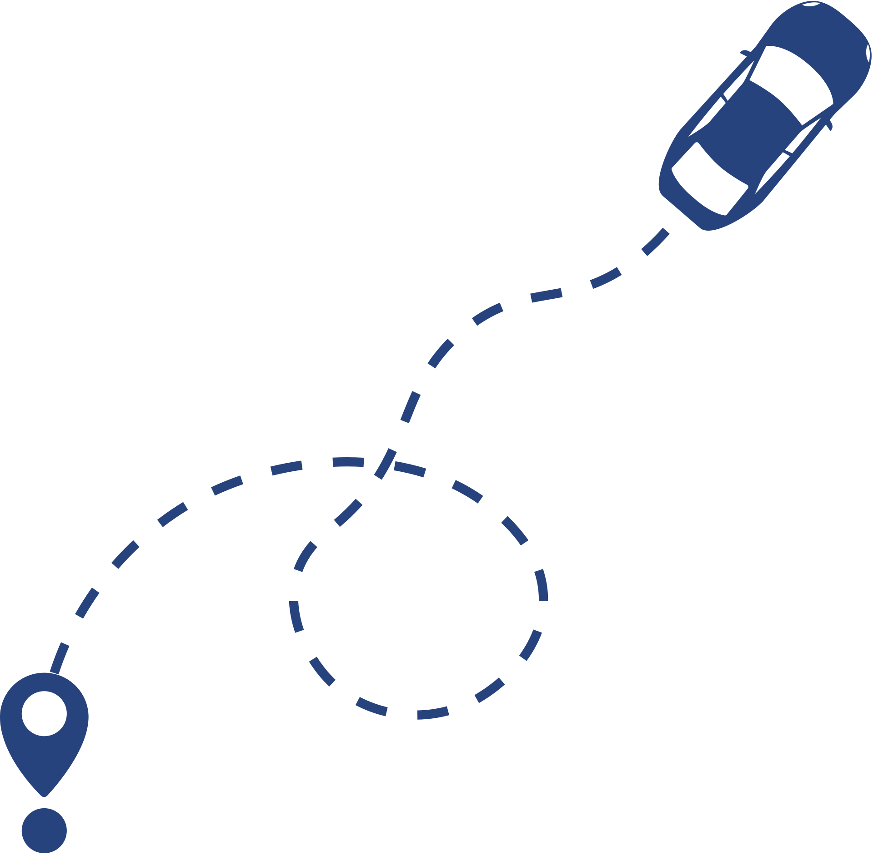

Idea
ParkNear helps citizens find the nearest available parking spots using a real-time reservation system.

Slide 4
Problem
1
3
5
Environmental pollution
Difficulty Finding Available parking
Cost Issues
2
4
Time-Consuming
Searches
Traffic congestion

Slide 5
The Solution :
ParkNear is a mobile application designed to simplify the process of finding and booking parking spaces in Nablus city.

Slide 6

How ?
user's current location
App uses real-time data
nearest available parking spots
booking options and prices

Slide 7


The technology used :
Power App
Low - code
Support By GPS
Easy to learne
Connect to Database (SharePoint)

Slide 8
Functionality
User Registration/Login
Reservation system
Location and Nearby Parking
Automated Check-In and Check-Out

Slide 9
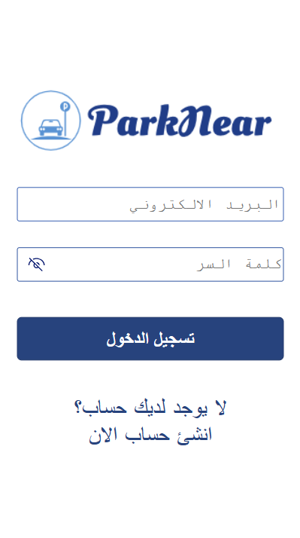
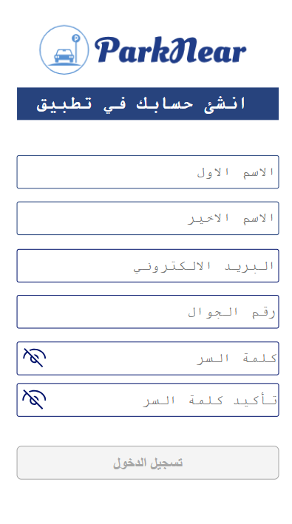
Registration and
Login

Slide 10
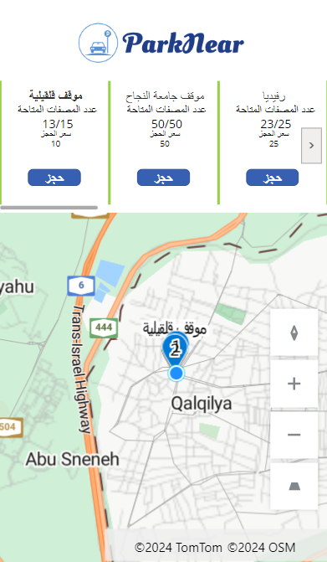
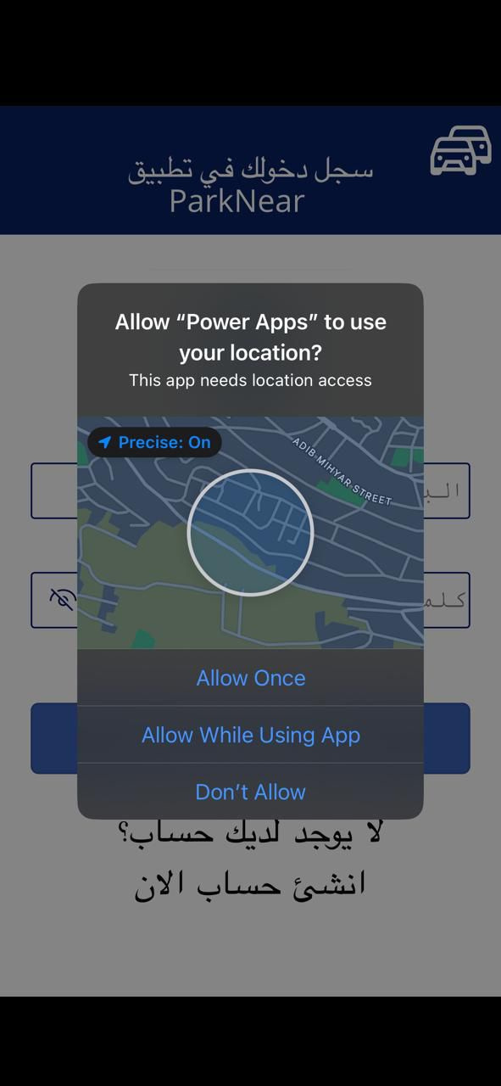
Location and Nearby Parking

Slide 11
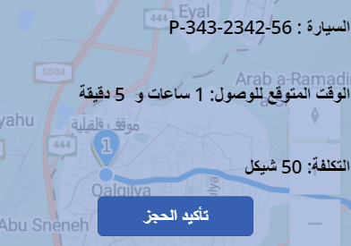
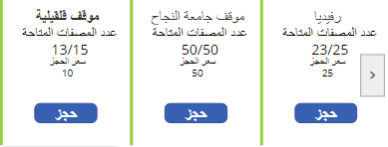
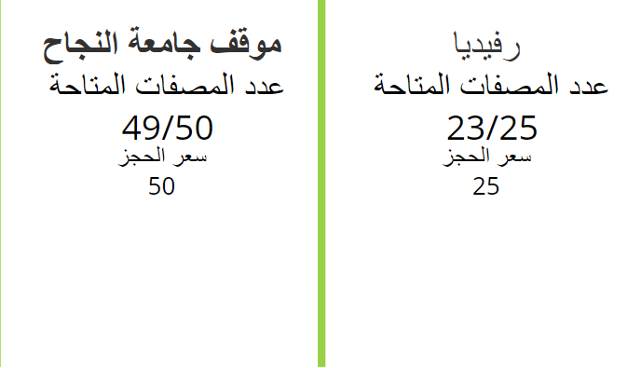

Reservation system

Slide 12
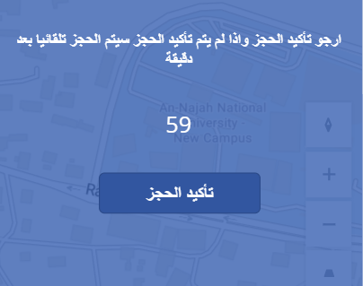
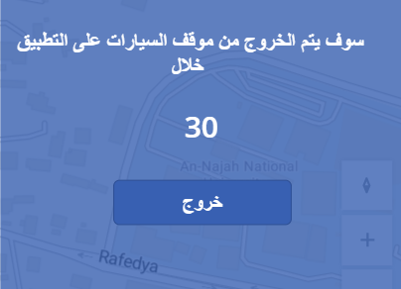
Automated Check-In and Check-Out

Slide 13
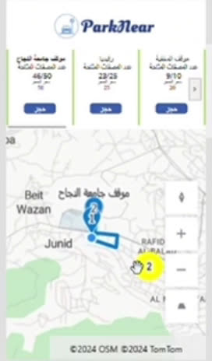
Automated Check-In and Check-Out

Slide 14

Future work
Public parking in Nablus
Export to Google play and App stores
Payment method

Slide 15
Thank you

