Slide 1

Presented by:
Sawsan Qasem
Ghada Adnan
Rana Jawabry
Submitted to:
Dr. Yousef Dama
“ PAPR Reduction using SLM & PTS ”

Slide 2
Outlines:
Introduction to PAPR
Background.
PAPR Reduction Algorithms.
SLM(Sellective Mapping )
PTS(Partial Transmit Sequence)
MATLAB Results.

Slide 3


Peak-to-Average Power Ratio in OFDM System
where Xn is expressed as:
Notes:
Where Ppeak represents peak output power, P average means average output power. E ∙ denotes the expected value; Xn represents the transmitted OFDM signals which are obtained by taking IFFT operation on modulated input symbols Xk

Slide 4
Factors Effecting PAPR:
Number of sub carriers
Modulation Order
Modulation | PAPR
m-PSK (reference) | 0dB
16-QAM | 2.55dB
64-QAM | 3.68dB
256-QAM | 4.23dB
256-QAM(modified) | 2.85dB

Slide 5
Background of the Problem
High PAPR is one of the most serious problems in MIMO-OFDM system.
To transmit signals with high PAPR, it requires power amplifiers with very high power scope.
To combat high PAPR, one intuitive solution is to adopt amplifiers to have larger trade-off range. However, these types of amplifiers are generally expensive and have low efficiency.
On the other side, certain algorithms were introduced and been proved have a good performance of high PAPR reduction.
Notes:
If there are no measures to reduce the high PAPR, MIMO-OFDM system could face serious restriction for practical applications.

Slide 6
PAPR Reduction technique:
Signal Scrambling Techniques
• Selected Mapping (SLM)
• Partial Transmit Sequence (PTS)
• Interleaving Technique
• Tone Reservation (TR)
• Tone Injection (TI)
Signal Distortion Techniques
• Peak Windowing
• Envelope Scaling
• Peak Reduction Carrier
• Clipping and Filtering

Slide 7
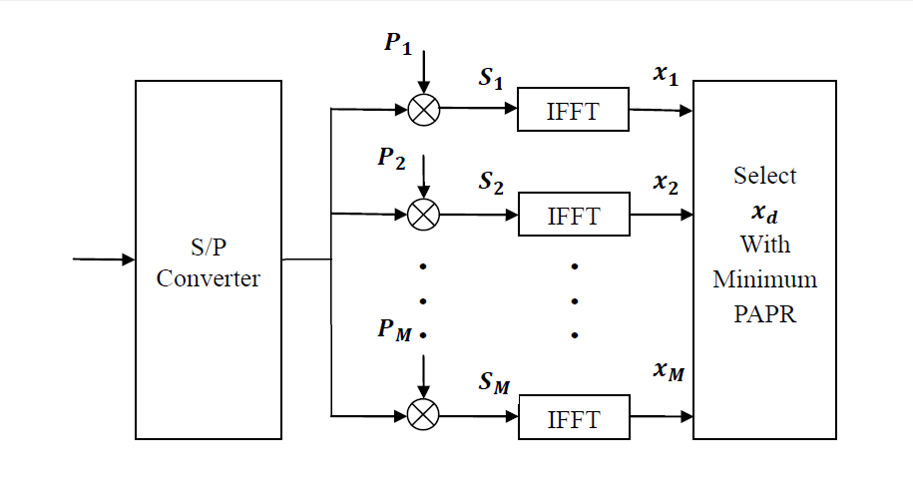
Selective Mapping (SLM)
The idea of selective mapping is simple: partition all possible signals to subsets and pick from each subset a representative with the minimum PAPR.

Slide 8
The key point of selected mapping method lies in how to generate multiple OFDM signals when the information is the same.
First, defined different pseudo-random sequences,
Pm =[Pm,0,Pm,1,…,Pm,N-1] ^{T} , m=1,2,…,M where
Pm,n= and stands for the rotation factor. Pm,n is also known as the weighting factor. φm,n is uniformly distributed in [0 2π].
The process can be performed as a dot product operation on a data block Xn with rotation factor Pm.

Slide 9
Simulation of SLM Scheme
PAPR reduction using SLM is affected by :
1- route number M
2-subcarriernumber N

Slide 13
PAPR (dB) for SLM for different values of M and N
 | PAPR(dB)
N | 64 | 128 | 256 | 520 | 1024
Origin | 10.74 | 11.62 | 11.03 | 11.61 | 11.4
M=2 | 9.214 | 9.262 | 9.876 | 10.06 | 10.82
M=4 | 8.081 | 8.579 | 9.117 | 9.457 | 9.811
M=8 | 7.461 | 7.944 | 8.552 | 8.965 | 9.305
M=16 | 7.023 | 7.577 | 8.009 | 8.53 | 8.989

Slide 14
SLM PAPR reduction efficiency for different values of M and N
 | SLM PAPR reduction efficiency
N | 64 | 128 | 256 | 512 | 1024
M=2 | 14.209 % | 20.29 % | 10.46 % | 13.35 % | 5.09 %
M=4 | 24.76 % | 26.17 % | 17.34 % | 18.54 % | 13.94 %
M=8 | 30.53 % | 31.64 % | 22.47 % | 22.78 % | 18.38 %
M=16 | 39.56 % | 34.79 % | 27.39 % | 26.53 % | 21.15 %

Slide 15
Partial Transmit sequence (PTS)
Is one of the most important techniques for reducing the peak to average power ratio (PAPR) in OFDM systems.
The basic idea of partial transmit sequences algorithm is divide the original OFDM sequence into several sub-sequences , and for each sub-sequence , multiplied by different weights until an optimum value is chosen .

Slide 16
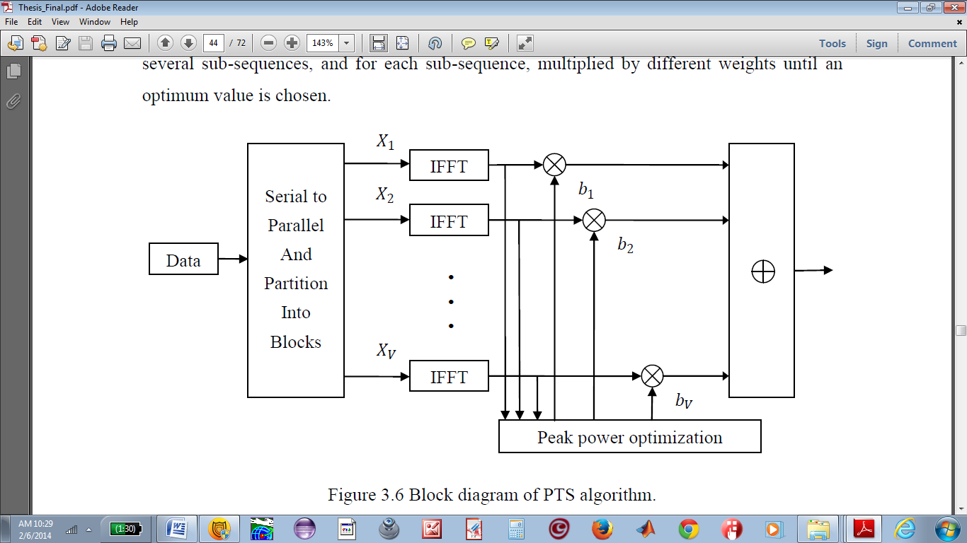
Partial Transmit sequence (PTS)

Slide 17
Results of PTS

Slide 19
Comparison of SLM and PTS Algorithm
Comparison of auxiliary information.
Comparison of PAPR reduction performances between SLM and PTS method

Slide 20
Comparison of PAPR reduction performances between SLM and PTS
The above fig . With V=M=4

Slide 21
Elapsed time for SLM with different values of N
Number of sub-carriers | Elapsed time(SLM)
N=64 | 4:11 minutes
N=128 | 4:10 minutes
N=256 | 4:12 minutes
N=512 | 4:27 minutes
N=1024 | 4:56 minutes

Slide 22
Elapsed time for PTS with different values of N
Number of sub-carriers | Elapsed time(PTS)
N=64 | 15 minutes
N=128 | 15 minutes
N=256 | 17 minutes
N=512 | 20 minutes
N=1024 | 22.30 minutes

Slide 23
PAPR (dB) for PTS for different values of V and N
 | PAPR(dB) PTS
N | 64 | 128 | 256 | 512 | 1024
Origin | 10.41 | 10.58 | 10.73 | 11.16 | 11.5
V=2 | 8.463 | 8.629 | 9.101 | 9.532 | 9.642
V=4 | 6.276 | 6.825 | 7.394 | 7.812 | 8.237

Slide 24
PTS PAPR reduction efficiency for different values of V and N
 | PTS PAPR reduction efficiency
N | 64 | 128 | 256 | 512 | 1024
V=2 | 18.7 % | 18.44 % | 15.18 % | 14.59 % | 16.16 %
V=4 | 39.71 % | 35.49 % | 31.09 % | 30 % | 28.37 %

Slide 25
SLM PAPR reduction efficiency for different values of M and N
 | SLM PAPR reduction efficiency
N | 64 | 128 | 256 | 512 | 1024
M=2 | 14.209 % | 20.29 % | 10.46 % | 13.35 % | 5.09 %
M=4 | 24.76 % | 26.17 % | 17.34 % | 18.54 % | 13.94 %
M=8 | 30.53 % | 31.64 % | 22.47 % | 22.78 % | 18.38 %
M=16 | 39.56 % | 34.79 % | 27.39 % | 26.53 % | 21.15 %

Slide 26
Space Time Block Coding
Alamouti Space-Time Code:
Alamouti scheme is the first space-time block code scheme that provides full transmit diversity for systems with two transmit and one receive antennas It is a unique scheme in that it is the only space-time block code with an nT x nT complex transmission matrix to achieve the full rate of one

Slide 27
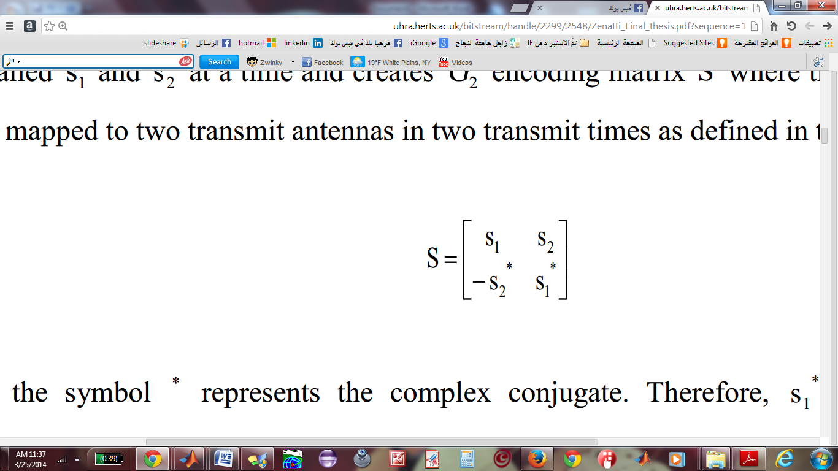
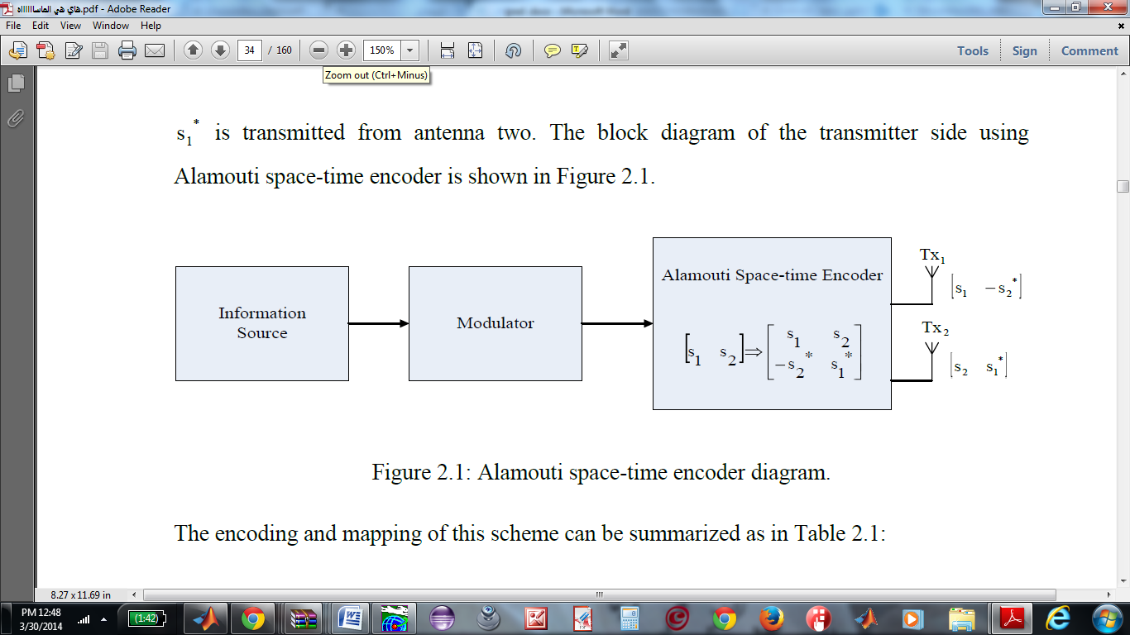
Notes:
Where the symbol * represents the complex conjugate. Therefore, s1* is the complex conjugate of s1. The encoders outputs are transmitted in two consecutive transmission periods from the two transmit antennas. In the first transmission period, the signal s1 is transmitted from antenna one and the signal s2 is transmitted from antenna two, simultaneously. In the second transmission period, the signal - s2* is transmitted from antenna one and the signal s1 is transmitted from antenna two.

Slide 28
The encoding and mapping of this scheme can be summarized as in this table
 | Tx1 | Tx2
t | S1 | S2
t+T | -S2* | S1*
Where t represents the transmission symbol period, Tx1 and Tx2 are the first and second transmit antennas. The transmit sequence from antennas one and two denoted by s¹ and s² are encoded in both space and time domains.
s¹= [s1 -s2*]
s²= [s2 s1*]

Slide 29
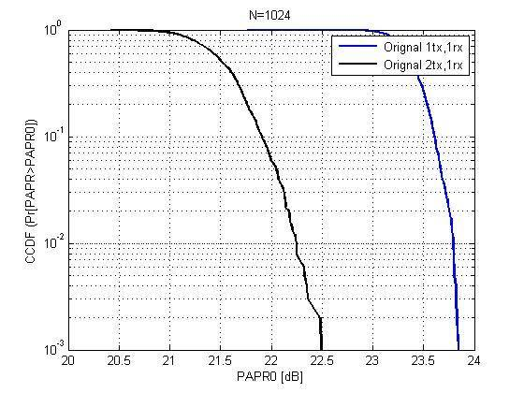
the following result show the effect of adding STBC to the system in existence SLM and PTS algorithms
PAPR in MISO and SISO systems is shown in this figure
Notes:
When we implement the system (OFDM) by using STBC we notice that there is some enhancement in PAPR

Slide 30
The effect of STBC and PAPR reduction techniques:
1-SLM using STBC
Notes:
: simulation of PAPR using SLM with N=1024 and different values of M by using SISO versus MISO system

Slide 31
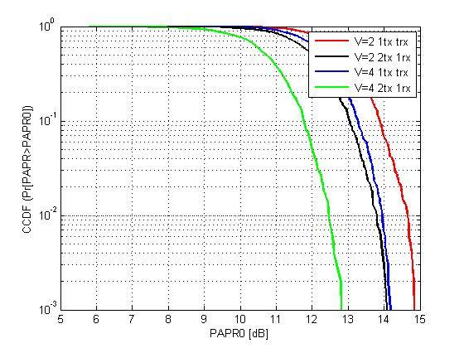
2-PTS using STBC

Slide 32
Conclusion:
High PAPR is main problem assisted with OFDM system.
There are many algorithms to reduce PAPR like, PTS and SLM.
PTS is more efficient in term of PAPR reduction ,but in expend of complexity.

Slide 33
Thank you

