Slide 1




2024
SELF-HEALING CONCRETE

Slide 2

ACKNOWLEDGEMENTS
We express our deepest gratitude to all who contributed to our civil engineering graduation project. Special thanks to our project advisor, Dr. Mohammad Samaaneh, for his invaluable guidance and support, and to Eng. Sameer Halaweh for his assistance in the experimental process. We are also grateful to Dr. Abd al-Fatah Al-Mallah for his constructive feedback. Finally, we thank our families and friends for their unwavering encouragement. Your support has been instrumental in our success. Thank you.
An-Najah National University

Slide 3
ABSTRACT
  Self-healing concrete aims to reduce cracks, minimize crack width, and maintain structural integrity without compromising strength, thereby extending the lifespan and reducing maintenance costs.
  In this study, we used wastewater containing bacteria from a WWTP in Nablus, Palestine, in various mixing percentages in our concrete samples. We conducted tests on compressive and tensile strength, flexural strength, and abrasion, comparing results with standard specifications.
  Our goal is to induce cracks and observe the self-healing process over time.
An-Najah National University

Slide 4
INTRODUCTION TO SELF-HEALING CONCRETE
  Concrete is widely used in construction for its strength, durability, and versatility.
  Cracks are a common problem in concrete, potentially leading to larger failures.
  Cracks develop during the hardening phase and over decades, especially in damp environments.
  This project aims to create a self-healing concrete mix.
  We use treated wastewater in the mix to achieve self-healing properties.
An-Najah National University

Slide 5
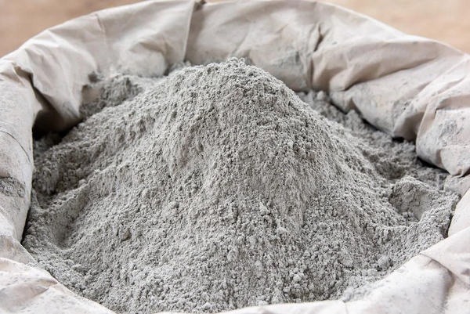
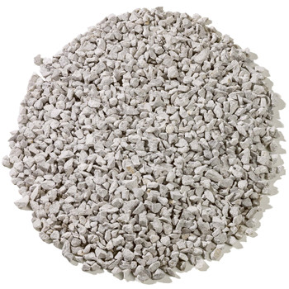
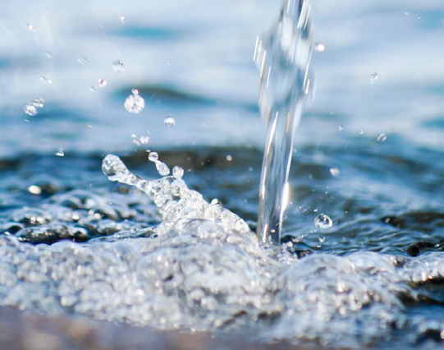
MATERILAS
Cement
Aggregates
Water
An-Najah National University

Slide 6
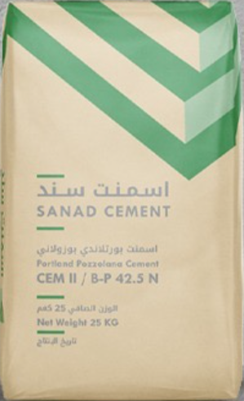
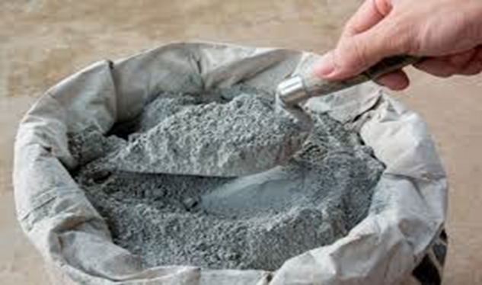
CEMENT
  The cement used in the experimental work is Composed Portland cement (CEM I 42.5 N).
An-Najah National University

Slide 7
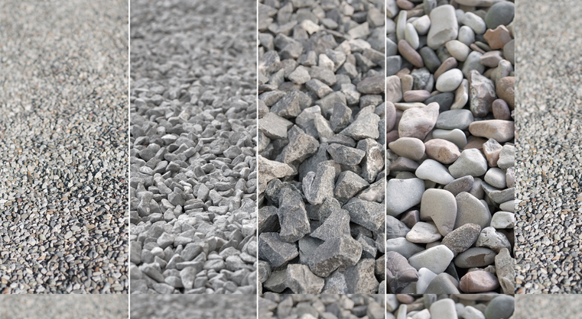
AGGREGATES
  Fine and coarse aggregates were used according to the ASTM C136 reference. Crushed limestone aggregates with a maximum 25 mm.
An-Najah National University

Slide 8
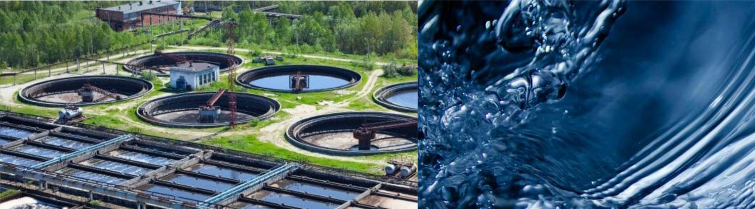
WATER
  Potable tap water was used for the sample either completely or with different proportions with WW.
An-Najah National University

Slide 9
WASTE WATER
  In our project, we develop self-healing concrete using treated water and we will study the effect of wastewater on concrete
  We collected around 60 liters of treated water from the Nablus West treatment plant.
  To study the effect of treated water on this type of concrete we make three concrete mixes (100% of pure water, 100% of treated water, and 50% treated 50% pure)
An-Najah National University

Slide 10
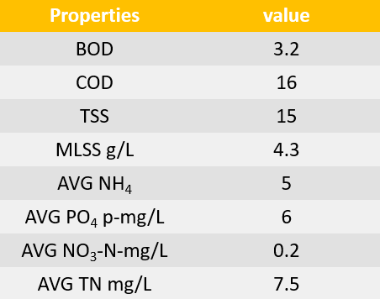
PROPERITIES OF WATER WE USED
  We take these results from the Nablus West treatment plant
  The pH for water Equals 7.35
  In this project COD/BOD = 16/3.2 = 5
An-Najah National University

Slide 11
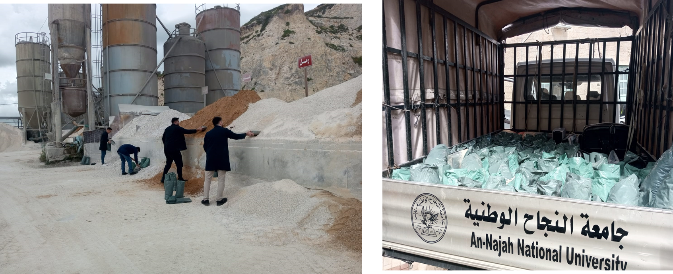
MATERIALS PREPARATION
An-Najah National University

Slide 12
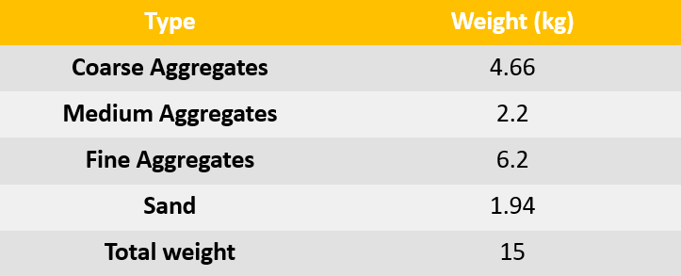
MATERIALS PREPARATION
  Sieve analysis:
An-Najah National University

Slide 13
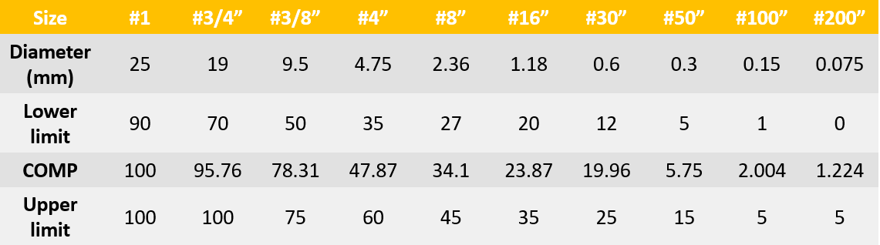
MATERIALS PREPARATION
  Sieve analysis:
An-Najah National University

Slide 14
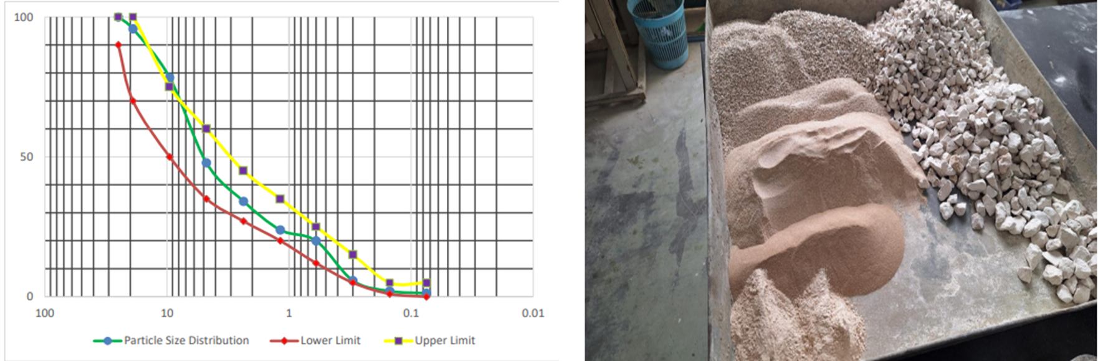
MATERIALS PREPARATION
  Sieve analysis:
An-Najah National University

Slide 15
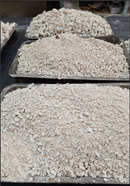
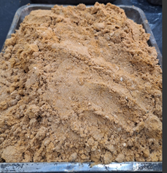
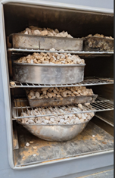
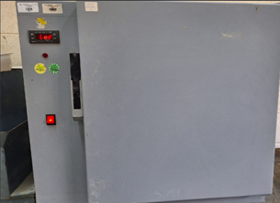
MATERIALS PREPARATION
  Absorption rate:
An-Najah National University

Slide 16
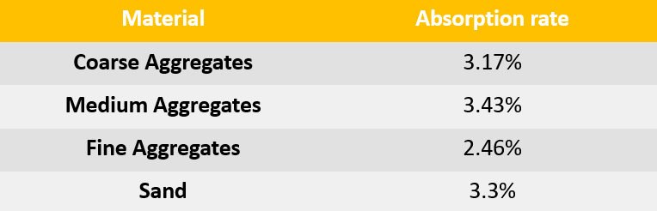
MATERIALS PREPARATION
  Absorption rate:
An-Najah National University

Slide 17
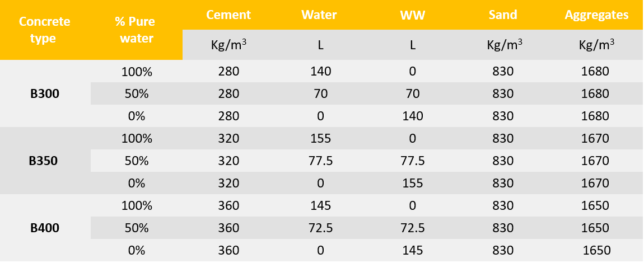
MIX PROPORTIONS OF CONCRETE MIX
An-Najah National University

Slide 18
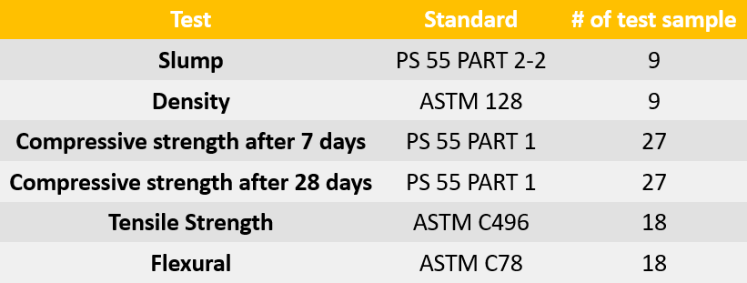
TESTING METHODOLOGY
  The following table illustrates the details of tests operated on samples :
An-Najah National University

Slide 19
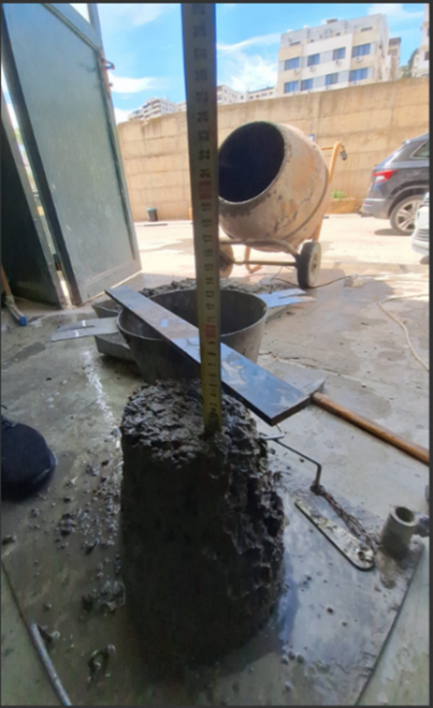
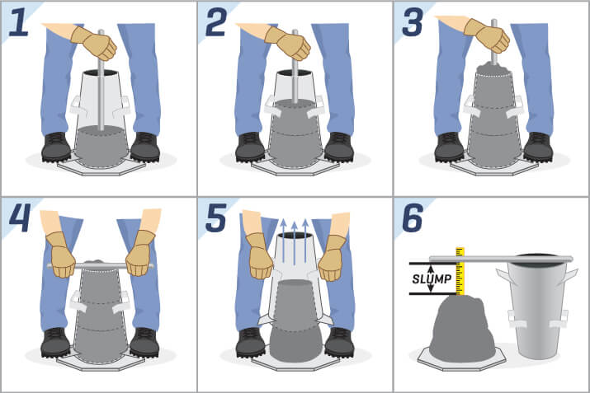
TESTING METHODOLOGY
  The slump test.
An-Najah National University

Slide 20
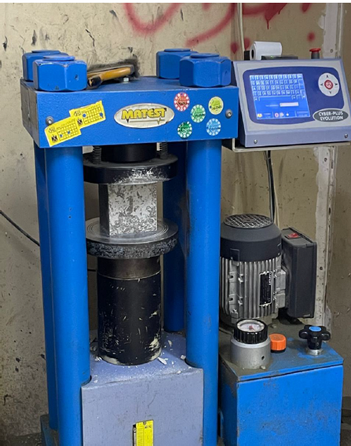
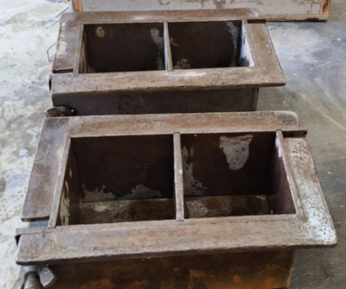
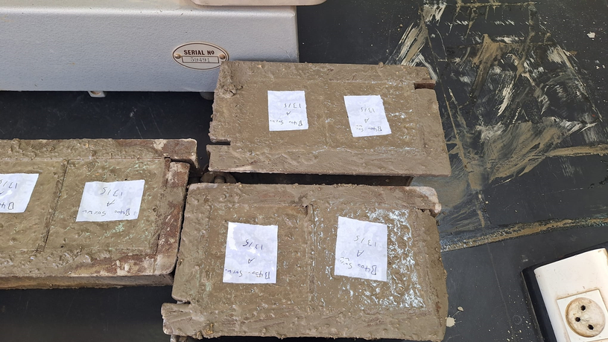
TESTING METHODOLOGY
  Test of compressive strength following 7 days.
  Test of compressive strength following 28 days.
An-Najah National University

Slide 21
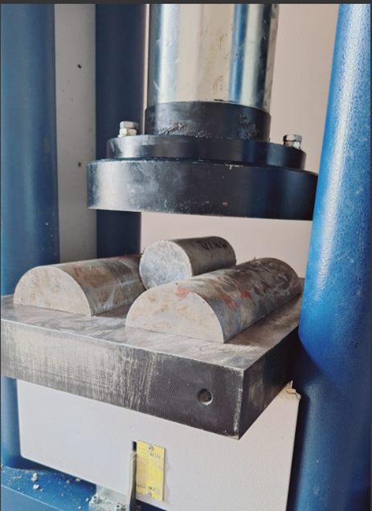
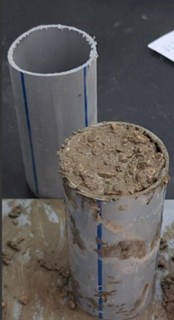
TESTING METHODOLOGY
  Test for tensile strength.
An-Najah National University

Slide 22
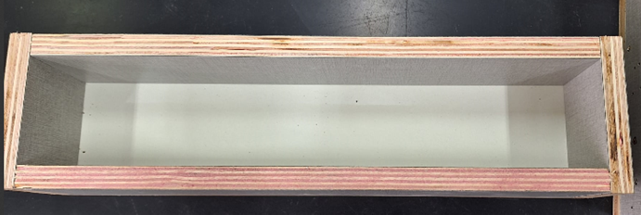
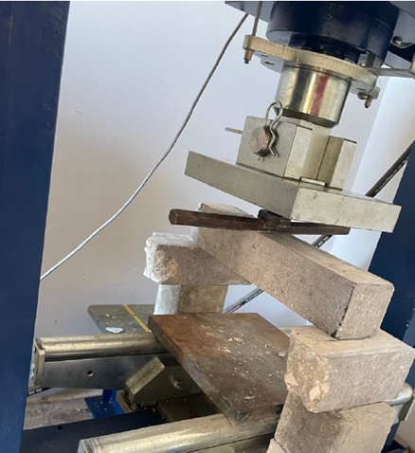
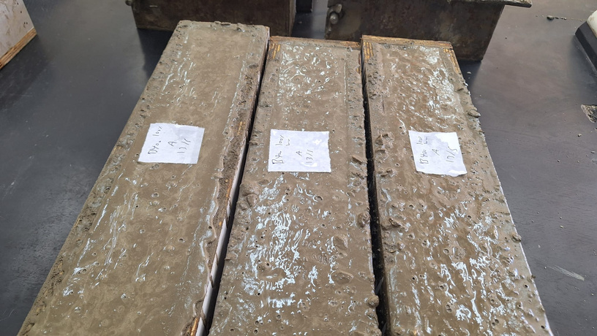
TESTING METHODOLOGY
  Flexural strength test.
An-Najah National University

Slide 23
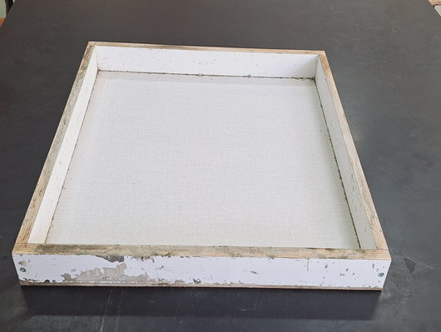
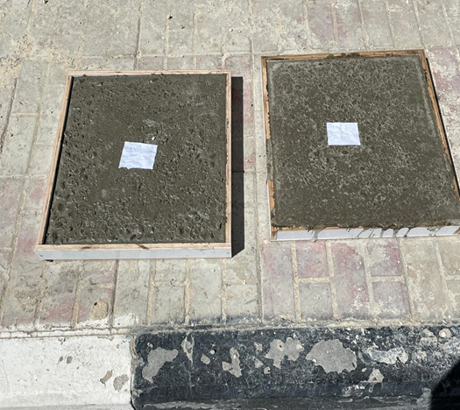
TESTING METHODOLOGY
  Self-healing monitor samples
An-Najah National University

Slide 24
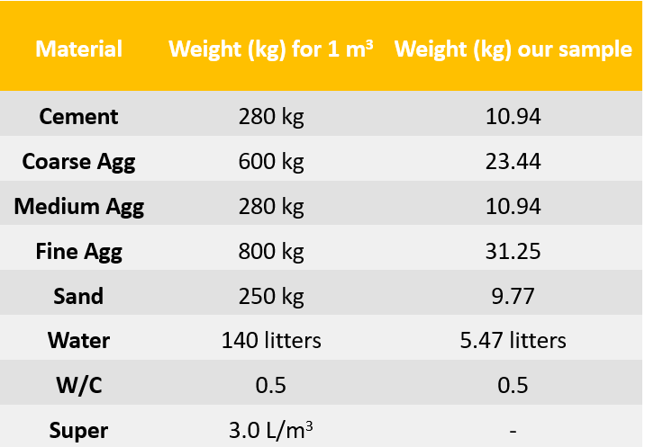
METHODOLGY AND ANALYSIS
  Ingredients of B300:
An-Najah National University

Slide 25
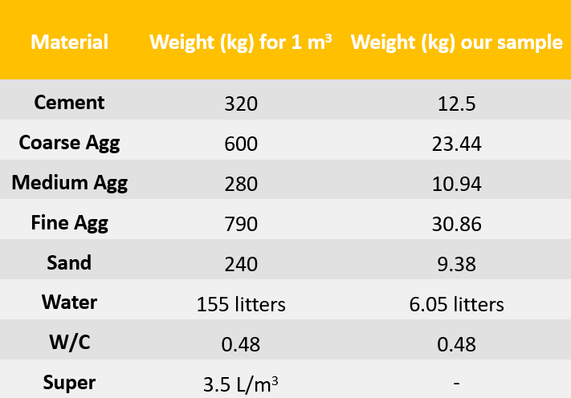
METHODOLGY AND ANALYSIS
  Ingredients of B350 :
An-Najah National University

Slide 26
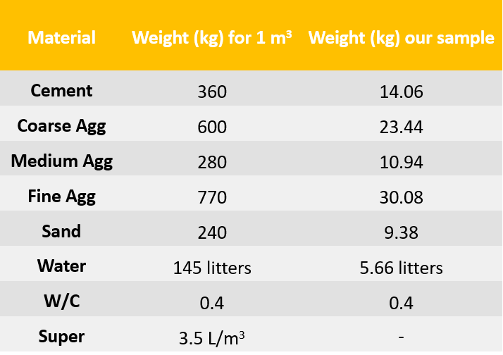
METHODOLGY AND ANALYSIS
  Ingredients of B400:
An-Najah National University

Slide 27
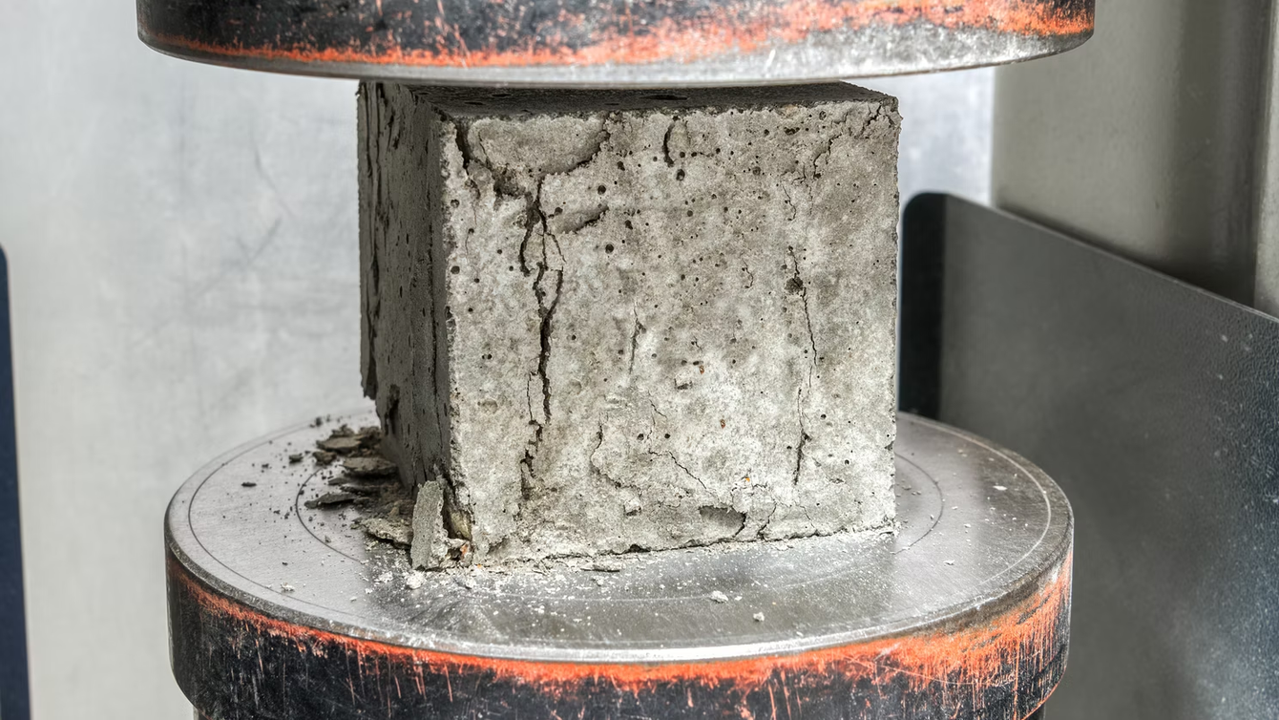

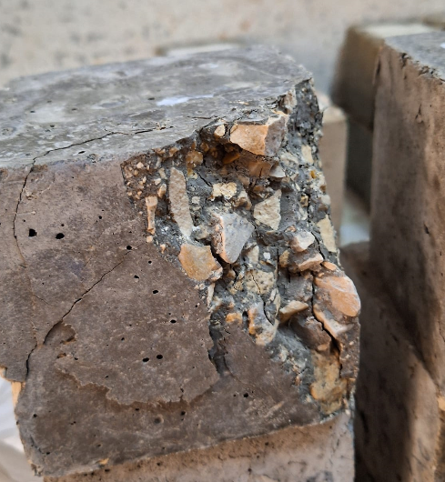
RESULTS

Slide 28
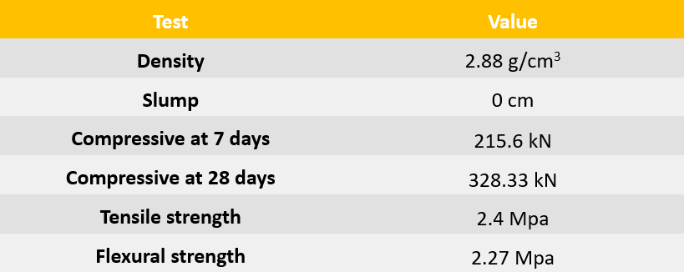
B300 MIX TESTS RESULTS
  B300 (0% WW):
An-Najah National University

Slide 29
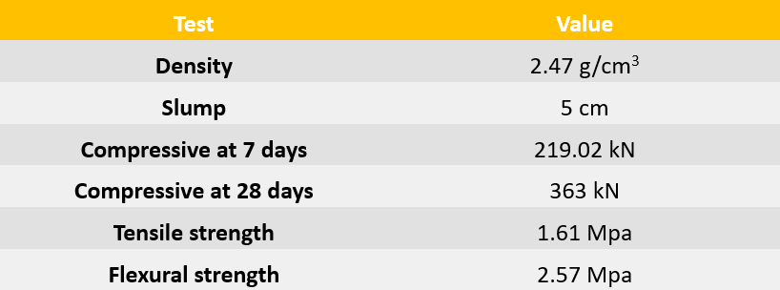
B300 MIX TESTS RESULTS
  B300 (50% WW):
An-Najah National University

Slide 30
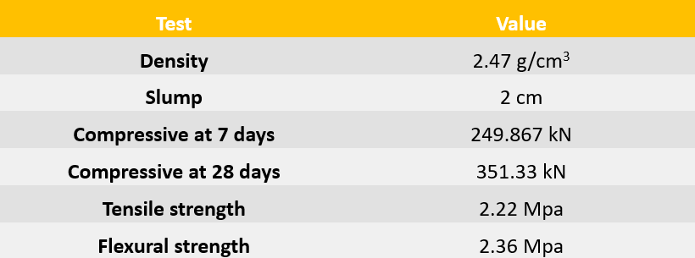
B300 MIX TESTS RESULTS
  B300 (100% WW):
An-Najah National University

Slide 31
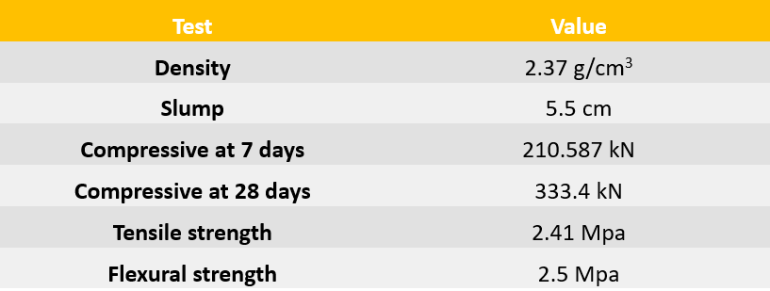
B350 MIX TESTS RESULTS
  B350 (0% WW):
An-Najah National University

Slide 32
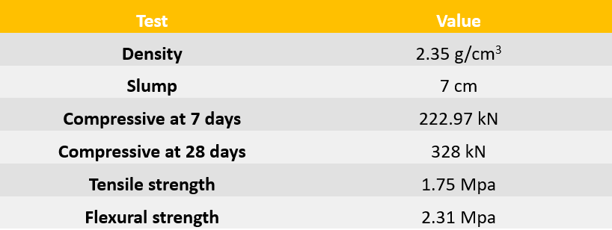
B350 MIX TESTS RESULTS
  B350 (50% WW):
An-Najah National University

Slide 33
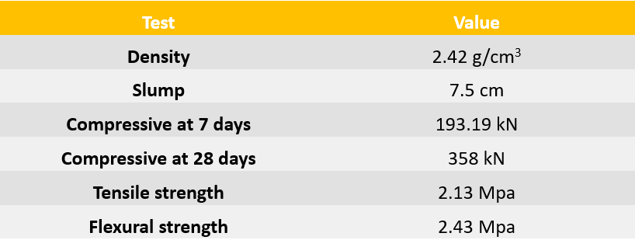
B350 MIX TESTS RESULTS
  B350 (100% WW):
An-Najah National University

Slide 34

B400 MIX TESTS RESULTS
  B400 (0% WW):
An-Najah National University

Slide 35
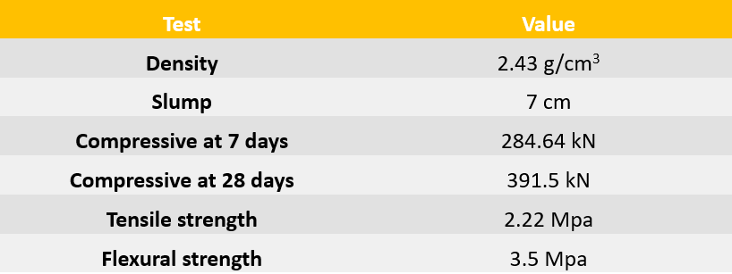
B400 MIX TESTS RESULTS
  B400 (50% WW):
An-Najah National University

Slide 36
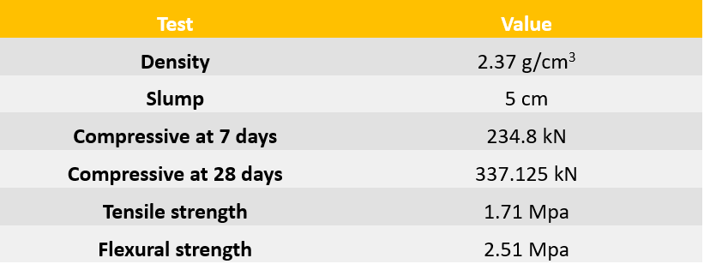
B400 MIX TESTS RESULTS
  B400 (100% WW):
An-Najah National University

Slide 37

DISCUSSION

Slide 38
OUTCOMES AND DISCUSSION
  Density: Treated Waste Water (WW) has no impact on the density values of fresh concrete
  Slump Values: WW does not affect slump values differently than ordinary water; the amount of added water is the key factor
An-Najah National University

Slide 39
OUTCOMES AND DISCUSSION
  Compression Strength (7 Days): WW affects the early reaction of concrete, notably decreasing compressive strength in high-strength designs (B350 and B400 mixes).
  Compression Strength (28 Days): Mixed results; some samples showed increased strength with 50% WW, while others showed decreased strength. The same variability was observed with 100% WW.
An-Najah National University

Slide 40
OUTCOMES AND DISCUSSION
  Tensile Strength: WW tends to decrease tensile strength, especially at a 50% WW mixing ratio.
  Flexural Strength: No major differences were observed in the flexural strength of concrete due to the addition of WW.
An-Najah National University

Slide 41
SELF-HEALING PROGRESS OBSERVATION
  Regarding cracks case in concrete, we observed an inverse relationship between the amount of WW added to the mixtures, and the number of cracks occurring in the healed samples, the more WW added to mixtures, the less cracks occur.
An-Najah National University

Slide 42
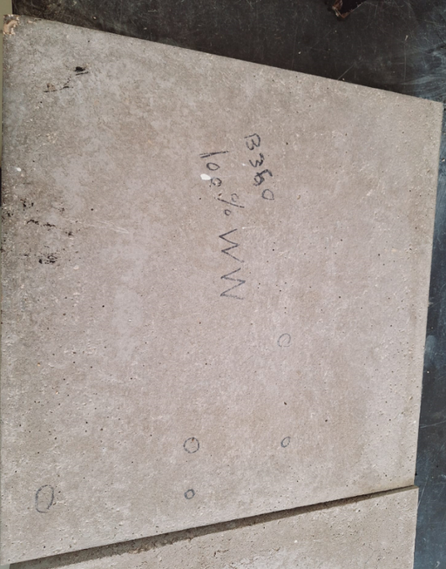
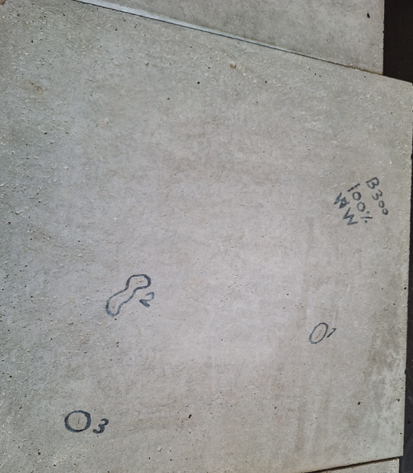
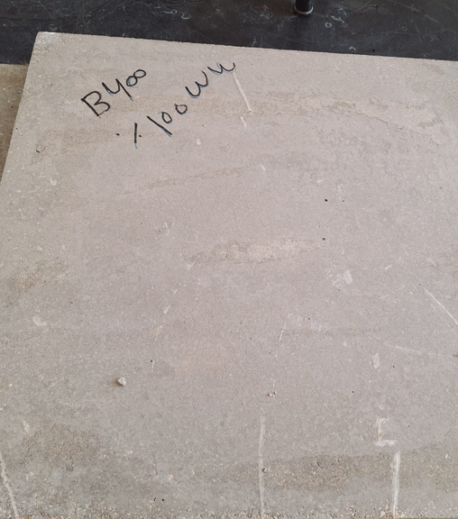
SELF-HEALING PROGRESS OBSERVATION
100 % WW
An-Najah National University

Slide 43
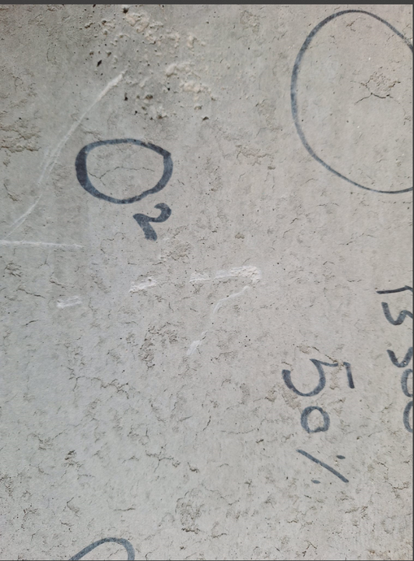
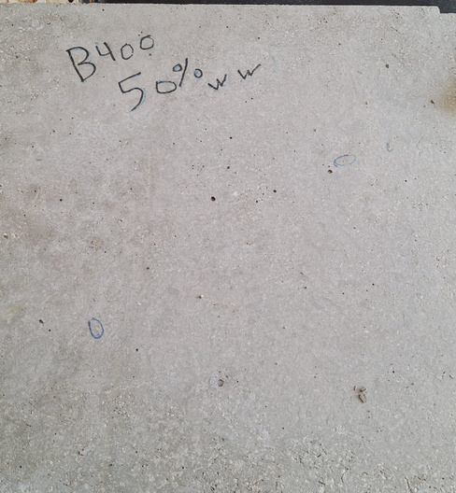
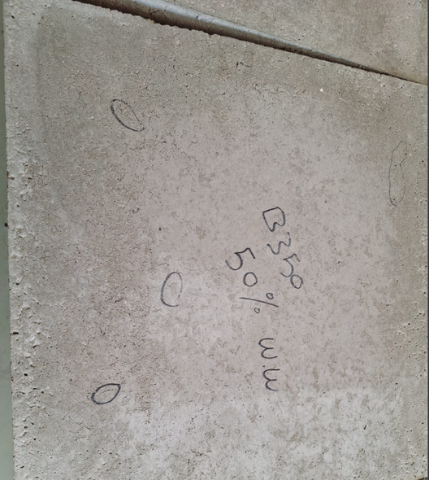
SELF-HEALING PROGRESS OBSERVATION
50 % WW
An-Najah National University

Slide 44



SELF-HEALING PROGRESS OBSERVATION
0 % WW
An-Najah National University

Slide 45
CONCLUSION
  Based on the results of previous experiments, we found that replacing pure water with wastewater is feasible, especially from an economic standpoint. The price of a cubic meter of pure water is about 11-12 shekels, while wastewater is 2-3 shekels. Also from a political standpoint, due to the presence of the occupation and the difficulty of extracting groundwater, it can be used. As an alternative in other construction matters
  As for self-healing, we did not notice any change in the samples due to the short time for the project
An-Najah National University

Slide 46

RECOMMENDATIONS
  Conduct more experiments with different percentages, such as 25% and 75%, to obtain more accurate results.
  Monitoring self-healing samples over a period ranging from one to six months.
  Treated water can be used in mortar.
  Study of the environmental impact of concrete after using treated water.
An-Najah National University

Slide 47


THANK YOU
“Brick by brick, stone by stone, every great thing was built by those who believed they could.”
Tom “The Mason” Mitchell
An-Najah National University

