Slide 1
PROJECT NAME:
HVAC AND MECHANICAL SYSTEMS DESIGN
FOR
MUSSLUM HOSPITAL
Prepared by:
Islam Tahayna
Mohammad Elyan
Ahmad Abualwafa
Abed-Aljwad Najjar
Supervisor:
Eng. Ramez AL- Khaldi

Slide 2
Project Objectives
The objective of this project is to design the heating ventilation and air conditioning systems (HVAC) for building of Mussalam hospital which is located in Ramallah city , in addition all the recommended mechanical systems that the building should contain like (potable water, derange, medical gases and firefighting) systems .

Slide 3
What is HVAC
HVAC (heating, Ventilation, and Air conditioning) is the technology of indoor and automotive environmental comfort. HVAC system design is a major sub discipline of mechanical engineering, based on the principles of thermodynamics, fluid mechanics, and heat transfer. Also the mechanical systems are to be introduced in our research including potable, drainage, firefighting and medical gases.

Slide 4
Building description
Location :
- Country: Palestine / west bank.
- City: Ramallah
- Street: Al-Ersal Street.
- Elevation: 940 m above sea level.
- Latitude: 32 N.
- Longitude: 35 E.
-Wind’s speed in Ramallah is about 5 m/s above

Slide 5
Building description
In general, our hospital consists of eight floors with different departments starting with receptions and ending with operation rooms.
The building consist of two basements , ground, first, second, third, fourth and top roof floors.
Each floor has an area about 750 m^2, and a total building area of 6000 m^2
Each floor is described clearly in our project.

Slide 6
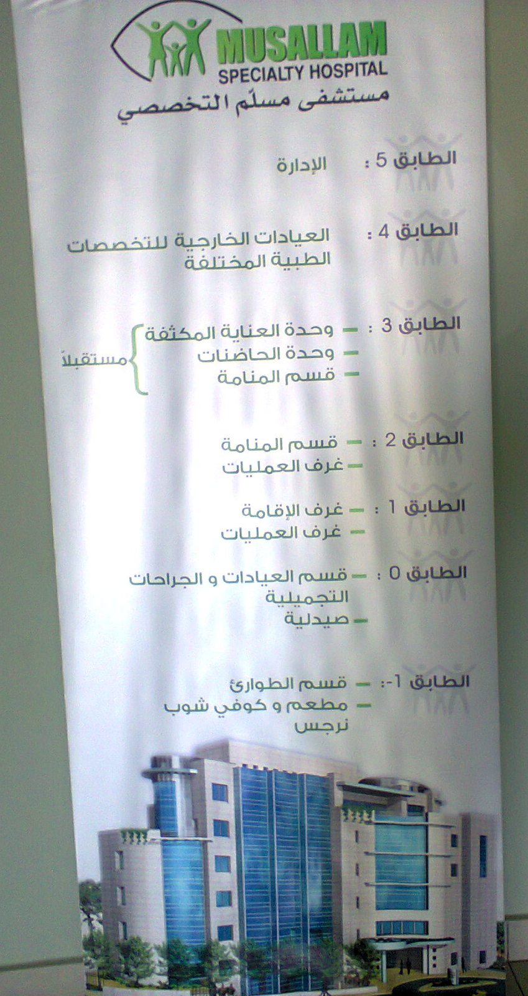

Slide 7
Heat Transfer coefficients
(U (W\m². C))
R_{cond} = X / K ………….Thermal Resistance Of Solid Construction
Overall Heat Transfer Coefficient U
U = 1 / (R_{i} + x₁ / k₁ + x₂ / k₂+ x₃ / k₃ +…...+ R_{o})
R_{conv} = $\frac{1 }{h}……………$Thermal resistance of fluid
R_{conv} = (1 )/ℎ……………Thermal resistance of fluid

Slide 8
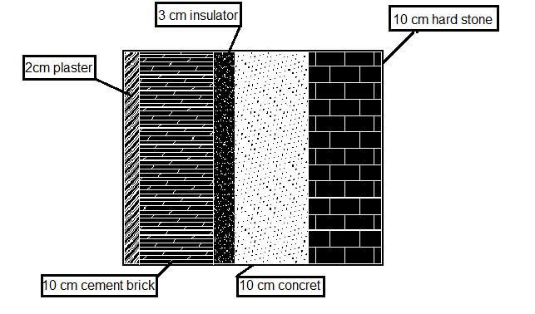
Heat Transfer coefficients
(U (W\m². C))
This picture shows the components of the external wall……………………. U=0.8634 W\m². C

Slide 9
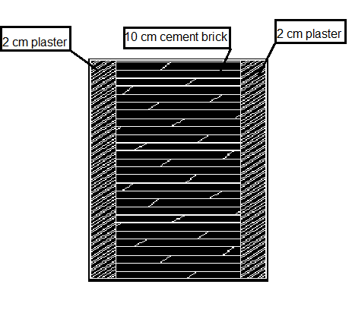
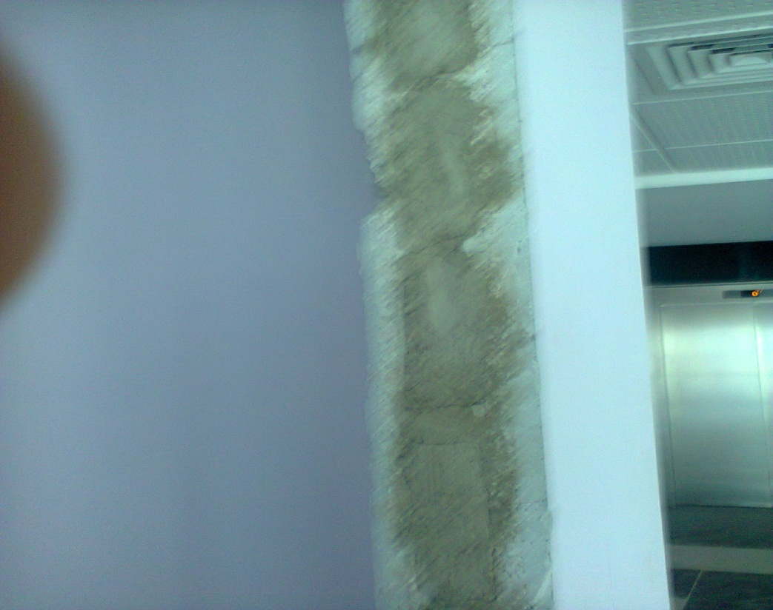
Heat Transfer coefficients
(U (W\m². C))
This picture shows the components of the internal wall……………………. U=2.4259 W\m². C

Slide 10
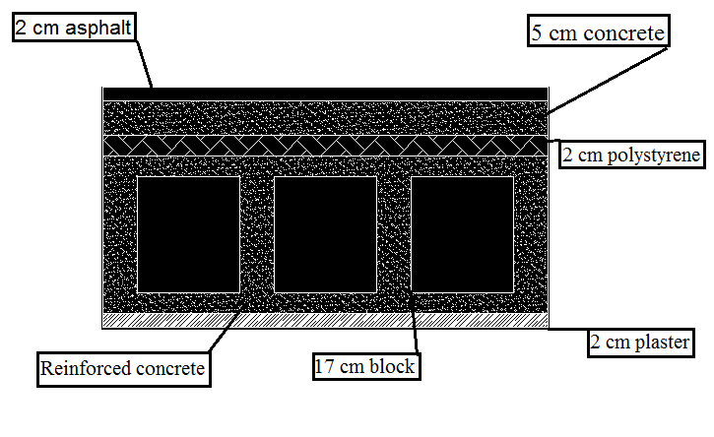
Heat Transfer coefficients
(U (W\m². C))
This picture shows the components of the ceiling…………………….U = 0.83788 W\m². C

Slide 11
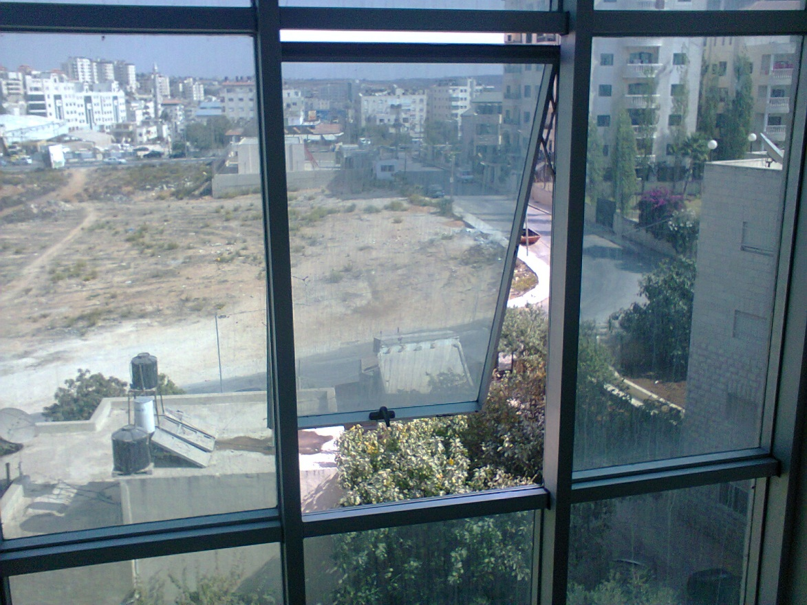
Heat Transfer coefficients
(U (W\m². C))
Windows double glasses with aluminum material type, wind speed more than 5 m/s then U_{window} = 3.5 W/m².C

Slide 12
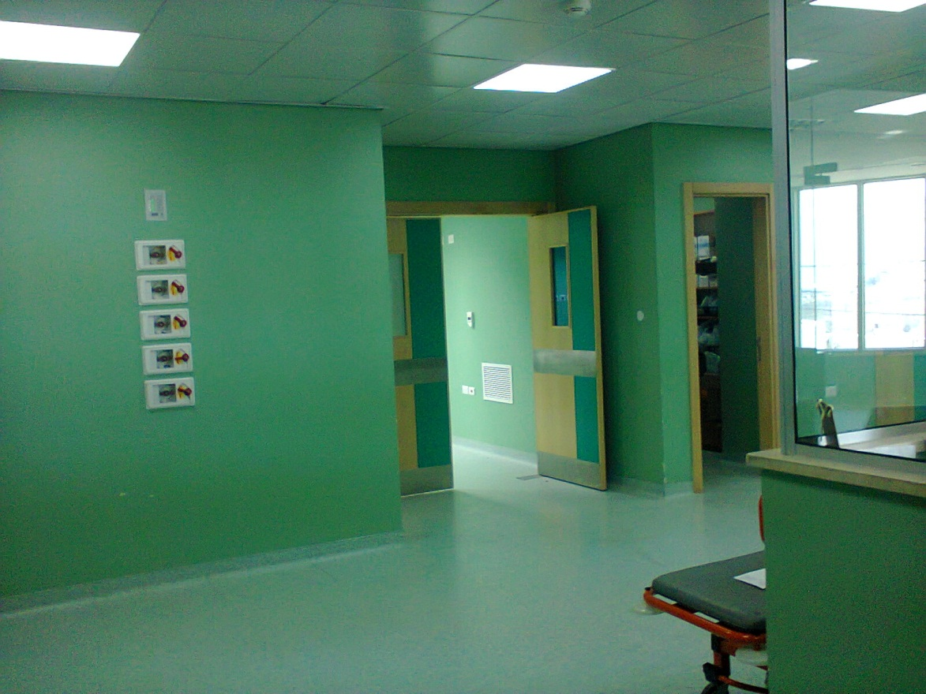
Heat Transfer coefficients
(U (W\m². C))
Doors with wood material type ………… U_{door} = 2.4 W/m².C

Slide 13
Heating load principle
The main heat losses through a building comes from :
External wall
Internal wall
Ceiling and floor
Window and doors
Ventilation and Infiltration

Slide 14
Heating load principle
Heat loss occurs by several mechanisms
Conduction: Mainly through external, internal wall and ceiling.
Convection: Due ventilation and infiltration.
Radiation: Mainly by sun
Evaporation: by human

Slide 15
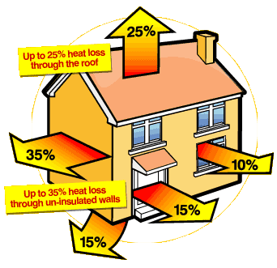
Heating load principle

Slide 16
Heating load principle
(Outside and inside design conditions)
From the Palestinian code the inside and outside design conditions for winter heating in Ramallah city are:
Outside design condition
T_{o} = 4.7 C.
Relative humidity = 70%
Inside design condition
T_{i} = 22 C.
Relative humidity = 50%.

Slide 17
Heating load principle
(Related formulas)
Q = U * A * ΔT ………………(heat loss through fixtures)
Where:
Q: Is the sensible heat transfer
U: Heat transfer coefficient
A: Surface area
ΔT: Temperature difference between inside and outside or between inside and unheated spaces or the floor temperature
T_{un} = To + 0.5 (Tin – To) ……………………………..for unheated spaces
Tun = To + (5→10) ………………………………………for the floor

Slide 18
Heating load principle
(Related formulas)
Infiltration = ACH * A * ( 1000 / 3600 ) (L/S)
A: Area
ACH: Air change per hour
Ventilation = n * value of ventilation (L/S)
Value of ventilation depends on the application type
n: number of occupants
Q_{s} _{(vent,inf)} = 1.2 * V * (T_{i} – T_{o})

Slide 19
Heating load principle
(Related formulas)
Q domestic water =M_{w} * C_{p} * ((T_{h} – T_{o}) / Δt)
(T_{h} – T_{o}) = (50 – 60)
T: time = 2 hours
C_{p}: specific heat = 4810 J/kg.K
Q_{total} = Qs _{cond} + Qs _{(vent,inf)} + Q_{domestic}
Q_{boiler} = 1.1 *Q_{total}

Slide 20
Cooling load principle
Sources Of Cooling load:
Conductive heat gain
Heat gain from solar radiation
Ventilation and Infiltration
Heat gain from equipment's, lighting and occupants

Slide 21
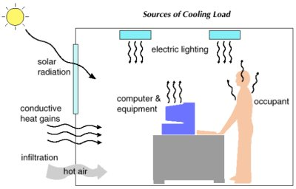

Slide 22
Cooling load principle
(Outside and inside design conditions)
From the Palestinian code the inside and outside design conditions for summer cooling in Ramallah city are:
Outside design condition
T_{o} = 30 C.
Relative humidity = 51.5%
Inside design condition
T_{i} = 22 C.
Relative humidity = 50%.

Slide 23
Cooling load principle
(Related formulas)
The Cooling Load Temperature Difference Method (CLTD)
Q = (U) (A) (CLTD) _{corr}
T_{un} = T_{in} + 2/3 (T_{o} – T_{in})
(CLTD)_{corr} = (CLTD+LM)K+(25.5- T_{in})+(T_{o}-29.4)
For exterior walls and roofs

Slide 24
Cooling load principle
(Related formulas)
Heat gain due to windows:
Transmitted heat gain
Q = A (SHG) (SC) (CLF)
Convection heat gain
Q = (U) (A) (CLTD) _{corr}
(CLTD)_{corr} = (CLTD)+(25.5- T_{in})+(T_{o}-29.4)

Slide 25
Cooling load principle
(Related formulas)
Heat gain due to people
Q_{L} = N (HG)
Q_{s} = N (HG)_{s} (CLF)
Heat gain due to lighting
q_{i} = W . A
Q _{light} = q_{i} CLF
Heat gain due to equipment's
Qs = qs * CLF
Ql = ql

Slide 26
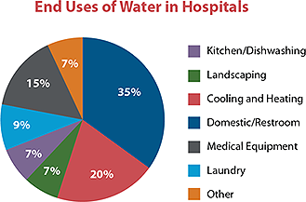
Mechanical systems
(Potable water)

Slide 27
Mechanical systems
(Potable water)
No. of fixture units is to be calculated to start sizing using special tables for potable design.
For internal network plastic pipes to be used.
For external network steel pipes to be used

Slide 28
Mechanical systems
(Drainage)
No. of fixtures is to be determined to start sizing for the stacks and horizontal branches using special tables.

Slide 29
Mechanical systems
(Firefighting system)
We are going to use three types of firefighting components such fire extinguishers , landing valves and cabinet .
Usually landing valve is 2 ½ “ …….. (NFPA code)
The cabinet is usually 1 ½ “ ………(NFPA code)
Sprinklers system and another heat , smoke detectors to be used too.

Slide 30
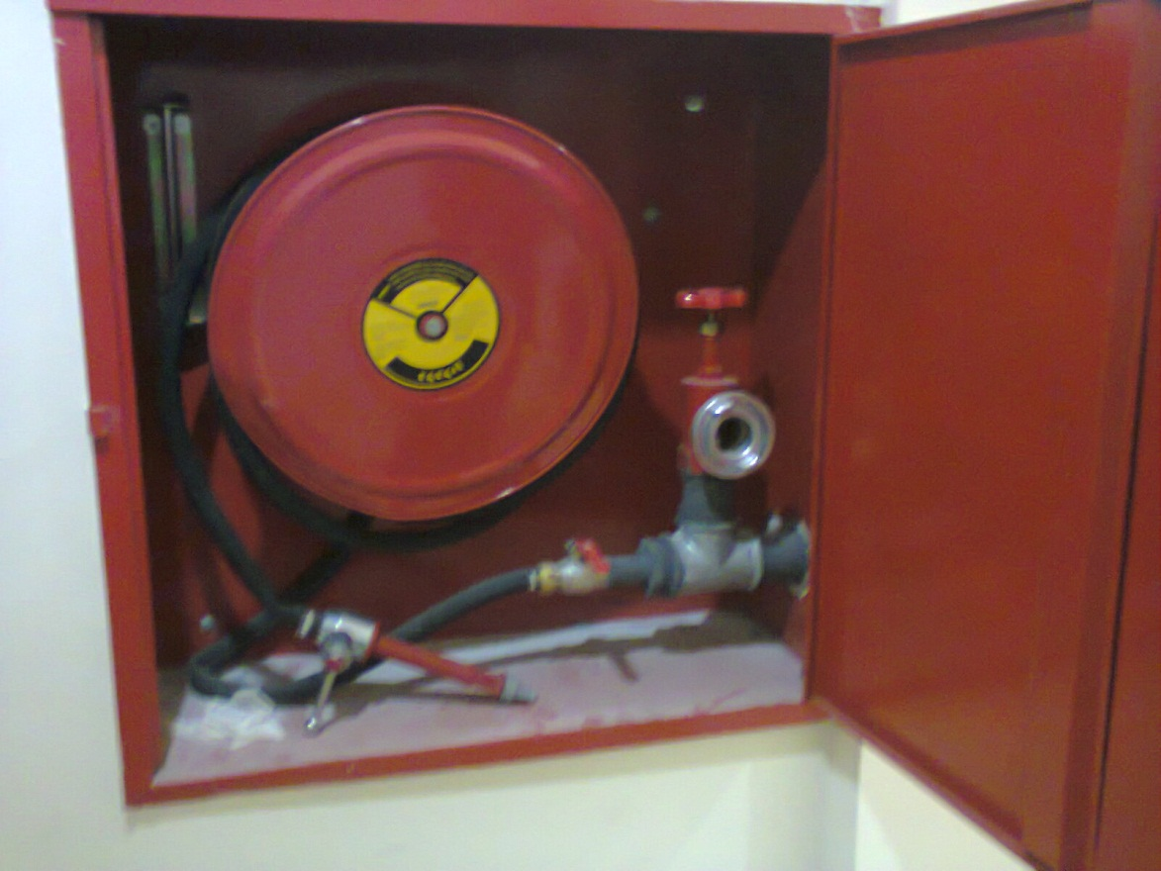
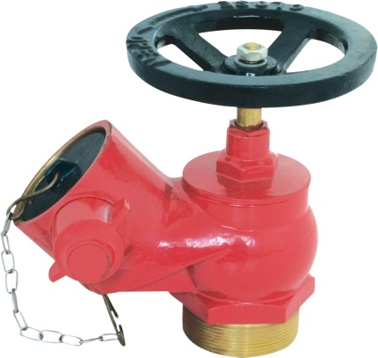
Mechanical systems
(Firefighting system)

Slide 31
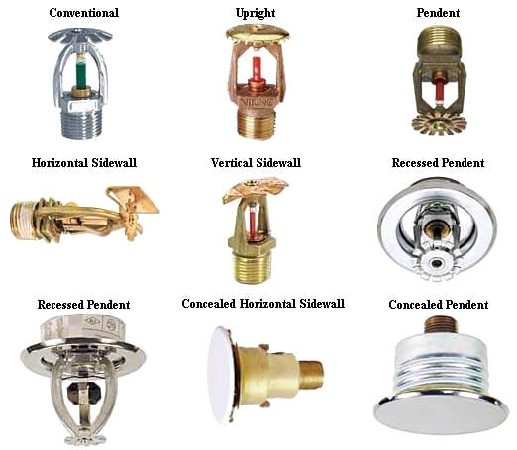
Mechanical systems
(Firefighting system)

Slide 32
Mechanical systems
(Medical gas system)
All our design of medical gas system follow HTMs, reference NFPA 99 to provide an safety design and balance cost of investment to optimized performance of system and running cost, Medical piped gas systems in hospitals, and most other healthcare facilities, are essential for supplying piped oxygen, nitrous oxide, nitrogen, carbon dioxide and medical air to various parts of the hospital. These systems are usually highly monitored by various computerized alarm systems.

Slide 33
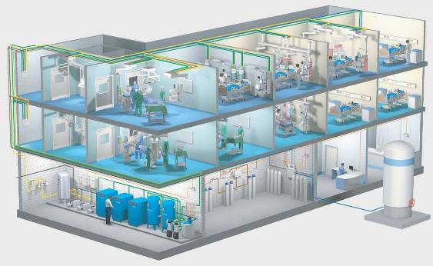
Mechanical systems
(Medical gas system)

Slide 34
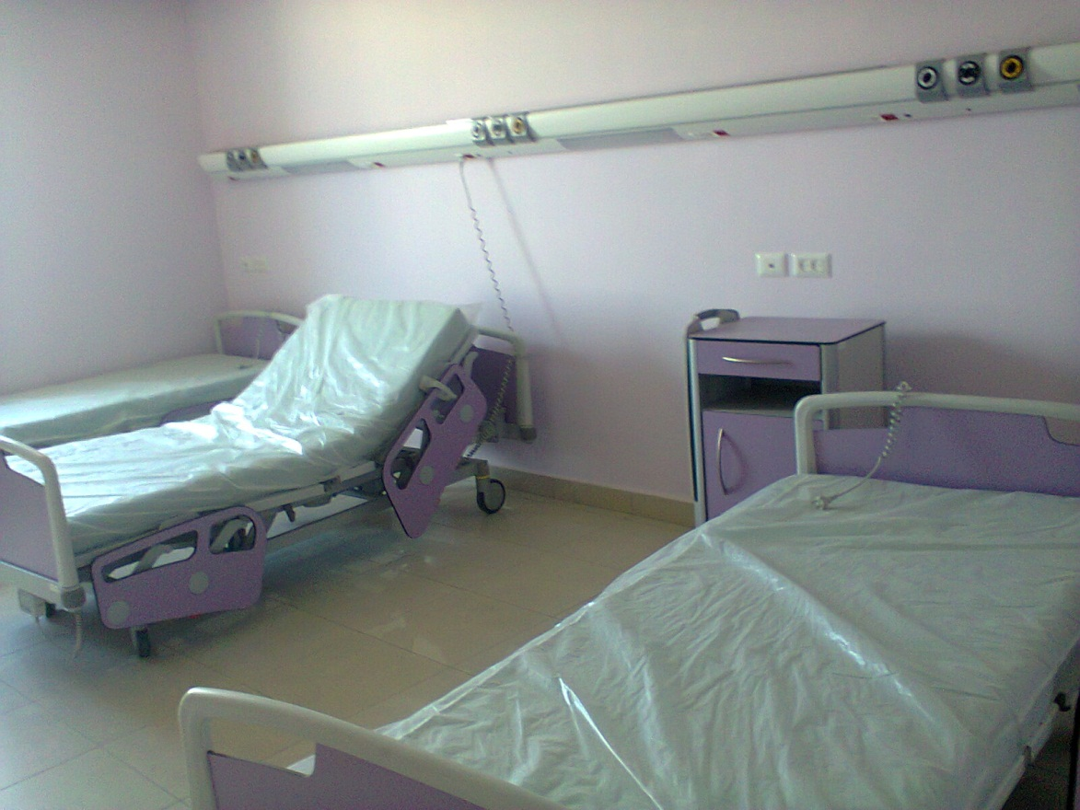
Mechanical systems
(Medical gas system)

Slide 35
Mechanical systems
(Elevators)
The first step in specifying elevators is to determine the right system for your project.
Elevators are selected due to type , speed , size and quantity.

Slide 36
Thank you all
End

