Slide 1

Moonbucks Machine
By: Hamzeh Saleh & Mohammad Mubaslat

Slide 2
Roadmap
Introduction
Process steps
Devices used
1
3
5
2
4
6
Objectives
Main features
Future work

Slide 3


Introduction
Where is the Idea come from?
About 40% of the people drink Nescafe every day.
No time to prepare it manually.

Slide 4
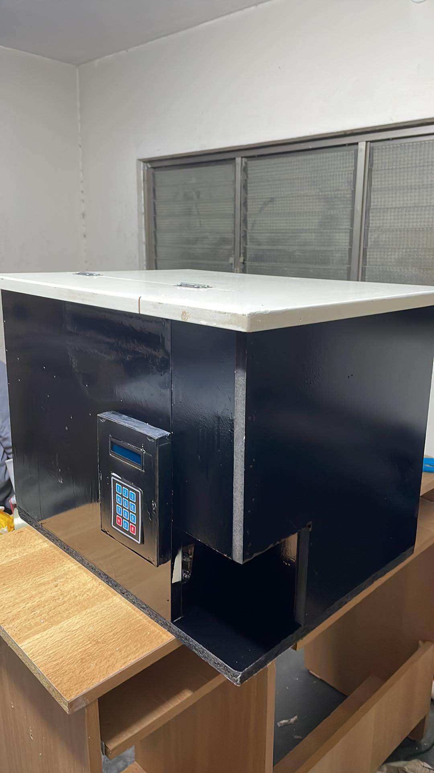
Introduction
What is Moonbucks Machine?
The updated version of traditional Nescafe machines.
Can prepare your Nescafe cup automatically.

Slide 5
Objectives
Good Nescafe in perfect way.
Save time and effort on making Nescafe.
Dynamic cups and ingredients.
Smartphone ordering.

Slide 6
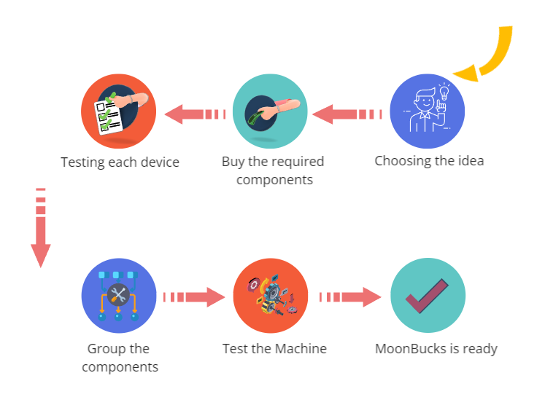
Process steps

Slide 7

Main Features
Smart machine which can be used from mobile.
Shorter time and more efficiency.
Auto detect for the cup.
A menu is provided for the user to choose what to drink

Slide 8
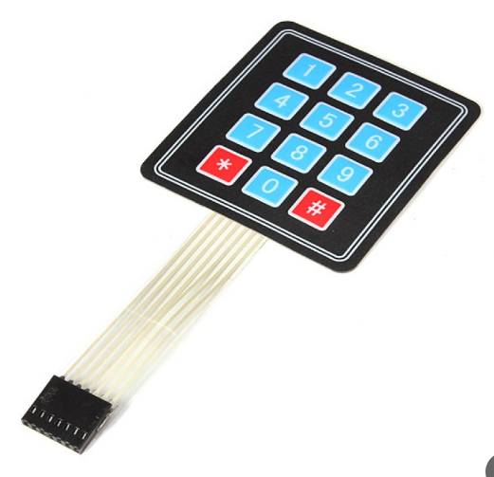
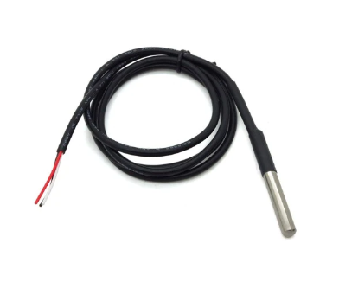
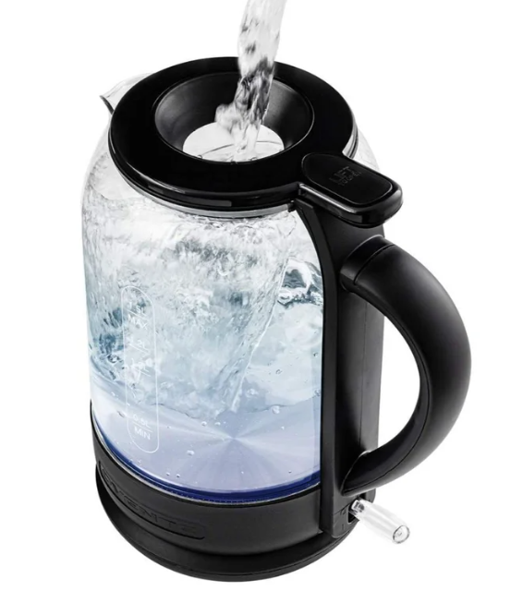
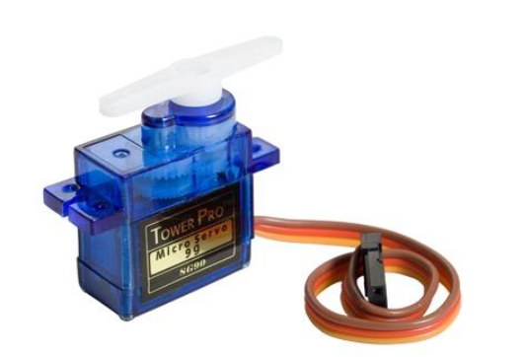

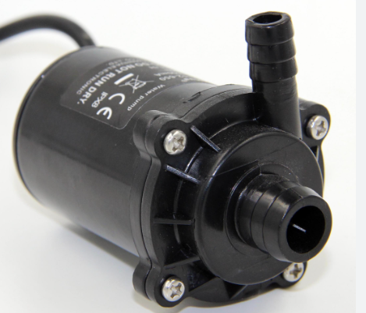
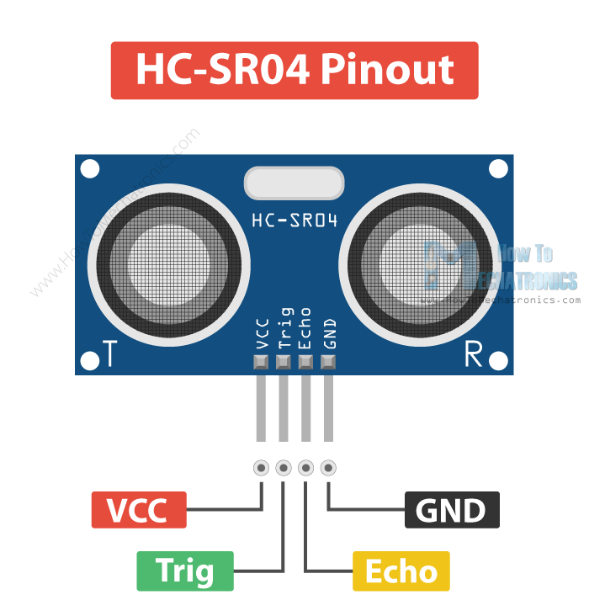
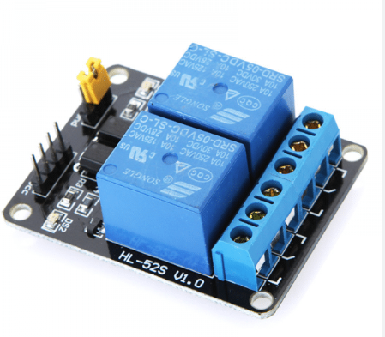
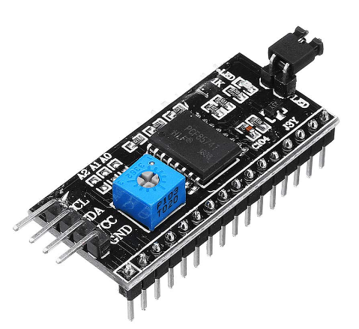
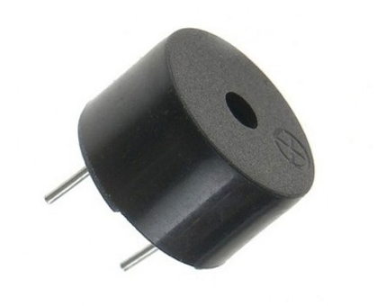
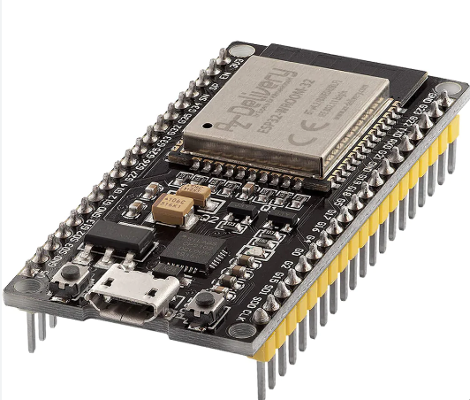
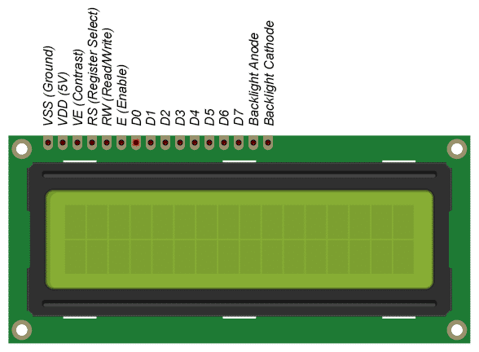
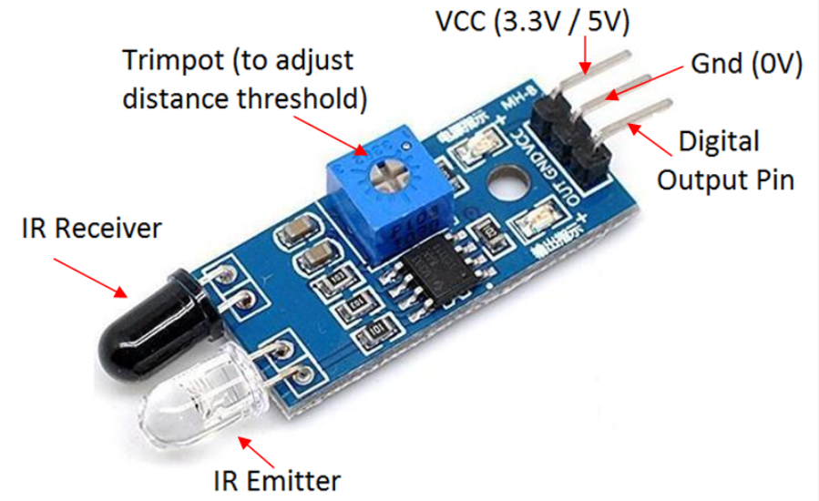
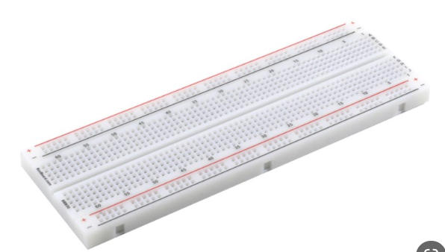
Hardware devices Used

Slide 9

Future work

Slide 10
Future Work
Bidirectional
communication
GSM to send
messages
Add more
drinks

Slide 11
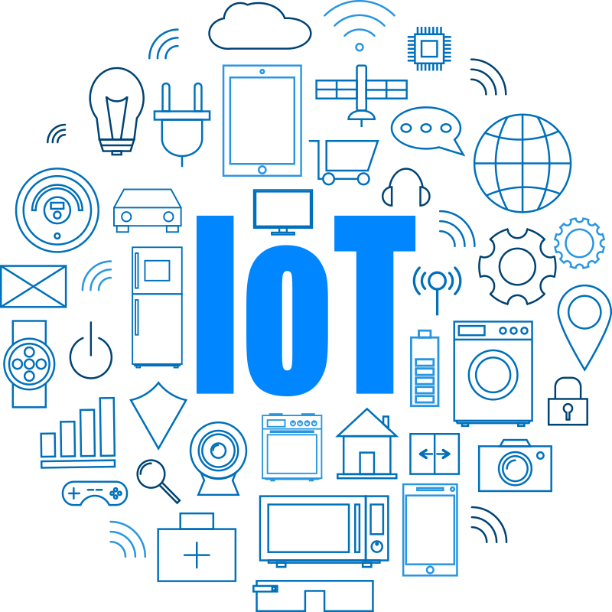
The end
Special Thanks
Dr. Asmaa Afifi
And Everyone Who Helped Us Complete This Project Even If With a Single Word

