Slide 1
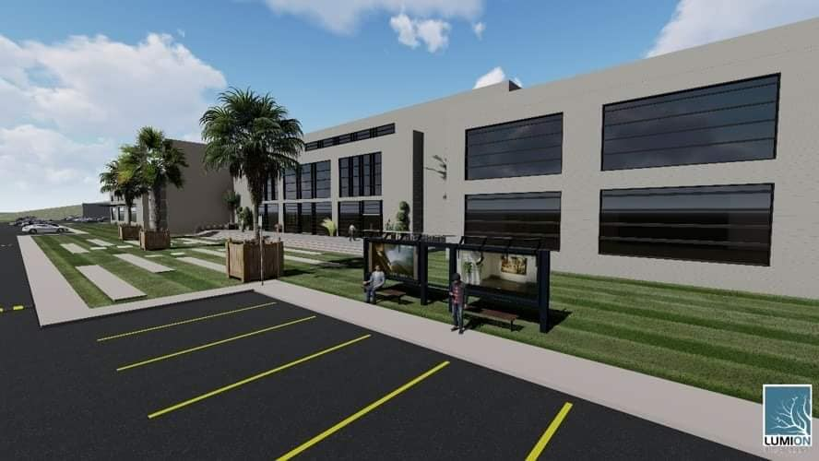
Scientific Research Center
Building Engineering Department
Graduation project II
Prepared By:
Basher Kabaha
Mohammad Karmi
Mohammad Nawahda
Ibrahim Salah Al-Dean
Supervisor:
Dr. Ahmad Saleh
Supervisor:
Dr. Ahmed Saleh

Slide 2
contents
Introduction
Architectural aspect
Environmental aspect
Structural design concept
Electrical aspect
Mechanical aspect
System integration
Cost Estimation

Slide 3
Introduction
Scientific Research Center
located near the villages of Beit Furik and Beit Dajan east of Nablus city.
It consist of three floor
Floor area: 5000m2
Total area of building : 16000m2
Area of Site : 20 donum.

Slide 4
Architectural Aspect

Slide 5
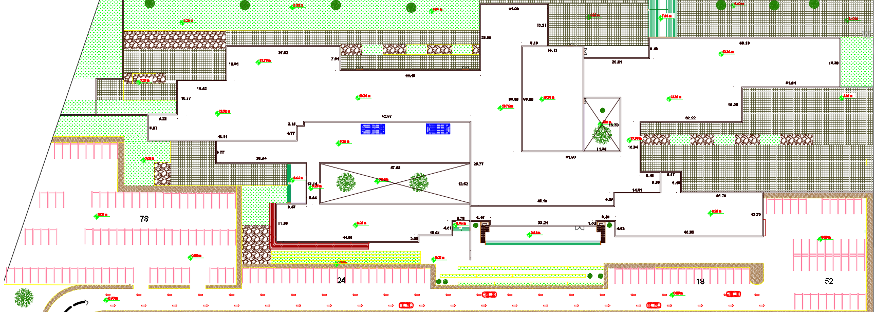
Project plans
Site Plan

Slide 6
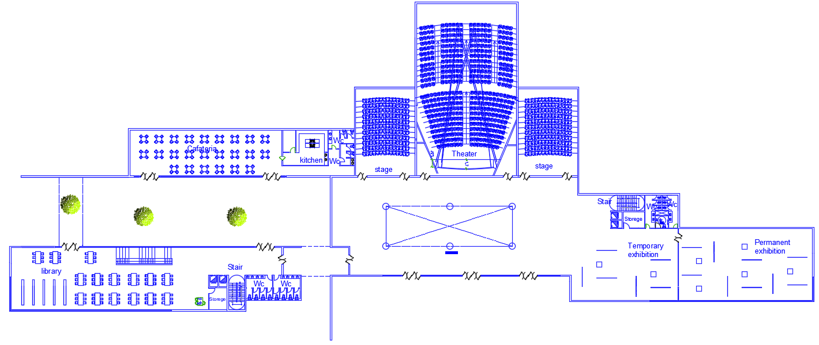
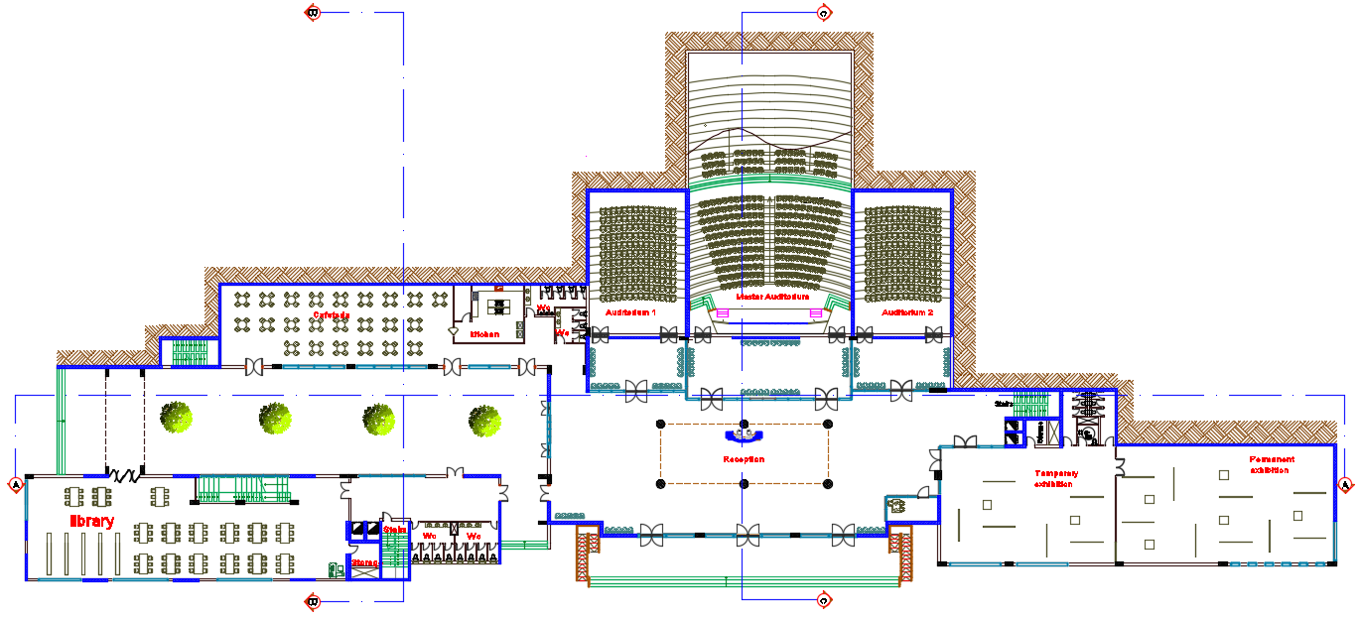
Editing for ground floor plans
Before
After

Slide 7
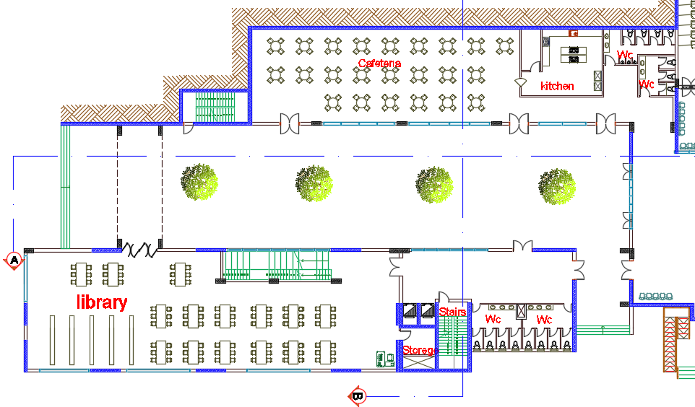
Project plans
Ground Floor Plan

Slide 8
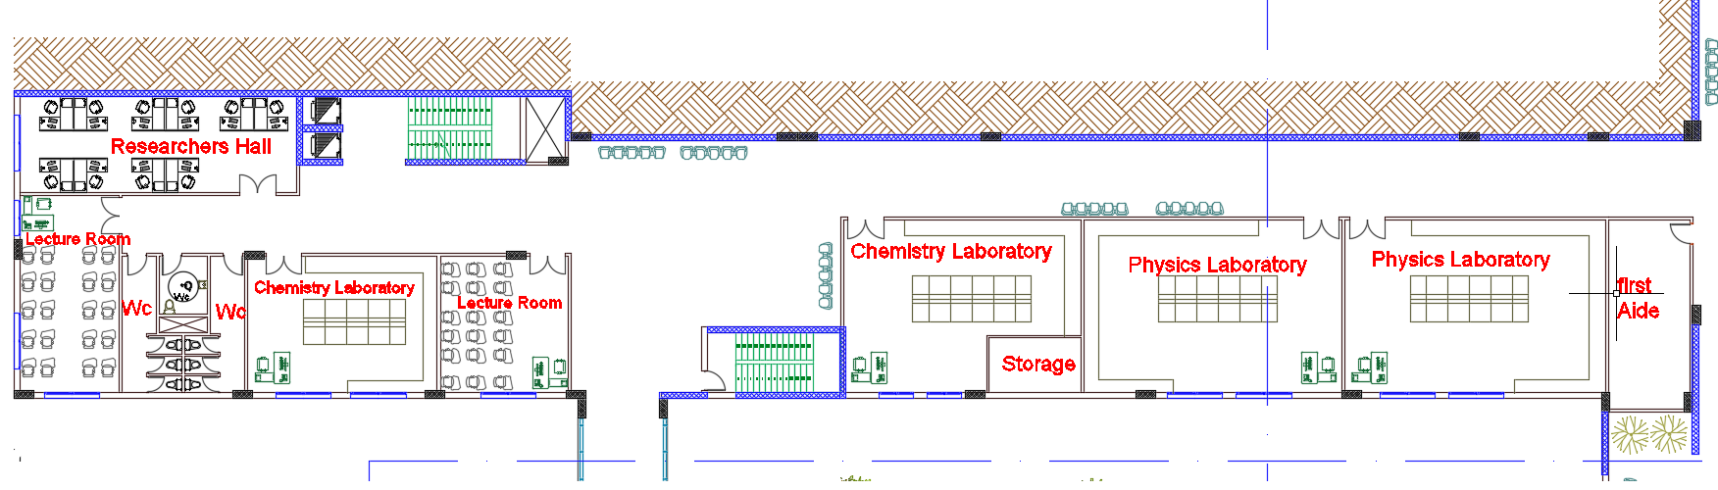
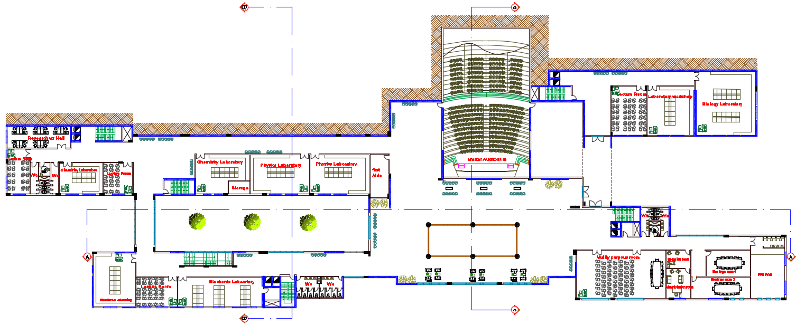
Project plans
First Floor Plan

Slide 9
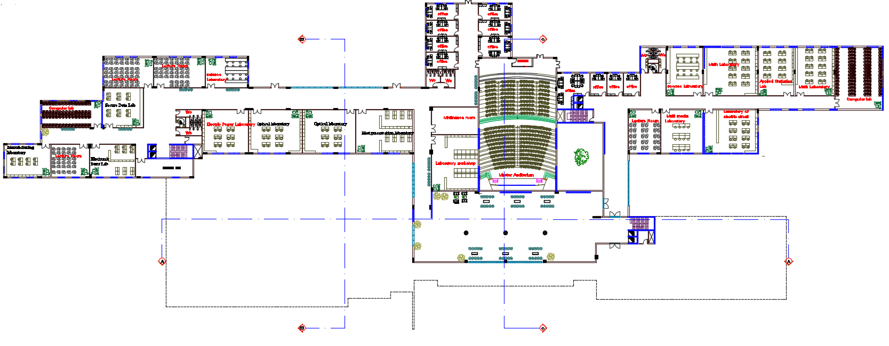
Project plans
Second Floor Plan

Slide 10
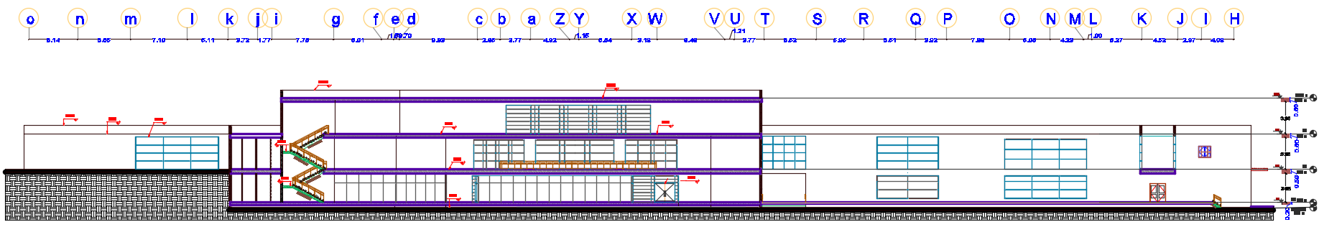
Project plans
Section A-A

Slide 11
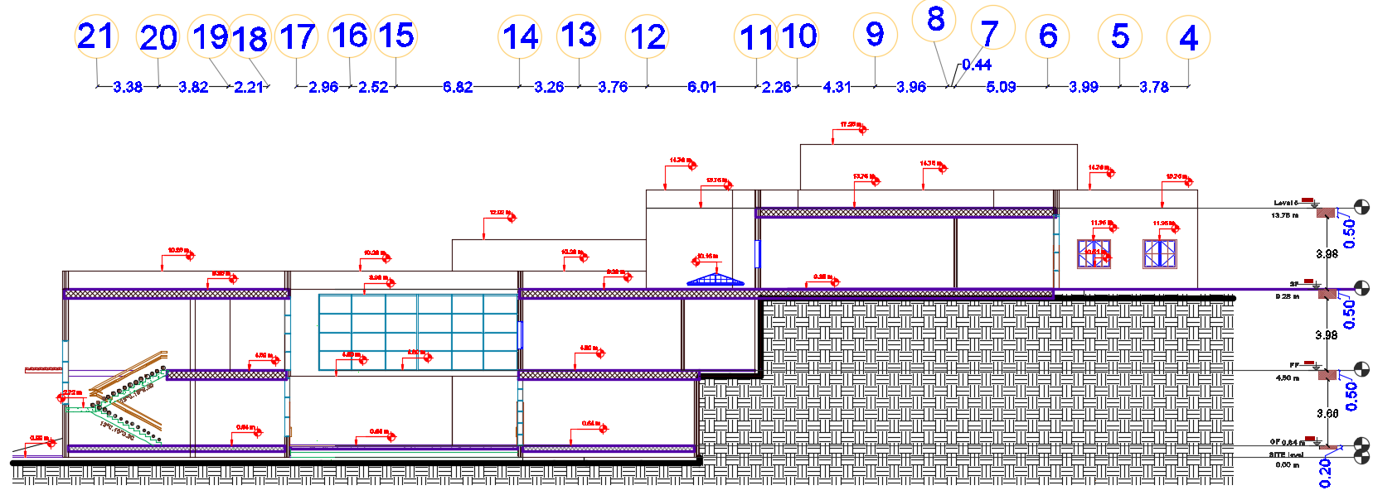
Project plans
Section B-B

Slide 12
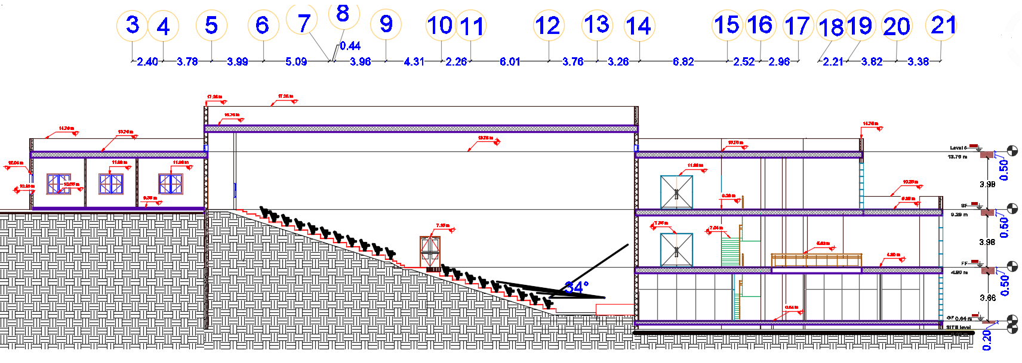
Project plans
Section C-C

Slide 13
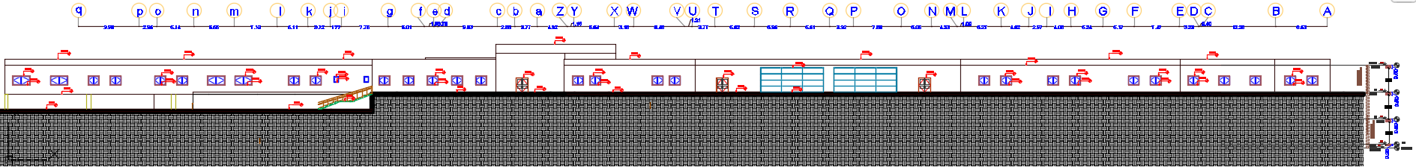
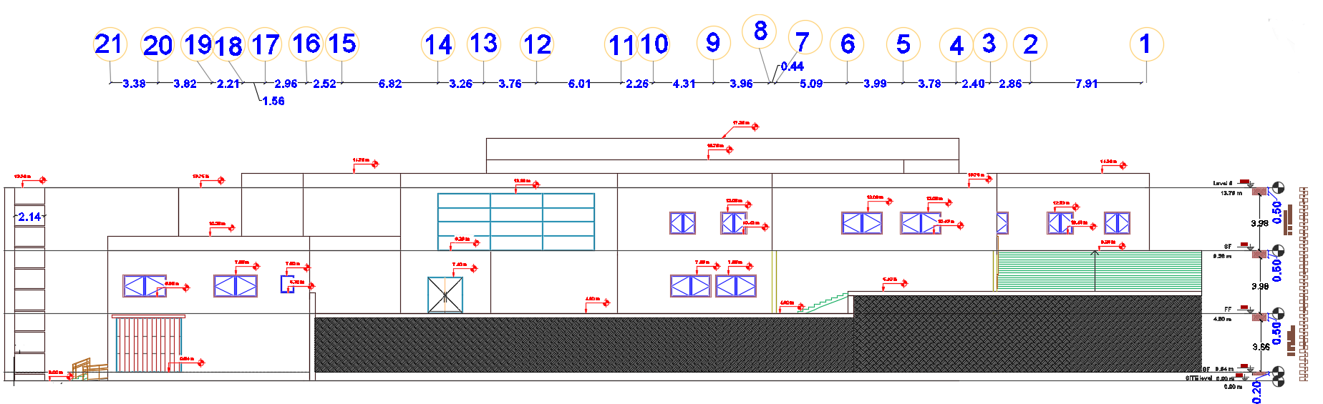
Project plans
Northern elevation
Eastern elevation

Slide 14
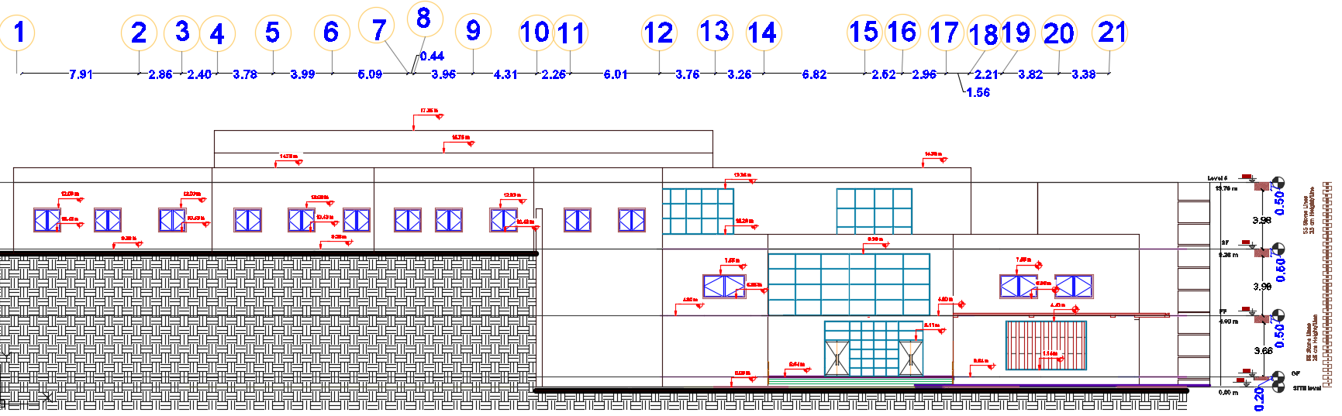
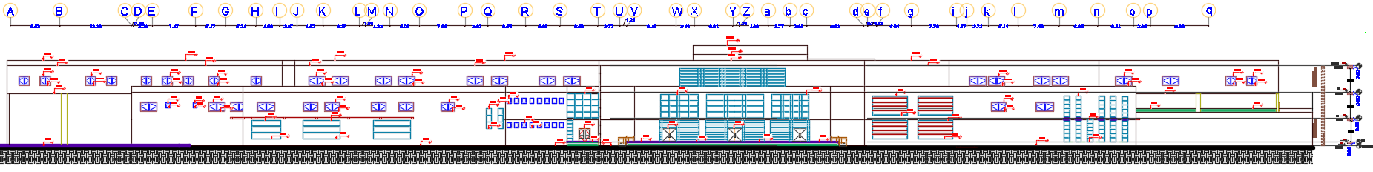
Project plans
Western
elevation
Southern elevation

Slide 15
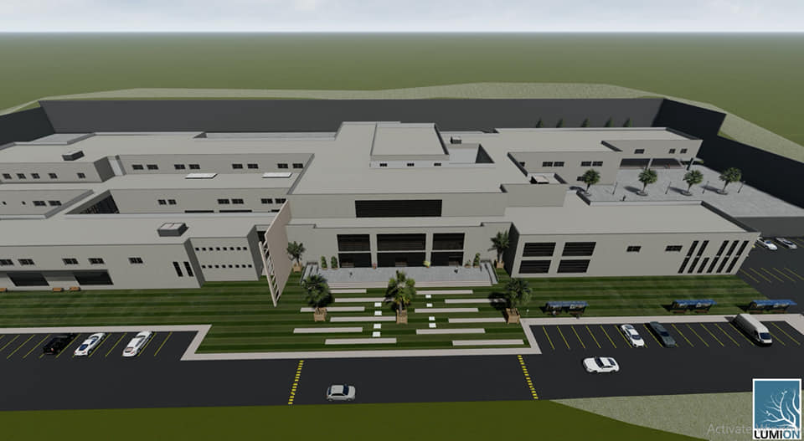
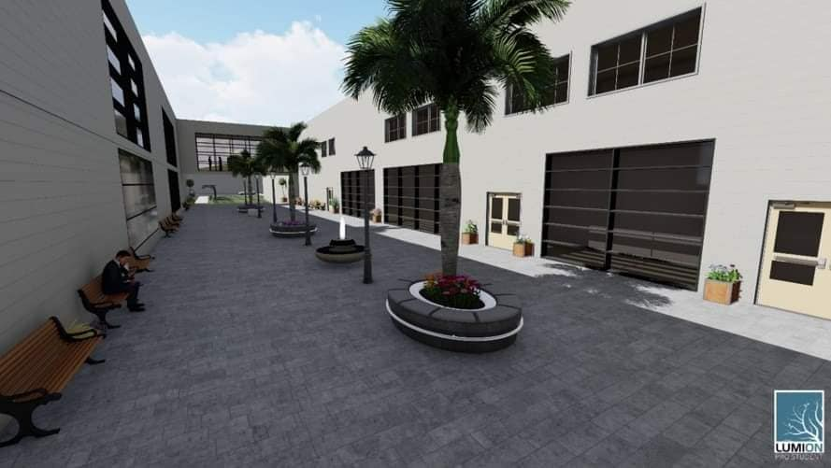
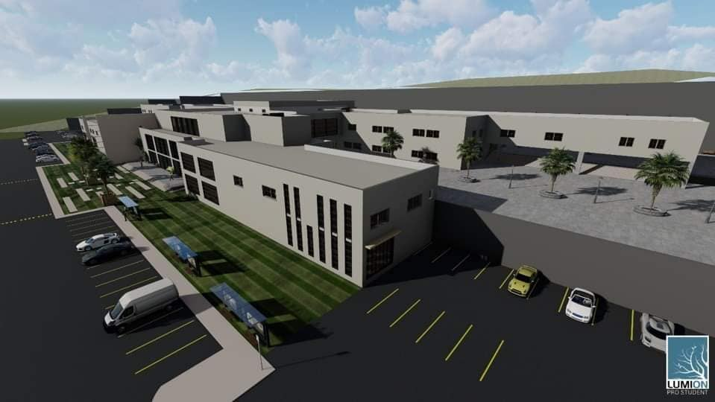
Rendering For Project

Slide 16
Environmental Aspect

Slide 17
Contents
Shading
Day light factor
Material Properties
Acoustical Analysis
Solar Radiation

Slide 18
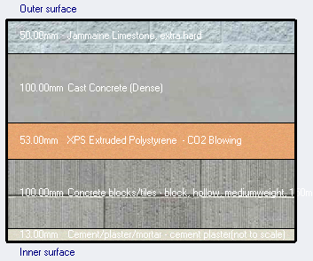
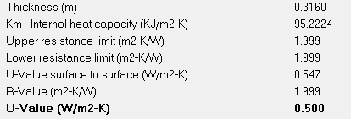
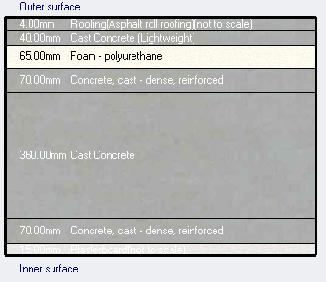
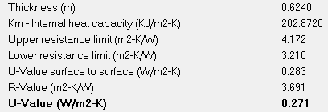
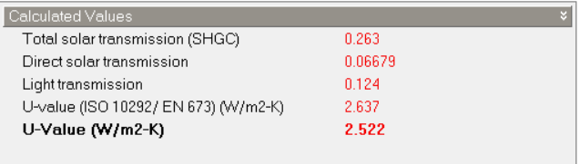
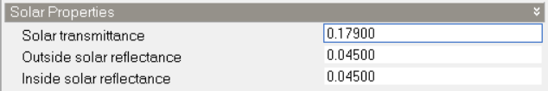
Material properties
External Wall
Roof material
Window Glass

Slide 19
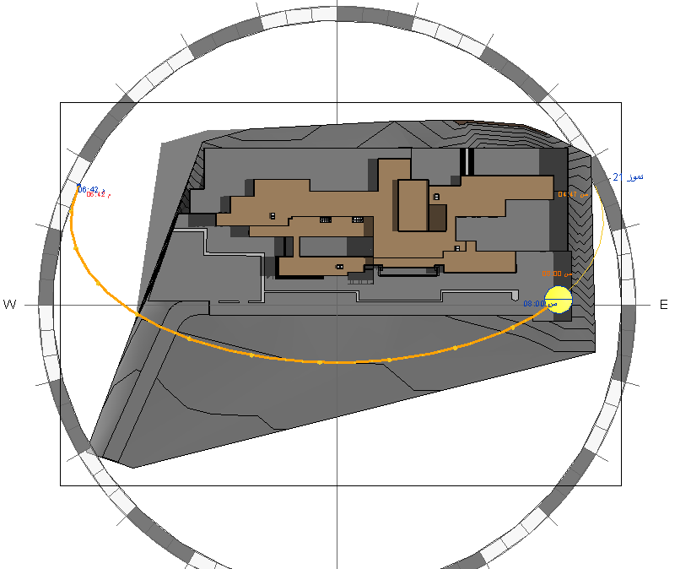
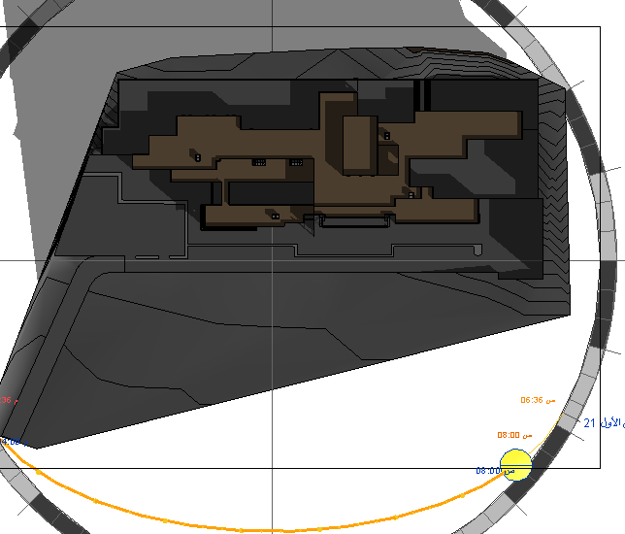
Shading
Shading in Winter at 8:00AM
Shading in Summer at 8:00AM

Slide 20
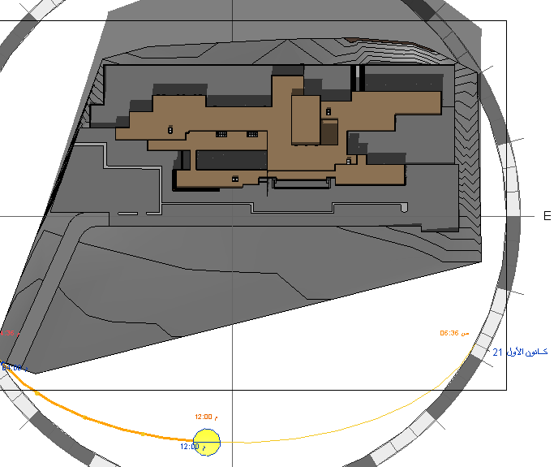
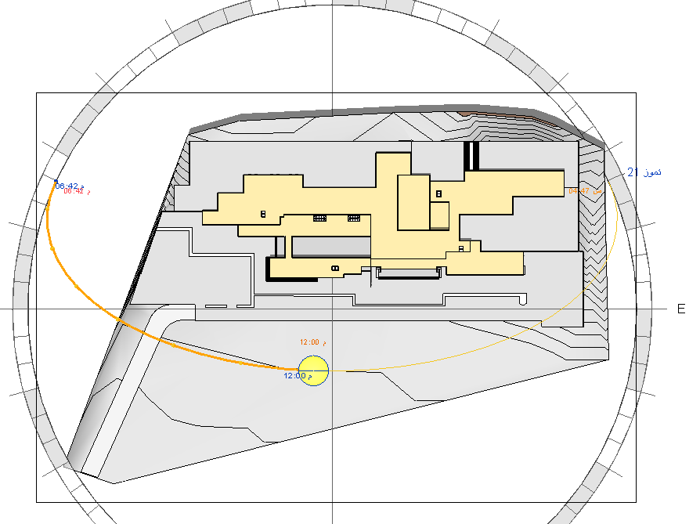
Shading
Shading in Winter at 12:00PM
Shading in Summer at 12:00PM

Slide 21
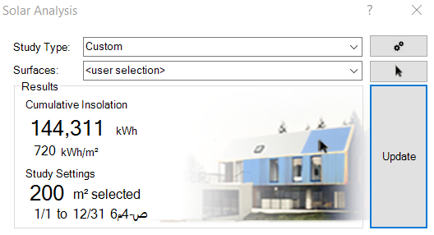
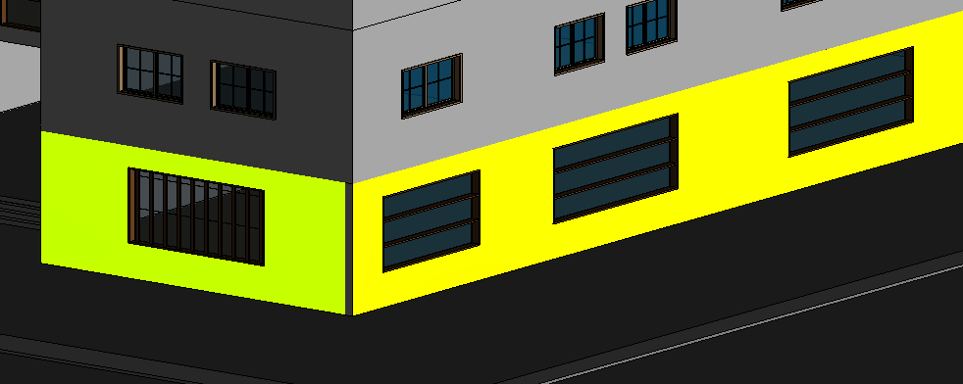
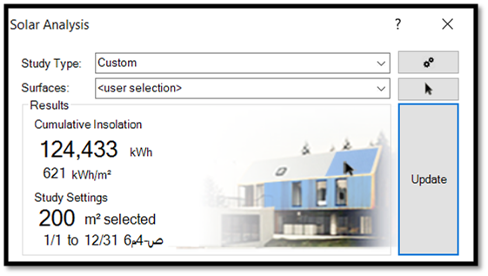
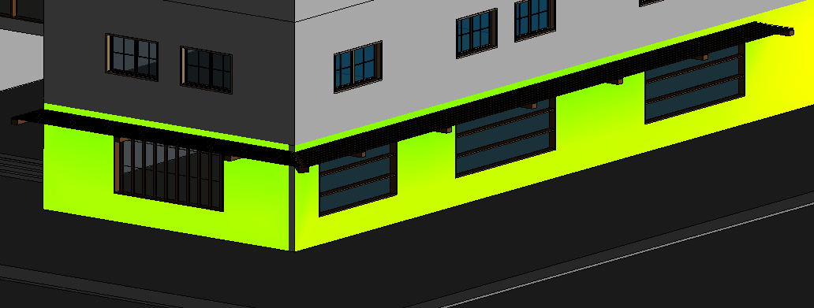
Solar Radiation
Before Treatment
After Treatment

Slide 22
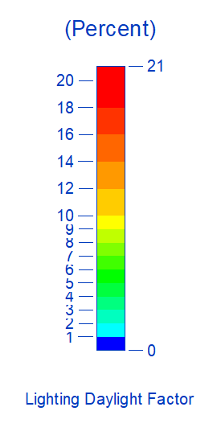
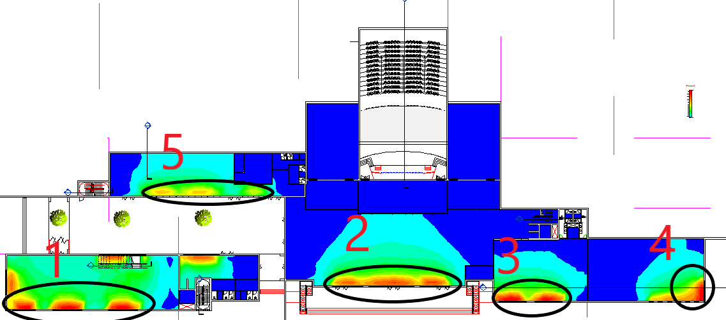
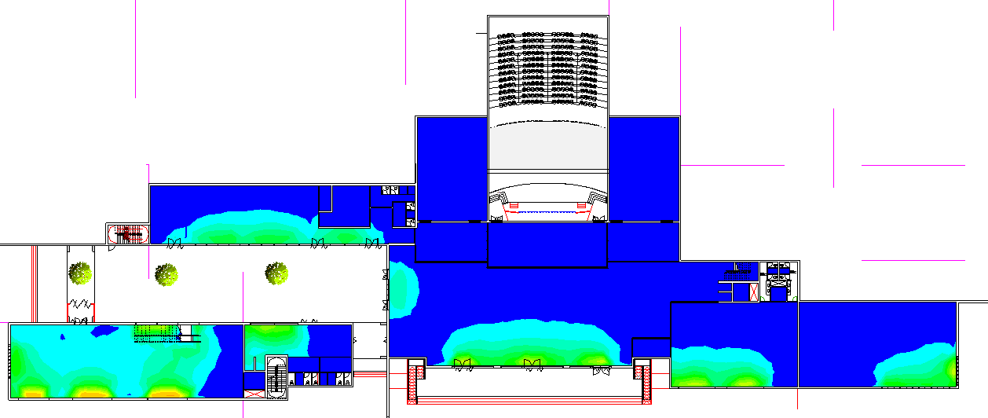
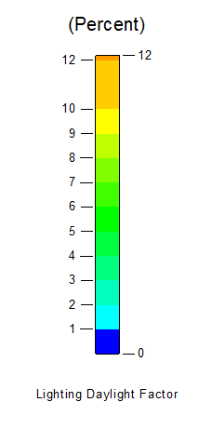
Daylight Factor
Ground floor
Before Treatment
After Treatment

Slide 23
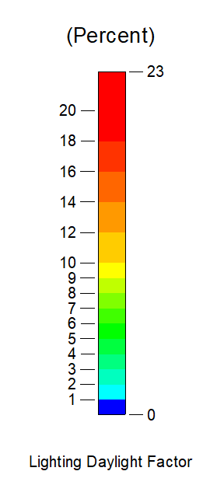
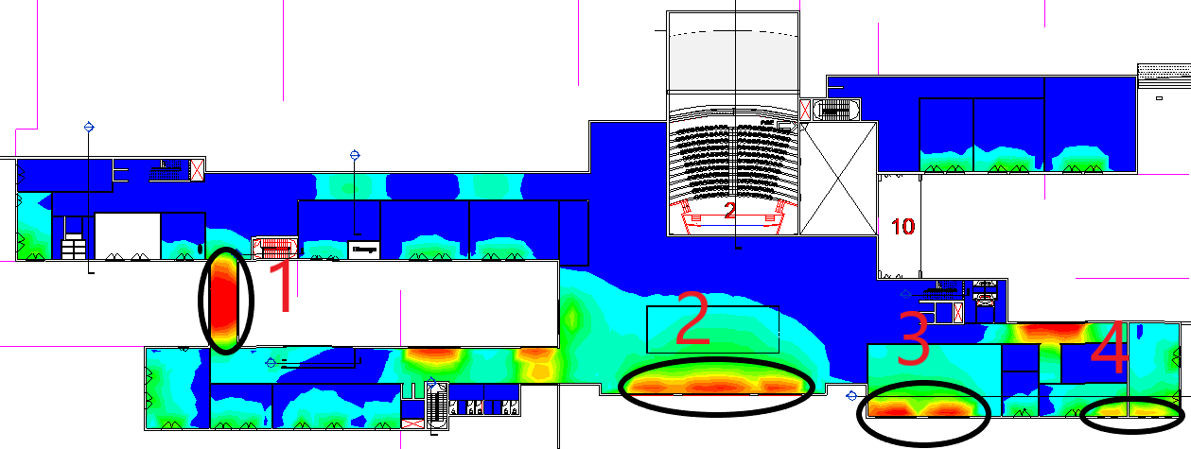
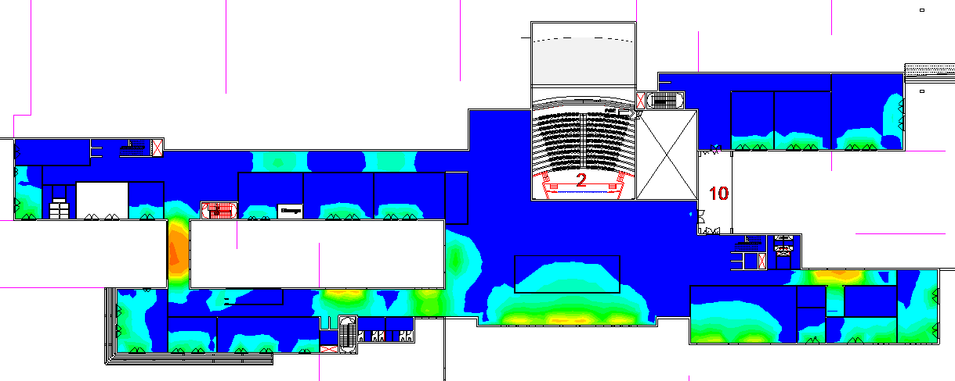
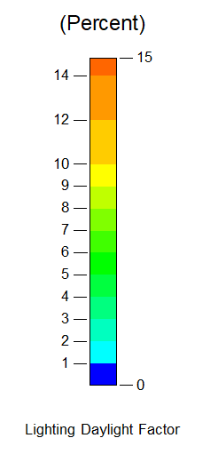
First floor
Before Treatment
After Treatment

Slide 24
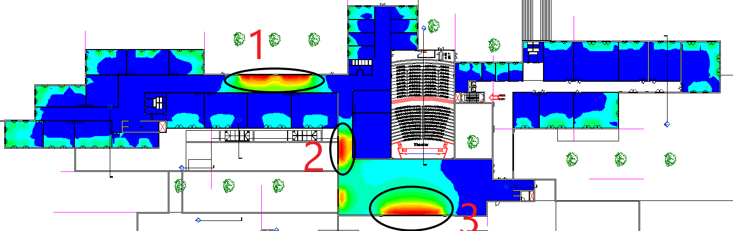
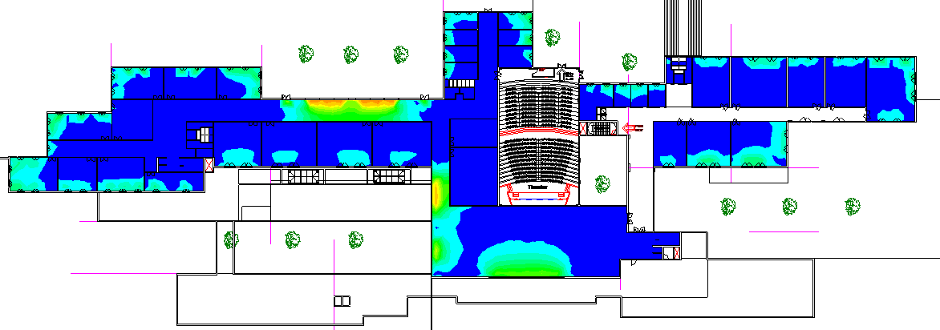
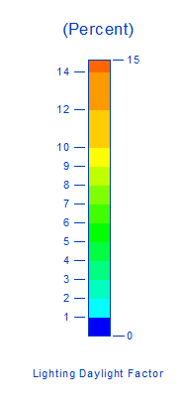
Second floor
Before Treatment
After Treatment

Slide 25
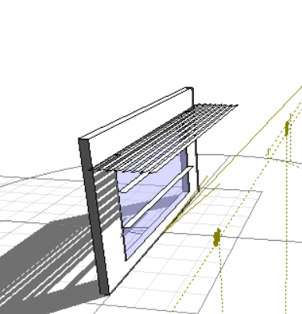
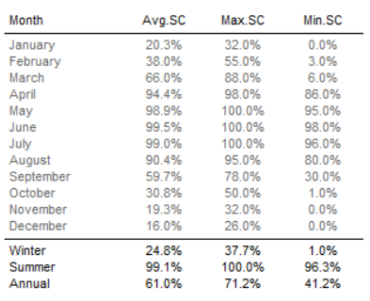
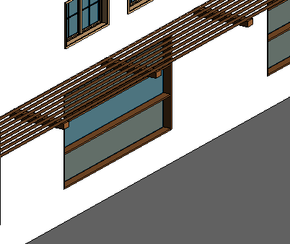
Treatment used
Treatment of south elevation( Solar Pergola)
Effective Shading Coefficient of south elevation

Slide 26
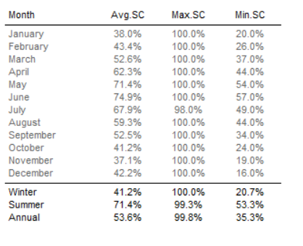
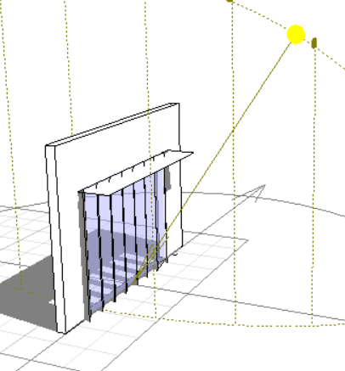
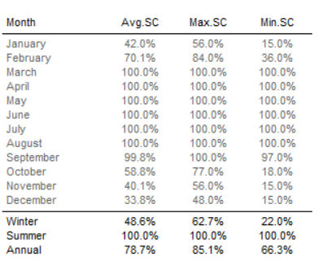
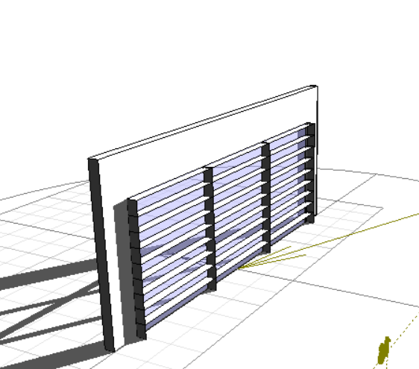
Treatment used
Treatment of East and West elevation
Effective Shading Coefficient of East elevation
Treatment of South elevation
Effective Shading Coefficient of south elevation

Slide 27




Treatment of south elevation
Effective Shading Coefficient of South elevation
Treatment of South elevation
Effective Shading Coefficient of south elevation

Slide 28





Acoustical Analysis
STC (Sound Transmission Class ) for Internal Wall

Slide 29


Acoustical Analysis
STC (Sound Transmission Class ) for
External Wall and OITC (Outdoor–Indoor Transmission Class)
(55 - 60 dBA)
Where the outdoor background noise level is between 55 dBA and 60 dBA, Since the amount of (background noise level) is 55dBA so that OITC rating not less than 55 – 25= 30dB this value is less than the actual OITC value of the wall 50dB, so its acceptable

Slide 30







Auditorium
Reverberation time (0.6 – 1.3 Sec)
Acoustic wood panel
Material of Chairs (Fabric)
Carpet
Gypsum Boards

Slide 31




Class room
Reverberation time (0.45 – 0.85 Sec)
Sabine
RT60 | Freq.
0.69 | 63Hz
0.54 | 125Hz
0.5 | 250Hz
0.63 | 500Hz
0.74 | 1KHz
0.79 | 2KHz
0.69 | 4KHz
0.55 | 8KHz
0.55 | 16KHz
Plaster Board
Tiles
Gypsum Boards

Slide 32


Auditorium
Articulation loss(AL) < 7%
Class room
Articulation loss(AL) < 7%
Articulation Loss | Frequency
3.1 | 100Hz
3.1 | 125Hz
3.1 | 160Hz
3.1 | 200Hz
3.1 | 250Hz
3.1 | 315Hz
3.1 | 400Hz
3.1 | 500Hz
3.1 | 630Hz

Slide 33


Speakers in corridor
The converge angle for speakers = 111֠
Coverage area = 9.5 m²

Slide 34

The distributed of the speakers in first floor

Slide 35
Structural Aspect

Slide 36

Ground floor Plan with expansion joint

Slide 37

First floor Plan with expansion joint

Slide 38

Second floor Plan with expansion joint

Slide 39












ETABS model for all blocks :
Block 1
Block 2
Block 3
Block 4
Block 5
Block 6
Block 7
Block 8
Block 9
Block 10
Block 11
Block 12

Slide 40
Information Analysis :
Codes :
ACI318-14 Code
UBC-97
Material Specification :
Compressive strength (F'c = 28MPa)
Yielding strength of steel (Fy = 420Mpa)
Loads :
Live Load = 6KN/m2
SID = 5KN/m2
Wall Load = 22KN/m

Slide 41
Information for seismic Analysis :
The parameters seismic analysis :
Seismic zone : the Scientific Research Center is located in Nablus city therefore the seismic zone is (2B) and the Z value is 0.20 .
Soil profile : type of soil is rock so the soil profile is SB .
Force Reduction Factor R = 5.5 (Building Frame System is used) (shear wall) .
Importance factor I = 1.25
Acceleration-Dependent Seismic Coefficient Ca = 0.2
Velocity-Dependent Seismic Coefficient Cv = 0.2
Weight source : Dead Load 100% and Live Load 25% .

Slide 42


Element dimensions :
Slab Thickness(U-Boot) used : 50cm ,65cm
Sections of Beams: 70*80cm, 80*80cm, 80*100cm and 50*50cm
Columns Sections: 30*60 cm, 40*80cm, 50*100cm, 70*70cm and 50*110cm
Shear Wall: 30cm thickness

Slide 43




Models from programs :
ETABS model for block 6 :
Safe model for block 6 :
ETABS model for block 4 :
Safe model for block 4 :

Slide 44
Seismic checks :
Drift check for block 4 :
Drift check for block 6 :
All drifts in floors is less than limit .
All drifts in floors is less than limit .
Base shear check for block 4 :
Base shear check for block 6 :
The values from ETABS is greater than manual values .
The values from ETABS is greater than manual values .

Slide 45




Design columns :
Table of design for block 4:
Table of design for block 6:
Detailing for columns :

Slide 46


Design columns :
Detailing for columns :

Slide 47




Design beams :
Detailing for beam :

Slide 48


Design slab :
Detailing for slab :

Slide 49

Design footing :
Plan footing for block 6:

Slide 50




Design footing :
Detailing for footing and Tie beam :

Slide 51


Design water tank :
Detailing for water tank:

Slide 52


Design Retaining Wall:
Detailing for Retaining wall :

Slide 53
Electrical Aspects

Slide 54









Artificial Lighting
Luminaries used in project
RC72
LI43
LI61
Ad 31
LI33
CR32
Ad 31
RC52
Specification for Luminaries

Slide 55




Result from DIALux evo for the Physical Lab .
Rendering for Physical Lab.
Check for illuminance and UGR .

Slide 56




All Luminaries used for the ground floor.
Rendering for cafeteria
Rendering for staircase
Rendering for Library

Slide 57



Rendering for auditorium from DIALux evo

Slide 58

All Luminaries used for the First Floor.
Rendering for Physical Lab

Slide 59


All Luminaries used for the Second floor.
Rendering for Computer Lab

Slide 60



Check for illuminance and UGR for all spaces
Check for illuminance and UGR for Ground floor
Check for illuminance and UGR for First floor
Check for illuminance and UGR for Second floor

Slide 61



Distribute the lighting on the ground floor
Symbols of Lighting

Slide 62


Distribute the lighting on the First floor

Slide 63


Distribute the lighting on the Second floor

Slide 64


Distribute the lighting on the Auditorium

Slide 65



Distribute the Sockets on the Ground floor
Symbols of Socket

Slide 66


Distribute the Sockets on the First floor

Slide 67


Distribute the Sockets on the Second floor

Slide 68

Main distribution board
Main distribution board for all floors
Distribution of circuit breaker in distribution board 1

Slide 69

Main distribution board
Main distribution board of circuit breaker in the ground floor

Slide 70

PV system
Position of modules
Area | 1740 m2
No. modules | 896
Power produced | 278 kw

Slide 71

PV system
Drawing Modules distribution by AutoCAD program

Slide 72



PV system
Drawing modules distribution by REVIT program

Slide 73
PV system
Summary
Type of module | Yingli solar (310w /31v)
Type of inverter | Generic (30 kw/400-700 v)
The power produced by PV sys | 278 kw
The power lighting usage in the building | 124 kw
The power produced by PV sys | 480 MWh/year
The solar energy value covers the entire lighting, and the extra value cover the building's energy consumption

Slide 74

PV system
Summary cash flow

Slide 75
Mechanical Aspects
Plumbing system
Water Supply system
Fire Fighting system
HVAC system

Slide 76


Plumbing system
Plumbing ground floor plan
EXAMPLE

Slide 77


Plumbing system
Plumbing first floor plan
EXAMPLE

Slide 78


EXAMPLE
Plumbing system
Plumbing second floor plan

Slide 79


Manholes distribution

Slide 80

Water supply
Water supply Ground floor

Slide 81

Water supply
Water supply first floor

Slide 82

Water supply
Water supply second floor

Slide 83

Distribution water tank

Slide 84
Water supply
Water consumption
 | Water consumption
Fresh water | 100 (m3/4days)
Gray water | 12 (m3/day)
Storm water | 1640 (m3/year)
Net water needed |  | 25 (m3/days)
Size of water tank
 | Volume (m3) | Number of tank | Diminution (m)
Fresh water | 100 | 2 | 5 x 5 x 4
Grey & storm water | 1676 | 2 | 21 x 20 x 4
Black water | 285 | 2 | 10 x 10 x 2.9

Slide 85



Fire fighting system
The symbols of the suppression system in the plans

Slide 86


Fire fighting system
Fire fighting in Ground floor
Space | sprinkler | Extinguisher
cafeteria | Water | Water
Space | sprinkler | Extinguisher
corridor | Water | Water
Space | sprinkler | Extinguisher
Library | Powder | Powder

Slide 87

Fire fighting system
Fire fighting in First floor
Space | sprinkler | Extinguisher
Meeting room | Powder | Powder
Space | sprinkler | Extinguisher
corridor | Water | Water
Space | sprinkler | Extinguisher
Labs | Powder | Powder

Slide 88

Fire fighting system
Fire fighting in Second floor
Space | sprinkler | Extinguisher
Labs | Powder | Powder
Space | sprinkler | Extinguisher
corridor | Water | Water

Slide 89

HVAC system
The system used in the project VRF system
The table below shows the amount of design capacity for building floors
Capacity (Q)(KW) | Floor
366 | Ground floor
262 | First floor
338 | Second floor
966 | Total

Slide 90



HVAC system
Specification of VRF System components
  2- Fan coil (YORK company)
  1- Diffuser

Slide 91

HVAC system
  3- Outdoor unit(YORK company)

Slide 92

HVAC system
  Cross section ducts in Electronic Lab
Table give air velocity in ducts, duct dimension in Electronic Lab
Duct Dimensions |  | Velocity | Duct Name
Width(mm) | Height(mm)
425 | 425 | 5m/s | Sec (A-B) Supply
325 | 325 | 5m/s | Sec (C-D)Supply
225 | 225 | 5m/s | Sec (D-E)Supply
325 | 325 | 5m/s | Sec (F-G)Supply
325 | 325 | 5m/s | Sec (H-I) Return
225 | 225 | 5m/s | Sec (J-K)Return
225 | 225 | 5m/s | Sec (L-M)Return

Slide 93



HVAC system
Distributing the HVAC system on the Ground floor
Symbols of HVAC system

Slide 94


HVAC system
Distributing the HVAC system on the First floor

Slide 95


HVAC system
Distributing the HVAC system on the Second floor

Slide 96


HVAC system
3D molding for HVAC system

Slide 97


Systems integration
False Ceiling for Ground floor

Slide 98


Systems integration
False Ceiling for First floor

Slide 99


Systems integration
False Ceiling for Second floor

Slide 100
Cost Estimation
The information below is for the entire building
Mobilization = 18000 NIS
Excavation = 269950.1 NIS
Water Tank = 39166.5 NIS
Site Work = 515648.8 NIS

Slide 101


Cost Estimation
The total area of the Block 1(Exhibition) is 1760 m2.
BLOCK1
WORK | COST | %Percent | Cost for 1 MS
Structural | 753269.8 | 29.10 | 579.4
Finish work | 615900 | 23.79 | 473.8
Mechanical | 400008.2 | 15.45 | 307.7
Electrical | 38874.0 | 1.50 | 29.9
Site Work | 780568.1 | 30.15 | 446.0
TOTAL | 2588620.6 | 100.00 | 1836.8

Slide 102


Cost Estimation
The total area of the Block 6 (Library) is 951.6 m2.
BLOCK6 (Librarity)
WORK | COST | %percent | Cost for 1 MS
Structural | 405132.7 | 26.35 | 506.4
Finish work | 471411 | 30.66 | 589.3
Mechanical | 5040.0 | 0.33 | 6.3
Electrical | 25715.0 | 1.67 | 32.1
Site Work | 630456.3 | 41.00 | 662.9
TOTAL | 1537754.9 | 100 | 1922.2

Slide 103



Cost Estimation
The total area of the Block 2 (Auditorium) is 1963 m2.
BLOCK 2 (auditorium)
WORK | COST | %percent | Cost for 1 MS
Structural | 432645.1 | 17.00 | 360.5
Finish work | 256990 | 10.10 | 214.2
Mechanical | 990036.8 | 38.91 | 825.0
Electrical | 51200.0 | 2.01 | 42.7
Site Work | 813574.3 | 31.97 | 414.5
TOTAL | 2544446.2 | 100 | 1856.8

Slide 104



Cost Estimation
The total area of the Block 4 (Reception) is 2765 m2.
BLOCK 4 (Reception)
WORK | COST | %percent | Cost for 1 MS
Structural | 581205.2 | 26.77 | 484.3
Finish work | 387762 | 17.86 | 323.1
Mechanical | 318254.4 | 14.66 | 265.2
Electrical | 21560.0 | 0.99 | 18.0
Site Work | 862314.4 | 39.72 | 312.4
TOTAL | 2171096.5 | 100 | 1809.2

Slide 105
Thank
You

