Slide 1
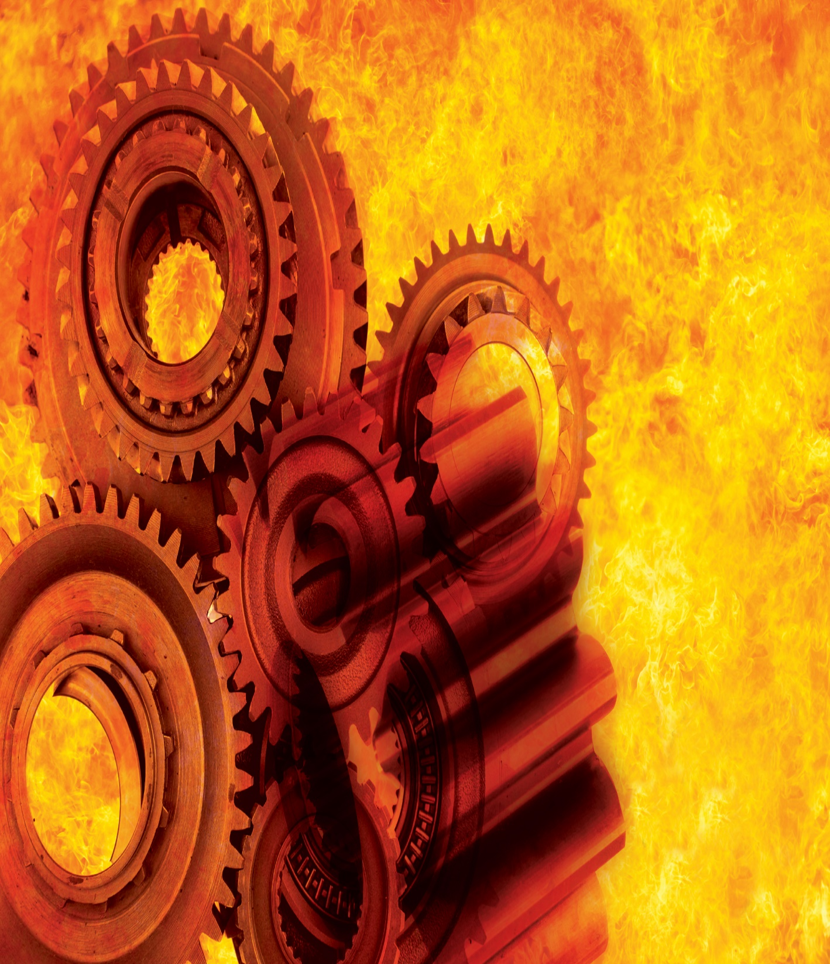

An-Najah National University Faculty of Engineering and Information Technology
GRADUATION PROJET (2)
Heat Treatment Furnace
Muhannad Ishtayeh
Ala Shurap
Supervisor:
Dr. Osayd Abdulfattah
6 Jun 2021

Slide 2
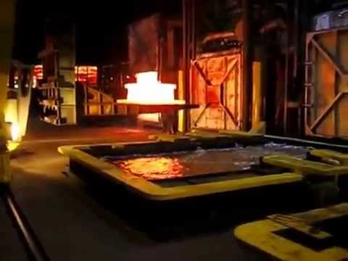
Abstract
The main objective of this project is design and builds a metals heat treatment furnace. The furnace operating temperature must be control from (180° C-1200° C) by using electrical heater and special sensor to control temperature inside the furnace. This furnace is built from thermal insulation material such as thermal bricks, refractory’s, and other materials. Outside temperature of the furnace must be between (40°C-50°C).

Slide 3
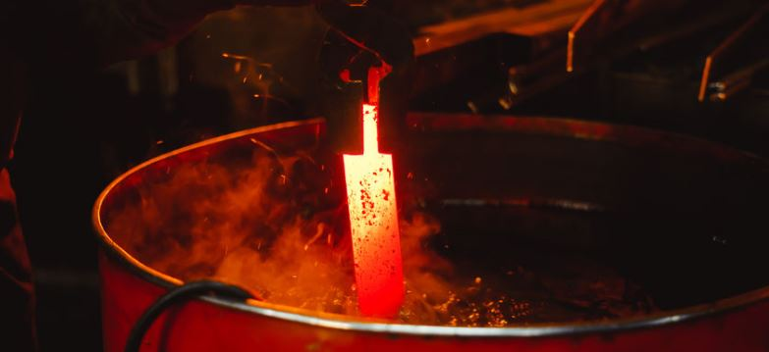
Objectives
The main objective of the project is design a heat treatment furnace in order to enhance the material's mechanical properties by regulating the hardness and ductility of solid state transformation, in order to design the furnace most selected the following:
1-Best thermal insulator types.
2-Best forms of thermal conductivity (wires).
3-Design and manufacture of the best shape from of the furnace.

Slide 4
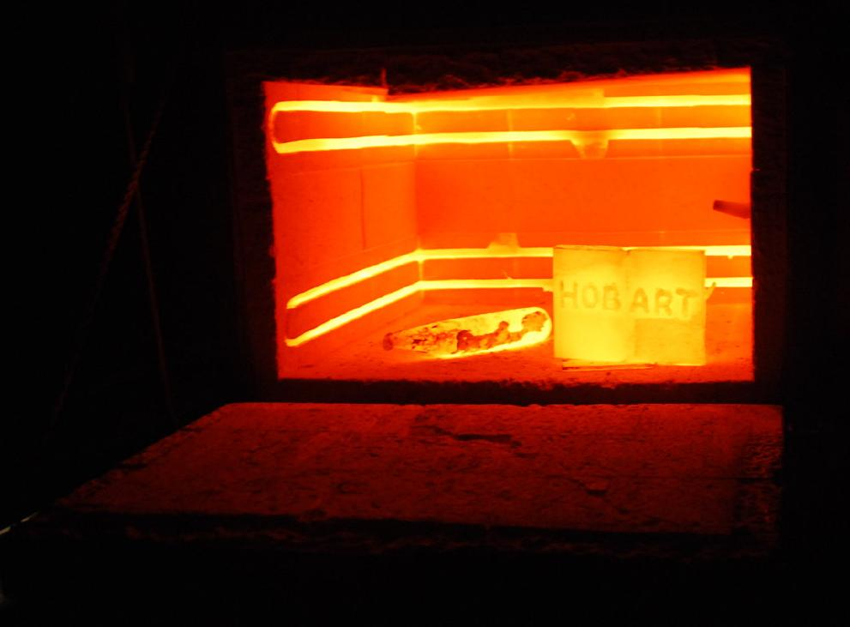
Some heat treatment-requiring systems
The replacement parts of cars.
Sections of a motorcycle.
Tools for experts.
Cars gear.
Properties which control by metal heat treatment
Increase in hardness metal.
Increase ductility metal.
Tensile strength the metal.
Increase the ability of the metal to shape and process operations.
Removal of internal tension the metal induced by activities.
Remove the consequences of cold forming processes.

Slide 5
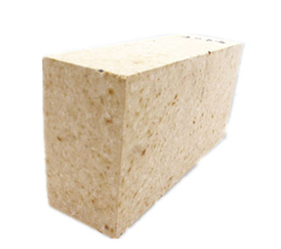
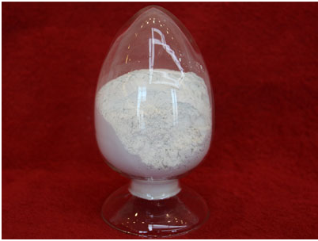
Literature review
Types of heat treatment furnace:
1-Heating by combustion:
-Solid Fuels (Coal/Pulverized Coal).
-Liquid Combustibles (oil).
2-Electric heating:
-Electrical heater.
-Electric induction.
**We will select an electric heater furnace after reviewing the available parts of the furnaces on the market.
2. Furnace Refractory
Refractory cement
High Alumina Cement.**
Calcium Aluminate Cement.
Refractory bricks.
Silica Brick.**
Silica Refractory/Fire Brick.
Chrome Corundum Brick.
High Alumina Refractory Brick.

Slide 6
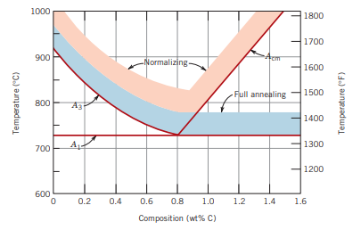
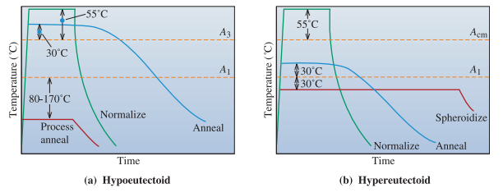
Heat treatment processes
There are several different types of heat treatment processes, by regulating the time of heating and cooling, and they are classified into several types:
Annealing.
Normalizing .
Quenching and Tempering.

Slide 7
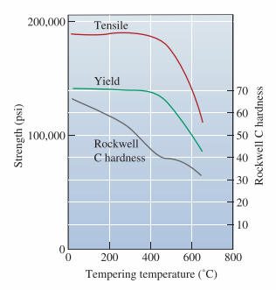
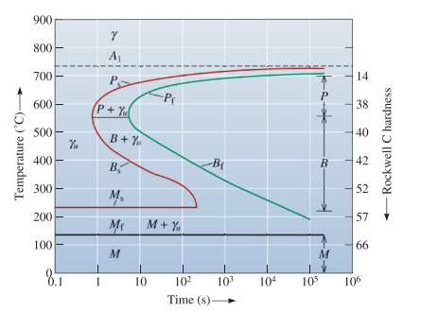
The time-temperature-transformation (TTT) diagram for a eutectoid steel
Effect of tempering temperature on the properties of a eutectoid steel.

Slide 8
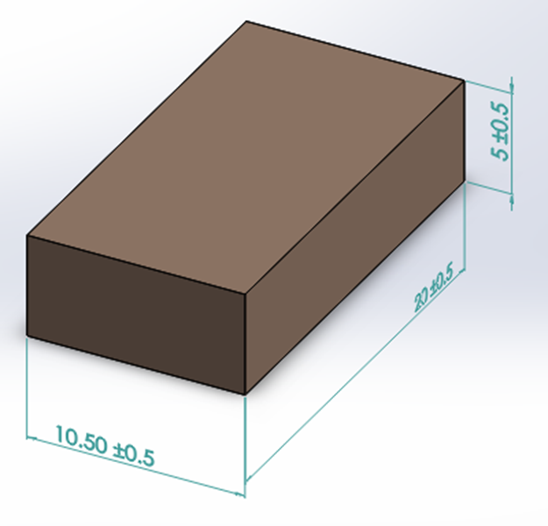
Methodology
Furnace methodology
The design of the furnace was studied in two main parts:
The structural model.
The furnace's structural model
Heat insulators
Heater locations
Sample control charts.
Parts of the furnace wall:
Refractory bricks: It is a refractory ceramic block used for furnace liners. Refractory bricks are primarily designed to withstand high temperatures and generally have low thermal conductivity to increase the efficiency of insulation.
Dimensions:-
(5×10×20)

Slide 9
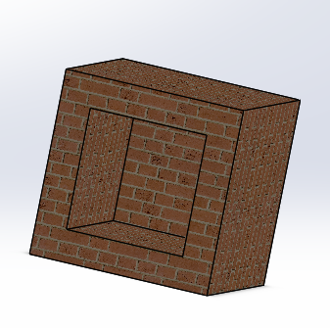
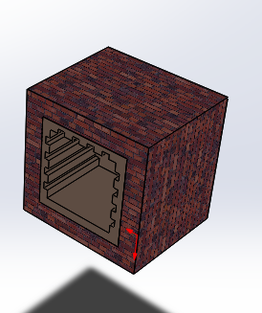
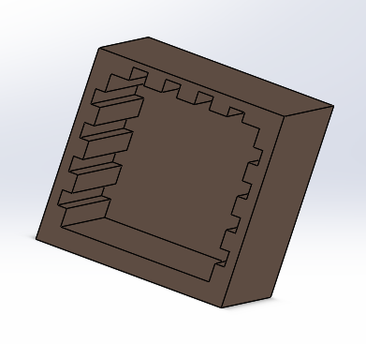
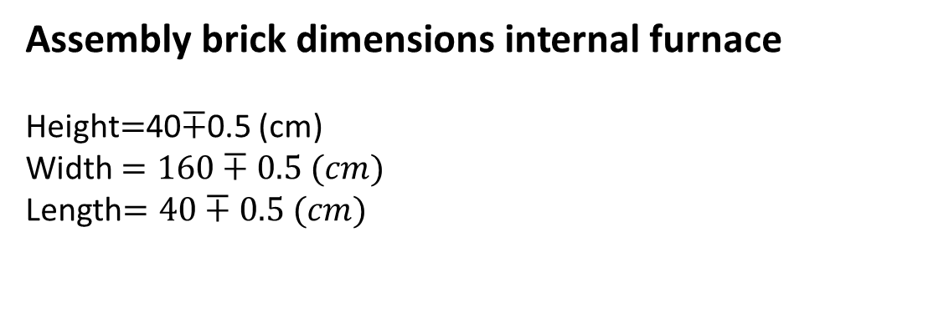
Assembly brick dimensions internal furnace
Height$=$40$∓$0.5 (cm)
Width $=160∓0.5 (cm)$
Length$=40∓0.5 (cm)$
Heater duct shape
Conduits are designed for wire fixation and placement.
With special refractory cement, Sewers is poured with.
Wire conduits are built on the side and upper walls only.

Slide 10
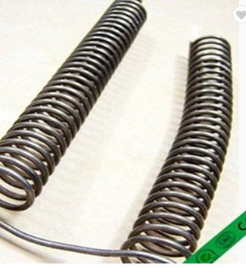
Power system
power supply
As the power source for the furnace, the electric heater was selected.
Characteristics of the electric heater:
No environmental pollution.
It needs a power supply (for heat supply).
It is efficient and plentiful.
**Selected the Kanthal A1 heater as the electric heater in this project

Slide 11
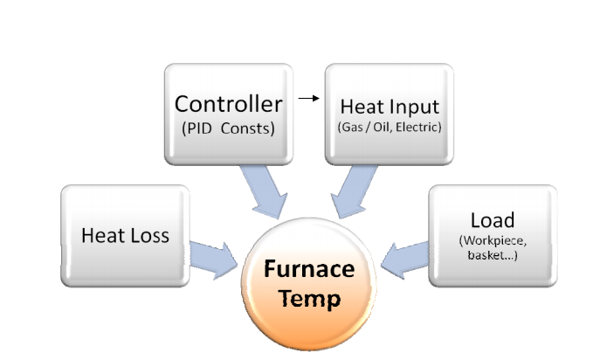
Heat transfer
Factors which impact the measurement of the furnace temperature:

Slide 12
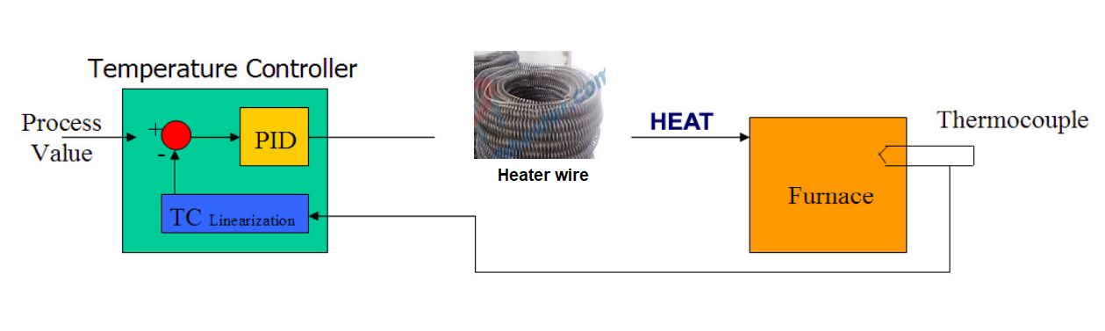
Furnace temperature control
Temperature controllers regulate the furnaces. Temperatures of the Controllers receive their inputs from a thermocouple located inside the furnace and give the sensor the necessary control action to maintain the set point of the process .

Slide 13
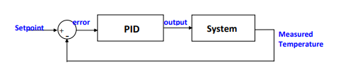
The control system is made up of numerous components
Contractor
Phase sequence:
Thermocouple temperature sensor:
Controller

Slide 14
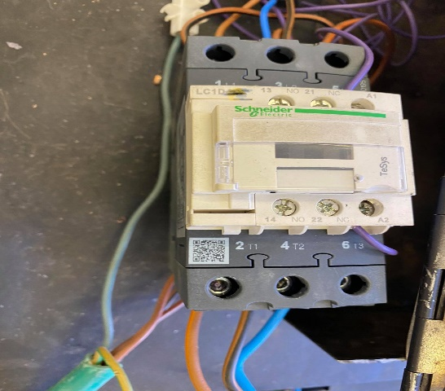
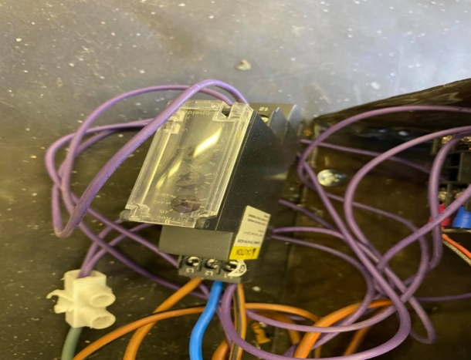
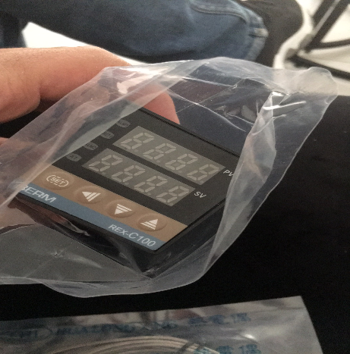
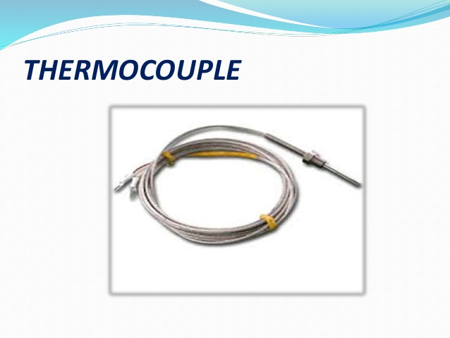
Contractor
Phase sequence
Controller
Thermocouple temperature sensor

Slide 15
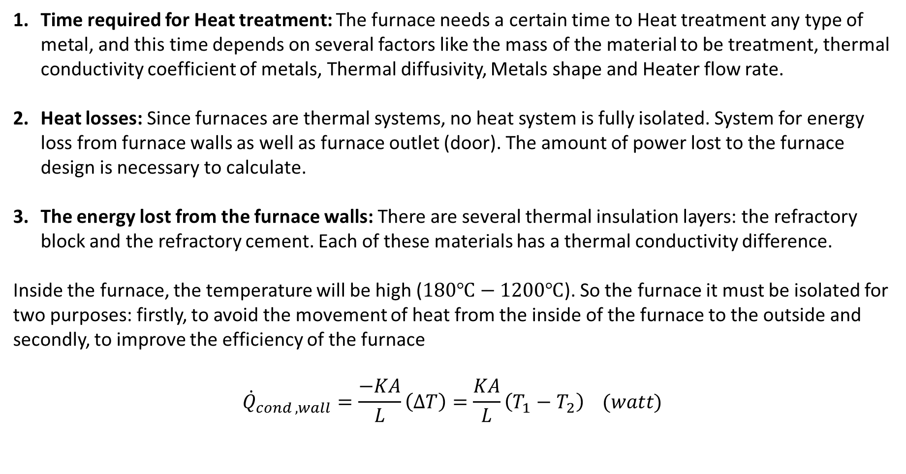
Furnace Design
Time required for Heat treatment: The furnace needs a certain time to Heat treatment any type of metal, and this time depends on several factors like the mass of the material to be treatment, thermal conductivity coefficient of metals, Thermal diffusivity, Metals shape and Heater flow rate.
Heat losses: Since furnaces are thermal systems, no heat system is fully isolated. System for energy loss from furnace walls as well as furnace outlet (door). The amount of power lost to the furnace design is necessary to calculate.
The energy lost from the furnace walls: There are several thermal insulation layers: the refractory block and the refractory cement. Each of these materials has a thermal conductivity difference.
Inside the furnace, the temperature will be high ($180℃−1200℃$). So the furnace it must be isolated for two purposes: firstly, to avoid the movement of heat from the inside of the furnace to the outside and secondly, to improve the efficiency of the furnace
$${\dot{Q}}_{cond ,wall}=\frac{−KA}{L}\left(∆T\right)=\frac{KA}{L}\left(T_{1}−T_{2}\right) (watt)$$

Slide 16
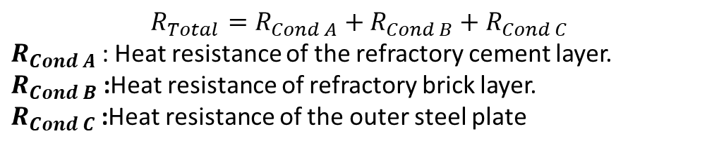
Thermal resistance network
$$R_{Total}=R_{Cond A}+R_{Cond B}+R_{Cond C}$$
$R_{Cond A}$ : Heat resistance of the refractory cement layer.
$R_{Cond B}$ :Heat resistance of refractory brick layer.
$R_{Cond C}$ :Heat resistance of the outer steel plate
Table 1: thermal resistance and thickness of the wall component
layer | Thermal conductivity “ k” | Thickness (mm)
refractory cement (A) | 0.74 | 20
refractory brick (B) | 0.55 | 105
Steel (C) | 50 | 3

Slide 17
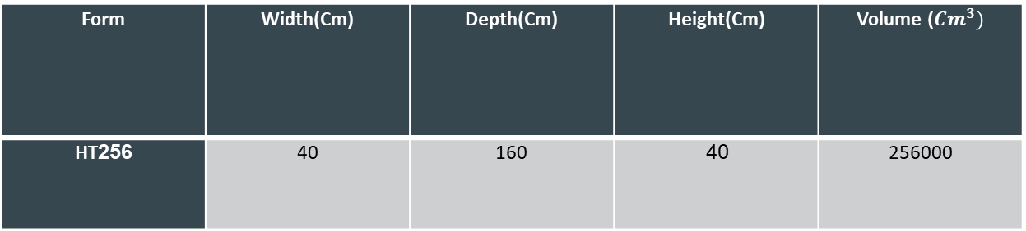
Typical model sizes for furnaces
Table 2 : dimension
Form | Width(Cm) | Depth(Cm) | Height(Cm) | Volume (${Cm}^{3})$
HT256 | 40 | 160 | 40 | 256000
Technical information
Table 3 : electrical component
Form | Voltage | energy | Heating element | Control power type | sensor measure | Temperature extremes
HT256 | 380 V | 20733 KW | Kanthal A1 | PID-SSR | PtRh%10-Pt | 1200 °C

Slide 18

Calculations
R wire =42(ohm)
V=380 (V)
I line =63× √3 =109.12 (A)
P = V * I * √3 * cosf
P=380 ×109.12 ×cos(60)=20733 watt
$$T_{s,cylinder}=1200℃+273=1473 K$$
Calculate ${\dot{e}}_{gen}$⇾⇾⇾⇾⇾⇾ ${\dot{e}}_{gen}=$56640 (KWatt)
$\dot{Q}={\dot{e}}_{gen} V$⇾⇾⇾$\dot{Q}={\dot{e}}_{gen}πr_{o}^{2}L$
wire length=116.6$±2$ (m)

Slide 19
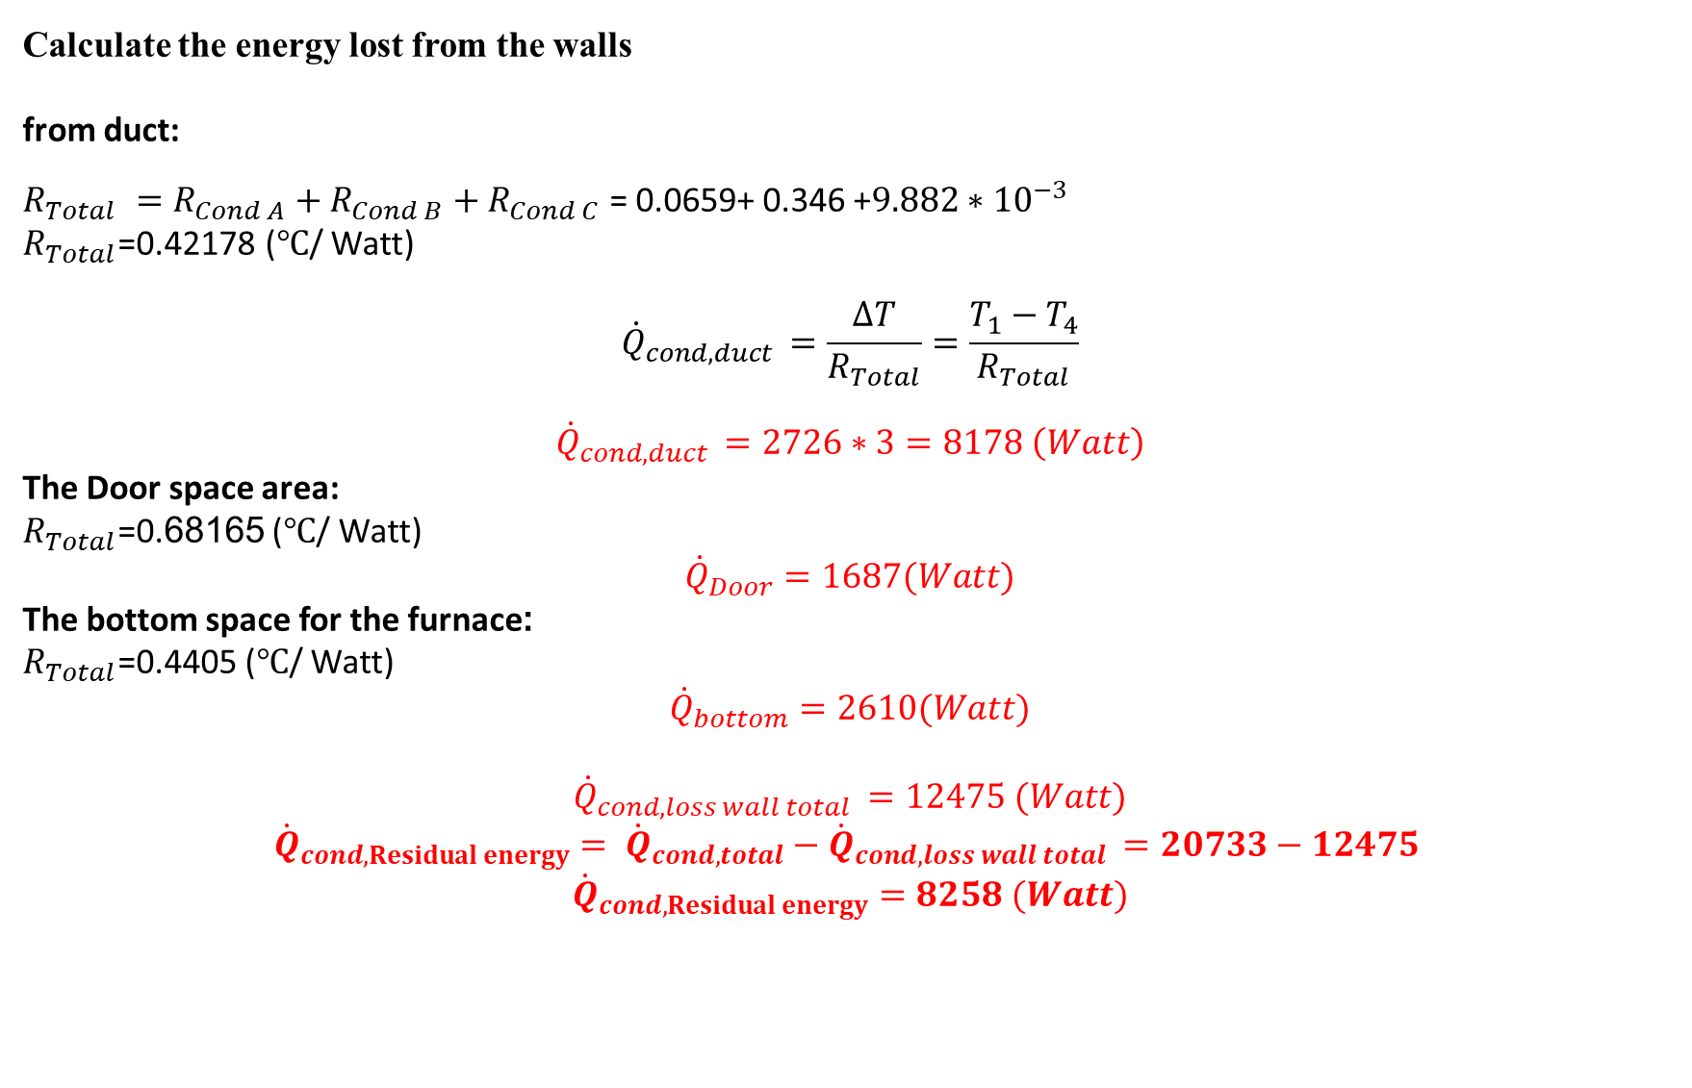
Calculate the energy lost from the walls
from duct:
$R_{Total} =R_{Cond A}+R_{Cond B}+R_{Cond C}$ = 0.0659+ 0.346 +$9.882∗{10}^{−3}$
$R_{Total}$=0.42178 ($℃$/ Watt)
$${\dot{Q}}_{cond,duct }=\frac{∆T}{R_{Total}}=\frac{T_{1}−T_{4}}{R_{Total}}$$
$${\dot{Q}}_{cond,duct }=2726∗3=8178 \left(Watt\right)$$
The Door space area:
$R_{Total}$=0.68165 ($℃$/ Watt)
$${\dot{Q}}_{Door}=1687(Watt)$$
The bottom space for the furnace:
$R_{Total}$=0.4405 ($℃$/ Watt)
$${\dot{Q}}_{bottom}=2610(Watt)$$
$${\dot{Q}}_{cond,loss wall total }=12475 (Watt)$$
$${\dot{Q}}_{cond,Residual energy}= {\dot{Q}}_{cond,total}−{\dot{Q}}_{cond,loss wall total }=20733−12475$$
$${\dot{Q}}_{cond,Residual energy}=8258 (Watt)$$

Slide 20
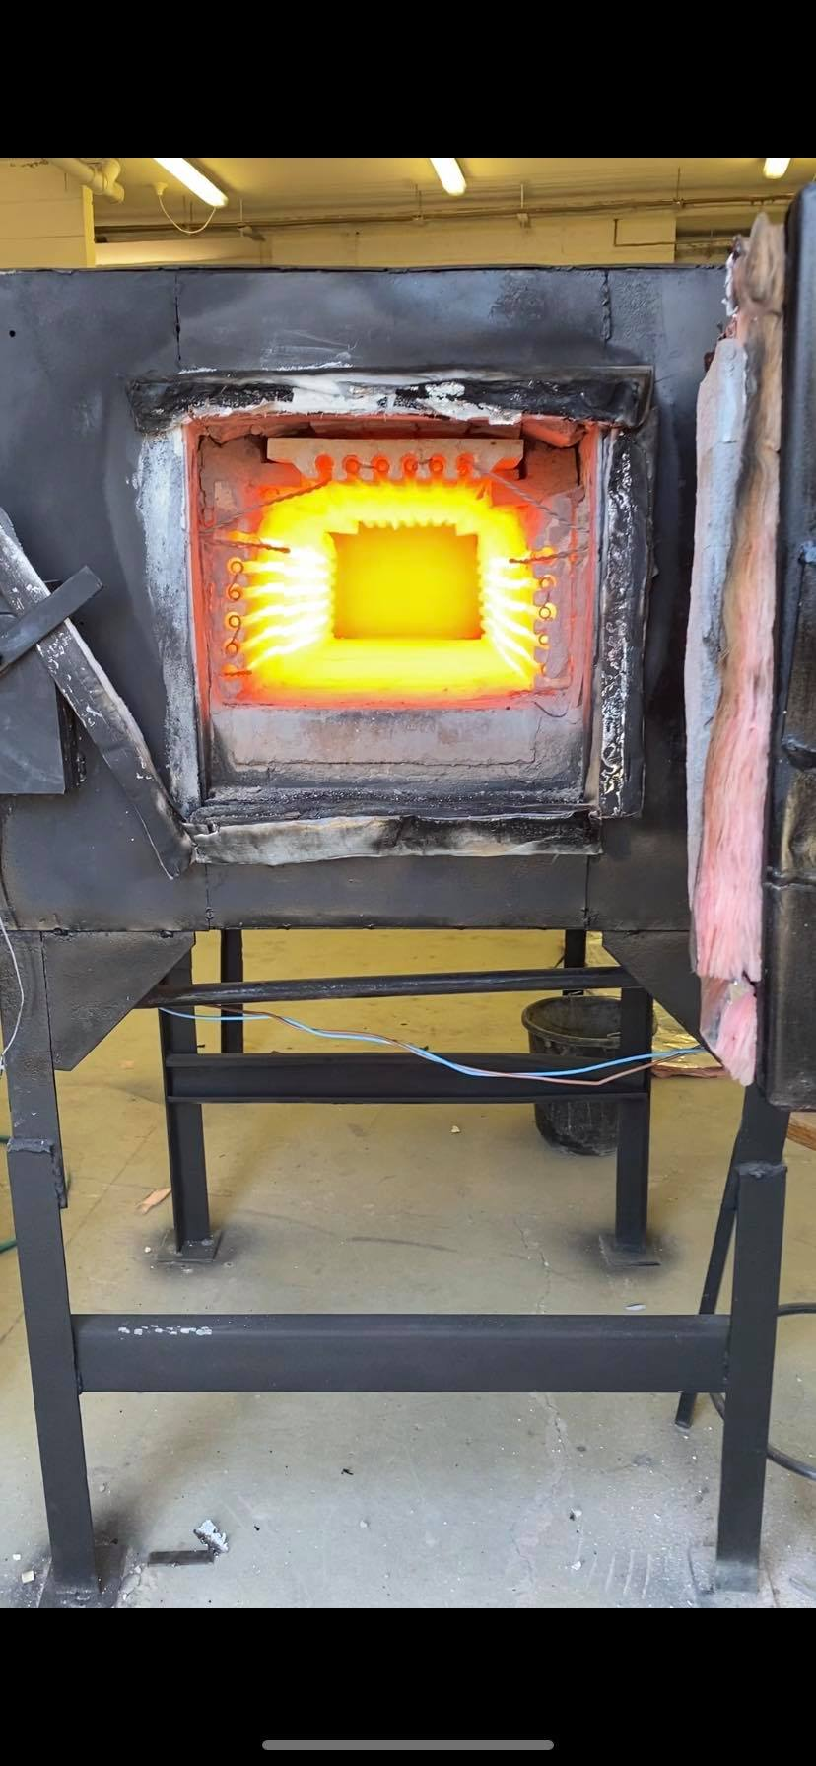
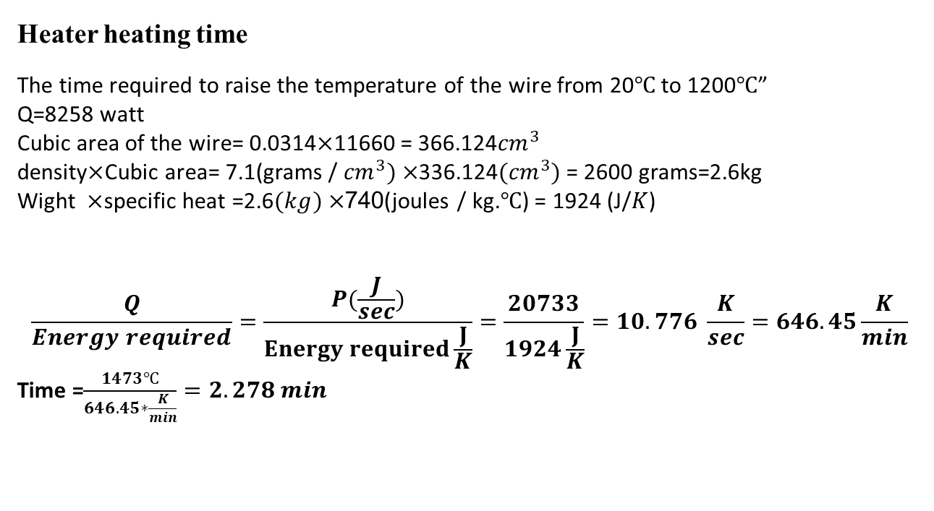
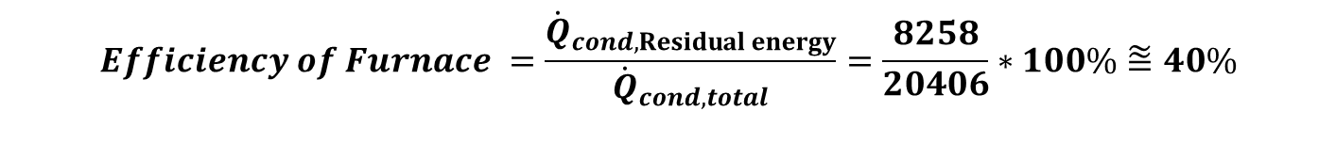
$$Efficiency of Furnace =\frac{{\dot{Q}}_{cond,Residual energy}}{{\dot{Q}}_{cond,total}}=\frac{8258}{20406}∗100\%⩰40\%$$
Heater heating time
The time required to raise the temperature of the wire from 20$℃$ to 1200$℃$”
Q=8258 watt
Cubic area of the wire= 0.0314$×$11660 = 366.124${cm}^{3}$
density$×$Cubic area= 7.1(grams / ${cm}^{3})×$336.124${(cm}^{3})$ = 2600 grams=2.6kg
Wight $×$specific heat =2.6$(kg)×$740(joules / kg.$℃$) = 1924 (J/$K$)
$$\frac{Q}{Energy required}=\frac{P(\frac{J}{sec})}{Energy required\frac{J}{K}}=\frac{20733}{1924\frac{J}{K}}=10.776 \frac{K}{sec}=646.45\frac{K}{min}$$
Time =$\frac{1473℃}{646.45∗\frac{K}{min}}=2.278 min$

Slide 21
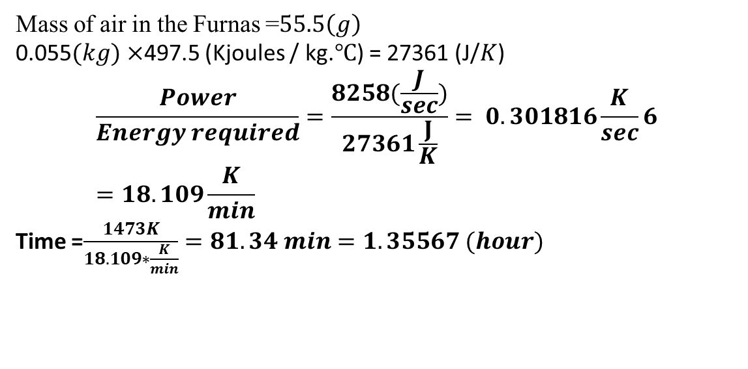
air heating time:
Mass of air in the Furnas =$55.5\left(g\right)$
0.055$(kg)×$497.5 (Kjoules / kg.$℃$) = 27361 (J/$K$)
$$\frac{Power}{Energy required}=\frac{8258(\frac{J}{sec})}{27361\frac{J}{K}}= 0.301816\frac{K}{sec}6=18.109\frac{K}{min}$$
Time =$\frac{1473K}{18.109∗\frac{K}{min}}=81.34 min=1.35567 (hour)$
Time total = 81.34+2.278=83.618$(min)$ = 1.3936 (hour)

Slide 22
Conclusion and recommendations
Conclusion:-
Heater:
In this project, 116.6 meters long electrical wires were designed to provide power of 56640 K watts, resulting from this generated energy thermal conductivity energy of 20.733 kilowatts, The total loss from the furnace wall is 12475 watts, and power required for heat treatment is 8258 watts,then the efficiency is 39.83 %.
Heater ducts:
After a detailed analysis of the heat treatment furnaces and a study of the Structural design of the heater ducts, it was concluded that, in order to achieve the best heat distribution inside the furnace, most heat treatment furnaces put heating wires on the side and upper walls of the furnace.

Slide 23
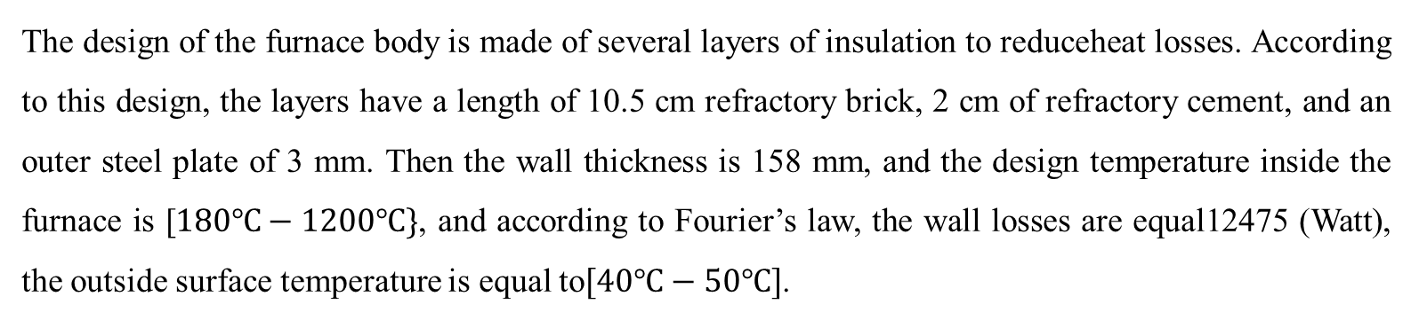
Furnace body
The design of the furnace body is made of several layers of insulation to reduceheat losses. According to this design, the layers have a length of 10.5 cm refractory brick, 2 cm of refractory cement, and an outer steel plate of 3 mm. Then the wall thickness is 158 mm, and the design temperature inside the furnace is [$180℃−1200℃\}$, and according to Fourier’s law, the wall losses are equal12475 (Watt), the outside surface temperature is equal to$[40℃−50℃]$.
Control system
The furnace is fitted with a system for temperature control, and the temperature is taken from the furnace sensor. By opening and closing the electric current, the temperature is controlled via a control system. This will allow the critical control unit to maintain strict control over the process of heat treatment. This will still be valid furnace if the parameters of the process (load size, heating amount, etc.) change over time.

Slide 24
recommendations
The wasted energy of doors and oven wall is relatively high, so we suggest installing a new, stronger insulation layer between doors and furnace wall, such as a layer of rock wool. Since the rock wool has very little thermal conductivity and good sealing of the furnace, this will greatly reduce losses.

Slide 25
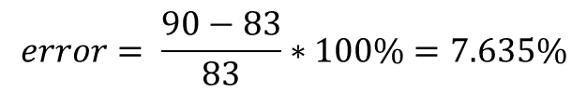
Results
It has been noticed that the temperature of the furnace must go from 20°C to 1200°C. The theoretical time needed for the furnace to reach 1200°C is 83 mentis while the practical time needed was about 90 mentis. This error in the required heating time is due to multiple factors such as:
Heat escaping from the door’s frame.
The electrical current is changing during the starting period before reaching steady state current.
Heat escaping from the thermocouple temperature sensors hole.
$$error= \frac{90−83}{83}∗100\%=7.635\%$$

Slide 26
Table 4 :Result of Adjusting some temperatures and following up on the control device
Section # | Set Temperature (°C) | Measured Temperature (°C) | Error Percentage (%)
1 | 500 | 465 | 7
2 | 700 | 665 | 5
3 | 900 | 865 | 3.88
4 | 1000 | 965 | 3.5
5 | 1100 | 1065 | 3.18
6 | 1200 | 1165 | 2.91

Slide 27
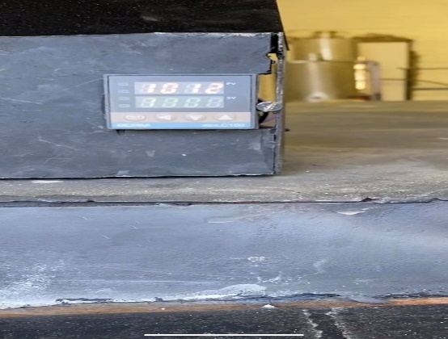
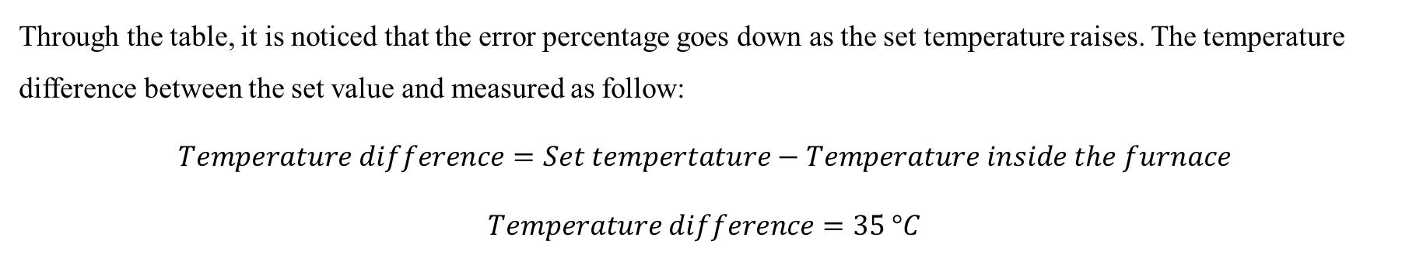
Through the table, it is noticed that the error percentage goes down as the set temperature raises. The temperature difference between the set value and measured as follow:
$$Temperature difference=Set tempertature−Temperature inside the furnace$$
$$Temperature difference=35 °C$$

Slide 28
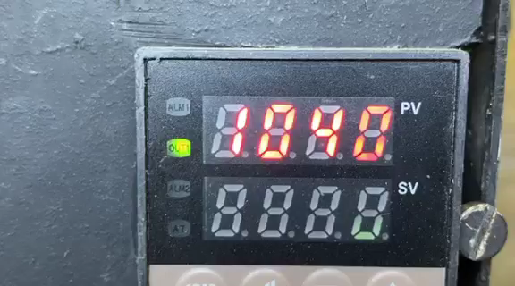

Slide 29
Thank you

