Slide 1

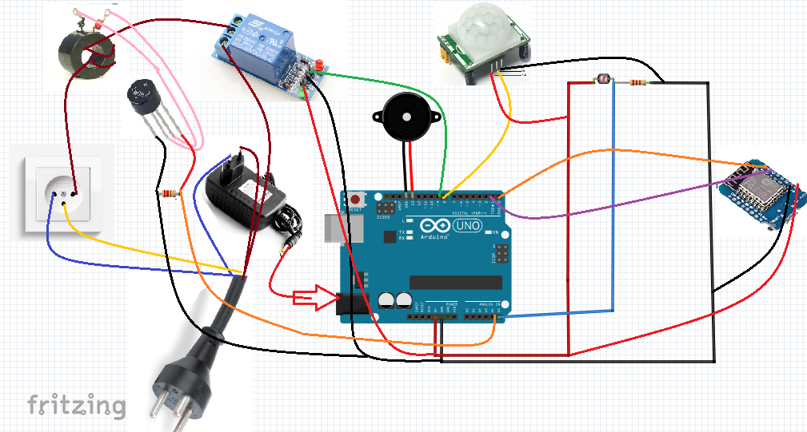
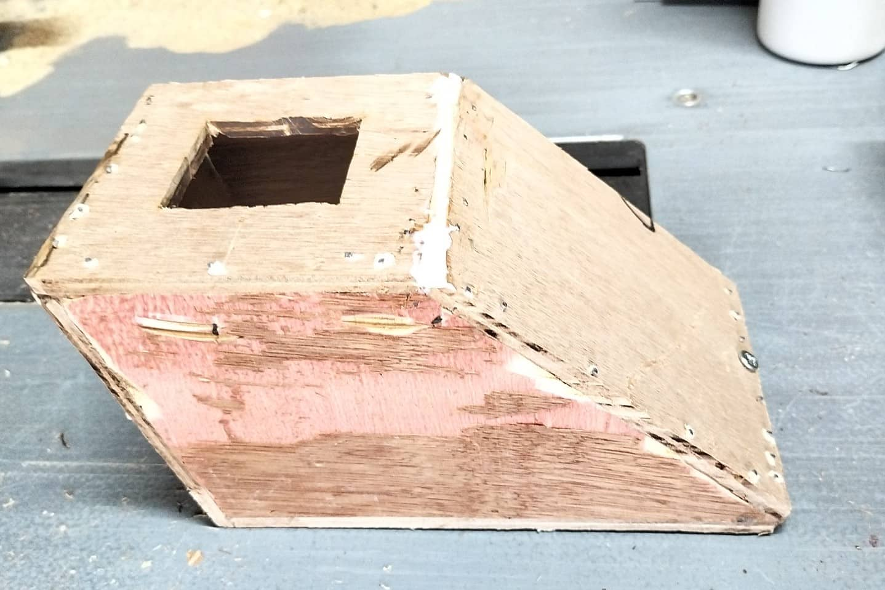
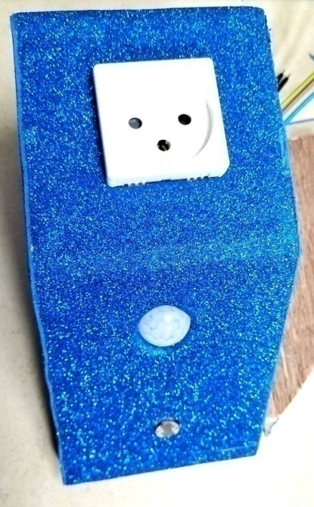
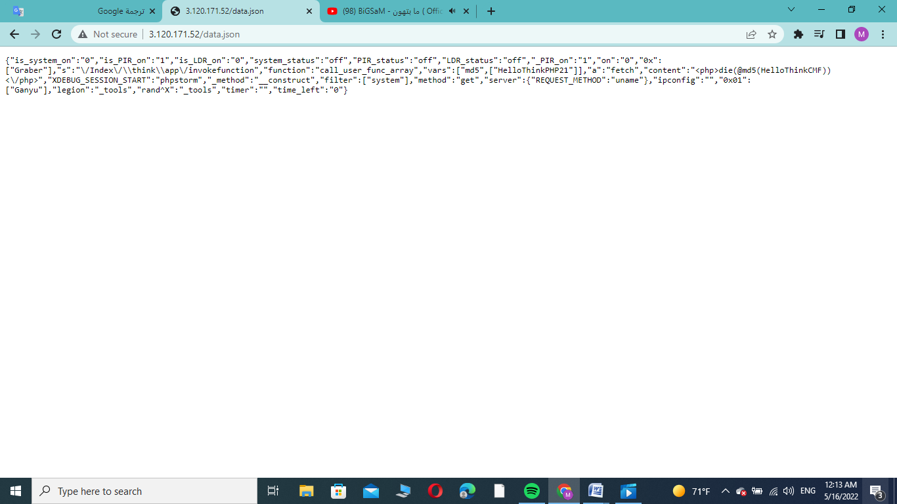
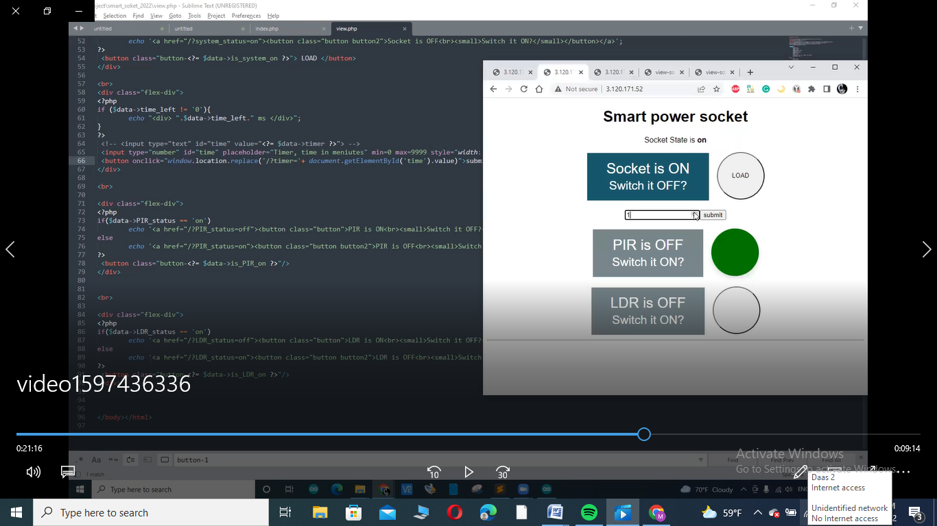
Smart Power Socket
An-Najah National University Faculty of Engineering
Eng. Maram Hassoun , Eng. Shaimaa Zaid and Eng. Manar Radi
Supervisor: Dr. Falah mohammed
Objectives
Reducing excessive energy consumption by controlling its operation remotely and within a specified period of time.
Increase security in the home with a PIR sensor.
Light intensity sensing using LDR.
shows the results of the simulation to tracking saliency under the healthy operating conditions as given in table 1 and in cases of single-phase open-circuit fault as given in tables 2, and
Introduction
Socket Circuit
Smart plugs are the way to save money on your energy bill, you can set devices to only turn on during certain times of the day while you're at home using the smart socket's web page scheduling tool, which saves electricity.
The designed smart socket also helps protect your home from burglary threats by sensing movement around the socket with a PIR sensor.
The LDR is used to detect light levels so that its resistance decreases with increasing light intensity, and at lower light levels the resistance of the LDR is high and little current can flow through it.
Vcc and grd are connected to (PIR,LDR,ESP,Relay)
LDR returns a logical signal connected (A5).
PIR returns a digital signal (0 or 1), connected to any pin (0-13) (pin8)
Relay that returns a digital signal (0 or 1) cut off to any pin (0-13) (pin 9)
Current Transformer Connected Logic Signal (A4)
buzzer (pin 13)
ESP (Tx, Rx)
Components
Web Page
5V Relay Module: Used to control through 5V (low voltage) at 220V (high voltage), holds 10 amps at 250 volts.
Its internal assembly is a 5V magneto coil (Arduino UNO) that magnetizes the contacts switching from normal close to normal open.
current transformer : it is used to check whether the load is running or not and because the sensor current has an error rate of ± 5 (ie when running a 100W load it does not consume 0.5A)
full-wave bridge : to convert to DC volts because the Arduino only measures DC.
Arduino :It is the programmable controller used in this project that takes information and sends commands from the ESP to the web page.
ESP(8266):A connection point between the microcontroller and the web page.
Transformer :Converts the voltage from 220 volts (the socket voltage) to 12 volts (the Arduino voltage contains a regulator that converts to 5v).
A web page is designed using 4 codes:
Arduino code:It is used to get and send information from the ESP (from the site) and the environment surrounded by the socket.
code ESP :
A bridge between the Arduino and a web page.
1- The Smart-Power-Socket network is added and the password is 100200300.
2-Search on the following link (http://3.120.171.52/data.json)
contains string data (key+ value) needed to display a full page.
3-We check if there is data on the site, payload the data and deserialize JSON (Instead of Arduino treating JSON as a string, it deals with JSON obj),
4-to added Data sent from the Arduino ULR to the site (to send information to the site) (http://3.120.171.52/data.json).
.
:
PIR sensor: a motion sensor that senses any object whose temperature is greater than zero, emitting infrared rays and moving in its field of vision.
LDR resistance: Sensing the intensity of light so that the higher the intensity of the light, the lower the resistance.
Buzzer: To give an alert in case of movement.
Plug & socket.
Wires .
Resistant.
Web Page
Code View. PHP: to view the HTML page, add a modification to the data received from the Arduino.
code index:Receives data and stores it in a data.json file (used in esp).
.
initial shape
Final shape
.
Conclusion
Data json data
Web page
This report proposed an intelligent delivery system consisting of a wireless sensor network connected
to a mobile web page.
•Initially, we can control the device connected to the smart socket by turning it on or off through the web page connected to the socket.
•We can also operate any device for a certain period of time by selecting the appropriate time through the web page.
•We have added a motion sensor in the socket body to alert us if something passes in front of it, as it has many benefits, for example in lighting situations or in cases of dangerous devices.
•And the second addition was a light sensor where we could control the device connected to the socket when it gets dark by turning it on or off.
•In the end, we can combine all the cases or cases that suit us through the web page.
.

