Slide 1

Hajj&Umrah EGuide
Represented by :RoBA YOUNIS
&
Duha jitan
Supervised by :
dr emad el natshe

Slide 2
Outline :
introduction
For whom
Used Technology
Feature &Explain our Project
Future work
conclusion

Slide 3
Introduction:
Hajj, the pilgrimage to Mecca, is an obligatory responsibility to be carried out at least once by all Muslims who are capable.
Because Hajj and Umrah are essential, we have come to the idea of our project, Hajj and Umrah E-guide.
For our app we combines several existing projects that are focused for booking hotels and programs and add a lot of features the solved the problem may be facing the piligram.
As a result we build a system explain all of things.

Slide 4
For whom:
Website for :
Visitor
User
Admin
Mobile Application for :
For pilgrim user

Slide 5
Used technology:
                Website (WEB)
HTML5, Jquery ,CSS ,AJAX , JavaScript for developing front-end, PHP, MySQL database for back-end of the web application.
Mobile (android)
Java for android, json for http connection to the php server

Slide 6
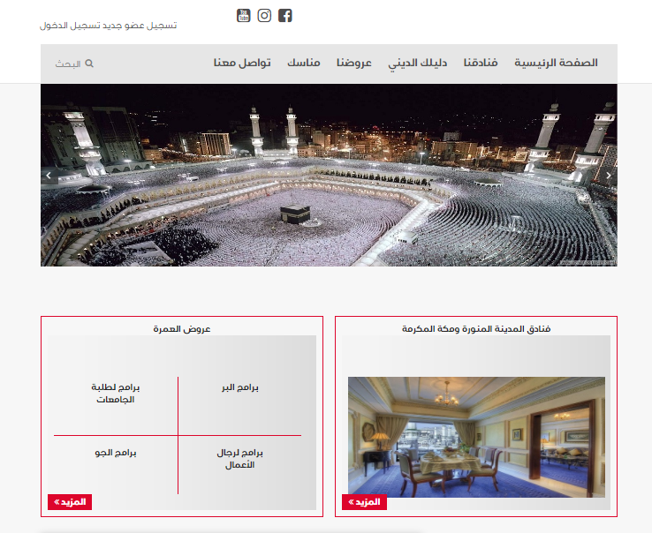
Main web feature:
Visitor can visit our website for see program , hotel .
If he want to allocate in any offer ,must have an account to allow it do .
Admin responsible for website and can add program of trips ,and put information about every hotel .
Profile page for every user to see program which allocate it .
Hajj tracker.
Note :see it in the demo

Slide 7
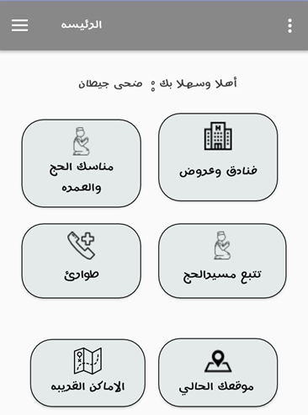
Main mobile feature:
Allocate for hotel and program.
Interest of places.
Draw path .
Update traffic.
Hajj tracker.
Learn about Manask of umrah .
Note :see it in the demo

Slide 8
Future work
Develop our project so can hotel itself control every thing not just admin.
Provide pay throw credit and debit card pay pall.
Make allocate easy for how outside The arb world.
The free choice of the program is to be unrestricted so that the user can ask what suits him and then booking.

Slide 9

conclusion
The goal that we aspire to, thank God, has achieved a large part of it and we seek to develop it better, but for us as students of our business we can sell it in the future.

Slide 10

Thank you ☺

