Slide 1
RECOMMENDATION SYSTEM FOR MATCHING RESUMES TO JOB
ASIM MAZEN
ESRAN QAHER
AHMAD ATEF

Slide 2
OUTLINE
  Introduction
  Objective
  Technologies
  Implementation
  Related work
  Future work
  Conclusion

Slide 3
INTRODUCTION
The demand of Recommendation system is increasing which it depends on application and user need

Slide 4
OBJECTIVE
The aim of our project is to :
Match resumes with job posts
Match job posts with resumes

Slide 5
TECHNOLOGIES
MYSQL server
Django framework
Git
Python 3
Html ,sass, ajax, JavaScript, jQuery, Json
Elastic search
NLTK
TFIDF

Slide 6
IMPLEMENTATION
TFIDF
NLTK
Elastic Search
Database

Slide 7
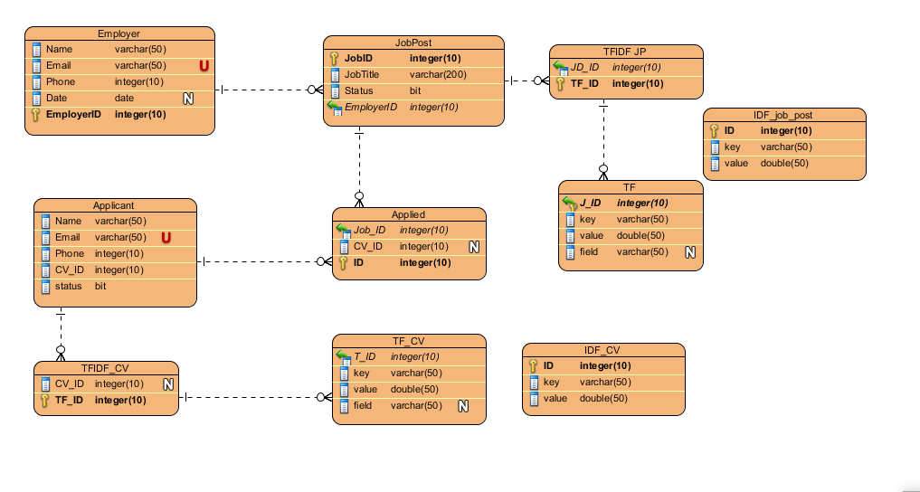
IMPLEMENTATION
ERD

Slide 8
RELATED WORK
Indeed
LinkedIn

Slide 9
FUTURE WORK
Use content based celebrating filtering to get more accurate recommendation
Support Arabic language
Support uploading pdf resume and analyze it

