Slide 1
Introducing SBOX 2007
Quick tour

Slide 2
SBox from 500 miles
SBOX
Web
Application
WAP
Service
SMS
Service
Java 2 Mobile Edition
SBox is a Unique Package that maximize the interaction between instructors and students in easy reliable ,efficient way .
Sbox is Devided into 4 main parts :
Web Application
Sbox Mobile Application
WAP service
[two-way] SMS system

Slide 3
SBOX Web Application

Slide 4
The SBox Backbone
Web interface
WML
Sms
Mobile Application
Sbox web App . Acts as the backbone of the sbox system , all other services are controlled from inside the Web application .

Slide 5
Why SBox ?
….
Standard Implementation.
Http/S Connections
Unique ,Simple and User Friendly Interface.
Security .
Logging System.
Intelligent Course Management System.

Slide 6
SBOX Enhancments
A number of Enhancements added to Sbox system to increase the efficiency and Popularity of the System .
SBox Mobile Application
SBox WAP
SBox 2-Way SMS Service

Slide 7
SBOX
Java Mobile Application

Slide 8

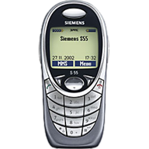
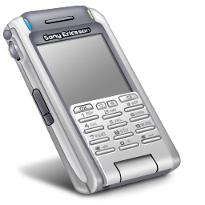
Why Mobile Devices?
Wild Spread .
Easy to get
Cheap
Anytime Everywhere
No Wireless Network needed .

Slide 9
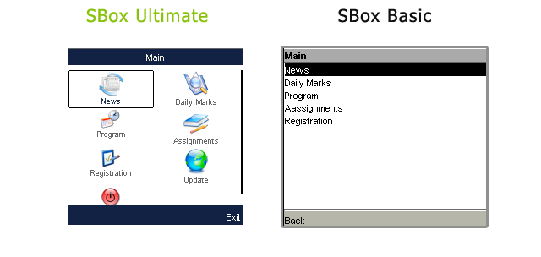
SBOX Mobile Application Design
SBOX Mobile Application
Basic
Ultimate
- Intelligent Interface
- More User-Friendly Design
Uniform Interface
- Ability to Update Software
- Basic Functionality
- Minimum Compact Size
Minimum coast
Less Device Requirements

Slide 10

How to Get SBox Mobile App.?
Sbox team made his best so Sbox can reach to any Most Devices easily without the need for cables ,IR ..etc :
Automated Service Message System.
SBox WAP page .
In Either ways ,our system will guide through Installation Process , which Identifies your Vendor and Mobile type and send you Your Compatible version Directly to your Mobile .

Slide 11
SBOX
SMS Service

Slide 12

No Java support ? !
Np problem then , Sbox offer you another way to
To request information abut your account .
Sbox Support 2 WAY sms messaging , that’s mean
You can request the info you want
Marks , news , etc ….
sms service must be enabled from your account.
You can request the sms in the following form .
[ username ] [password] <OPTION>
The system will respond with the service u requested after
Authentication process .

Slide 13
SBOX
WAP Service

Slide 14
Your final chance !!!
Sbox offer new a simple way to reach to your account , through your mobile browser , Sbox WAP .
Simple
Low cost
Almost any mobile

