Slide 1

An-Najah National University
Faculty of Engineering
Civil Engineering Department
جامعة النجاح الوطنية
كلية الهندسة وتكنولوجيا المعلومات
Graduation Project (II)
Structural Analysis and Design of Residential Building in
Taybie–Palestine
By:
Abdelqader Alsalhi
Ahmad Jabaly
Mohammad Mawasi
Majd Mawasi
Under supervision of: Dr.Mohammad Sama’neh.

Slide 2
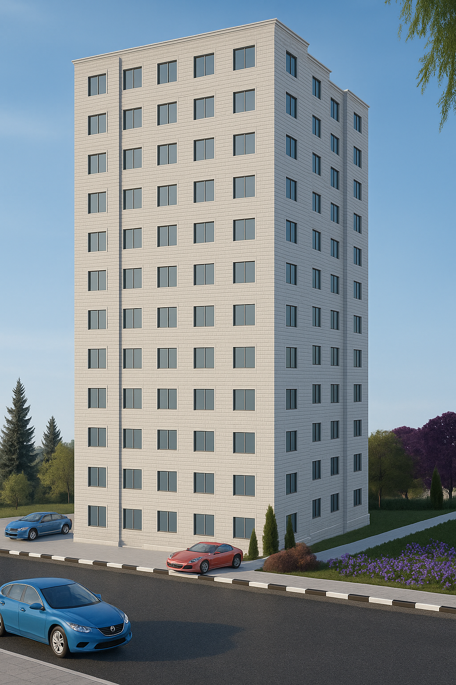
Jabaly’s Building

Slide 3
Outline project:
1
General Description
2
Preliminary Design
3
Three-dimensional analysis and design.

Slide 4
General Description:
This graduation project presents the structural design for a 12-floor residential building owned by Mr. Hassan Jabaly, located in Taybie , Israel, specifically on plot 18 at basin 7852. The building covers a floor area of 541 square meters, with a staircase landing area of 12 square meters on each floor, and each floor has a height of 3.25 meters. Our objective is to conduct a comprehensive structural analysis and design of the building's main components, including the ceilings, columns, beams, foundations, staircase, and shear walls.
Floor | Area(m²) | Height(m) | Function
Ground-11 | 541 | 3.25 | residential

Slide 5
Project plans

Slide 6
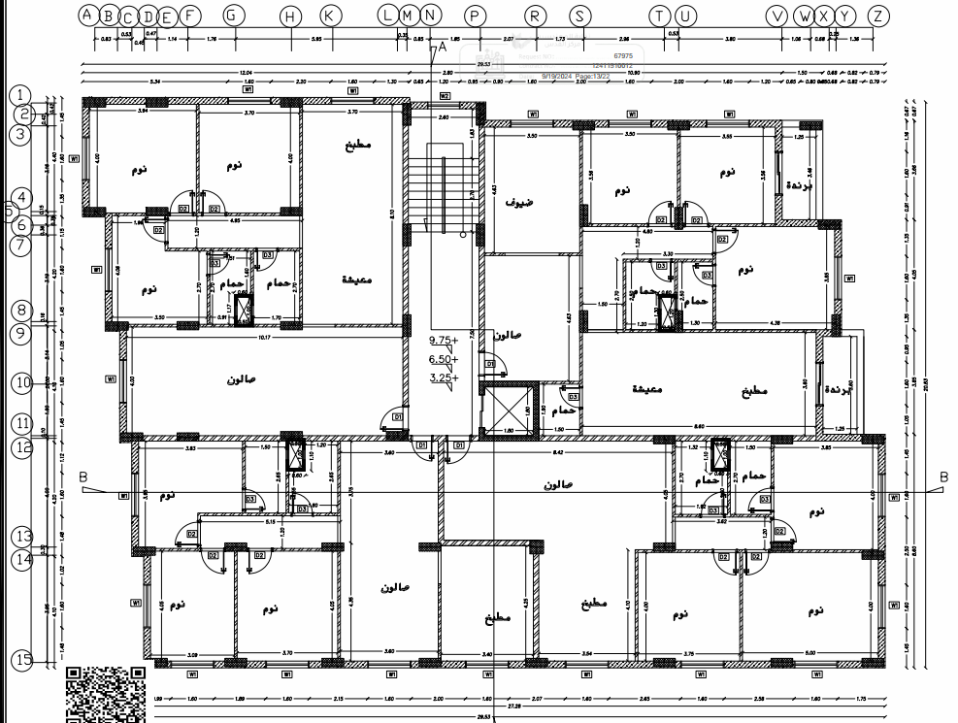

Slide 7
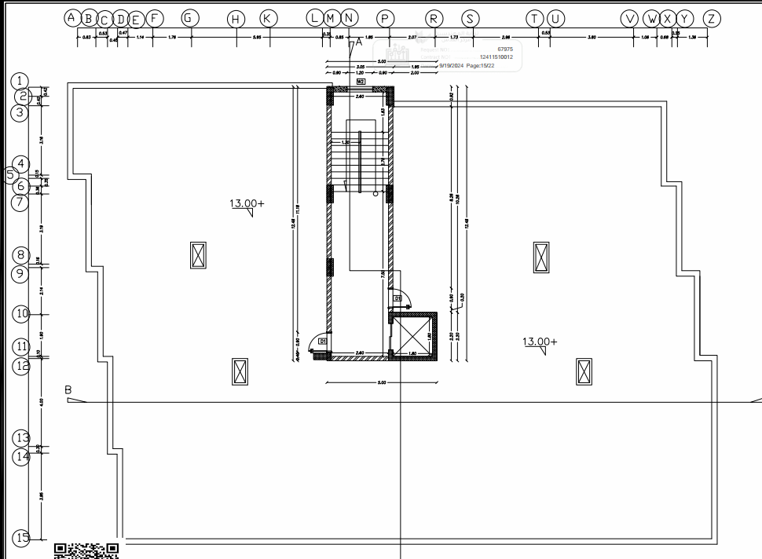

Slide 8
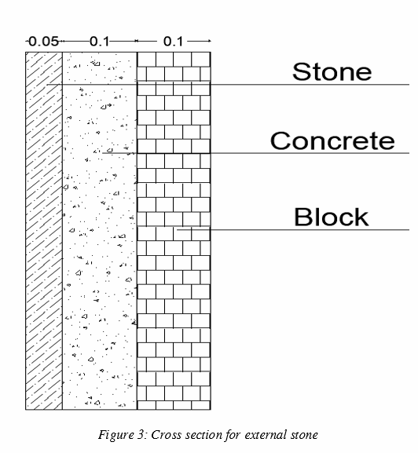
An inside brief about the project:
The building includes interior and exterior walls which are 30 cm in thickness made of reinforced concrete, the staircase and elevator walls are 20 cm thick and will be constructed as shear wall, and some exterior walls are of 25 cm thick and made of three layers 10 cm block, 10 cm concrete and 5 cm stone, with some openings, which are windows for the building.

Slide 9
Codes and Standards:
1
ACI-318M-19: which was used in the design of structural elements (Static design).
2
ASCE-7-16 Minimum Design Loads and Associated Criteria for Buildings: which was used in the design of the earthquake in the building.
3
IBC-2016: for seismic loads and design.

Slide 10
Construction Materials:
1- Structural Elements.
Unit Weight, γ_{c} | 25 KN/m³
Modulus of Elasticity, E_{c} | 24870 MPa
Poisons Ratio, v | 0.2
Compressive Strength, f_{c} | 28 MPa
Flexure | 3.28 MPa
Tensile Strength, f_{t} | 1.75 MPa

Slide 11
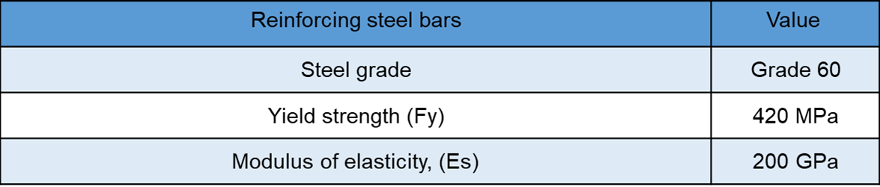
Reinforcing Steel:

Slide 12
Material | Unit Weight KN/m³
Aggregates | 16
Stone | 24
Tiles | 27
Cement Mortar | 23
Concrete | 25
Rib concrete blocks | 12.54
Block | 16

Slide 13
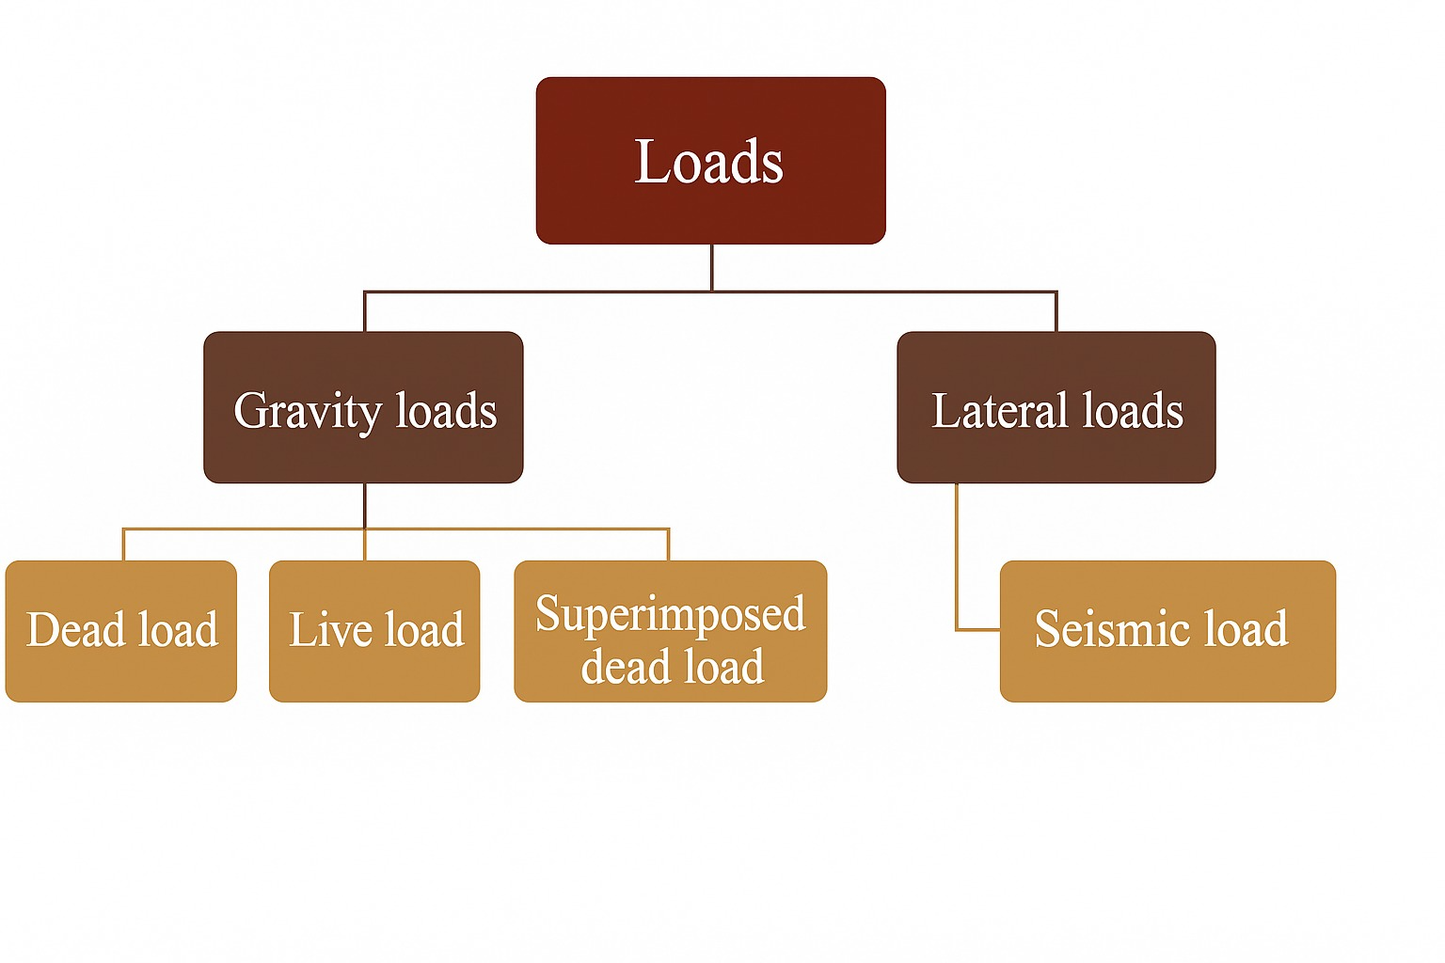
LOADS

Slide 14
A(GRAVITY LOADS:
1) Dead load: self weigh of the structure
2) Live load:The variable load resulting from the use of the building, such as the movement of people, furniture, or temporary equipment.
3) Superimposed load: Superimposed dead load is the weight of non-structural elements in the structure, such as tiles, glass, plaster, etc.
Floor | Uses for | Live Load | Super dead load
Ground-11th | Residential | 2 KN/m² | 6.3 KN/m²

Slide 15
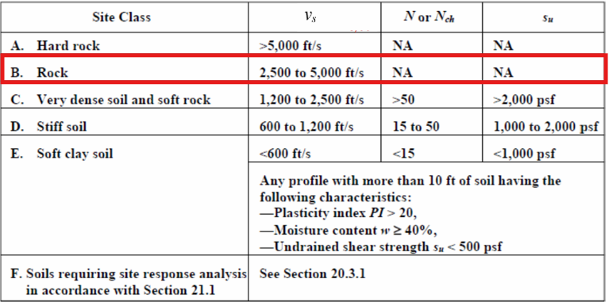
2- Seismic loads
According to ASCE 7-16 code to seismic analysis for this structure:
1-Mapped acceleration parameters Ss&S1:
  From Palestine seismic map:
  Ss= 0.3
  S1 = 0.08
2- Site class: Site classification is B

Slide 16
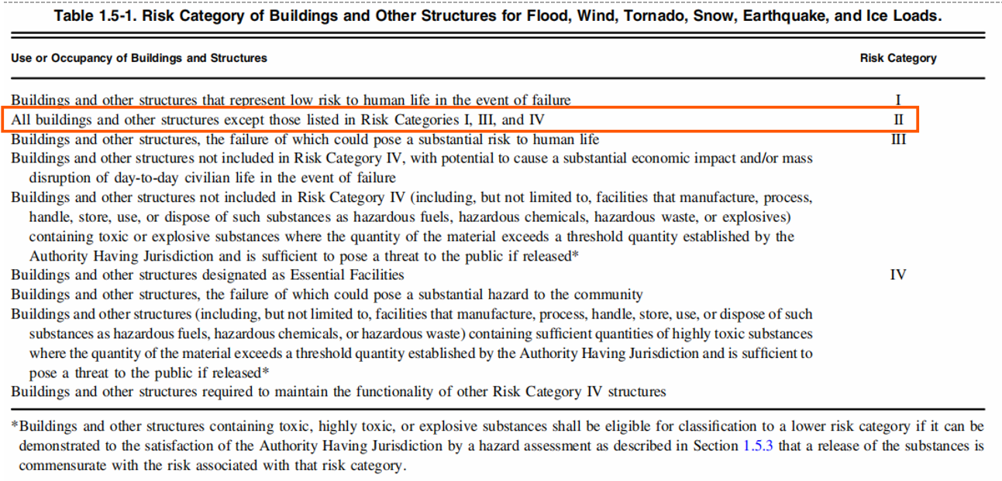
3- Risk category:
risk category of the building is II

Slide 17
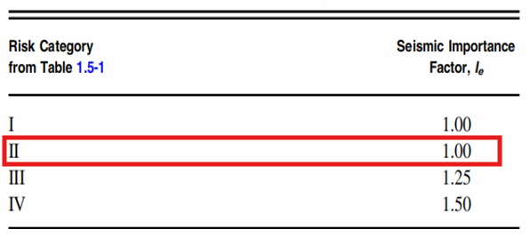
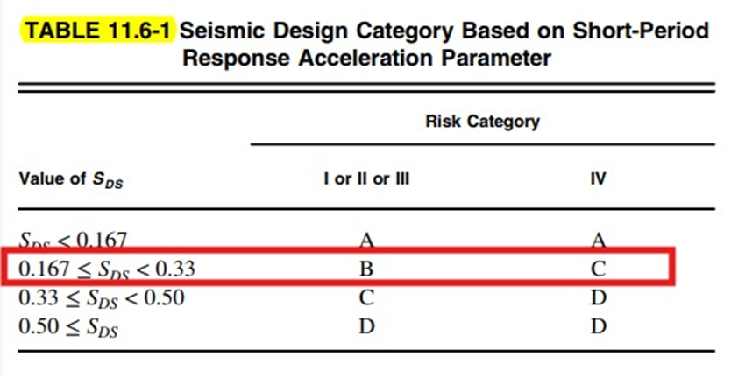
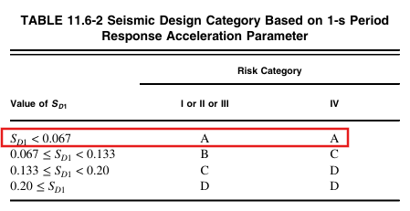
4- Seismic Design Category : B
5- Importance factor : Ie = 1

Slide 18
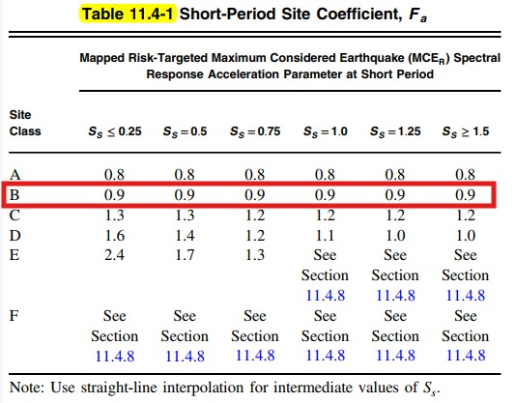
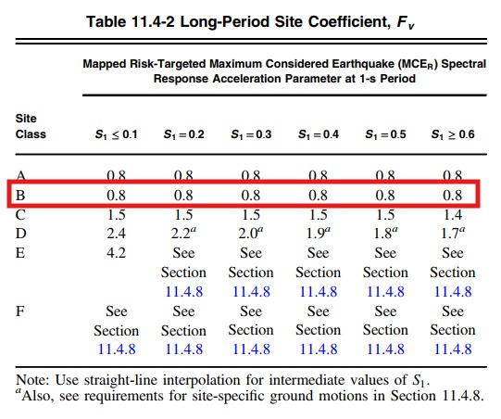
6- Site coefficients: The values of Fa 1.132= and Fv =1.67

Slide 19
*The maximum considered earthquake Spectral Response Acceleration Parameters SMS and SM1 :
          SMS=Fa * Ss= 0. 9 * 0.3 = 0.27
          SM1= Fv * S1 = 0.8 * 0.08 = 0.064
*Design spectral acceleration (SDS & SD1)
          SDS = 2/3 SMS = 0.18
          SD1 =2/3 SM1 = 0.0426

Slide 20


7- Type of the lateral forces resisting system:
building frame system: special shear walls
Response modification factor= 5
Overstrength factor Ω = 2.5
Deflection Amplification Factor = 4.5

Slide 21
8- Seismic Base Shear
V = Cs W
Cs= 0.011
W= D+SD+0.25SL

Slide 22
CHAPTER 2: Preliminary Design.
1) Slab structural system.
2)Preliminary slab thickness.
3)Preliminary dimensions of Beams .
4)Preliminary dimensions of columns and walls.

Slide 23
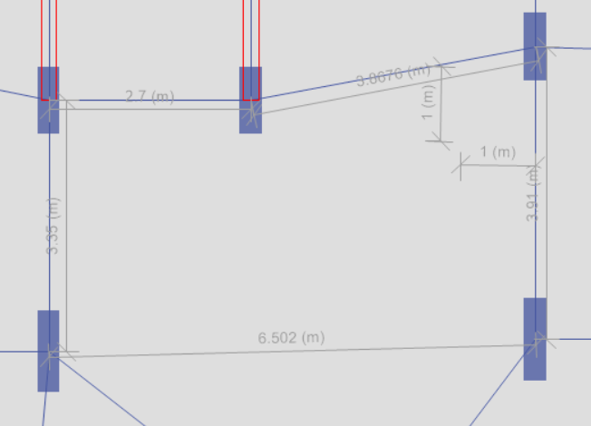
General Notes about dimension
1) The slab structural system used in this building is a one-way&two-way ribbed slab.
2) preliminary dimensions were be chosen according to ACI 318-19
3) Use the longest span for calculation
4) For Column dimension,
assuming ρ = 0.01 → A_{s} = 0.01 A_{g}

Slide 24
Preliminary dimensions of the structural elements
Structural element | Preliminary dimensions
Slab | Thickness = 250mm
Walls | Thickness = 200&300mm
columns | b = 300 mm & h = 600 mm
Beams | Exterior b = 600 mm & h = 250 mm Interior b = 800 mm & h = 250 mm

Slide 25
Final dimensions of the structural elements
Structural element | Final dimensions
Slab | Thickness =(250)mm
Walls | Thickness = (300, 200)mm

Slide 26
Final dimensions of the structural elements
Beams:
Beam item | Width(mm) | Thickness(mm)
B1 | 500 | 250
B2 | 600 | 250
B3 | 700 | 250

Slide 27
Final dimensions of the structural elements
Columns:
Column item | length(mm) | width(mm)
C1 | 800 | 300
C2 | 900 | 300
C3 | 1000 | 300
C4 | 1100 | 300
C5 | 1000 | 350
C6 | 1000 | 400

Slide 28



Modeling Programs
AutoCAD
ETABS
SAFE

Slide 29
Modeling Programs
AutoCAD
1) Drawing Plans.
2) Drawing Detailed Sections.
3) Illustrate Shop Drawing.

Slide 30
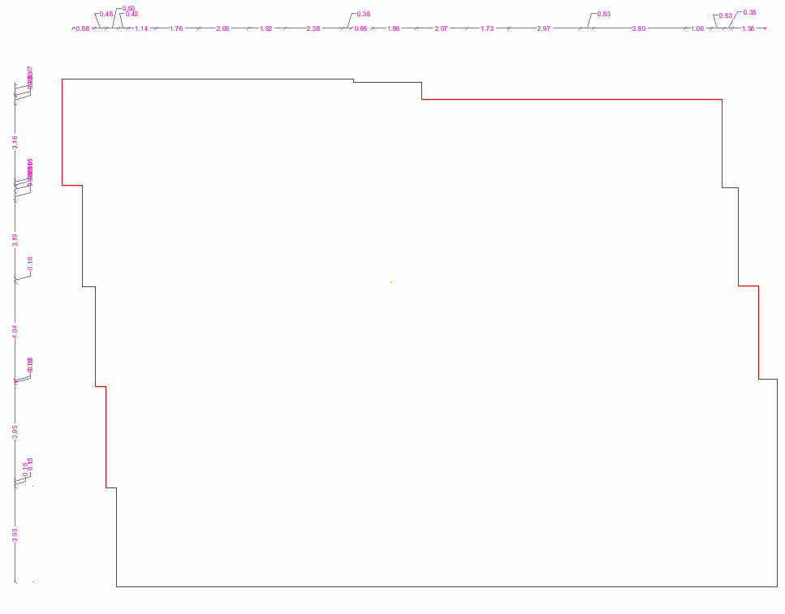
AutoCAD (Outline)

Slide 31
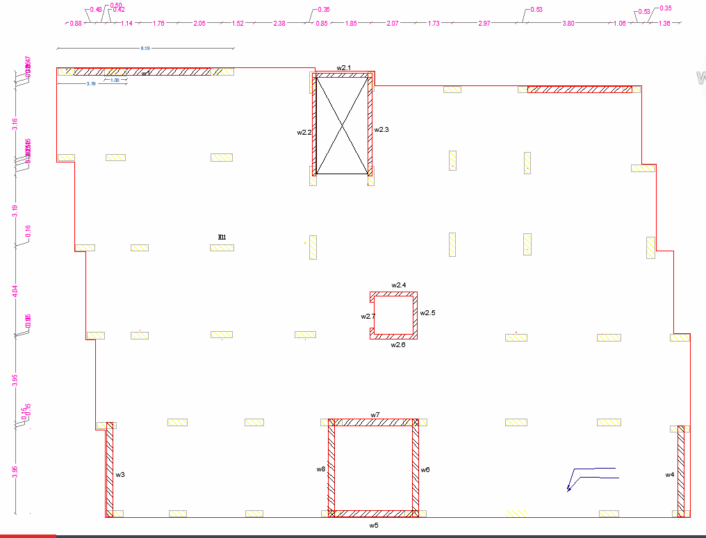
AutoCAD (Structural Plan)

Slide 32
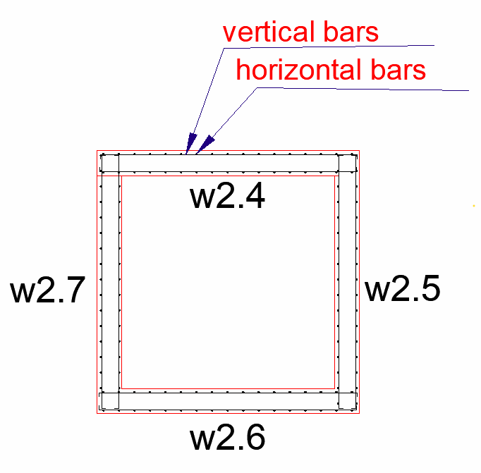
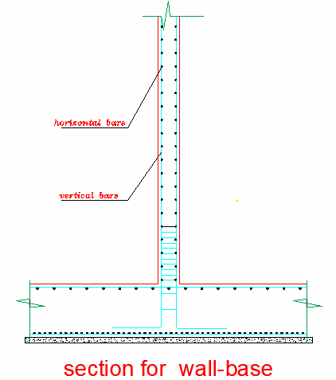
AutoCAD (Detailed Section)

Slide 33
Modeling Programs
ETABS
1) Modeling Structures.
2) Analyzing structures.
3) Design Structures

Slide 34
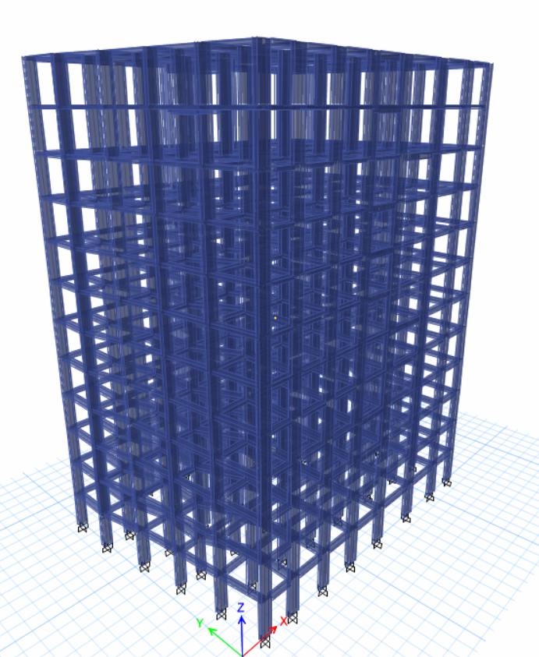
ETABS (3D Frame)

Slide 35
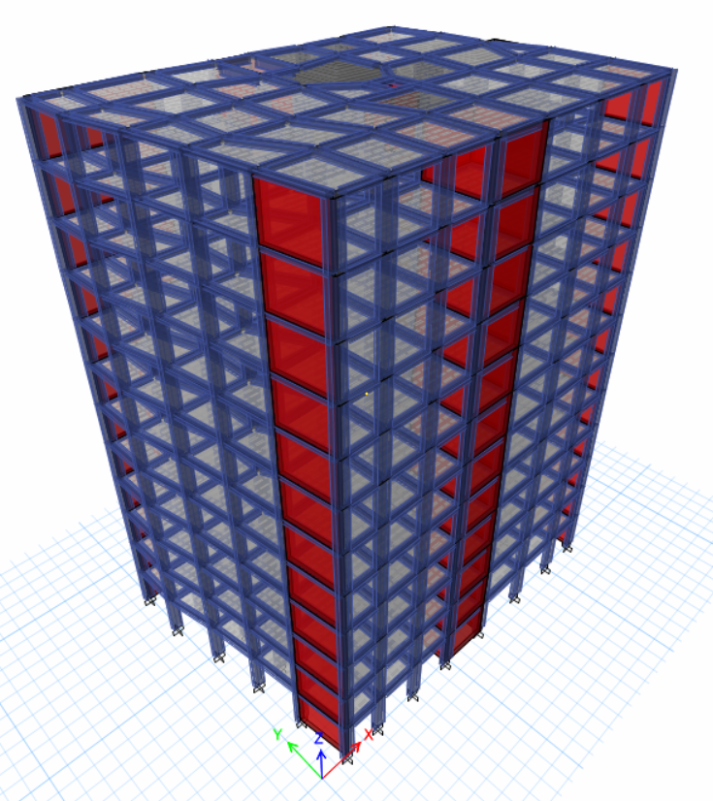
ETABS (3D Model)

Slide 36
Modeling Programs
SAFE
1) Modeling Foundations.
2) Analyzing Foundations.
3) Design Foundations.

Slide 37
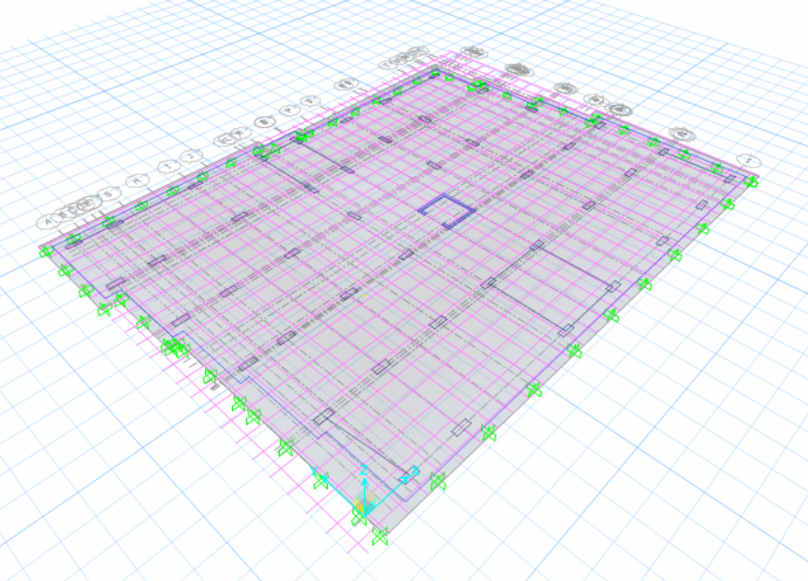
SAFE Model

Slide 38
Lateral Load Definition
in this project, the only lateral loads affecting the structure are those induced by seismic (earthquake) forces.

Slide 39

Cause of Earthquake
The random movements of the tectonic plates are the main natural cause of the earthquake

Slide 40
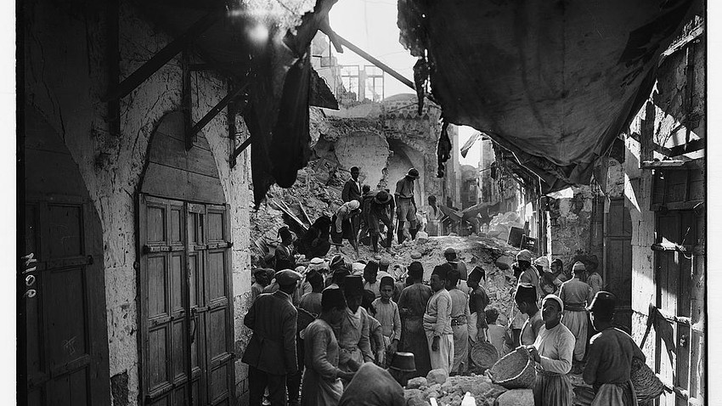
History of Earthquake in Palestine
In 1927, a strong earthquake hit Nablus with a volume of 6.2 on the Richter scale which last for a duration of 90 secs.

Slide 41
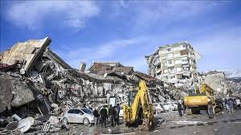
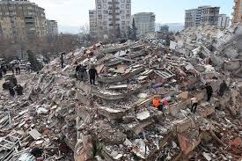
Tragedy of Earthquakes

Slide 42
Provisions By the ASCE 7-16 Code
The design earthquake has a probability of exceedance of 2% every 50 years.
That means every the 2500 years, an earthquake large than the design earthquake will occur.

Slide 43
Seismic Modeling Methods
Equivalent Static Method (Static).
Response Spectrum Method (Dynamic).
Time History Method (Dynamic).

Slide 44
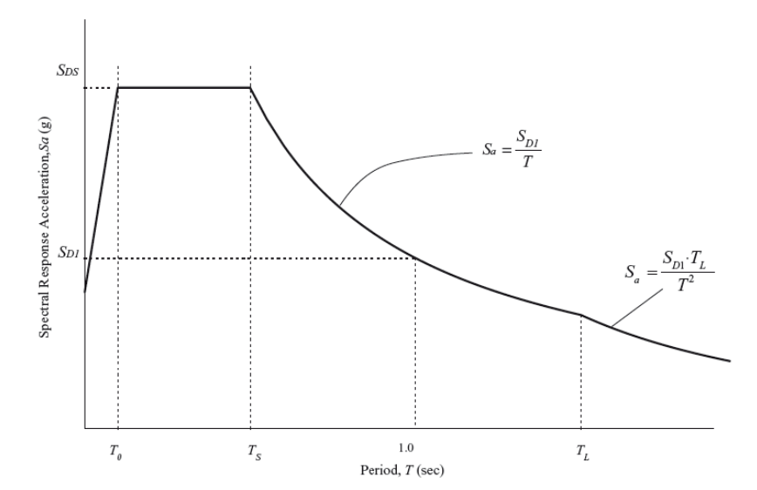
Response Spectrum Method
It perform multiple Equivalent Static Method in each mode of the structure and combined them in the end as one force.

Slide 45
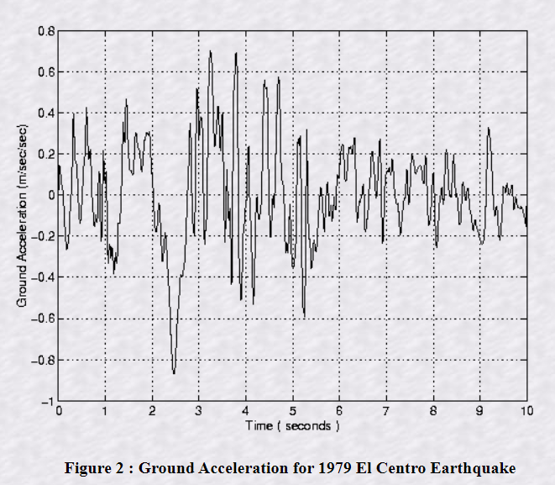
Time History Method
This applies the dynamic forces on the building as a function of time during the earthquake.

Slide 46
Structural Irregularity
There are two types of Structural Irregularities:
Horizontal Structural Irregularity
Vertical Structural Irregularity

Slide 47
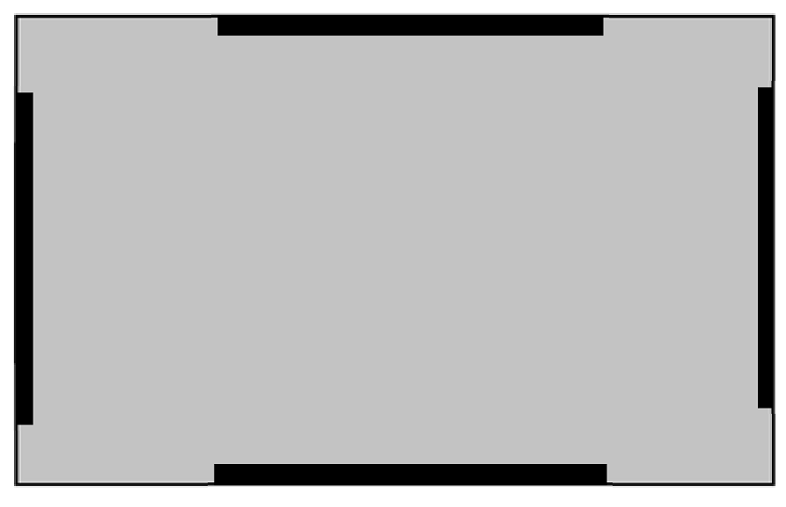
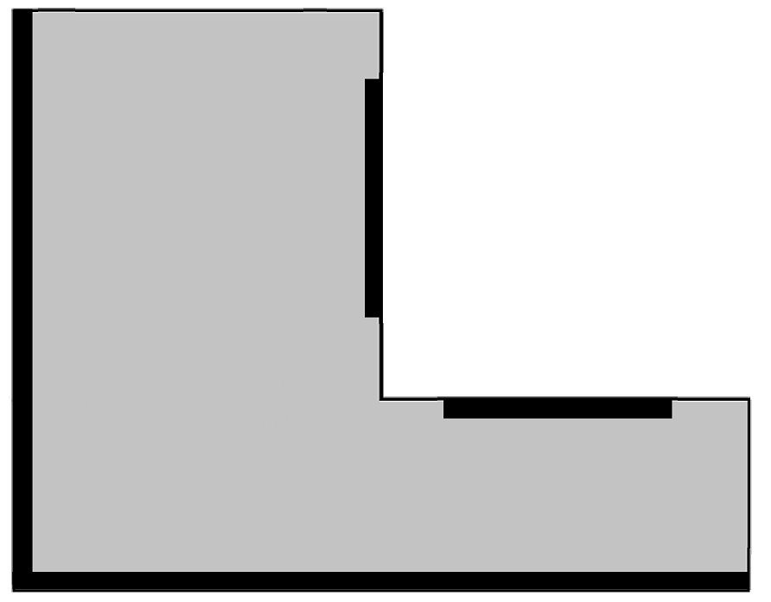
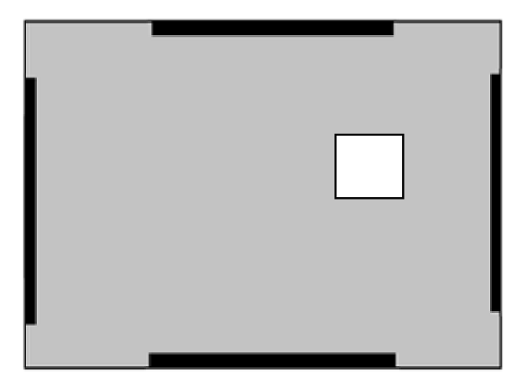
Horizontal Structural Irregularity

Slide 48
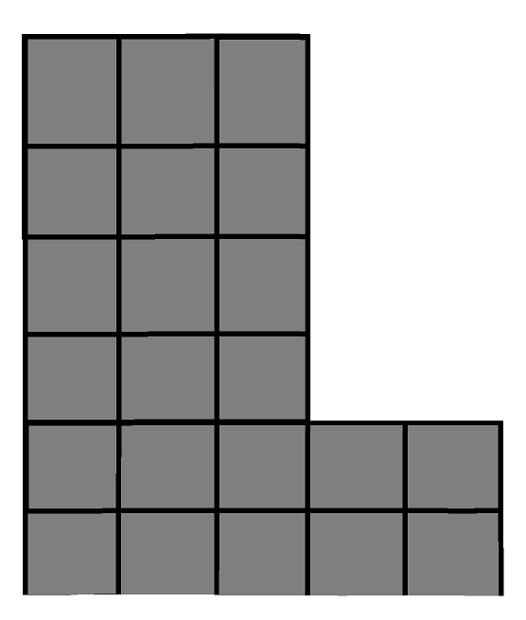
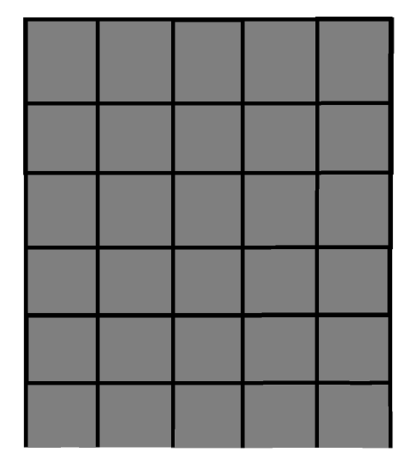
Vertical Structural Irregularity

Slide 49
Seismic Checks
1- Base shear check :-total seismic load
2- Torsional Irregularity Ratio:-the displacement deference ratio
3-sum of Mass participation ratio
4- Type of Lateral-resisting system

Slide 50
Designs of Structural Elements
Steel Reinforcement is used for multiple reasons:
1- To support the concrete with resisting the tension forces mainly
and compression forces.
2- To prevent shrinkage of concrete.
3- To make the concrete a ductile material.

Slide 51
Designs of Structural Elements
1- Slabs
2- Beams
3- Columns
4- Shear Walls
5- Stairs
6- Foundations

Slide 52
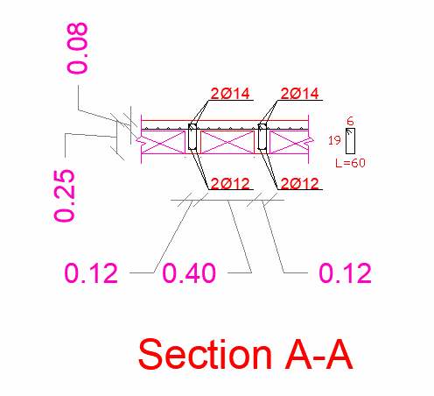
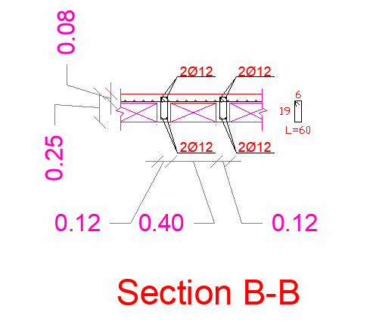
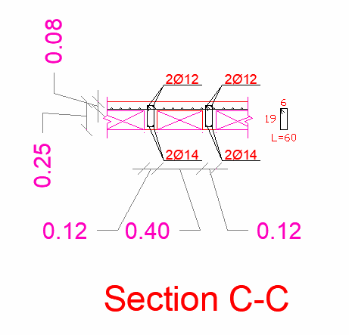
Design of slabs
One-way
One-way
two-way

Slide 53
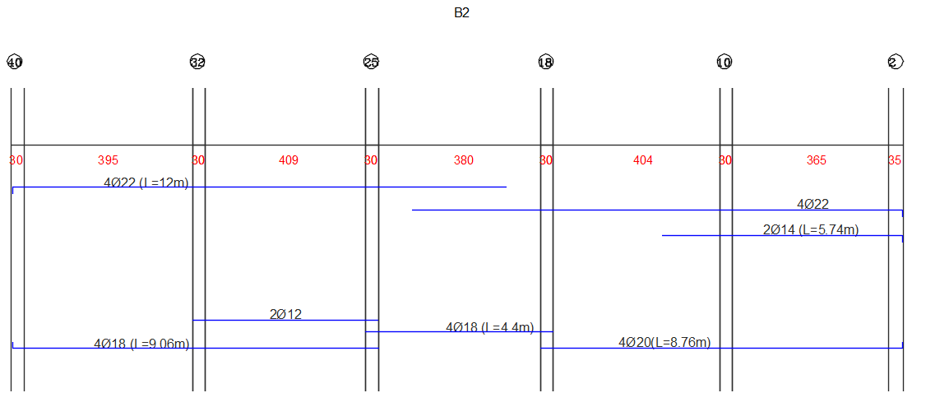
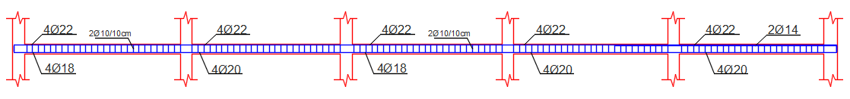
Beams

Slide 54
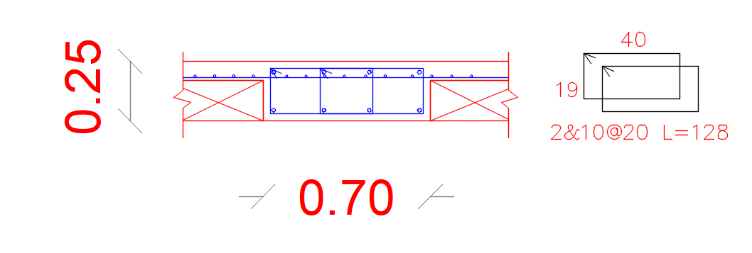

Slide 55
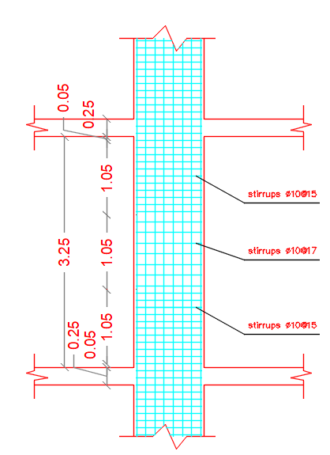
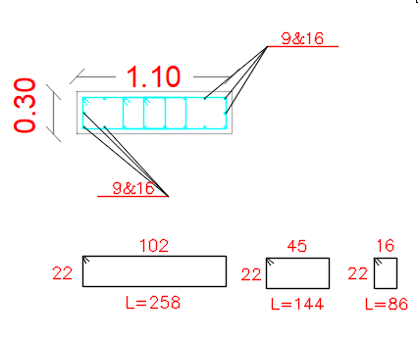
Columns

Slide 56
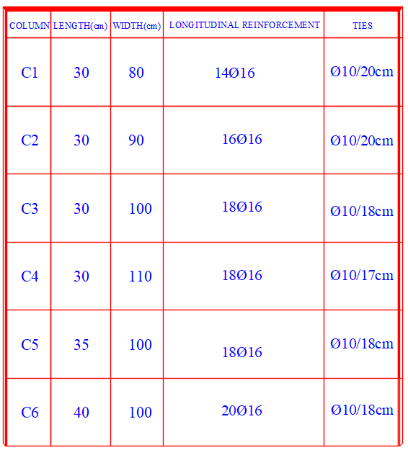
Columns

Slide 57
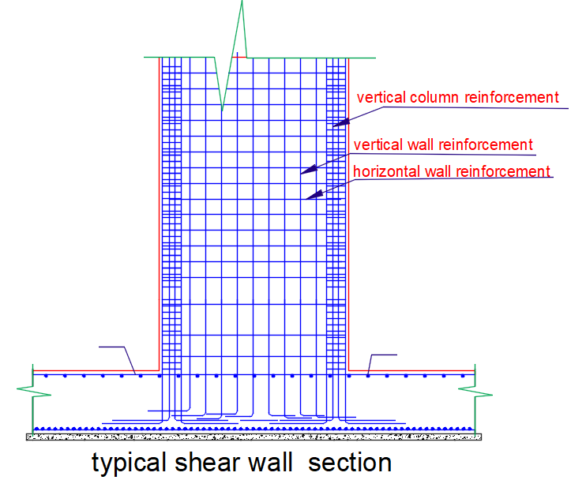
Shear Walls

Slide 58
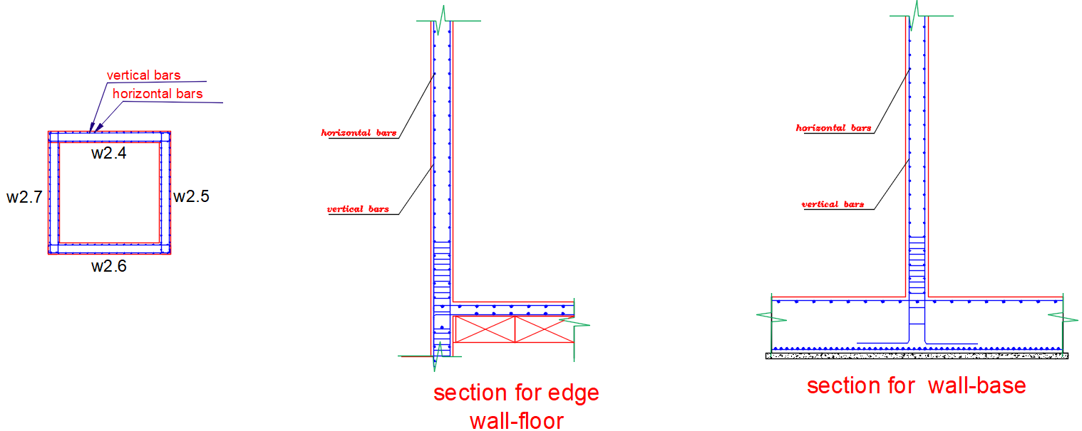
Shear Walls

Slide 59
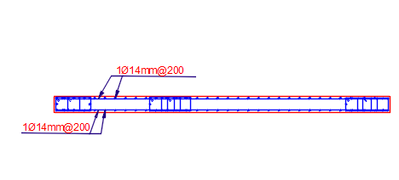
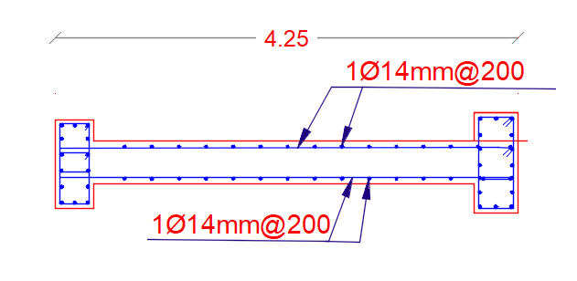
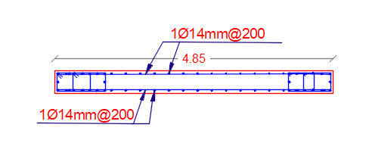
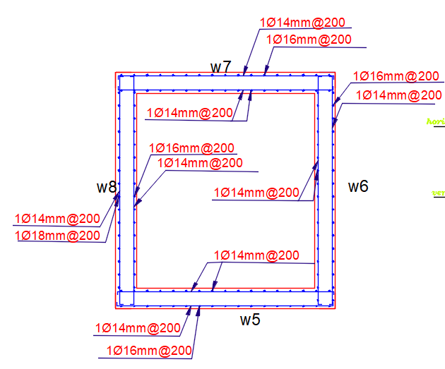
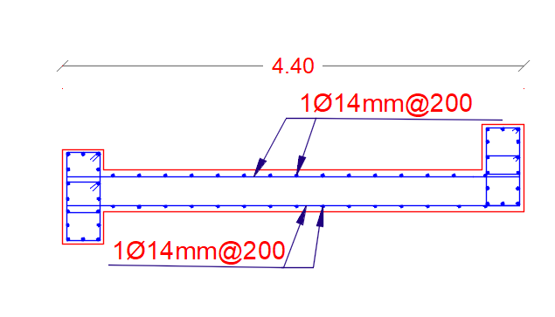
Shear Walls

Slide 60
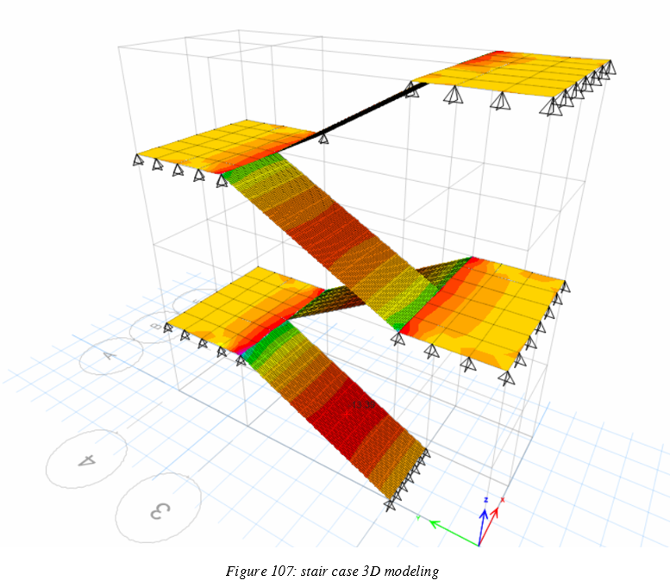
Stairs
The staircase is an important element in the structural elements that connect from one floor to another.

Slide 61
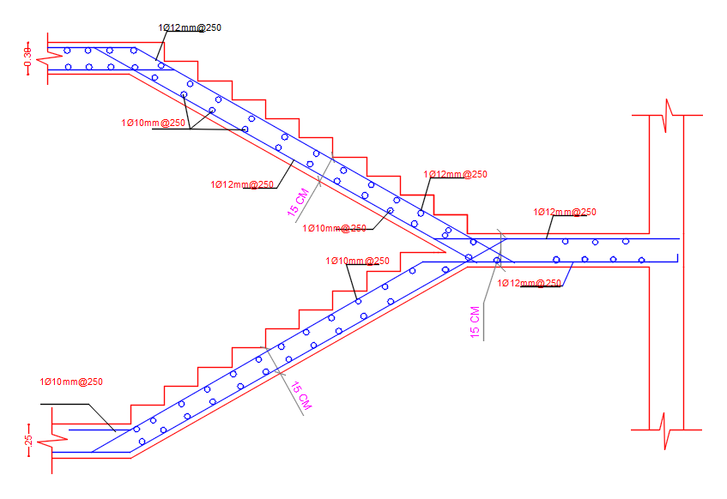
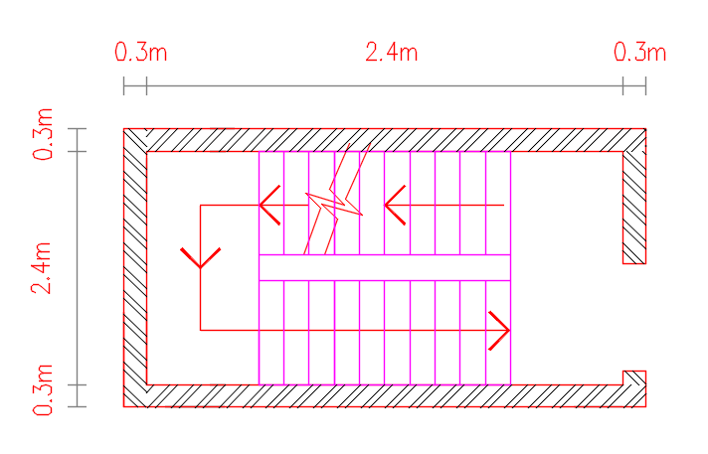
Stairs

Slide 62
Foundations
The foundation is the most critical structural element responsible for supporting all building loads.
In order to select the appropriate foundation type, it was necessary to determine the ratio of the total column base areas to the building footprint.
This ratio was calculated to be 68%, which indicated that a mat foundation would be the most suitable choice.
Following several design calculations, the mat foundation was designed with a thickness of 90 cm.

Slide 63


Slide 64


Slide 65


Slide 66


Slide 67


Slide 68
شكراً لحسن استماعكم و دمتم لنا ذخراً نفتخر بكم دائماً

