Slide 1
Mahmoud Yasin
Madi Nawahda
Ziyad Yousef supervisor
Dr:Hafez Shaheen
Project : Fall 2011-2012
Wastewater collection and treatment plant system for al Yamon

Slide 2
OBJECTIVES
Address the environmental problems in AL- YAMON village that are caused by the un-safe disposal of wastewater
Conceptual design of a Wastewater collection system.
Conceptual design of the wastewater treatment.

Slide 3
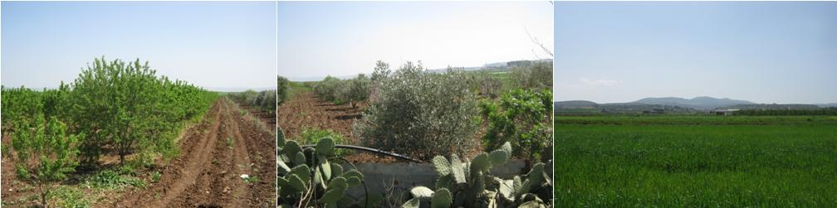
Project area

Slide 4
Project area
AL- YAMON is located in the northern West Bank about 9km west of Jenin.
Al Yamoun is located approximately 150 m above mean sea level and consists of 20,000 donums.
Number of population in 2011 = 18404, expected to increase to around 40000 in 2040.
Growth rate 2.95%

Slide 5
Population analaysis

Slide 6
What was done in project 1
Data collection
Collect the data of network from the municipality
Visit location project and collect data about Al Yamon
Collect the hydrological information of the area including climate, geology, water resources, sanitation and public health data.

Slide 7
Questionnaire
Apply questionnaire on people in Al Yamon town,and estimate water consumption and future demand per capita/day.
Analysis of questionnaire to obtain socio-economic data.
The village has no wastewater collection system and septic tanks are used to dispose of wastewater causing social and environmental problems.

Slide 8
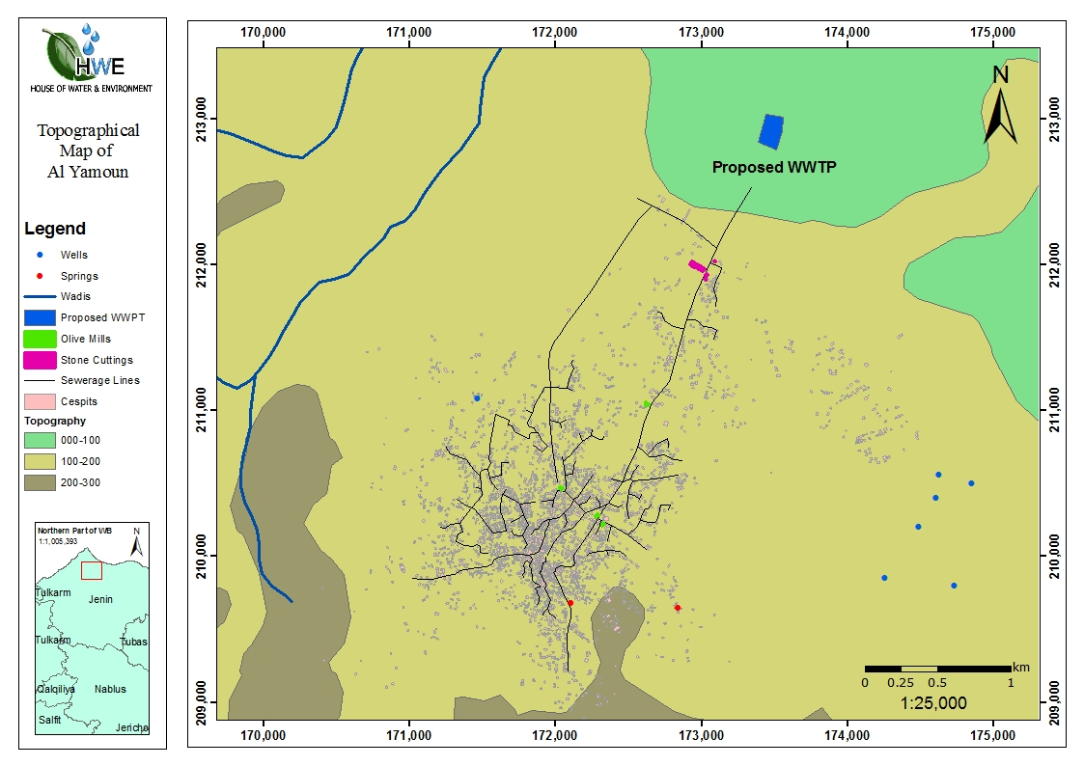
Proposed WW collection system and WWTP location

Slide 9
Project 2
Assise the Layout of the network
Design wastewater network .
Conceptual design of the wastewater treatment plant.
Design wastewater network using sewarcad.

Slide 10
Design consideration
Design period: 30 year (from 2011 – 2040).
Present population of Al Yamoun (year 2011): 18404.
The population growth rate has been taken as 2.95%.
Future population (year 2040) of Al-Yamoun : 40000.
Water consumption 120 l/c.d .
Wastewater conversion 80%.

Slide 11
Formula to be used in design of sewers ( Manning’s formula).
V =( )*R^{2/3}*S^{1/2}
Minimum velocity : 0.6 m/s .
Maximum velocity : 2 m/s .
Maximum manhole spacing:100m for trunk.
Maximum manhole spacing:60m for 8&10˝ pipes

Slide 12
Minimum pipe diameter : 200 mm (8 inch).
Infiltration rate equal 25% of the domestic sewage flow.
Peak factor = 3
Depth of sewer pipe:minimum cover not less than 1.0 m.

Slide 13
For treatment planet
Design period: 15 year (from 2011 – 2026).
Sewage production = 100 l/c.d
BOD production = 50 g/c.d
SS production = 60 g/c.d
N production = 5 g/c.d
P production = 0.5 g/c.d
Effluent BOD = 45 mg/l (Irrigation of crops and citrus and olive trees)

Slide 14

THANK YOU

