Slide 1
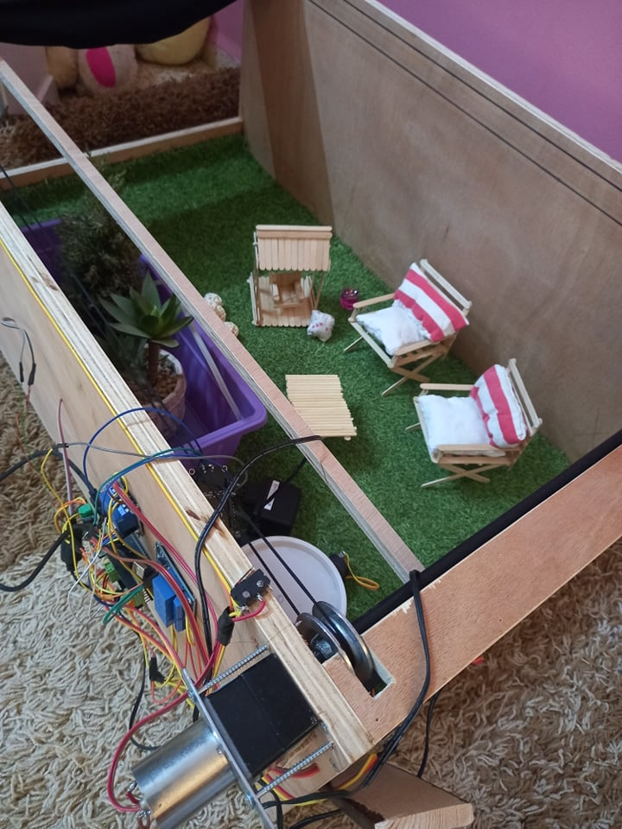

Smart Garden Based on IoT
Graduation Project 2
Majdoleen Malek & Aseel Ghanim
Supervisor: Dr. Aladdin Masri

Slide 2
Outline :
Introduction
Problem Statement
Internet of Things (IoT)
Solution
Smart Garden Advantages
Methodology
Conclusion and Future Work

Slide 3
Introduction:

Slide 4
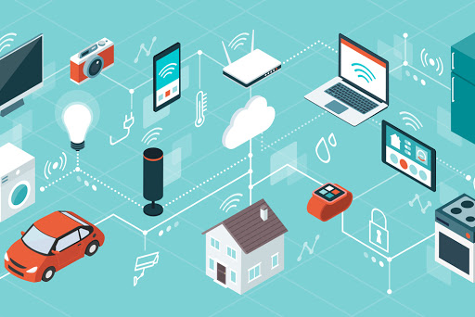
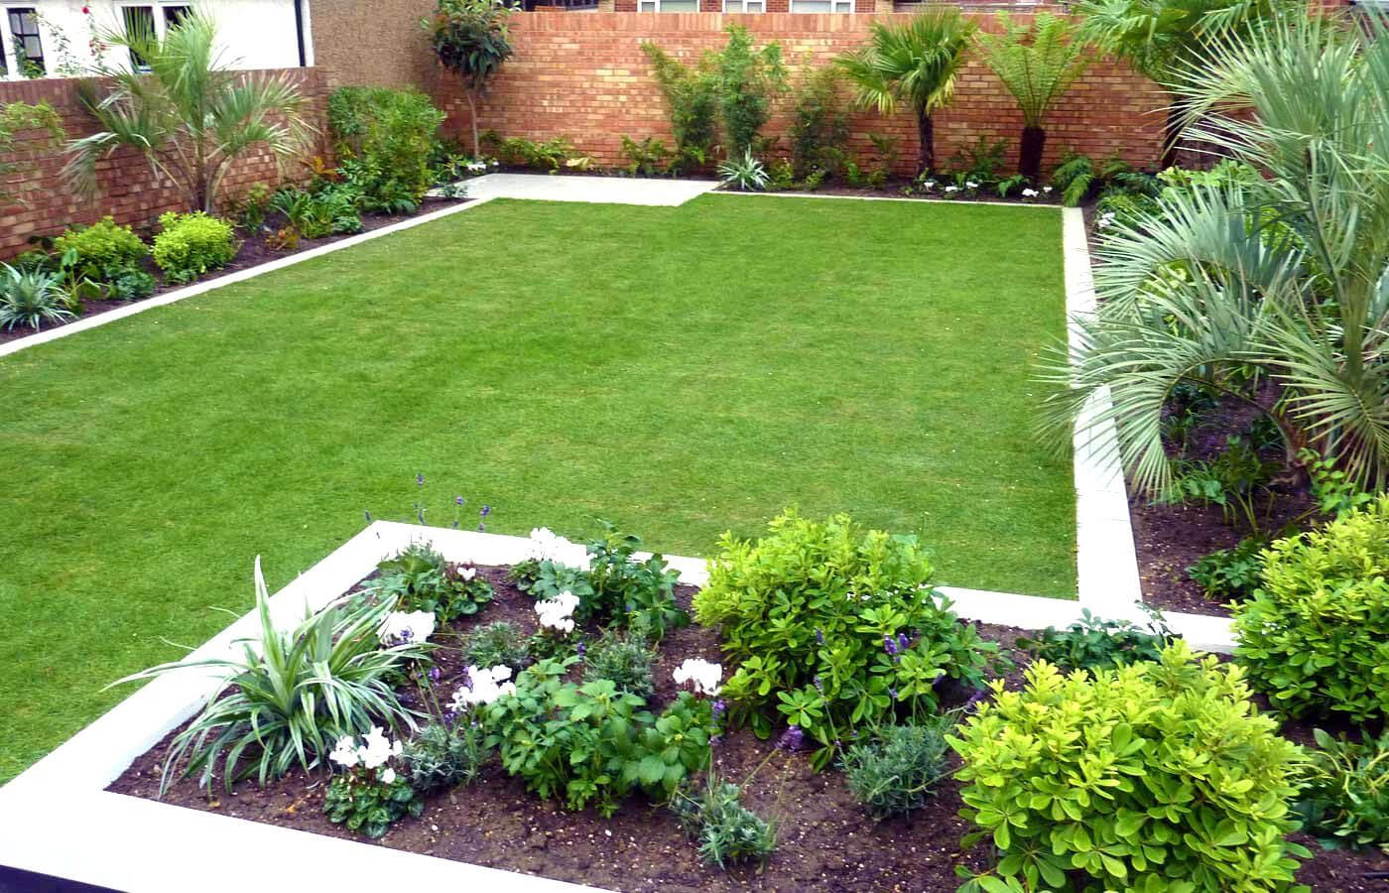
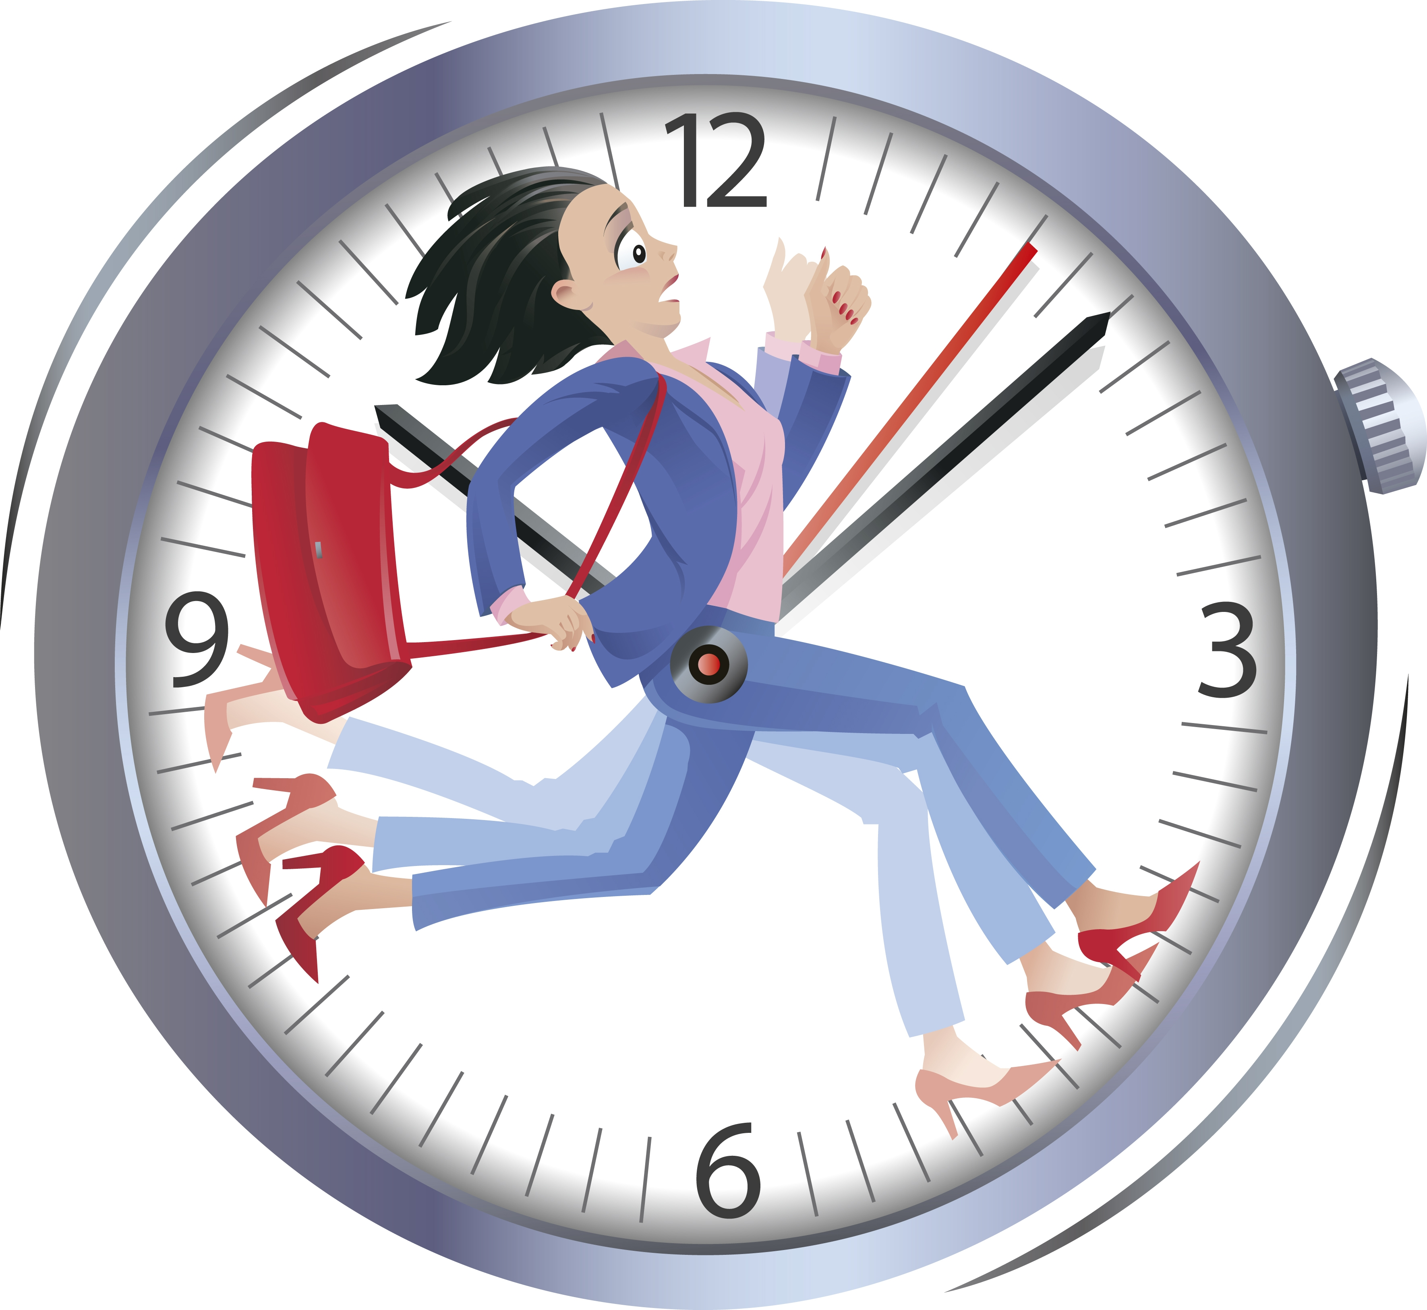
Introduction :
+

Slide 5
Problem Statement
garden owner cannot irrigate his plants or control any object when he
is not nearby.
there may be some error of supply consumption or even shortage since
the owner cannot really understand the plant supplies accurately.

Slide 6
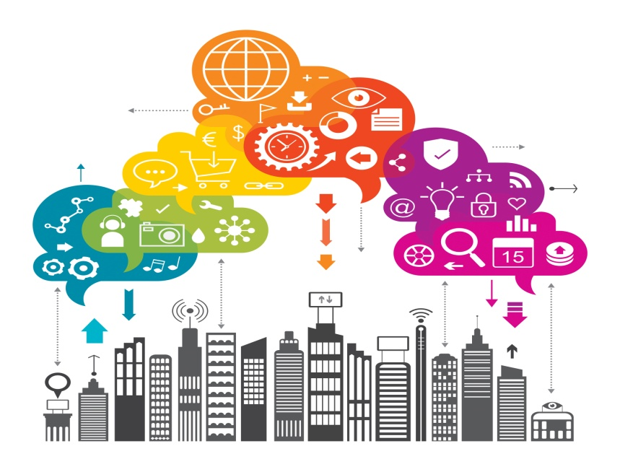
Internet of Things (IoT)
The Internet of Things (IoT) is a concept in which surrounding objects are connected through wired and wireless networks without user intervention. In the field of IoT, the objects communicate and exchange information to provide advanced intelligent services for users.

Slide 7
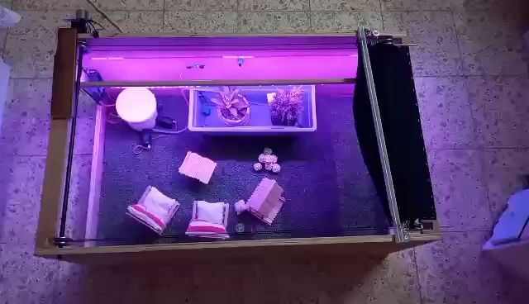
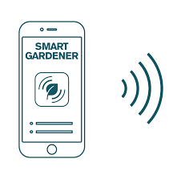

Solution :
Using an IoT-based smart garden system that provides the owner to control the garden easily. He can control the objects from any place in the world via the wireless network when having an internet connection.

Slide 8
Smart Garden Advantages:
Easy control
Control from any place
Water consumption or leakage
Good environment to grow plants

Slide 9
Methodology

Slide 10
Methodology
Design
System’s Block Diagram

Slide 11
Design

Slide 12
Full System Design
Sensing
Monitoring
Control

Slide 13
Smart garden components:
Mobile application
Planets irrigation(pump)
Fan
External lights
internal lights
Roof (DC Motor + Micro switches)

Slide 14
System’s Block Diagram

Slide 15
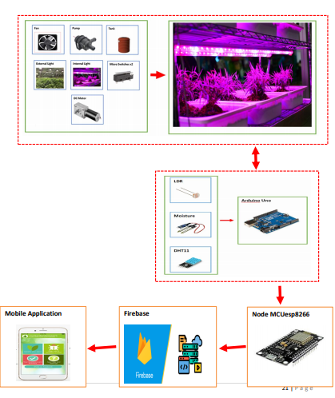

Slide 16
Conclusion and Future Work:

Slide 17
Conclusion
The project is aimed to provide the user with a mobile application to simplify controlling his home garden.
Besides, it solves the problem of controlling the garden when far from home.
It also supplies the plants with distinct amount of supplies neither more nor less.
The user can choose to automatically or manually control the garden.

Slide 18
Future Work:
connect the second pump with fountain.
add gas sensor.

Slide 19
The End

