Slide 1

Assessing Public Acceptance for Recycling Facilities Projects: Case of Palestine
Prepared By:
Khalil Jamal Jumaa
Supervisor:
Dr. Ramiz Assaf

Slide 2
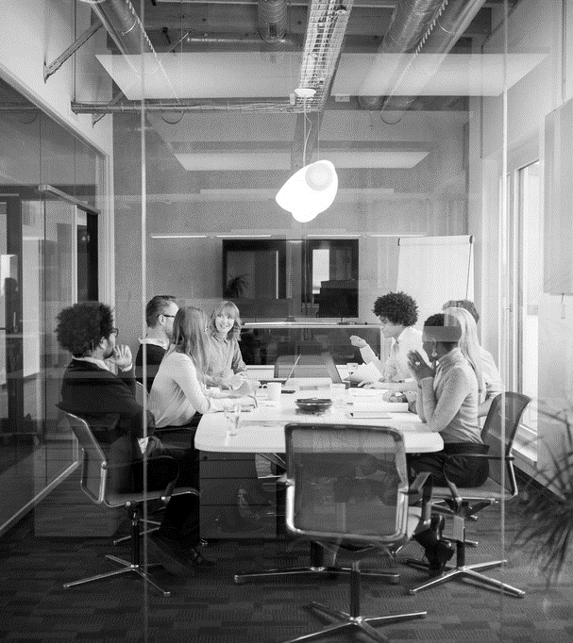
Agenda
ABOUT THE PROJECT
METHODOLOGY
ABOUT THE QUESTIONNARE
ANALYSIS OF SURVEY RESPONSES
CONCLUSION
RECOMNDATIONS
SUUGESTED SOLUTIONS

Slide 3
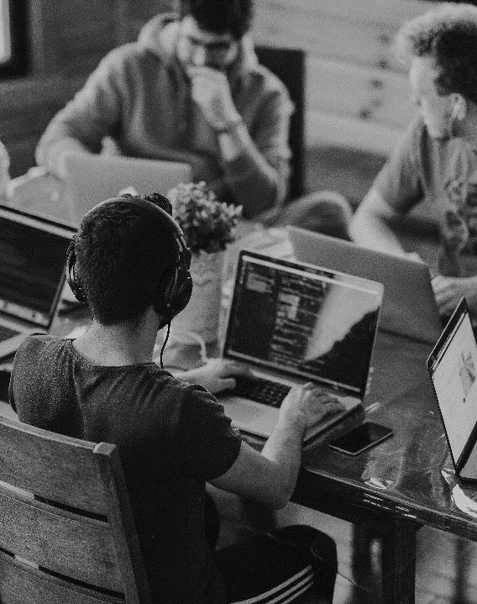
ABOUT THE PROJECT
The Nablus Municipality is responsible for managing solid waste and establishing landfills for recycling. However, global factors like greenhouse gas emissions and population growth have increased demand for waste disposal sites. Conventional methods like landfilling, incineration, composting, and solid waste handling are widely used. The project aims to examine locations and propose solutions to gain public acceptance of waste recycling facilities. Historical data will be used to develop models for waste recycling stations, aligning with sustainability principles. A study of 608 Palestinian residents in West Bank and occupied Jerusalem revealed their opinions on waste accumulation and reasons for rejecting waste dumps near their residences.
This project aims to understand why people reject landfill recycling stations in Palestinian cities, taking into account factors such as building functionality, environmental design, public safety requirements, and site analysis. It will also work on developing proposals and solutions to persuade people to accept waste recycling dumpsites on safe conditions that guarantee a healthy life free of pollution and diseases.

Slide 4

Methodology
This project aims to study solid waste management in Palestinian cities in the West Bank, such as Nablus, Ramallah, Jenin, Tulkarm, Jerusalem, and others. The study focused on people's acceptance of waste recycling plants and suggested technical solutions. A detailed questionnaire was conducted to find out the reasons why people reject landfills and its impact on their areas. The questionnaire was used to identify suitable sites for landfills that would not harm residents, animals or natural resources, and avoid future legal accountability.

Slide 5
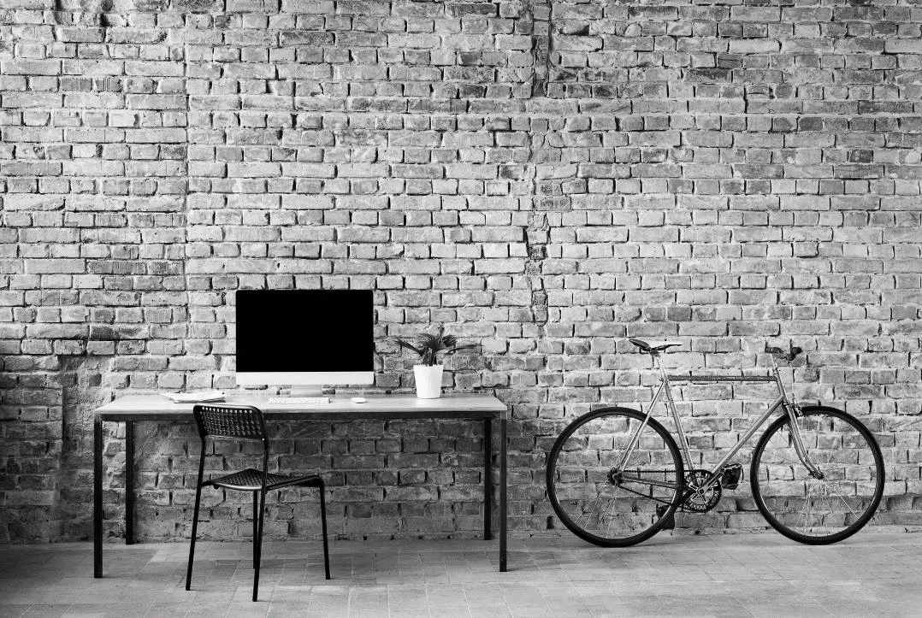
ABOUT THE QUESTIONNARE
A questionnaire was conducted to understand why people reject waste recycling dumpsites near their homes. The survey included all societal groups, males and females, and was limited to Palestinian cities in the West Bank, Nablus, Ramallah, Tulkarm, Jenin, Salfit, Tubas, Bethlehem, Jerusalem, Hebron, Qalqilya, Jericho. The questionnaire was distributed electronically on social networking sites, with 608 samples collected over several months. The main goal was to understand the reasons people reject waste recycling dumps near their homes.

Slide 6
ANALYSIS OF SURVEY RESPONSES
Type
 |  | Frequency | Percent | Valid Percent | Cumulative Percent
Valid | Female | 296 | 48.7 | 48.7 | 48.7
 | Male | 312 | 51.3 | 51.3 | 100.0
 | Total | 608 | 100.0 | 100.0
Family members
 |  | Frequency | Percent | Valid Percent | Cumulative Percent
Valid | 2 | 24 | 3.9 | 3.9 | 3.9
 | 3 | 46 | 7.6 | 7.6 | 11.5
 | 4 | 119 | 19.6 | 19.6 | 31.1
 | 5 | 174 | 28.6 | 28.6 | 59.7
 | 6 | 165 | 27.1 | 27.1 | 86.8
 | 7 or more | 80 | 13.2 | 13.2 | 100.0
 | Total | 608 | 100.0 | 100.0
The total number of respondents (608), in terms of gender, is characterized by a predominant number of female respondents (48.7 %) than male (51.3 %).
Regarding the number of family members, the values vary in the range of 2 to 4 members is 31.1%, then 5 to 7 or more members is 68.9%
2 : family are 2 members, ‘
3: family are three members,
4: family are four members
, 5: family are five members,
6: family are six members,
7: family are seven members

Slide 7
ANALYSIS OF SURVEY RESPONSES
Is there_a_garbage_dump_near_you?
 |  | Frequency | Percent | Valid Percent | Cumulative Percent
Valid | No | 362 | 59.5 | 59.5 | 59.5
 | Yes | 246 | 40.5 | 40.5 | 100.0
 | Total | 608 | 100.0 | 100.0
Bags size
 |  | Frequency | Percent | Valid Percent | Cumulative Percent
Valid | Small | 51 | 8.4 | 8.4 | 8.4
 | Medium | 428 | 70.4 | 70.4 | 78.8
 | Large | 129 | 21.2 | 21.2 | 100.0
 | Total | 608 | 100.0 | 100.0
Also, the next chart shows is there any Landfills near the place of living the samples shows that in percent of 60% answers yes that there a landfill near and a percent of 40% says no
For the garbage bags size and quantity of bags the figures below show the results of, where the first chart says that the average size of garbage sizes is small (1) by 8% ratio, the medium size (2) by 71% and the larger size (3) is about 21% of the sample. Also, the next bar chart shows the quantity of bags where nearly throw one bag (1) is about 132 bags in percent of 21.7%, whom throw 2 bags about 366 by 60.2% , the families throw 3 bags about 83 bags by 13.7% and the people who throw 4 bags or more get the lowest percent by 4.4% about 27 bags, this is a daily use.

Slide 8
ANALYSIS OF SURVEY RESPONSES
Bags quantity
 |  | Frequency | Percent | Valid Percent | Cumulative Percent
Valid | One bag | 132 | 21.7 | 21.7 | 21.7
 | Two bags | 366 | 60.2 | 60.2 | 81.9
 | Three bags | 83 | 13.7 | 13.7 | 95.6
 | More than three | 27 | 4.4 | 4.4 | 100.0
 | Total | 608 | 100.0 | 100.0
Garbage types
 |  | Frequency | Percent | Valid Percent | Cumulative Percent
Valid | Organic | 92 | 15.1 | 15.1 | 15.1
 | Paper | 279 | 45.9 | 45.9 | 61.0
 | Glass | 151 | 24.8 | 24.8 | 85.9
 | Metallic | 86 | 14.1 | 14.1 | 100.0
 | Total | 608 | 100.0 | 100.0
For the types of garbage there are many types and we consider that there are 4 types here Organic, paper, glass, metallic,respectively, organic materials get 15.1%, paper 45.9%, glass 24.8% and metallic 14.1%, The chart below show the percents, Also, we asked if the are separate the garbage that they throw, about 84% says no and 16% says yes.

Slide 9
ANALYSIS OF SURVEY RESPONSES
Separate garpage
 |  | Frequency | Percent | Valid Percent | Cumulative Percent
Valid | No | 511 | 84.0 | 84.0 | 84.0
 | Yes | 97 | 16.0 | 16.0 | 100.0
 | Total | 608 | 100.0 | 100.0
Waste_collection_service_how_many_times
 |  | Frequency | Percent | Valid Percent | Cumulative Percent
Valid | Daily | 91 | 15.0 | 15.0 | 15.0
 | Weekly | 216 | 35.5 | 35.5 | 50.5
 | More than | 301 | 49.5 | 49.5 | 100.0
 | Total | 608 | 100.0 | 100.0
And the time that the garbage where collect due to the survey daily gets 15%, weekly gets 36% and more than that gets 49%

Slide 10
ANALYSIS OF SURVEY RESPONSES
Are_you_ready_to_pay_to_solve_the_problem?
 |  | Frequency | Percent | Valid Percent | Cumulative Percent
Valid | No | 197 | 32.4 | 32.4 | 32.4
 | Yes | 411 | 67.6 | 67.6 | 100.0
 | Total | 608 | 100.0 | 100.0
Would you accept that there is a dump near you?
 |  | Frequency | Percent | Valid Percent | Cumulative Percent
Valid | No | 544 | 89.5 | 89.5 | 89.5
 | Yes | 64 | 10.5 | 10.5 | 100.0
 | Total | 608 | 100.0 | 100.0
Most of people don’t want to be there a landfill near them due to the questionnaire answers, at the same time most of the sample answers that they will pay for a landfill to solve the problem by 68% of the sample

Slide 11

Reasons | Percent of people
Fear of causing diseases | 90.1
Decrease in real estate values | 39.3
Soil, air and water pollution | 67.6
Increased traffic and noise in the area | 35.4
Loss of green spaces | 30.8

Slide 12
CONCLUSION
The results showed that 84% of participants do not separate their waste by type, leading to inefficient recycling. The accumulation of waste near residential areas is due to insufficient landfills, disposal sites, and lack of dedicated facilities for emptying waste. The majority of respondents expressed willingness to pay for solutions to waste management challenges, but some believed the responsibility lies with the municipality and state. Economic hardship, low income, and poor economic conditions add financial burdens to waste management. Concerns about environmental pollution, health risks, loss of green spaces, property values, increased traffic, and noise in the area also contributed to resistance. The study emphasizes the urgent need for comprehensive waste management reforms, addressing public concerns and emphasizing the environmental, health, and community benefits of waste disposal practices

Slide 13
RECOMMENDATION
The recommendation is to engage the community through targeted awareness campaigns, invest in efficient waste collection systems, and engage urban planners and architects to design recycling facilities that balance comfort and aesthetics. Incentives such as discounts on municipal services and tax benefits can encourage waste separation and recycling. Flexible payment solutions, such as tiered payment structures, can help residents access waste management services. By combining these solutions, a culture of sustainable waste management can be promoted, fostering a positive attitude towards waste recycling dumpsites near residences.

Slide 14


SUGGESTED SOLUTIONS
Focusing on development in the station construction area: The focus is on development in the station construction area, conducting property valuation assessments to compensate affected parties, investing in aesthetic design with seamless landscaping and architecture, and involving residents in the planning process to ensure the station meets their aesthetic and functional needs.
.Fear of causing disease: The proposed station aims to address the fear of disease by focusing on proper waste management, education, and advanced technology. It will adhere to strict hygiene standards, share examples of existing stations, and collaborate with schools, universities, and civil society institutions. The facility will also include local residents in a free health insurance program.

Slide 15

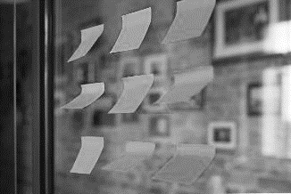
SUGGESTED SOLUTIONS
The station is implementing modern technologies to prevent leakage and environmental safety, continuously monitoring air quality, and installing appropriate drainage and treatment systems to prevent pollution. Regular inspections and maintenance are also being implemented to ensure environmental safety.
The station will be designed to minimize footprint while preserving green space, incorporating landscapes and promoting plant biodiversity. It may also be integrated with a community garden for improved waste management and psychological comfort.

Slide 16
THANK YOU

