Slide 1

Graduation Project (2)
"Sustainability Assessment of Palestinians Universities"
Prepared By
:Nada Kharraz
Dania Anaya
Supervised By
:Dr. Ahmad Ramahi

Slide 2
CONTENTS:
- Introduction
- The Study Problem
- The concept of Sustainable University
- pillars of sustainability
- The importance of Sustainable University
- Characteristics of Sustainability in Universities
- Indicators of Sustainable University
- Methodology
- Assessment Tool
- Data Analysis and Results
- Conclusion and Recommendation

Slide 3
Introduction
The term sustainability gained great global attention through the findings of the famous Brundtland report "Our Common Future" issued by the International Committee for Development and Environment WCED in 1987.
Brundtland definition incorporated two main issues:[6]
The first issue: the need, especially the need to create situation to maintain a satisfactory standard of life for all people.
The second issue: the maximum limits imposed by conditions according to the level of technology and social systems.
Through these two issues, all forms of sustainability can be assessed, whether educational or social or economical.

Slide 4
The Study Problem
The problem of the Study lies in the absence of applying the concepts and applications of sustainability in planning and design university buildings in the West Bank, which adversely affects their environmental and economic efficiency and social.

Slide 5
The concept of Sustainable University
The term sustainable university is defined in this study:
The University’s continuity, prosperity, flexibility, and ability to absorb challenges in the most effective and efficient way, while preserving its general structure, basic functions, operational capacity, readiness, and economic viability today and in the future, provided that the environment and natural resources are preserved, and not negatively affected

Slide 6
pillars of sustainability
- Academic sustainability
- Research sustainability
- Social sustainability

Slide 7
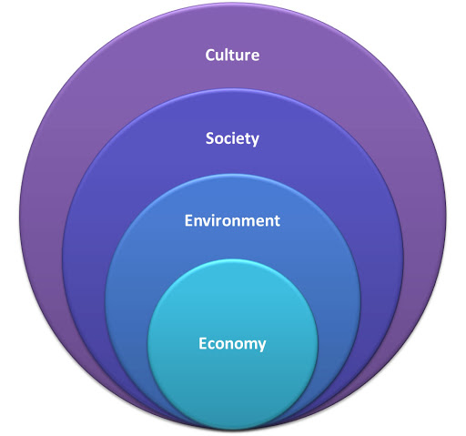
Continue…
Sustainability Pillars

Slide 8
The importance of Sustainable University
Achieving sustainability in one of pillars of sustainability leads unbalance in the rest of the pillars of sustainability, so for sustainability to be achieved in its comprehensive concept it must be achieved sustainability in all pillars, and among the most important of these pillars is educational sustainability it has three branches: academic, research, and social. So education should be treated as a pillar essential and important for achieving a sustainable economy, weak or lack of education, or one of the pillars of sustainability the other; it will likely affect sustainability as a whole, just as achieving educational sustainability in its holistic concept, it will help build the rest of pillars and maintain it

Slide 9
Characteristics of Sustainability in Universities
- Availability
- Dependability
- Capability
- Affordability
- Marketability

Slide 10
Indicators of Sustainable University
- (STARS): it refers to The Sustainability Tracking Assessment and Rating System.
- University Sustainability Rating Index (UI Green Metric):
- Times Higher Education Impact Ranking

Slide 11
Methodology
The study adopts the descriptive analytical method in studying the reality of the design of Palestinian universities in the West Bank and their conformity with the planning and design standards of sustainable international universities. then assessing the level of sustainability in those universities and knowing the shortcomings in those levels, then reaching recommendations on mechanisms to achieve sustainability in the design of Palestinian universities through the following research tools:

Slide 12
Continue…
- Access to published research, books, periodicals, and some websites.
- Field visits to a number of Palestinian universities in the West Bank, and conducting some interviews.
- Conducting interviews with those responsible for developing current and future plans for sustainable education and with engineers who specialize in designing universities that achieve the concept of sustainability in addition to members of the governing body.
- Analyzing case studies of universities around the world that are somewhat similar to the climate in the West Bank, and have achieved sustainability in their design, where their applications can be used to achieve sustainability significantly.
- Analyzing the evaluation results using the SPSS statistical analysis program ,where the program questionnaires are distributed to the parties concerned with the university, including teachers, administrative staff, officials, local community and engineers.

Slide 13
Assessment Tool
In light of the available human, material and temporal capabilities, the questionnaire was used as a tool to collect data in order to answer the study questions, because these questions depend on the viewpoint of the study members. Below is an illustration of the steps that were taken until the questionnaire reached its final form.

Slide 14
Data Analysis and Results
To reach the results, a descriptive analytical approach was followed for the study sample represented by An-Najah University employees. The study tool (the questionnaire) was arrived at by presenting it to a group of experts and specialists in the field of sustainability and statistical analysis

Slide 15
The questionnaire included:
-detailed information about the (employees) at An-Najah National University
-Key information on sustainability at the university
- The reality of the role of Palestinian university administrations in the transformation towards transformation of sustainability
Challenges facing Palestinian university administrations in shifting towards sustainability
-The administrative, organizational and development requirements necessary to activate the role of university departments in the transformation of Palestinian universities towards sustainability
-The role of Palestinian university administrations in shifting towards sustainability / academic field
- The role of university departments in shifting towards sustainability / research field
-The role of Palestinian university administrations in shifting towards sustainability / the social field
-The role of Palestinian university administrations in shifting towards sustainability / economic field

Slide 16
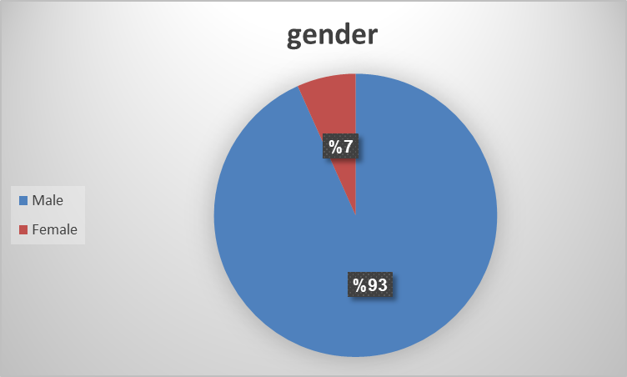
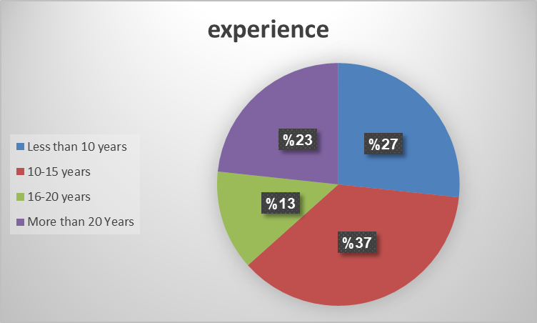
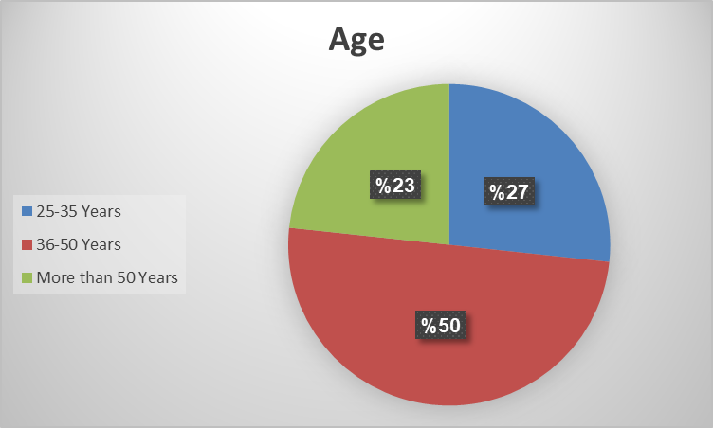
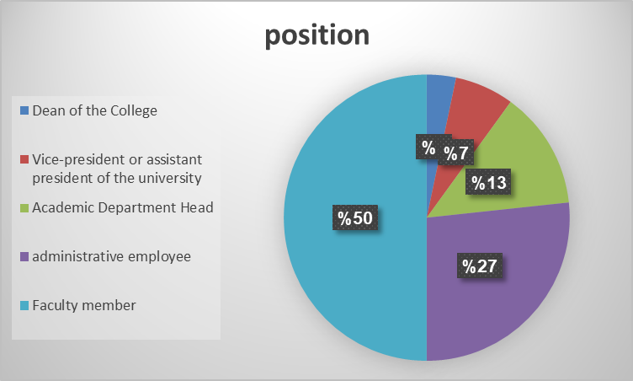
Results of demographic variables

Slide 17
Comment on the results
-As for the main information about the university’s administration, it was found that there is a clear chain for the shift towards sustainability. There is a special department responsible for the aspects of sustainability.
-With regard to the first part of the questionnaire, it was found that there is a big role for the university in shifting towards sustainability in all the questions that were asked, except for not observing the application of green building codes and the level of significance ≤0.05 as the correlation values ranged between (0.585 - 0.838)
-As for the challenges facing the university, it was represented in Lack of human competencies capable of leading the university's transformation towards sustainability and lack of interest thanks to the competitive advantages that distinguish it from other universities , and the level of significance ≤0.05 as the correlation values ranged between (0.547 - 0.855)
-Regarding the administrative, organizational and development requirements necessary to activate the role of university departments in the transformation of Palestinian universities towards sustainability It was great and strongly agreed to fulfill all requirements and the level of significance ≤0.05 as the correlation values ranged between(0.622 - 0.890)

Slide 18
-Regarding the administrative requirements necessary to activate It was great and strongly agreed to fulfill all requirements as for the proposed perception of the university’s role in integrating sustainability with education and research, there was approval from university employees on all methods of implementing sustainability and the level of significance ≤0.05 as the correlation values ranged between (0.725 - 0.823)
-As for the results from a social aspect of the university’s role, it had activities and a high impact and the level of significance ≤0.05 as the correlation values ranged between(0.693 - 0.879)
-As for the university’s role in economic terms, there is encouragement and support for students in entrepreneurial and youth projects and the level of significance ≤0.05 as the correlation values ranged between(0.509 - 0.914)

Slide 19
Recommendations
1-Studying the role of university departments in shifting towards sustainability in the rest of the sustainability pillars not covered in this study; Such as: financial sustainability, human sustainability, and industrial sustainability
2-Building a proposed strategy for the transformation of Palestinian university administrations towards sustainability in light of the American and Canadian experience
3-The application of this study to the general education stages; Through studying the role of education departments in shifting public education towards sustainability.
4-Study the challenges facing university departments in participating and benefiting from the global systems and indicators specialized in the money of universities' transition towards sustainability, such as the sustainability tracking, assessment and classification system (STARS) and the University Sustainability Rating Index (UI Green Metric)
5- Training human resources that are able to turn the university towards sustainability
6-Green Building System is more applied in university buildings and facilities

