Slide 1
Utilization Of Plastic Waste On Concrete Mixes
Prepared by :
Ghadeer Mahmoud
Renad Issa
Marah Assad
Thaer Saif
Submitted to Dr. Shadi Sawalha

Slide 2
Content
Problem and objective
Concrete
Polymers
Polymer in Concrete mix
Methodology
Tests perform on the concrete
Sample of calculation
Results and Discussion
Conclusion

Slide 3
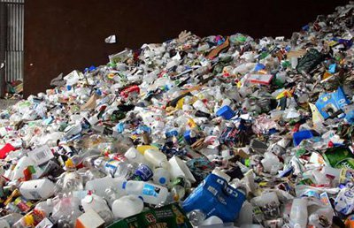
Problem
A substantial growth in the consumption of plastic is observed all over the world in recent years.
These wastes cause many of environmental and economical problems also cause negative effects on human and animal health.
several ways were found for disposing of this waste of plastic.
Burning of plastics is one of the methods
that used, Plastic waste can also be used to
Produce new plastic based products after
processing.

Slide 4
About Our Project :
Two types of plastics will be used : PET and Styrofoam,. We will used different shapes of PET waste at different percentages.
Styrofoam in the form of Styrofoam granules and dissolved Styrofoam will be also used.
The compressive strength and water absorption of concrete will be tested after adding each type.

Slide 5
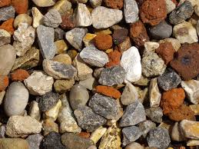
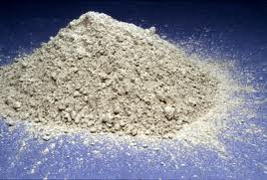
Concrete
*Concrete is a composite material composed mainly of water, aggregate, and cement.
*additives and reinforcements are included in the mixture to achieve the desired physical properties of the finished material.

Slide 6
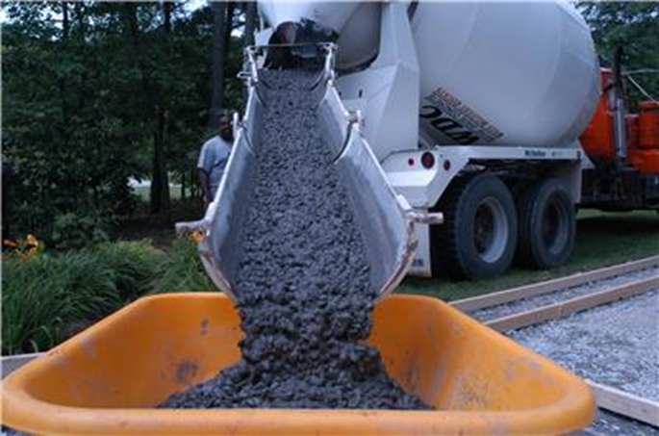
Properties of Concrete
Concrete properties make it the building material of choice for most purposes. The most important features are:
• Strength and Durability
• Versatility
• Low maintenance
• Affordability
• Fire-resistance
• Thermal mass
• Locally produced and used

Slide 7
Polymers
A polymer Consists of a very large number of a small structural unit which called a monomer, repeating unit one by another are made to link up by covalent bonds under appropriate conditions.
Polymer classification :
origin polymer.
Affect of Temperature on polymer.
A difference in the chemical structure.
A rating based on the shape of the molecules of the polymer.

Slide 8
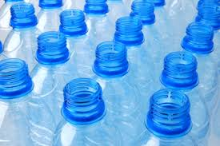
Example of Polymer.
PET, LDPE, HDPE, Polypropylene, PVC, Polystyrene, etc.
Polyethylene terephthalate (PET).

Slide 9
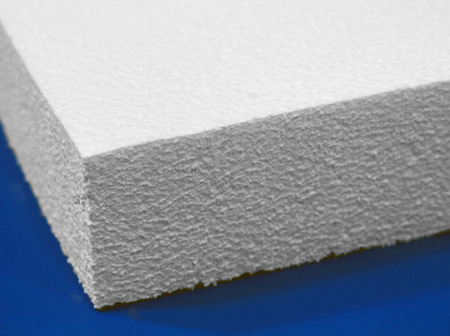
Polystyrene.
commonly known by the trade-name expanded Styrofoam, the raw material is synthesized from petroleum by products (benzene, ethylene) and formed into beads.

Slide 10
Polymer in Concrete mix
The positive side of concrete including able to be cast and durability, heat storage and low maintenance and can be reused or recycled.
The negative side of low tensile strength, large drying shrinkage, low chemical resistance.
reduce this bad effect of concrete, many attempt were carried out to use polymer for this purpose ,Also to solve and reduce solve an environmental problem.

Slide 11
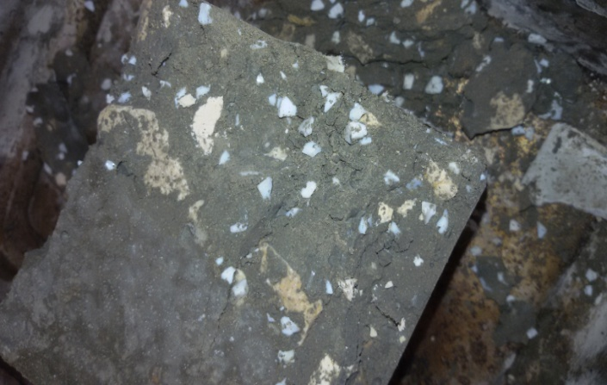
Polymer-modified cement can be obtain by replacing cement binders in ordinary Portland cement with polymeric compounds.
The addition of the polymer to the cement paste leads to improved quality, which would be expected to have a high chemical resistance.
By adding polymer in concrete the strength of the product have been increased, which increases the interfacial bond between the polymer and aggregate.

Slide 12
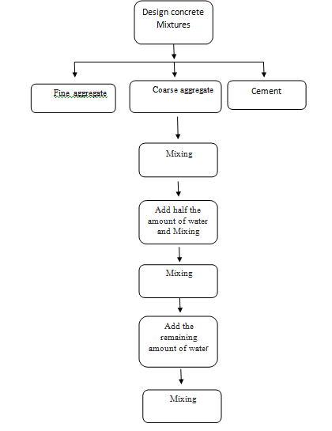
Methodology

Slide 13
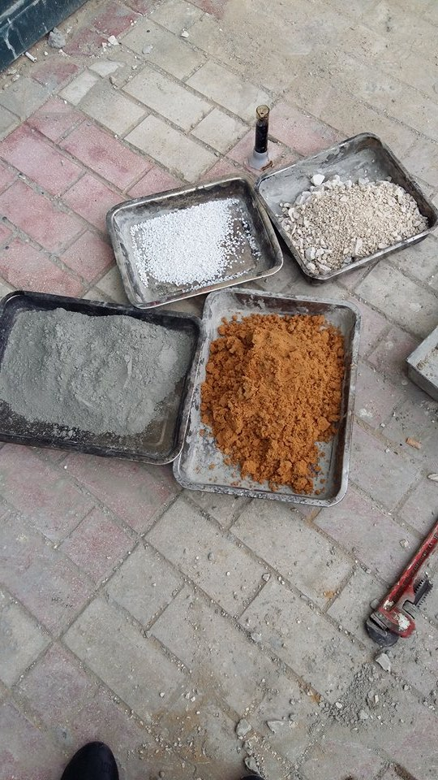
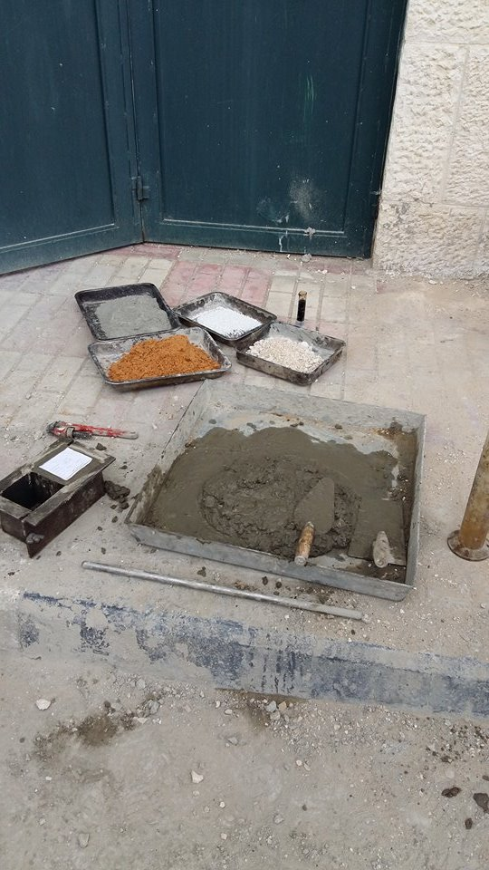
figure2:The amount of aggregates, plastic, cement, and sand

Slide 14
Summary of the samples prepared from different types of plastic
Water cement ratio | Present of plastic |  |  |  |  | Type
60% | Mass ratio | 20% | 15% | 10% | 5% | coarse granules PET instead of sand
60% | Mass ratio | 20% | 15% | 10% | 5% | coarse granules PET instead of aggregate
60% | Mass ratio | 20% | 15% | 10% | 5% | fine granules PET instead of sand
60% | Mass ratio | 20% | 15% | 10% | 5% | fine granules PET instead of aggregate
60% | Mass ratio | 20% | 15% | 10% | 5% | Flakes instead of sand
60% | Mass ratio | 20% | 15% | 10% | 5% | Flakes instead of aggregate
60% | volumetric ratio | 20% | 15% | 10% | 5% | Styrofoam instead of sand
60% | volumetric ratio | 20% | 15% | 10% | 5% | Styrofoam instead of aggregate
60% | Mass ratio | 20% | 15% | 10% | 5% | Powder PET instead of sand

Slide 15
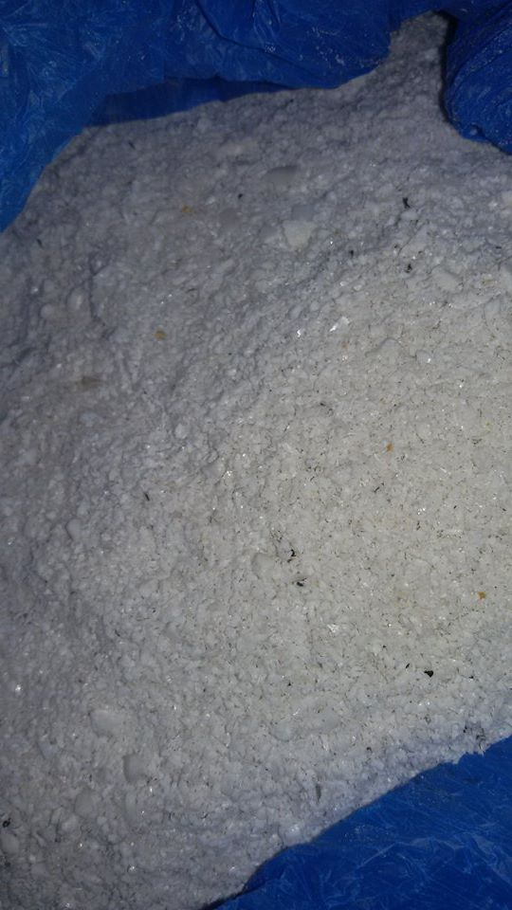
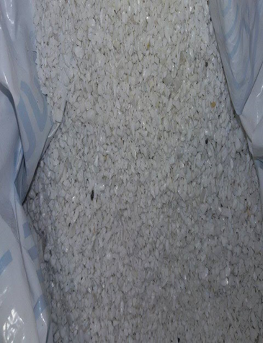
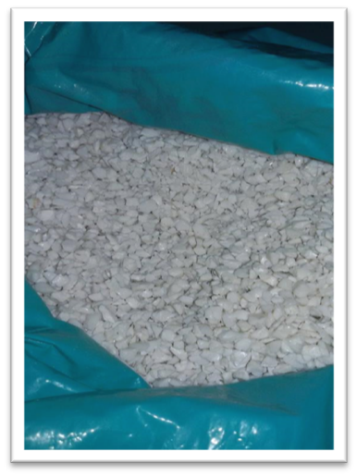
PET forms :
Powder
Fine granules
Coarse granules

Slide 16
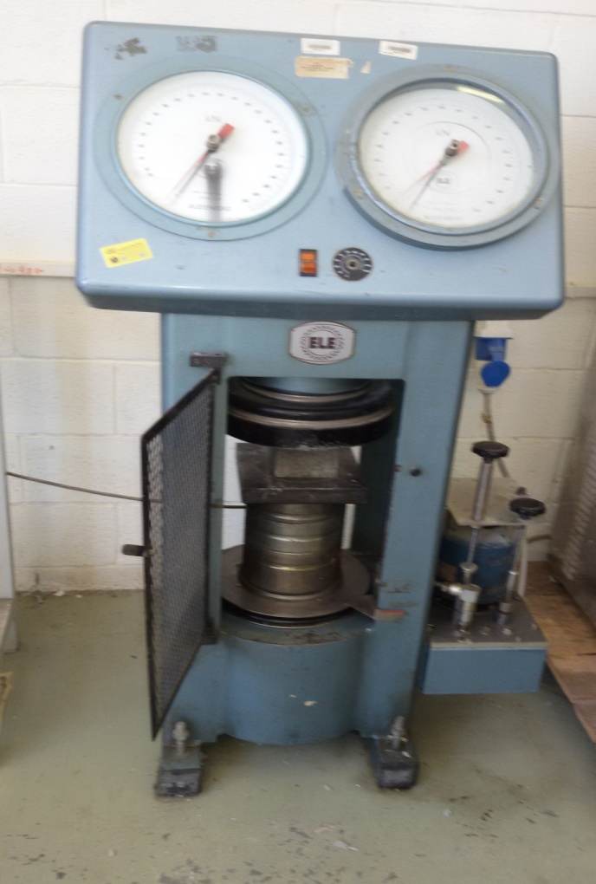
Tests perform on the concrete
1-Compressive strength test : take one cube from the curing tank after 7 days then put it in the compression machine and turn it on until the cube cracks then taking the result from the machine.
.

Slide 17
2- Calculating the tensile strength : the maximum tension the material can with stand without tearing . Which equal 10% of the compressive strength in (M Pa).
3-Absorption test: taken other cube from the curing tank after 7 days then put it in oven dry for 24 hours at 110 ⁰C then get it from the oven and measure the weight then put it for 1 day at curing tank then measure its weight another time
Absorption, percent =(A-B)/B * 100
A = wet mass of unit
B = dry mass of unit

Slide 18
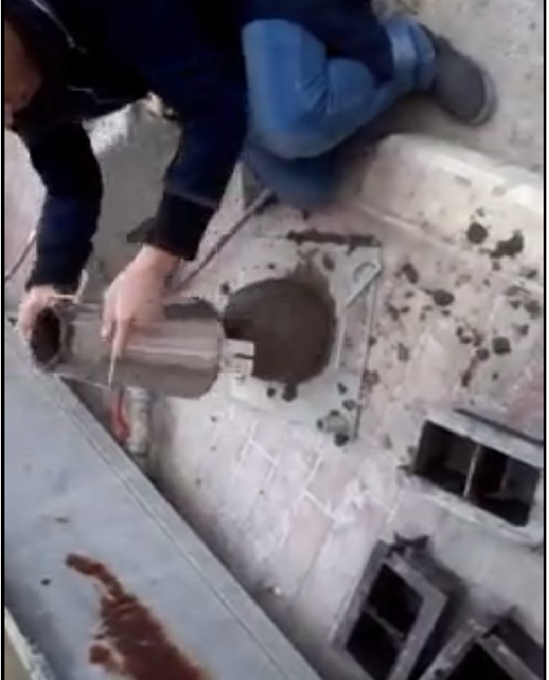
3-Slump test : it measures the workability of concrete
The test is carried out using a mould known as a slump cone. The cone is placed on a hard non-absorbent surface.This cone is filled with concrete in three stages, each time it is tamped using a rod of standard dimensions. At the end of the third stage, concrete is struck off flush to the top of the mould. The mould is carefully lifted vertically upwards, so as not to disturb the concrete cone. Concrete subsides. This subsidence is termed as slump.

Slide 19
Video
result of fresh concrete mixture sample 1-
2- results of adding 5% coarse granules PET to the concrete instead of (sand)
3-results of adding 15% fine granules PET to the concrete instead of (sand)
4- results of adding 5 % flakes to the concrete instead of (aggregate )
5-results of load when using plasticizer (5%flakes to the concrete instead of aggregate )
6-results of load when using plasticizer (5%flakes to the concrete instead of sand )
7-results of load when using plasticizer (5% Styrofoam to the concrete instead of sand )

Slide 20
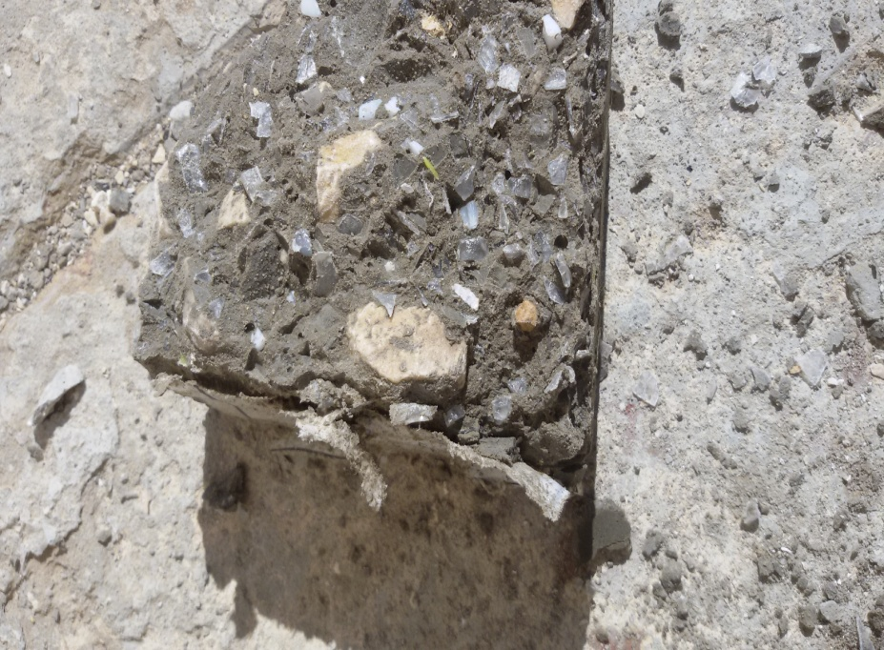
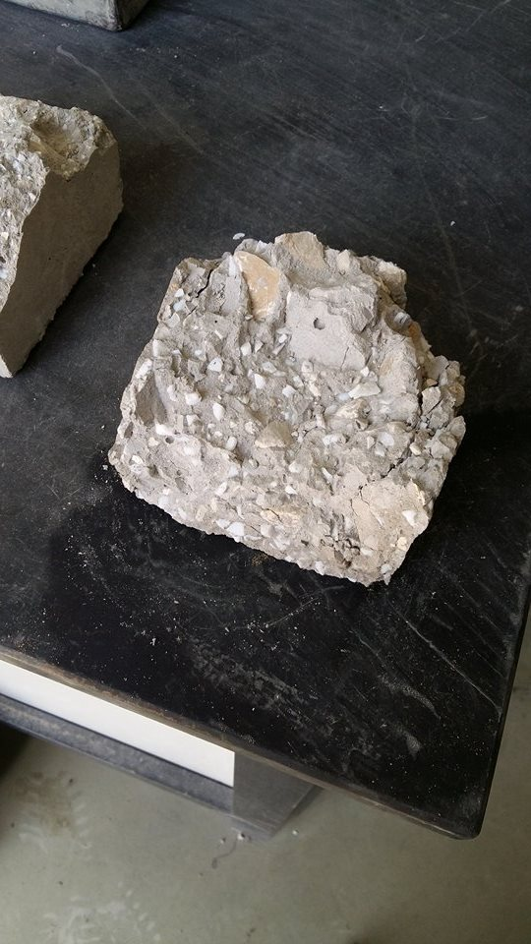
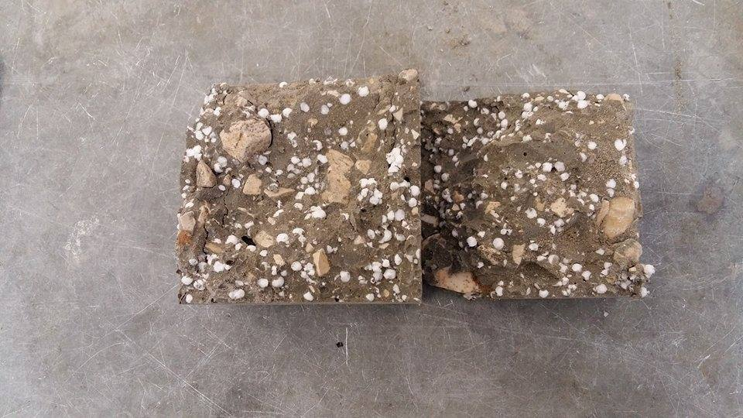
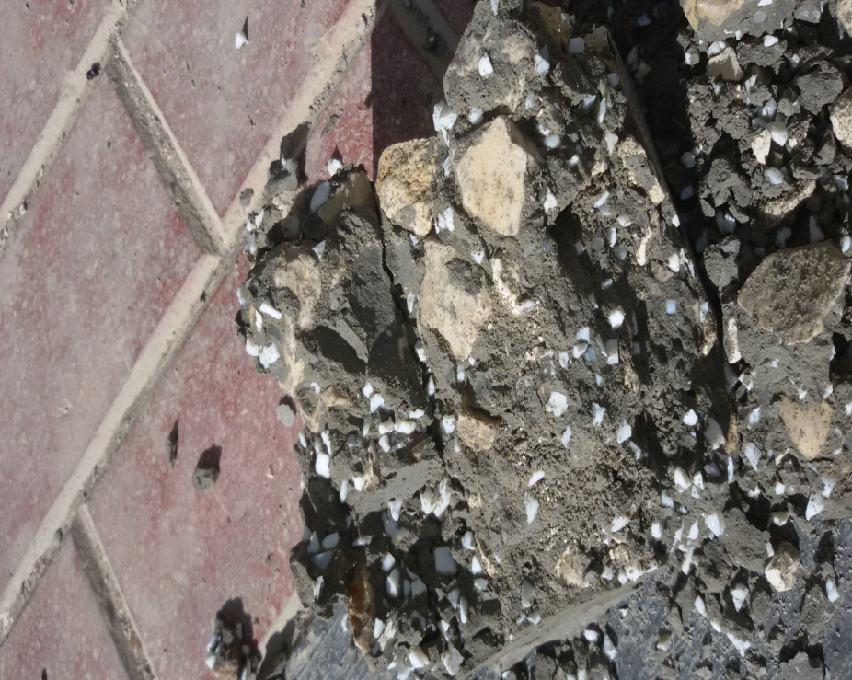
Flakes
Fine PET
Styrofoam
Coarse PET

Slide 21

Sample of calculation
The load measured by the machine was 220KN.
Compressive strength (Kg/cm²) =
= 224.26(kg/cm²)
=
Compressive strength after 28 days (kg/cm²) =
=
= 329.7 (kg/cm² )
= 323.45KN

Slide 22

Compressive strength after 28 days (Mpa) =
=
= 32.345 (M Pa)
Tensile strength (after 28days) =
10%
compressive strength (MPa )
=
10%
32.34 = 3.23 M Pa
Absorption rate =
%100
=
100 % = 6.99%.

Slide 23
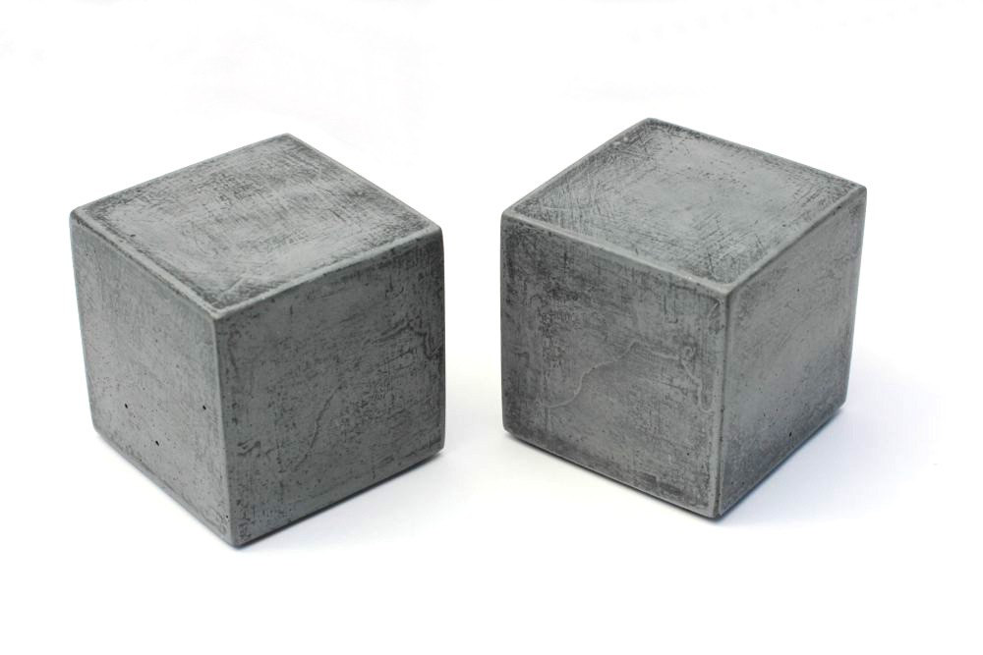
Results and Discussion
The Palestinian standards states that the compression strength of concrete mixes (1:2:2)(cement : sand: aggregate ) should be between 250-350(kg/cm2).The compressive strength were 330 (kg/cm2) for a sample prepared as a reference sample (fresh).

Slide 24
Figure (a , b) shows the relationship between compressive strength and .percentage of coarse granules PET in mixture

Slide 25
Figure (a, b) shows the relationship between compressive strength and the percentage of fine granules PET in the mixture.

Slide 26
The following figure shows the relationship between compressive strength and the percentage of powder PET in the mixture.

Slide 27
Figure (a, b) shows the relationship between compressive strength and the percentages of PET flakes in the mixture.

Slide 28
Figure 8 (a, b) shows the relationship between compressive strength and percentage of Styrofoam in the mixture.

Slide 29
The following figure shows the compressive strength when using plasticizer in the concrete

Slide 30
The following figure shows the relationship between density and the percentage of plastic in the mixture

Slide 31
The following figure shows the relationship between absorption and the percentage of plastic in the mixture.

Slide 32
Conclusion
The compressive strength for fresh concrete mixture was =330( Kg/cm² ) and tensile strength of the sample = 3.32 M Pa
Adding coarse PET improved the compressive strength.
Adding fine PET instead of sand didn't affect on the compressive strength
When using flakes the results were within the standards but less than the reference sample until using 15% of flakes instead of sand or aggregate.
Adding Styrofoam affected badly on the compressive strength.

Slide 33
Conclusion continue
The samples which contain Styrofoam can be used for decoration purposes and as insulator for sound and heat
Adding Plasticizer to the mixture improved the compressive strength about 8 to 10 %.
Most samples had true or shear slump.

Slide 34
سوف اكتب هنا بالورق والقلم
لأجل قدسنا ولأجل ألوان العلم
لأجل الشهداء و مدامع الأطفال
لأجل أسرانا القابعون في سجون الاحتلال
لأجل الجـمـيع
أعمالنا لن تضـيـع
أيام مضت من عمرنا بدأناها بخطوة وها نحن اليوم نقطف ثمار مسيرة أعوام كان هدفنا فيها واضحا وكنا نسعى في كل يوم لتحقيقه والوصول له مهما كان صعبا.
نقف أمامكم اليوم وقد وصلنا وبيدينا شعلة علم وسنحرص كل الحرص عليها حتى لا تنطفئ.
ونشكر الله أولا وأخير على أن وفقنا وساعدنا على ذلك.
ثم نتقدم بالشكر إلى القلب الحنون من كانت بجانبنا بكل المراحل إلى من كانت شمعه تحترق لتنير دربنا إلى أمهاتنا الحبيبات.
وإلى من علمنا أن نقف وكيف نبدأ الألف ميل بخطوة إلى يدنا اليمنى إلى من علمنا الصعود وعيناه تراقبنا إلى والدنا لمن أمسك بيدينا وعلمنا حرفا حرفا سنهدي له نجاحنا اليوم.
إلى من كانوا سندا لنا إلى من لهم الفضل بإرشادنا إلى طريق العلم والمعرفة إلى أساتذتنا الأفاضل كم نحن فخورون بكم, ونخص بالشكر الدكتور الرائع شادي صوالحة لمساعدتنا و أرشادنا للوصول إلى مشروع نفخر به, ألف شكر لك, وكفانا فخرا أن كنا طلابك ونتمنى أننا كنا عند حسن ظنك.
إلى شركاء حياتنا إلى نور أعيننا الذين ساعدونا بكل ما لديهم وتحملوا انشغالنا عنهم لكم كل الشكر على دعمكم لنا وتفهمكم .
أصدقائنا وأحبتنا ومن سهروا معنا في مسيرتنا العلمية إلى من مدوا أياديهم البيضاء في ظلام الليل وكانوا عونا لنا.
أيام جميله قضيناها نعيشها الآن لحظة بلحظة ونشعر وكأنها شريط يمر بمخيلتنا من جديد عاما بعد عام يوما يليه يوم .
شكرا لكم جميعا .

