Slide 1
Shobbek-Lobbek Social
Prepared by :
Mostafa Alshaer And Khaled kayed.
Supervisor : Dr.Muhand Aljabe.

Slide 2
Outline
Introduction.
Tools and technologies.
The Main Structure.
Server.
Website.
Mobile Application.
Challenges.
Future work.
Conclusion.

Slide 3
Introduction
As student in An-Najah National University, how can I :
Save my time while searching for the best services around? Books, shops, restaurants, …etc
Save my time while searching for the best accommodations around?
Save my time while searching for transportation availability?

Slide 4
Introduction
As student in An-Najah National University, how can I :
Stay in contact with my professors and colleagues?
Contribute towards Najah Smart Community

Slide 5
Introduction
Therefore our project is part of a research with Fratello Holding about :
“Migration from IOT towards IOP in smart communities”

Slide 6
Tools and Technologies
ASP.NET/C# .
Android Studio .
Open Street maps .
Google maps .
SQL Server Management .
Azure Server .

Slide 7
The Main Structure
.
Website
Android application
Server

Slide 8
Server
Database.
Website Pages and Web services .

Slide 9
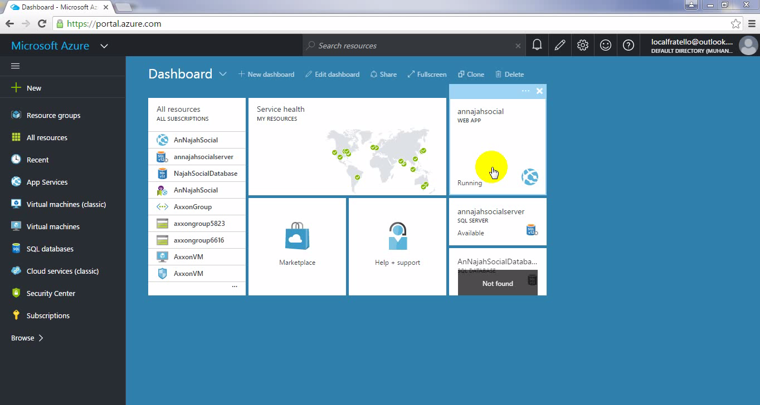
Database

Slide 10
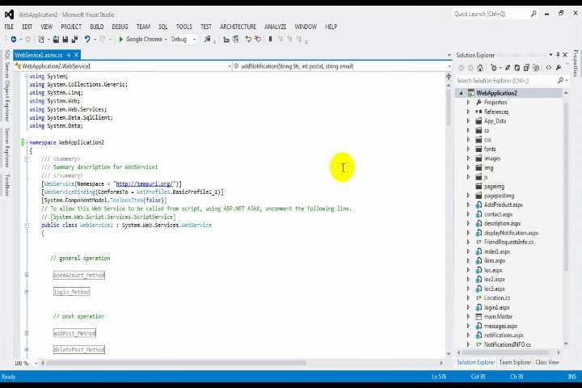
Website Pages and Web services

Slide 11
Website
Marketer Registration and Login.
Timeline.
Update marketing page information.
Location.
Photos.
Products and Services.
Messages.
Likes.
Notifications.

Slide 12
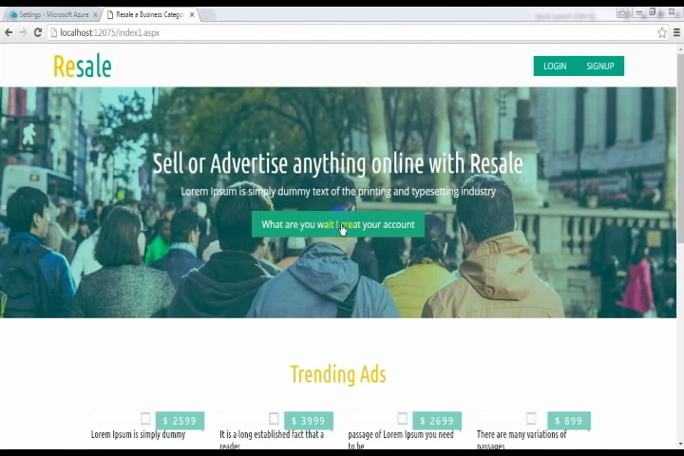
Marketer Registration and Login

Slide 13
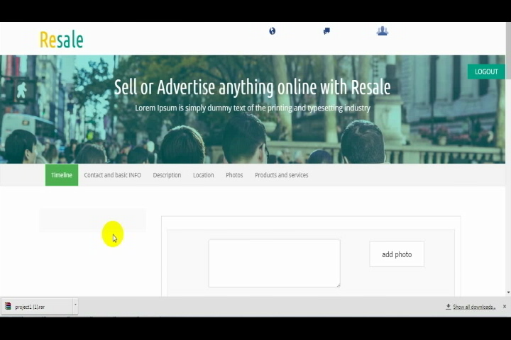
Timeline

Slide 14
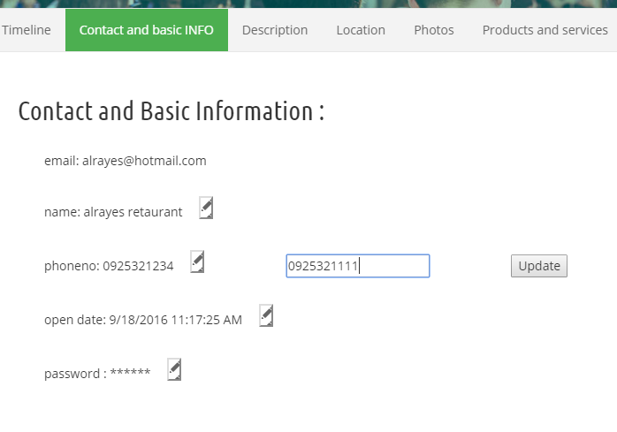
Update marketing page information

Slide 15
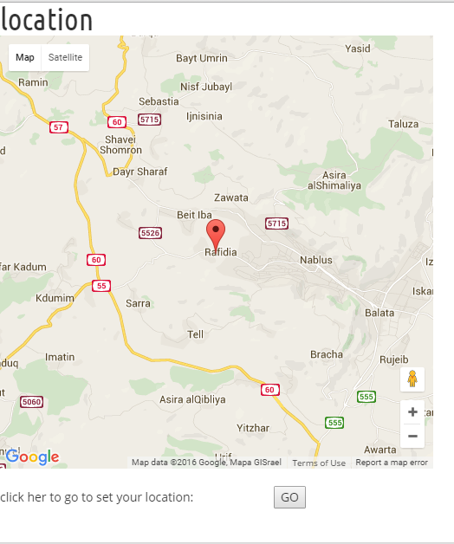
Location

Slide 16
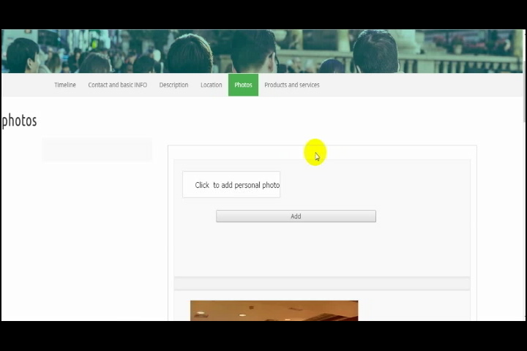
Photos

Slide 17
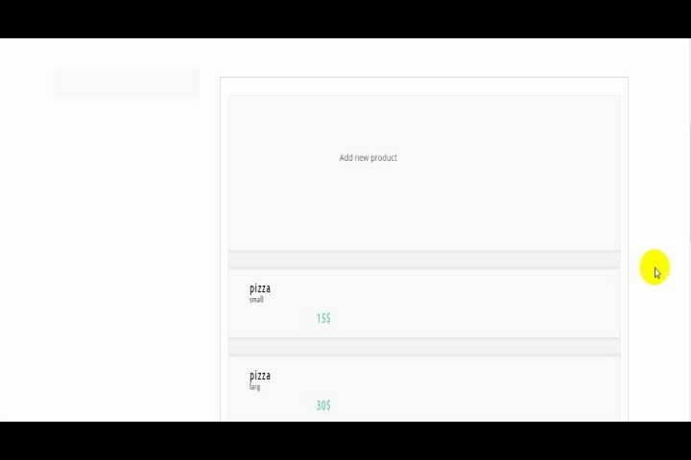
Products and Services

Slide 18
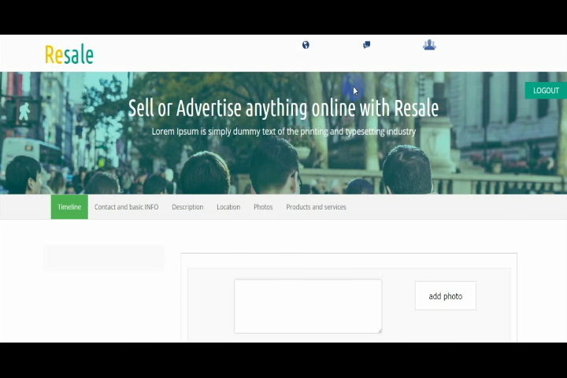
Messages

Slide 19
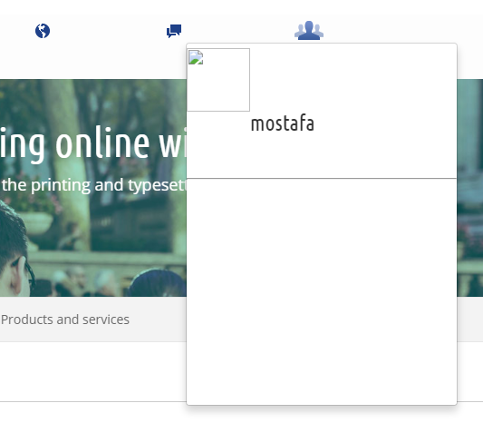
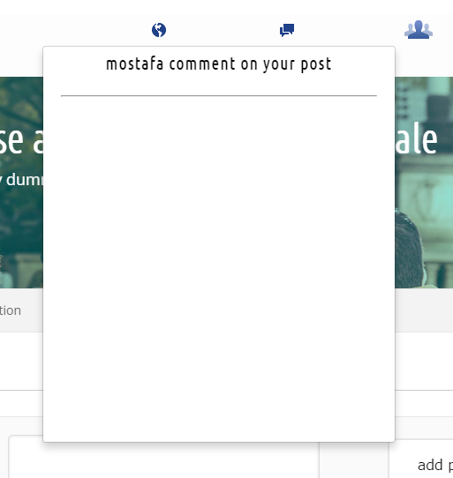
Likes and Notifications

Slide 20
Mobile application
User Registration and Login.
Home Page.
Notifications.
Friend Requests.
One User personal Page.
Friends.

Slide 21
Mobile application(cont.)
Places.
Quick search on map.
Search about places.
Update personal information.
Marketer Page.
Messages.

Slide 22
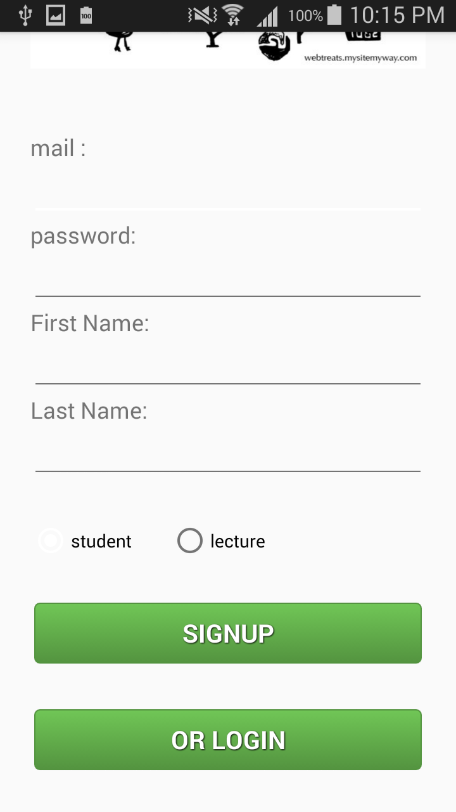
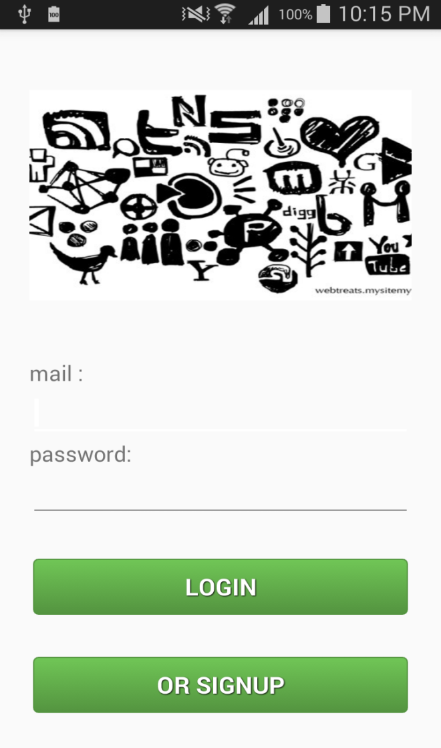
User Registration and Login

Slide 23
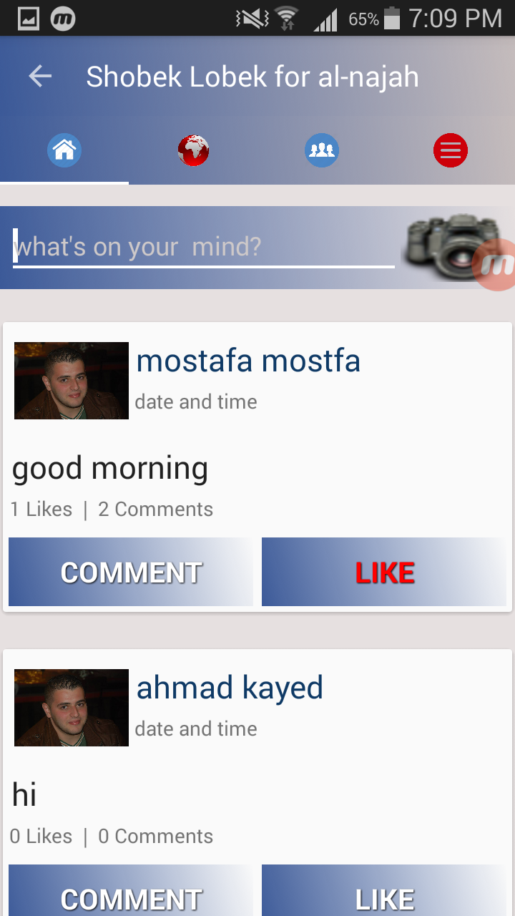
Home page

Slide 24
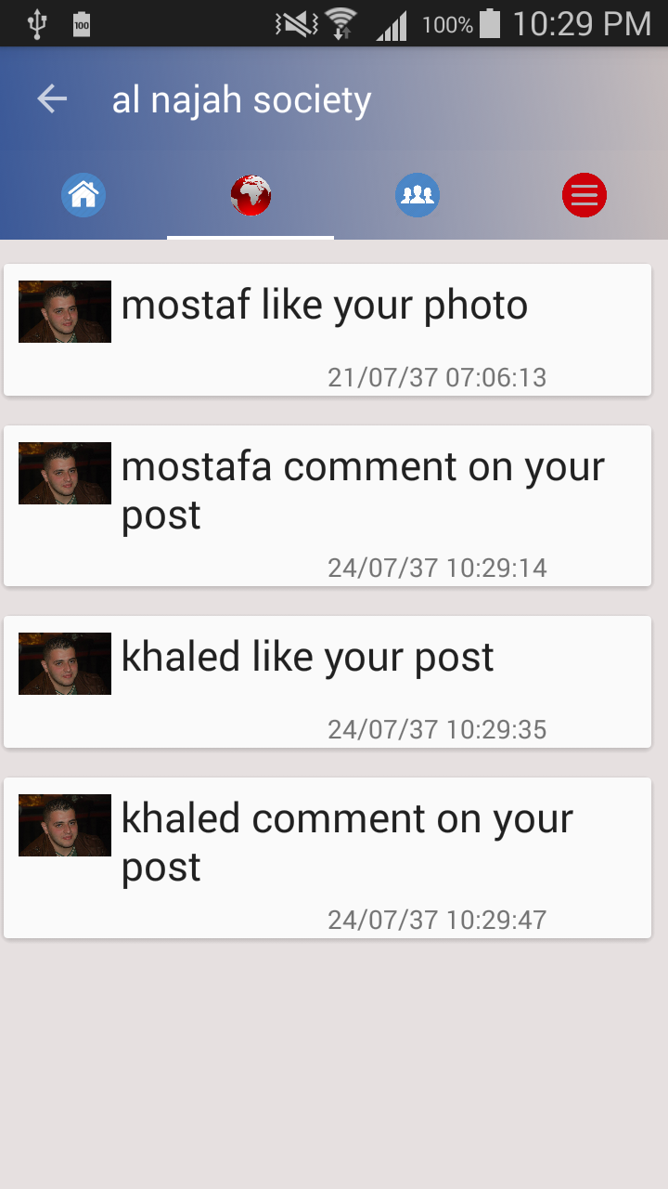
Notifications

Slide 25
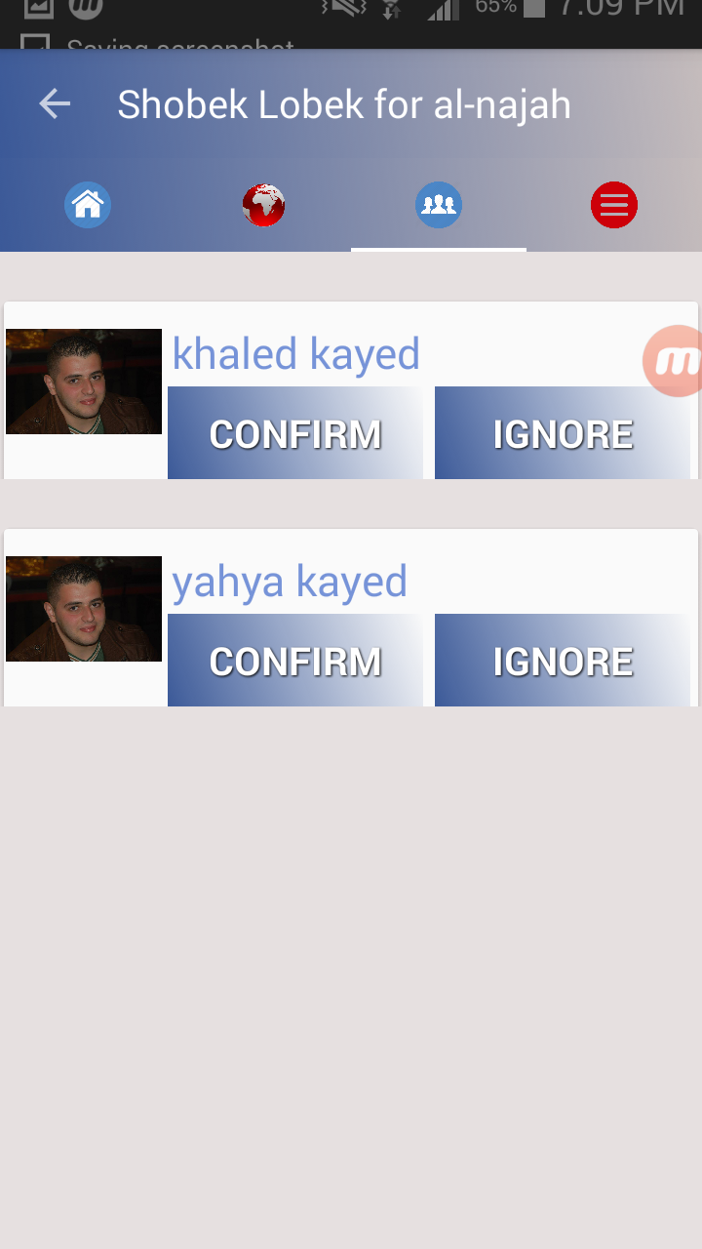
Friend Requests

Slide 26
One user personal page

Slide 27
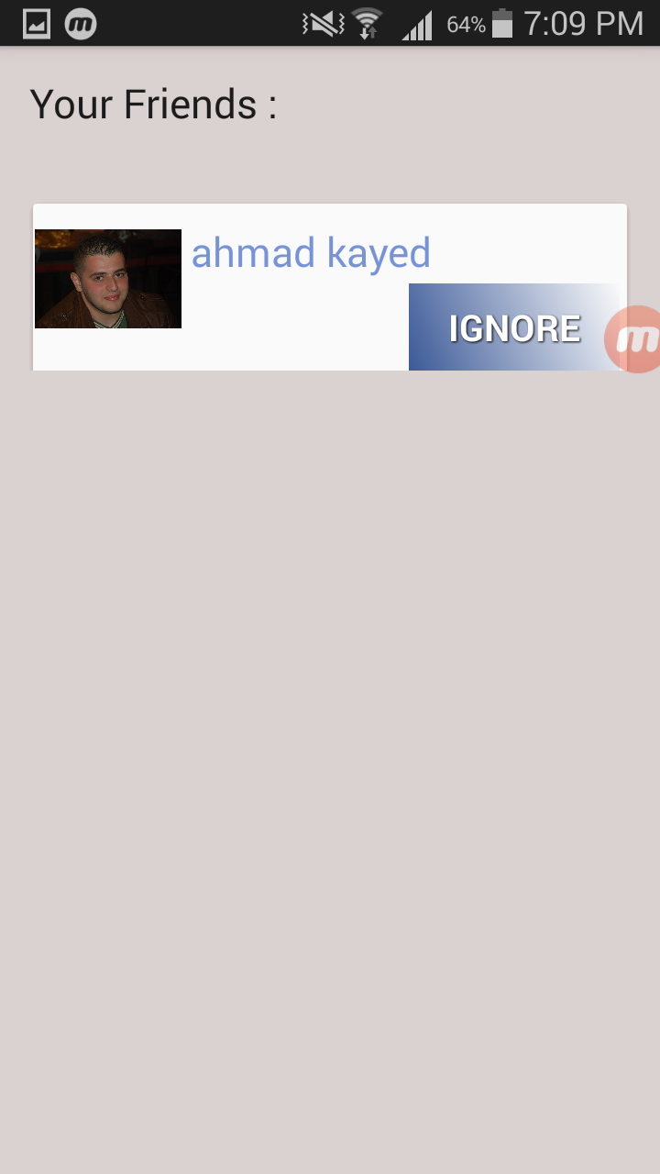
Friends

Slide 28
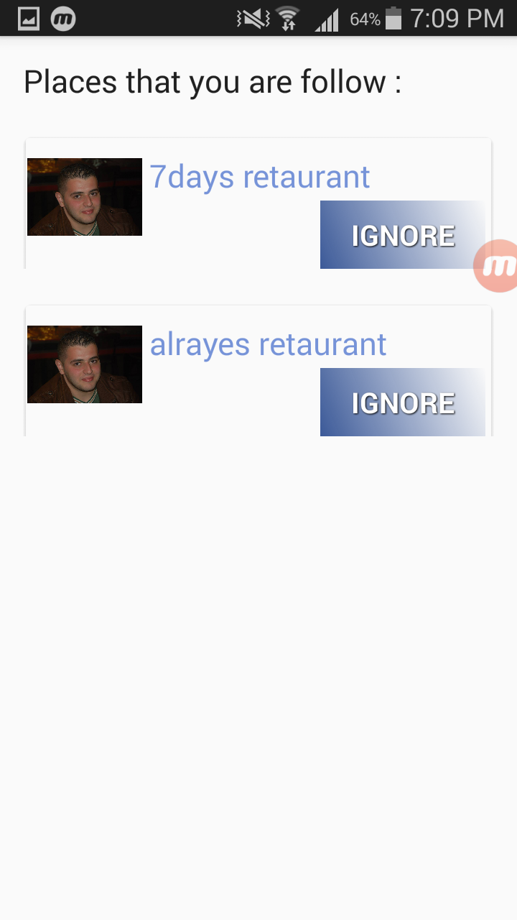
Places

Slide 29

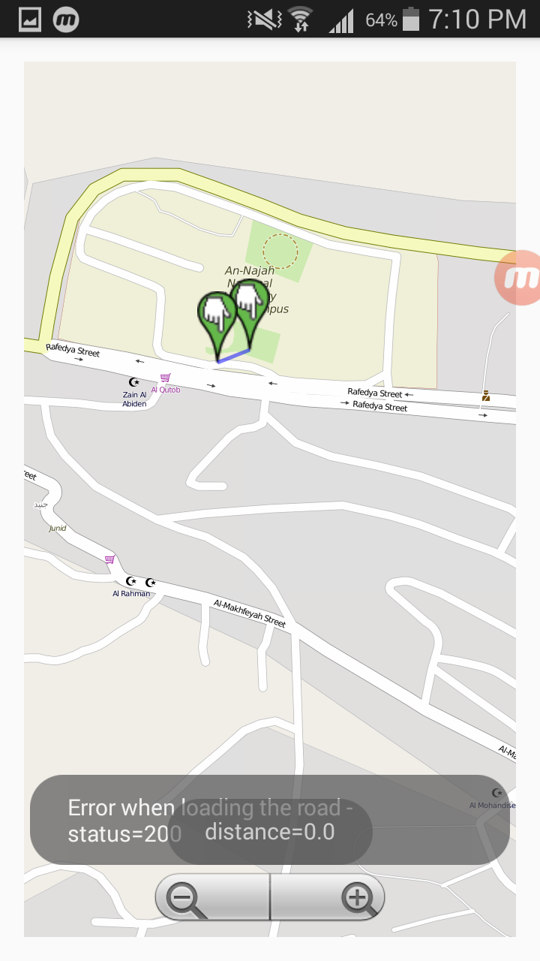
Quick search on map

Slide 30
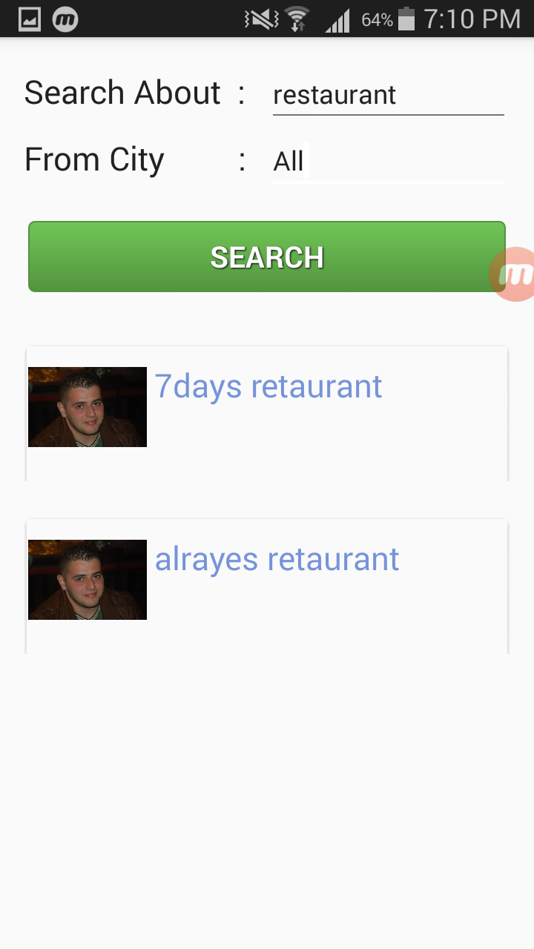
Search about places

Slide 31
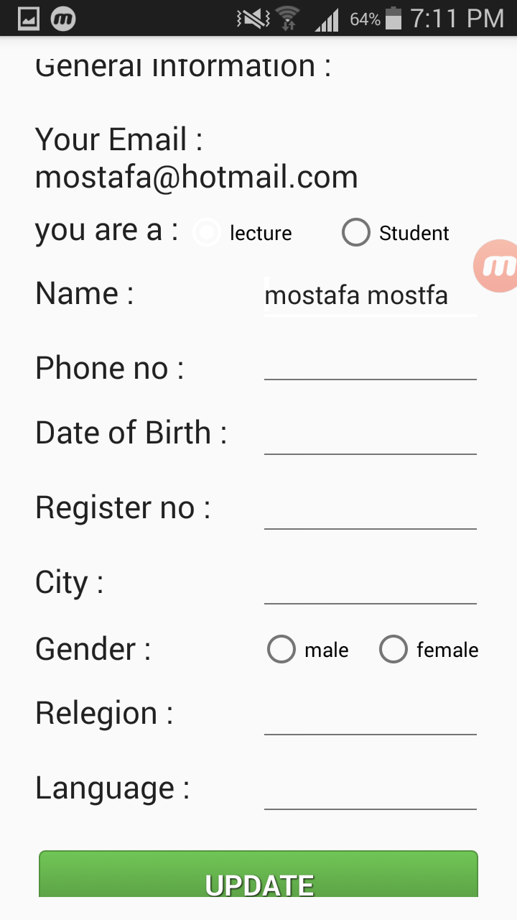
Update personal information

Slide 32
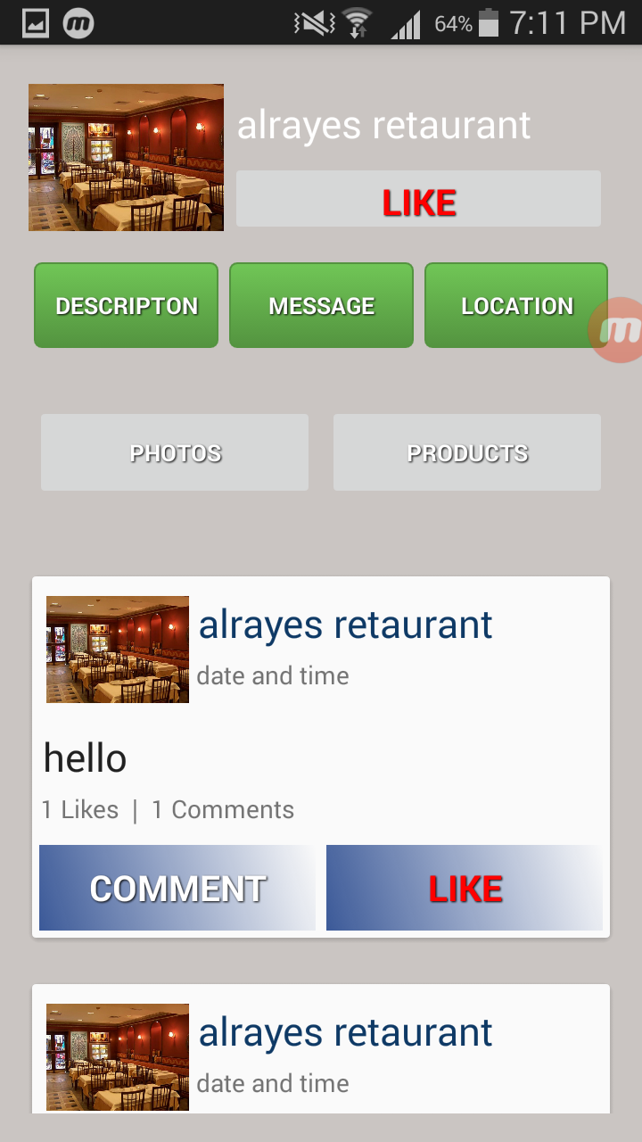
Marketer page

Slide 33
Messages

Slide 34
Challenges
Time .
Devices and Tools.

Slide 35
Future work
Rework the design.
Improve performance and security.
Admin panel.
Your course.

Slide 36
any questions ?
Thanks for attention

