Slide 1


Graduation Project
Indoor Cell Planning For An-Najah Educational National Hospital
In Corporation With Jawwal
Superviser
Dr.Allam Mousa
Prepared by
Mohammed Donbok
Haitham Fahed

Slide 2
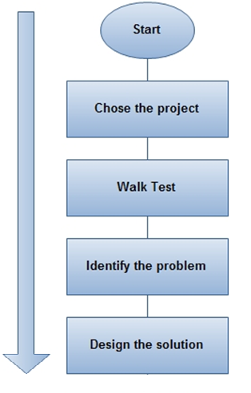

Slide 3
Problems’ Description
This project discussed the problems existing in An Najah Educational National Hospital which are poor quality calls, drop calls and call setup failure. These problems are because of weak signal strength.

Slide 4
Project’s Goal
Solve the problems inside the building of An Najah Educational National Hospital which is considered to serve the areas north of the West Bank, with an acceptable range of coverage, capacity, quality.

Slide 5
Problem Solution
Design a system that will distribute a uniform strong signal inside the building, from the indoor cell, using indoor system in order to provide sufficient coverage, quality, capacity and dominance.
RX-Level
Deep Indoor | -45 dBm to -64 dBm
Indoor | -65 dBm to -74 dBm
InCar | -75 dBm to -84 dBm
Outdoor | -85 dBm to -94 dBm
Bad Service | -95 dBm to -110 dBm

Slide 6
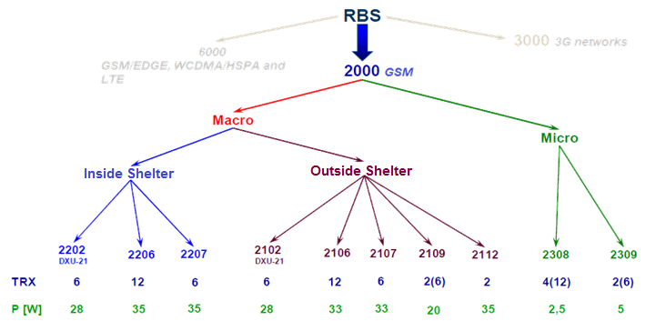
System Components
1- Radio Base Station (RBS) : Ericsson 2308, 4 TRUs, 34 dBm output power.

Slide 7
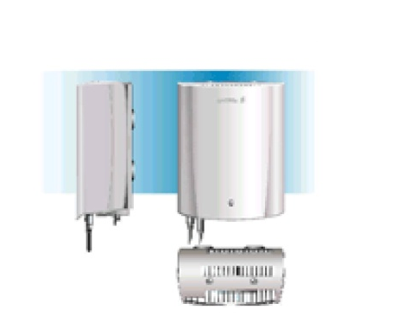
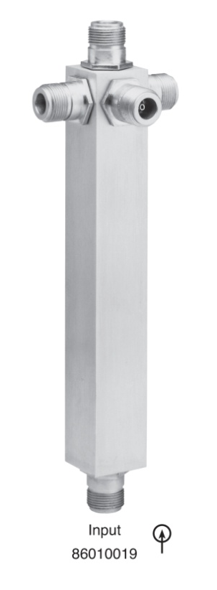
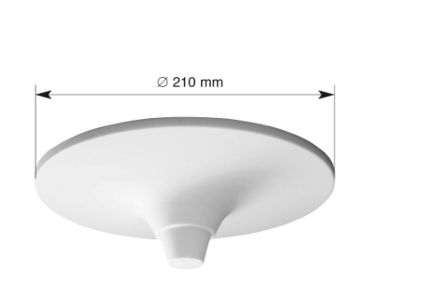
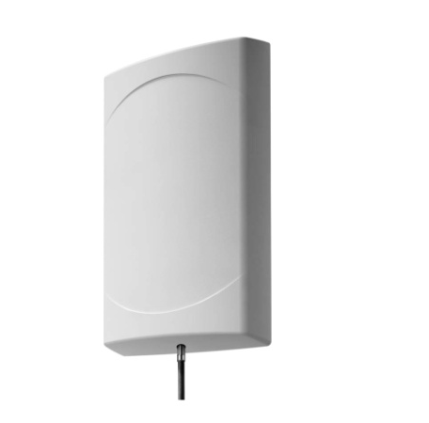

Cont’d
(System Components)
2- Antennas : Omni and Directional Antennas.
3- Splitters : 2,3 and 4 ports.
4- Cables: ½in with 7dB/100m loss.

Slide 8
The Design
1- Passive or Active Distributed Antenna Systems?
Two system types can be used for indoor solution, Active DAS or Passive DAS.
In this project Passive DAS has been used for these reasons:
Components from different manufacturers are compatible.
It can be installed in harsh environment.
No high data rate needed.
No DC power supply is needed for the equipments.

Slide 9
Cont’d
( The Design )
2- Capacity Dimensioning.
These conditions should be determined to calculate the number of channels that are needed to solve the capacity problem.
Number of subscriber = 900 subscribers.
Types of subscriber : Normal = 25 mE.
Grade of service (Call Blocking Rate ) = 2%.

Slide 10
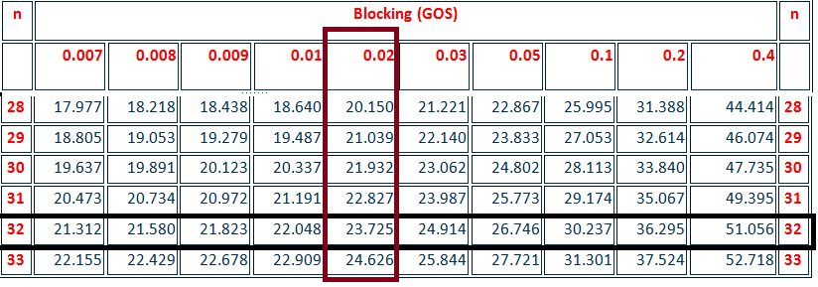
Cont’d
(Capacity Dimensioning)
Total Load = number of Subscribers X Load Per User
Total Load = 900 X 0.025
≈ 23 E
According to Erlang B-Table with 2% GOS,
32 channels are needed.

Slide 11
Cont’d
(Capacity Dimensioning)
Every TRUs can carry 8 channels so
32/8 = 4 TRUs are needed.
The system uses 3 channels for control so
32 – 3 = 29 traffic channels.

Slide 12
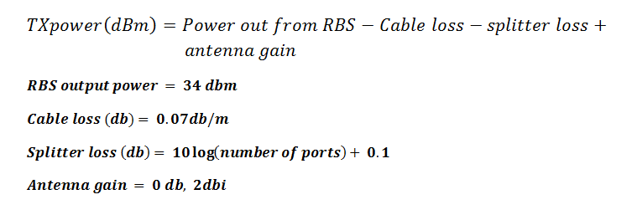
Indoor Link Calculations ( By Hand )
1-Link Budget: The power that just comes out antenna can be calculated according to this equation:

Slide 13
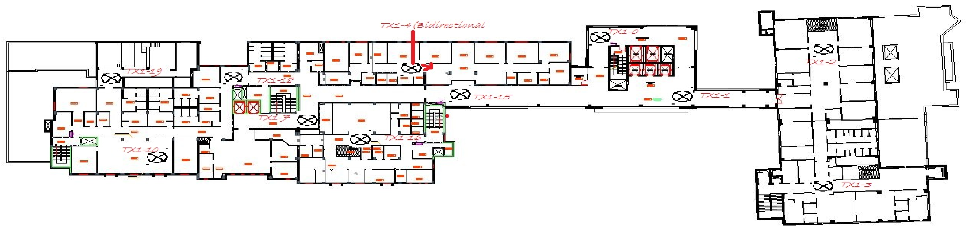
Cont’d
(Indoor Link Budget)
First Try
Antenna Locations in B1

Slide 14
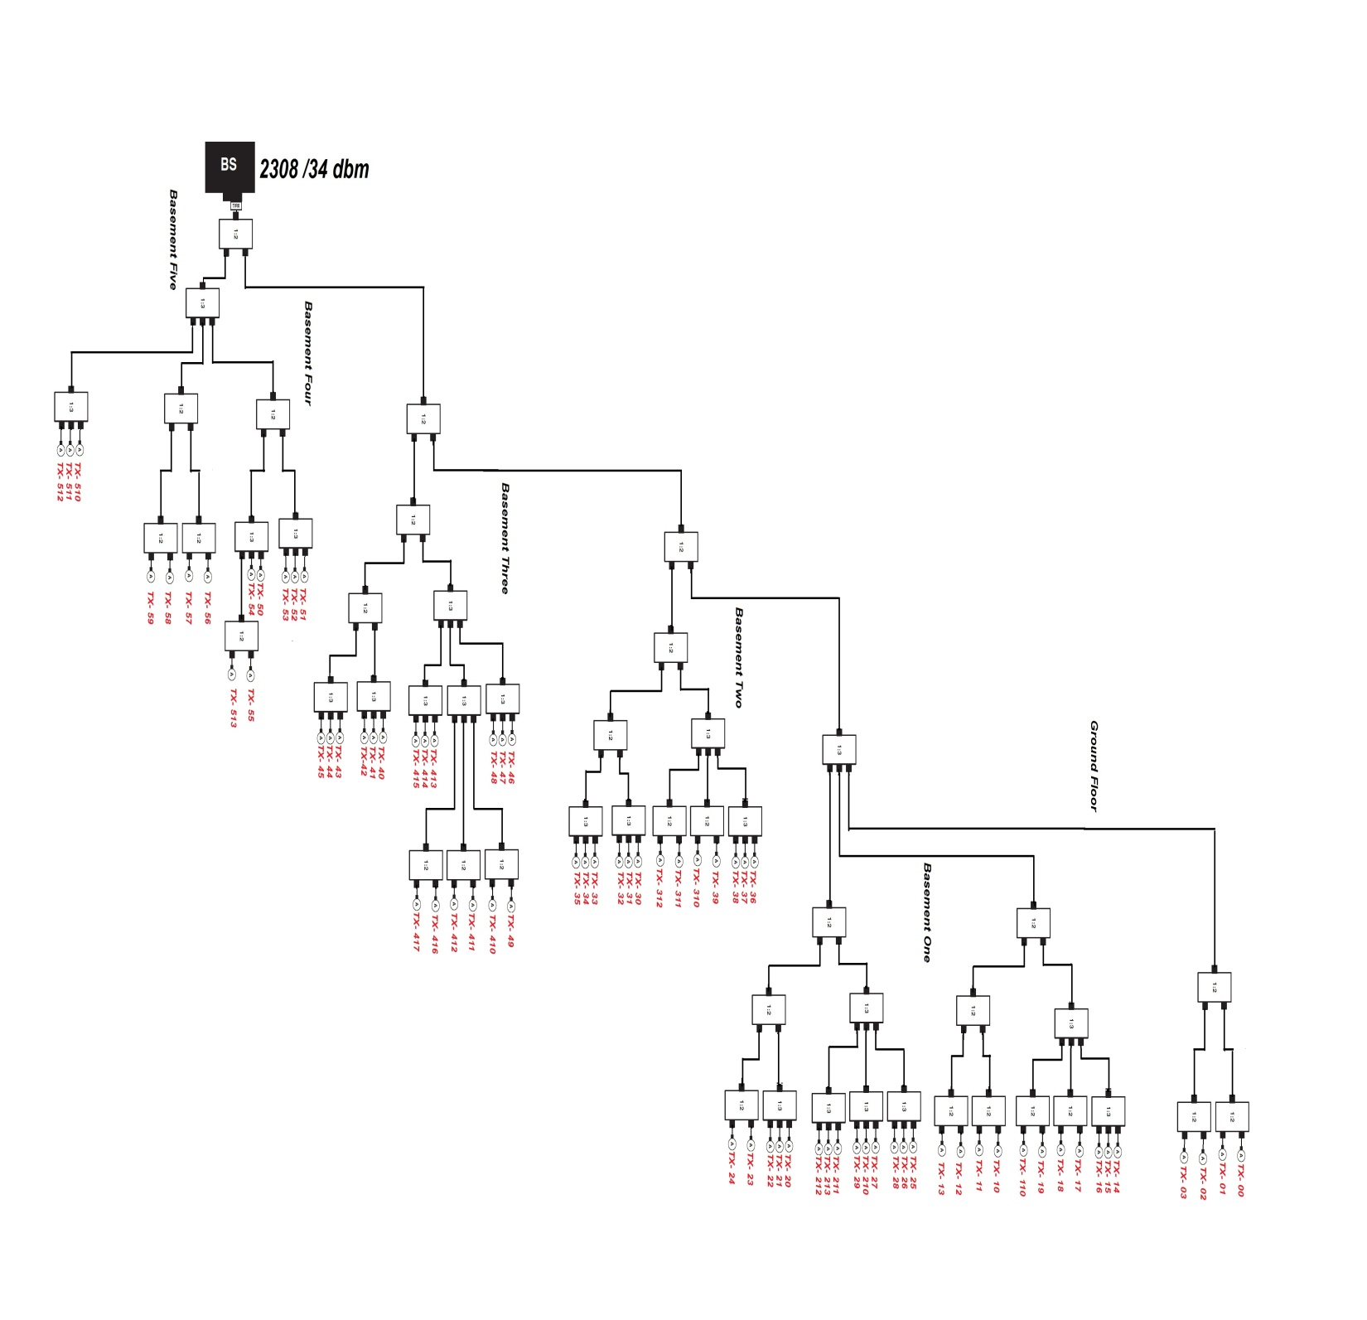
Cont’d
(First Try)
Power Splitting

Slide 15
Floor | Antenna # | RBS output power (dBm) | Cable Length (m) |  |  | 2 Port Splitter | 3 Port Splitter | 4 Port Splitter | TX Power (dBm)
B1 | TX-10 | 34 | 25 | 11 | 0 | 6 | 1 | 0 | 7.95
B1 | TX-11 | 34 | 25 | 11 | 0 | 6 | 1 | 0 | 7.32
B1 | TX-12 | 34 | 25 | 11 | 0 | 6 | 1 | 0 | 5.50
B1 | TX-13 | 34 | 25 | 11 | 0 | 6 | 1 | 0 | 5.64
B1 | TX-14 | 34 | 25 | 11 | 0 | 4 | 3 | 0 | 3.03
B1 | TX-15 | 34 | 25 | 11 | 0 | 4 | 3 | 0 | 2.40
B1 | TX-16 | 34 | 25 | 11 | 0 | 4 | 3 | 0 | 0.27
B1 | TX-17 | 34 | 25 | 11 | 0 | 6 | 2 | 0 | -1.19
B1 | TX-18 | 34 | 25 | 11 | 0 | 6 | 2 | 0 | -0.98
B1 | TX-19 | 34 | 25 | 11 | 0 | 6 | 2 | 0 | -2.10
B1 | TX-110 | 34 | 25 | 11 | 0 | 6 | 2 | 0 | -3.15
Basement one
Antenna | Loss in Cable | Loss in splitter | Total Loss | Tx (antenna
Tx 1-0 | 1.2 | 9.3 | 10.5 | 5
Tx 1-1 | 1.2 | 9.3 | 10.5 | 5
Tx 1-2 | 2.5 | 9.3 | 11.8 | 3.7
Tx 1-3 | 3.2 | 9.3 | 12.5 | 3
Tx 1-4 | 2.5 | 12.71 | 15.21 | 0.29
Tx 1-5 | 3.1 | 12.71 | 15.81 | -0.31
Tx 1-6 | 3.2 | 12.71 | 15.91 | -0.41
Tx 1-7 | 3.8 | 11 | 14.8 | 0.7
Tx 1-8 | 4.1 | 11 | 15.1 | 0.4
Tx 1-9 | 4.9 | 11 | 15.9 | -0.4
Tx 1-10 | 5.1 | 11 | 16.1 | -0.6
link Budget Calculations for B1 Floor

Slide 16
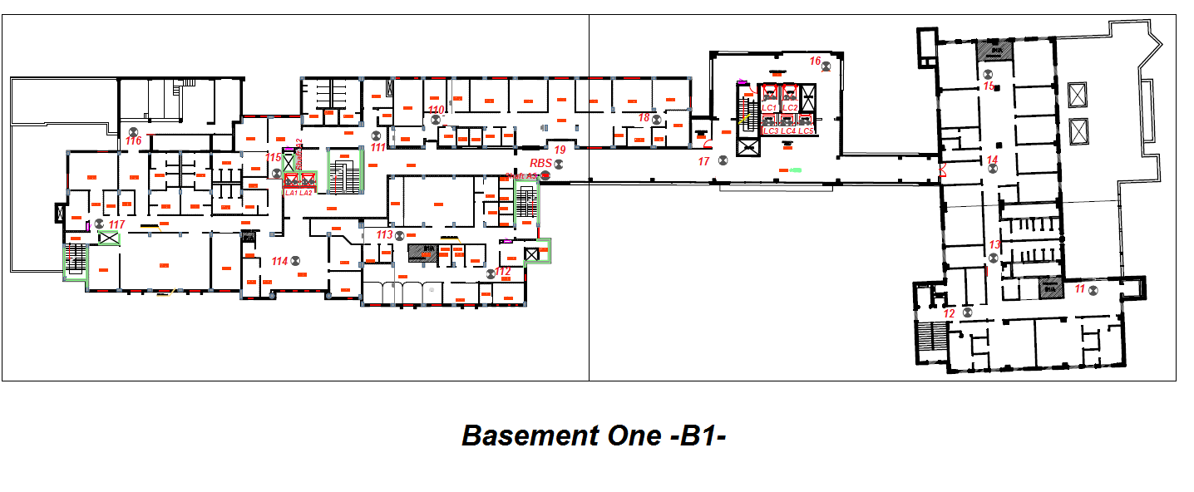
Cont’d
(Indoor Link Budget)
Final Design
Antenna Location in B1

Slide 17
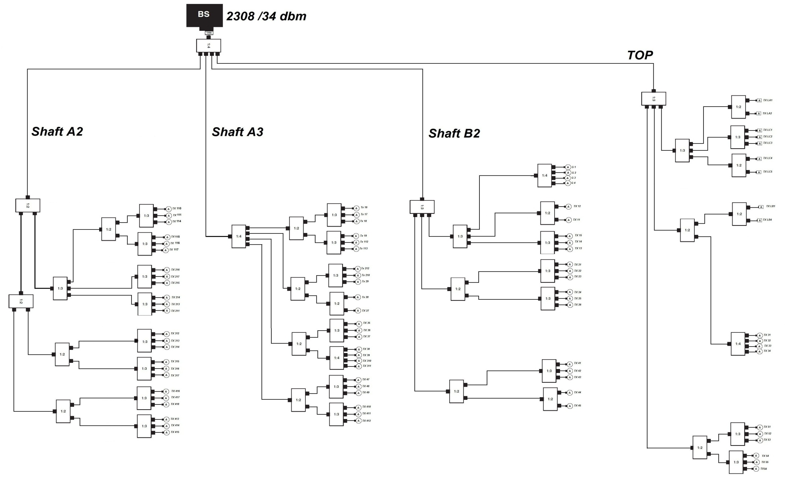
Power Splitting

Slide 18
Floor | Antenna # | RBS output power (dBm) | Cable Length (m) |  |  | 2 Port Splitter | 3 Port Splitter | 4 Port Splitter | TX Power (dBm)
B1 | 11 | 34 | 63 | 10 | 35 | 1 | 2 | 1 | 7.47
B1 | 12 | 34 | 63 | 10 | 18 | 1 | 2 | 1 | 8.66
B1 | 13 | 34 | 63 | 10 | 9 | 0 | 3 | 1 | 7.53
B1 | 14 | 34 | 63 | 10 | 9 | 0 | 3 | 1 | 7.53
B1 | 15 | 34 | 63 | 10 | 20 | 0 | 3 | 1 | 6.76
B1 | 16 | 34 | 0 | 5 | 48 | 1 | 1 | 2 | 10.07
B1 | 17 | 34 | 0 | 5 | 22 | 1 | 1 | 2 | 11.89
B1 | 18 | 34 | 0 | 5 | 20 | 1 | 1 | 2 | 12.03
B1 | 19 | 34 | 0 | 5 | 3 | 1 | 1 | 2 | 13.22
B1 | 112 | 34 | 0 | 5 | 20 | 1 | 1 | 2 | 12.03
B1 | 113 | 34 | 0 | 5 | 34 | 1 | 1 | 2 | 11.05
B1 | 110 | 34 | 40 | 5 | 28 | 2 | 2 | 1 | 6.81
B1 | 111 | 34 | 40 | 5 | 14 | 2 | 2 | 1 | 7.79
B1 | 114 | 34 | 40 | 5 | 21 | 2 | 2 | 1 | 7.30
B1 | 115 | 34 | 40 | 5 | 7 | 2 | 2 | 1 | 8.28
B1 | 116 | 34 | 40 | 5 | 28 | 2 | 2 | 1 | 6.81
B1 | 117 | 34 | 40 | 5 | 34 | 2 | 2 | 1 | 6.39
link Budget for B1

Slide 19
Antenna # | RBS output power (dBm) | Cable Length (m) |  |  | 2 Port Splitter | 3 Port Splitter | 4 Port Splitter | TX Power (dBm)
LA1 | 34 | 34 |  | 1 | 1 | 2 | 1 | 19.43
LA2 | 34 | 34 |  | 1 | 1 | 2 | 1 | 19.43
LC1 | 34 | 40 |  | 1 | 0 | 3 | 1 | 17.25
LC2 | 34 | 40 |  | 1 | 0 | 3 | 1 | 17.25
LC3 | 34 | 41 |  | 1 | 0 | 3 | 1 | 17.18
LC4 | 34 | 42 |  | 1 | 1 | 2 | 1 | 18.87
LC5 | 34 | 43 |  | 1 | 1 | 2 | 1 | 18.80
LB1 | 34 | 63 | 25 | 1 | 2 | 1 | 1 | 17.41
LB4 | 34 | 63 | 24 | 1 | 2 | 1 | 1 | 17.48
Lifts link Budget

Slide 20
Cont’d
(Indoor Link Calculations)
2- Path loss Calculations
FSPL : Free Space Path Loss ( dB )
d: Distance in (Km)
f: frequency ( MHz)

Slide 21
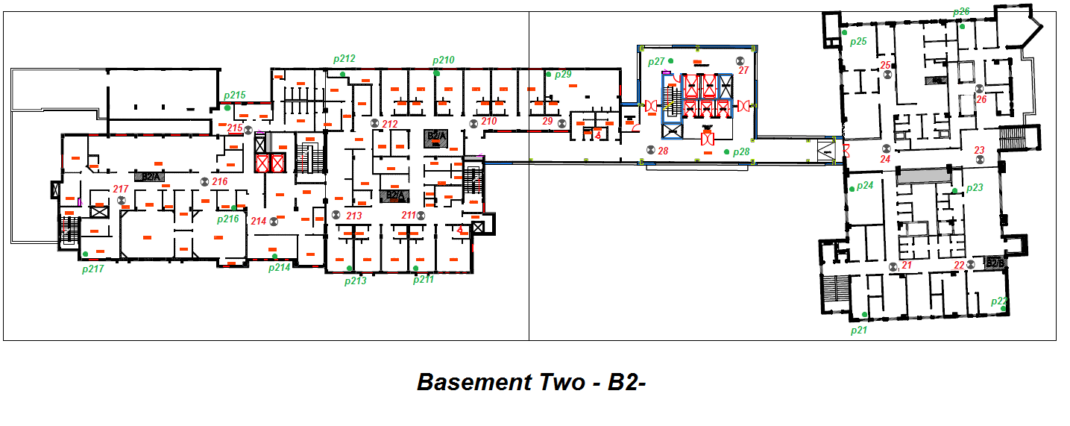
Floor | Point # | TX Power (dBm) | EIRP (dBm) | Distance (m) | Freq. (MHz) | FSPL (dB) | # of walls | Loss In Walls (dB) | RX Power (dBm)
B2 | P212 | 10.47 | 12.47 | 09.60 | 950 | -51.7 | 4 | -12.80 | -52.07
B2 | P210 | 11.66 | 13.66 | 11.30 | 950 | -53.1 | 1 | -3.20 | -42.69
Path Loss Samples Of Basement Two

Slide 22
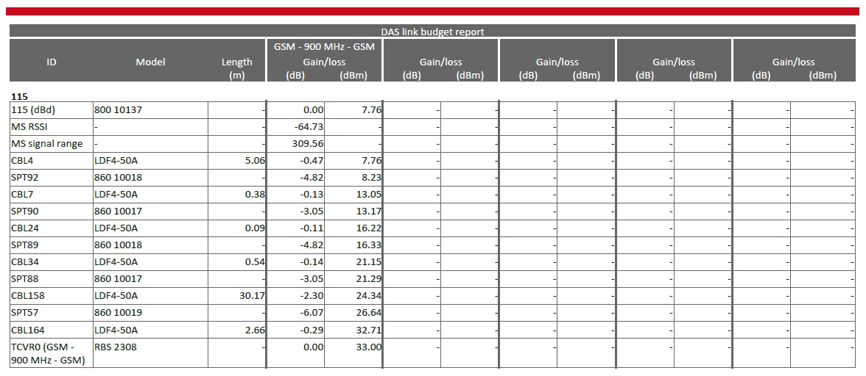
Software Results
1- Link budget.
Antenna # | Hand Calculations | iBwave Calculations | Difference
115 | 8.82 dBm | 7.76 dBm | 1.06 dB
Notes:
Why

Slide 23
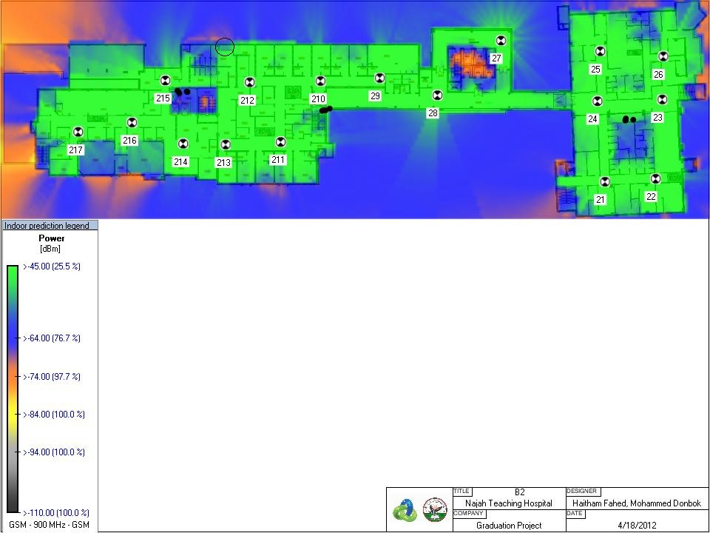
2- Path Loss
Sample | Hand calculation | iBwave calculation | Results
p212 | -52 dBm | -51 to -54 dBm | Deep indoor

Slide 24
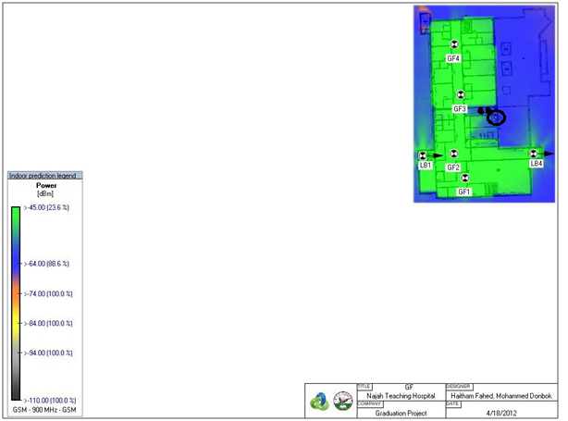

Slide 25
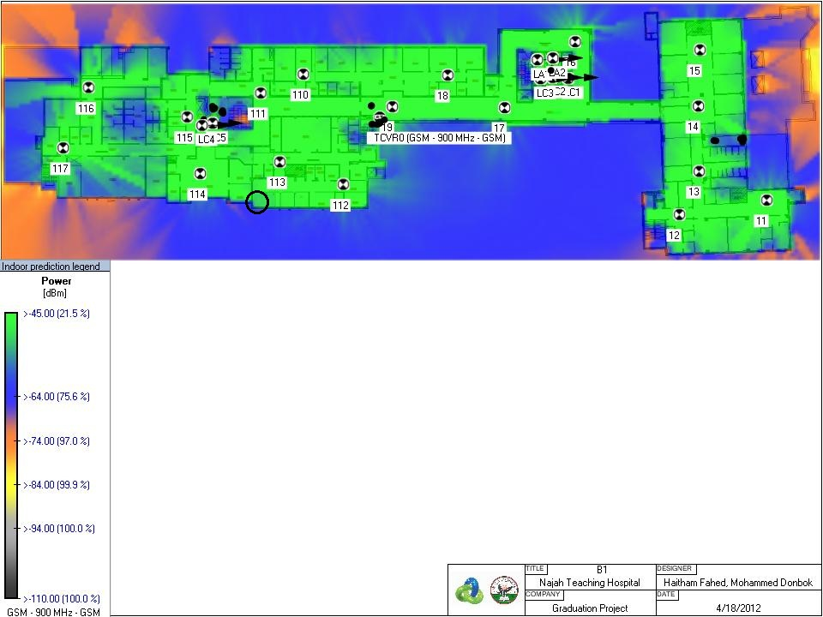

Slide 27
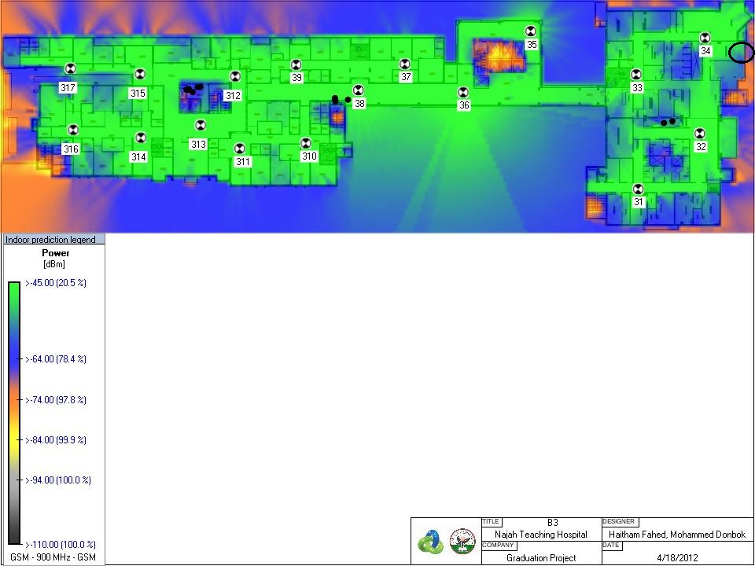

Slide 28
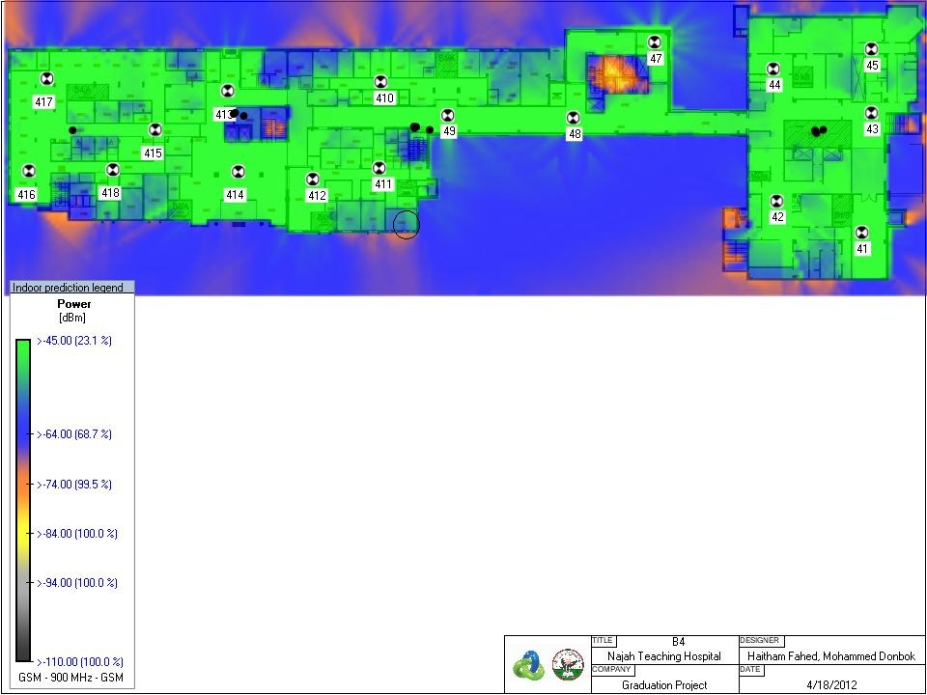

Slide 29
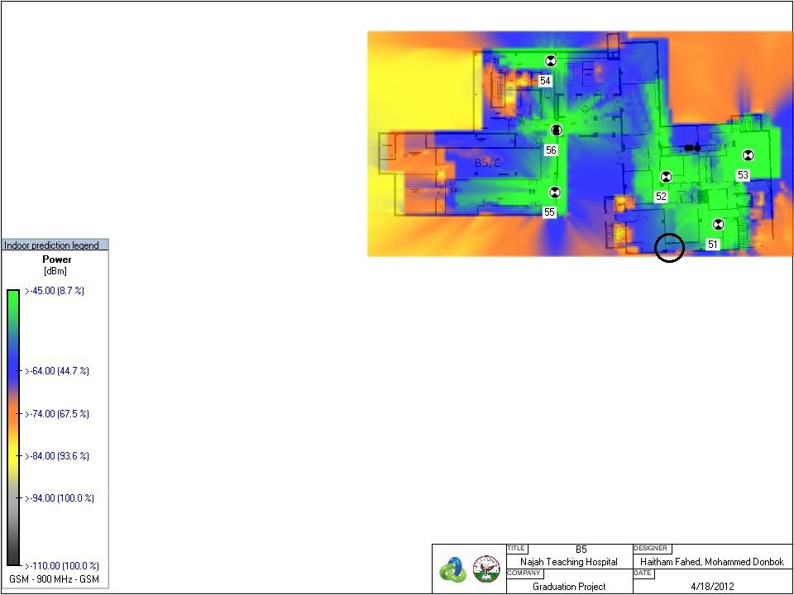

Slide 30
Conclusion
Indoor systems can be a solution if the coverage, quality and capacity from outdoor cells are weak.
The indoor system will radiate a dominant signal inside a building.
The way of splitting affects on RX-signal.
The design process includes: capacity dimensioning, choosing the components, deciding the target coverage level and distributing the antennas inside the building.

Slide 31
Cont’d
(Conclustion)
This design solve the existing problems completely which means that the goal of this project has been achieved.
The most important areas inside the hospital have a deep indoor signal level ( >-64 dBm ).
The design can serve 900 subscribers.

Slide 32

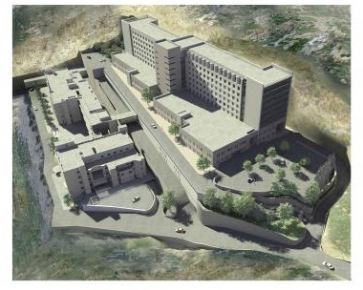
Questions

Slide 33

BIG THANKS
AN-Najah National University
JAWWAL COMPANY

