Slide 1

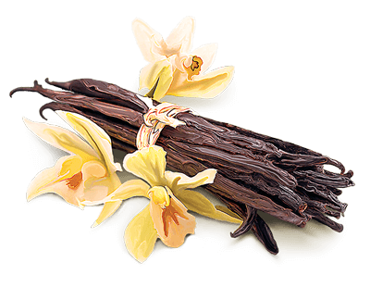
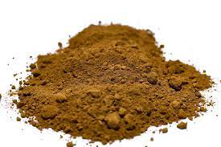

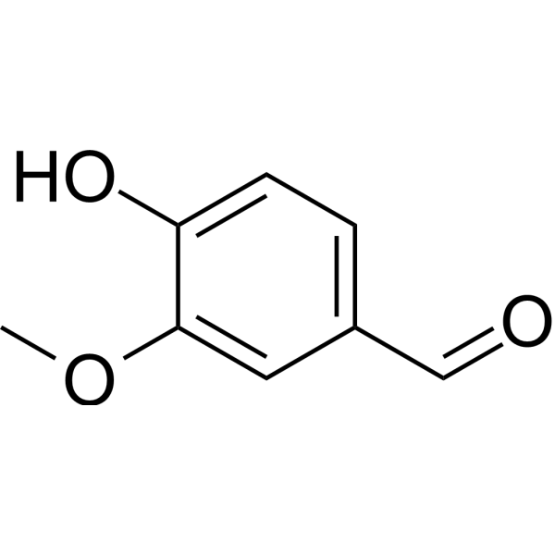
An-Najah National University
Faculty of Engineering
Chemical Engineering Program
Graduation Project (10626591)
Turning Wood Waste Lignin into a Valuable Vanillin Flavor
Prepared by:
Areen Al-Shaer
Hiba Saify
Sara Salameh
Taima Haj
WASTE
VALUE
Supervisor:
Dr. Majd Eshtaya
2024-2025

Slide 2
Table of Contents
Total Lignin Content
Extraction Vanillin Results
1
Introduction
5
9
Lignin Extraction Results
10
2
Objectives
6
Future Works
Nitrobenzene Oxidation
Summary of Results
3
Organosolv Lignin
7
11
Fractionation of Lignin
4
Alkali lignin
8
12
Conclusions

Slide 3
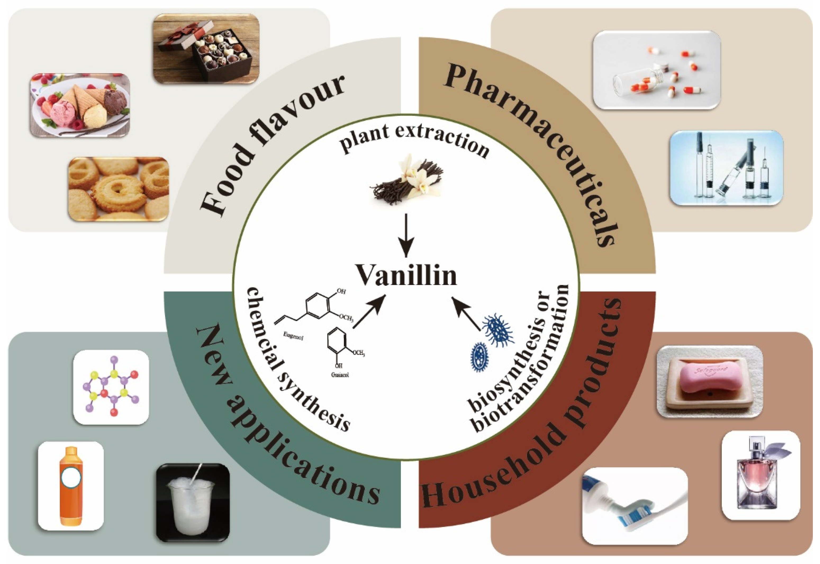
Vanillin
Is an aromatic organic compound and the primary component responsible for the characteristic flavor and scent of vanilla.
Widely used in food, cosmetics, and pharmaceuticals.
Can be synthesized from lignin as a sustainable source.
Figure 1: Applications of vanillin in various industries
1

Slide 4
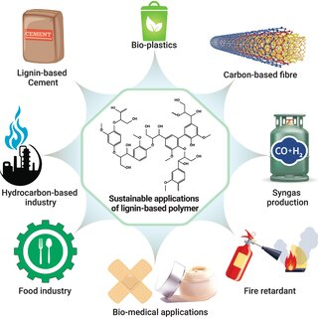
Lignin
A complex phenolic polymer found in plant cell walls.
Provides rigidity and resistance to degradation.
Composed of monomers: coniferyl, sinapyl, and coumaryl alcohol.
Figure 2: Applications of lignin in various industries
2

Slide 5
Objectives
Determine lignin and sugar content in sawdust and pulp.
Extract vanillin via:
Compare the two extraction methods based on yield, cost, and environmental impact.
Analyze vanillin using HPLC, and Lignin using FT-IR
Isolate lignin from pine sawdust using Organosolv and KOH methods.
Nitrobenzene oxidation (for sawdust & Organosolv lignin).
Fractionation + catalytic oxidation (for alkali lignin).
1
2
3
4
5
3

Slide 6
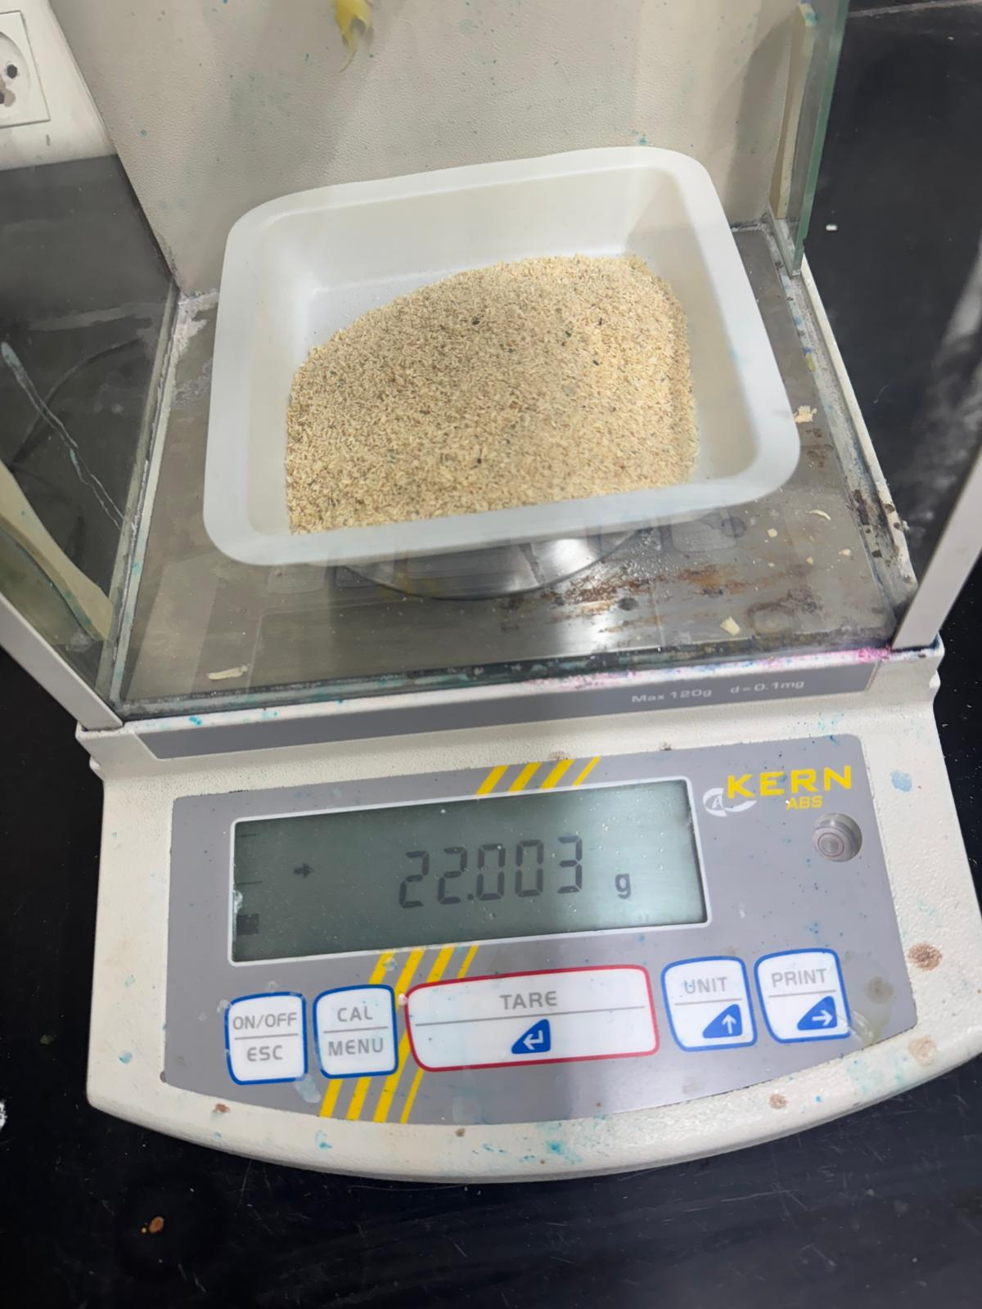
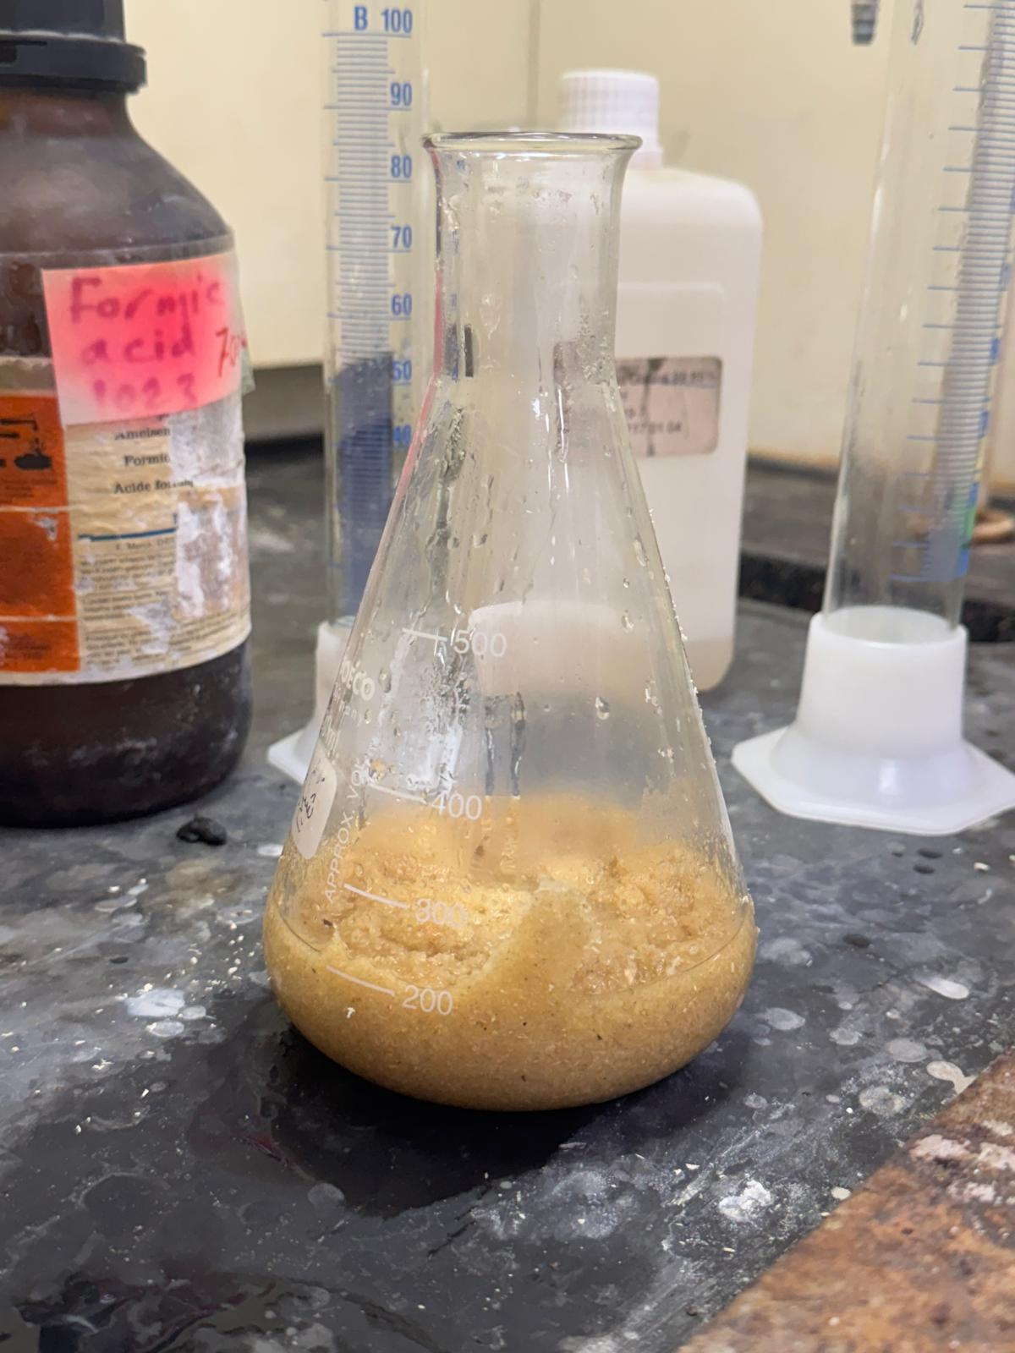
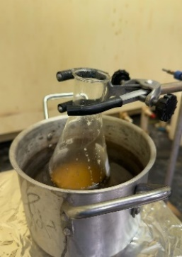
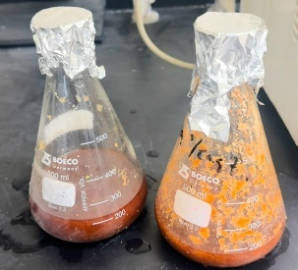
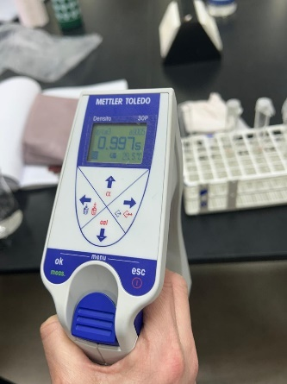
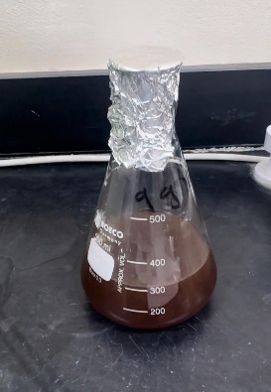
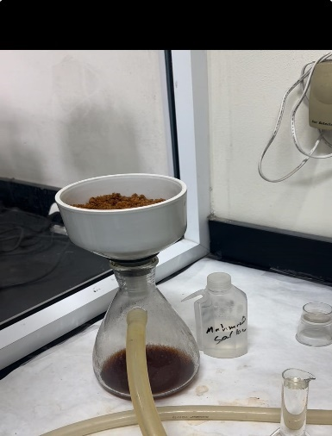
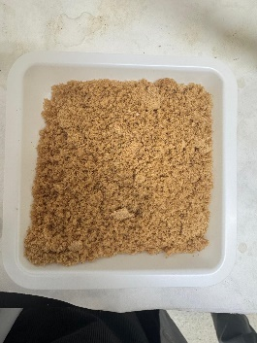
      Organosolv Method: Formic acid- Acetic Acid Treatment
44g of sawdust
Adding FA/AA
Heating on hot plate
The samples after heating
Concentrated liquor
Measure the Brix value
Pulp
Vacuum filtration
4

Slide 7
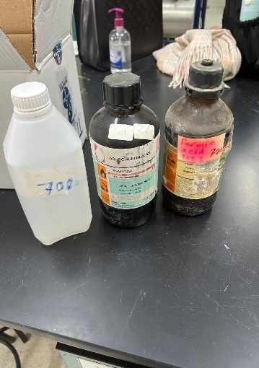
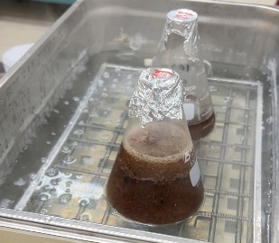
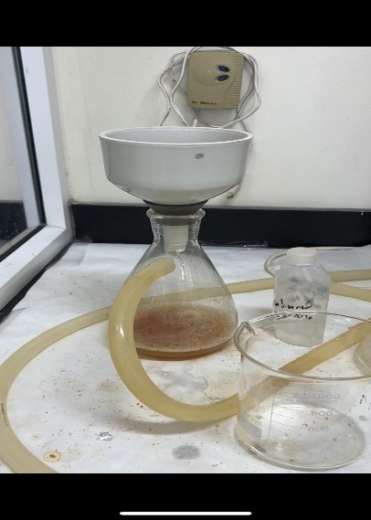
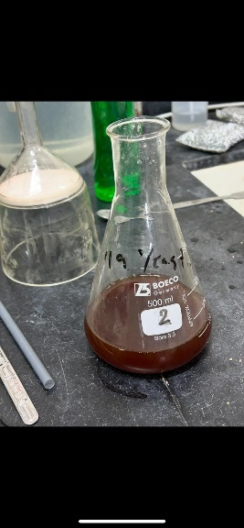
      Organosolv Method: Peroxyformic Acid/Peroxyacetic Acid Treatment
Adding H₂O₂, and 85% acid mixture
The samples were placed in a water path at 80⁰C for 2 hr
Vacuum filtration
Concentrated liquor after filtration
5

Slide 8
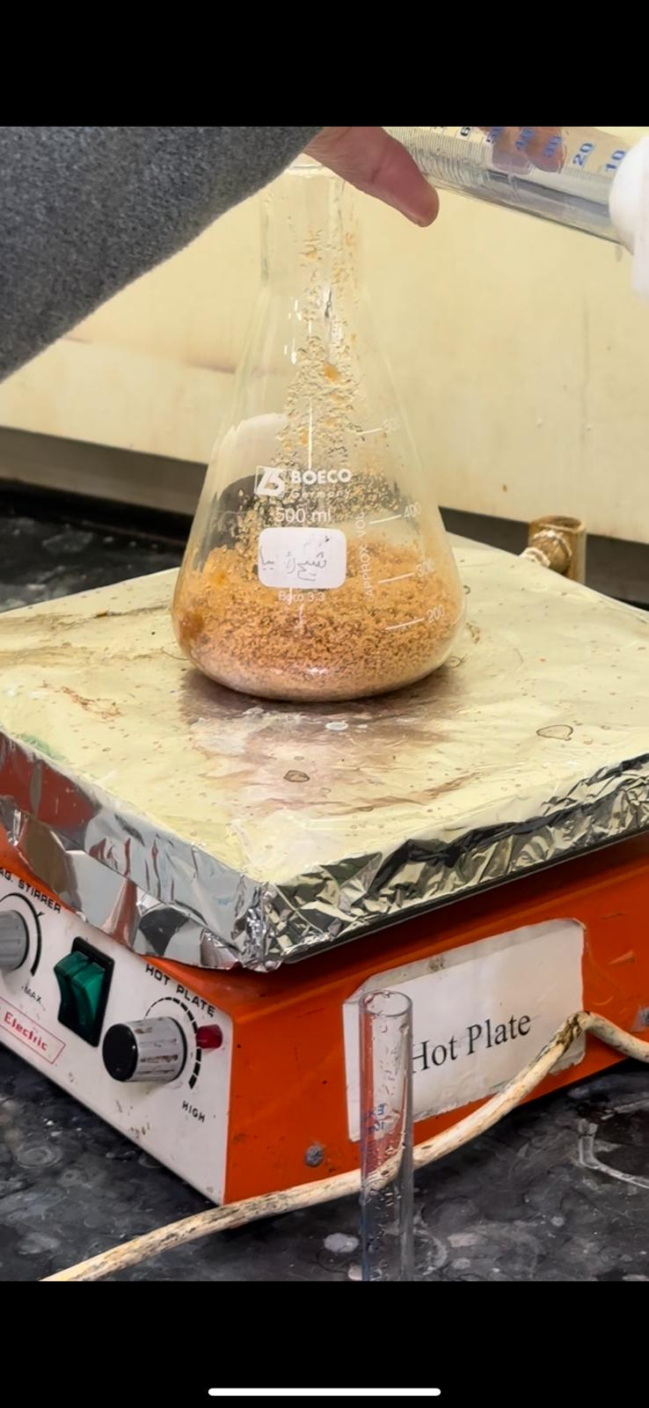
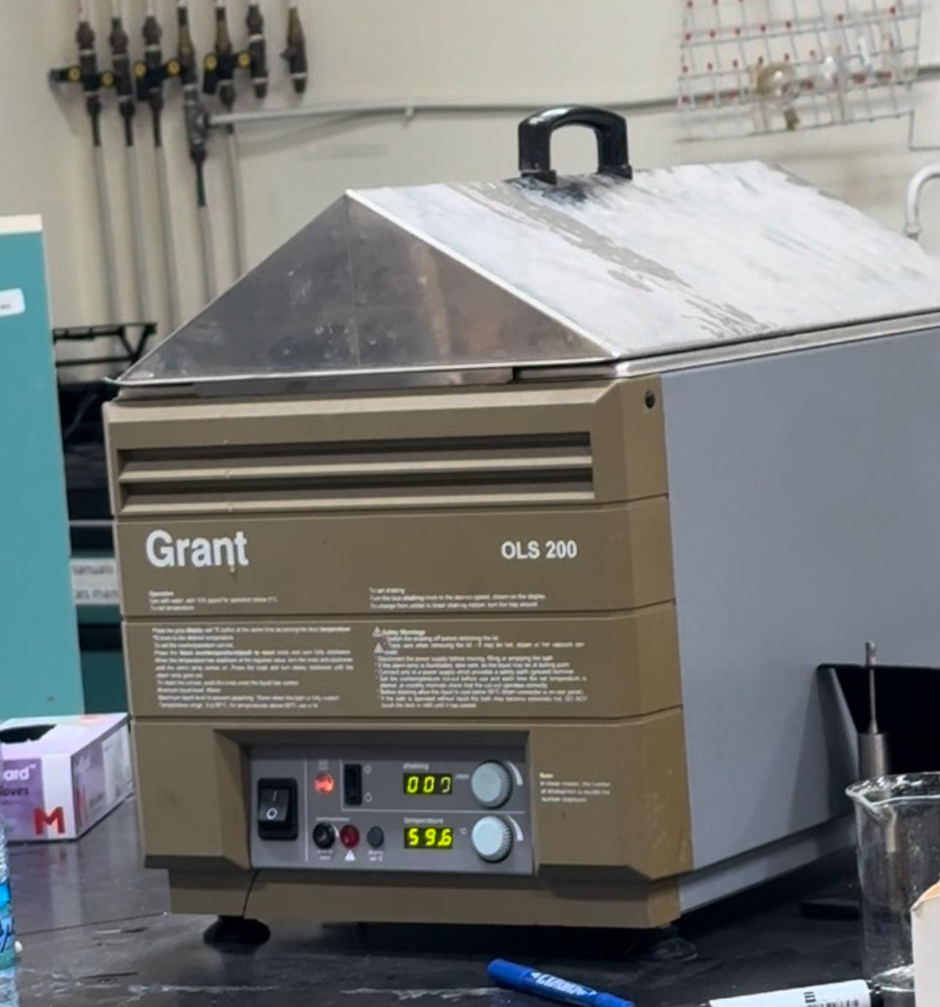
Organosolv Method: Bleaching
Add 28 mL of hydrogen peroxide
Put the in-water bath at 80°C for 2hr
6

Slide 9
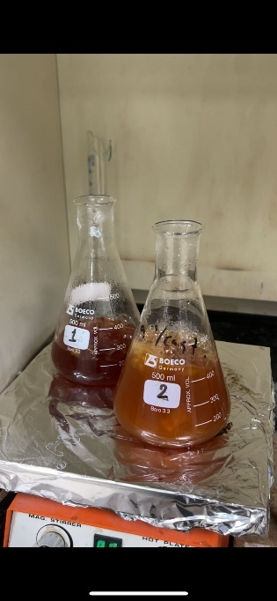
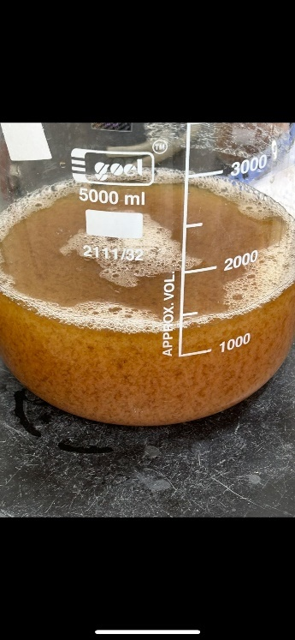
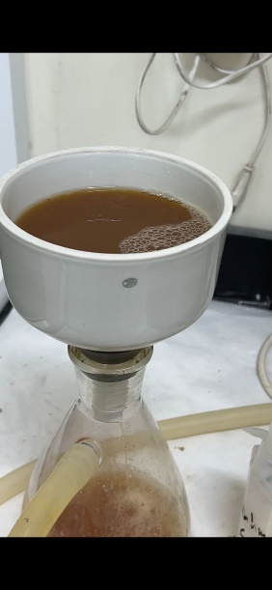
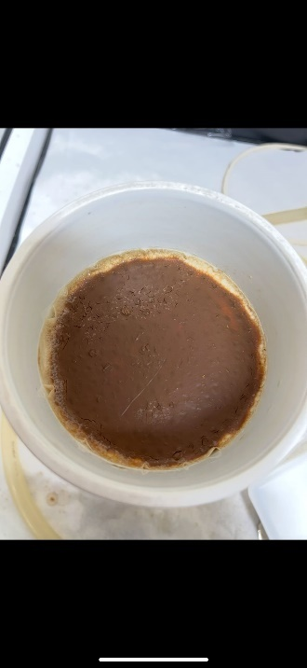
      Organosolv Method: Isolation of Lignin
The black liquor was heated to 105⁰C.
Adding deionized water (5 times the amount of concentrated liquor).
Vacuum filtration
Isolated lignin
7

Slide 10
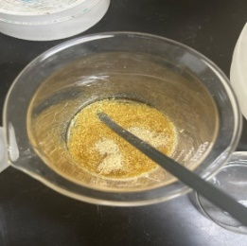
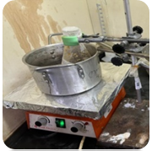
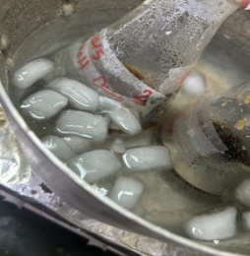
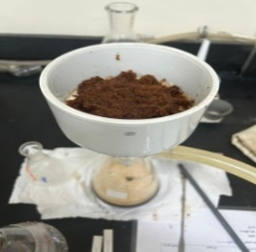
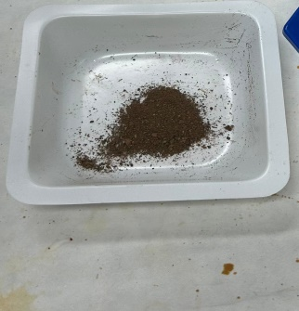
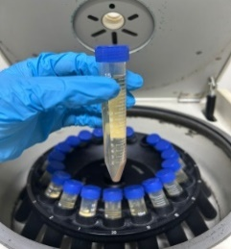
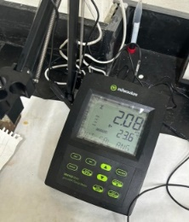
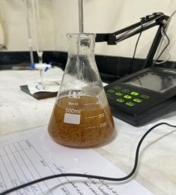
Lignin Extraction Using KOH
1. Alkaline Pretreatment
Sawdust , KOH and deionized water
Heat at 100°C for 3hr.
Cool to room temperature.
Vacuum filtration of the mixture.
2. Lignin Isolation
Lignin
Centrifuge for 15 min and dried at 60°C.
Lignin precipitate.
Adjust PH to=2
8

Slide 11
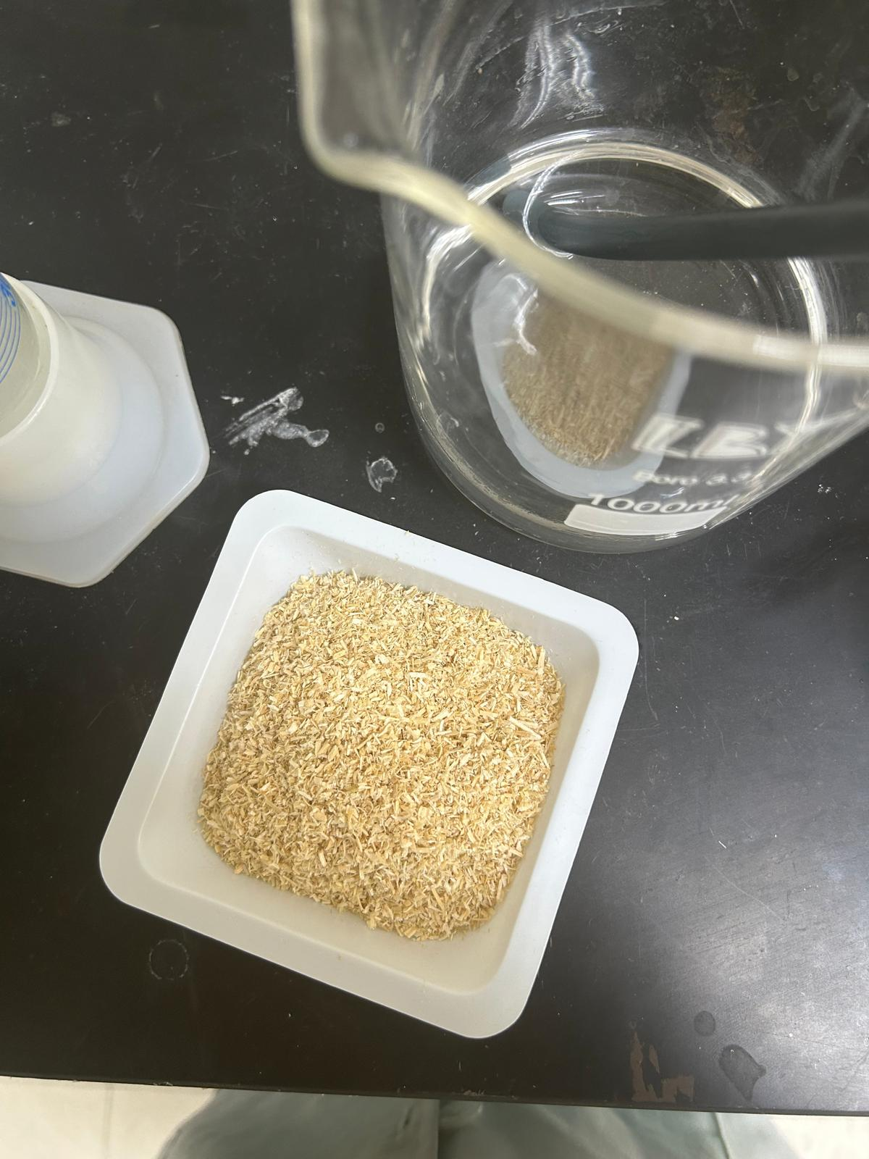
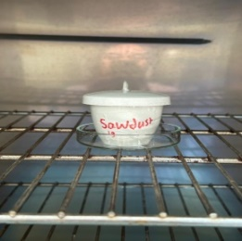
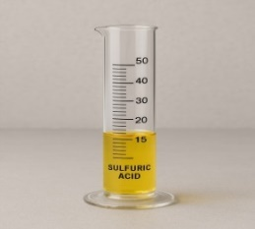
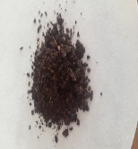
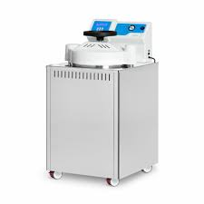
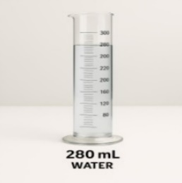
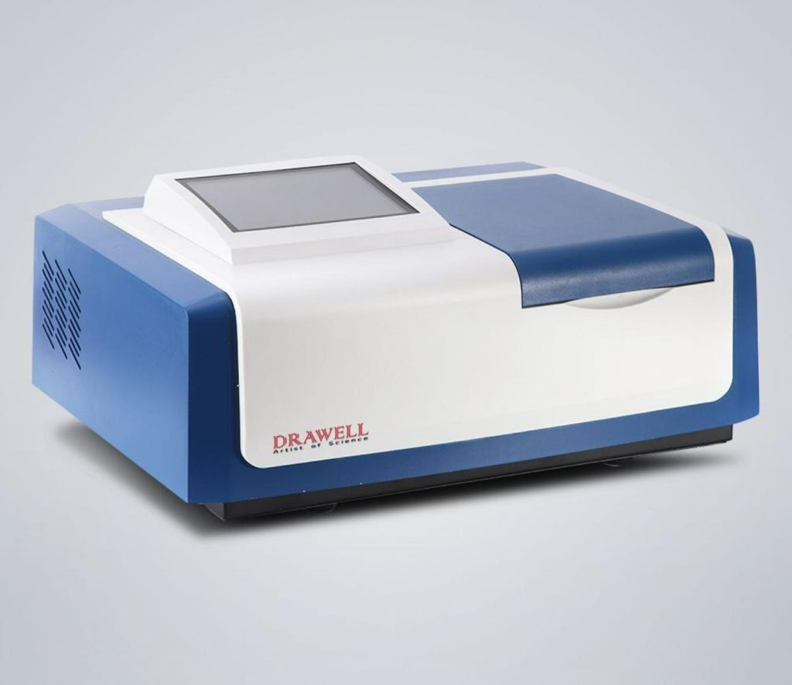
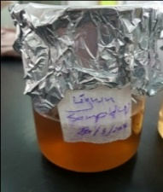
Total Lignin Content
Samples Preparation
1g of sawdust or 2g of pulp were put in crucibles.
Drying of sample.
Preparation of 72 wt.% Sulfuric Acid.
Hydrolysis with Sulfuric Acid.
Acid insoluble lignin (AIR)
Measure the absorbance
Acid soluble lignin (ASL)
Autoclaved at 120°C for one hour.
Deionized water was added to the samples.
9

Slide 12
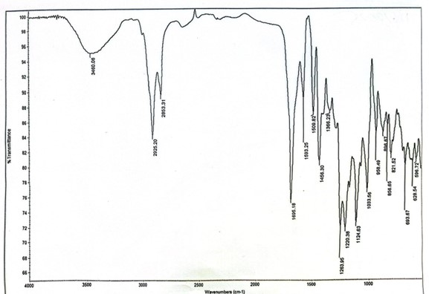
Lignin Extraction Results
FT-IR for Organosolv lignin
FT-IR for alkali lignin
10

Slide 13
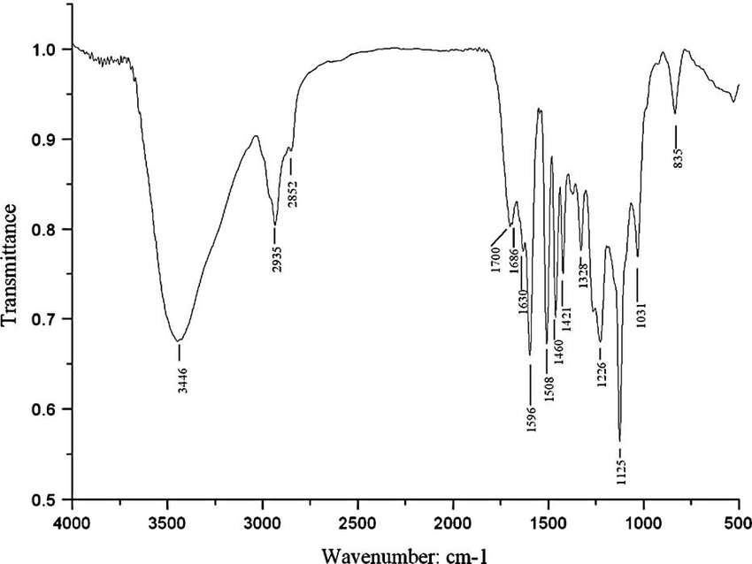
Table1: Functional groups
FTIR for standard lignin
Wave length (cm⁻¹) | Possible explanation
3381.98 | Hydroxyl group (Alcohol or phenol)
2937.40 | Aromatic methoxyl groups and methyl
2358.85 | Caused by CO₂
1716.10 | Aromatic acetoxy group
1507.31 | Ring stretching vibration peak of benzene ring
1456.34 | Stretching in aromatic rings (phenols)
1216.91 | Stretching in phenols or ethers
1029.98 | C-O stretching in cellulose and hemicellulose
12

Slide 14
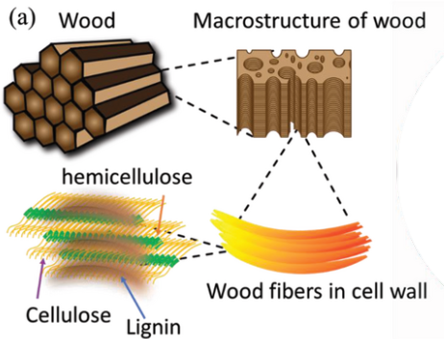
Sugar Content
Brix values were measured using a Densitometer during the experiment to extract lignin using formic acid/ acetic acid (Organosolv method) and KOH (alkali method) in order to determine the sugar concentration in sawdust which represents the amount of hydrolysable carbohydrates.
Figure 3: Wood content
11

Slide 15
Organosolv Lignin
KOH Lignin
Process
Involves several steps.
Environmental impact
A mixture of harmful acids such as formic and acetic acid.
Yield
Conditions
Cost of raw materials
Expensive
High temperatures
Requires time and effort.
Produces 16.74% from 44g of pine sawdust.
It affects human safety and the environment.
  It consists of simple.
  straightforward steps.
  Moderate temperatures
  Affordable
  Less harmful are used
  Lower toxic effect.
  Produces 29% lignin from 12.8g pine sawdust
13

Slide 16
Vanillin Extraction : Nitrobenzene Oxidation
Lignin
(Polymeric aromatic structure )
Nitrobenzene +NaOH oxidation
Breakdown of specific( β-O-4)and side chain.
Formation of Aromatic Aldehydes.
Vanillin
14

Slide 17
Nitrobenzene Oxidation: Oxidation Reaction
Weight 0.4g of sawdust /Organosolv lignin.
Reflux the mixture at 140°C for 3 hrs.
Cool to room temperature.
Pour the mixture into a separatory funnel.
Add chloroform (20 ml × 6 times) for extraction.
Add 1ml nitrobenzene with 14ml NaOH.
15

Slide 18
Nitrobenzene Oxidation: Extraction with Chloroform
Add 5 ml of 4 M HCl to aid separation.
Transfer the organic layer (chloroform ) to a rotary evaporator at 40°C .
The residue after evaporation is the vanillin-rich product.
Collect the both aqueous(top) & organic (bottom)
HPLC analysis
16

Slide 19
Extraction Vanillin from fractionated Lignin
Alkali Lignin
(Complex aromatic polymer.)
Fractionation
Partial dissolution &Separation
(lower molecular weight lignin)
Oxidative of aromatic unit and side chain
Formation of Vanillin
17

Slide 20
Extraction Vanillin from fractionated Lignin: Fractionation of lignin
Weight 0.6g of alkali lignin .
Reflux the mixture at 78°C for 4 hrs.
Separate the mixture by vacuum filtration. .
Add 30ml of ethanol to a rounded bottom flask.
cool to room temperature
18

Slide 21
Extraction Vanillin from fractionated Lignin: Catalytic Oxidation
In a conical flask , add to the mixture 15ml of NaOH with 6mg of (CuSO₄•5H₂O) .
Add 405 µL of 33% hydrogen peroxide (H2O2).
Place the mixture in a silicon oil bath 120⁰C for 1 hour .
Then, cool to room temperature .
19

Slide 22
Extraction Vanillin from fractionated Lignin: Post-Reaction Processing
Add 12ml of H2SO4 to the mixture & separate by vacuum filtration.
Collect the top (organic) layer containing ethyl acetate.
Transfer the organic layer to a rotary evaporator set at 77 °C.
Extract the filtrate with ethyl acetate (12 ml × 5 times).
HPLC analysis
20

Slide 23
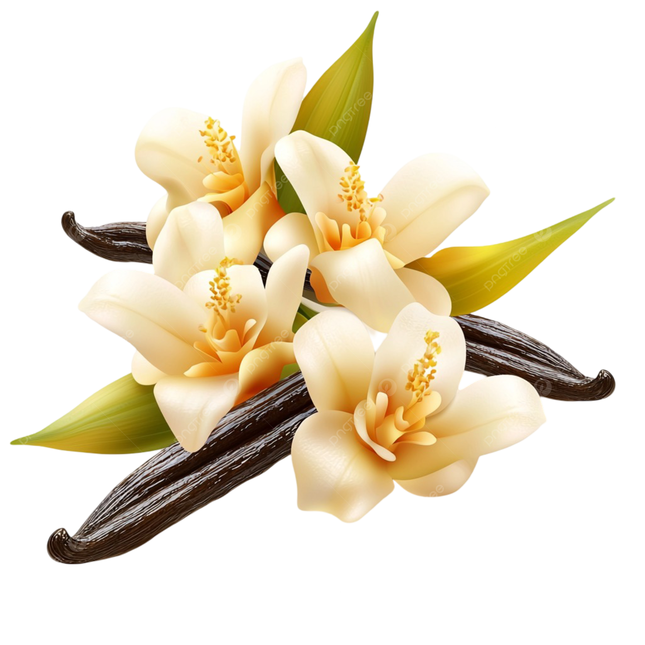
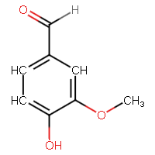
Vanillin Synthesis Outcomes
Nitrobenzene oxidation for sawdust and Organosolv lignin
0.084% Vanillin
(based on 0.4 g sawdust)
Nitrobenzene, NaOH
0.4 g Sawdust/ Organosolv lignin
140 ⁰C
0.39% Vanillin
(based on 0.4 g Organosolv lignin )
Figure 4: The chemical reaction of Organosolv lignin and sawdust with nitrobenzene
21

Slide 24
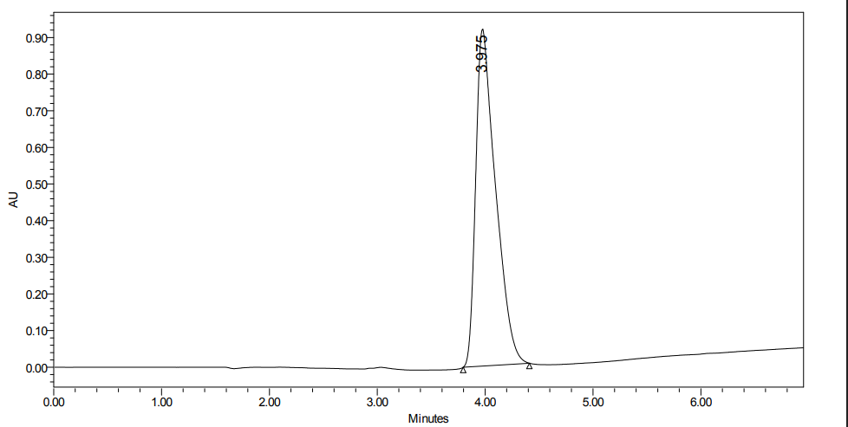
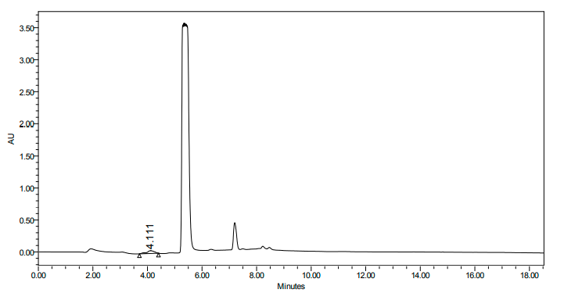
Vanillin Quantification by HPLC
Table 2: HPLC analysis data of vanillin sample from sawdust
Sample | Standard Vanillin | Sawdust
Retention time, min | 3.975 | 4.111
Area, µV.s | 22919079 | 386845
Height, µV | 1807343 | 30664
Concentration, mg/ml | 0.2 | 33.7×10⁻⁴
%Yield | --- | 0.084
Figure 4: A chromatogram of standard vanillin and vanillin sample from sawdust
22

Slide 25
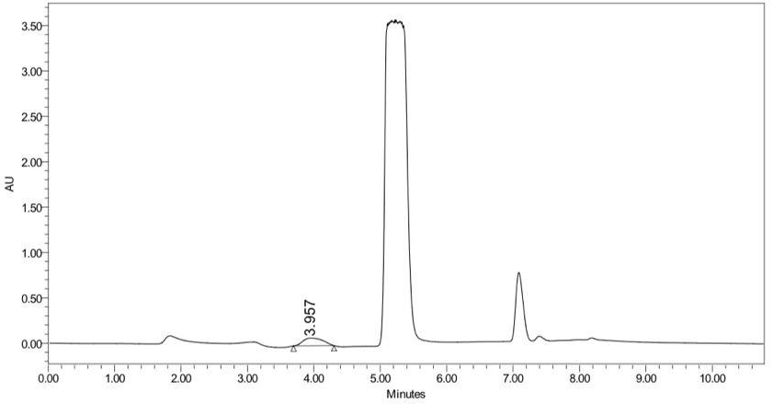
Vanillin Quantification by HPLC
Table 3: HPLC analysis data of vanillin sample from Organosolv lignin
Sample | Standard Vanillin | Organosolv lignin
Retention time, min | 3.975 | 3.957
Area, µV.s | 22919079 | 1798840
Height, µV | 1807343 | 84854
Concentration, mg/ml | 0.2 | 15.7×10⁻⁴
%Yield | --- | 0.39
Figure 5: A chromatogram of standard vanillin and vanillin sample from Organosolv lignin
23

Slide 26
Vanillin Synthesis Outcomes
Facile synthesis of vanillin from fractionated alkali lignin
hydrogen peroxide, copper sulfate pentahydrate
1.78% Vanillin
(based on 60 mg alkali lignin)
60 mg of alkali lignin
120 ⁰C
Figure 6: The chemical reaction of alkali lignin with hydrogen peroxide
24

Slide 27
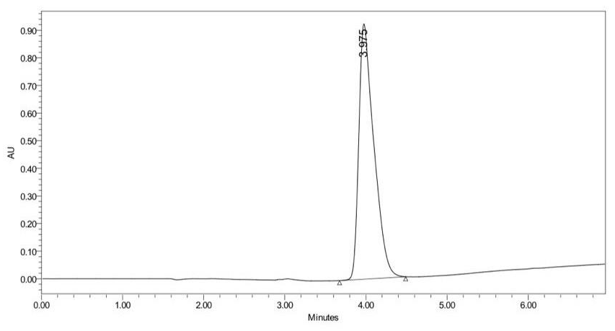
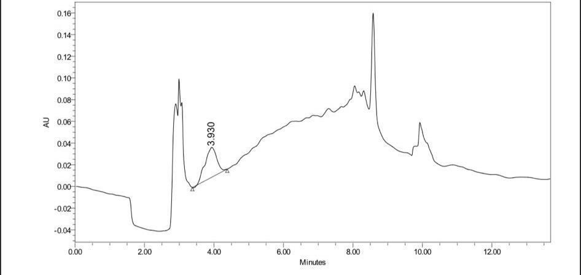
Vanillin Quantification by HPLC
Table 4: HPLC analysis data of vanillin sample from alkali lignin
Sample | Standard Vanillin | Organosolv lignin
Retention time, min | 3.975 | 3.930
Area, µV.s | 11808384 | 632049
Height, µV | 921482 | 27213
Concentration, mg/ml | 0.2 | 10.7××10⁻³
%Yield | --- | 1.78
25
Figure 7: A chromatogram of standard vanillin and vanillin sample from alkali lignin

Slide 28
Summary of Results
Category |  |  | Yield | Sugar Content | FT-IR analysis
Lignin Extraction | Organosolv Method | Organosolv Method | 3.86 ± 1.1% | Higher sugar content in residue due to acid hydrolysis. | FT-IR confirmed the presence of lignin functional groups.
 | Alkaline (KOH) Method | Alkaline (KOH) Method | 29% (more efficient than Organosolv). | Lower sugar content in residue.
Category |  |  | Yield | Oxidation method | HPLC analysis
Vanillin Production: Nitrobenzene Oxidation |  | From Organosolv Lignin | 0.39% | Nitrobenzene | Match indication of retention time for the vanillin sample and the standard .
 |  | From Raw Sawdust | 0.084%
Vanillin Production: Fractionation of Lignin. |  | Alkaline Lignin | 1.78% | Catalytic oxidation with Fractionation of lignin.
26

Slide 29
Evaluation of Achieved Goals and Proposed Future Directions
Objectives from the first project
Lignin extraction using the Organosolv lignin. ✔
Measuring the total lignin content in sawdust and pulp. ✔
Vanillin extraction from lignin. ✔
Lignin characterization using FT-IR. ✔
Vanillin quantification using HPLC. ✔
Purification of vanillin. ✗
Future Works
Improve vanillin yield by optimizing reaction conditions like temperature.
Extract lignin from alternative sources such as straw and agricultural waste.
Purify vanillin and investigate its physicochemical properties.
27

Slide 30
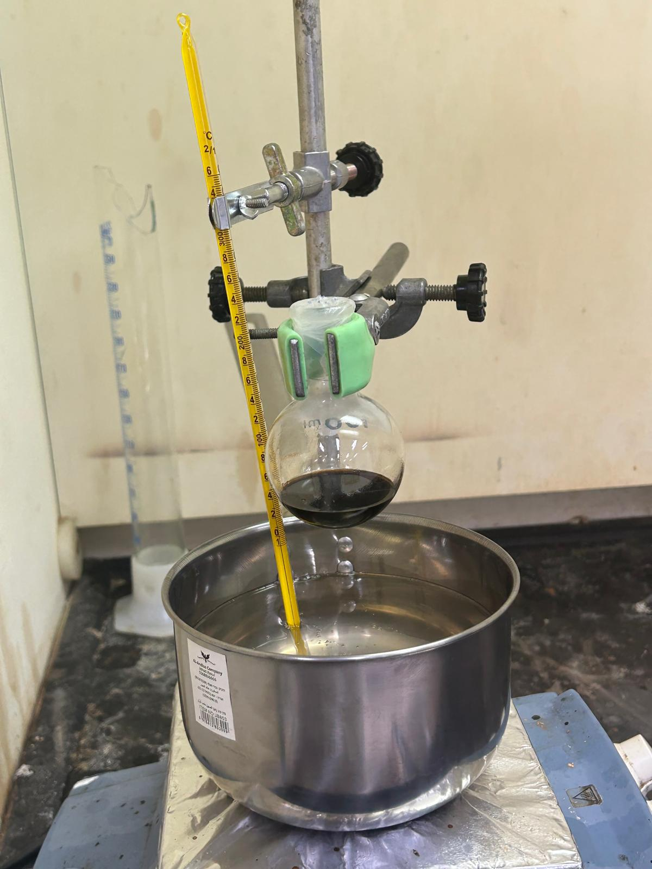







Conclusion
The project proved that vanillin can be extracted from different lignin sources.
The main goal was achieved.
Economic challenges exist but can be overcome.
With better processes and resource use, large-scale production is promising.
28

