Slide 1
Design of Sahab building at Palestine-Nablus
Prepared by: Ashraf Abu Azezi
Aqeel Hasson
Khaled Salah
Mohammad Zaiter

Slide 2
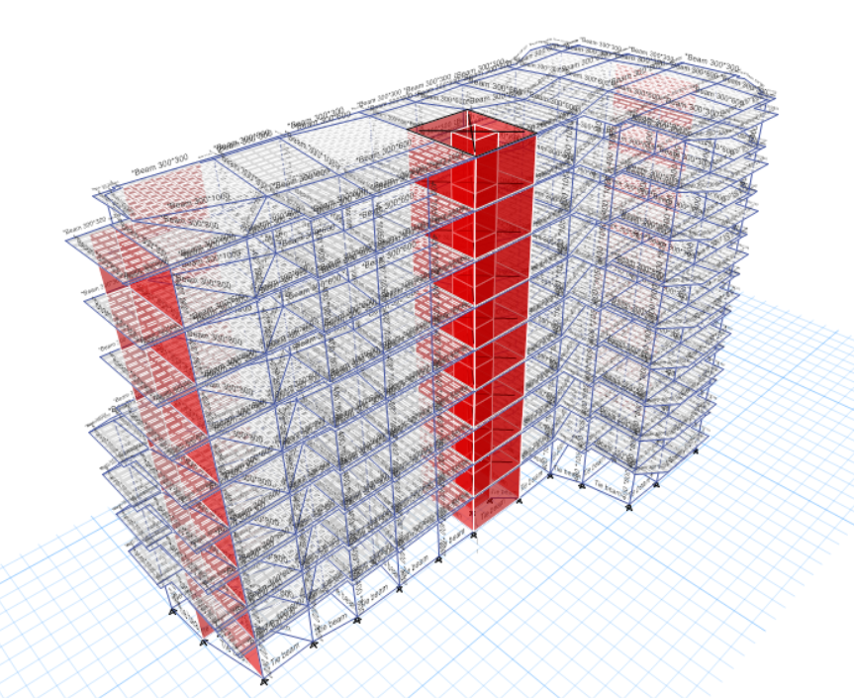

Slide 3
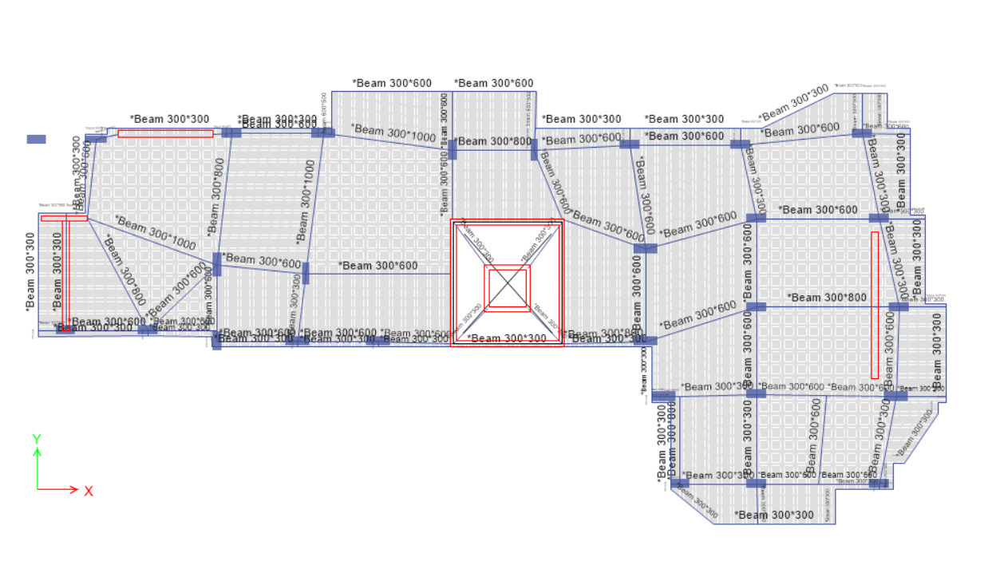
Plan view

Slide 4
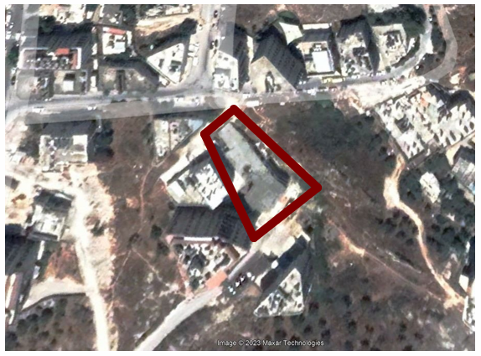
Site Location

Slide 5
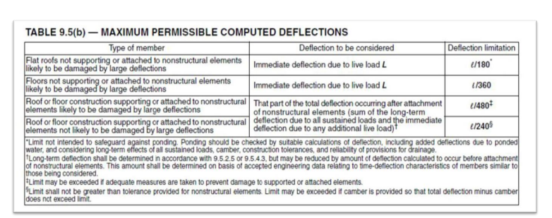
Deflection Check
long term deflections for slab systems
Table of Deflection Limits – ACI318-11

Slide 6
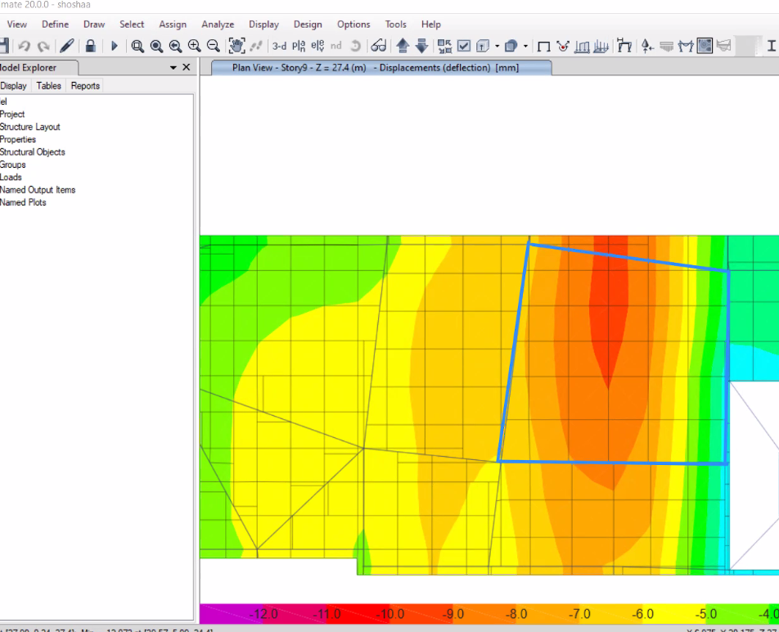
Long term deflection combination: 2D+2SD+1.5 L

Slide 7
Check deflection In X direction:
long term deflection allowable deflection =L/240 = (6.305/240) *1000=26.27 mm .
long-term deflections for slab systems at the middle = 15.12 mm
long-term deflections for slab systems at the right side = 3.11 mm
long-term deflections for slab systems at the left side = 10.9 mm
Relative long-term deflection = 15.12 – 3.11+10.9/2 = 8.17< 26.27 it is ok

Slide 8
Check deflection In Y direction:
long term deflection allowable deflection =L/240 = (6.17/240) *1000=25.7 mm .
long-term deflections for slab systems at the middle = 15.12 mm
long-term deflections for slab systems at the top = 15.17 mm
long-term deflections for slab systems at the bottom = 13.5 mm
Relative long-term deflection = 15.12– 15.17+13.5/2 = 0.78 < 25.7 it is ok

Slide 9
Design and Check for Gravity and Lateral Loads
The structural members that were designed are:
1- Columns
2- Beams
3- Slabs (One way and two way Ribbed slab)
4- Shear walls
5- Footings
6- Stairs

Slide 10
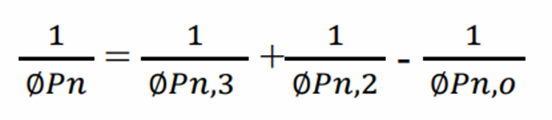
Check and design for Columns
We use Bressler’s Reciprocal load method shall be applied to check the column section for the moments

Slide 11
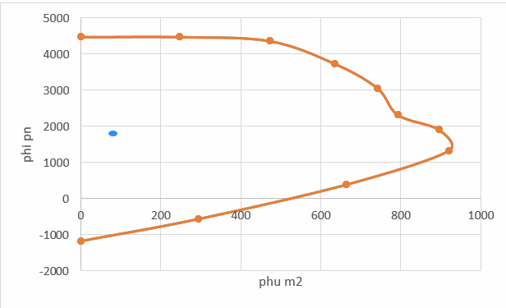
Figure shown interaction diagram between ØPn and ØMn,2, to check the column capacity for them.
ØPn and ØMn,2
ØPn,3 = 4500 kN
ØPn,2 = 4500 kN
ØPn, o = Ø ƛ (0.85 f’c (Ag-As) + As fy) ØPn
ØPn,o = 4547.4 kN
ØPn=4453.6 KN < 1957.7 KN then its ok

Slide 12
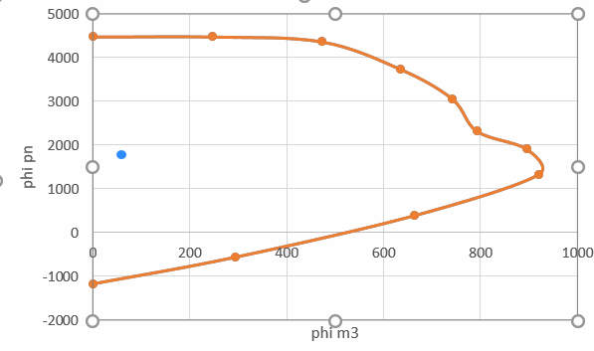
Check and design for Columns
Figure shown interaction diagram between ØPn and ØMn,3, to check the column capacity for them.

Slide 13
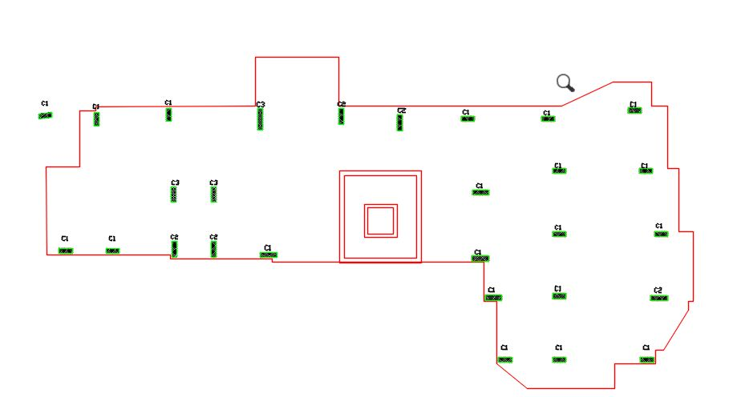
Design for Columns
column1 (400*800)
column2 (1050*400)
column3 (950*300)

Slide 14
Design for Column (C1)
Check slenderness
M1=12.3 KN.m, M2=25.7 KN.m
R=0.3*0.4=0.12, Lu=3.1m
K*Lu/r= 25.83
34+12M1/M2= 39.7<40 Then no slenderness, consider a short column.
Pu=2601 KN, ρ From Etabs=0.01
As=0.01*400*850=3400mm ,▲Use 14ø18
Transverse reinforcment:
The spacing between stirrups is as the following
S < 48ds= 48*10=480 mm
< 16dp=16*16=256 mm
< least lateral dimension of column=400 mm
Use 1ø10/250mm.

Slide 15
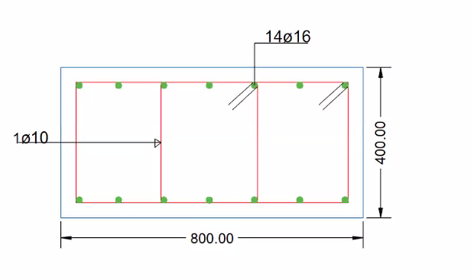
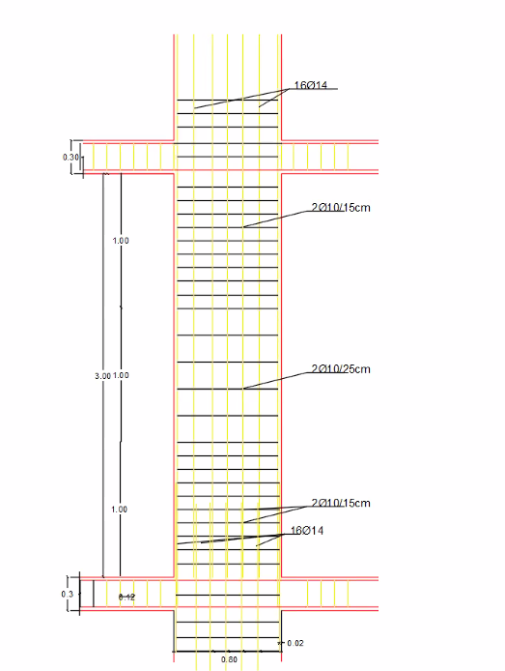
Cross section for column 1 ↓
for
General longitudinal section in column ⟶

Slide 16
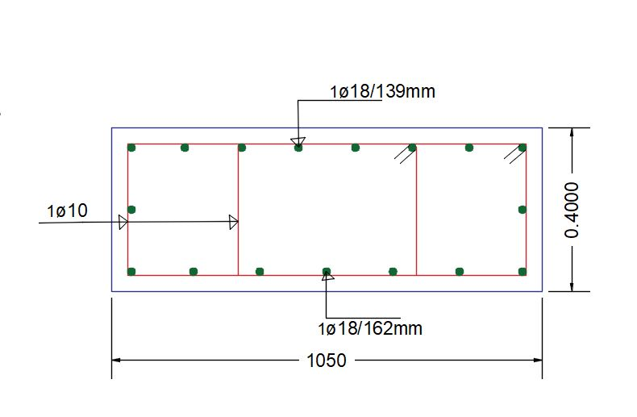
Cross section in column 2

Slide 17
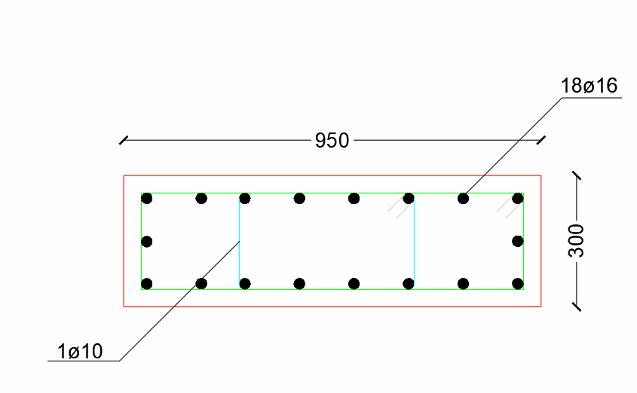
Cross section in column 3
Cross section in column 2

Slide 18
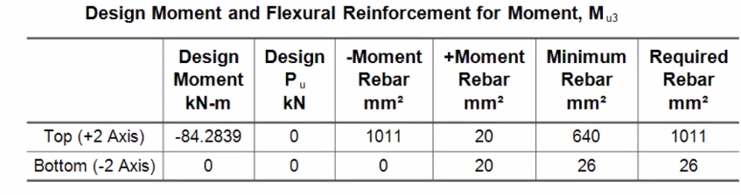

Check and design for beams
Mu = 84.28 KN.m
The area of steel for this beam due to
the ultimate negative moment = 1011 mm2 .
ρ =0.0051
As = ρ b d = 0.0051× 800 × 240 = 979.2 mm2
. As min= ρ min × b × d = 0.00333 × 800 × 240 = 640 mm2 .
As >As min ,its ok.
𝜌 max.singly = 0.01806
As, max = 0.01806*800*240 = 3476.5 mm2 Ok
Difference percentage between the longitudinal reinforcement from the manual and from ETABS
Difference percentage = 𝑨𝒔 𝒇𝒓𝒐𝒎 𝒎𝒂𝒏𝒖𝒂𝒍−𝑨𝒔 𝒇𝒓𝒐𝒎 𝑬𝑻𝑨𝑩𝑺 /𝑨𝒔 𝒇𝒓𝒐𝒎 𝑬𝑻𝑨𝑩𝑺 * 100% = 3.2%

Slide 19
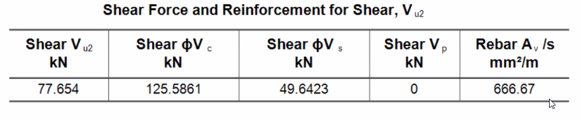
Shear Design Verification
Vu = 77.654 kN
Vc =1/6 *√28 *bw*d = 1/6 *√28 *800*240/ 1000 = 169.32 kN
Ø Vc=0.75*169.32= 127 KN
ØVc > Vu then no need for shear reinforcement, use Av/s min
𝐴𝑣/𝑆_𝑚𝑖𝑛 = max of (0.062 √𝑓𝑐∗𝑏𝑤 / fy , 0.35∗𝑏𝑤 /𝑓𝑦)
(0.062 √𝑓𝑐∗𝑏𝑤 /𝑓y = 625 mm^2/m
0.35∗𝑏𝑤 /𝑓𝑦= 666.67 mm^2/m

Slide 20
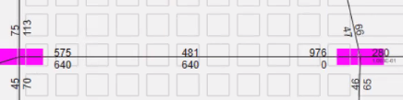
  Design of beams
H=300,D=240,B=800
As Bottom = 640mm2 .
As Top1 = 640 mm2 .
As Top2 =976 mm2 .
As, min = 0.0033*800*240 = 633.6 mm2 → O.K
𝜌 max.singly = 0.01806
As, max = 0.01806*800*240 = 3467.52 mm2 → O.K.
❖ Longitudinal Reinforcement:
Bottom Steel:
As = 640mm2 → use 4Ø14
Top1 Steel:
As = 640mm → use 4Ø14
Top2 Steel:
As = 976 mm2 → use 5Ø16

Slide 21

Shear strength:
Av/s=0.6667
Av=2*78.5=157 mm^2
S=235 mm
S max=min of (d/2, 600)=(240/2,600).Then Smax=120mm
Use 2 Ø10 each 120 mm

Slide 22
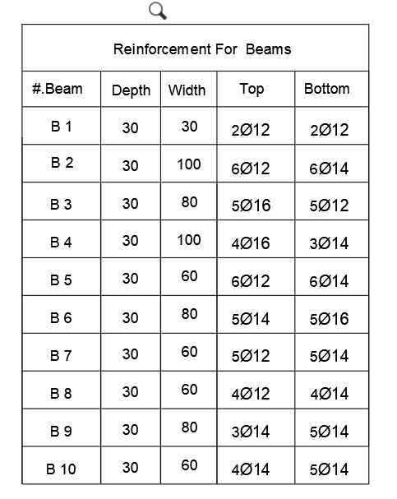
Reinforcement for beams

Slide 23
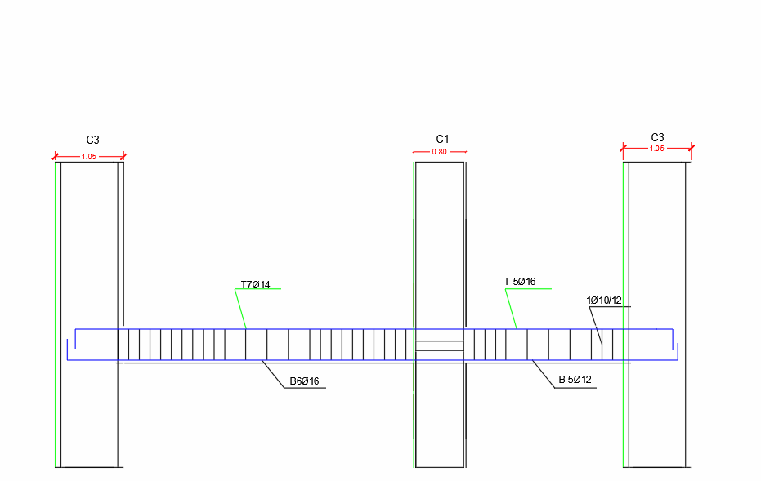
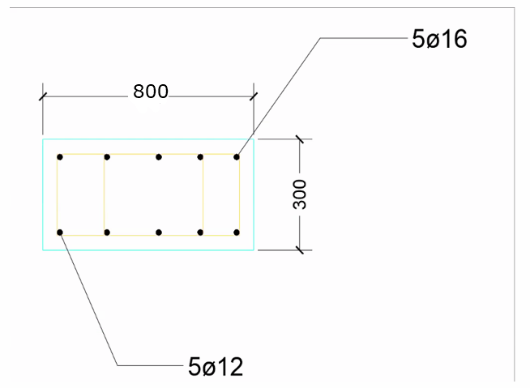
longitudinal section Cross section For beam3

Slide 24
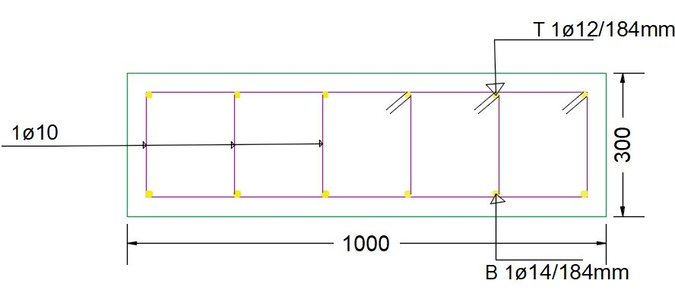
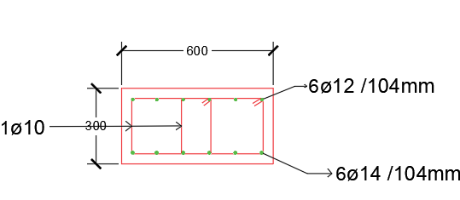
Cross section For Beam5 Cross section For Beam2

Slide 25
Design of Stair
Weight of staircase = 0.02 ∗ 23 + 0.05 ∗ 17 + 0.03 ∗ 27 = 2.12𝐾𝑁/𝑚2 .
Stair width = 30cm and height = 15cm, so:
Wight of concrete triangle of the stair = 0.5∗0.17∗0.3/ 0.345^2 = 0.214𝐾𝑁/𝑚2 .
Total S.D load on the stair= 2.12 + 0.214 = 2.334 𝐾𝑁/𝑚2
Dead load of stair slab= 25 ∗ 0.2 = 5 𝐾𝑁/𝑚2
Wu=1.2𝐷 + 1.6𝐿
𝑊𝑢 = 1.2 ∗ (5 + 2.334) + 1.6 ∗ 5 = 16.8 𝐾𝑁/𝑚𝑚2.
f’c = 28 MPa
fy = 420 MPa
d=160 mm
Assume simply supported slab:
✓ Shear check
𝑉𝑢 = 𝑤𝑢∗𝐿 2 = 16.8∗2.75/ 2 = 23.3𝐾
∅ Vc = ∅/ 6 ∗ 𝜆 ∗ √f’c ∗ 𝑏𝑤 ∗ 𝑑= ∅ /6 ∗ 1 ∗ √28 ∗ 1000 ∗ 160=105.8KN > Vu ,OK
✓ Flexural reinforcement
Mu = 𝑤𝑢∗𝐿^2 /8 = 16.8∗2.75^2/ 8 = 15.88𝐾𝑁. M

Slide 26
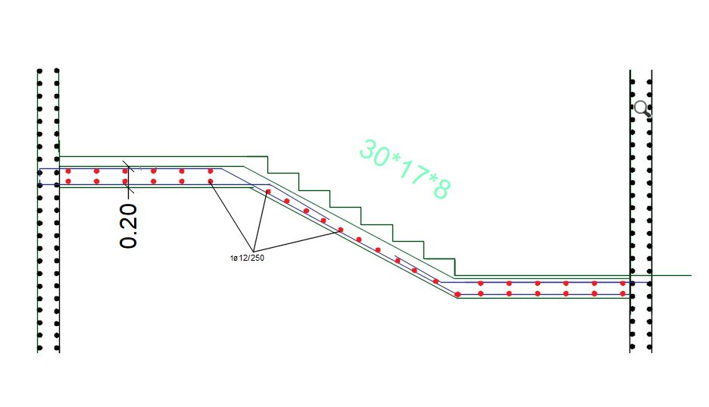
Reinforcement for staircase

