Slide 1

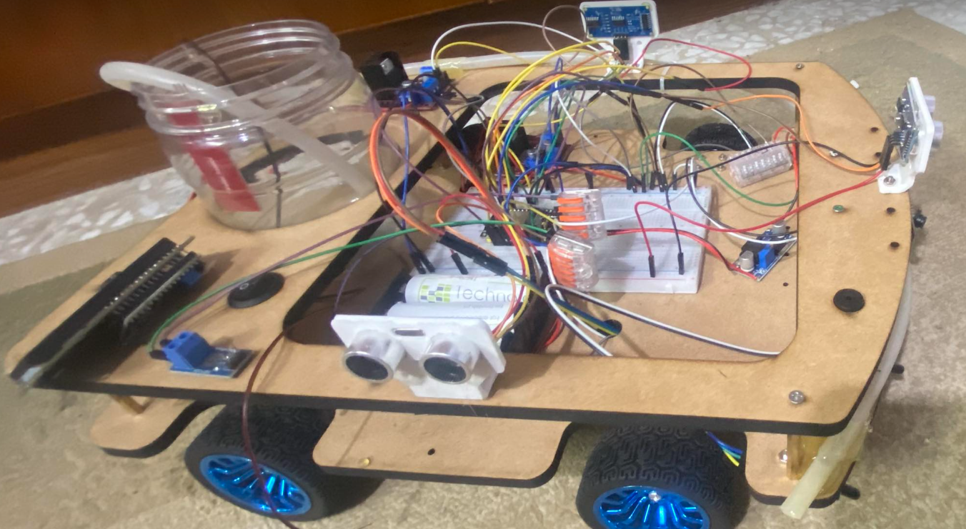
AN-NAJAH UNIVERSITY
FireFighter X
SUPERVISOR : DR. Asmaa Afefi
PARTICIPANTS : Abd alkareem Salah & Ameer Yaish

Slide 2
Roadmap
Introduction
Hardware Componenets
Challenges
1
3
5
2
4
4
Project Overview
Working Princible
Conclusion

Slide 3

Introduction
Firefighting is a dangerous and complex task that often puts human lives at risk. In recent years, the use of robots in firefighting has become increasingly popular, as they can help reduce the danger to human interactions, The Robot has a successful development of a fire-fighting robot that has the potential to revolutionize the way in which indoor fires are fought and managed. It can help save humans lives especially families, reduce property damages, and increase the efficiency and effectiveness of firefighting operations.

Slide 4
PROJECT OVERVIEW
Basically, The robot will be equipped with sensors and cameras to detect and navigate through the fire environment, as well as a variety of tools to extinguish fires, there is HTML page with buttons and live video streaming attained by esp cam, so that the user chooses the mode he prefers to control the robot remotely, it contains two basic options for fire fighting, which are manual, so that the robot’s movement is controlled by commands or buttons and the second mode is autonomous where the robot handle the process automatically without assistance, It is based mainly on the ultrasonic sensors and the servo motor so that the motor moves, and the ultrasonic scans the room and chooses the appropriate path for the robot in order to avoid obstacles that can be encountered.
Features:
Navigate autonomously through a simulated fire scenario and detect the fire using a combination of sensors (such as flame sensors and cameras).
Extinguish the fire using liquid water and foam.
Effectively communicate with a human operator and receive commands through a wireless connection.
Avoid obstacles and move efficiently through the environment.
Lcd that shows the battery charge percentage of the robot.
Lcd that shows the percentage of water remaining in the tank.
A web page to control the robot manually using Wireless Module.
Life video streaming using esp32-cam.

Slide 5
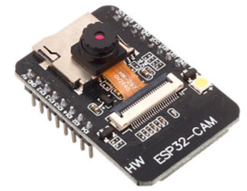
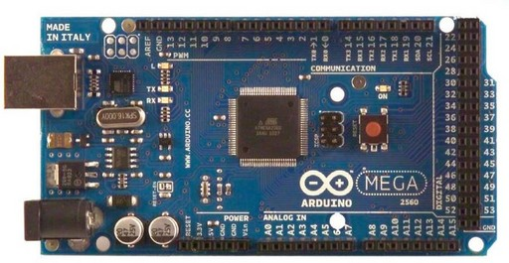
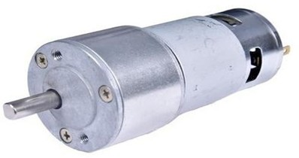
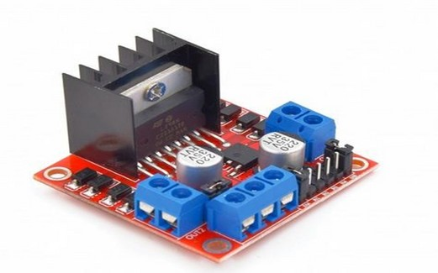
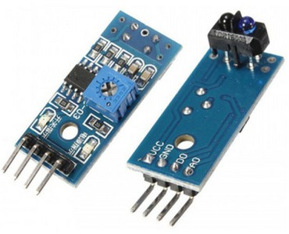
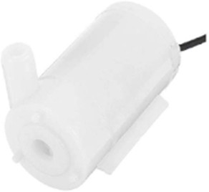
Hardware Components
ARDUINO MEGA
DC MOTOR
ESP32 CAM
L 298 N DRIVER
IR SENSOR
WATER PUMP

Slide 6
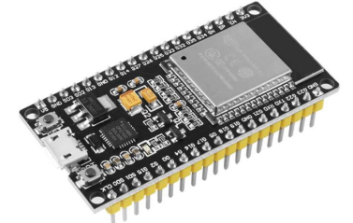
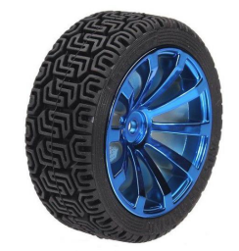
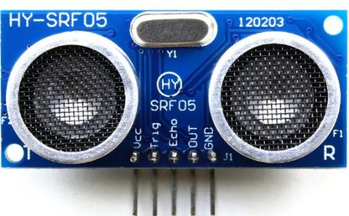
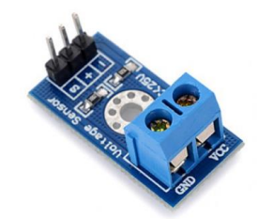
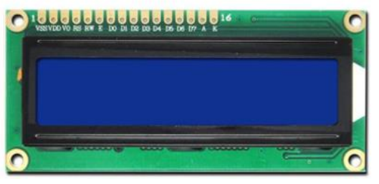
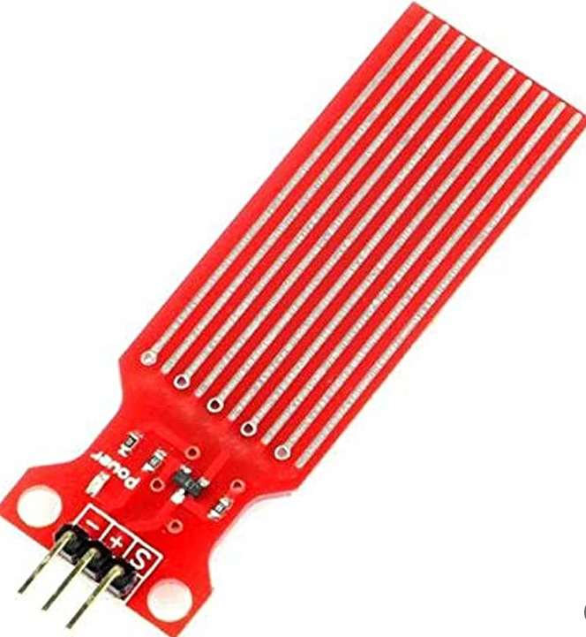
Hardware Components
ESP WROOM
ULTRASONIC SENSOR
RUBBER WHEEL
VOLTAGE SENSOR
LCD
WATER SENSOR

Slide 7


Problems
Serial
Communication
Power
Constraints
Compatibility issues

Slide 8
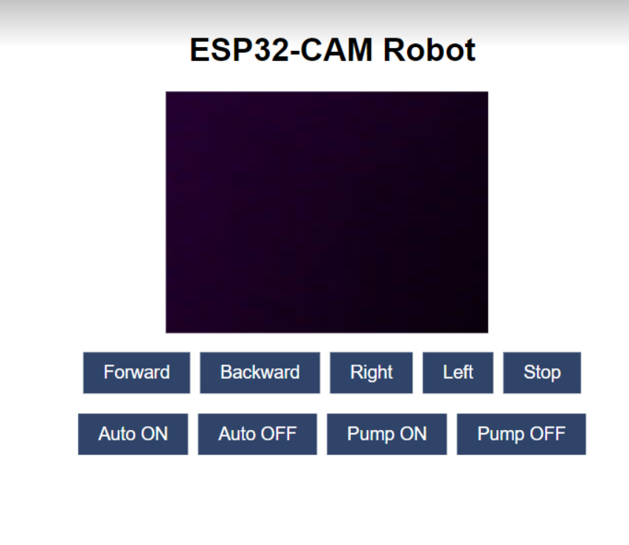
WORKING PRINCIPLE
The fire-fighting robot works on two modes where the esp cam broadcasts a live video streaming on html page and then the user chooses to control the robot manually using wireless mode or autonomously depending on sensors.
As we see in the picture there is nine buttons for
controlling the robot five of them are for the directions,
two for turning the pump on/off and the last two
buttons are for the autonomous mode.
Each time the user clicks any of these buttons a request
is sent to the microcontroller that has a software
applies the requested functionality.

Slide 9
THE ALGORITHM WE USED
Wall Avoidance :
The algorithm presented defines the behavior of a robot when confronted with obstacles in its environment. Equipped with three sensors, namely sensor 1, sensor 2, and sensor 3, the robot's response varies based on the sensor readings. If no obstacles are detected by any sensor, the robot proceeds to move forward. In the event that only sensor 3 detects an obstacle, the robot adjusts its path by executing a right turn. Should sensor 1 detect an obstacle exclusively, the robot initiates a backward movement followed by a right turn to navigate around the obstruction. When sensor 2 detects an obstacle on its own, the robot turns left to avoid it. If both sensor 2 and sensor 3 detect obstacles simultaneously, the robot continues moving forward as it can navigate through. Similarly, when both sensor 1 and sensor 3 detect obstacles, the algorithm prioritizes the avoidance of obstacles on the right side, leading the robot to perform a right turn. Conversely, if sensor 1 and sensor 2 detect obstacles, the algorithm prioritizes avoiding obstacles on the left side, prompting the robot to execute a left turn. In cases where all sensors detect obstacles, the algorithm introduces an element of randomness to the robot's response, allowing it to perform a random maneuver. By adhering to this algorithm, the robot demonstrates adaptive behavior, effectively navigating its surroundings while evading obstacles.

Slide 10
Future Work
Optimize robot’s design, materials for different environments
The ability of the robot to charge automatically
The ability of the robot to refill the tank automatically
increase the range of flame sensor
Improve robot's communication
with the operator

Slide 11
CONCLUSION
The fire-fighting robot developed in this project demonstrates a promising potential for combating fires in indoor environments, where restricted access and poor visibility pose significant challenges. The robot showcases autonomous navigation capabilities, effectively maneuvering through obstacles and confined spaces. With a combination of advanced sensors, it efficiently detects fires and promptly initiates fire-suppression procedures, employing water and foam mechanisms. The robot's seamless communication with the operator ensures successful firefighting operations, particularly in indoor settings, where real-time updates and coordination are crucial. The robot can be upgraded with additional features to improve fire fighting process effectively.

Slide 12


