Slide 1

بسم الله الرحمن الرحيم
Development of a Water Master Plan for Jenin Governorate (2020-2040)
Prepared by
Yasmeen Nairat Ayah Dweikat
Isra Balati Amna Melham
Under supervision of: Dr. Anan Jayyousi

Slide 2
Introduction
we will choose Jenin Governorate as an area to study the future problem of water lack by studying the difference between the required and existing quantity of water that Jenin need it in the next 20 years by developing a Master plan that will propose a new water resources with an investigation plan to implement the project during the next 20 years.

Slide 3
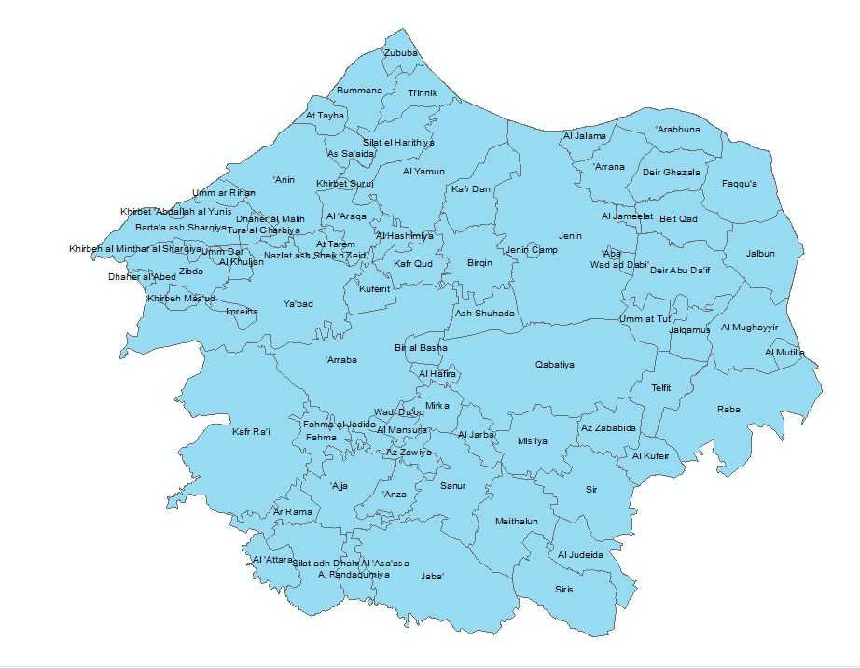
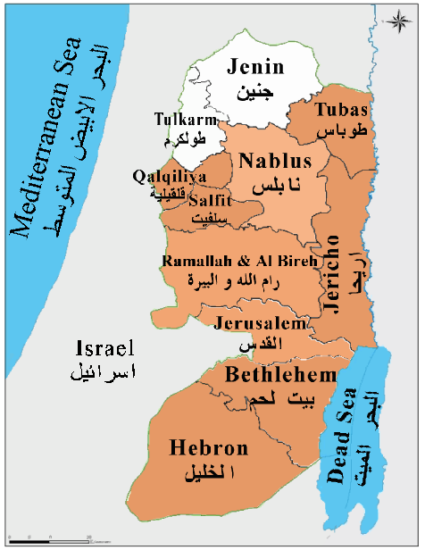
OVERVIEW OF JENIN
LOCATION AND COMMUNTIES

Slide 4
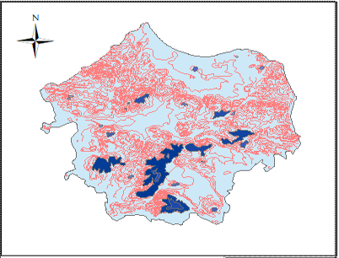
OVERVIEW OF JENIN
Topography

Slide 5
Existing Water Supply System
Water Resources:
Selected Indicators for Water Statistics in the West Bank..

Slide 6
Water Produced per Basin in the West Bank For Jenin Governorate.
Palestinian Water Wells and its Annual Pumping Quantity for Jenin Governorate and Type of Use.

Slide 7
Domestic Sector, Water Consumed, Total Losses, Population and Daily Consumption per Capita in Jenin Governorate.
Needed, Supply and Consumed Quantities, Population and Deficit in Domestic Supply in Jenin Governorate.

Slide 8
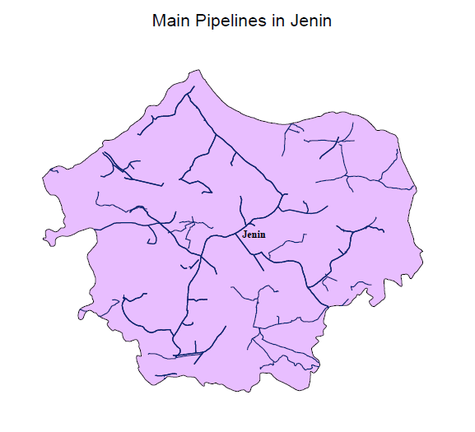
Water Networks:
In the Figure, the main pipelines in Jenin Governorate that we will work on it to develop the water plan in Jenin in the future. It’s the most important part because water reach to Jenin by it

Slide 9

Present Water Demand:
We collected data on the population and current water demand in each city, village, and cluster. This information is obtained from the Palestinian Central Bureau of Statistics and the Water Authority according to 2017 statistics.
Using the formula:
P_{future} = P_{now} * (1+r)^{n}
P_{now}: Population in 2017
P_{future}: Population in 2020.
n: No. of years, n =3 years.
r: growth rate. We take it from the following table

Slide 11
Future water demand
Demand (year) = (The population (year) * Demand unit (year L/Capita/Day) * 365 (day/year) /)1000 (L/m3) * (1-loss %))
Year | Demand unit (l/c/day) | N | Loss %
2020 | 60 | 3 | 46.12
2025 | 80 | 8 | 35
2030 | 100 | 13 | 25
2040 | 120 | 23 | 15

Slide 12
Clusters in Jenin Government
We divided Jenin government into clusters based on several factors, and these factors are:
Some communities get water from certain sources in the present time, so we cannot separate them in the future.
Administrative divisions.
Social divisions.
Commercial divisions

Slide 13
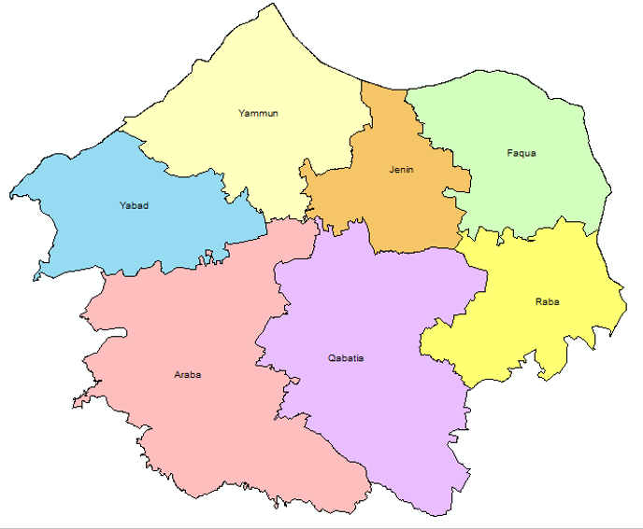
this cluster.
Qabaytia cluster.
Araba cluster.
Yabad cluster.
Jenin cluster.
Faqquaa cluster.
AL-Yammun cluster.
Raba cluster

Slide 14
Population and Supply in the years 2017, 2020, 2025, 2030 and 2040.

Slide 15
Population and Demand in the years 2020, 2025, 2030 and 2040

Slide 16
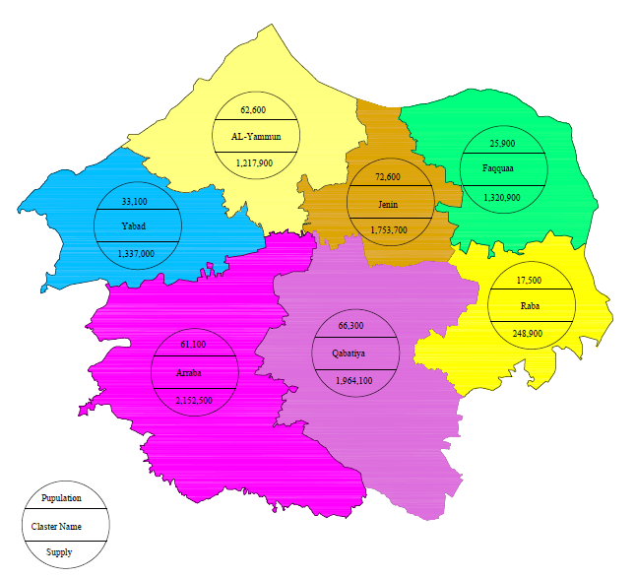
Population and Supply for the year 2020 (m³).

Slide 17
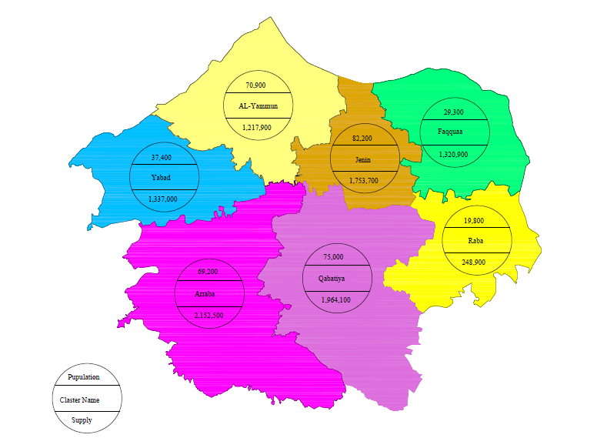
Population and Supply for the year 2025(m³).

Slide 18
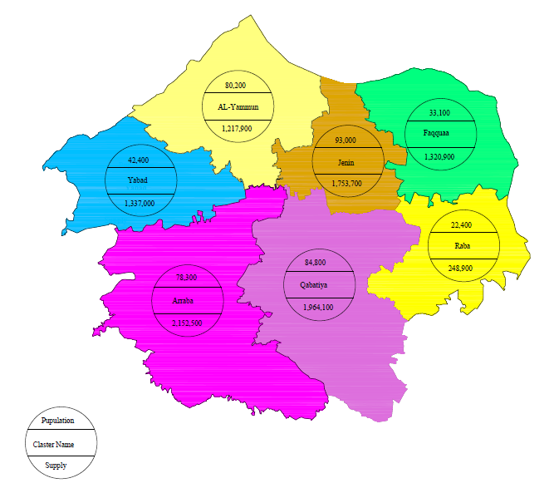
Population and Supply for the year 2030(m³).

Slide 19
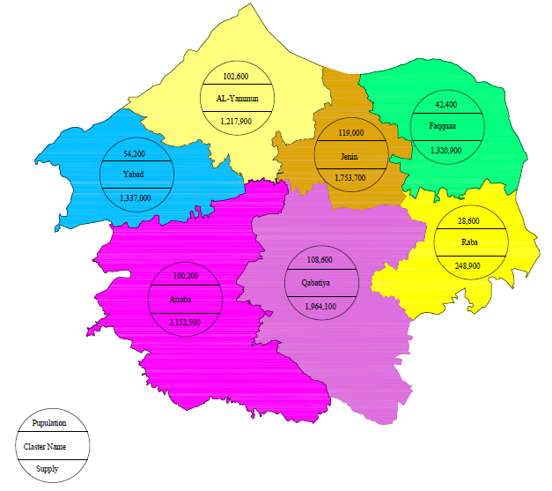
Population and Supply for the year 2040(m³).

Slide 20
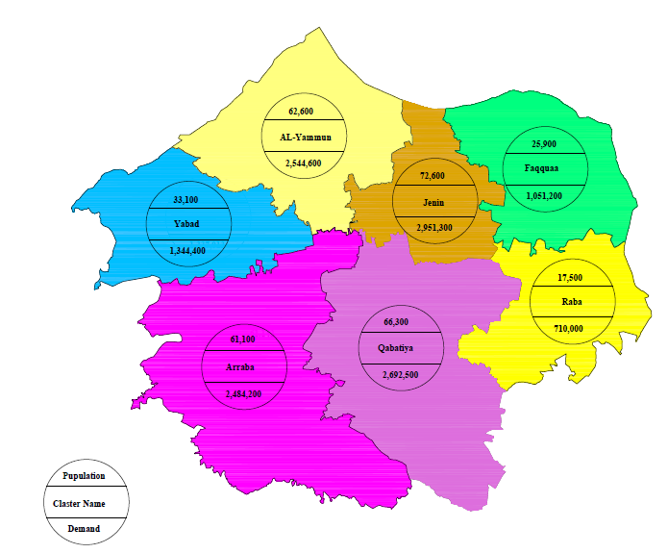
Population and Demand in the year 2020(m³).

Slide 21
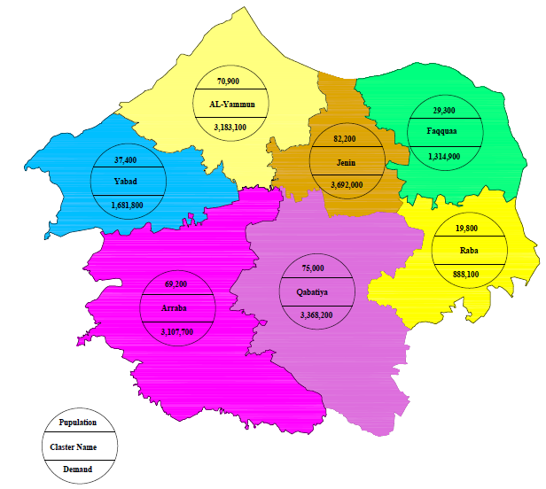
Population and Demand in the year 2025(m³).

Slide 22
Population and Demand in the year 2025(m³).

Slide 23
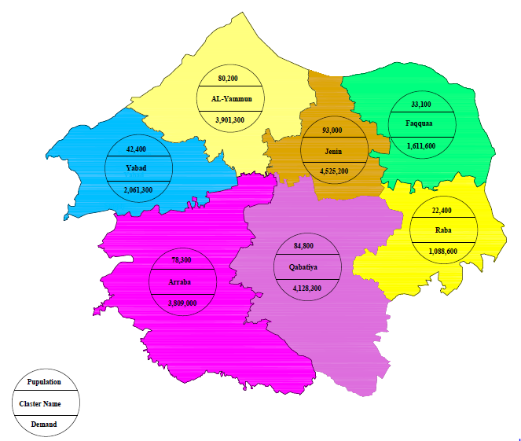
Population and Demand in the year 2030(m³).

Slide 24
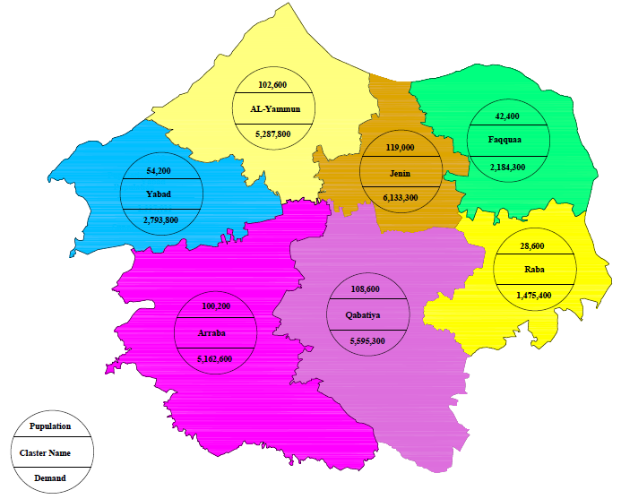
Population and Demand in the year 2040(m³).

Slide 25
Gap of water demand in Jenin governorate
After we found population and demand in years of present and future time, and by knowing about the amount of water supply in Jenin government in 2017, we consider that the amount of water supply are constant in the next years in the future (2020-2040)
So depending on this information and assumption, we account the amount of gap of the water
We use this formula
Amount of gap = demand – supply.

Slide 26
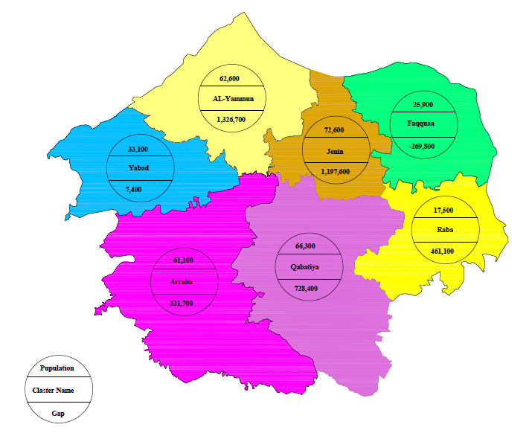
Population and Gap for the year 2020(m³).

Slide 27
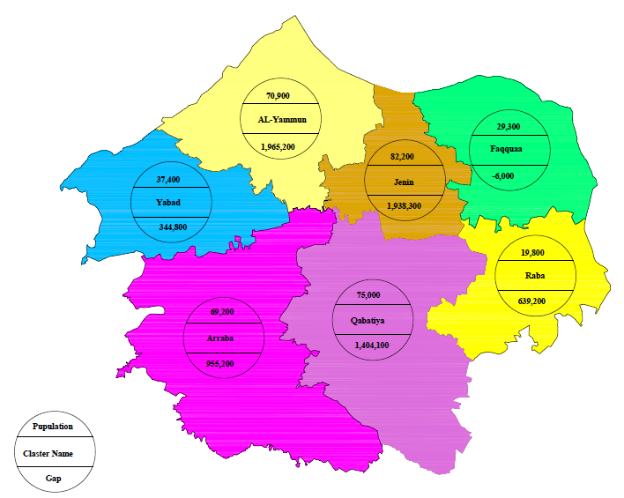
Population and Gap for the year 2025(m³).

Slide 28
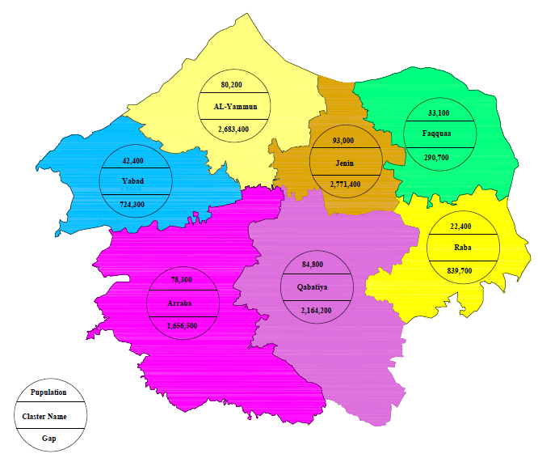
Population and Gap for the year 2030(m³).

Slide 29
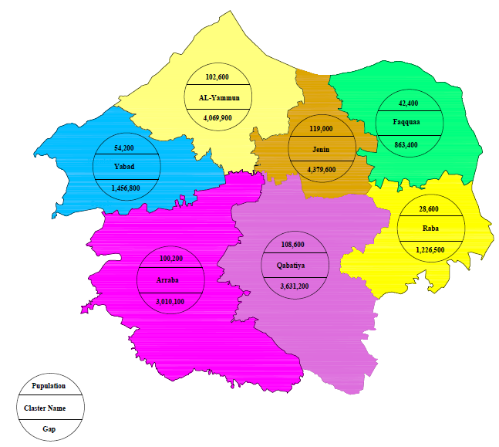
Population and Gap for the year 2040(m³).

Slide 30
Introduction to Graduation Project 2
After finding Gap in this part of the project, the purpose of the second part of the graduation project is suppose a suitable solutions of this Gap.
The solutions is divided into two types:
1-The short-term solutions:
Decrease the network losses
By the frequent maintenance on the pipelines networks
2-The long-term solutions:
Construction of wells
Taking water from Jordon Valley

Slide 31
Thank you

Slide 32
Plans to cover the gap
The short-term solutions
Maintenance of the existing networks
Rain Water Harvesting
The long-Term Solutions:
Taking water from Jordon Valley
Construction of wells

Slide 33
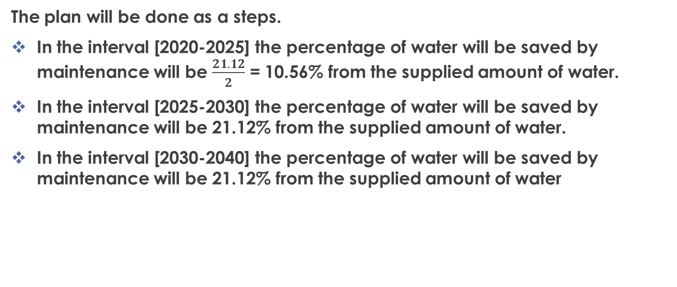
Maintenance of the existing networks
The plan will be done as a steps.
In the interval [2020-2025] the percentage of water will be saved by maintenance will be $\frac{21.12}{2}$ = 10.56% from the supplied amount of water.
In the interval [2025-2030] the percentage of water will be saved by maintenance will be 21.12% from the supplied amount of water.
In the interval [2030-2040] the percentage of water will be saved by maintenance will be 21.12% from the supplied amount of water

Slide 34
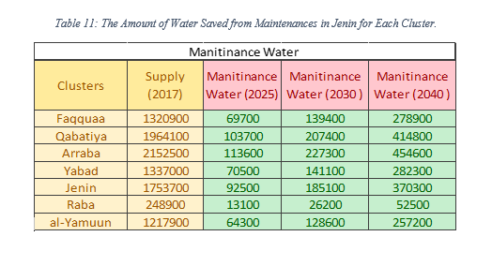

Slide 35
Rain Water Harvesting
Avg. family size is 4.8 capita.
No. of floor in each building is 3 floors.
Avg. area of each apartment is 167.7 m².
Avg. annual rainfall is 528 mm.

Slide 36
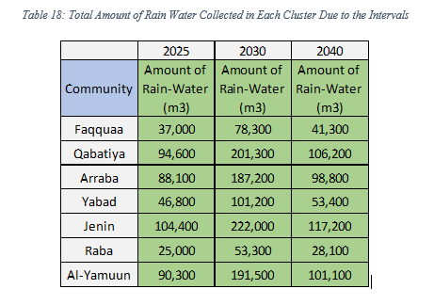

Slide 37
The amount of water saved from The short-term solutions
Total Amount of Water Provided from Two Solutions

Slide 38
Remain Gap
The New Gap Results from Short Term Solutions

Slide 39
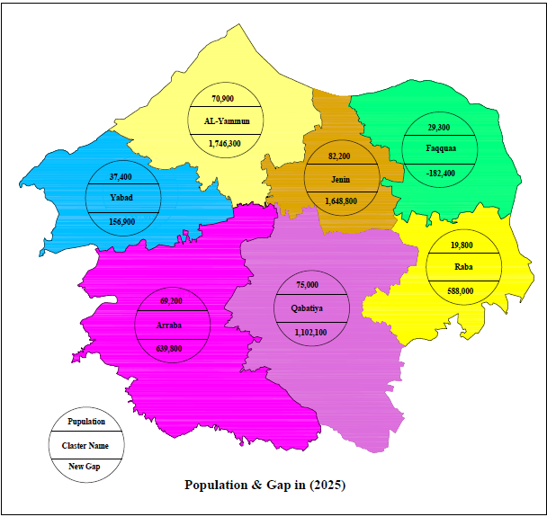
The Population and the New Gap for Jenin Governorate in 2025.

Slide 40

The Population and the New Gap for Jenin Governorate in 2030.

Slide 41

The Population and the New Gap for Jenin Governorate in 2040.

Slide 42
The long-Term Solutions:
Taking water from Jordon Valley
Palestinians are allowed to use only permitted to use 40% of the water in this basin or approximately 58 mcm of water per year. Since its occupation in 1967
Based on the right of the Palestinian people to Jordan waters according to the agreements, in this project, water will be taken from the Jordan Valley for use in Jenin for agricultural uses. This is because in the project it will solve the water gap in home use. Therefore, the agricultural aspect is taken into account in the project

Slide 43
Construction of wells
These wells will be supplied with water from the northeastern basin, because the Jenin site is in the northeastern basin.
The New Gap for the Intervals of the Plan in each Cluster.

Slide 44
The Plan will take a three terms to be construct and supply water to the clusters.
Short-term Plan:
Wells will be constructed equal 1,400,000 m3
his results that 5 wells is needed to construct in Jenin Governorate through the interval until 2025.
5 wells, 3 in the North and 2 in the east of Jenin Governorate

Slide 45
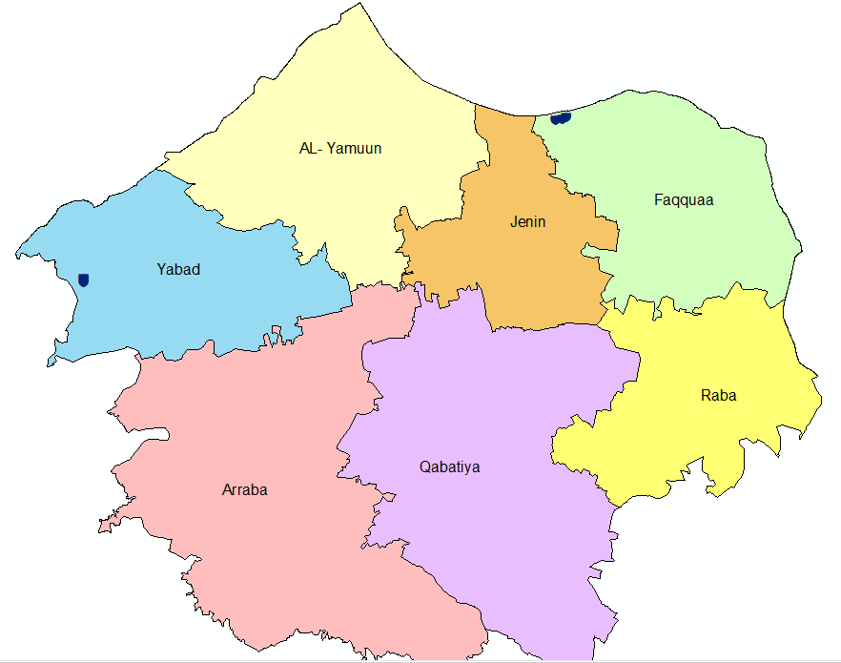
The Proposed Wells in Jenin Governorate for the Year 2025.

