Slide 1

Save Home
By: Saja Saif
Malak Ramadan

Slide 2

Introduction
One the most common accident those days is home accident many live die because of fires or gas leak
Save Home is a smart home system that provides alert for accidents like fires and gas leak , security against theft incidents and easy light controlling by a mobile application connected by Bluetooth .
We add flame sensor ,gas sensor MQ-5, temperature sensor (DHT11) ,reed switch, Movement sensor (PIR) and FRID

Slide 3
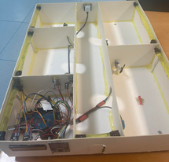
Design
We built our project using cardboard and silicon the project consist of
Arduino MEGA
RFID
LCD
Flame Sensor
gas sensor (MQ-5)
temperature sensor(DHT11)
move sensor (PIR)
Reed Switch LDR , Bluetooth module
2 potentiometers , leds , a fan , and heater Represented by 4 red leds.

Slide 4
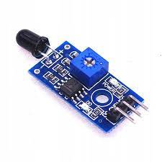
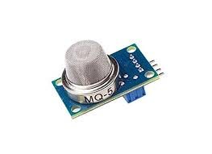
Features
Detects flame by a flame sensor then give an alarm
Detect gas by gas sensor then give an alarm

Slide 5
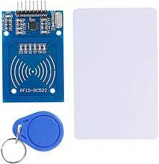
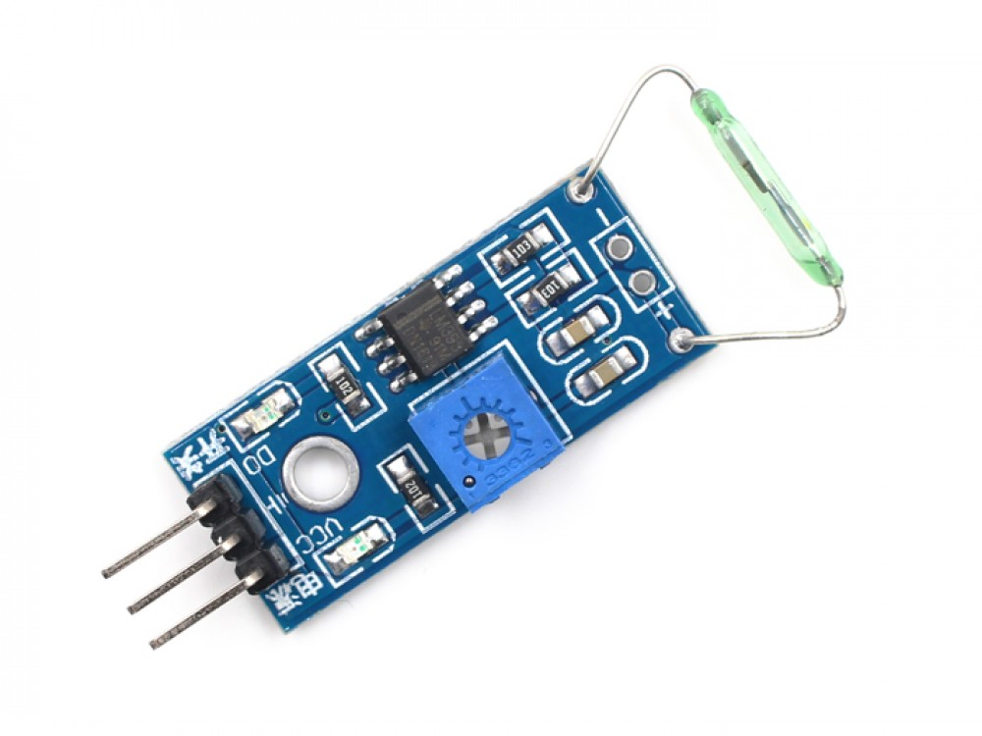
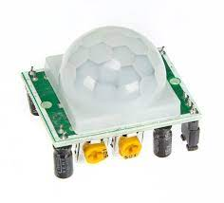
Features
Security by using RFID, read switch ,and sense any movement in the house by PIR sensor and give an alarm if any movement happened in the house without entering the right card or if the door opened without entering the right card .

Slide 6
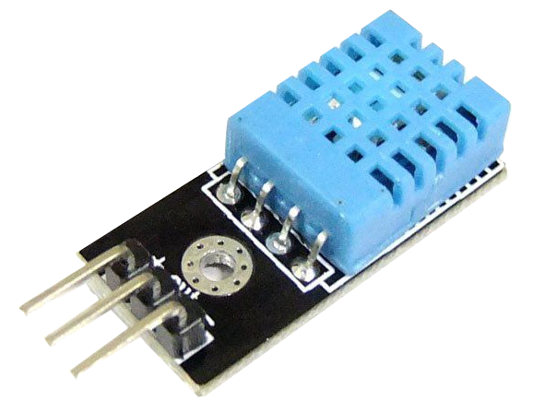
Features
control the temperature: by sensing the temperature by DHT11 and if it rises above specific degree a fan will work if it less a heater (here we use leds) will work .

Slide 7
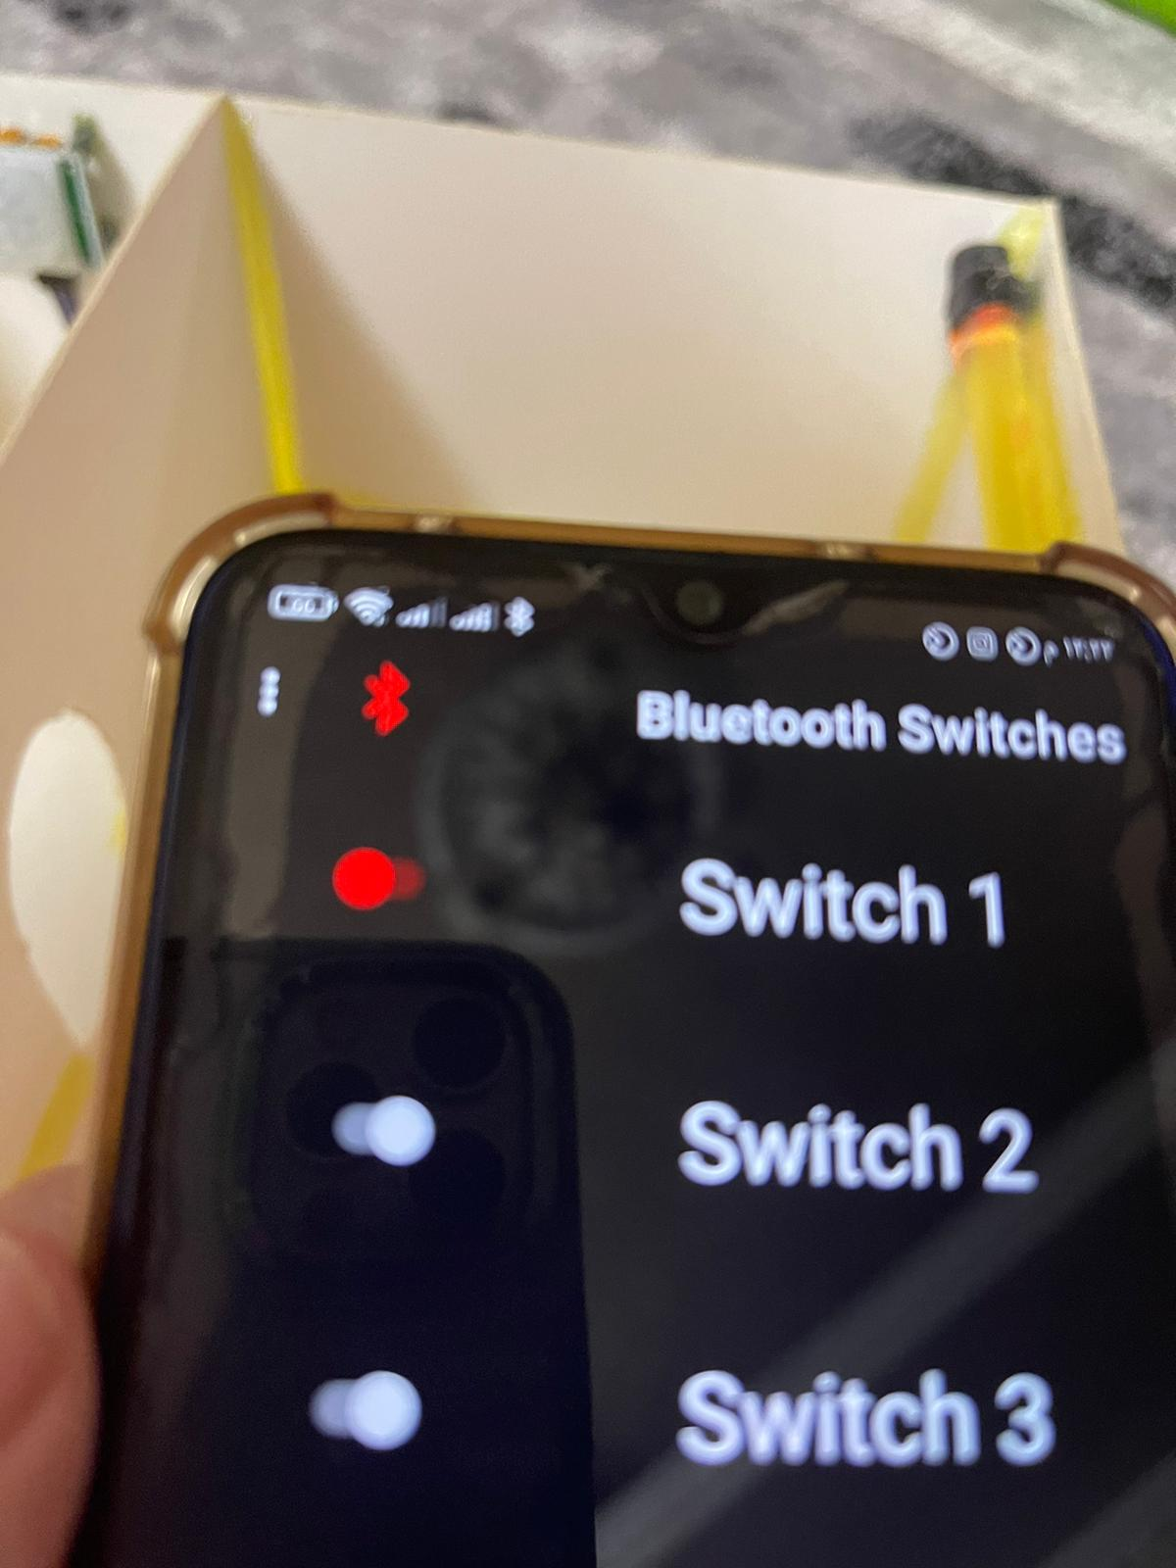
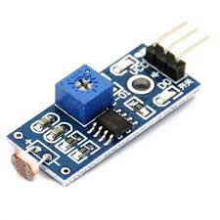
Features
control the lights by a mobile application also detect light by LDR sensor if it gets dark a light automatic will be on .

Slide 8
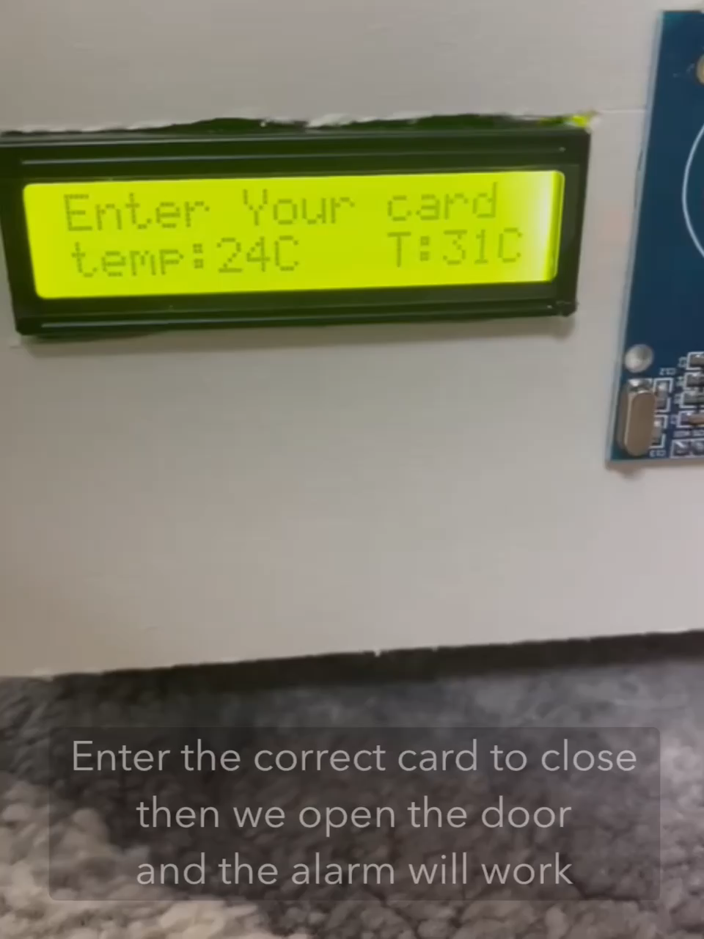
Project demo

Slide 9

Future work
there is lot of features that could added to our project to be perfect home and more efficient for example add cameras and connect them with application on smartphone this cameras takes photo to any person enter the home and analysis this photo by use AI to recognize if he is member to this home or not.

