Slide 1

An-Najah National University
Faculty of Engineering and Information Technology
Civil Engineering Department
Graduation Project 2
Structural Design of Iktaba Comprehensive activity center
Prepared by:
Raya Ahmad Tammam
Under supervision of:
Dr . Imad Al-Qasem

Slide 2
`
Outline :
Introduction.
Architectural Drawing.
Preliminary Structural Design.
Three Dimensional Structural Analysis.
Design of columns
Design of footings

Slide 3
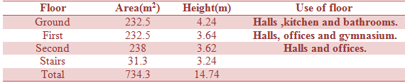
Project Description
The project is structural analysis and design of Iktaba comprehensive activity center –Tulkarm.
The building is three floors of reinforced concrete.
Contains one block

Slide 4
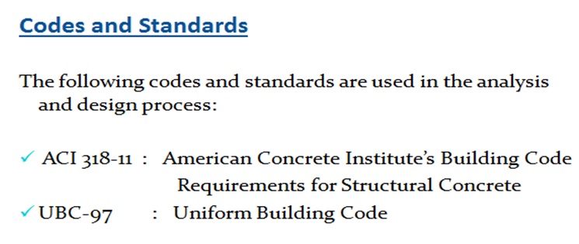
Analysis and Design Principles
Three dimensional model is used to model the building using SAP2000 program.
The footings are considered as pin supports .

Slide 5
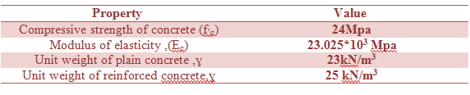
Structural Materials
Concrete:
The concrete type for all structural Element is B300
  Steel:
The steel used in all reinforcements is ASTM A955 Grade 60, and this type has a tensile strength of 620 MPa, yield strength of 420 MPa, and modulus of elasticity of 200 GPa.

Slide 6

  Loads
Gravity loads:
  Live load: according to ACI-318 , the following uniform live loads are used
    Live load of 4.79 KN/m² is used for ground and first floor
    Live load of 10 KN/m² is used for the roof
  Dead load:
  The super imposed dead load on slabs = 5 kN/m².

Slide 7
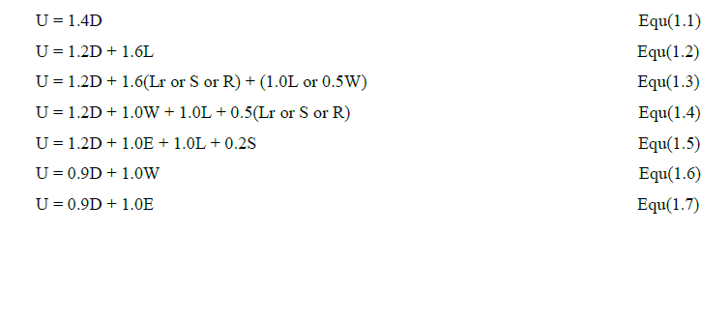
Load combinations

Slide 8
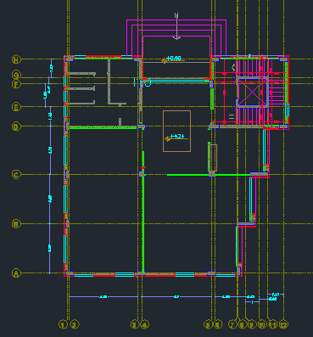
Architectural Drawings

Slide 9
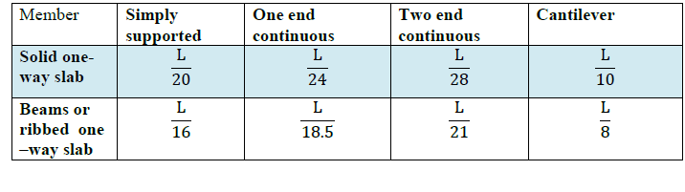

Preliminary Slabs Thickness and Loads
According to ACI 318-11, Table 9.5(a), the thickness of one way slabs and beams can be obtained based on the deflection limit:

Slide 10
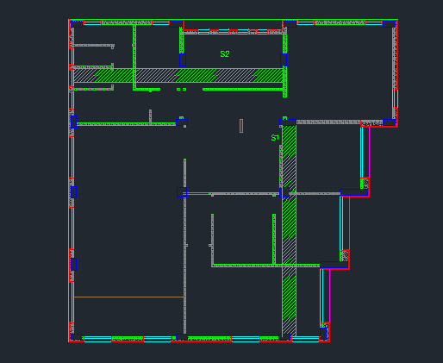

Slide 11
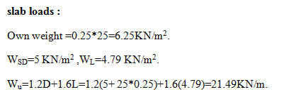
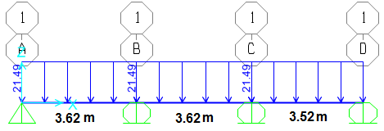
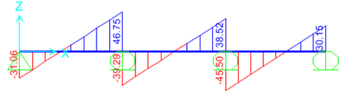
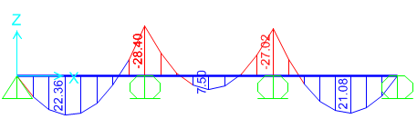

Slide 12
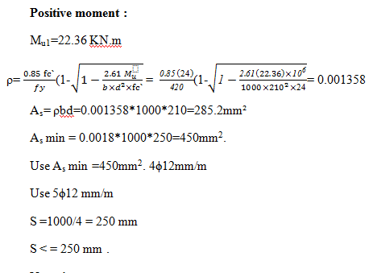
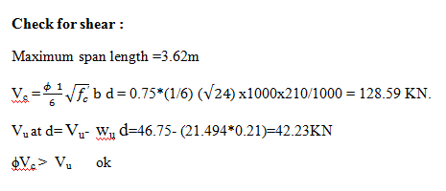

Slide 13
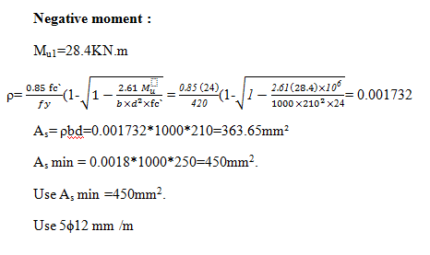

Slide 14

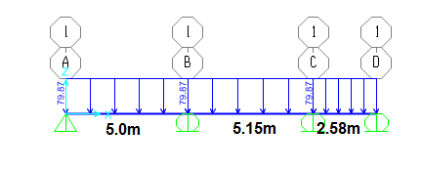
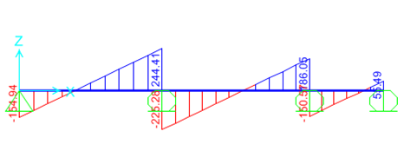
Design for beam B17 B18 B19 :

Slide 15
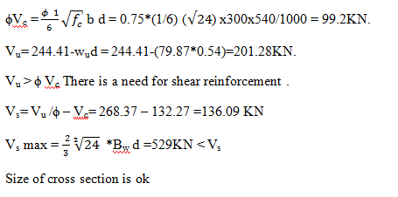

Slide 16
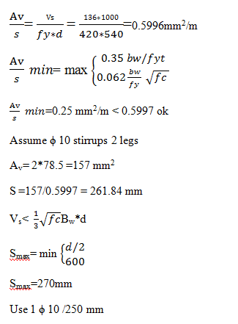

Slide 17
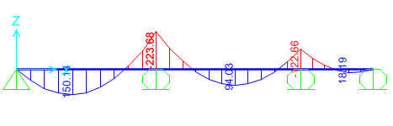
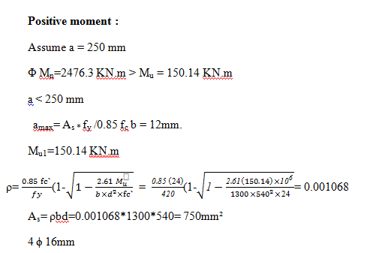

Slide 18
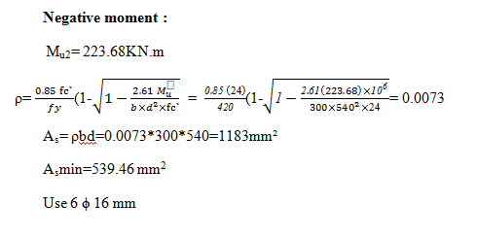

Slide 19


Slide 20
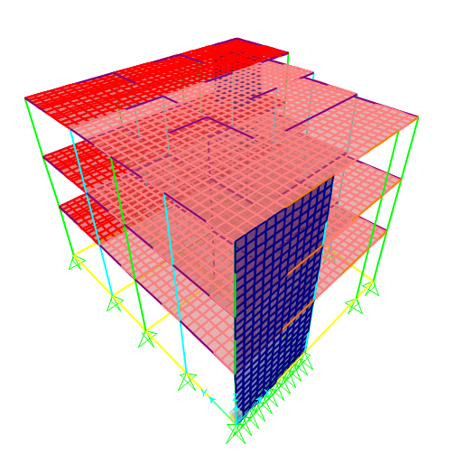

Slide 21
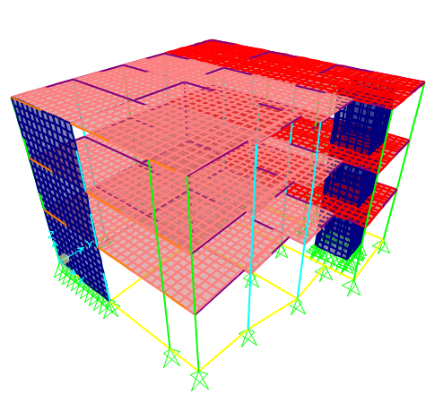

Slide 22
Structural Modeling of the Building
Units:
  The main units are kilo Newton (KN) for loads and meter (m) for lengths.
  Materials:
  Concrete 24MPa was used for all structural elements
  modifiers for beam 0.35
  for columns 0.7
  For slab 0.25 ,0.025 ,0.025

Slide 23
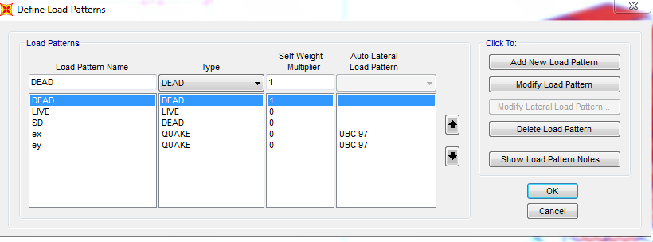
Loads Patterns

Slide 24
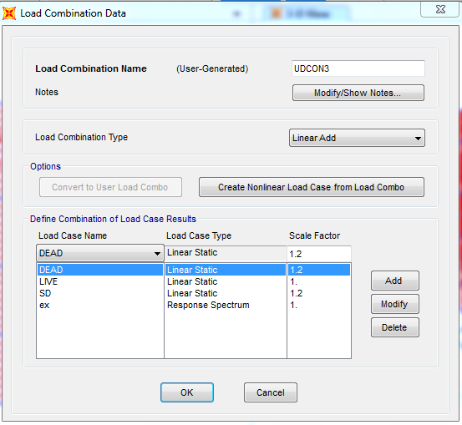
Definition of load combinations :

Slide 25
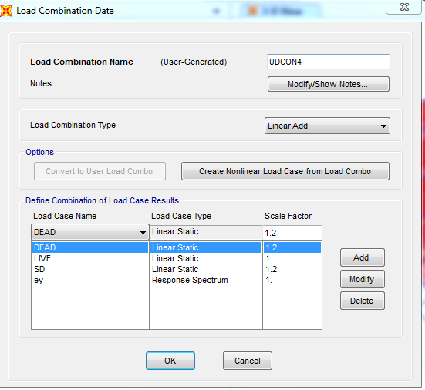
Definition of load combinations :

Slide 26
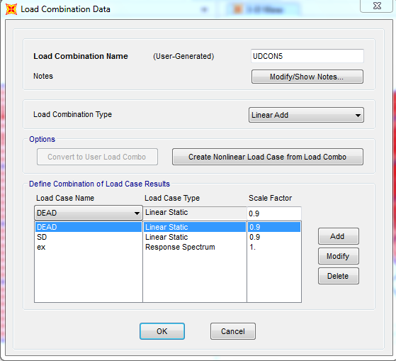
Definition of load combinations :

Slide 27
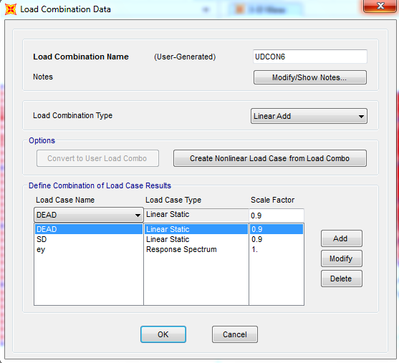
Definition of load combinations :

Slide 28
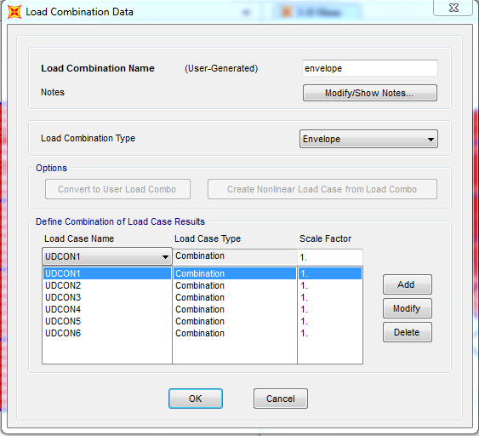
Definition of load combinations :

Slide 29
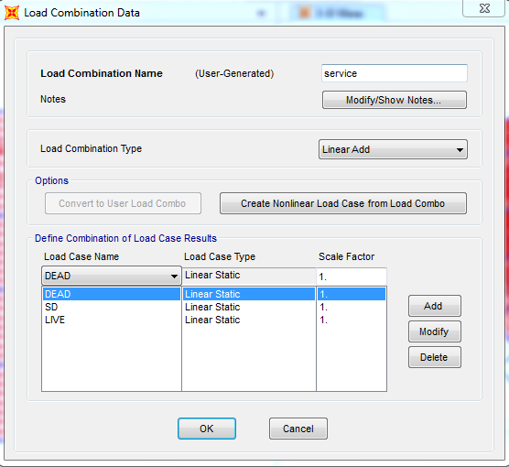
Definition of load combinations :

Slide 30
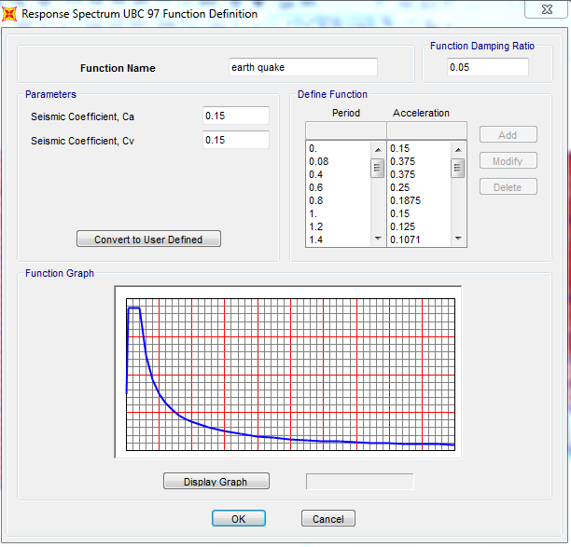
Definition of Response Spectrum :

Slide 31
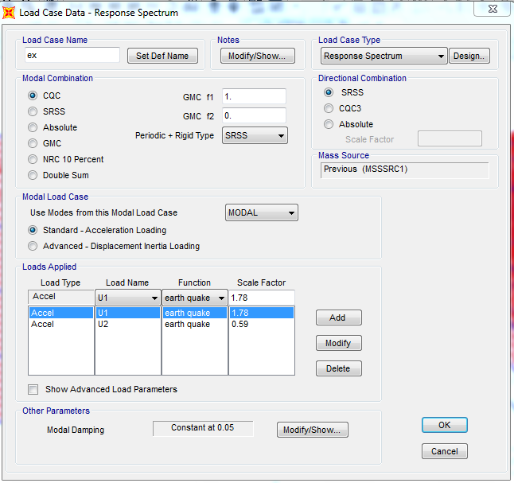
Definition of load cases :

Slide 32
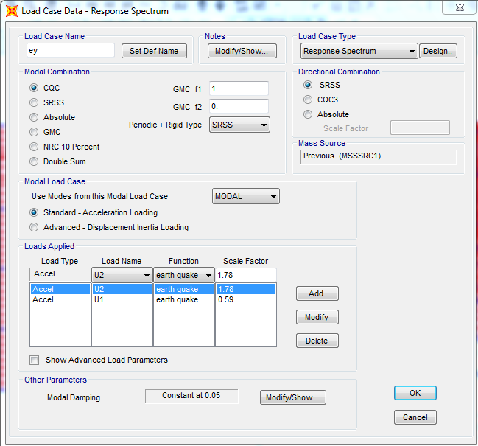
Definition of load cases :

Slide 33
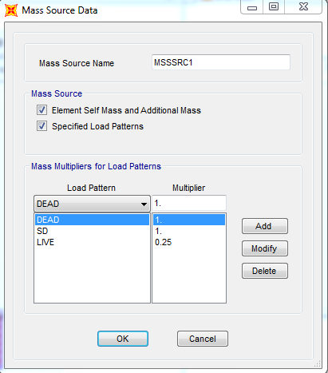
Definition of mass source:

Slide 34


Slide 35

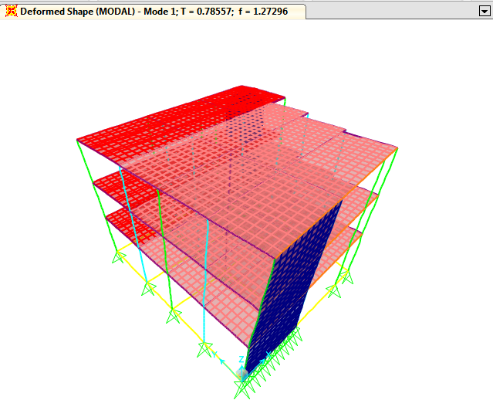

Slide 36

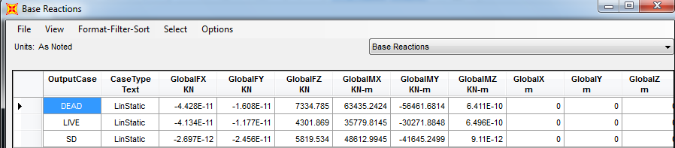


Slide 37

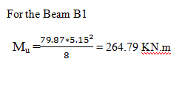
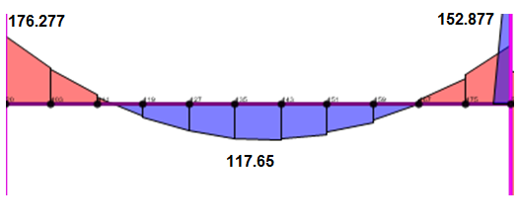
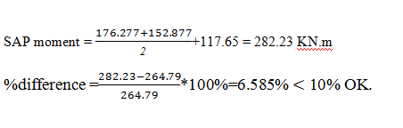

Slide 38

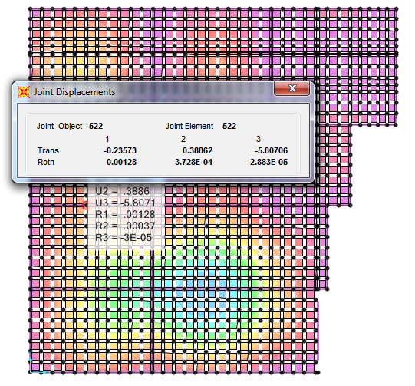
Deflection

Slide 39
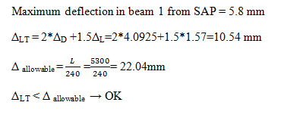

Slide 40
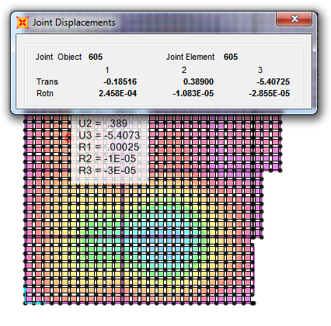

Slide 41
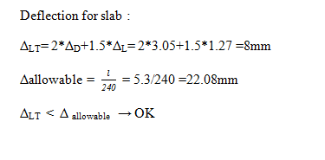

Slide 42

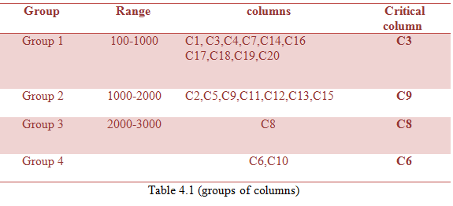

Slide 43
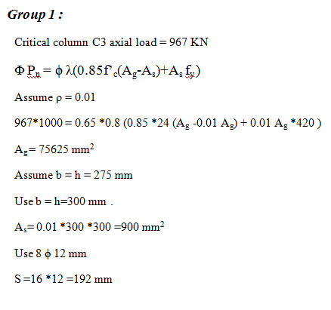

Slide 44


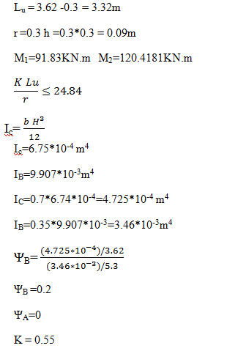

Slide 45
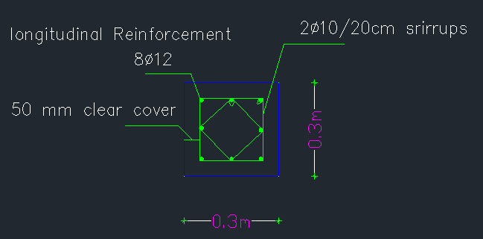
Column Group 1

Slide 46
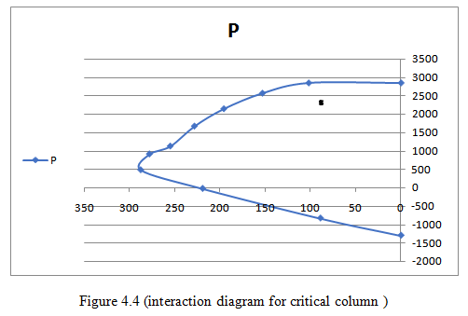

Slide 47
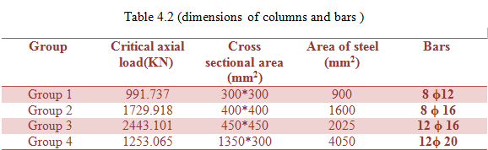
Summary of Columns

Slide 48
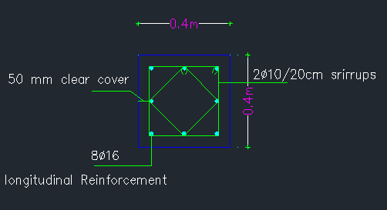
Column Group 2

Slide 49

Column Group 3

Slide 50

Column Group 4

Slide 51



Slide 52


Slide 53


Slide 54


Slide 55


Slide 56


Slide 57



Slide 58


Slide 59




