Slide 1



EliteStay
Submitted By: Fatima Zhraa Saidi Lana Sammer Hassan
Supervisor: Sulaiman Abu Kharmeh

Slide 2



Table of Contents
What’s our app about
App workflow
Technologies we used
Future work

Slide 3
WHAT’S OUR APP ABOUT
EliteStay is a modern and convenient platform that simplifies hotel bookings and enhances the tourist experience in Palestine- The application allows you to explore hotels, compare prices and book all services by supporting local hospitality and sustainable tourism-
Next Slide

Slide 4




Technologies we used
React Native
C#
SQL
React
Java Script
.Net
Next Slide

Slide 5
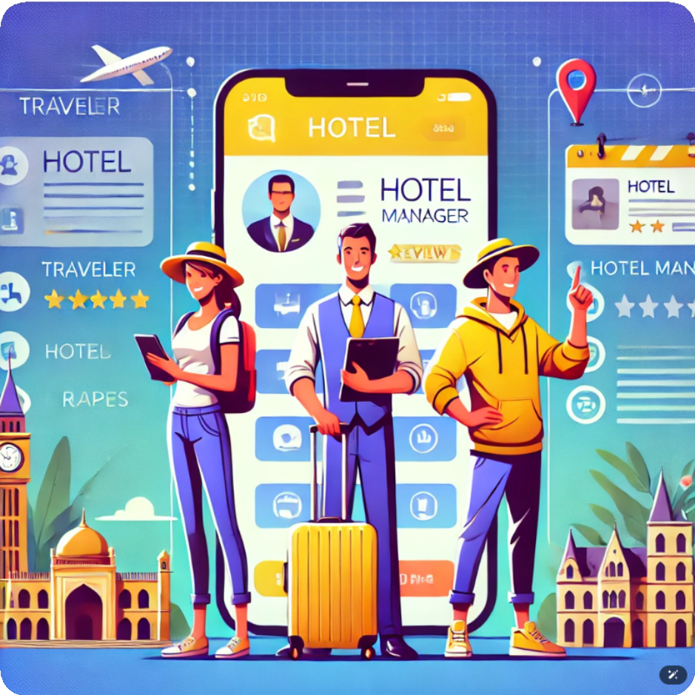
Types of users in the application
Hotel Owners
Guests/Clients
Next Slide

Slide 6
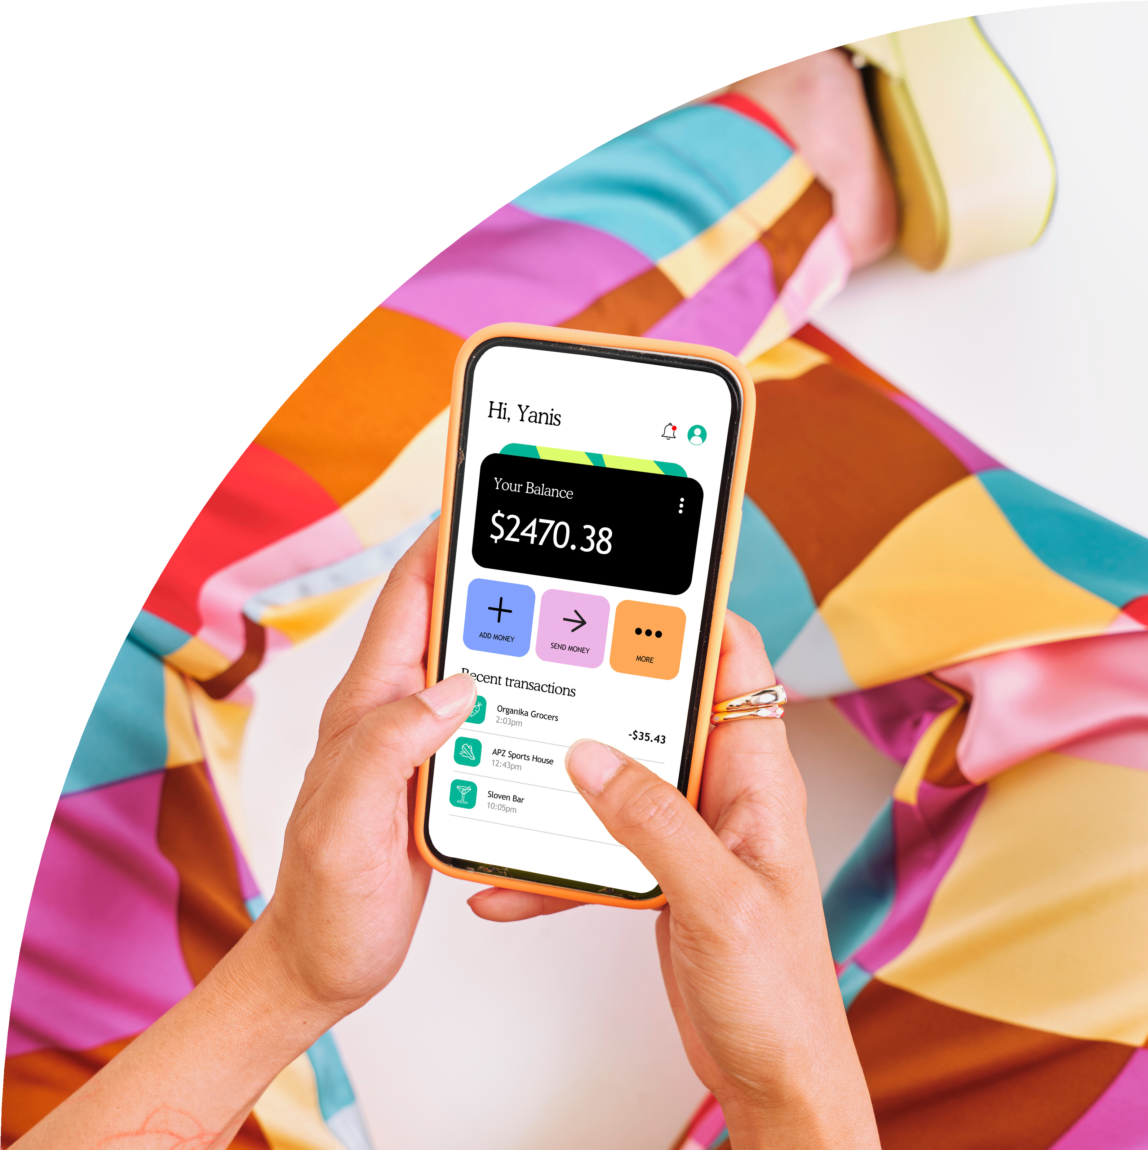
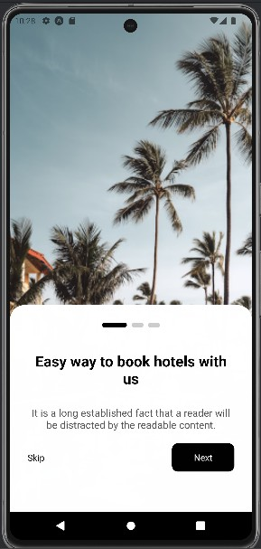
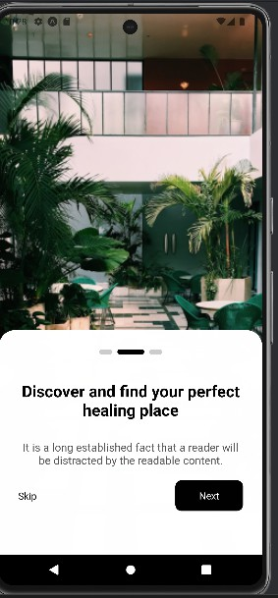
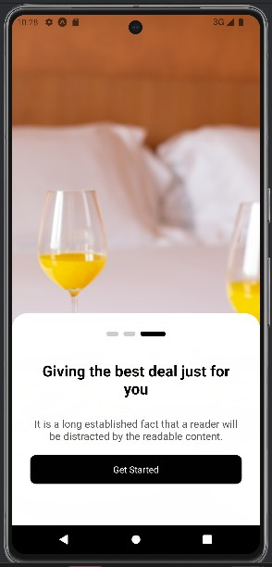
Guests/Clients
Befor login
Next Slide

Slide 7
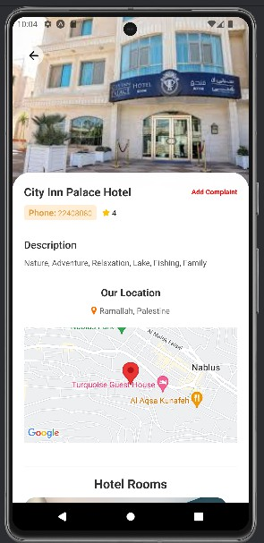
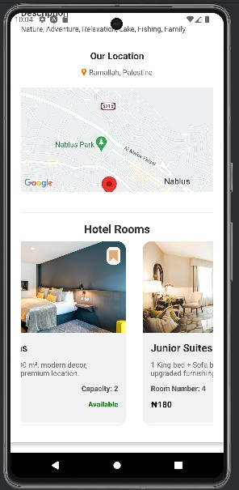
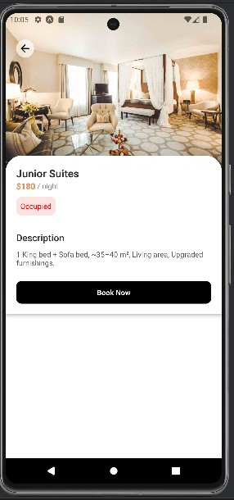
Guests/Clients
Profile Hotel
Profile Room

Slide 8
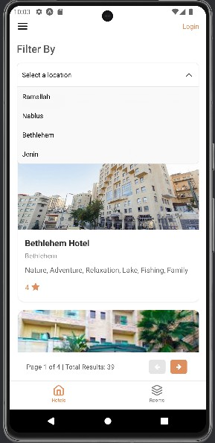
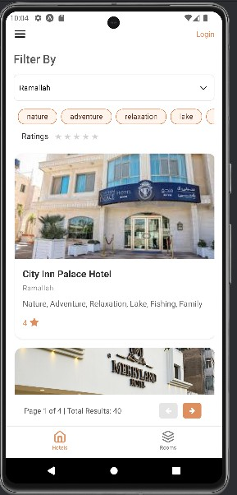
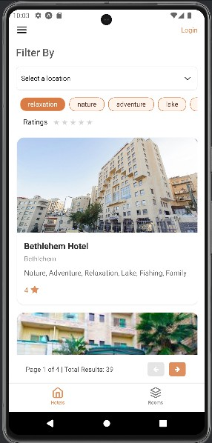
Guests/Clients
Filter By
Location
Tags
Stars
Next Slide

Slide 9
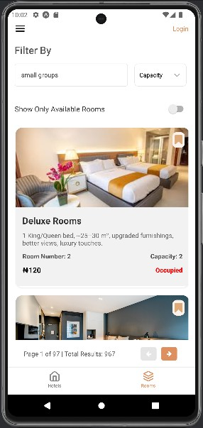
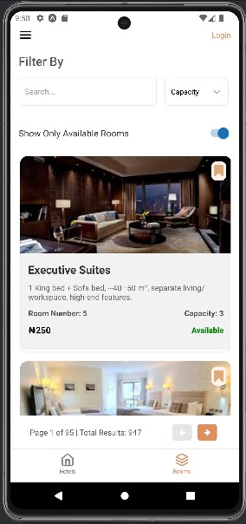
Room
Guests/Clients
Filter By
Display only Available Room

Slide 10
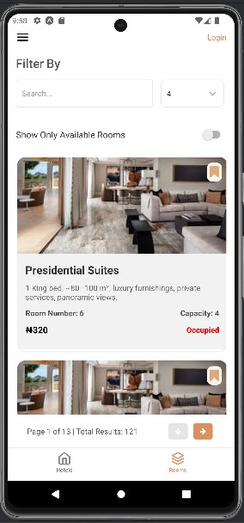
Room
Guests/Clients
Filter By
Capacity

Slide 11
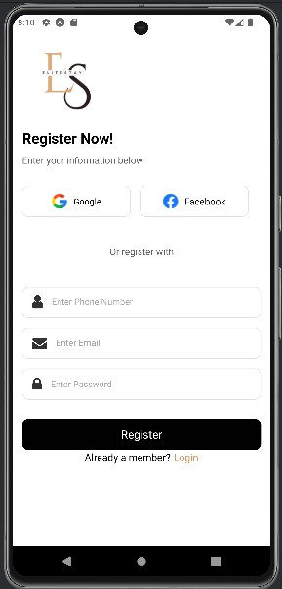
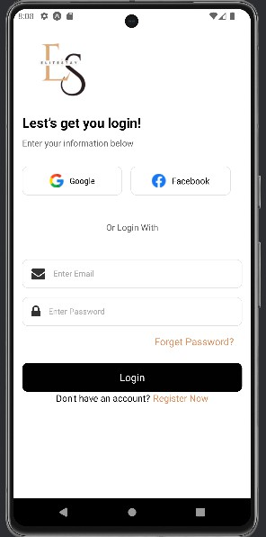
Guests/Clients
Create Account
Login

Slide 12
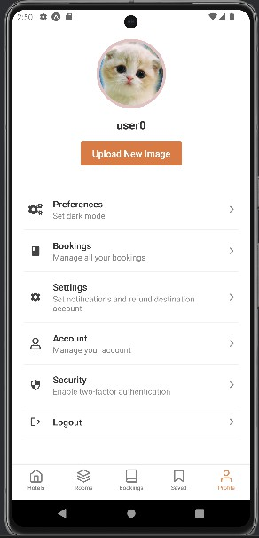
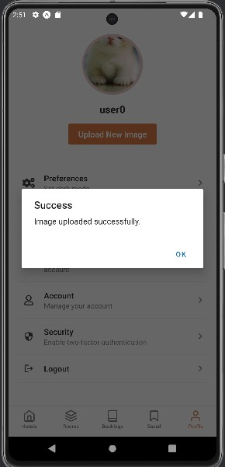
Guests/Clients
User profile

Slide 13
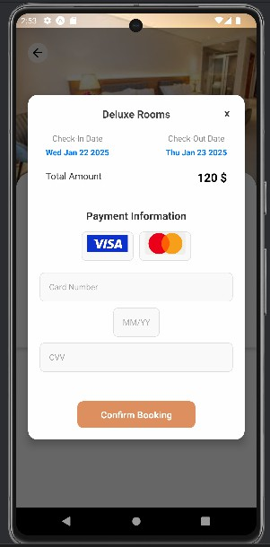
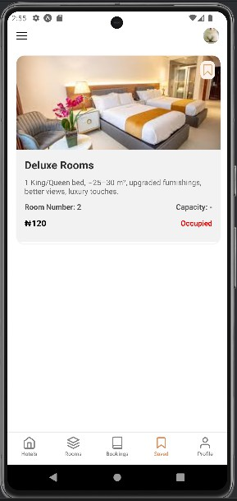
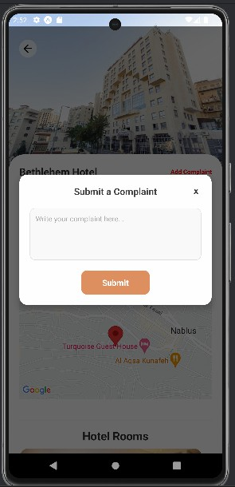
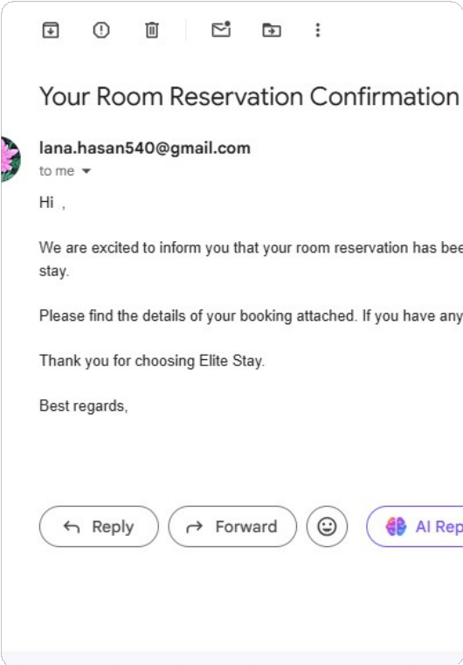
Guests/Clients
Save Room
Complaint
Booking
Booking Confirmation

Slide 14
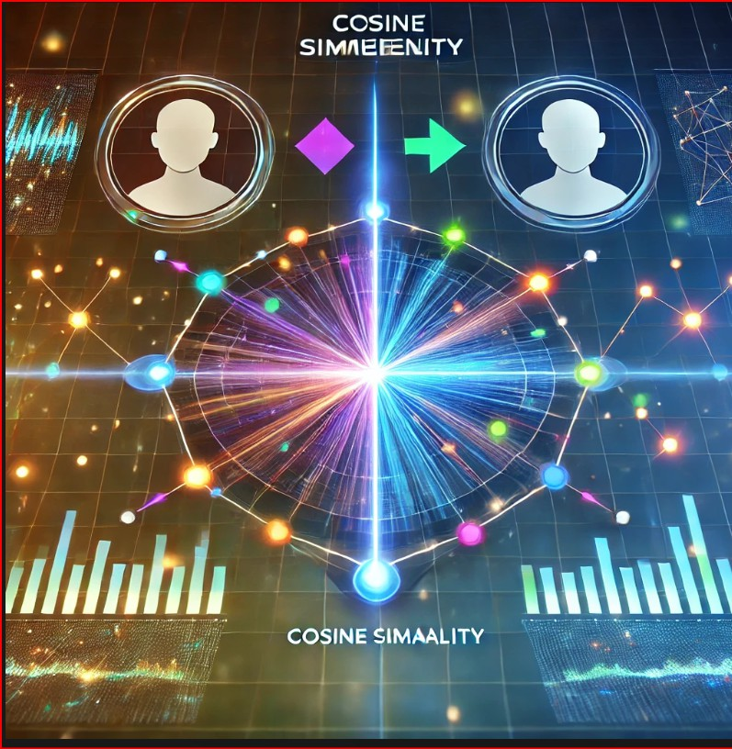
Guests/Clients

Slide 15
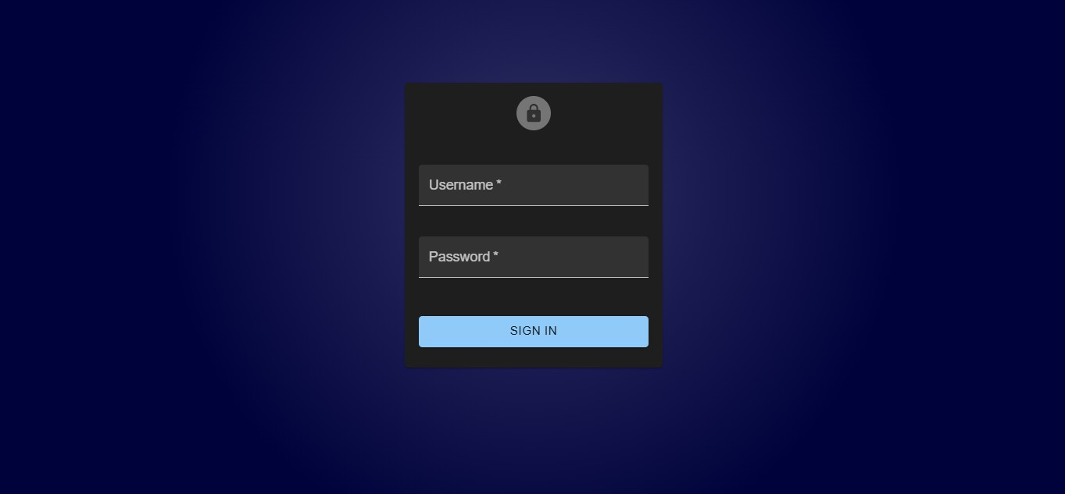
Hotel Owners & Admin
Login

Slide 16
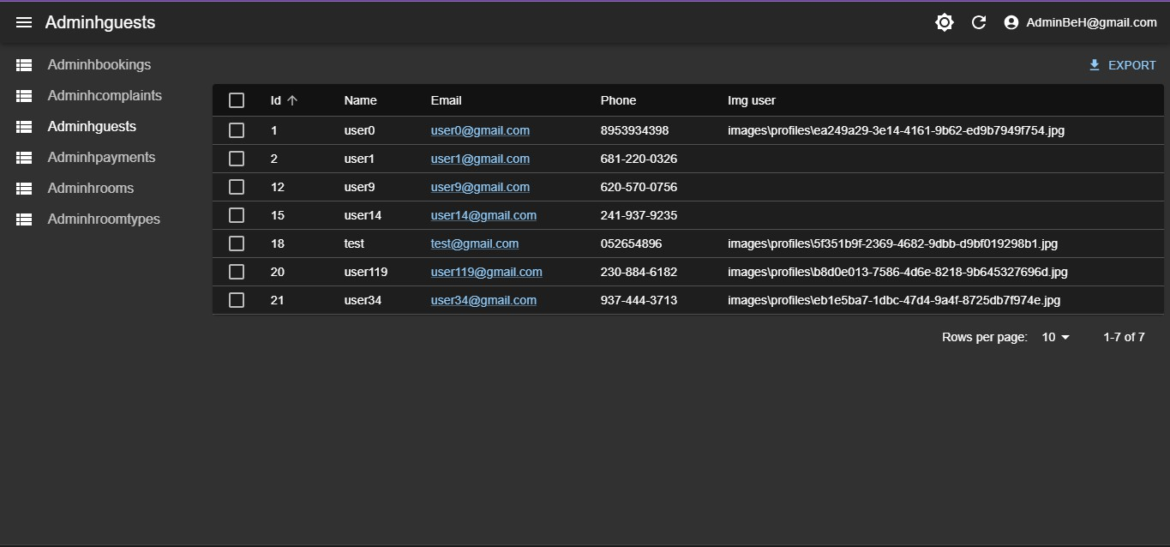
Hotel Owners
Complaint Table

Slide 17
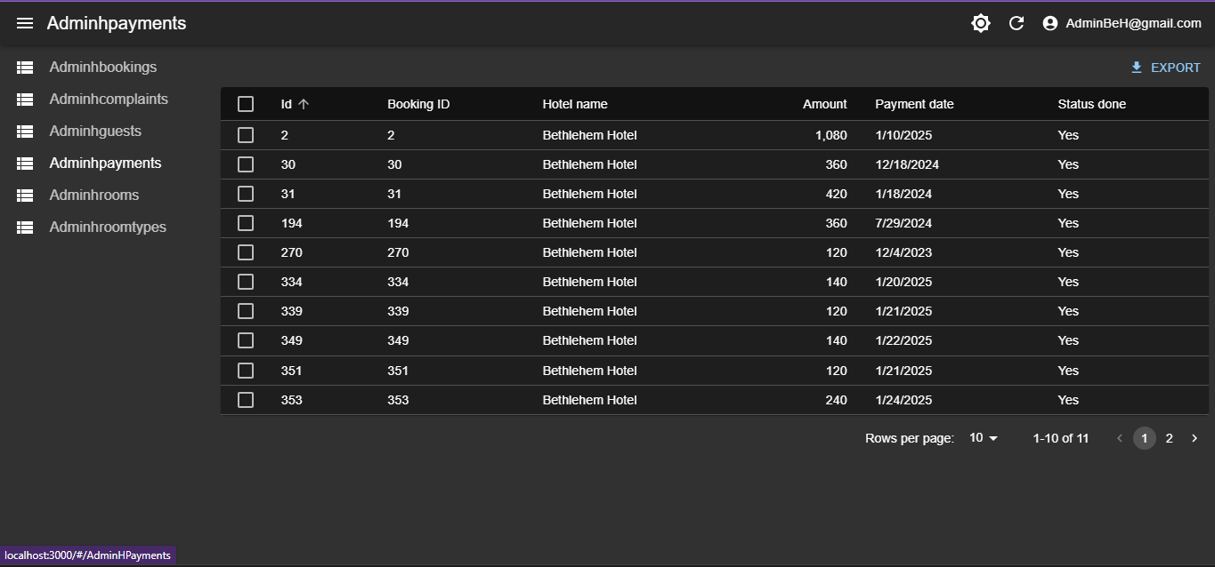
Hotel Owners
Payment Table

Slide 18
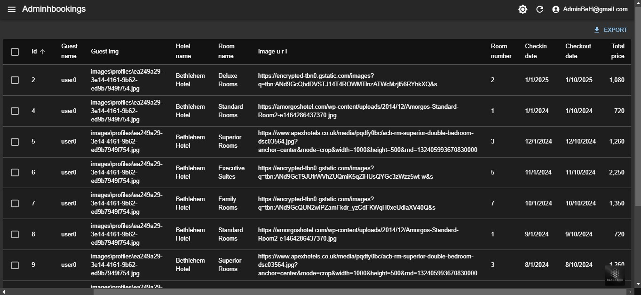
Hotel Owners
Booking Table

Slide 19
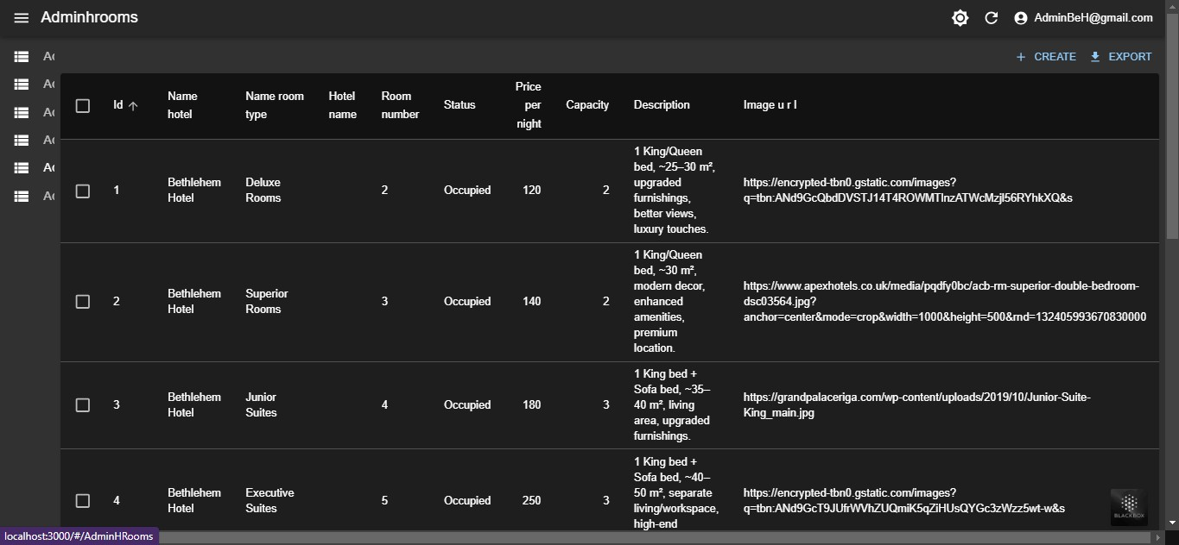
Hotel Owners
Room Table

Slide 20
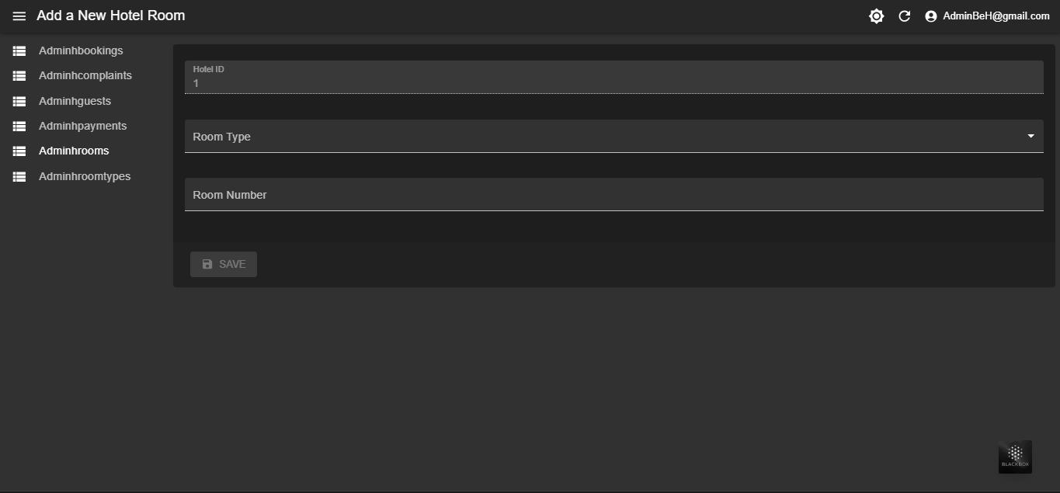
Hotel Owners
Add room in Hotel

Slide 21
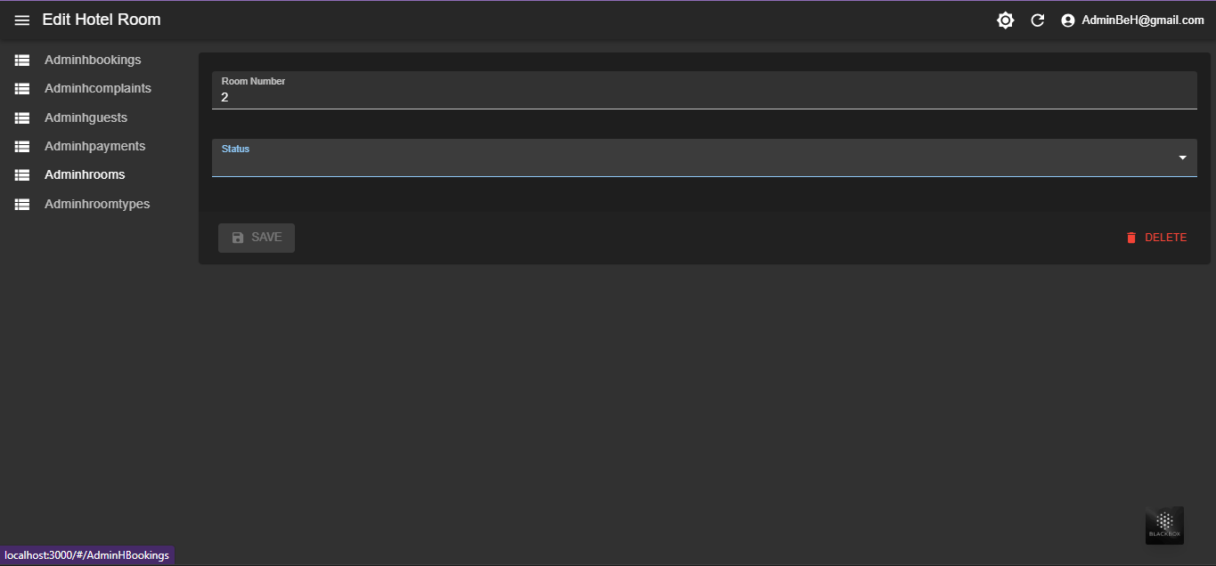
Hotel Owners
Edit Room

Slide 22
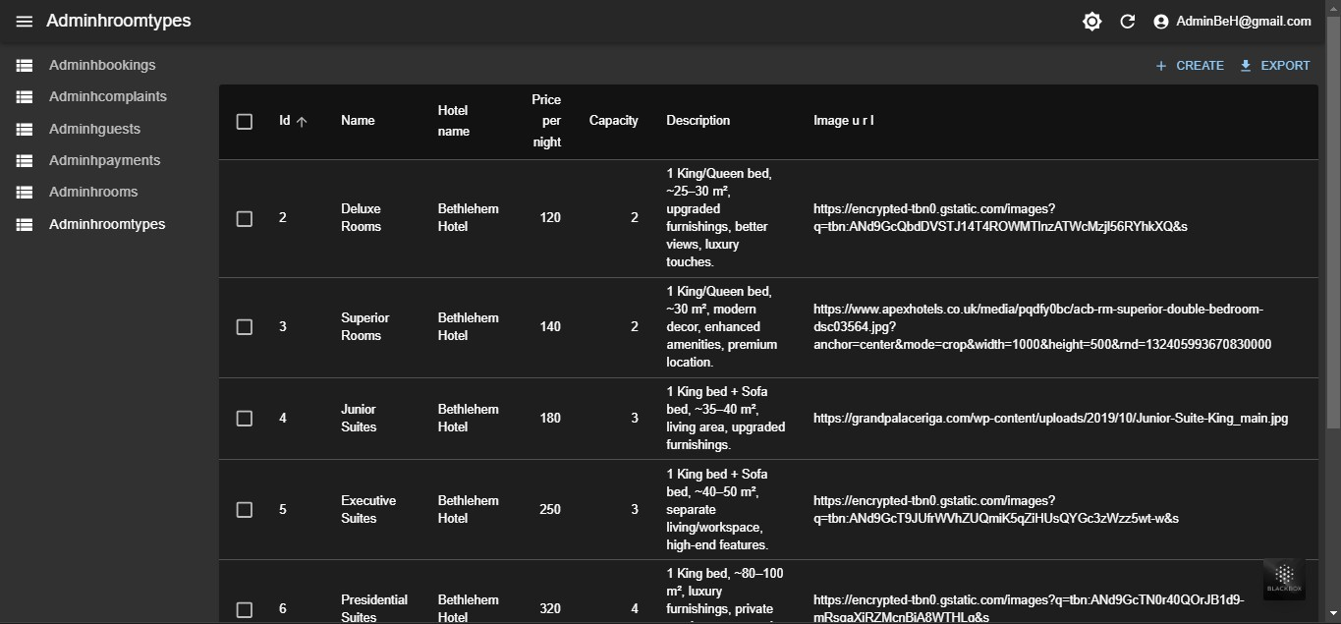
Hotel Owners
Room Type Table

Slide 23
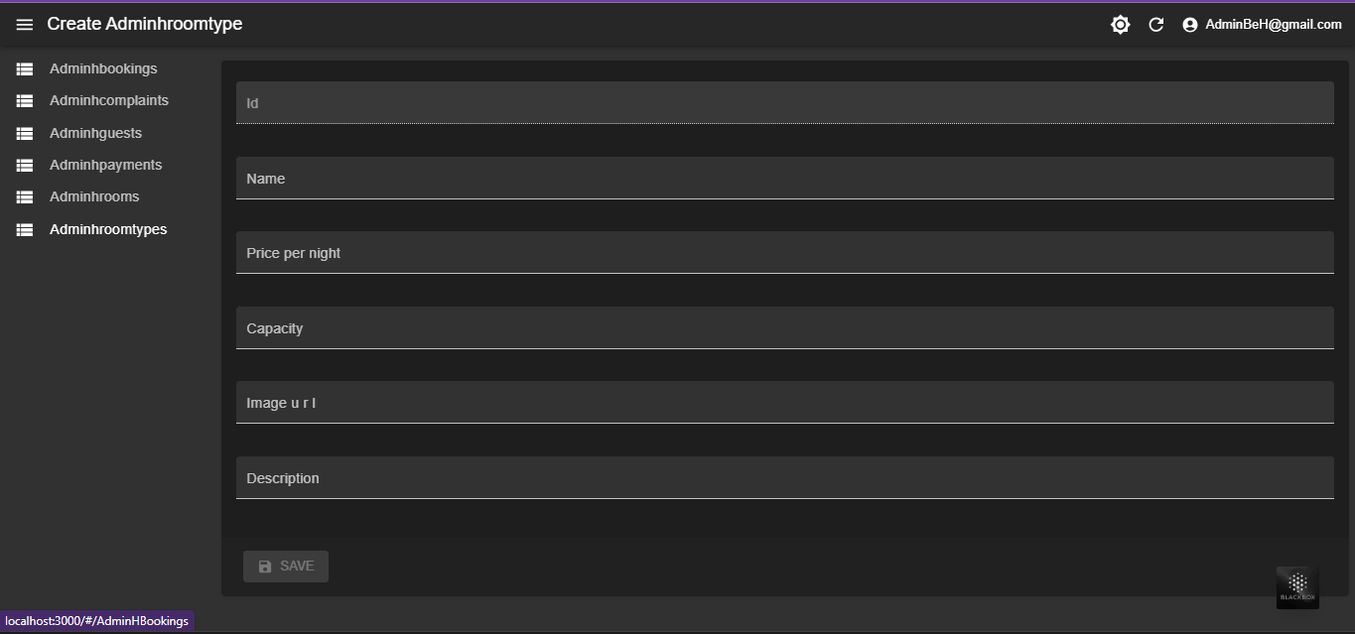
Hotel Owners
Add Room Type

Slide 24
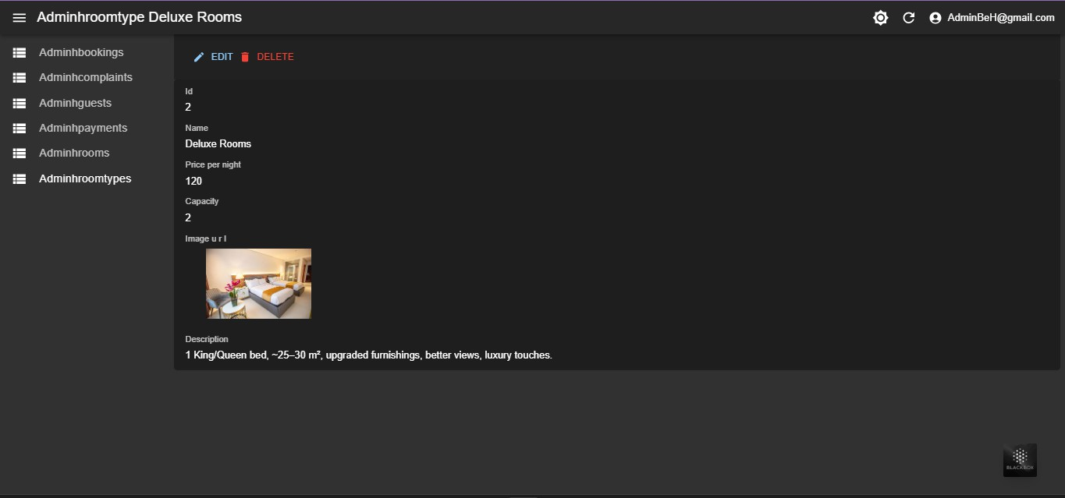
Hotel Owners
Edite Or Delete Room type

Slide 25
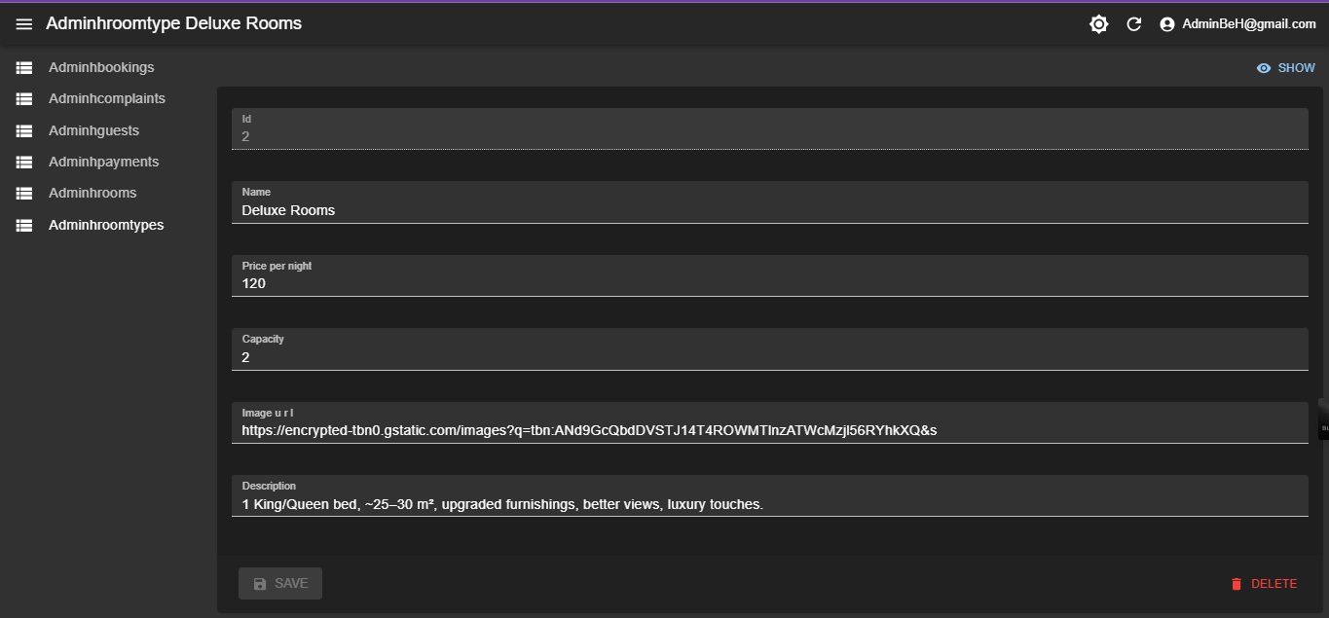
Hotel Owners
Edite Room Type Screen

Slide 26
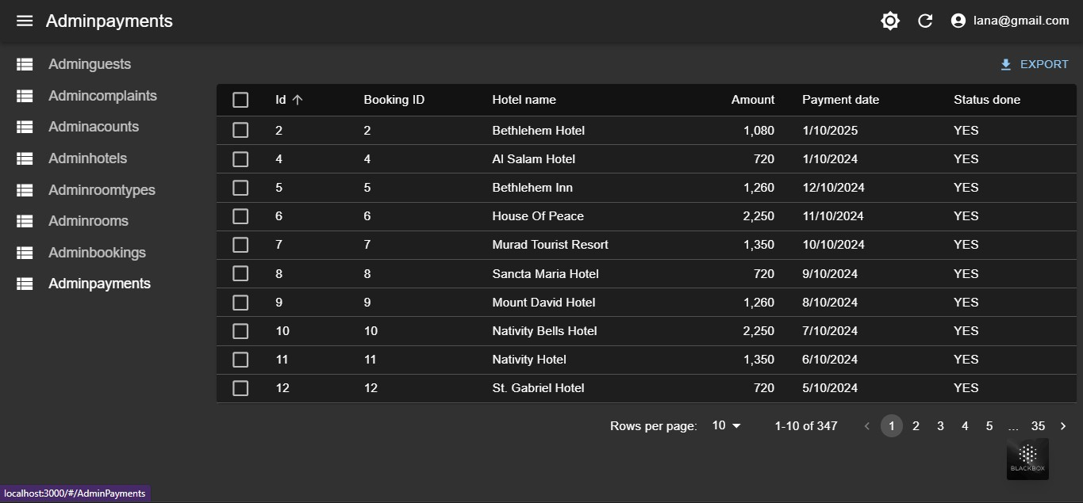
Admin
Payment Table

Slide 27
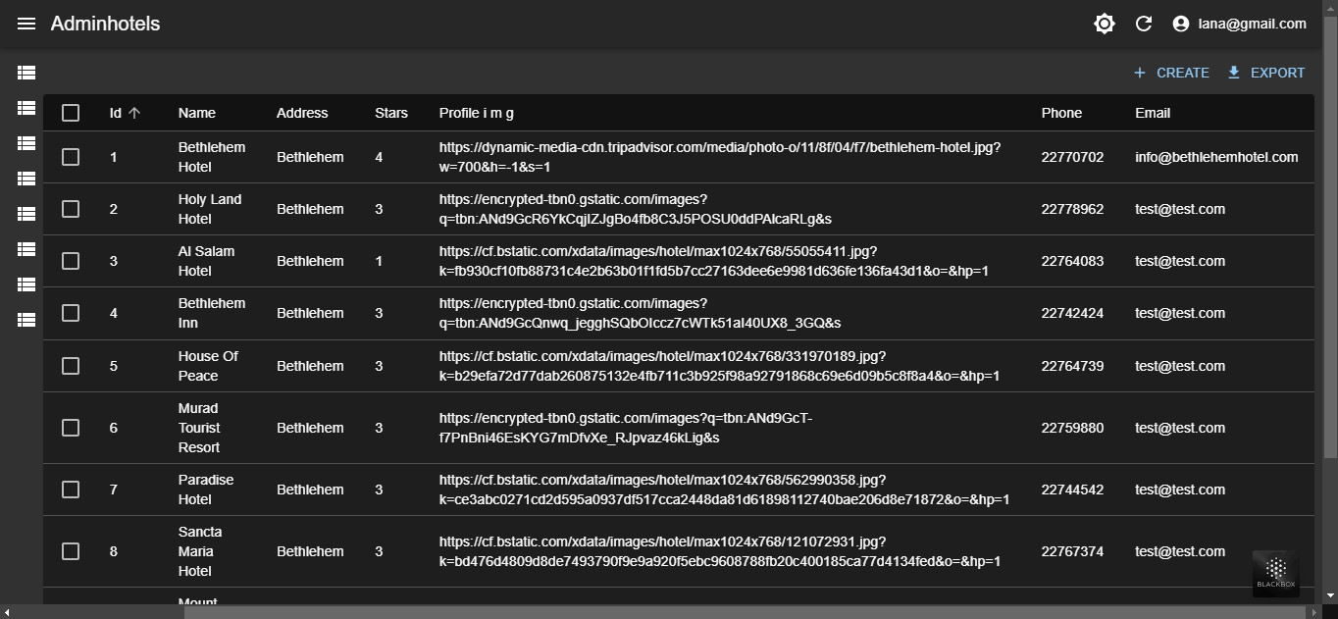
Admin
Hotel Table

Slide 28
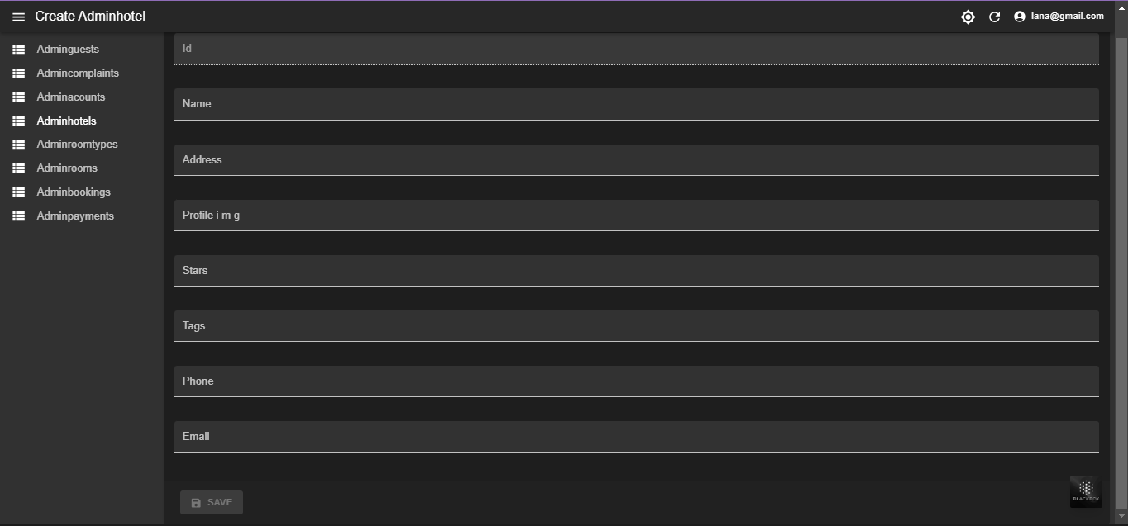
Admin
Add Hotel

Slide 29
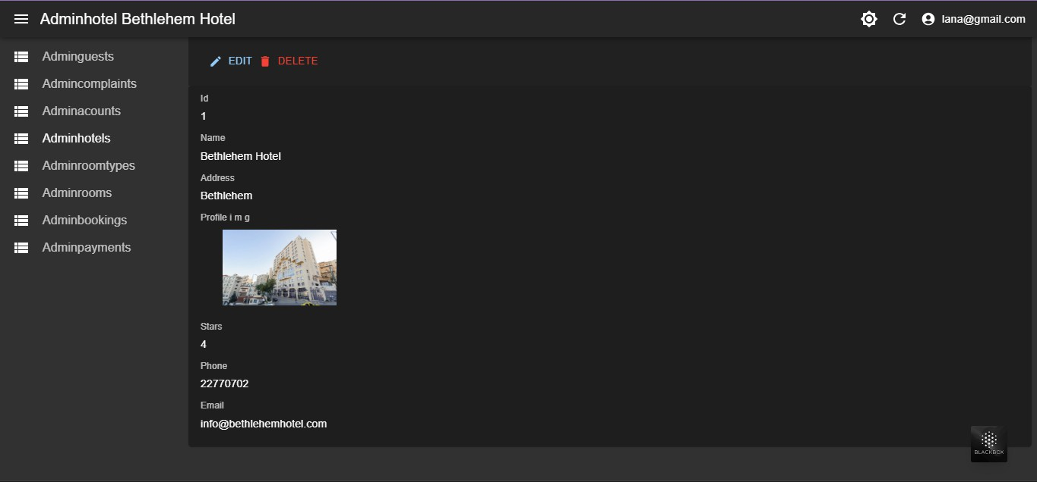
Admin
Edite Or Delete Hotel

Slide 30
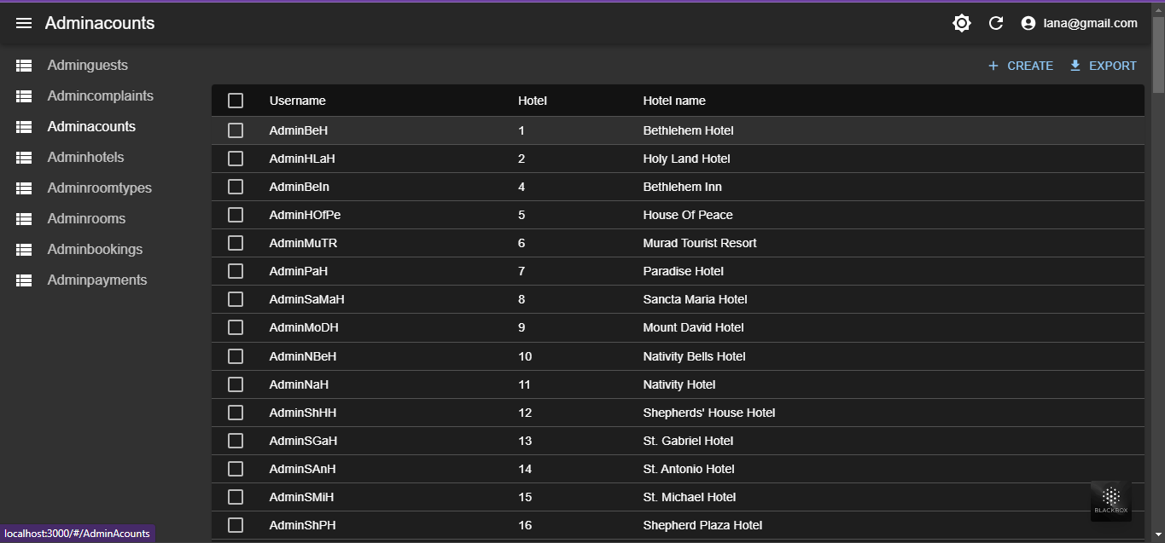
Admin
Admin and his Hotel

Slide 31
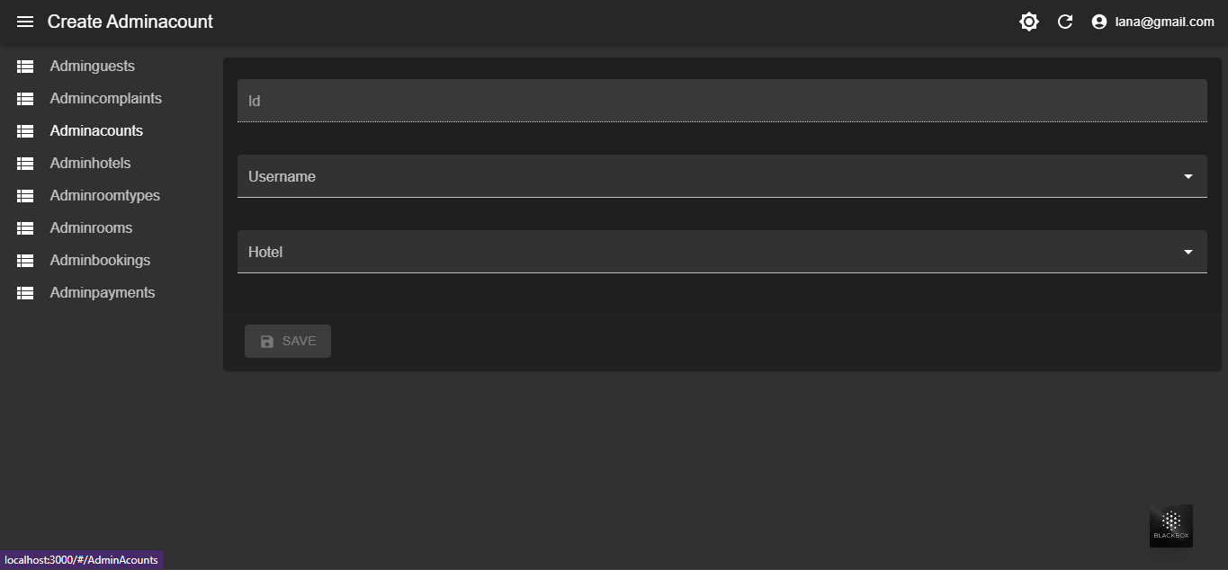
Admin
Add Admin for hotel

Slide 32

Future Work
Enhance offerings:
Multi-language support:
Sustainability aspects:

Slide 33

Thank You

