Slide 1
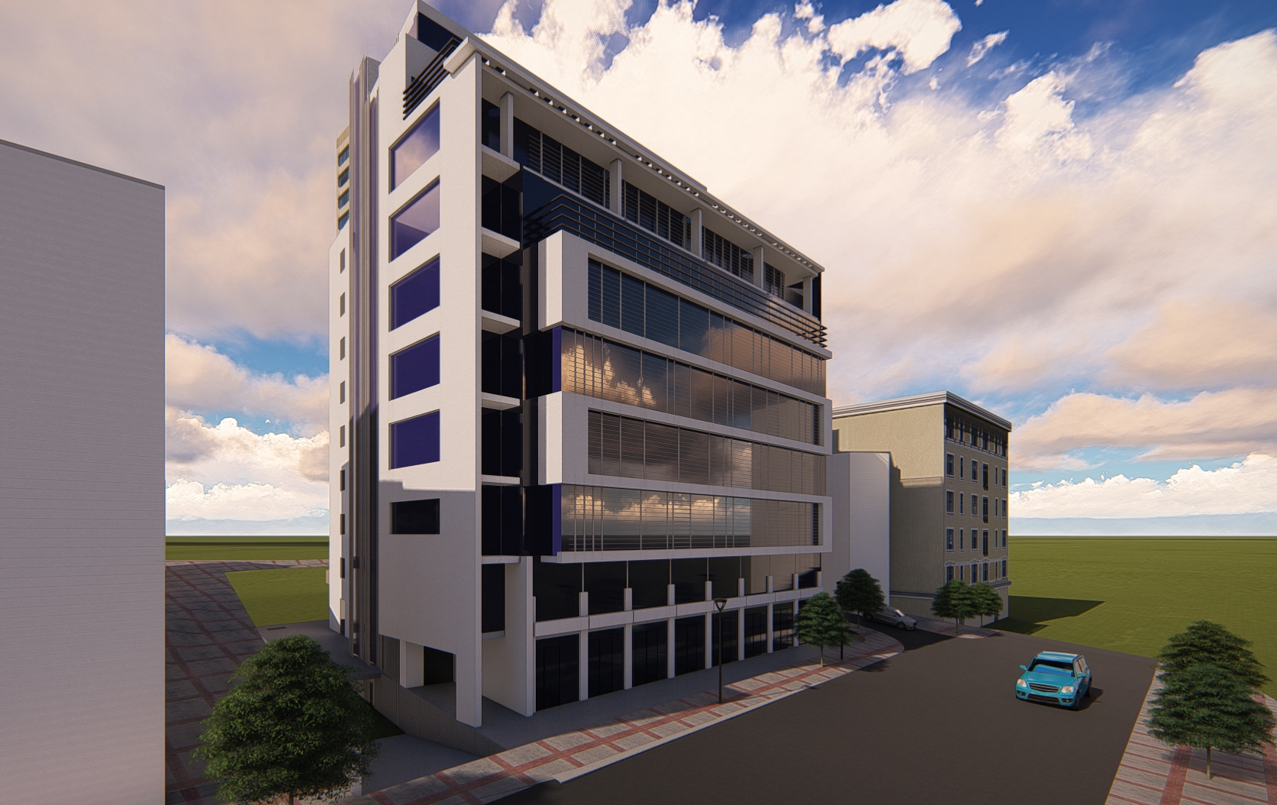

An-Najah National University
Building Engineering Department
Graduation Project – II
Integrated Re-design Ayesh office Building in Ramallah AL-Bireh
Sajeda Murad
Alaa dumaidi
Ahmad Kiwan
2020-2021
Supervised name: Dr. Nermen AlBarq

Slide 2
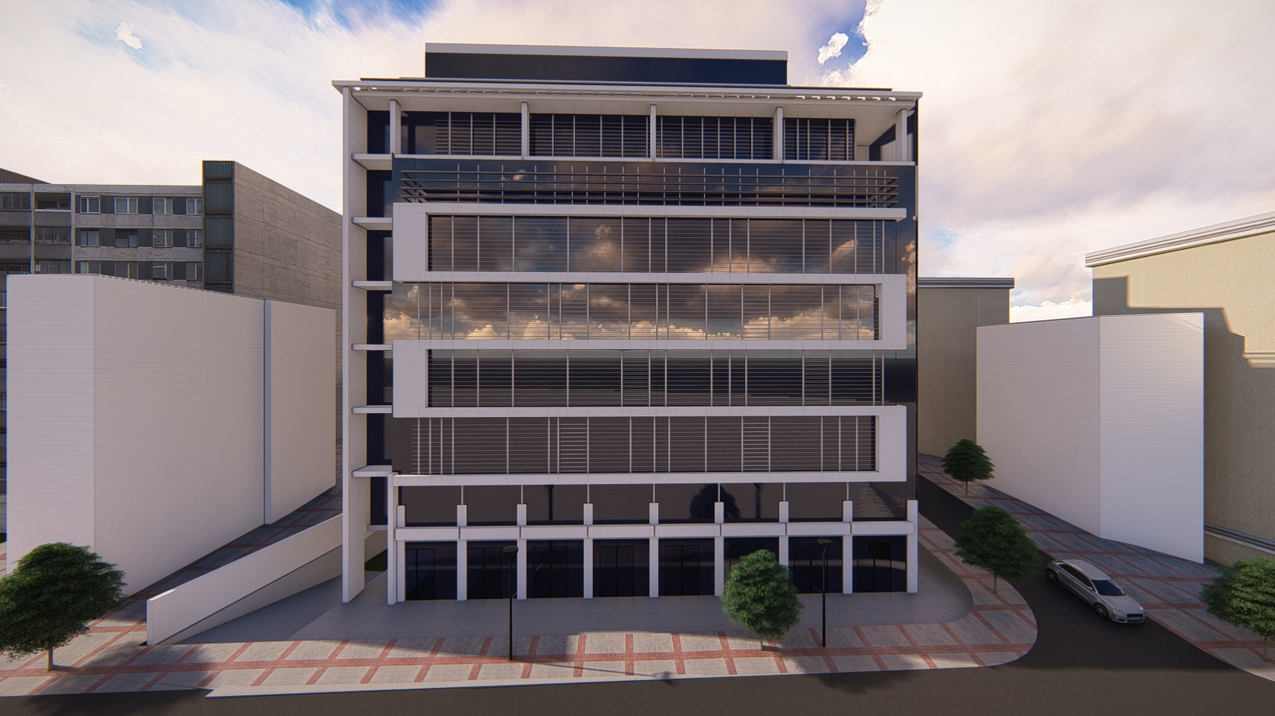
Table of Contents
Introduction of the project
Architectural aspects
Environmental aspects
Structural aspects
Electro-mechanical
Quantities

Slide 3
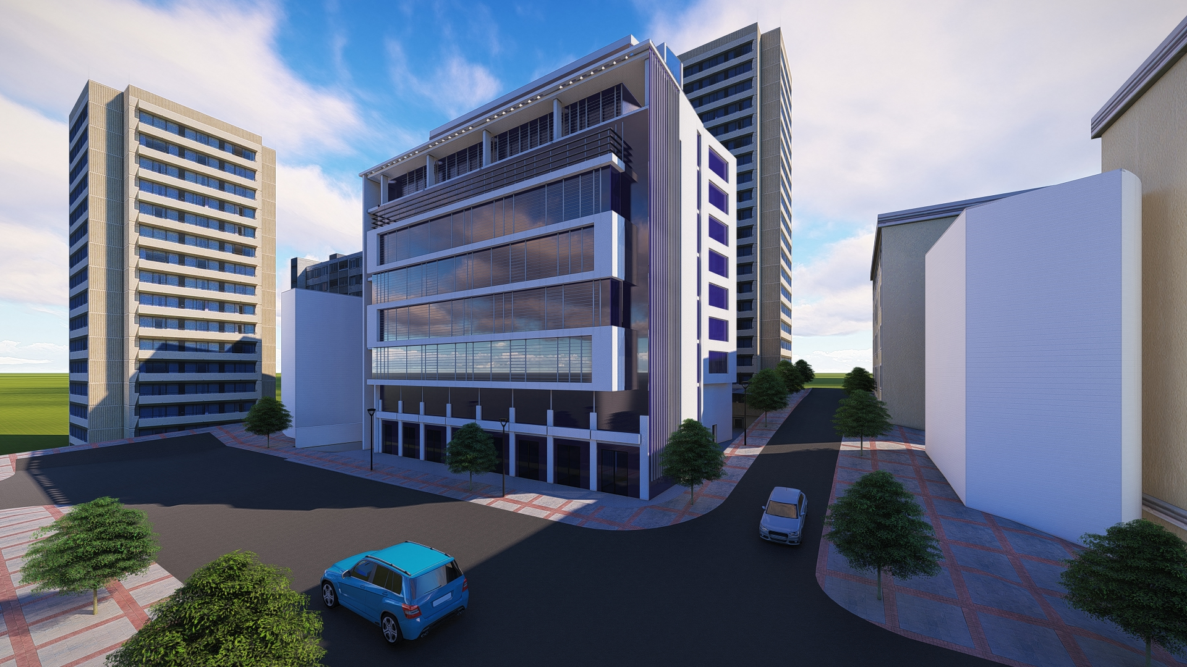
Introduction

Slide 4
Architectural design

Slide 5
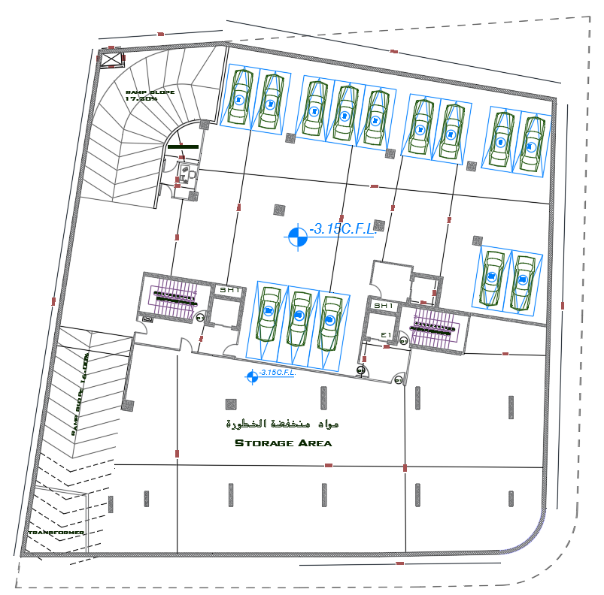
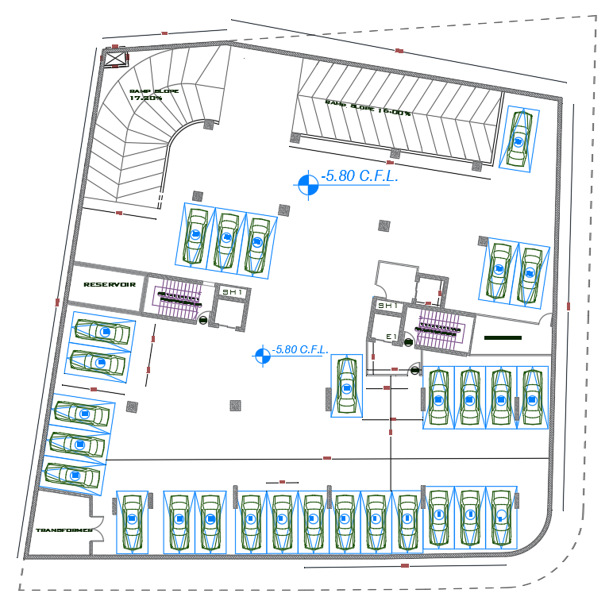
Basement Floor.

Slide 6
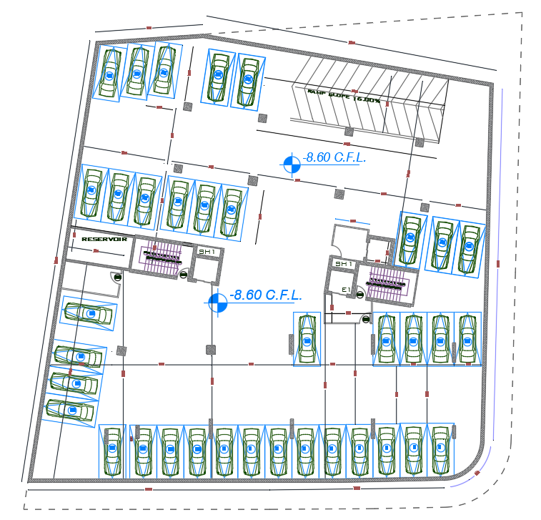

Slide 7
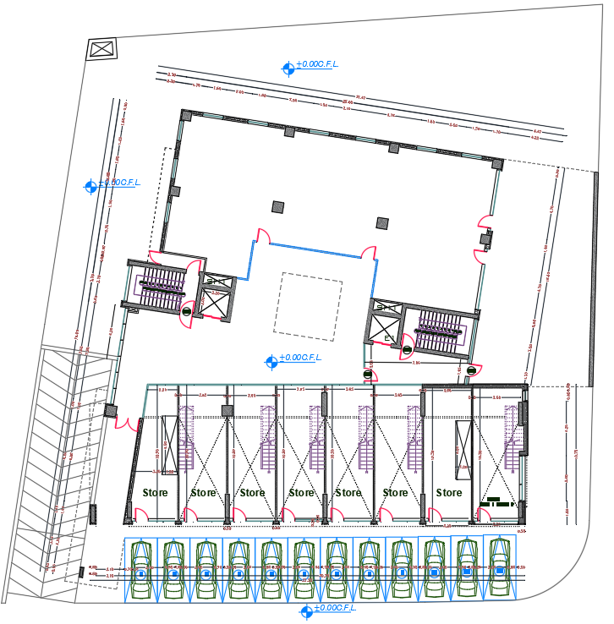
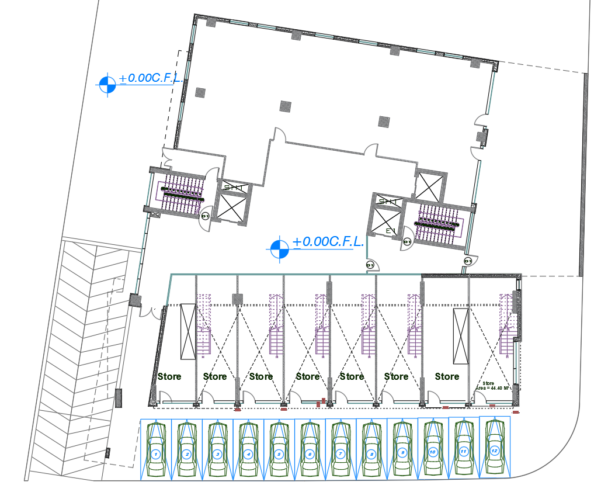
Ground Floor.
Before Modification.(Area 830 m2)
After Modification.(Area 830m2)

Slide 8
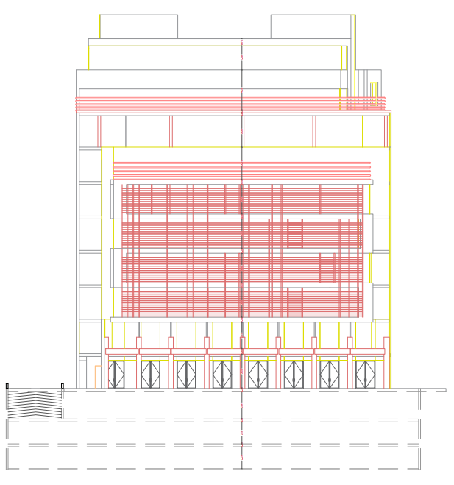
South Elevation.

Slide 9
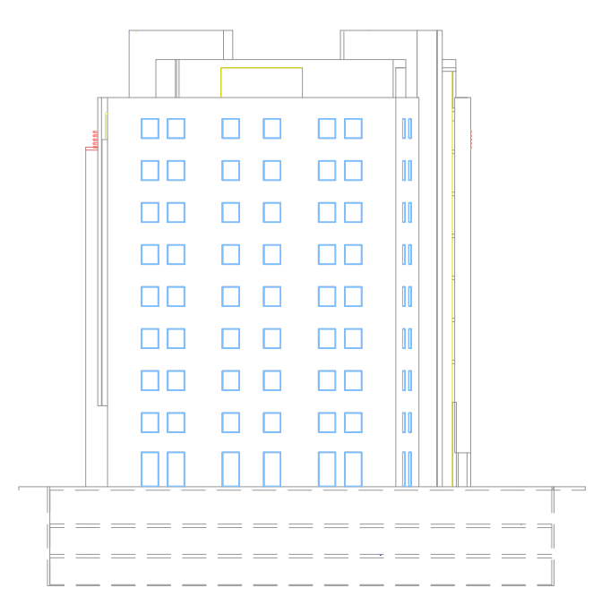
North Elevation.

Slide 10
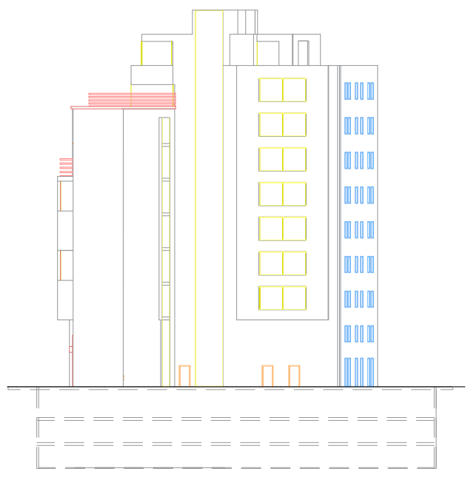
West Elevation.

Slide 11
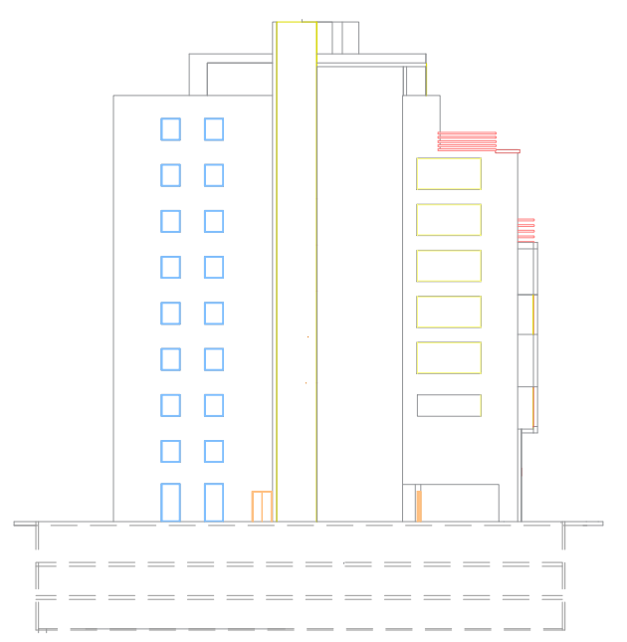
East Elevation.

Slide 12


3 D VIEW

Slide 13
Environmental design
Environmental Adjustments
Daylighting
Thermal analysis
HVAC design

Slide 14
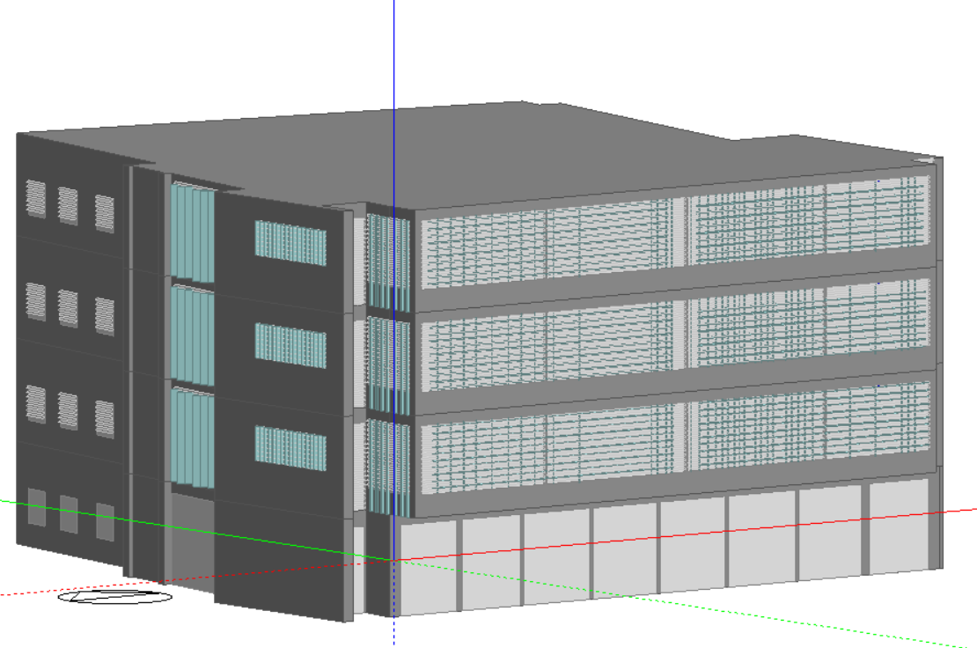
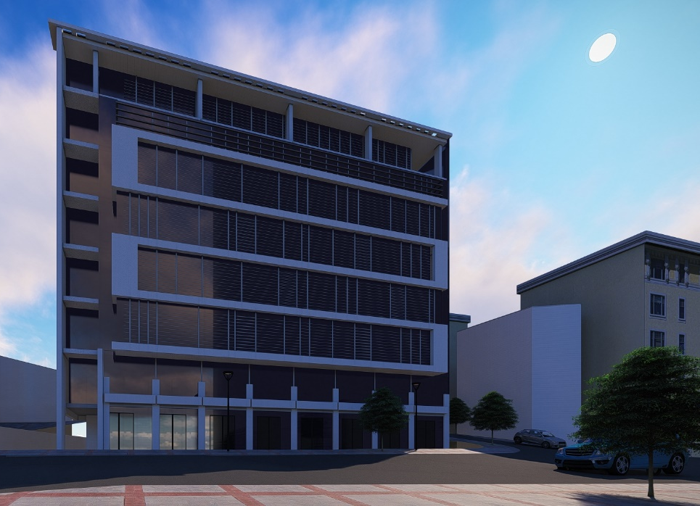
Environmental Adjustments
Horizontal louvers were added on the south elevation.
Vertical louvers were added on the west & east elevations.
the external wall, roof ,floor were isolated to get the required U value.
The double class used

Slide 15
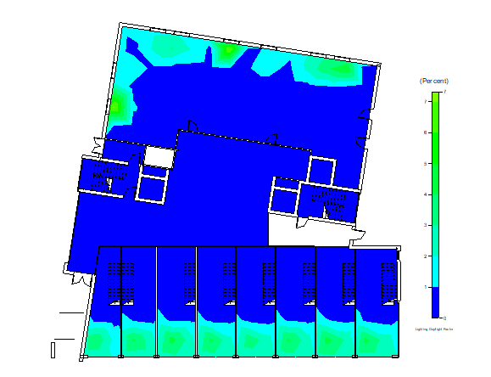
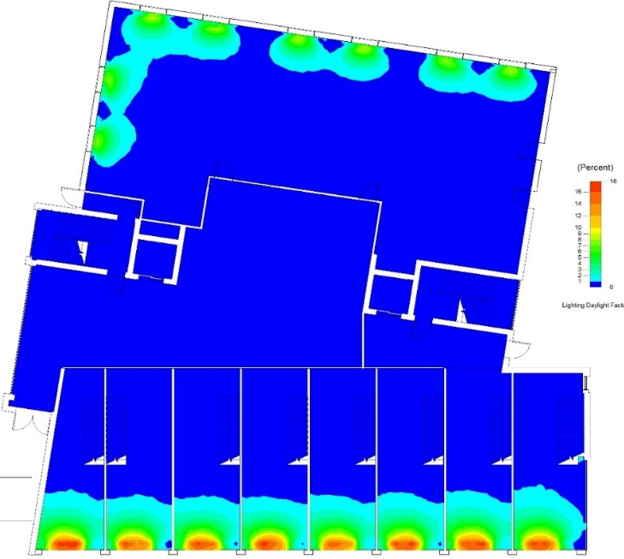
Daylighting
before
after

Slide 16
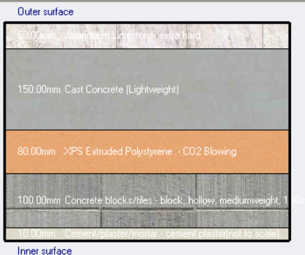
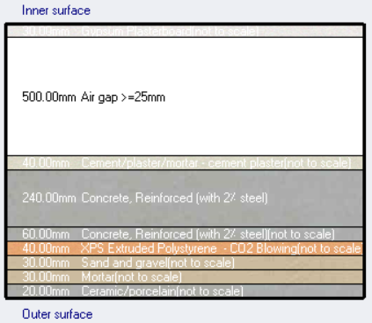
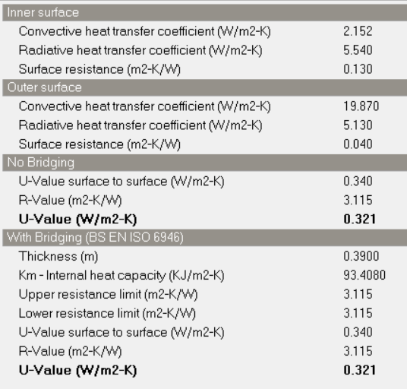
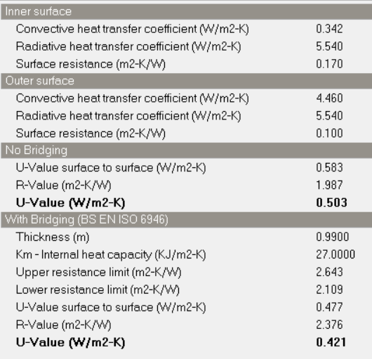
Elemental properties of structural and material layers within the element:
External wall
Floor
U-value for external wall =0.321<0.5
U-value for floor = 0.421<0.85

Slide 17
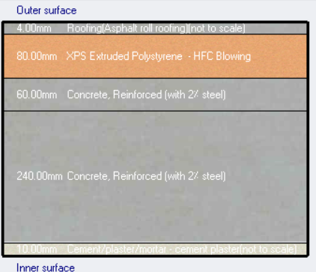
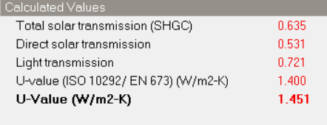
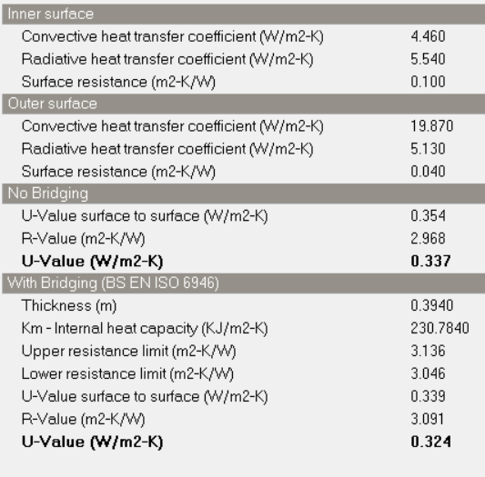
Elemental properties of structural and material layers within the element:
Window
Roof
(double glazing, low Clr 6mm/6mm XENON)
U-value for roof =0.324<0.39

Slide 18
Thermal analysis
Results for heating & cooling load analysis after adjustment :
Block | Design cooling Capacity (kW) | Design Heating Capacity (kW)
Totals | 723.87 | 325.64

Slide 19
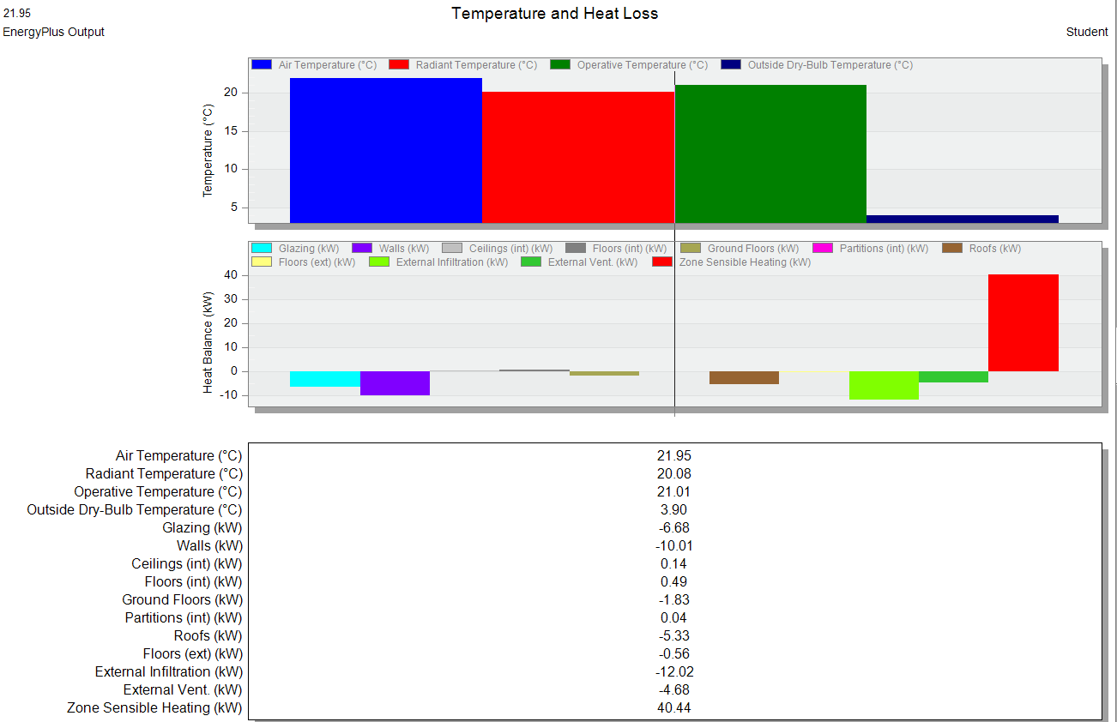
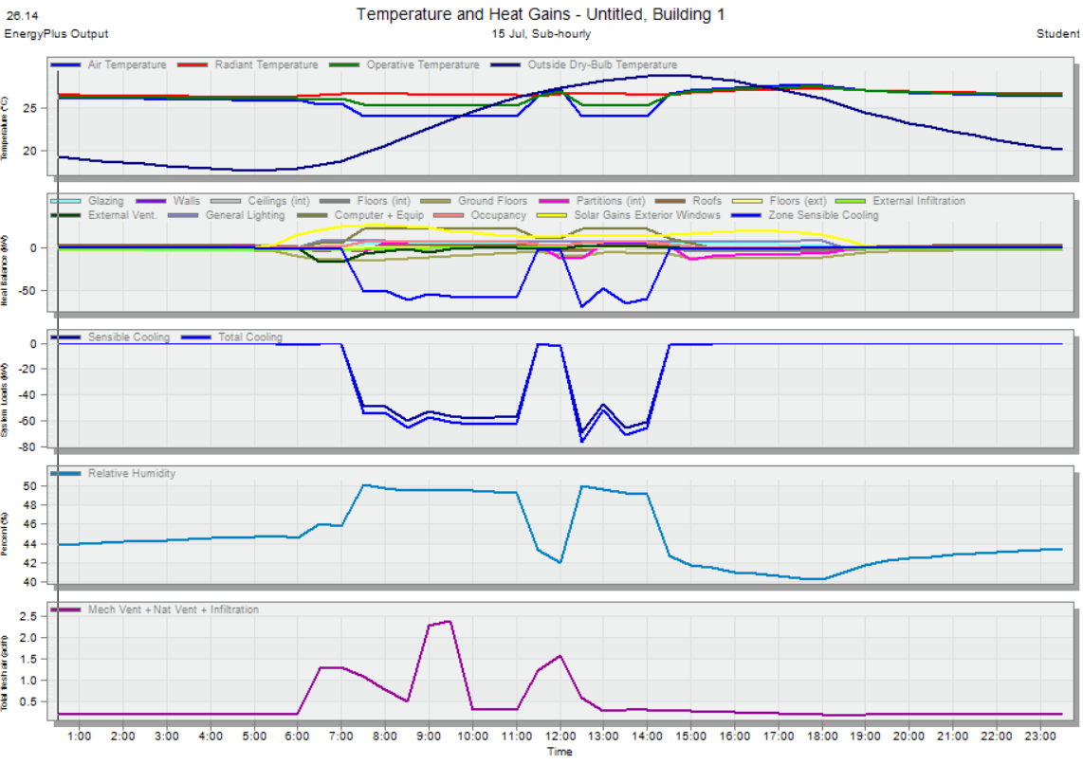
Thermal analysis
Results for heating load analysis
Total heating load =325.64 KW
Design heating Load Per Floor Area= 27.38(W/m2) =
Results for cooling load analysis
Total cooling load =723.87 kw
Design Cooling Load Per Floor Area
(W/m2) =60.8W

Slide 20
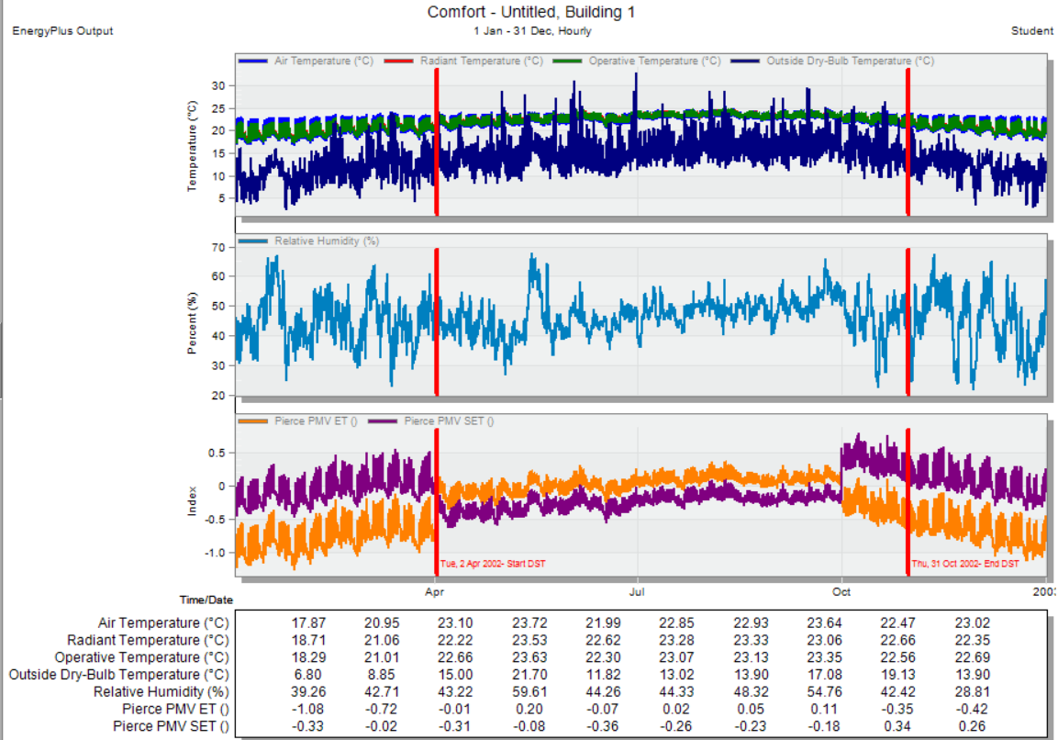
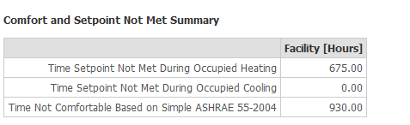
Thermal analysis
comfort results
The number of non-comfort hours in the building:

Slide 21
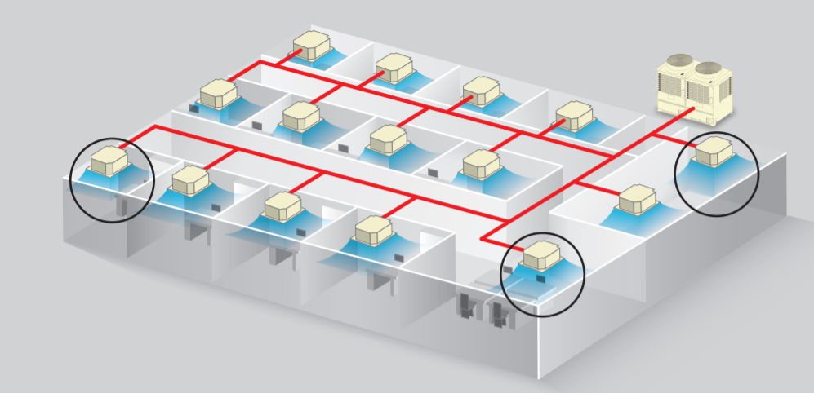
HVAC System
From the Design Builder program:
Total Heating Load = 325.64 kW.
Total Cooling Load = 723.87 kW.
Total Flowrate = 46004 L/s.
Design Flow Rate (m3/s) | Humidity (%) | # Of out door unit
46.004 | 49.2 | 6

Slide 22

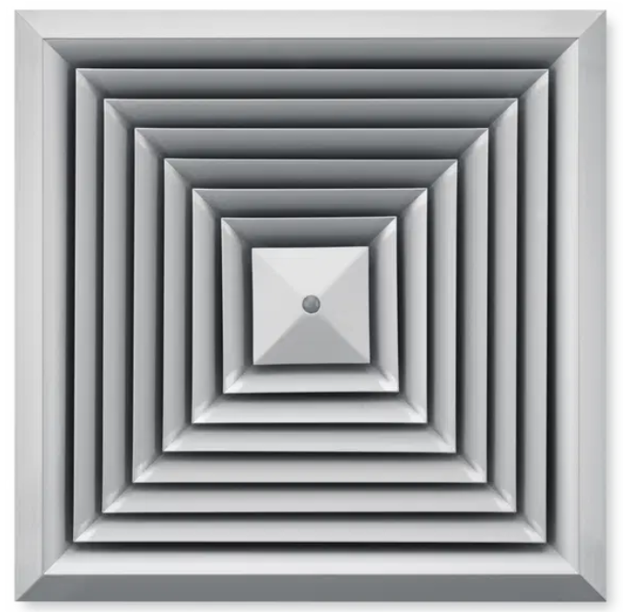
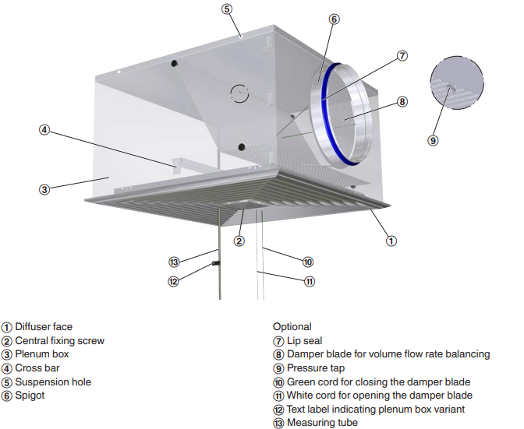
HVAC System
Outdoor unit :
6VRF unit with capacity 135 KW
Indoor unit:
AP4814HT8P-E
Diffuser
VRF units AP4814HT8P-E
Rectangular diffuser ).3X.3M)

Slide 23
HVAC System
Supply diffusers
Return diffusers
Block | Zone | Design Flow Rate (m3/s) | Design Capacity (kW)Cooling | Design Capacity (kW) Heating | Floor Area (m2) | No. Diffuser | 76 | L/S from catalogue
G.F | Storage | 0.1171 | 1.74 | 1.18 | 27.7 | 1 | 400 | 385
 | Storage | 0.1292 | 1.92 | 1.34 | 32.1 | 2
 | Storage | 0.1261 | 1.91 | 1.3 | 31.4 | 2
 | Storage | 0.1259 | 1.87 | 1.31 | 31.1 | 2
 | Storage | 0.1440 | 2.14 | 1.44 | 36.6 | 2
 | Storage | 0.1439 | 2.18 | 1.39 | 34.9 | 2
 | Storage | 0.1989 | 2.99 | 1.98 | 37 | 2
 | Zone 4 | 0.0074 | 0.12 | 0.05 | 2.6 | 1
 | W.C | 0.0079 | 0.13 | 0.07 | 3 | 1
 | W.C | 0.0074 | 0.11 | 0.06 | 2.6 | 1
 | W.C | 0.0094 | 0.14 | 0.08 | 3.1 | 1
 | Office | 0.2236 | 3.38 | 2.27 | 52 | 3
 | Stair & elevator | 0.2041 | 3.23 | 1.53 | 51 | 3
 | room( Storage) | 0.9617 | 15.48 | 6.55 | 228.8 | 11
 | Carddor | 0.4937 | 8.1 | 2.98 | 137.3 | 7
 | Stair & elevator | 0.1212 | 2.01 | 0.92 | 38.1 | 2
FF | Stair & elevator | 0.3299 | 5.24 | 1.71 | 71 | 4
 | Carddor | 0.4868 | 7.76 | 2.07 | 110.6 | 6
 | Office | 0.1586 | 2.52 | 0.9 | 33 | 2
 | Office | 0.2487 | 3.83 | 2.09 | 48.4 | 2
 | Stair & elevator | 0.0852 | 1.18 | 0.69 | 38.6 | 2
 | Office | 0.2125 | 3.37 | 1.43 | 46.3 | 2
 | Office | 0.1604 | 2.55 | 0.8 | 34.4 | 2
 | Office | 0.1341 | 2.12 | 0.7 | 28.4 | 1
 | Office | 0.2021 | 3.21 | 1.41 | 43.7 | 2
 | Office | 0.4635 | 7.18 | 2.96 | 91.6 | 5
 | Office | 0.3560 | 5.69 | 2.41 | 92.8 | 5
 | Office | 0.3933 | 6.29 | 2.61 | 103.4 | 5
 | Office | 0.3192 | 4.99 | 2.29 | 71.6 | 4
 | Totals | 6.5720 | 103.41 | 46.52 | 1563.2

Slide 24
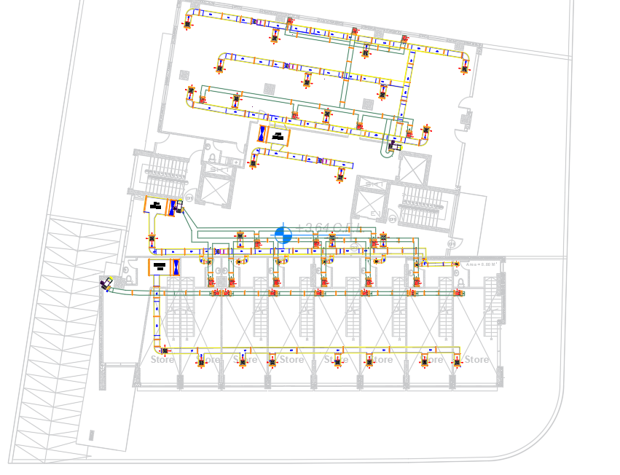
HVAC System

Slide 25
Structural Design

Slide 26
Load material and code Data:
Load :
Type of load | Load considered (KN/m²)
Live load | 3.5 KN/m2
Live load ( Basement floor) | 3.5 KN/m2
Superimposed dead load | 5.96KN/m2
Partitions dead load /m height | 1.66 KN/m2
Materials Data
Construction materials that were used in the building:
For slab and beam use concrete B300 with fʹc =24 MPa.
For column and shear wall & mat foundation use concrete B350 with fʹc =28MPa.
Steel reinforcements with yielding strength fy=420MPa.
Design Codes:
ASCE: American society of civil engineers.
ACI 318-14: American concrete institute 2014.
Jordanian National Building Codes - Loads and Forces Code.
UBC-97 For seismic design

Slide 27
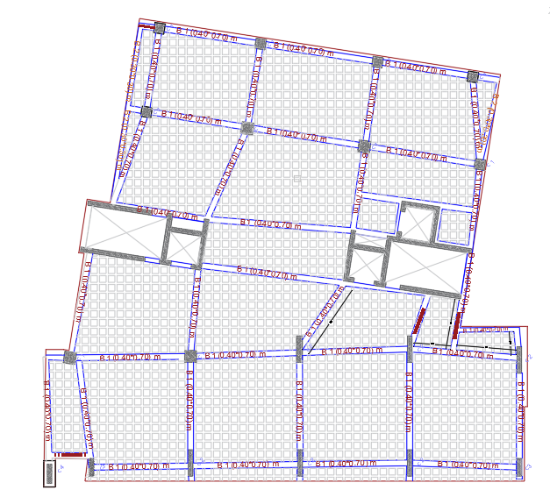
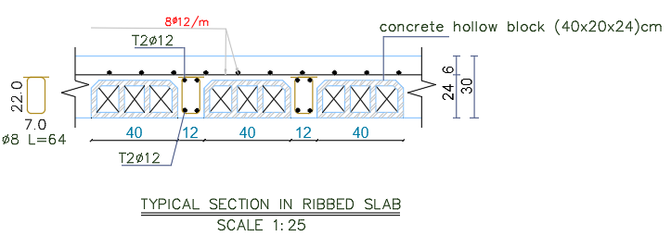
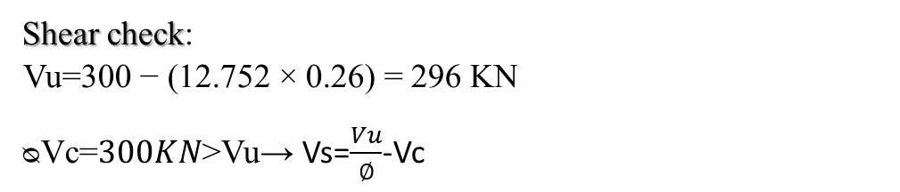
  The structural system of Slab
-Slab thickness design :
Two Way ribbed slab H=300mm.
Shear check:
Vu$\text{=}\text{300 }\text{− (}\text{12.752 }\text{×} \text{0.26}\text{) = }\text{296 }\text{KN}$
ᴓVc=$300KN$˃Vu→ Vs=$\frac{Vu}{∅}$-Vc

Slide 28
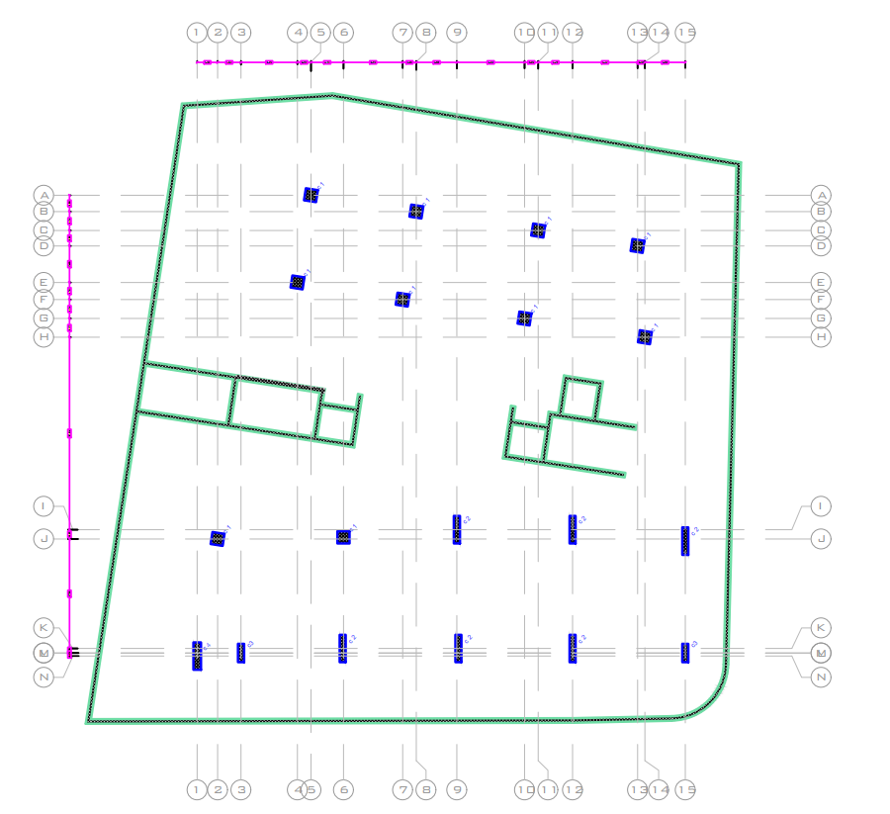
Column distribution :
Dimensions of Columns
column type |  | length (cm) | width (cm)
rectangular | c1 | 180 | 30
 | c2 | 180 | 40
 | c3 | 80 | 80
 | c4 | 180 | 80

Slide 29
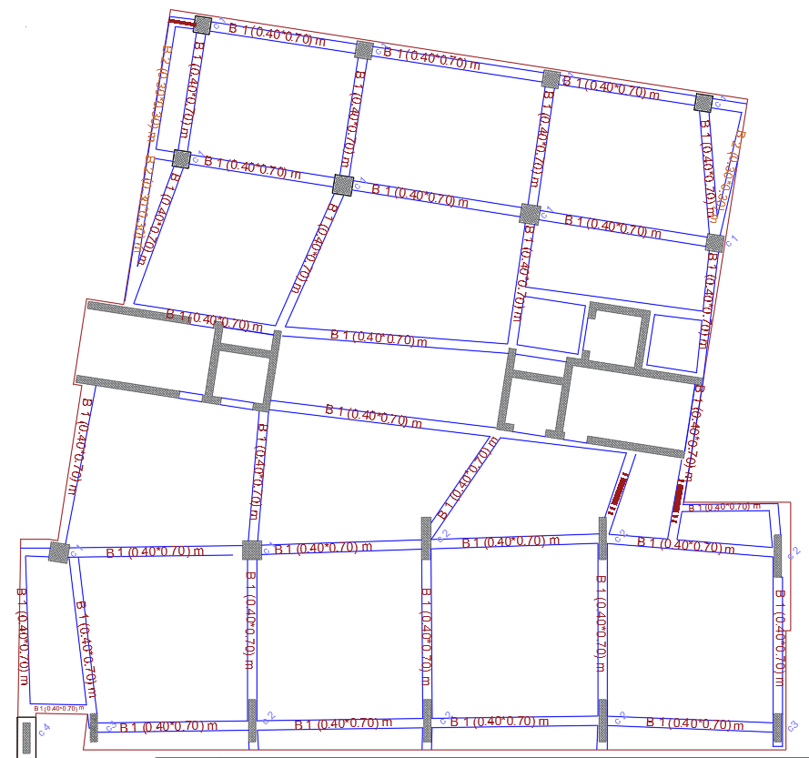
Dimensions of Beams
Beam design in B3, B2,B1
Beam | Width | Depth | Effective depth
B1 | 400 | 700 | 640
Beam design in GF, FF,SF UP to Roof
Beam | Width | Depth | Effective depth
B1 | 400 | 700 | 640
B2 | 300 | 700 | 640

Slide 30
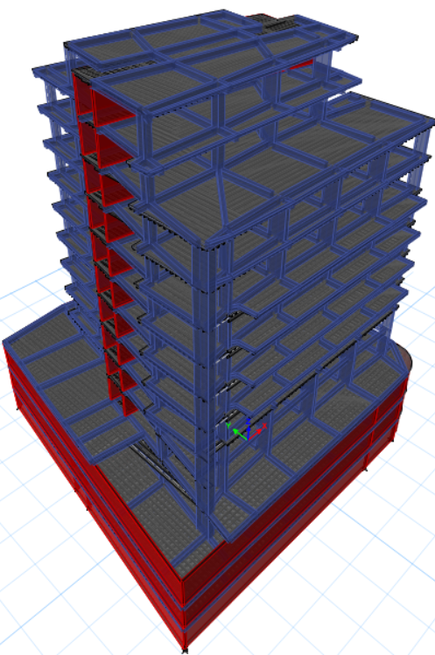
Structural analysis
Checks
Compatibility check
Equilibrium check
Stress σ & Strain ɛ check
Period check
Base shear check
Drift check

Slide 31
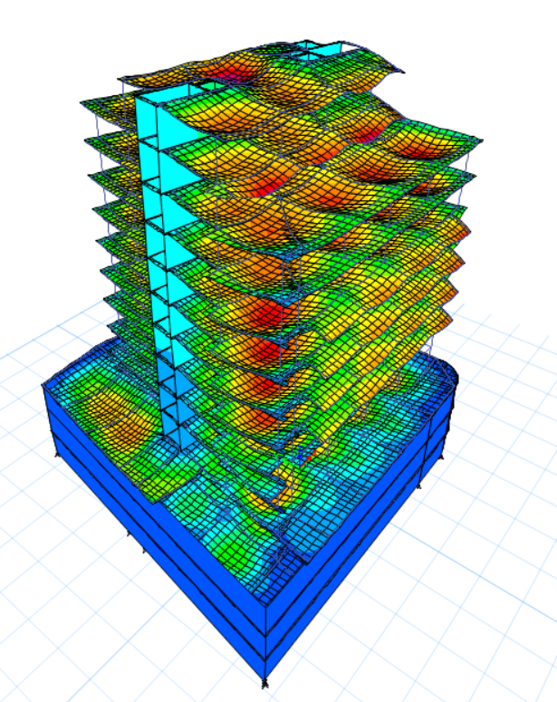
Compatibility check and Period
Period check.
Case | Mode | Period | UX | UY | UZ | Sum UX | Sum UY
 |  | sec
Modal | 1 | 1.437 | 0.0001 | 0.1941 | 0 | 0.0001 | 0.1941
Modal | 2 | 1.221 | 0.045 | 0.2578 | 0 | 0.0451 | 0.4519
Modal | 3 | 1.139 | 0.4326 | 0.0305 | 0 | 0.4777 | 0.4823
Modal | 4 | 0.384 | 6.62E-06 | 0.0138 | 0 | 0.4777 | 0.4961
Modal | 5 | 0.285 | 0.0017 | 0.1235 | 0 | 0.4794 | 0.6195
Modal | 6 | 0.224 | 0.146 | 0.0017 | 0 | 0.6255 | 0.6212
Modal | 7 | 0.202 | 0.005 | 1.73E-05 | 0 | 0.6305 | 0.6212
Modal | 8 | 0.195 | 0 | 0.0008 | 0 | 0.6305 | 0.6221
Modal | 9 | 0.192 | 0 | 0.0004 | 0 | 0.6305 | 0.6225
Modal | 10 | 0.188 | 0.0006 | 0.0041 | 0 | 0.6311 | 0.6266
Modal | 11 | 0.164 | 9.65E-06 | 0.0035 | 0 | 0.6311 | 0.6301
Modal | 12 | 0.136 | 0.0002 | 0.0273 | 0 | 0.6313 | 0.6574
T =1.4 × Ct (hn) ^{¾}
T =1.4 × 0.0488 (52) ^{¾} =1.51 Sec.
𝑇𝑒𝑡𝑎𝑏𝑠 𝑠ℎ𝑜𝑢𝑙𝑑 𝑏𝑒 ≤ 𝑇𝑚𝑒𝑡ℎ𝑜𝑑𝑎
𝑇𝑥 = 1.437 < 1.51 → 𝑂𝐾.
𝑇𝑦 = 1.221 < 1.51 → 𝑂𝐾.

Slide 32
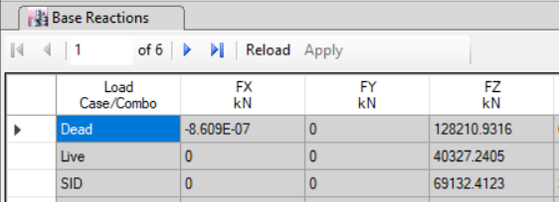
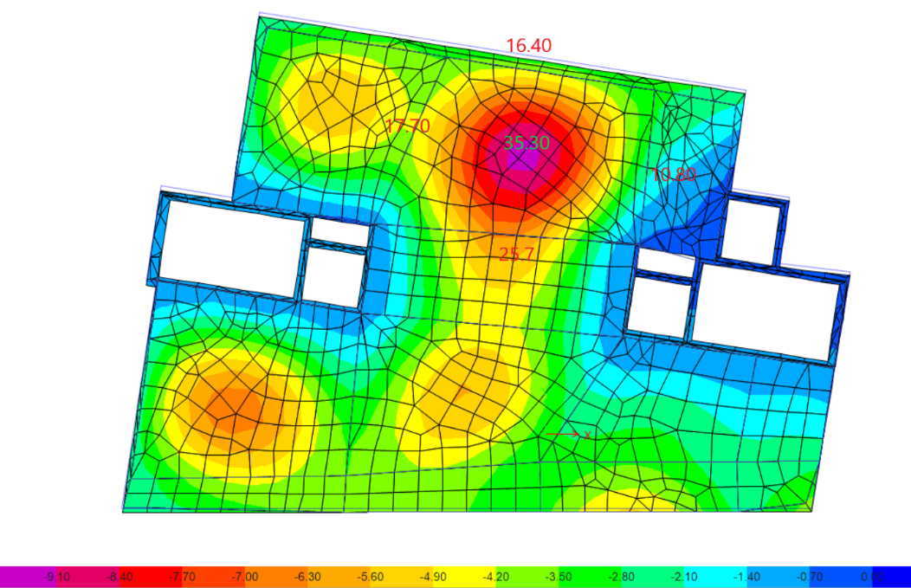
Equilibrium check:
Error % Doesn’t exceed 5 %
Deflection check:
Maximum deflection calculate by Etabs from serves =36.75< 45mm .
 | load | from etabs | from manual | error
live load | 3.5 | 40323.24 | 40056.07 | 0.66%
SID load | 5.96 | 69132.4 | 68667.54 | 0.67%

Slide 33
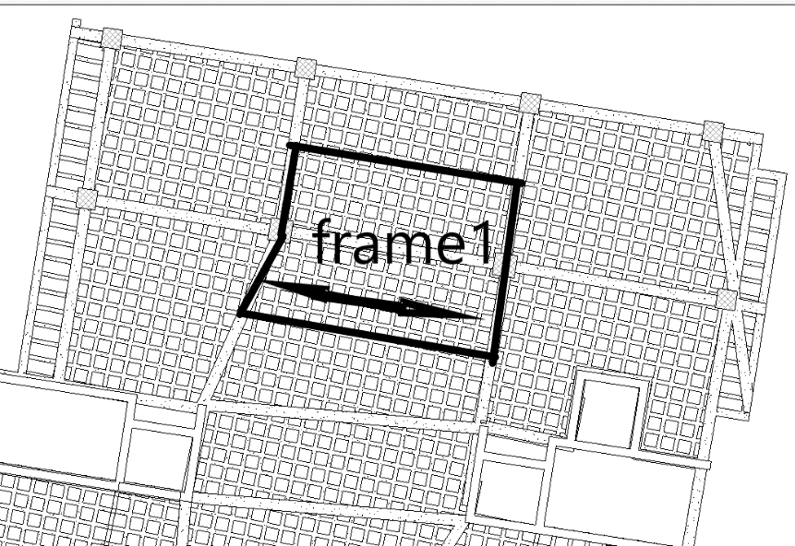
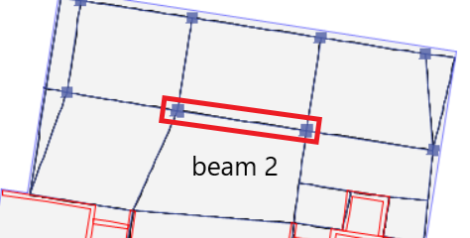
Stress-strain check:
Slab internal force:
Column internal force:
Frame | M manual | M Etabs (KN.m) | % Error
 | (kN.m)
AB | 135.9 KN.m | 131.73 | 3.16%
 | Manual (KN) | ETABS (KN) | %Error
live load | 2049.6 | 2062.3 | 0.62%
SID load | 3513.6 | 3535.53 | 0.62%
dead | 4104.16 | 4346.75 | 5.58%
Beam internal force
BEAM | M manual (KN) | M etabs (KN) | % Error
Beam 2 | 121.41 | 101.8 | 1.125
33

Slide 34
    Seismic design criteria
1
Mass source: 100% for dead laods and SID , 25% for live laods.
2
Seismic zone : The faculty is located in Ramallah city Therefore, the seismic zone is 2B and the Z value is equal to 0.20.
3
Soil profile: The soil type is clay so the soil profile is SD .
4
5
6
Force Reduction Factor R = 5.5 (Building Frame System - shear wall)
Importance Factor I = 1.0
Acceleration-Dependent Seismic Coefficient Ca = 0.2
7
Velocity-Dependent Seismic Coefficient Cv = 0.2
8
Response spectrum scale factor = $\frac{I×g}{R}$ = $\frac{1.25 ∗9810}{5.5}$ = 2230
Response spectrum scale factor = (𝐼×𝑔)/𝑅 = (1.25 ∗9810)/5.5 = 2230

Slide 35
Base shear check
BASE SHEAR CHECK
Soil profile | SD
I | 1
Ca | 0.28
Cv | 0.4
R | 5.5
Ω | 2.8
Ct | 0.0488
hn | 52
T | 1.52
Tetabs | 1.437
w | 2.08E+05
Vmain | 2.91E+04
Vsecondry | 8.73E+03
EQx Max= 29092.6292
EQy Max= 29091.7554
EQ ≥ V its ok.
Load Case/Combo |  | FX | FY
 |  | kN | kN
After Scaling
EQx Max | 29092.6292 |  | 5490.6615
EQy Max | 12595.1634 |  | 29091.7554

Slide 36
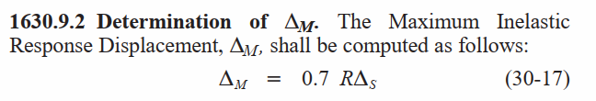
Drift check
Story | Height | Dis X | Dis Y | Drift X | Drift Y | Delta X | Delta Y | Delta Limits
0 | _ | 0 | 0 | _
B3 | 4000 | 0.235 | 0.235 | 0.235 | 0.235 | 0.905 | 0.905 | 80.00
B2 | 4000 | 0.594 | 0.596 | 0.359 | 0.361 | 1.382 | 1.390 | 80.00
B1 | 4000 | 1.494 | 1.496 | 0.900 | 0.900 | 3.465 | 3.465 | 80.00
GF | 4500 | 10.150 | 11.512 | 8.656 | 10.016 | 33.326 | 38.562 | 90.00
F1 | 4000 | 21.683 | 26.569 | 11.533 | 15.057 | 44.402 | 57.969 | 80.00
F2 | 4000 | 35.299 | 44.503 | 13.616 | 17.934 | 52.422 | 69.046 | 80.00
F3 | 4000 | 50.269 | 64.520 | 14.970 | 20.017 | 57.635 | 77.065 | 80.00
F4 | 4000 | 66.339 | 85.572 | 16.070 | 21.052 | 61.870 | 80.192 | 80.00
F5 | 4000 | 82.972 | 107.666 | 16.633 | 22.094 | 64.037 | 80.192 | 80.00
F6 | 4000 | 100.056 | 129.208 | 17.084 | 21.542 | 65.773 | 80.192 | 80.00
F7 | 4000 | 117.043 | 150.037 | 16.987 | 20.829 | 65.400 | 80.192 | 80.00
F8 | 4000 | 130.349 | 170.344 | 13.306 | 20.307 | 51.228 | 78.182 | 80.00
F9 | 4000 | 150.326 | 190.755 | 19.977 | 20.411 | 76.911 | 78.582 | 80.00
T ˂ 0.7, Δ M =2.5% * H, H: story height.
T ≥ 0.7, Δ M =2.0% * H, H: story height.

Slide 37
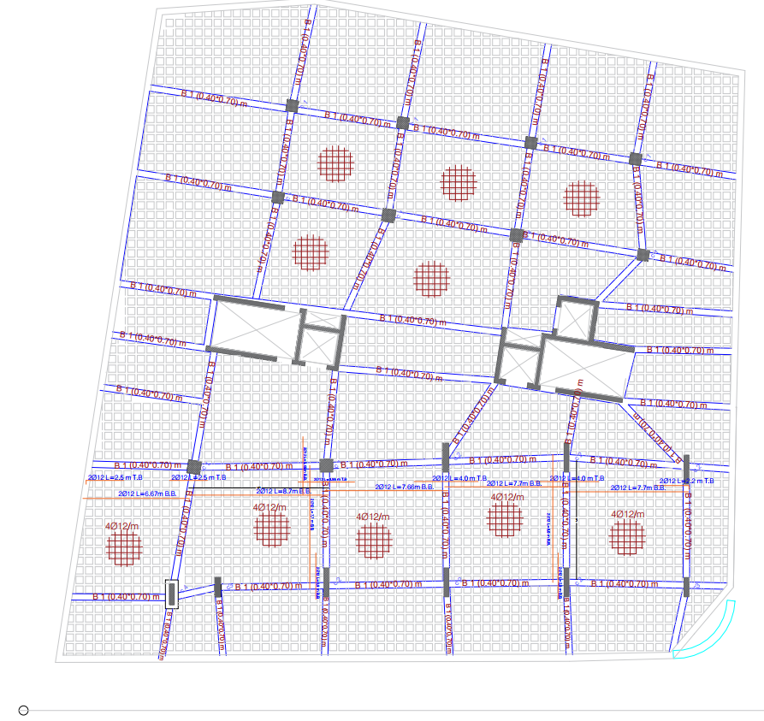
Detailing requirements:
Diaphragm details:

Slide 38
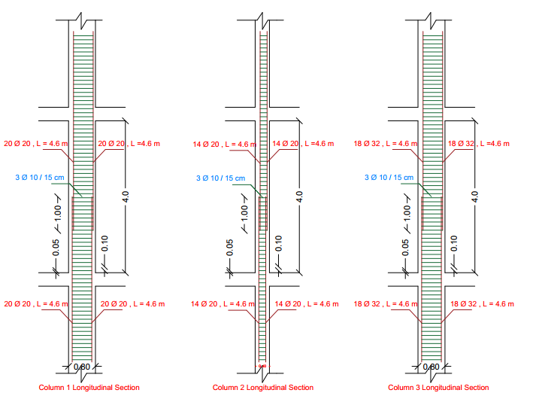
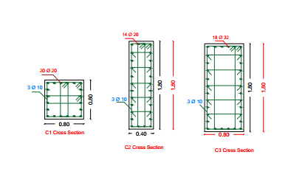
Columns details details:
Rectangular columns details:

Slide 39
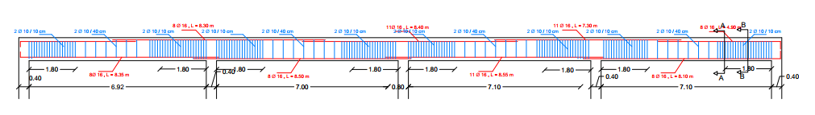
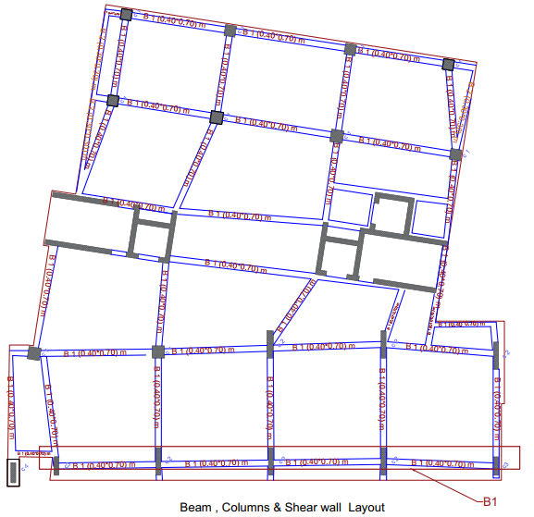
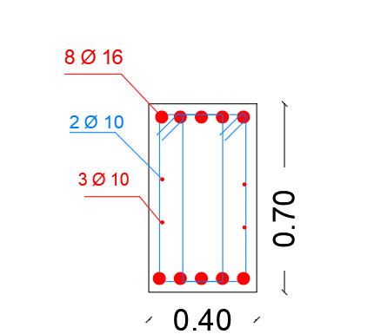
Beams details:

Slide 40
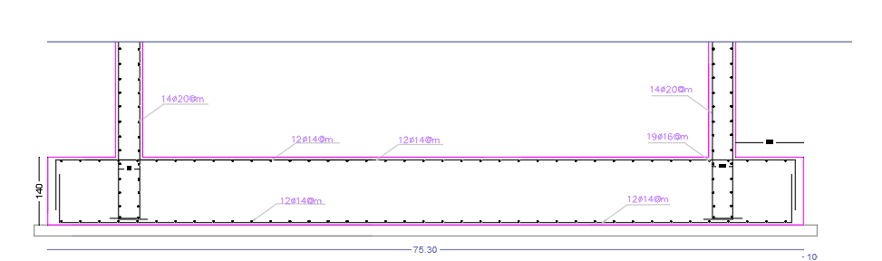


Mat foundation Layout

Slide 41

Mat foundation Layout
Basement Retaining wall
Shear check:
For toe and heal :
ØV_{C} = ( 0.75/6 )×√28 × 380 × 1000 ×10⁻³ = 251.3 KN/m
Toe maximum shear is:98.45KN/m , less than ØV_{C} → ok
Heel maximum shear is : = 154.48KN/m , less than ØV_{C}

Slide 42
Lighting units and switches /Electrical design

Slide 43

Lighting Unit layout
Plan for Mezzanine Floor Plan & ground floor.

Slide 44

Lighting Unit layout
plan for first floor.

Slide 45

Lighting Unit layout
plan for second floor.

Slide 46






Office Lab DIALUX results.
UGR Check.
Luminaire layout plan for Computer lab

Slide 47





Slide 48
Electrical power

Slide 49

Switch distribution of Mezzanine Floor Plan & ground floor

Slide 50

Switch distribution
of first floor

Slide 51

Switch distribution
of second floor

Slide 52
Mechanical system

Slide 53


Mezzanine Floor Plan & ground floor
Diameter Of Pipes
 | Meter | vertical | Horizontal | branch | Critical branch
Diam. (inch) | 2 1/2” | 3” | 2” | 2” | 1 ½”
Pressure loss | 0.35 | 4.5 | 0.17 | 0.49 | 2.52
Total loss | 8.03

Slide 54

First floor

Slide 55


Drainage system
The distribution of manhole

Slide 56
FIREFIGHTING SYSTEM

Slide 57


Slide 58



Slide 59
Acoustical- design.

Slide 60



Office 1
Standard of RT60= (0.5-1.1) Sec.

Slide 61
Quantity surveying and cost estimate

Slide 62
Work | Budget Cost (NIS)
Sub-Structure | 1554239.652
Super Structure | 1806806.938
Non- Structure | 182325
Finishing | 2417599.133
Mechanical Work | 2651154
Electrical Work | 80235
safety work | 5880
External work | 50000
Total Cost | 10393589.07
Total cost that estimated for cultural center = 10393589.07 NIS.→ 3093330.081$
Cost for project building per m²= 3093330.081/11893.7=260$.

Slide 63
Thank you for listening ☺
Any questions

