Slide 1

Graduation Project II
3D Dynamic Analysis And Design of
Masjed Al –Kawther
An-Najah National University
Faculty of Engineering
Civil Engineering Department
Supervisor by :
Dr . Riyad Awad
By:
Oday Sawalha
Mohammad Zaki
Laith Khaldi

Slide 2
Outline
Introduction
3-D dynamic Analysis and design for Massjed
Minaret Analysis and design
Discussion & Conclusion

Slide 3
Introduction
Site
Project description
Materials
Loading

Slide 4
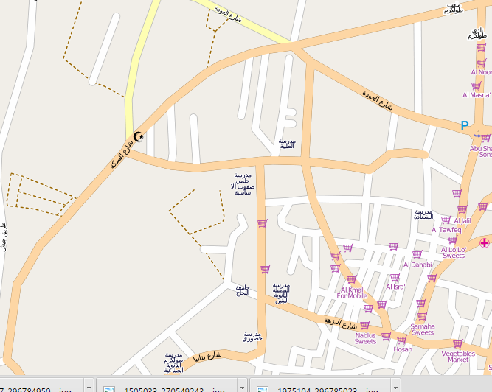
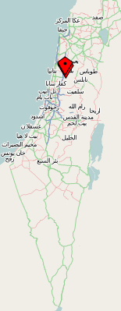
Introduction
Site
Site Tulkarem city

Slide 5
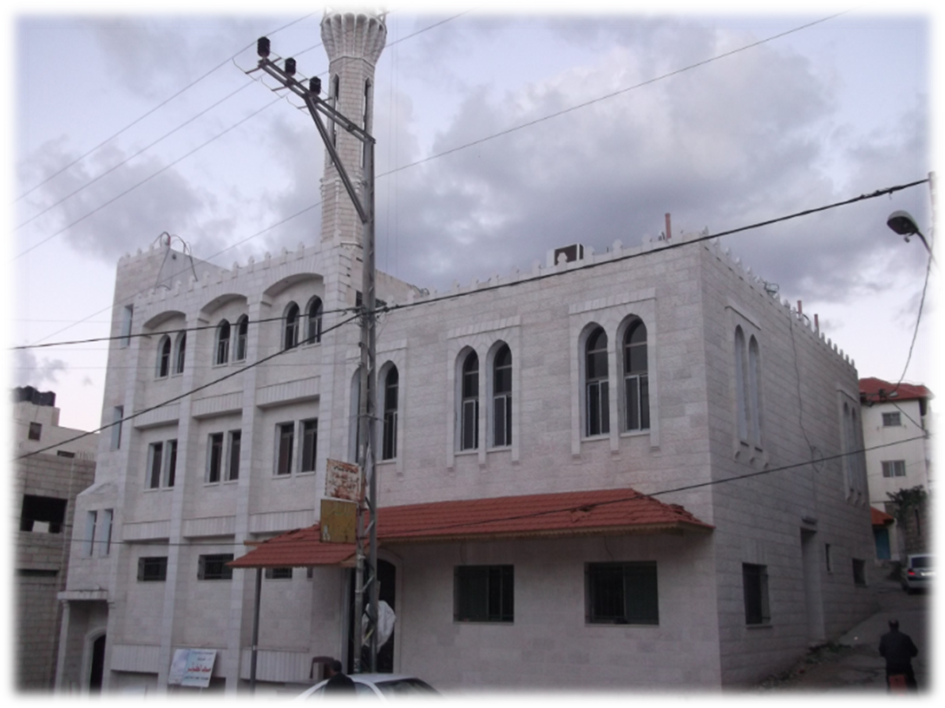
Introduction
Project description
Notes:
The project consists of three floors with a total area about 360 m².The first floor has residence for the imam 56 m², center for learning Holy Quran 120 m² , bathrooms 30 m² , place to ablutions 21 m² and place to special case 64 m². The second floor has place for men to pray 292 m². The third floor has place for woman to pray 135 m² . In addition , it contains minaret has 36 m high from ground and its base area about 10m² and dome has 12.2 m high from ground and its base area about 13 m² .

Slide 6
Introduction
Project description
Floor | Elevation (m) | Area (m²)
First ground floor | 3 | 292
Second floor | 3.5 | 292
Third floor | 3.5 | 135
Notes:
The project consists of three floors with a total area about 360 m².The first floor has residence for the imam 56 m², center for learning Holy Quran 120 m² , bathrooms 30 m² , place to ablutions 21 m² and place to special case 64 m². The second floor has place for men to pray 292 m². The third floor has place for woman to pray 135 m² . In addition , it contains minaret has 36 m high from ground and its base area about 10m² and dome has 12.2 m high from ground and its base area about 13 m² .

Slide 7
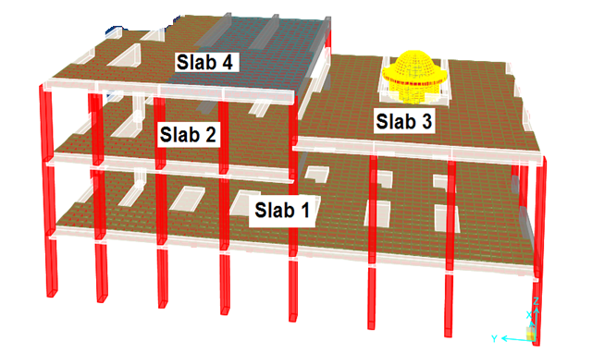
Introduction
Notes:
The project consists of three floors with a total area about 360 m².The first floor has residence for the imam 56 m², center for learning Holy Quran 120 m² , bathrooms 30 m² , place to ablutions 21 m² and place to special case 64 m². The second floor has place for men to pray 292 m². The third floor has place for woman to pray 135 m² . In addition , it contains minaret has 36 m high from ground and its base area about 10m² and dome has 12.2 m high from ground and its base area about 13 m² .

Slide 8
Introduction
Loading
Loads type and Values on slab 1 , 2
Loads type and Values on slab 3 , 4
Notes:
The project consists of three floors with a total area about 360 m².The first floor has residence for the imam 56 m², center for learning Holy Quran 120 m² , bathrooms 30 m² , place to ablutions 21 m² and place to special case 64 m². The second floor has place for men to pray 292 m². The third floor has place for woman to pray 135 m² . In addition , it contains minaret has 36 m high from ground and its base area about 10m² and dome has 12.2 m high from ground and its base area about 13 m² .

Slide 9
3-D dynamic Analysis and design for Massjed

Slide 10
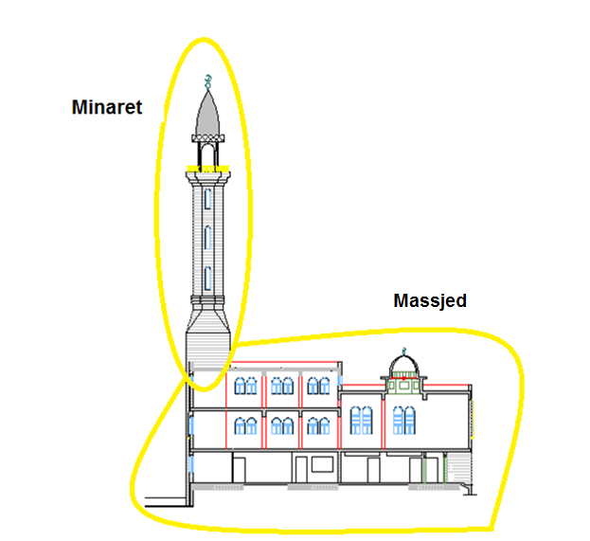

Slide 11
The mosque in zone 2A ( Tulkarm ) Z=0.15
The soil profile is Sd (the soil is stiff soil profile)
Importance factor = 1.00
The value of R = 5.5 because the type of structural is intermediate resistance frame system .
Ca = 0.22
Cv = 0.32

Slide 12
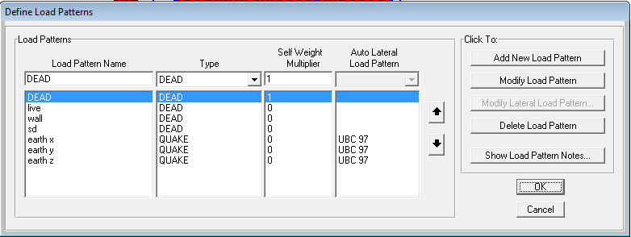

Slide 13
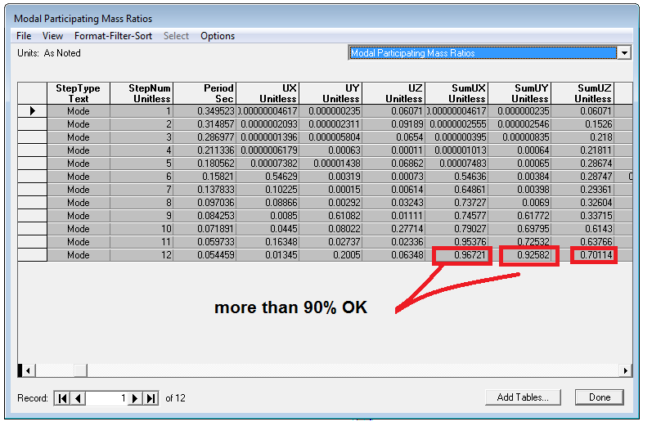
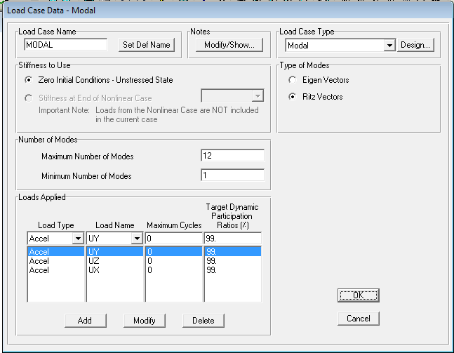
Check of sap result
Check time :-
Check the percent of number of modes in X and Y directions that must be represent 90% and more of cases of failure of building when the building occur

Slide 14

Check of sap result
Check time :-
1- Equivalent force method
Check period in y direction the sap result from one unit load = 0.0843 and this less than reyleigh’s period = 0.106 OK

Slide 15
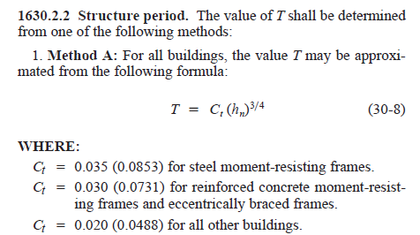
From this formula T = 0.0731*(10)^{0.75} =0.41 > 0.35 OK
2- Method A

Slide 16
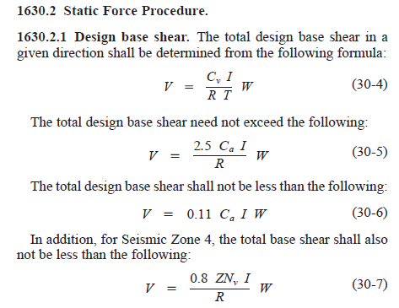
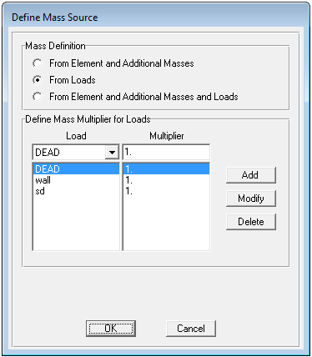

Check shear due to seismic loads
V=$\frac{Cv∗I}{Tx∗R}$* W ; W is the total of structural loads that affected by earthquake .
W include dead load ,wall load and
superimposed dead load .
; T the max period in the same of shear direction

Slide 17
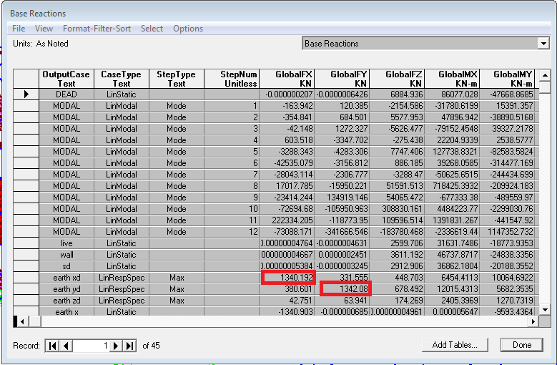
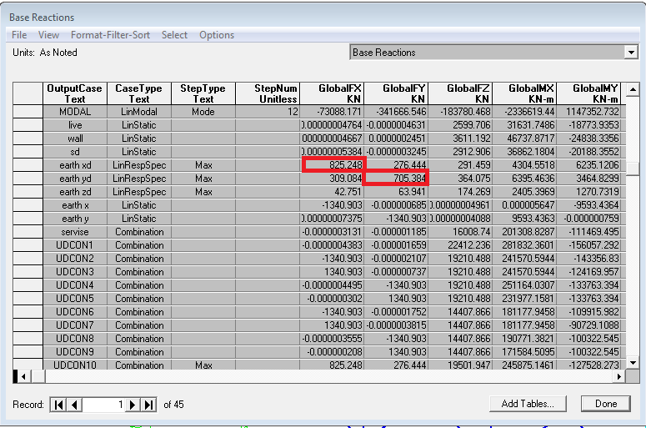
Must static earthquake force in X and Y equal dynamic earthquake force .

Slide 18
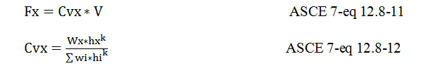
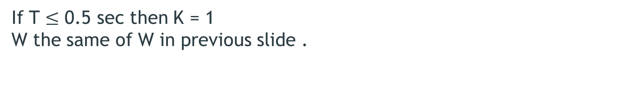
Check the distribution of shear on the building on height each slab:
If T $≤$ 0.5 sec then K = 1
W the same of W in previous slide .

Slide 19
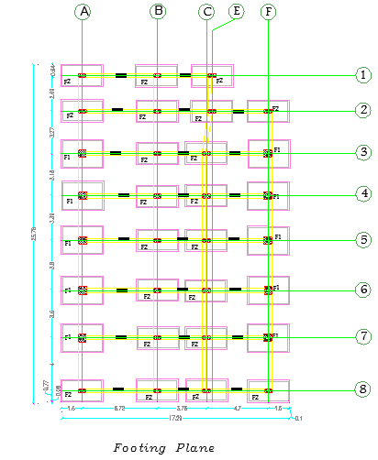
DESIGN OF FOOTINGS :

Slide 20
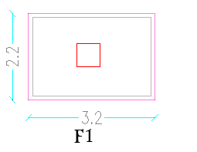
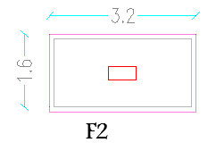
Dimension | Max.service Moment | Max.service load | Group
2.2*3.2 | 22 | 1055 KN | F1
1.6*3.2 | 21 | 782.1 KN | F2

Slide 21
Design footing :
Determine single footing area F1 :
If M = 0, Af = (1055.2) *1.1/250 = 4.63 m^2. Af = (4.63) ^1/2 = 2.2m.
With moment assume L = 3m and we want to estimate W.
Q = 1.1*(1055.2)/B*3 + (22*1.5)/ ((1/12) *B*3^3) + 12(B/2)/ ((1/12) *3*B^3) = 250KN/m^2.
We solve this equation and we found B = 1.6m >>>>> use B = 2m.
Check footing:
Q max = 1.1*(1055.2)/2*3 + (22*1.5)/ ((1/12) *2*3^3) + 12(2/2)/ ((1/12) *3*2^3) = 200<250>>>OK.
Q min = 1.1*(1055.2)/2*3 - (22*1.5)/ ((1/12) *2*3^3) - 12(2/2)/ ((1/12) *3*2^3) = 186.8>0 >>OK.
Use footing (2*3) m

Slide 22
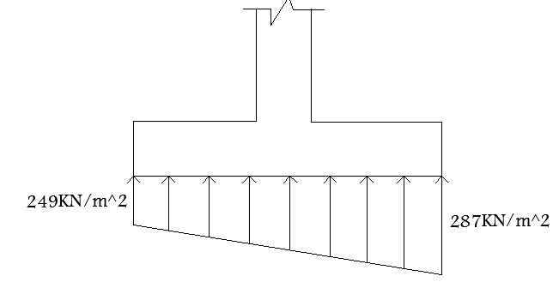
Design footing :
Determine single footing thickness for F1 :
Assume h = 500mm and d = 420 mm.
Check of wide beam shear:
We find Vu at distance d from face of support.
Vu = ((287+249)/2) *.78*1 = 209KN.
VC = (1/6) * 0.75*1*(24) ^1/2 *1000*520/1000 = 257.2KN>209KN>>>>OKᴓ
Check of Punching shear:
Vu, p = 287*2*3 = 1722KN
VC = 0.75*0.33*(24) ^1/2 *4080*420/1000 = 2077.7>1722>>>>OK. ᴓ
Use footing thickness = 500mm.

Slide 23
Design footing :
Design single footing F1:

Slide 24
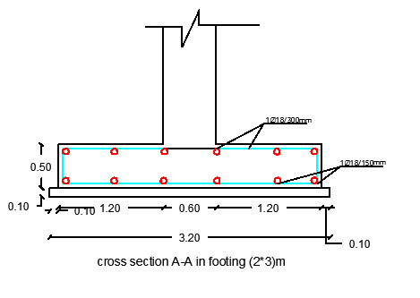
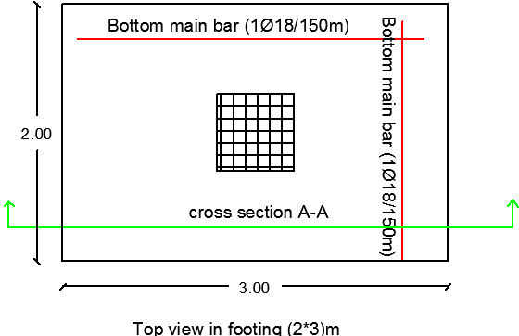

Slide 25
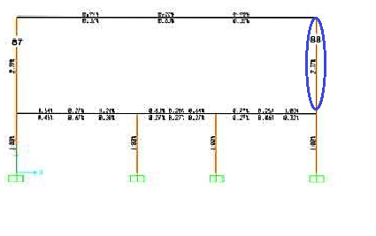
Design of columns :
Select the certain column

Slide 26
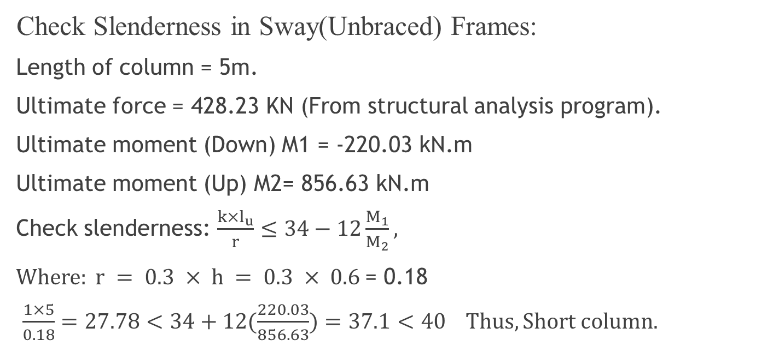
DESIGN OF columns
Check Slenderness in Sway(Unbraced) Frames:
Length of column = 5m.
Ultimate force = 428.23 KN (From structural analysis program).
Ultimate moment (Down) M1 = -220.03 kN.m
Ultimate moment (Up) M2= 856.63 kN.m
Check slenderness: $\frac{k×l_{u}}{r}≤34−12\frac{M_{1}}{M_{2}},$
$Where: r = 0.3 × h = 0.3 × 0.6$= 0.18
$\frac{1×5}{0.18}=27.78<34+12(\frac{220.03}{856.63})=37.1<40 Thus, Short column.$

Slide 27

Check the magnitude of $ρ$
Between SAP and manual by use :
Reciprocal load method
Section designer method

Slide 28
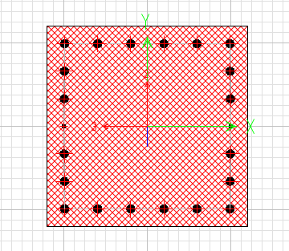
DESIGN OF columns :
use ρ=2.8 and b = 600 mm and H =600mm
As = ρ * Ag = .028* 600 *600 = 10080 mm ^2
Use 20Ø25 & 2Ø12

Slide 29
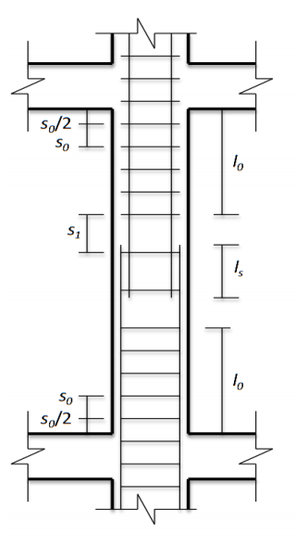
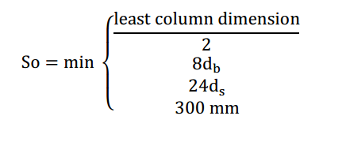
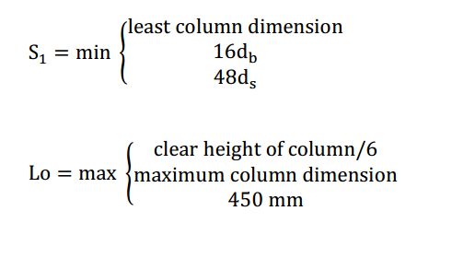
DESIGN OF columns :

Slide 30
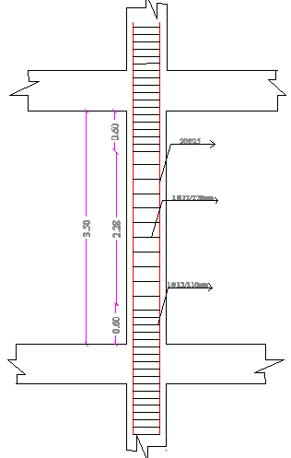
DESIGN OF columns :

Slide 31
Minaret Analysis and design
Modes and Periods
Response Spectrum Analysis
design

Slide 32
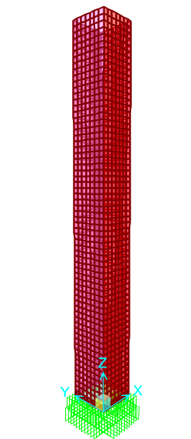
Minaret Analysis
Preliminary model

Slide 33
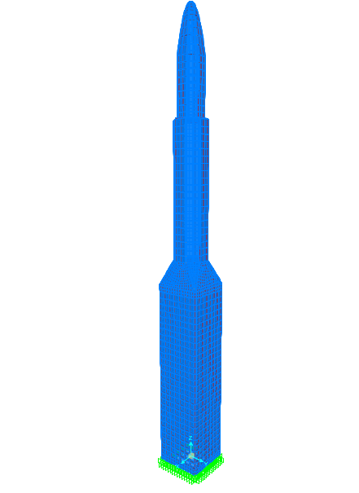
Minaret Analysis

Slide 34
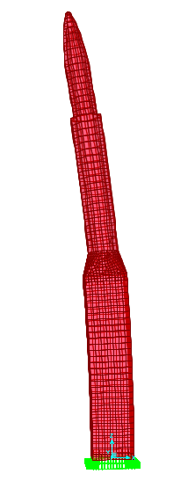
Minaret Analysis mode 1

Slide 35

Minaret Analysis
Period in X-direction
From SAP (mode 1): T=0.548 sec.

Slide 36

Minaret Analysis
Period in X-direction manual calculation (approximated method)

Slide 37
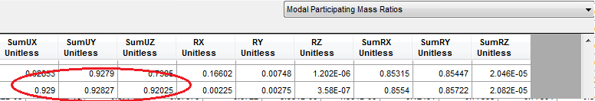
Minaret Analysis
Modal Mass Participation Ratio

Slide 38
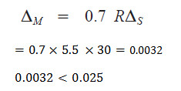
Minaret Analysis drift check

Slide 39
Minaret Analysis
Response Spectrum Analysis based on uBC 97
Z= 0.15 ca=0.22 cv=0.32

Slide 40
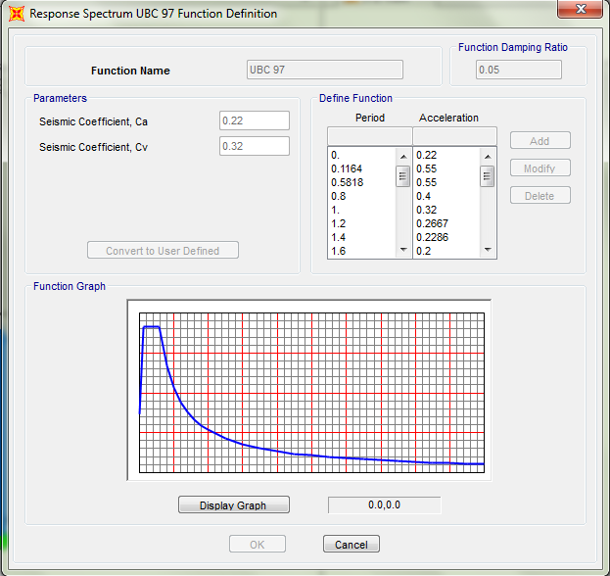
Minaret Analysis
Response Spectrum Analysis
Response spectrum function definition

Slide 41
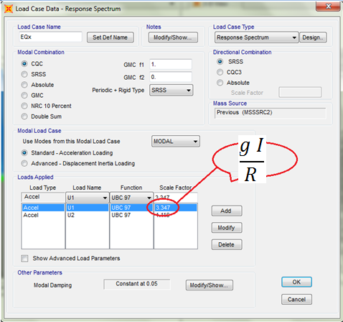
Minaret Analysis

Slide 42
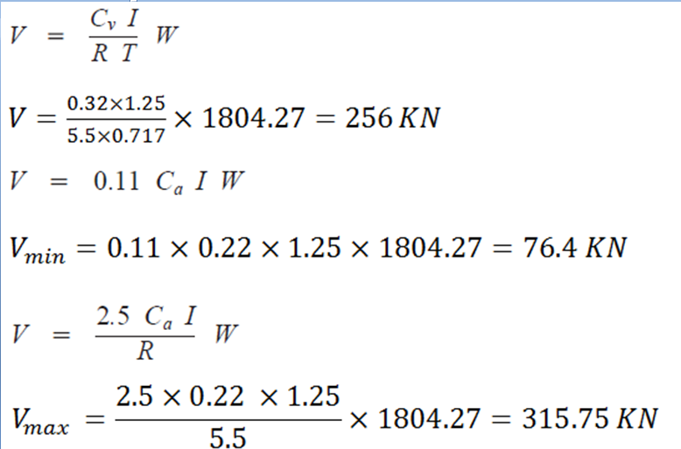
Minaret Analysis

Slide 43
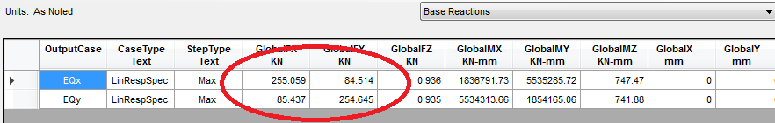
Minaret Analysis
Response Spectrum Analysis
Base Shear (V) from response spectrum

Slide 44

Minaret design

Slide 45
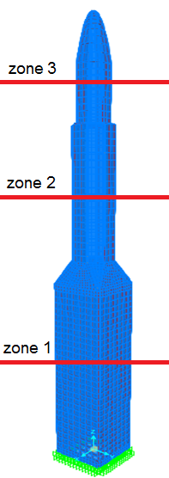
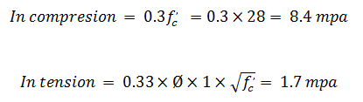

Minaret design

Slide 46
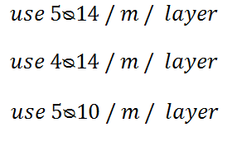
Minaret design
Longitudinal Steel

Slide 47
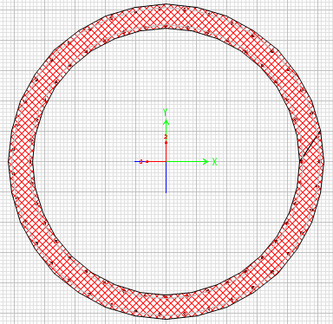
Minaret design zone 2

Slide 48
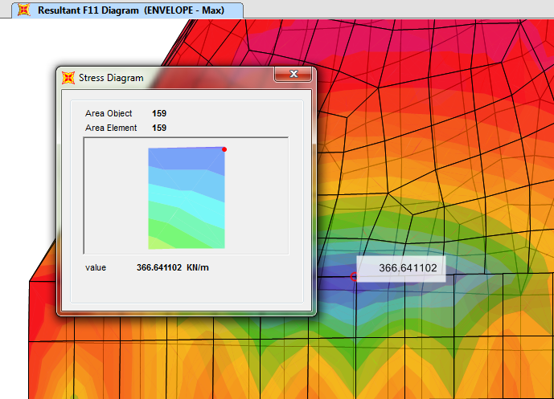
Minaret design
Transverse Steel

Slide 49
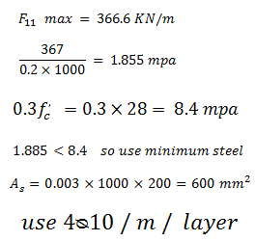
Minaret design
Transverse Steel

