Slide 1
Magic pyramid
Towards a 3D world
Feras Khateeb Yousef Azem
supervisor Dr.Lui Malhis

Slide 2
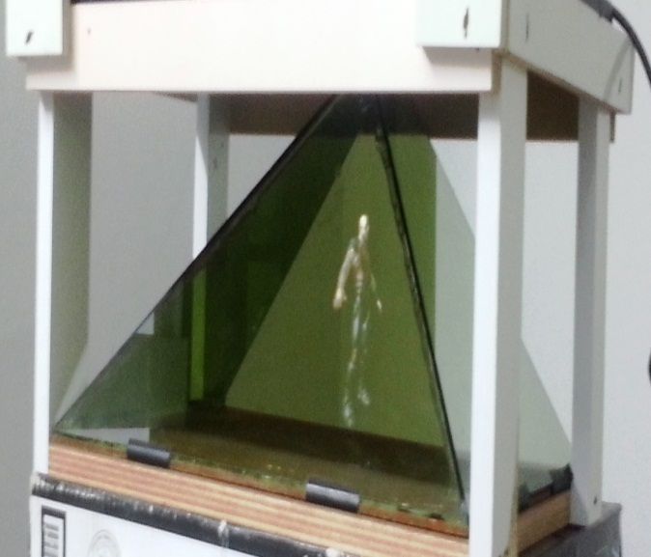
Magic pyramid| Towards a 3D world
Outline
Introduction.
System Parts.
applications.
Problems
Recommendations for Future Work

Slide 3
Magic pyramid| Towards a 3D world
Introduction
Magic Pyramid is used to view 3D object models in space.
This project include two parts:
Hardware
consists of a number of glass panels under an LCD screen which provide the source views for the 3D model
Software
will interface with our hardware design and synchronize the 3d object so that it is reflected correctly on the glass.
Notes:
Hardware
. The reflection of the different views is aligned to reflect on the different glass panels so that the object can be seen in the space in the middle of the panels/box.
Software

Slide 4
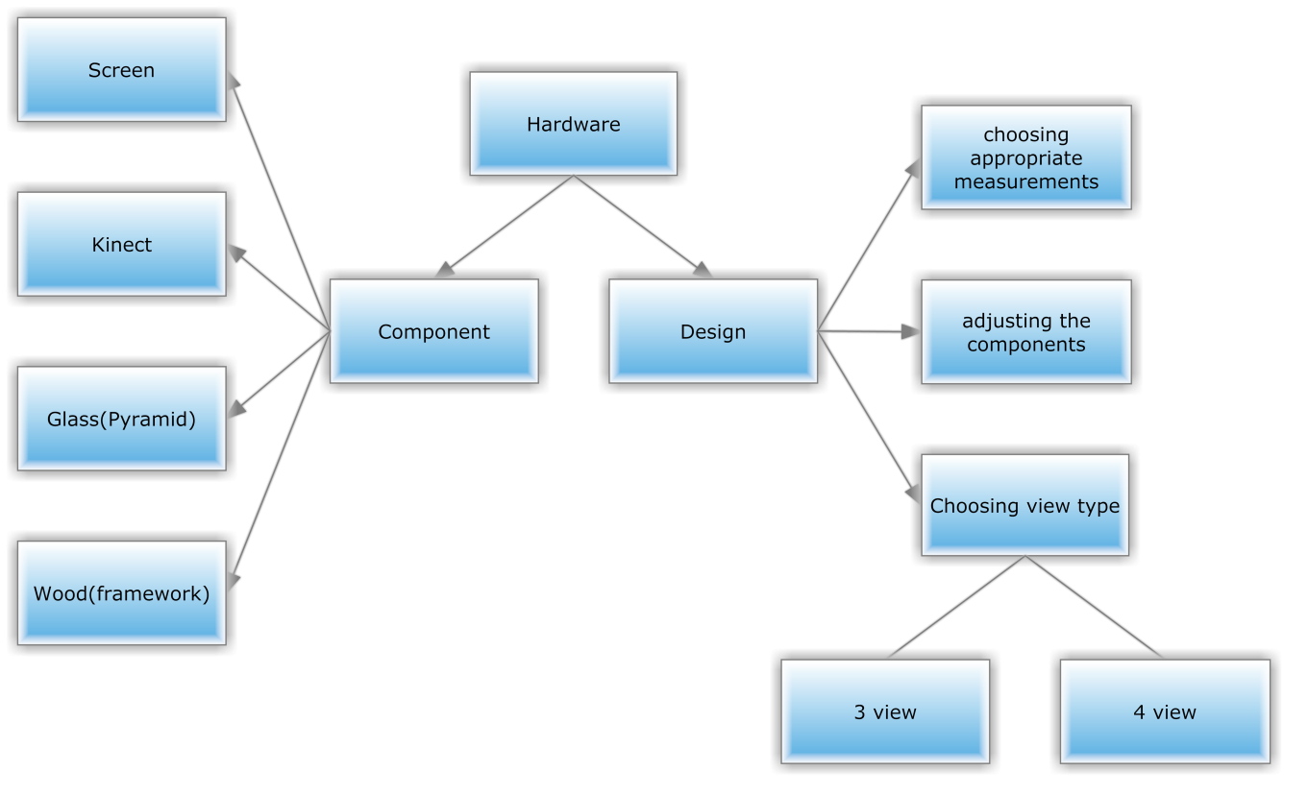
Magic pyramid| Towards a 3D world
Hardware
Notes:
Hardware
. The reflection of the different views is aligned to reflect on the different glass panels so that the object can be seen in the space in the middle of the panels/box.
Software

Slide 5
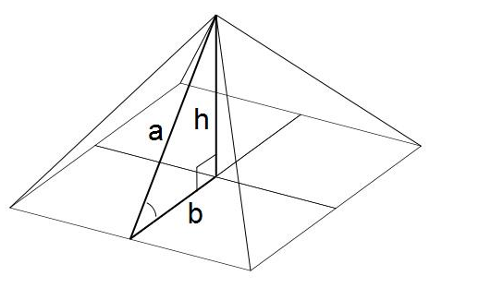
Magic pyramid| Towards a 3D world
Pyramid Design
what is the angle Deviation of each side?
The best angle of each side must be 45 degrees
Mathematical calculation
Tan angle (ab) = (h/b)
Tan 45 =h/20 =1
h=20 Cm
Sqrt (a) = b*b + h*h
Sqrt (a) =20*20 + 20*20 = 28 Cm
Notes:
, this due to reflection issue. To get the three objects that will be viewed on the pyramid of glass as a one model, each side of the pyramid must be with same angle of others.
Our Pyramid was chosen to be compatible with size of screen in this prototype .screen size is 40* 20 Cm so our calculations depend on it.

Slide 6
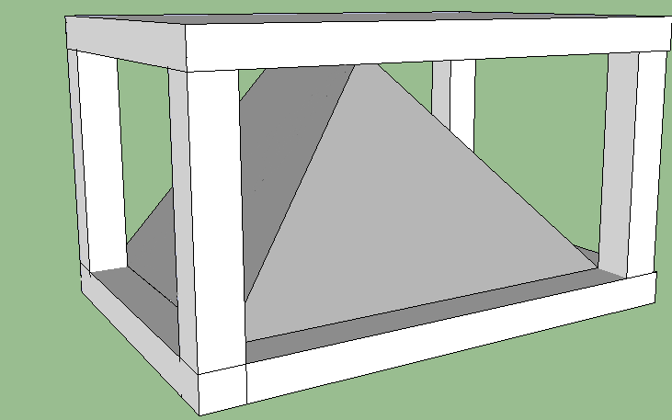
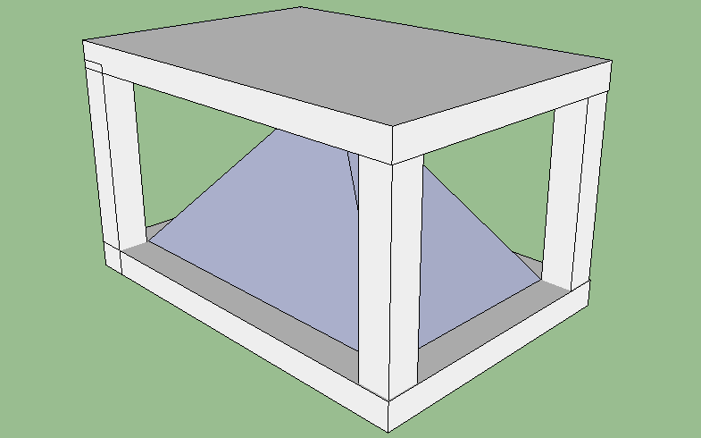
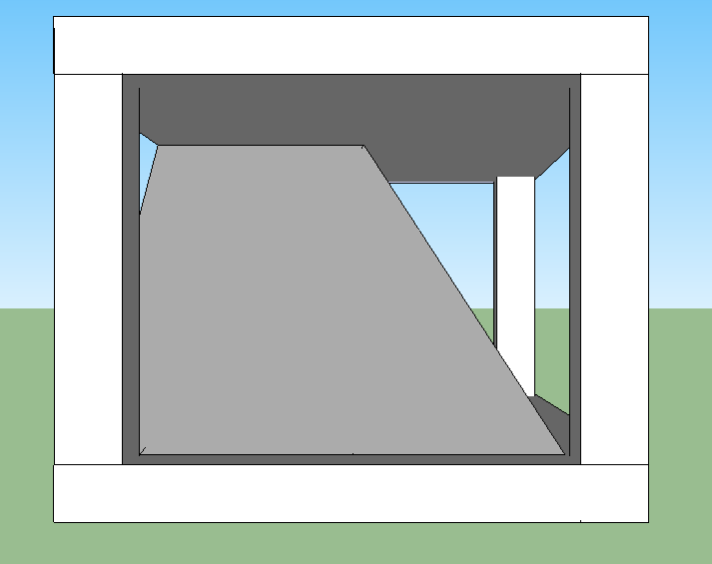
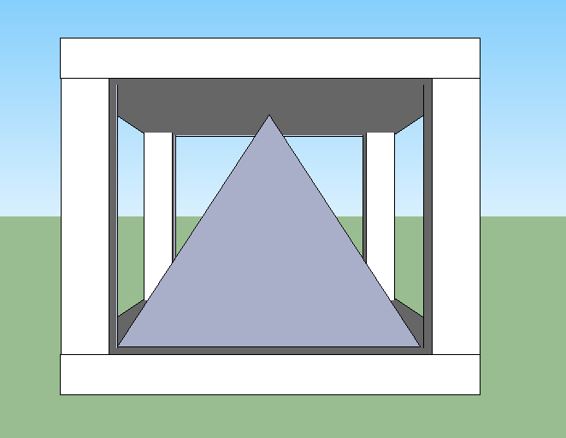
Magic pyramid| Towards a 3D world
Pyramid Design
Notes:
, this due to reflection issue. To get the three objects that will be viewed on the pyramid of glass as a one model, each side of the pyramid must be with same angle of others.
Our Pyramid was chosen to be compatible with size of screen in this prototype .screen size is 40* 20 Cm so our calculations depend on it.

Slide 7
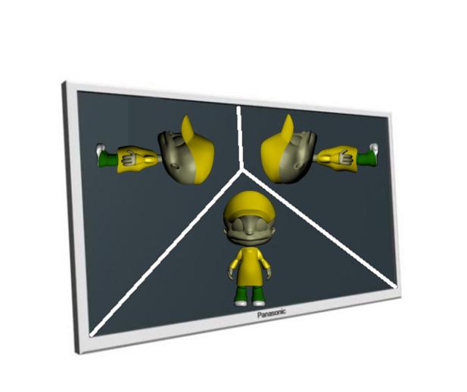
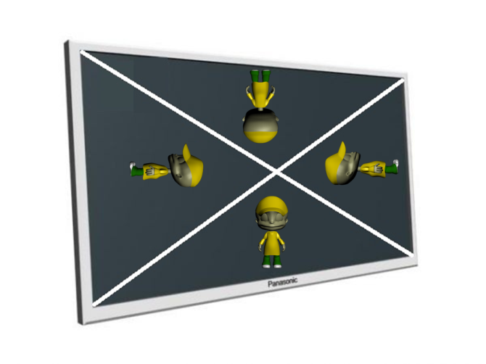
Magic pyramid| Towards a 3D world
Pyramid Design
what is kind of the pyramid? 3 Or 4 Views .
Notes:
Hardware
. The reflection of the different views is aligned to reflect on the different glass panels so that the object can be seen in the space in the middle of the panels/box.
Software

Slide 8
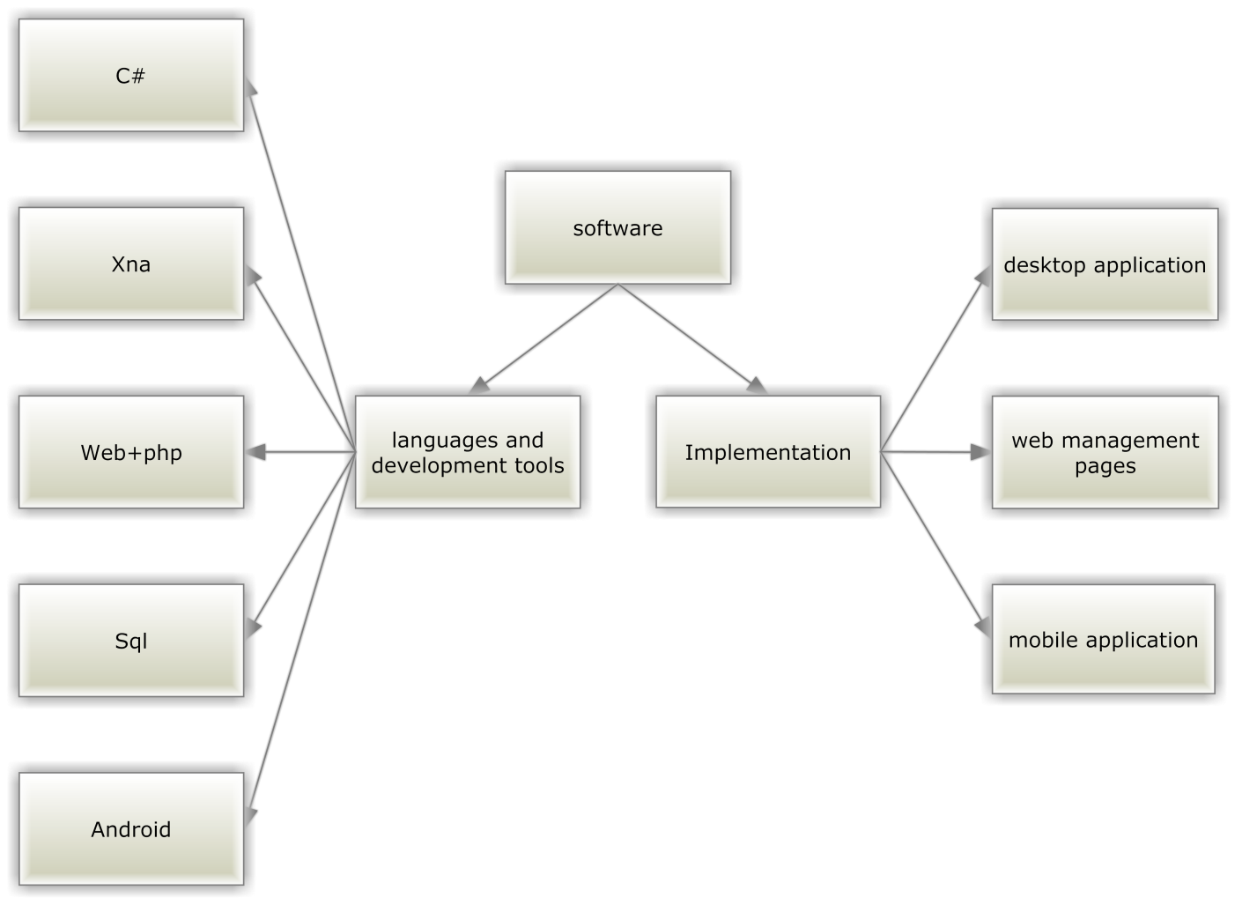
Magic pyramid| Towards a 3D world
Software
Notes:
Hardware
. The reflection of the different views is aligned to reflect on the different glass panels so that the object can be seen in the space in the middle of the panels/box.
Software

Slide 9
Magic pyramid| Towards a 3D world
Software Implementation
C# And XNA
Screen Splitting
Load Models
Object Size
File synchronization
CLICK HERE FOR MORE INFO

Slide 10
Magic pyramid| Towards a 3D world
Software Implementation
Screen Splitting
Region to every side
view ports
view ports Depend on screen size
CLICK HERE FOR MORE INFO

Slide 11
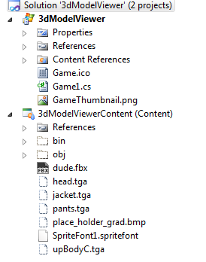
Magic pyramid| Towards a 3D world
Software Implementation
Load Models
Fbx Files
Adding model at coding
Xnb at run time
CLICK HERE FOR MORE INFO

Slide 12
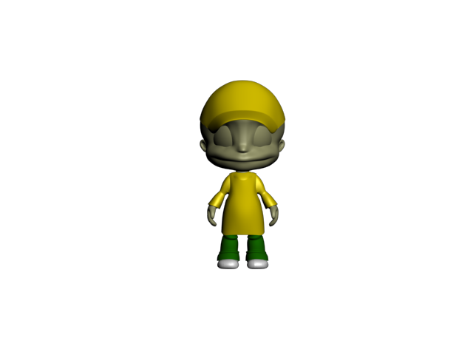


Magic pyramid| Towards a 3D world
Software Implementation
Object Size
Too large or too small
Many 3d programs
Measure Model
CLICK HERE FOR MORE INFO

Slide 13
Magic pyramid| Towards a 3D world
Software Implementation
File synchronization
Web control panel
Check database
thread
CLICK HERE FOR MORE INFO

Slide 14
Magic pyramid| Towards a 3D world
Software Implementation
Kinect Camera
Tracking Skeletons
Voice Recognition
CLICK HERE FOR MORE INFO

Slide 15
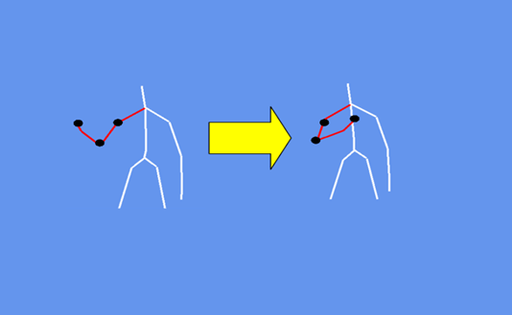
Magic pyramid| Towards a 3D world
Software Implementation
Tracking Skeletons
Handling input
Joints
CLICK HERE FOR MORE INFO

Slide 16
Magic pyramid| Towards a 3D world
Software Implementation
Voice Recognition
Api from Microsoft
Text-sound mapping
Next previous stop rotate
CLICK HERE FOR MORE INFO

Slide 17
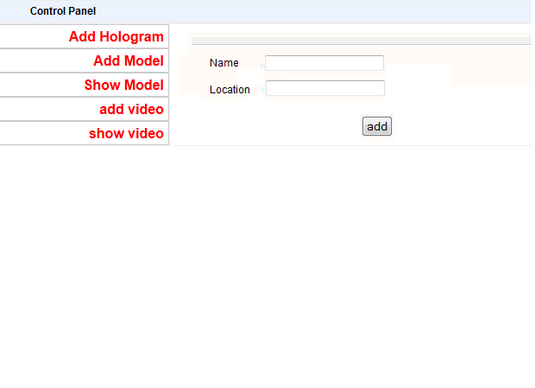
Magic pyramid| Towards a 3D world
Software Implementation
PHP Web And MySql
Control Panel
Database
CLICK HERE FOR MORE INFO

Slide 18
Magic pyramid| Towards a 3D world
Software Implementation
Android
Bluetooth Connection
Accelerometer Sensor
Internet connection
CLICK HERE FOR MORE INFO

Slide 19
Magic pyramid| Towards a 3D world
Software Implementation
Android
user
admin
gaming
CLICK HERE FOR MORE INFO

Slide 20
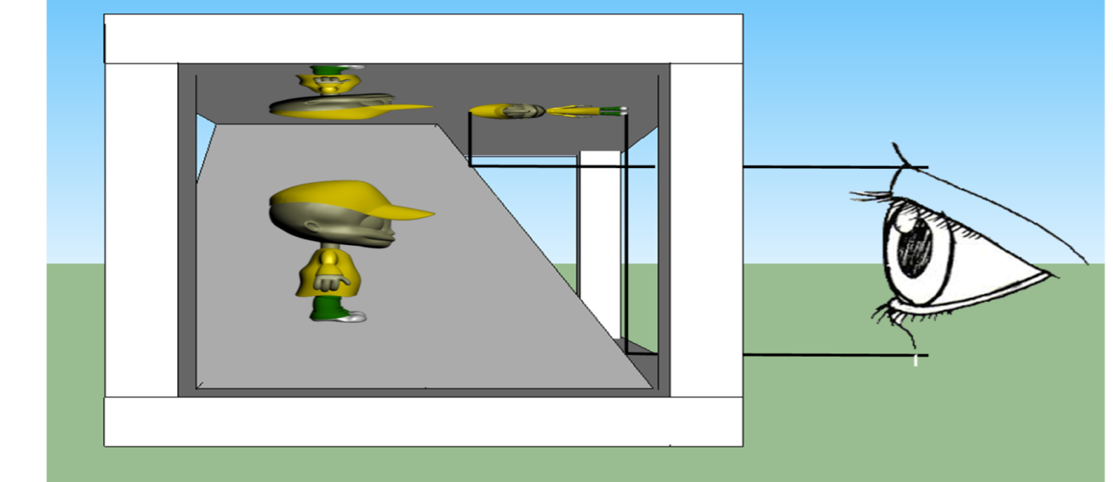
Magic pyramid| Towards a 3D world
Work Principle
The reflection of the different views is aligned to reflect on the different glass panels so that the object can be seen in the space in the middle of the panels/box
CLICK HERE FOR MORE INFO

Slide 21
Magic pyramid| Towards a 3D world
Software Implementation
Applications
CLICK HERE FOR MORE INFO

Slide 22
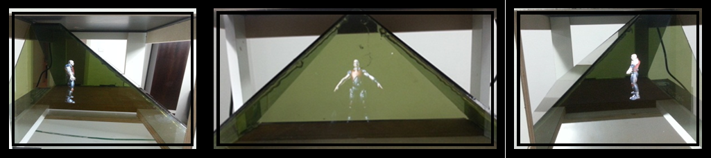
Magic pyramid| Towards a 3D world
Model view
Ability to view 3D object models in space
CLICK HERE FOR MORE INFO

Slide 23
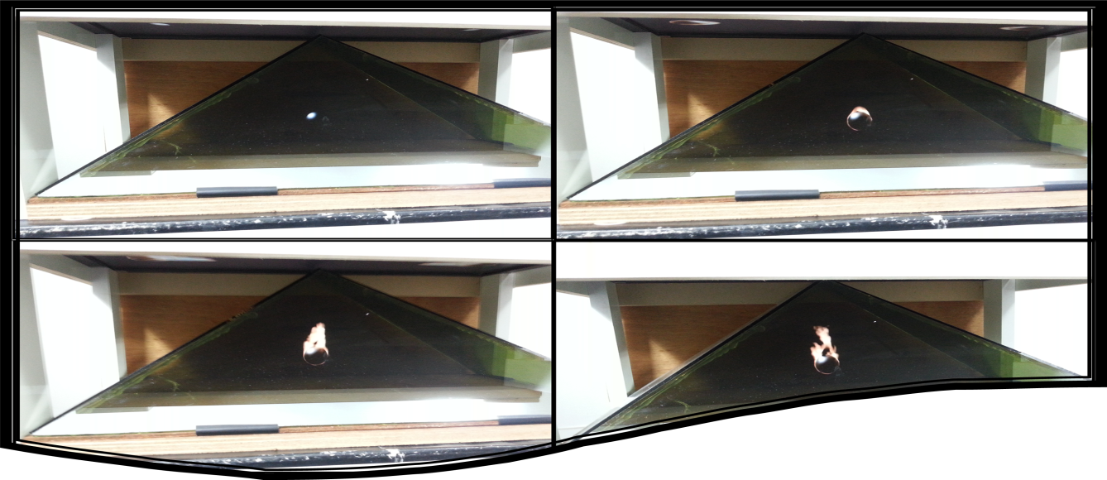
Magic pyramid| Towards a 3D world
Video view
Why video?

Slide 24
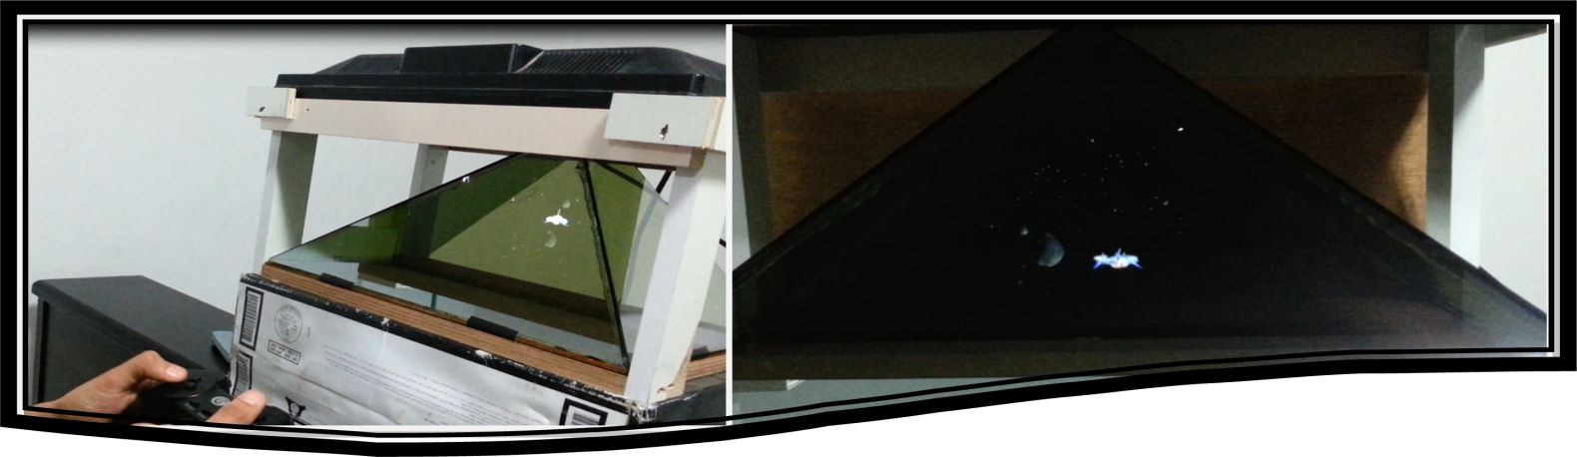
Magic pyramid| Towards a 3D world
Gaming
This game is Space War the ship is travels in the space and must avoid the rocks which are moving in the random way.
CLICK HERE FOR MORE INFO

Slide 25
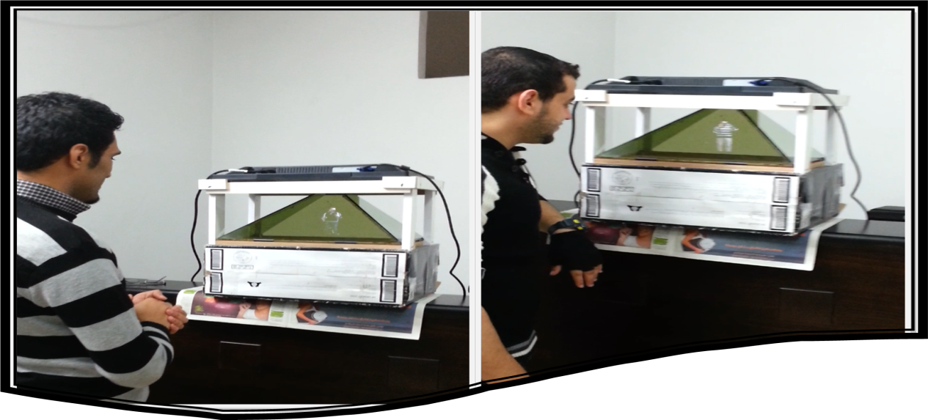
Magic pyramid| Towards a 3D world
Conference
Conference is another application of the hologram space, which allows you to see another person in hologram as virtual reality.
CLICK HERE FOR MORE INFO

Slide 26
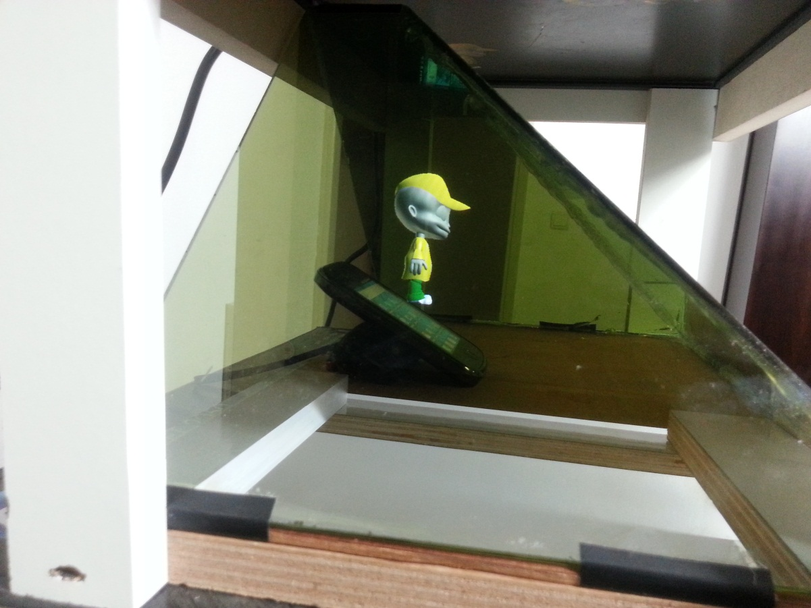
Magic pyramid| Towards a 3D world
Realistic
CLICK HERE FOR MORE INFO

Slide 27
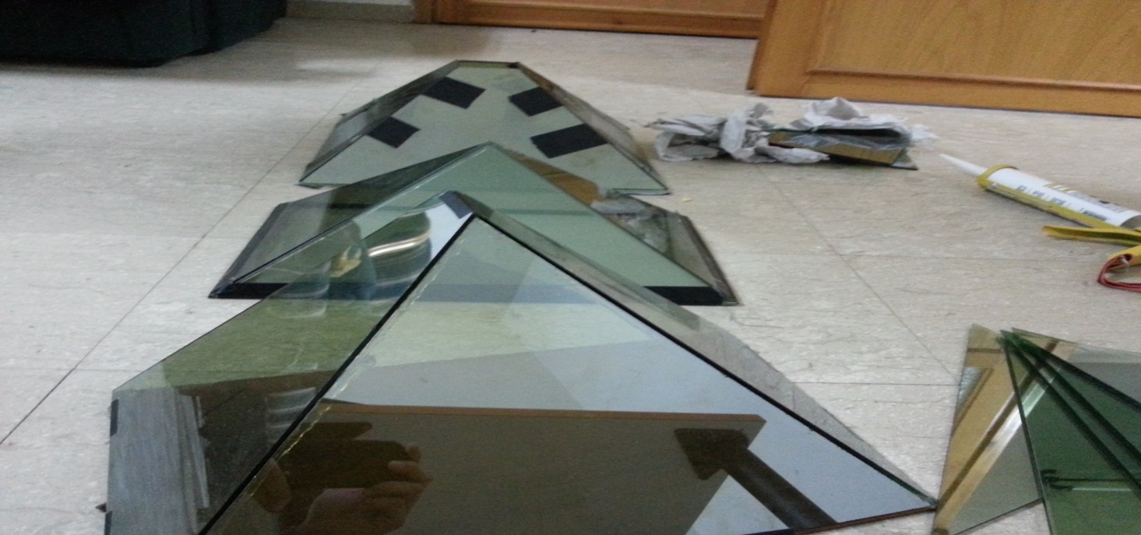
Magic pyramid| Towards a 3D world
Problems
Angle of deviation
CLICK HERE FOR MORE INFO

Slide 28
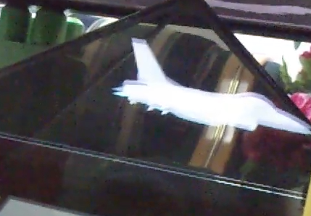
Magic pyramid| Towards a 3D world
Problems
Blurred glasses
CLICK HERE FOR MORE INFO

Slide 29
Magic pyramid| Towards a 3D world
Recommendations for Future Work.
We are looking for improving this system to make video conference over network using socket programming, and also to improve our games to take benefits of multi view sides
CLICK HERE FOR MORE INFO

Slide 30
Demo

Slide 31
Thank You

