Slide 1
Catalytic Conversion of Waste Rubber into
Liquid Oil Fuels: Lab scale and Industrial scale

Slide 3
Work Description
The work involves three parts:-
Part I:- Studying effect of catalyst on pyrolysis process, including type and amount of catalyst
”experimental lab scale ”,
Part II:- Controlling reaction conditions (temperature and carrier gas
”experimental lab scale ”.
Part III:- Commercial and industrial scale study
“Factory level study)

Slide 4
Part I
Studying effect of catalyst conversion process: catalyst type and amount
“Experimental lab scale ”

Slide 5
Introduction
This part includes:-
  Problem of waste rubber.
  Waste rubber treatment methods.
  How to convert waste tire rubber into useful fuel oil.
  Our lab scale experimental study
  Our results.

Slide 6
Reminding
In this study we used:
  batch reactor systems.
  magnetic stirring .
  poor temperature control.

Slide 7
Reminding
We could find :-
  Evaporation temperature.
  Time of evaporation.
  Time of dropping.
  Mass of fuel oil products.
  Mass of Sludge.

Slide 8
Reminding
By comparing results we found.
  Experiments with no catalyst needed higher reaction temperature and longer time.
  Experiments with no catalyst gave less amount of liquid oil fuel.
  Experiments with no catalyst gave Dark fraction color with high viscosity.
  Adding catalyst gives faster reaction at lower temperature with higher amount of liquid and gas products .

Slide 9
Reminding
  By lowering catalyst amount more liquid product resulted with longer time.
  By lowering catalyst amount, lower lost amounts of gaseous products resulted.
  By lowering catalyst amount, the reaction progress continued for longer times which yielded less amount of slug.
  With lower amounts of catalyst, the resulting liquid was not dark colored, but turbid green, compared to higher catalyst amount

Slide 10
Part II
Controlling reaction temperature
and
using carrier gas
”Experimental lab scale ”

Slide 11
Introduction
In part 1 there was no ability to control reaction temperature.
We used High accuracy tube furnace as a heat source.
We couldn’t use stirring.
We used Nitrogen gas as a carrier gas.

Slide 12
Objectives
Having more controlled reaction temperature.
Studying temperature effects and temperature critical points.
Studying the effect of using carrier gas.

Slide 13
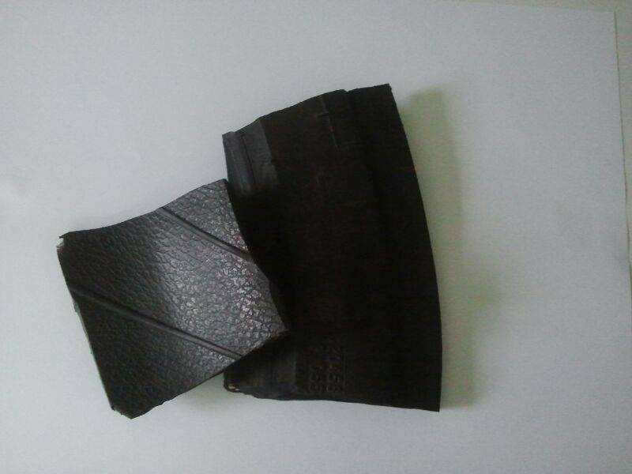
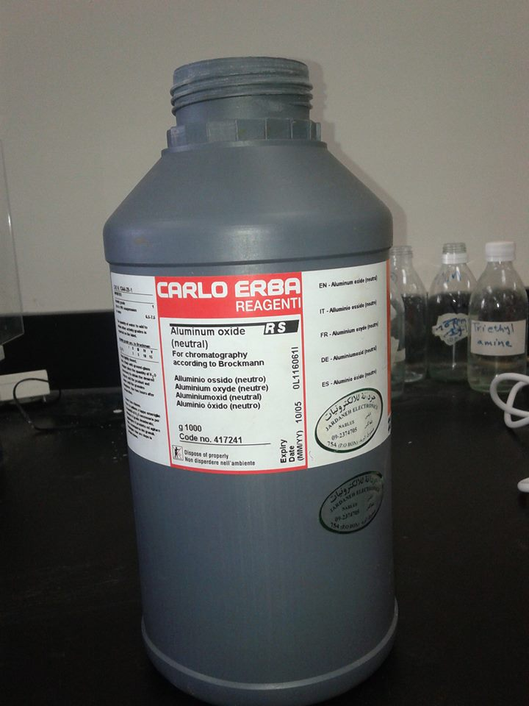
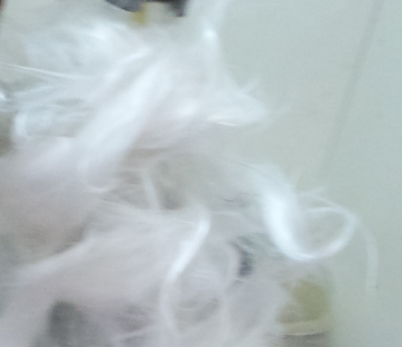
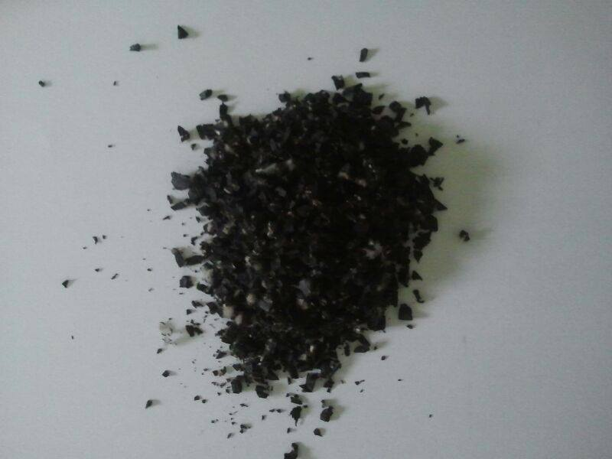
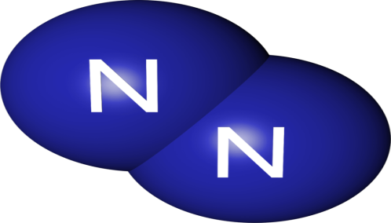
Methodology: Chemicals
Waste tire rubber Boiling chips Glass wool
Nitrogen gas

Slide 14
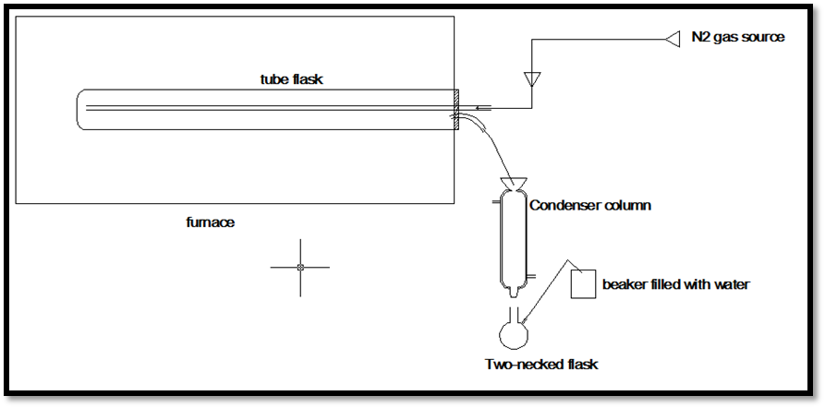
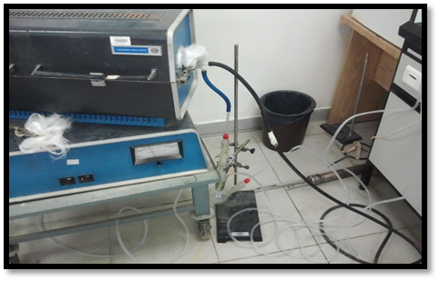
Methodology:
Equipment

Slide 15
Comparative Analysis
With and without Catalyst Comparison
At same temperature (400ºC) with no nitrogen.
One experiment was done with catalyst and the other without catalyst.
The Catalytic experiment gave oil, where dropping started and stopped in shorter time than the other .
The Catalytic experiment gave a liquid mass of 1.79g, while the Non-Catalyst experiment gave less than 1.39 g of liquid.
Both experiments showed comparable sludge masses (about 15 g) from originally 20 g waste.

Slide 16
Comparative Analysis
Catalytic Experiment With and Without Nitrogen.
Temperature was fixed at 400ºC.
The Nitrogen experiment gave gaseous product with intensity more than that without Nitrogen, and with shorter time.
In the Nitrogen experiment, oil dropping started and finished in shorter time compared to No-Nitrogen experiment.
The Nitrogen experiment has a mass of 0.83g, while the No- Nitrogen experiment has a liquid mass of 1.79 g.

Slide 17
Comparative Analysis
Temperature Comparison.
Both Catalyst and Nitrogen were used for experiments at different temperatures.
Reaction temperature was accurately fixed at certain value in each experiment.
It was noted that there were no liquid oil products for temperatures less than 300ºC.
Also for temperature less than 400ºC, the liquid oil product has high viscosity and has masses--.

Slide 18
Part III
Commercial and industrial scale

Slide 19
Introduction
In this part we will show the results of the project at the commercial and industrial scale.
We are following the merits of our project through application of our ideas in a factory (at 5 ton scale).
The factory is located 5 km North-East of Jenin city, in the north parts of the West Bank. Eng. Ramez Abdallah is the direct consultant for the factory. It was built with more than $300,000 capital cost.

Slide 20
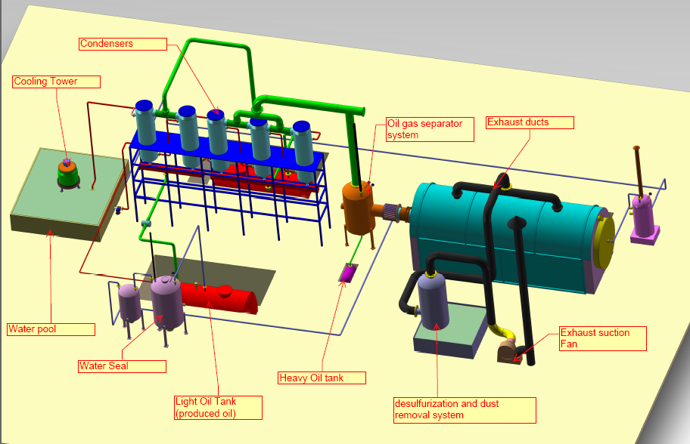
Description of The Factory

Slide 21
The Results of The Pyrolysis.
Liquid fuel, which is stored in tanks and sold to consumers
Gas fuel, which is used to feed the burning heater, and is not easy to store due to limited services for gas storage
Solid carbon stuff which is sold for different purposes.

Slide 22
Impact of Our Project on The Factory Processing
 | Gum unwanted products | Liquid products | Solid carbon products | Gas products | Time needed to start gas production | Time needed for the total process
With no catalyst | Plenty of unwanted gummy products in the filters. Plenty of oxidized products appeared | 40% Too dark products. Difficult to burn and use as fuel Not demanded by users | 40% | 10% | 3 hour | 17 hour
With catalyst | Far less gummy products. Less oxidized products appeared | 40% Clearer liquid products. Easy to burn and use Demanded by commercial users With selling price 2.5-3.0 NIS/Liter | 40% | 10% | 45 min | 10 hour
Notes:
مقارنة اقتصادية
مقارنة بيئية
ما في خروج للغازات العملية متدورة

Slide 23
Technical Feasibility of our project
- With no catalyst, liquid fuel was dark thick and difficult to burn
We recommended adding the catalyst
With catalyst better liquid fuel resulted (easy to burn, needed by market, selling at 3.5 NIS/Liter), fast to start product formation,
Instead of 3.5 hour only 45 min needed

Slide 24
Economic feasibility of our project
Without catalyst
produced oil was has dark color difficult to burn.
Not demanded by users and market.
Need 3 hr to start evaporation and 17 hr for total process
Full relative on external oil source.

Slide 25
Economic feasibility
With catalyst
One Ton of tires almost gives 400 kg liquid fuel.
Assuming that the density of the oil is 1 kg/liter.
One Ton of oil equals 1000 liters.
So one Ton of tires gives 400 liters liquid fuel.
One liters Sold with price of 2.5-3.0 NIS.
So one Ton of tires (100 NIS) gives 1200 NIS.

Slide 26
Economic feasibility
One Ton of tiers obtained with 100 NIS.
Using catalyst reduces evaporation time needed (from 3 hr to 45 min).
That reduces cost of the burning, also gas products A good alternative for the furnace.
Total time needed lowered from 17 hours to 10 hours (saves processing cost, effort, and energy)
Solid carbon can be Sold .
Metallic wires can be Sold .
Factory is generating its electricity by generator that uses the resulting fuels themselves. No need to buy electricity, now with the catalyst system.

Slide 27
Environmental impact
No free gas emitting, all fuel gases are being used.
Waste rubber is converted in useful oil, its not allowed to pollute environment.
Every piece in this work is used (gas, oil, Solid carbon, Metallic wires ).
Sulfur is taken by traps.

Slide 28
Limitations of The Project
Samples from lab scale and factory scale products were submitted for analysis to find chemical structures and molecular masses of produced liquid fuels.
The results were given to Center of Chemical, Biological and Medical Analysis.
Unfortunately, we have not received the results yet

Slide 29
Limitations of The Project
The factory stores the liquid products inside transparent plastic containers, more than 1 ton capacity for each.
The factory observed formation of solid (gelly) layers at the bottom long time of production.
We believe that this is due to presence of small molecules with unsaturated bonds (double bonds) called monomer molecules.
We recommend to keep storage tanks away from sun light to prevent polymerization.
Another suggestion is that the factory should add anti-polymerizing agents to the resulting fuels.

Slide 30
Limitations of The Project
We suggest to make additional accurate assessment for the environmental impact.
Our ideas improved the impact on the environment as discussed above
We could not get analysis results yet
Notes:
الطرق.........
لا يوجد كهرباء ........

Slide 31
Thanks a lot

