Slide 1
Move With Me
S.W Graduation Project
An Najah National University
Engineering Faculty
Computer Engineering Department
Supervisor : Dr. Raed Al-Qadi
Ghada Abu Awwad and Maha Al-Jamal

Slide 2
Outline
Introduction
  Project overview
  Project achieved requirements
  MWM application
  How to interact with application interface ?
Project Development
  Motion Detection part
  Game Constructing part
  Project Integration
Project Future

Slide 3
Project Overview
Our project aims to communicate with computer system using innovative non-traditional computer’s input devices
Our project is a motion detection based system that simulates the XBOX idea without a special hardware

Slide 4
Project Overview
We developed a software support instead of sensors .
We utilize our system to implement two game applications

Slide 5
Project Requirements
Accurate and fast movement detection
Real-time behavior and synchronization.
Innovative and User-friendly game Interface

Slide 6
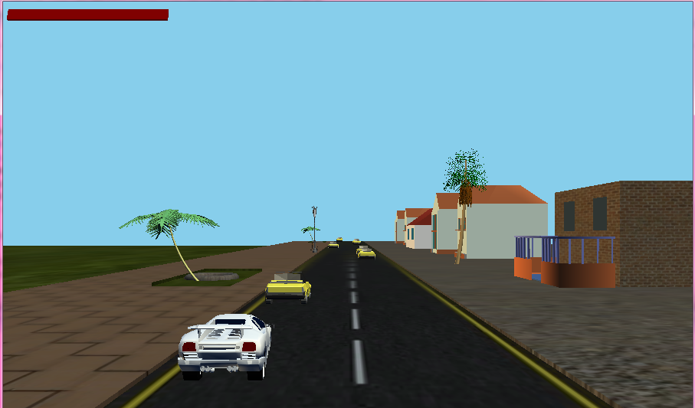
Move your body or head in order to avoid collision with barriers facing the car
MWM APPLICATIONS
3D Arcade Car Game

Slide 7
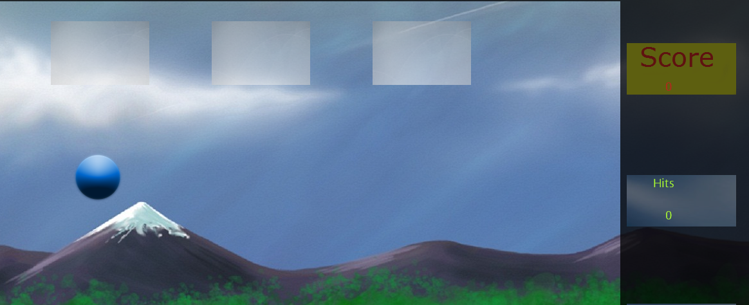
MWM Applications
Catch the Ball
Choose the right position of your hand in order to catch the ball.

Slide 8
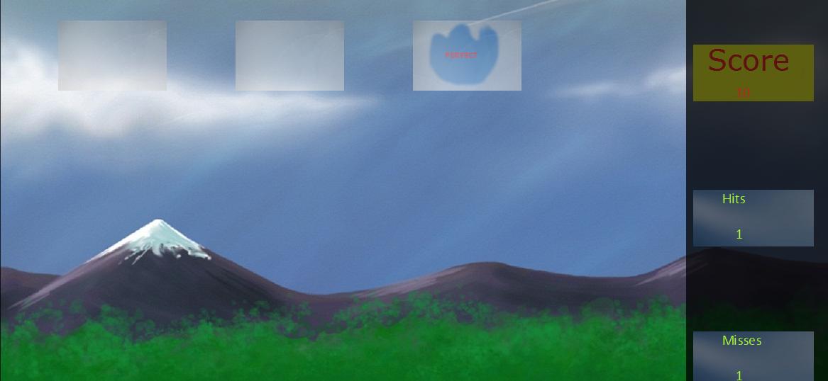
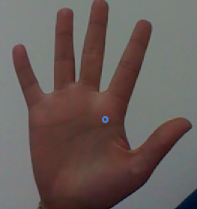
MWM Applications
Catch the Ball

Slide 9
Motion-driven Game Interface
Start and end game using hand shape
Play the games using the movement of the head, body and hand
Navigate the games option using the count of the fingers

Slide 10
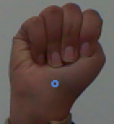
Start the game
End the game

Slide 11
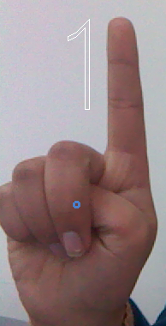
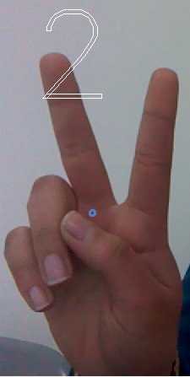
Choose play with head
Choose play with body

Slide 12
Project overflow
Start
First Part: Motion Detection Processing
Second Part: Creating the Game
Project Integration
Feedback
Feedback

Slide 13
Our Motion Detection Procedure Overview
Capture Images from Camera
Process captured frames of camera to detect motion of certain parts like head , body , hands and fingers
Trigger the corresponding behavior

Slide 14
Motion Detection
At first we used AForge.NET library to detect movement in general.
The work was accurate and as fast as we want.
When we enhanced the system to detect head movement the result was not acceptable.

Slide 15
Motion Detection
We used EmguCV which is an OpenCV-wrapper library
OpenCV is a computer vision library originally developed by Intel. It is four libraries in one
  CV :used for Computer Vision Algorithms
  CVAUX : Used for games
  CXCORE :used for Linear Algebra
  HIGHGUI :used for Media and window handling

Slide 16
Motion Detection in stages
Detect object and track it’s movement.
Build detectors for certain part like the hand.
Detect contours and track their movement.

Slide 17
Object Tracking Procedure-1st Step
The first frame is the background frame
  We detected the object using DetectHaarCascade function and haarcascade file.
  The function scans the image several times at different scales.
Notes:
Each time it considers overlapping regions in the image and applies the classifiers to the regions using cvRunHaarClassifierCascade.

Slide 18
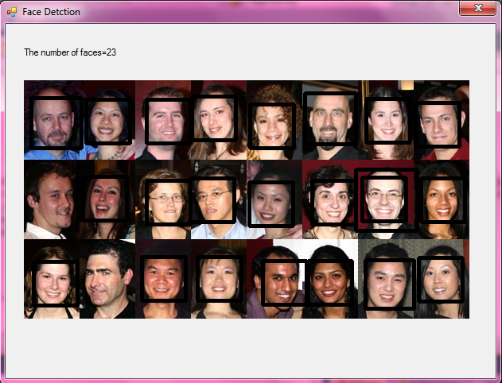
Object Detection

Slide 19
Object Tracking Procedure-1st Step
  We generated a tracking area , we found good features and sub-corners.
  The function iterates to find the sub-pixel accurate location of corners.
Notes:
Tracking features (points) across multiple images is a fundamental operation.
We need to track features of object in order to find the object from one image in another, to determine how an object or camera moved, or to resolve depth from a single camera

Slide 20
Object Tracking Procedure -2nd Step
We built convex hull of features using “ConvexHull” method
We implemented method to find polygon of the hull and we found the center of that polygon.
The center is the reference point.

Slide 21
Object Tracking Procedure -3rd Step
We applied optical flow method (PyrLK) which returns the features new positions.
We built convex hull of features and find the new center point of the hull.
We compared the reference center and the new center to determine the direction.
Notes:
Following frames compared to background to determine motion and it’s direction
Optical flow is one of used pattern to detect motion and object segmentation. To determine optical flow there are different methods used like phase acceleration, block based methods, differential methods and discrete optimization method.
We used Lucas-Kanade method with pyramids. This is one of differential methods to detect optical flow. It calculates the optical flow for a sparse feature set. It calculates the coordinates of the feature points on the current video frame given their coordinates on the previous frame. The function finds the coordinates with sub-pixel accuracy

Slide 22
Haartraining
We used previous procedure to detect face and body.
To detect hand we needed to built our own haarcascade
We read different papers on Haartraining and we worked for month building the file
We got a haarcascade which is not accurate as we want.

Slide 23
Contours Building Procedure
We used YCCSkinDetector to detect the region where certain color (skin) exists only.
We used FindContours method to retrieve contours from the binary image.
Notes:
The contours are a useful tool for shape analysis and object detection and recognition.
The Detector checks every pixel color, if it is within certain range of colors then add pixel to resultant image.
FindContours method retrieves contours from the binary image using the algorithm Suzuki85

Slide 24
Contours Building Procedure
We found the convex hull of points set.
We found all convexity defects of the input contour using GetconvexityDefects method
Notes:
Suzuki algorithm repeats passes through a binary image b(x,y) in the forward and backward raster directions alternatively.

Slide 25
Convexity Defects
A single contour convexity defect represented by points.
  Start: (x, y) point of the contour where the defect begins
  End: (x, y) point of the contour where the defect ends
  Depthpoint: (x, y) point farthest from the convex hull point within the defect
  Depth: distance between the farthest point and the convex hull

Slide 26
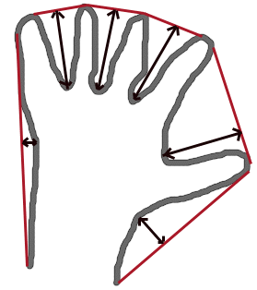
Convexity Defects

Slide 27
Contour Building Procedure
We implemented method to calculate the fingers number depending on defects.
We implemented method to find the direction of hand contour movement

Slide 28
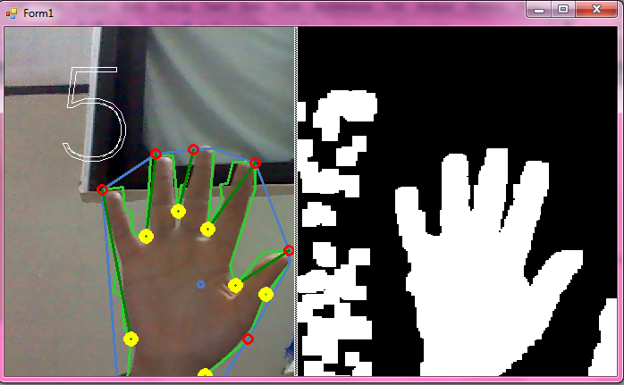
Contour Building Result

Slide 29
Game Constructing Experience
We Constructed the game in two stages :
Stage 1 – Models Design:
The first and the most important thing you have to think when creating a game is how to create the environment of the game.

Slide 30
Game Constructing Experience
Models should be designed in a way that :
  -The models must be consistent with the game subject .
  -The environment should simulate the real-world as much as possible.
It took us a considerable time to learn 3D max and how to design 3D models
    - We struggled to produce low-poly count models.

Slide 31
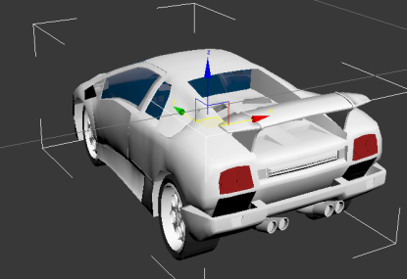
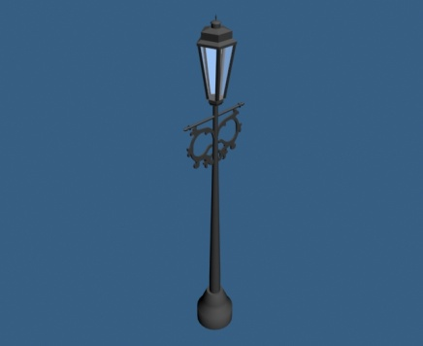
Car
Street Lamp

Slide 32
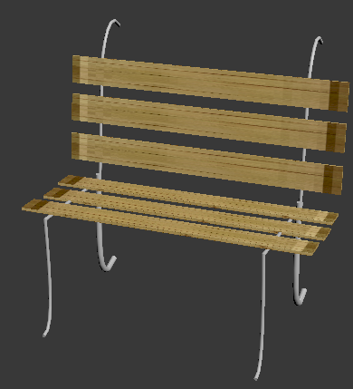
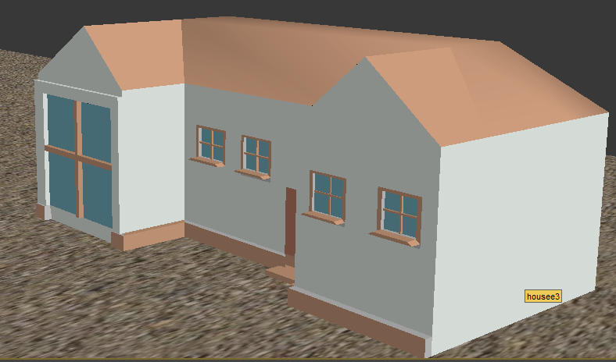
Chair
Home

Slide 33
Game Constructing Experience
Stage 2 – Game Logic:
We implemented the game logic using XNA , and although it takes a non-trivial amount of work, we used because we wanted to work with C#.

Slide 34
Game Constructing Experience
What is XNA?
Microsoft XNA is a set of tools with a managed runtime environment provided by Microsoft that facilitates video game development and management.

Slide 35
Game Constructing Experience
Working with XNA:
Three important issues :
  Loading Models and contents : XNA has limited number of importers for contents, Ex. :it accepts 3d models only of types ‘FBX’ , ‘X’.

Slide 36
Game Constructing Experience
Working with XNA:
Three important issues :
  Updating Game Logic:
    - In case of our game the car is walking depends on the equation :
    Distance = Speed * Time;

Slide 37
Game Constructing Experience
Working with XNA:
Three important issues :
  Updating Game Logic:
    -Collision Detection : we bound the 3d objects with a virtual sphere and if it intersects in X,Y,Z axis perform the collision effect.
      - A Player allowed to collide 5 times before he died.

Slide 38
Game Constructing Experience
Working with XNA:
Three Important Issues :
Drawing Objects :
  -Determine the position of each element (X, Y, Z positions).
  - then draw every mesh of every object.
  -set the camera.

Slide 39
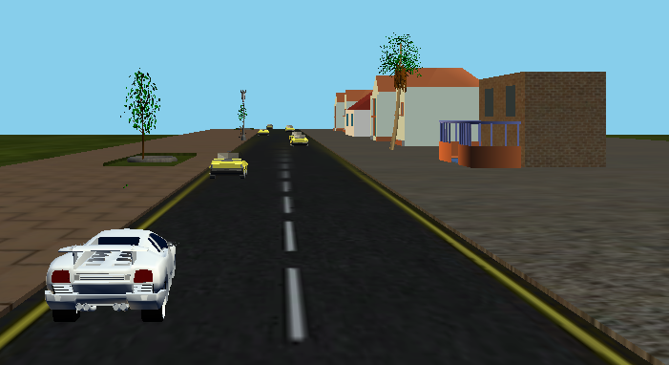
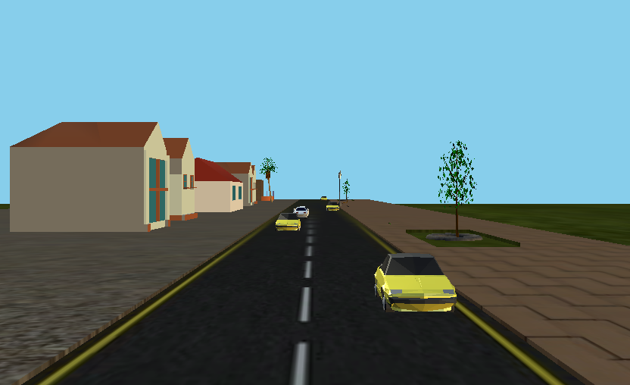
More than 6 camera parameters allow you to control how you can see the environment and what to look at.
Back view
Front View

Slide 40
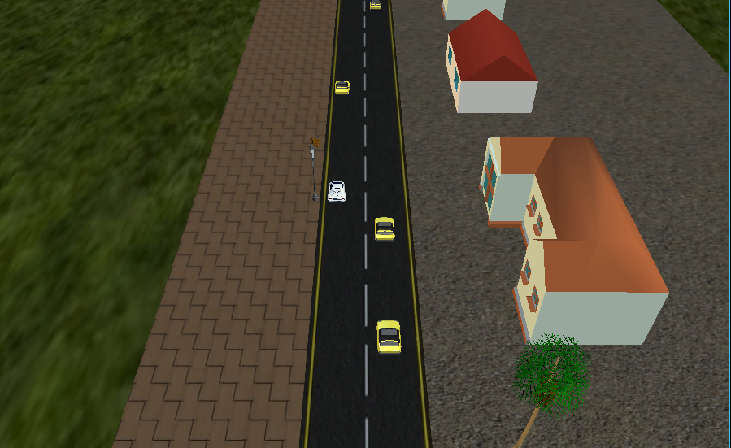
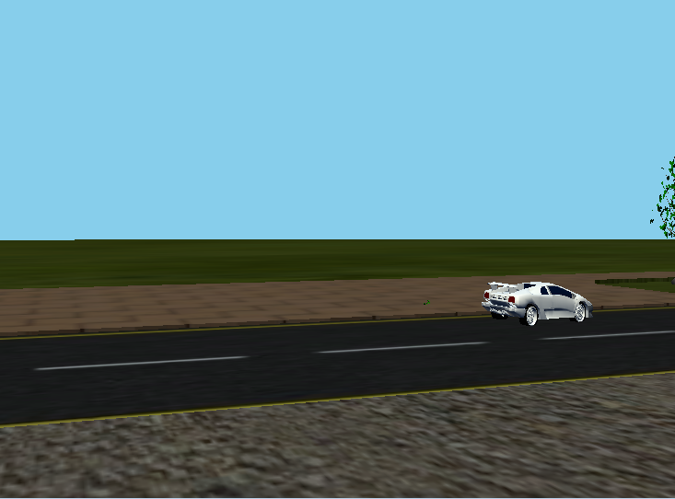
More than 6 camera parameters allow you to control how you can see the environment and what to look at.
Top view
Left view

Slide 41
Project Integration
We have multiple tasks that are working at the same time
We need real time triggering to corresponding behavior
We used multi threading implementation to achieve project requirements.

Slide 42
MWM in future
Building Applications that help old people to interact , move and play.

