Slide 1

Foundation Design of Residential Building
By:
Amjad Abdullah Hijab
Mahmood Ahmad Amer
Under supervision of:
Dr. Isam Jaradaneh

Slide 2
Outline:
Introduction
Objectives
Methodology
Analysis
Design
Results and Conclusion
recommendation

Slide 3
Introduction
The foundation is the most important part of a building as it provides a uniform base for the superstructure and transfers the load of the same down to the soil below it uniformly.
The main objectives of the foundations.
The foundations are divided into shallow foundations and deep foundations.
Selection of type of foundation for a building depends on nature of soil and load from the structure.

Slide 4
Objectives
This project aims to analyze and design suitable foundation system for proposed Residential Building located at Al Hisba Street. The building consists of 7 stories with 440 square meter plan area of each story.

Slide 5
methodology
Description of the building.
ETABS was used to analyze the building and calculate the load over each column.
Some data were taken from ETABS such as dead load and others were taken as following
-Superimposed dead load 4 kN/m² and live load 2.5 kN/m².
4 load combinations were defined.
Safe program was used to design the foundation.

Slide 6
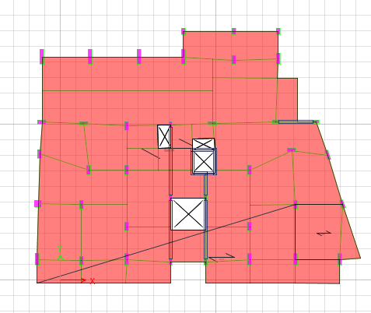
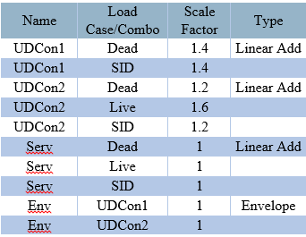
Analysis
Loads and load combination:
Dead loads: The dead load calculated by (ETABS).
Superimposed dead loads: The superimposed dead load was 4 KN/m².
Live loads: The live load was 2.5 KN/m².

Slide 7
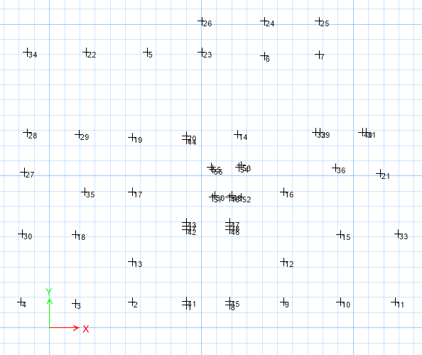
Analysis
The results of analysis on the base floor (loads of columns on foundation)
Joint 27 load = 1649.90 kN
Joint 28 load = 2387.75 kN
Joint 29 load = 1190.14 kN
Joint 30 load = 268.22 kN

Slide 8
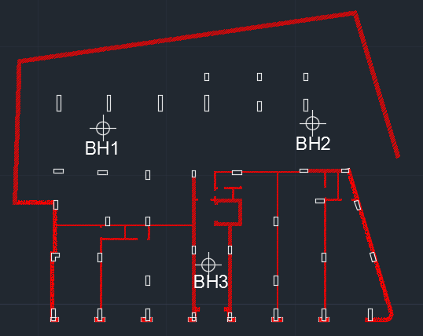
Analysis
Site Investigation
One borehole was dug to a depth of 13 m, while the rest two boreholes were dug out to depth of 9 m.

Slide 9
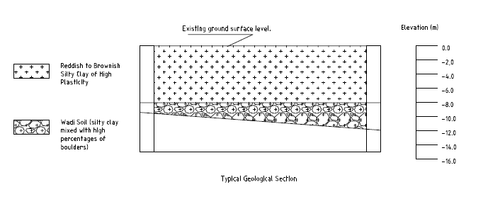
Analysis
Site Description
The top layers are silty clay to a depth of 8 m from the existing ground surface.
The bottom layer is wadi soil extends form 8 m from ground surface to the end of drilling.
Soil Report Recommendation
The top soil layer should be improved by 60 cm rockfill and 40 cm base course compacted according to standards, the bearing capacity is 180 kN/m² .

Slide 10
Design
The selection of type of footing was according to columns' loads.
Mat foundation was found to be the most appropriate foundation system for this project due to that more than 60% of the area of the plan site will be used as isolated footing.
Summation of load(service) = 51887.54 KN, Bearing capacity of soil = 180 KN/m².
Area of foundation = 51887.54/180 = 288.3 m², Building area = 440 m².
Area of foundation / Building area = 65.52 %, more than 60 %.
So, mat foundation is recommended.

Slide 11
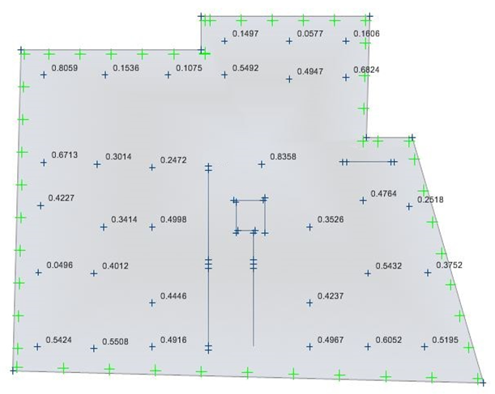
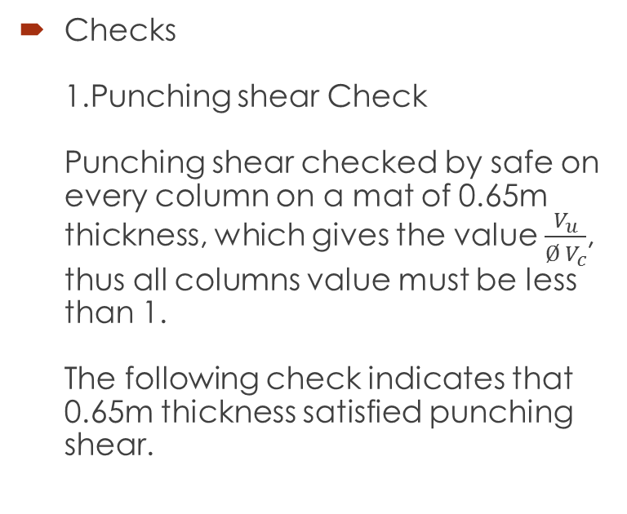
Design
Checks
1.Punching shear Check
Punching shear checked by safe on every column on a mat of 0.65m thickness, which gives the value$\frac{V_{u}}{Ø V_{c}}$, thus all columns value must be less than 1.
The following check indicates that 0.65m thickness satisfied punching shear.

Slide 12
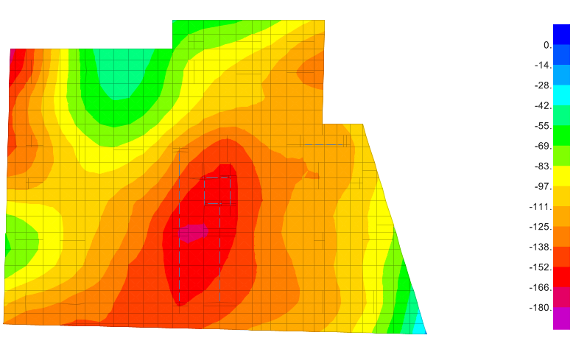
Design
2.Soil Failure Check
all pressures under the mat is compression and between range (25-172) KN/m² which are less than bearing capacity of soil (180 KN/m²).
Maximum soil pressure =
172.6 kN/m² <180 kN/m²
so 65 cm thickness is ok.

Slide 13
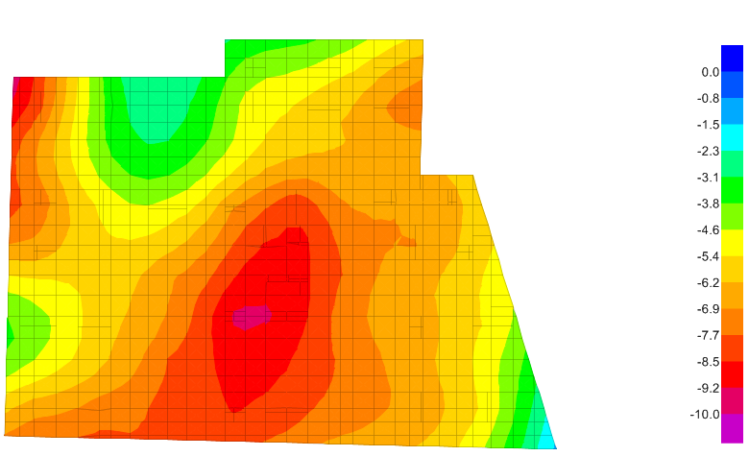
Design
3.Deformed Shape
all displacement is less than 10 mm, which is allowable deformation for mat foundation.

Slide 14
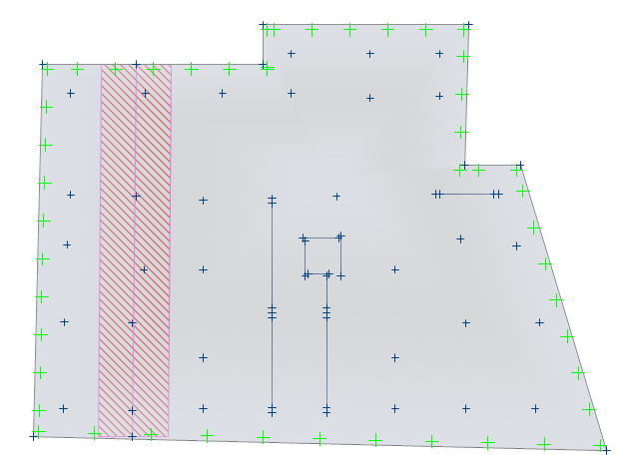
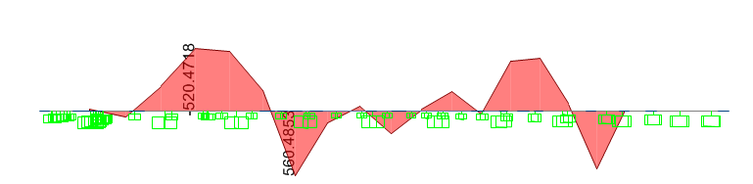
Design
Design of strip (3.65m)
M_{u top} = 520.5, b=3650, d=590
ρ =0.00109 < ρ_{min}
Use A_{s min}= 0.0018*3650*650 → 4271 mm² → (28Ø14) Top
M_{u bottom} = 560.5, b=3650, d=590
ρ =0.001179 < ρ_{min}
Use A_{s min}= 0.0018*3650*650 → 4271 mm² → (28Ø14) Bottom

Slide 15
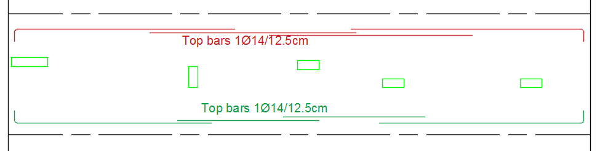
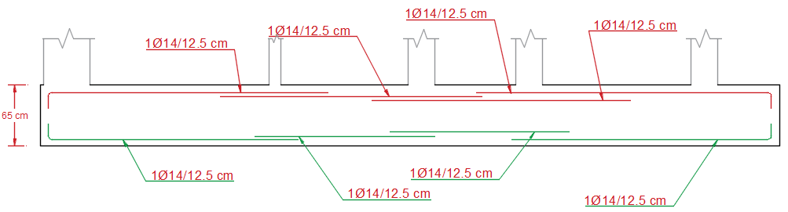
Design
the reinforcement for the strip

Slide 16
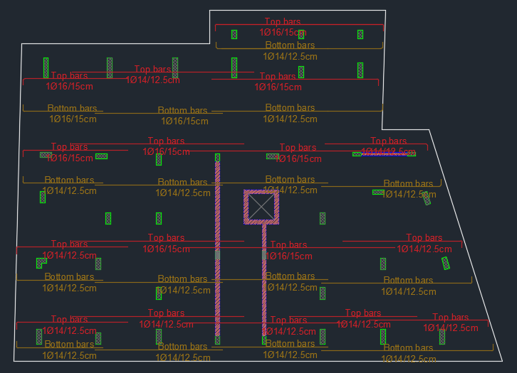
Results and Conclusion
The reinforcement of mat foundation in x direction.

Slide 17
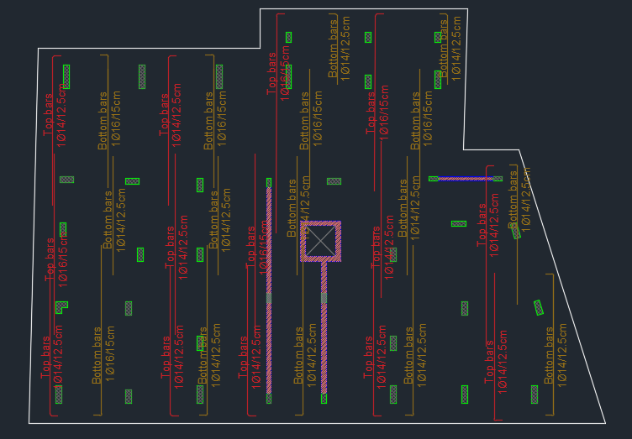
Results and Conclusion
The reinforcement of mat foundation in y direction.

Slide 18
Recommendation
We recommend to use mat foundation with a thickness of 65 cm.

Slide 19

Thanks for being here

